Slide 1
Virus Attack Final Presentation
Alex Whiteside | Audrey Simonne

Slide 2
The Threat Of Viruses
Over 32% of the world’s computer are currently infected with a virus
The United States ranks 11th on scale with over 30% infection
Viruses cause over $50,000,000,000 (50 Billion) in damage yearly
Anyone can create (or buy) a virus off the market and deploy it
No Special Skills are required
Over 74,000 Strains are created daily by computer polymorphism or by hand
Viruses propagate in an exponential way, causing harm as soon as they are detected
Academic models show no easy way to curb these attacks

Slide 3
Our Test
We wanted to determine how protected the average user was from simple web use
Two common operating systems : Windows 10, Windows 7
Some form of internal protection, but only the default
User running with Administrative privileges
People are random, so we wanted random sites
For each page we visit, we want to gather all possible links
Then open up 5 at random and repeat the process for each new link
We’ll stop the recursive approach when a page has less than 5 links

Slide 4
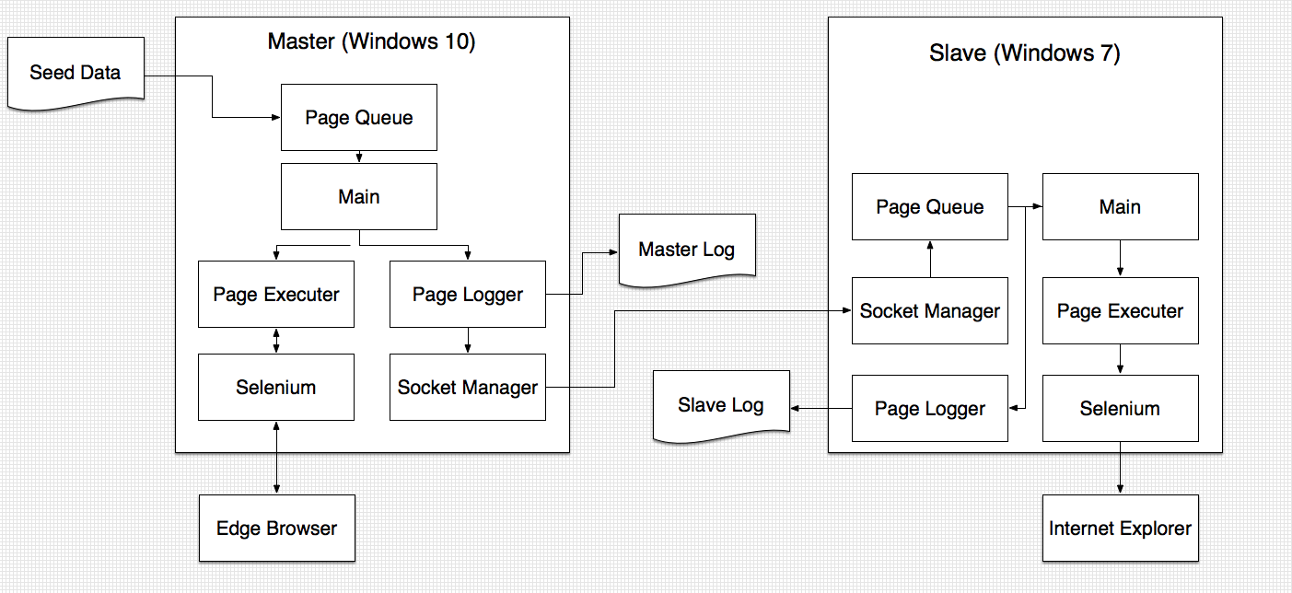
The Implementation

Slide 5
The Implementation
Language: Java
Java was a natural choice due to our programming backgrounds, it’s ease of deployment across platforms, and integration with Selenium.
Crawler Library: Selenium
Selenium is a popular library supporting all OS and web browsers
Logging: Custom
It was easier to implement our own logging to a file than to configure one
Network Connections: Standard Java Sockets
Rather than use a heavy protocol, we leverage Java Sockets to send strings representing the links from master to client.

Slide 6
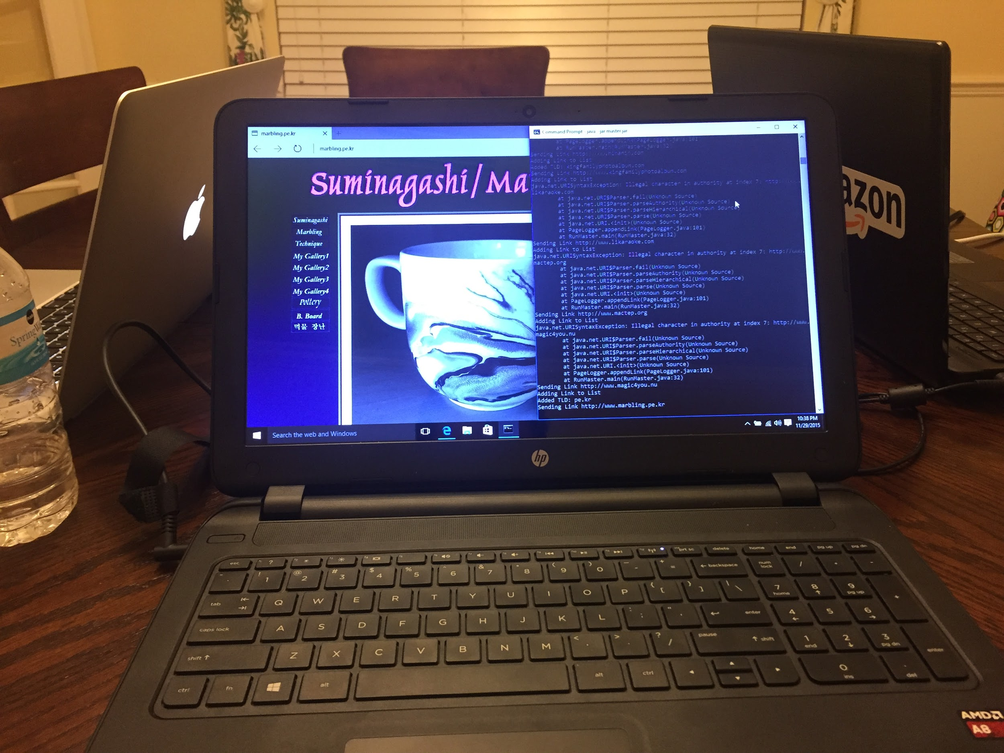
Execution
We setup the master and slave and began the test with a seed list of 36 sites.
We let the system run for 24 hours
We retrieved the logs for both systems
We ran a full virus scan on both systems
Master (center), Development Computer (left) and Slave (right) running the application and opening web pages.

Slide 7
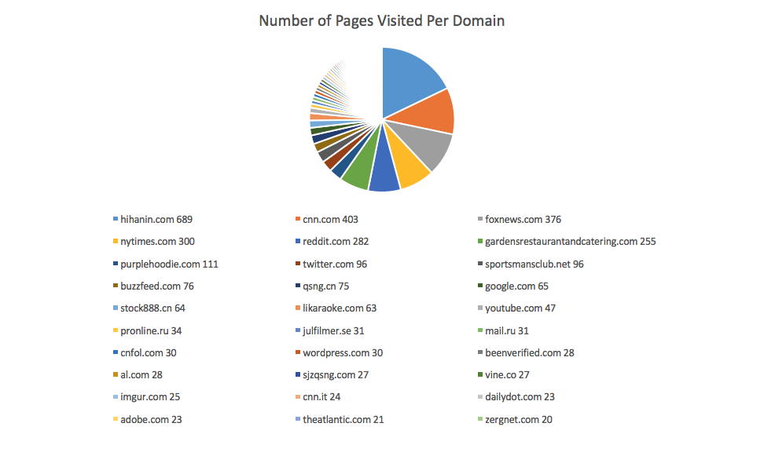
Results
Over 5000 Pages
183 recognized domains
Interesting correlation to ‘Hihanin.com’
Only 2 file downloads
No EXEs
0 Viruses on either system

Slide 8
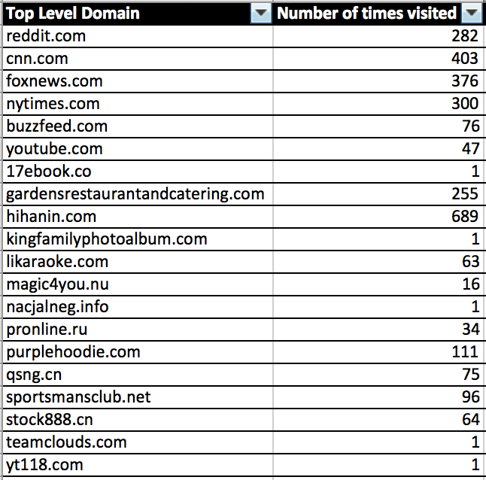
An interesting trend

Slide 9
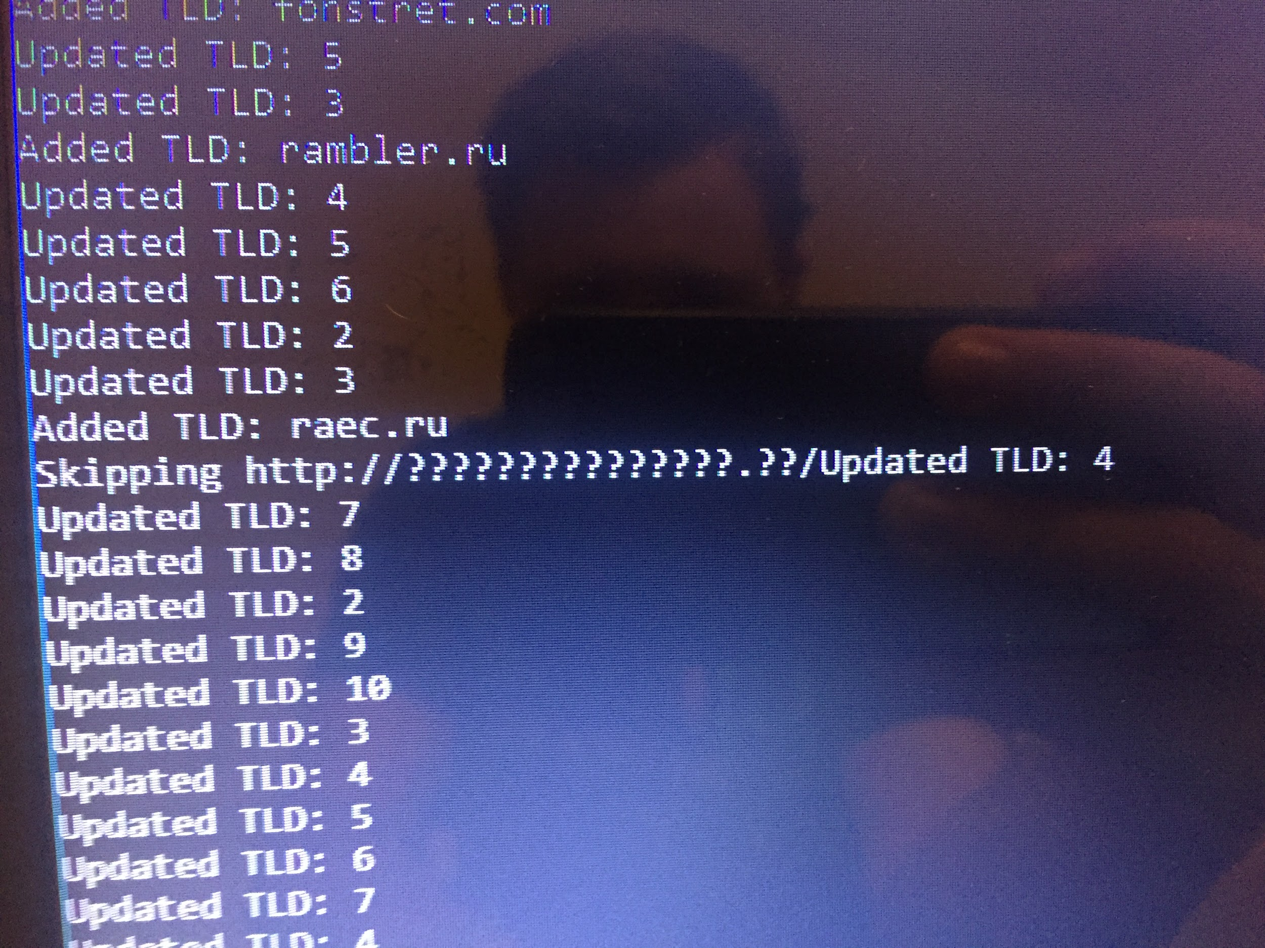
Problems
Various Exceptions
Random Events
Unrecognizable Domains
????????????.??
Malformed Popups
Windows Update
Many hits to ‘normal sites’

Slide 10
Conclusions
Simply browsing the web does not present an easy entry point for viruses when using default security.
This is important to Domain Administrators, as not all sites need to be blocked if the user does not actively look for downloads.
Hihanin.com is very interesting, as many unrelated sites recursively ended up there by random link choices.
Numerous exceptions can be thrown for many web related issues, and catching them at every point is the only way to continue operations gracefully.

Slide 11
Next Steps
Other entry points for viruses exist, each could be tested in a similar way
Email spam, opening and clicking through various ads
Torrenting files and running their contents
Downloading free software
Some users turn off their firewall and deviate from the basic security
Use computers that have not just been freshly installed, without patches
The tests could be run for longer periods of time
Tests could look for largest links, or incorporate more human choices

