Slide 1
1
Chapter 1 - Threats
Notes:
1
8/25/14
Introduction

Slide 2
2
Threats and Attacks
Eavesdropping: the interception of information intended for someone else during its transmission over a communication channel.
Alice
Bob
Eve

Slide 3

3
Threats and Attacks
Alteration: unauthorized modification of information.
Example: the man-in-the-middle attack, where a network stream is intercepted, modified, and retransmitted.
Sender
Communication
channel
Recipient
encrypt
decrypt
shared
secret
key
shared
secret
key
plaintext M
plaintext M′
ciphertext C
Attacker
(intercepting)
ciphertext C′

Slide 4
4
Threats and Attacks
Denial-of-service: the interruption or degradation of a data service or information access.
Example: email spam, to the degree that it is meant to simply fill up a mail queue and slow down an email server.
Alice

Slide 5
5
Threats and Attacks
Masquerading: the fabrication of information that is purported to be from someone who is not actually the author.
“From: Alice”
(really is from Eve)

Slide 6
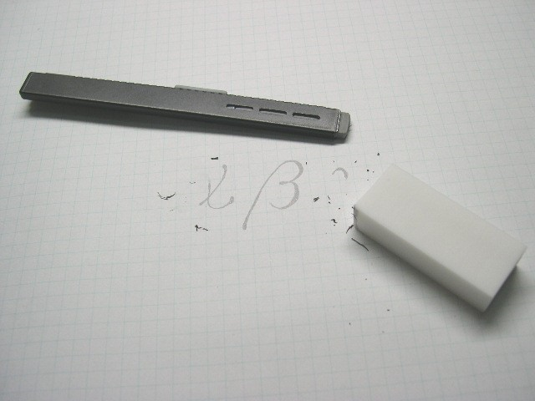
6
Threats and Attacks
Repudiation: the denial of a commitment or data receipt.
This involves an attempt to back out of a contract or a protocol that requires the different parties to provide receipts acknowledging that data has been received.
Public domain image from http://commons.wikimedia.org/wiki/File:Plastic_eraser.jpeg

Slide 7
7
Threats and Attacks
Correlation and traceback: the integration of multiple data sources and information flows to determine the source of a particular data stream or piece of information.

Slide 8
8
The Ten Security Principles
Compromise recording
Economy of mechanism
Fail-safe defaults
Security Principles
Work factor
Complete mediation
Psychological acceptability
Open design
Least common mechanism
Separation of privilege
Least privilege

Slide 9
9
Economy of mechanism
This principle stresses simplicity in the design and implementation of security measures.
While applicable to most engineering endeavors, the notion of simplicity is especially important in the security domain, since a simple security framework facilitates its understanding by developers and users and enables the efficient development and verification of enforcement methods for it.

Slide 10
10
Fail-safe defaults
This principle states that the default configuration of a system should have a conservative protection scheme.
For example, when adding a new user to an operating system, the default group of the user should have minimal access rights to files and services. Unfortunately, operating systems and applications often have default options that favor usability over security.

Slide 11
11
Fail-safe defaults
This principle states that the default configuration of a system should have a conservative protection scheme.
This has been historically the case for a number of popular applications, such as web browsers that allow the execution of code downloaded from the web server.

Slide 12
12
Complete mediation
The idea behind this principle is that every access to a resource must be checked for compliance with a protection scheme.
As a consequence, one should be wary of performance improvement techniques that save the results of previous authorization checks, since permissions can change over time.

Slide 13
13
Complete mediation
The idea behind this principle is that every access to a resource must be checked for compliance with a protection scheme.
For example, an online banking web site should require users to sign on again after a certain amount of time, say, 15 minutes, has elapsed.

Slide 14
14
Open design
According to this principle, the security architecture and design of a system should be made publicly available.
Security should rely only on keeping cryptographic keys secret. (Kerckhoff)

Slide 15
15
Open design
According to this principle, the security architecture and design of a system should be made publicly available.
Open design allows for a system to be scrutinized by multiple parties, which leads to the early discovery and correction of security vulnerabilities caused by design errors.

Slide 16
16
Open design
According to this principle, the security architecture and design of a system should be made publicly available.
The open design principle is the opposite of the approach known as security by obscurity, which tries to achieve security by keeping cryptographic algorithms secret and which has been historically used without success by several organizations.

Slide 17
17
Separation of privilege
This principle dictates that multiple conditions should be required to achieve access to restricted resources or have a program perform some action.

Slide 18
18
Least privilege
Each program and user of a computer system should operate with the bare minimum privileges necessary to function properly.
If this principle is enforced, abuse of privileges is restricted, and the damage caused by the compromise of a particular application or user account is minimized.

Slide 19
19
Least privilege
Each program and user of a computer system should operate with the bare minimum privileges necessary to function properly.
The military concept of need-to-know information is an example of this principle.

Slide 20
20
Least common mechanism
In systems with multiple users, mechanisms allowing resources to be shared by more than one user should be minimized.
For example, if a file or application needs to be accessed by more than one user, then these users should have separate channels by which to access these resources, to prevent unforeseen consequences that could cause security problems.

Slide 21
21
Psychological acceptability
This principle states that user interfaces should be well designed and intuitive, and all security-related settings should adhere to what an ordinary user might expect.

Slide 22
22
Psychological acceptability
Usability:
If it ain't usable, it ain't secure
Match mental models (understand meaning of policy in force)
Well-designed user interface (know what policy is in force)

Slide 23
23
Work factor
According to this principle, the cost of circumventing a security mechanism should be compared with the resources of an attacker when designing a security scheme.

Slide 24
24
Work factor
Example:
A system developed to protect student grades in a university database, which may be attacked by snoopers or students trying to change their grades, probably needs less sophisticated security measures than a system built to protect military secrets, which may be attacked by government intelligence organizations.

Slide 25
25
Compromise recording
This principle states that sometimes it is more desirable to record the details of an intrusion than to adopt more sophisticated measures to prevent it.

Slide 26
26
Compromise recording
This principle states that sometimes it is more desirable to record the details of an intrusion than to adopt more sophisticated measures to prevent it.
Internet-connected surveillance cameras are a typical example of an effective compromise record system that can be deployed to protect a building in lieu of reinforcing doors and windows.

Slide 27
27
Compromise recording
This principle states that sometimes it is more desirable to record the details of an intrusion than to adopt more sophisticated measures to prevent it.
The servers in an office network may maintain logs for all accesses to files, all emails sent and received, and all web browsing sessions.

Slide 28
28
Topic: Access Control
Users and groups
Authentication
Passwords
File protection
Access control lists
Which users can read/write which files?
Are my files really safe?
What does it mean to be root?
What do we really want to control?
8/25/14
Introduction

Slide 29
29
Access Control Matrices
A table that defines permissions.
Each row of this table is associated with a subject, which is a user, group, or system that can perform actions.
Each column of the table is associated with an object, which is a file, directory, document, device, resource, or any other entity for which we want to define access rights.

Slide 30
30
Access Control Matrices
A table that defines permissions.
Each cell of the table is then filled with the access rights for the associated combination of subject and object.
Access rights can include actions such as reading, writing, copying, executing, deleting, and annotating.
An empty cell means that no access rights are granted.

Slide 31
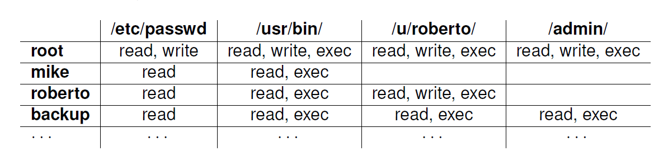
31
Example Access Control Matrix

Slide 32
32
Access Control Matrices
A table that defines permissions.
Problem: Table can be really big!
Ex: Unix system with 1000 users, 1000 groups: each process has ruid, rgid, euid, egid, or 10004 = 1 trillion domains
Same system has say 1000 files/folders per user, or 1 million objects (plus the other users and groups)
ACM has 1 million trillion cells....
But there is lots of redundancy!

Slide 33
33
Access Control Lists
It defines, for each object, o, a list, L, called o’s access control list, which enumerates all the subjects that have access rights for o and, for each such subject, s, gives the access rights that s has for object o.
/etc/passwd
/usr/bin/
/u/roberto/
/admin/
root: r,w
mike: r
roberto: r
backup: r
root: r,w,x
mike: r,x
roberto: r,x
backup: r,x
root: r,w,x
roberto: r,w,x
backup: r,x
root: r,w,x
backup: r,x

Slide 34
34
Capabilities
root
/etc/passwd: r,w,x; /usr/bin: r,w,x;
/u/roberto: r,w,x; /admin/: r,w,x
Takes a subject-centered approach to access control. It defines, for each subject s, the list of the objects for which s has nonempty access control rights, together with the specific rights for each such object.
mike
/usr/passwd: r; /usr/bin: r,x
roberto
/usr/passwd: r; /usr/bin: r;
/u/roberto: r,w,x
backup
/etc/passwd: r,x; /usr/bin: r,x;
/u/roberto: r,x; /admin/: r,x

Slide 35
35
Role-based Access Control
Define roles and then specify access control rights for these roles, rather than for subjects directly.
Specify to which roles a user can bind a process
Level of indirection – manage access by roles – handles all users with that role and expresses the rationale for access (or no access).

Slide 36
36
Role-based Access Control
Department Chair
Administrative Manager
Lab Manager
System Administrator
Undergraduate TA
Graduate TA
Accountant
Secretary
Lab Technician
Backup Agent
Undergraduate Student
Graduate Student
Administrative Personnel
Technical Personnel
Faculty
Student
Department Member

Slide 37
37
Cryptographic Concepts
Encryption: a means to allow two parties, customarily called Alice and Bob, to establish confidential communication over an insecure channel that is subject to eavesdropping.
Alice
Bob
Eve

Slide 38
38
Encryption and Decryption
The message M is called the plaintext.
Alice will convert plaintext M to an encrypted form using an encryption algorithm E that outputs a ciphertext C for M.
Sender
Communication
channel
Recipient
encrypt
decrypt
ciphertext
plaintext
plaintext
shared
secret
key
shared
secret
key
Attacker
(eavesdropping)

Slide 39
39
Encryption and Decryption
As equations:
C = E(M)
M = D(C)
The encryption and decryption algorithms are chosen so that it is infeasible for someone other than Alice and Bob to determine plaintext M from ciphertext C. Thus, ciphertext C can be transmitted over an insecure channel that can be eavesdropped by an adversary.

Slide 40
40
Cryptosystem
The set of possible plaintexts
The set of possible ciphertexts
The set of encryption keys
The set of decryption keys
The correspondence between encryption keys and decryption keys
The encryption algorithm to use
The decryption algorithm to use

Slide 41
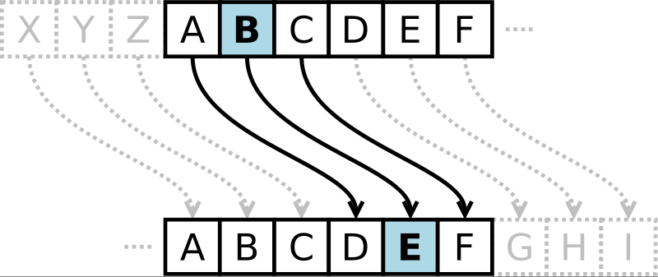
41
Caesar Cipher
Replace each letter with the one “three over” in the alphabet.
Public domain image from http://commons.wikimedia.org/wiki/File:Caesar3.svg

Slide 42
42
Symmetric Cryptosystems
Alice and Bob share a secret key, which is used for both encryption and decryption.
Sender
Communication
channel
Recipient
encrypt
decrypt
ciphertext
plaintext
plaintext
shared
secret
key
shared
secret
key
Attacker
(eavesdropping)
Same key

Slide 43
43
Symmetric Key Distribution
Requires each pair of communicating parties to share a (separate) secret key.
shared
secret
n (n−1)/2 keys
shared
secret
shared
secret
shared
secret
shared
secret
shared
secret

Slide 44
44
Public-Key Cryptography
Bob has two keys: a private key, SB, which Bob keeps secret, and a public key, PB, which Bob broadcasts widely.
In order for Alice to send an encrypted message to Bob, she need only obtain his public key, PB, use that to encrypt her message, M, and send the result, C = EPB (M), to Bob. Bob then uses his secret key to decrypt the message as M = DSB (C).

Slide 45
45
Public-Key Cryptography
Separate keys are used for encryption and decryption.
Communication
channel
Sender
Recipient
encrypt
decrypt
plaintext
ciphertext
plaintext
plaintext
public
key
private
key
Attacker
(eavesdropping)

Slide 46
46
Public Key Distribution
Only one key is needed for each recipient
private
private
public
public
n key pairs
public
public
private
private

Slide 47
47
Digital Signatures
Public-key encryption provides a method for doing digital signatures
To sign a message, M, Alice just encrypts it with her private key, SA, creating C = ESA(M).
Anyone can decrypt this message using Alice’s public key, as M’ = DPA(C), and compare that to the message M.

Slide 48
48
Cryptographic Hash Functions
A checksum on a message, M, that is:
One-way: it should be easy to compute Y=H(M), but hard to find M given only Y
Collision-resistant: it should be hard to find two messages, M and N, such that H(M)=H(N).
Examples: SHA-1, SHA-256.

Slide 49
49
Message Authentication Codes
Allows for Alice and Bob to have data integrity, if they share a secret key.
Given a message M, Alice computes H(K||M) and sends M and this hash to Bob.
Communication
channel
(attack detected)
=?
h
6B34339
4C66809
4C66809
87F9024
h
message M
MAC
MAC
received
MAC
computed
MAC
message M’
shared
secret
key
shared
secret
key
Sender
Attacker
(modifying)
Recipient

Slide 50
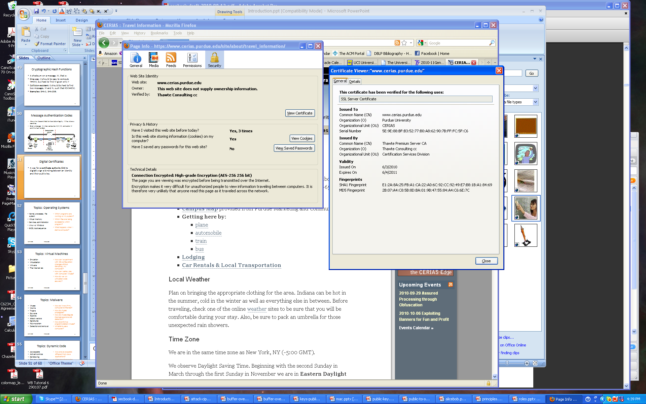
50
Digital Certificates
certificate authority (CA) digitally signs a binding between an identity and the public key for that identity.

Slide 51
51
Passwords
A short sequence of characters used as a means to authenticate someone via a secret that they know.
Userid: _________________
Password: ______________

Slide 52
How a password is stored?
User
Password file
Dog124
Butch:ASDSA
21QW3R50E
ERWWER323
…
…
hash function
Notes:
52

Slide 53
Strong Passwords
What is a strong password
UPPER/lower case characters
Special characters
Numbers
When is a password strong?
Seattle1
M1ke03
P@$$w0rd
TD2k5secV
53
Notes:
53
53
53
Spostare in altra sezione

Slide 54
Password Complexity
A fixed 6 symbols password:
Numbers
106 = 1,000,000
UPPER or lower case characters
266 = 308,915,776
UPPER and lower case characters
526 = 19,770,609,664
32 special characters (&, %, $, £, “, |, ^, §, etc.)
326 = 1,073,741,824
94 practical symbols available
946 = 689,869,781,056
ASCII standard 7 bit 27 =128 symbols
1286 = 4,398,046,511,104
54
Notes:
54

Slide 55

Password Length
26 UPPER/lower case characters = 52 characters
10 numbers
32 special characters
=> 94 characters available
5 characters: 945 = 7,339,040,224
6 characters: 946 = 689,869,781,056
7 characters: 947 = 64,847,759,419,264
8 characters: 948 = 6,095,689,385,410,816
9 characters: 949 = 572,994,802,228,616,704
55
Notes:
55
55
55

Slide 56
Password Validity: Brute Force Test
Password does not change for 60 days
how many passwords should I try for each second?
5 characters: 1,415 PW /sec
6 characters: 133,076 PW /sec
7 characters: 12,509,214 PW /sec
8 characters: 1,175,866,008 PW /sec
9 characters: 110,531,404,750 PW /sec
56
Notes:
56
56
56

Slide 57
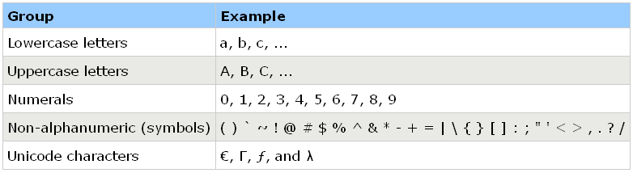
Secure Passwords
A strong password includes characters from at least three of the following groups:
Use pass phrases eg. "I re@lly want to buy 11 Dogs!"
57
Notes:
57

Slide 58
58
Social Engineering
Pretexting: creating a story that convinces an administrator or operator into revealing secret information.
Baiting: offering a kind of “gift” to get a user or agent to perform an insecure action.
Quid pro quo: offering an action or service and then expecting something in return.

