Slide 1
Malware:
Malicious Software

Slide 2
Viruses, Worms, Trojans, Rootkits
Malware can be classified into several categories, depending on propagation and concealment
Propagation
  Virus: human-assisted propagation (e.g., open email attachment)
    Modifies existing file, program, library, boot block, etc.
  Worm: automatic propagation without human assistance
    Stand-alone program
Concealment
  Rootkit: modifies operating system to hide its existence
  Trojan: provides desirable functionality but hides malicious operation
Various types of payloads, ranging from annoyance to crime
Notes:
Name derives from the wooden horse left by the Greeks at the gates of Troy during the siege of Troy
A Trojan horse program intentionally hides malicious activity while pretending to be something else
Usually described as innocuous looking, or software delivered through innocuous means which either allows to take control of systems
Trojan horse programs do not replicate themselves
Sometimes passed on using commonly passed executables, things like jokes forwarded by e-mail
Sometimes marketed/distributed as “remote administration tool”
Often combined with rootkits to disguise activity and remote access
Popularized to an extent by software like Cult of the Dead Cow’s Back Orifice, offered as a free download for running “remote administration” tasks or playing spooky jokes on friends
The line between user-launched worms and Trojans is highly blurred, with many user-launched worms behaving in a manner similar to worms.
Trojans are by definition malicious. The classic movie/television exploit of remotely opening disk drives is a definite symptom of being infected by a Trojan.
Have lately begun using much of the same defense mechanisms used by viruses, there are known Trojans which use WSH to run.
To detect infected computers, attackers often use so called sweep lists, list of IP addresses known to be online. One of the popular ways of doing this is to monitor IRC chat rooms and use the IP addresses of participants in these rooms.
Payload examples
perform amusing or annoying pranks
destroy/corrupt files and applications
monitor and transmit user activity (spyware, logger)
install backdoor (makes the infected computer a zombie)
email spam
launch denial-of-service attack
alter browser settings to display ads
dial out international or 900 numbers (dialer)

Slide 3
Insider Attacks
An insider attack is a security breach that is caused or facilitated by someone who is a part of the very organization that controls or builds the asset that should be protected.
In the case of malware, an insider attack refers to a security hole that is created in a software system by one of its programmers.

Slide 4
Backdoors
A backdoor, which is also sometimes called a trapdoor, is a hidden feature or command in a program that allows a user to perform actions he or she would not normally be allowed to do.
When used in a normal way, this program performs completely as expected and advertised.
But if the hidden feature is activated, the program does something unexpected, often in violation of security policies, such as performing a privilege escalation.
Benign example: Easter Eggs in DVDs and software

Slide 5
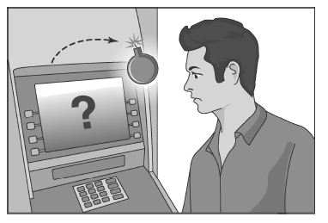
Logic Bombs
A logic bomb is a program that performs a malicious action as a result of a certain logic condition.
The classic example of a logic bomb is a programmer coding up the software for the payroll system who puts in code that makes the program crash should it ever process two consecutive payrolls without paying him.

Slide 6
Logic Bombs
A logic bomb is a program that performs a malicious action as a result of a certain logic condition.
Another classic example combines a logic bomb with a backdoor, where a programmer puts in a logic bomb that will crash the program on a certain date (i.e., a time bomb).

Slide 7
The Omega Engineering Logic Bomb
An example of a logic bomb that was actually triggered and caused damage is one that programmer Tim Lloyd was convicted of using on his former employer, Omega Engineering Corporation.
On July 31, 1996, a logic bomb was triggered on the server for Omega Engineering’s manufacturing operations, which ultimately cost the company millions of dollars in damages and led to it laying off many of its employees.

Slide 8
The Omega Bomb Code
The Logic Behind the Omega Engineering Time Bomb included the following strings:
7/30/96
  Event that triggered the bomb
F:
  Focused attention to volume F, which had critical files
F:\LOGIN\LOGIN 12345
  Login a fictitious user, 12345 (the back door)
CD \PUBLIC
  Moves to the public folder of programs
FIX.EXE /Y F:\*.*
  Run a program, called FIX, which actually deletes everything
PURGE F:\/ALL
  Prevent recovery of the deleted files

Slide 9
Defenses against Insider Attacks
Avoid single points of failure.
Use code walk-throughs.
Use archiving and reporting tools.
Limit authority and permissions.
Physically secure critical systems.
Monitor employee behavior.
Control software installations.

Slide 10
Computer Viruses
A virus is an obligate parasite
A computer virus is computer code that can replicate itself by modifying other files or programs to insert code that is capable of further replication.
Self-replication into existing files/programs is what distinguishes computer viruses from other kinds of malware, such as logic bombs.
Another distinguishing property of a virus is that replication requires some type of user assistance, such as clicking on an email attachment or sharing a USB drive – the infected file is opened.

Slide 11
Biological Analogy
Computer viruses share some properties with Biological viruses
Attack
Penetration
Replication and assembly
Release

Slide 12
Early History
1972 sci-fi novel “When HARLIE Was One” features a program called VIRUS that reproduces itself
First academic use of term virus by PhD student Fred Cohen in 1984, who credits advisor Len Adleman with coining it
In 1982, high-school student Rich Skrenta wrote first virus released in the wild: Elk Cloner, a boot sector virus
(c)Brain, by Basit and Amjood Farooq Alvi in 1986, credited with being the first virus to infect PCs
Notes:
Much of the macro classification carries over from viruses, worms based on macro capabilities of programs are programmed in much the same way as viruses, with minor differences
Primary classification has often been based on a worm relying on e-mail or IRC, ICQ, AIM.
Through much of the mid-90s IRC was a popular target, and worms were often combined with Trojans to allow for remotely controlling systems
Examples include IRC.Worm.Ceyda and IRC.Worm.Whacked, the later of which is also a Trojan
Simultaneously with a growth in instant messaging, popular IM clients have been targeted by worms
There are known worms targeting AIM (W32.AimVen.Worm), MSN (W32.Kelvir and variants), ICQ (W32.Bizex), Yahoo Messenger (W32.Hawawi) and pretty much every other popular IM network
P2P networks have been targeted of late, with W32.Hawawi and others spreading through Kazza
E-mail, exploited indirectly by the Morris Worm continues to be a popular propagation method, with worms like W97M.Melissa, and W32.Navidad relying on MAPI to provide them with an easy way to e-mail themselves out.

Slide 13
Virus Phases
Dormant phase.
Propagation phase.
Triggering phase.
Action phase.

Slide 14
Virus Phases
Dormant phase. During this phase, the virus just exists—the virus is laying low and avoiding detection.
Propagation phase. During this phase, the virus is replicating itself, infecting new files on new systems.
Triggering phase. In this phase, some logical condition causes the virus to move from a dormant or propagation phase to perform its intended action.

Slide 15
Virus Phases
Action phase. In this phase, the virus performs the malicious action that it was designed to perform, called payload.
  This action could include something seemingly innocent, like displaying a silly picture on a computer’s screen, or something quite malicious, such as deleting all essential files on the hard drive.

Slide 16
Infection Types
original code
Overwriting
  Destroys original code
Pre-pending
  Keeps original code, possibly compressed
Infection of libraries
  Allows virus to be memory resident
  E.g., kernel32.dll
Macro viruses
  Infects MS Office documents
  Often installs in main document template
virus
virus
original code
virus
compressed
Notes:
Resident viruses continue running after executing the infected file
Modified system calls
Modified DLLs
Non-resident viruses
Resident viruses are more common than non-resident viruses, and essentially latch onto system calls, DLLs and the like, and stay resident, affecting every program run subsequent to them being introduced into memory.
Non resident viruses are executed every time an infected file is executed
All Windows DLLs have an export table listing the functions provided and their addresses
A virus can hook onto a DLL
Fairly easy for viruses using DLLs to get memory resident
kernel32.dll is a collection of core Windows API calls (system calls) that is imported by most applications
Most viruses relying on patching DLLs usually attack kernel32.dll
For instance W32.Kriz will attack any PE executable, and also kernel32.dll to get a hook on system calls
Hooking system calls may be done by legitimate programs, such as Regmon (a registry monitoring utility)
Viruses hook onto DLLs by either changing their exported symbol table, so as to call malicious code, or by adding mallicious code to the DLL.

Slide 17
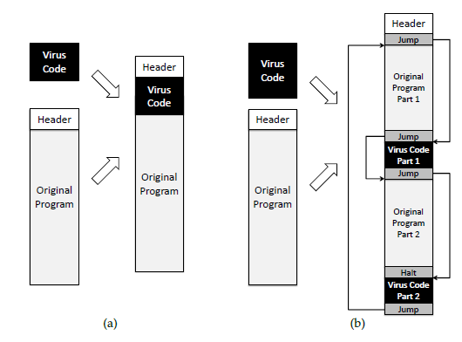
Degrees of Complication
Viruses have various degrees of complication in how they can insert themselves in computer code.

Slide 18
Concealment
Encrypted virus
  Decryption engine + encrypted body
  Randomly generate encryption key
  Detection looks for decryption engine
Polymorphic virus
  Encrypted virus with random variations of the decryption engine (e.g., padding code)
  Detection using CPU emulator
Metamorphic virus
  Different virus bodies
  Approaches include code permutation and instruction replacement
  Challenging to detect

Slide 19
Computer Worms
A computer worm is a malware program that spreads copies of itself without the need to inject itself in other programs, and usually without human interaction.
Thus, computer worms are technically not computer viruses (since they don’t infect other programs), but some people nevertheless confuse the terms, since both spread by self-replication.
In most cases, a computer worm will carry a malicious payload, such as deleting files or installing a backdoor.

Slide 20
Early History
First worms built in the labs of John Shock and Jon Hupp at Xerox PARC in the early 80s
CHRISTMA EXEC written in REXX, released in December 1987, and targeting IBM VM/CMS systems was the first worm to use e-mail service
The first internet worm was the Morris Worm, written by Cornell student Robert Tappan Morris and released on November 2, 1988
Notes:
Much of the macro classification carries over from viruses, worms based on macro capabilities of programs are programmed in much the same way as viruses, with minor differences
Primary classification has often been based on a worm relying on e-mail or IRC, ICQ, AIM.
Through much of the mid-90s IRC was a popular target, and worms were often combined with Trojans to allow for remotely controlling systems
Examples include IRC.Worm.Ceyda and IRC.Worm.Whacked, the later of which is also a Trojan
Simultaneously with a growth in instant messaging, popular IM clients have been targeted by worms
There are known worms targeting AIM (W32.AimVen.Worm), MSN (W32.Kelvir and variants), ICQ (W32.Bizex), Yahoo Messenger (W32.Hawawi) and pretty much every other popular IM network
P2P networks have been targeted of late, with W32.Hawawi and others spreading through Kazza
E-mail, exploited indirectly by the Morris Worm continues to be a popular propagation method, with worms like W97M.Melissa, and W32.Navidad relying on MAPI to provide them with an easy way to e-mail themselves out.

Slide 21
Worm Development
Identify vulnerability still unpatched
Write code for
  Exploit of vulnerability
  Generation of target list
    Random hosts on the internet
    Hosts on LAN
    Divide-and-conquer
  Installation and execution of payload
  Querying/reporting if a host is infected
Initial deployment on botnet
Worm template
  Generate target list
  For each host on target list
    Check if infected
    Check if vulnerable
    Infect
    Recur
Distributed graph search algorithm
  Forward edges: infection
  Back edges: already infected or not vulnerable

Slide 22
Morris Worm
Robert Morris – Cornell U. grad student (escape 1988.11.02)
Find target hosts
  /etc/hosts file
  .rhost
  hosts.equiv
at random, Gain access
  symmetry of trust (.rhost, hosts.equiv)
  common user accounts/passwords
  password guessing/cracking
  fingerd buffer overflow
  sendmail misconfiguration (DEGUG mode)

Slide 23
Morris Worm
Launch Grappling Hook (bootstrap loader)
  99 lines of C code transferred and compiled on target
  Could run on many kinds of hosts
  given one-time password used to authenticate itself to source machine
  fetch rest of worm from source machine to target - remove traces if any errors
  compile, link, load and execute
    Could only run on DEC Vax/4BSD and Sun-3 machines

Slide 24
Morris Worm
Hide
  use of one-time password for grappling hook
  encrypt memory-resident copy
  delete all files once in memory
  change name of program periodically
  change PID periodically
  exit before running for too long
    (note: this make cracking attempts limited per worm)

Slide 25
Morris Worm Fallout
Essentially shut down many university computing facilities (Vax and Sun-3s) (“estimate” of 6000), cost estimation by GAO of $100,000 - $10,000,000
Ad hoc response teams formed (CMU, Purdue, etc)
Those who disconnected from Internet did worse
First prosecution under 1986 Computer Fraud and Abuse Act
Lead to formation of CERT

Slide 26
Morris Worm
Failures of Morris Worm
  Re-infected same host multiple times
  Clogged up process table and network
Failures of Internet admins and users
  Admins did not patch fingerd
  Sendmail configuration interface was horrible
  No secure login capabilities available
  User passwords were pretty weak
  No mechanisms in place for coordination, etc.

Slide 27


Worm Propagation
Worms propagate by finding and infecting vulnerable hosts.
  They need a way to tell if a host is vulnerable
  They need a way to tell if a host is already infected.
initial infection

Slide 28
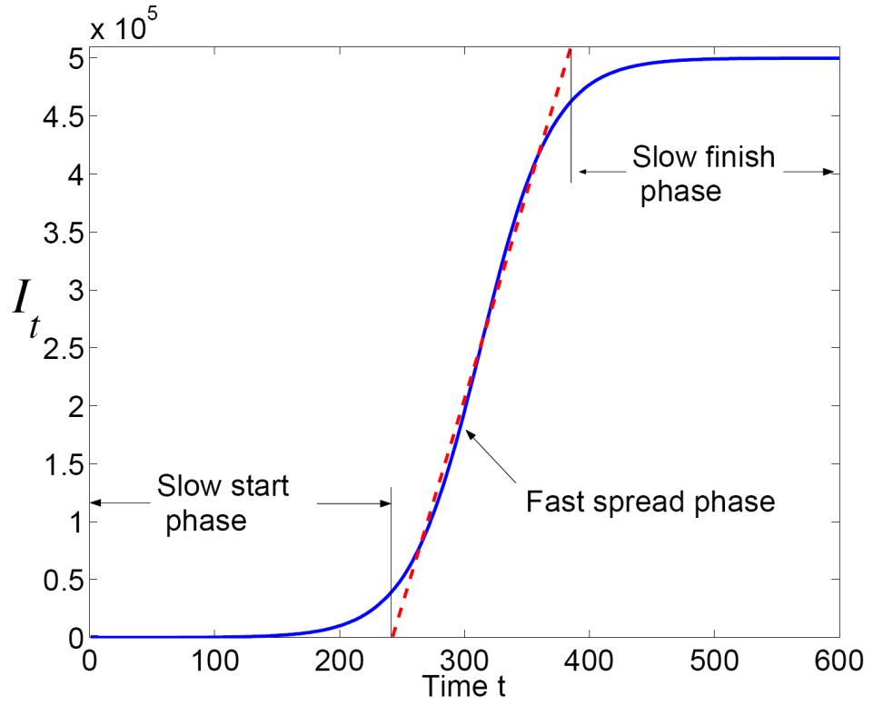
Propagation: Theory
Classic epidemic model
  N: total number of vulnerable hosts
  I(t): number of infected hosts at time t
  S(t): number of susceptible hosts at time t
  I(t) + S(t) = N
  β: infection rate
Differential equation for I(t):
dI/dt = βI(t) S(t)
More accurate models adjust propagation rate over time
Source:
Cliff C. Zou, Weibo Gong, Don Towsley, and Lixin Gao. The Monitoring and Early Detection of Internet Worms, IEEE/ACM Transactions on Networking, 2005.

Slide 29
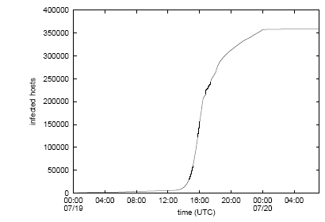
Propagation: Practice
Cumulative total of unique IP addresses infected by the first outbreak of Code-RedI v2 on July 19-20, 2001
Source:
David Moore, Colleen Shannon, and Jeffery Brown. Code-Red: a case study on the spread and victims of an Internet worm, CAIDA, 2002

Slide 30
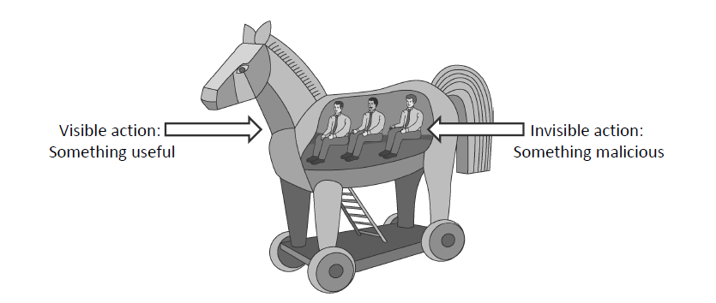
Trojan Horses
A Trojan horse (or Trojan) is a malware program that appears to perform some useful task, but which also does something with negative consequences (e.g., launches a keylogger).
Trojan horses can be installed as part of the payload of other malware but are often installed by a user or administrator, either deliberately or accidentally.

Slide 31
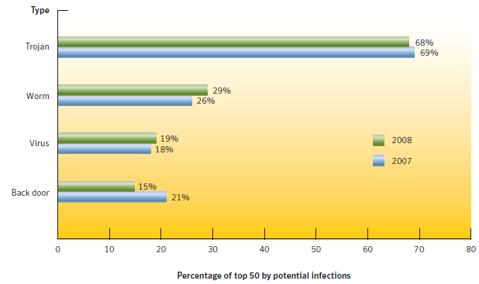
Current Trends
Trojans currently have largest infection potential
  Often exploit browser vulnerabilities
  Typically used to download other malware in multi-stage attacks
Source:
Symantec Internet Security Threat Report, April 2009

Slide 32
Rootkits
A rootkit modifies the operating system to hide its existence
  E.g., modifies file system exploration utilities
  Hard to detect using software that relies on the OS itself
RootkitRevealer
  By Bryce Cogswell and Mark Russinovich (Sysinternals)
  Two scans of file system
  High-level scan using the Windows API
  Raw scan using disk access methods
  Discrepancy reveals presence of rootkit
  Could be defeated by rootkit that intercepts and modifies results of raw scan operations

Slide 33
Malware Zombies
Malware can turn a computer in to a zombie, which is a machine that is controlled externally to perform malicious attacks, usually as a part of a botnet.
Botnet Controller (Attacker)
Attack Commands
Botnet:
Attack Actions
Victim

Slide 34
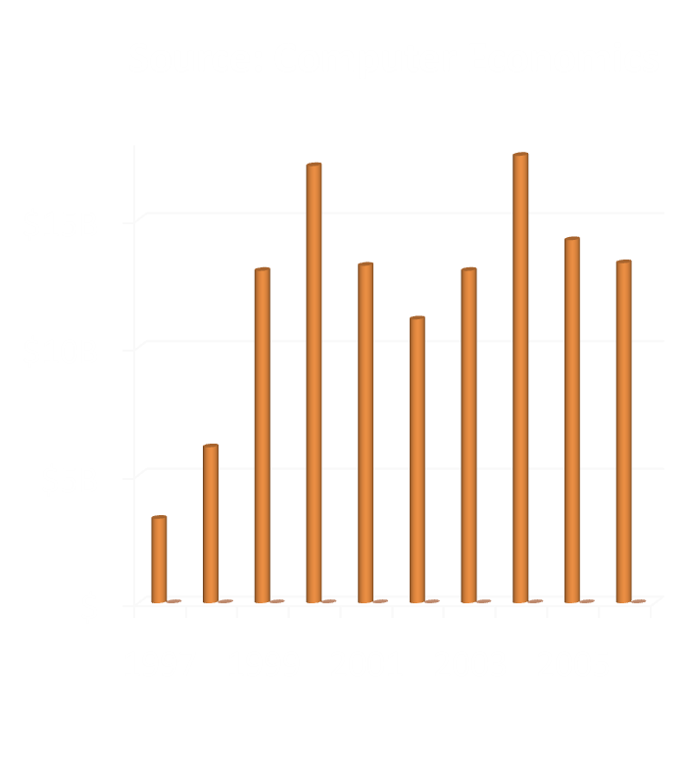
Financial Impact
Malware often affects a large user population
Significant financial impact, though estimates vary widely, up to $100B per year (mi2g)
Examples
  LoveBug (2000) caused $8.75B in damages and shut down the British parliament
  In 2004, 8% of emails infected by W32/MyDoom.A at its peak
  In February 2006, the Russian Stock Exchange was taken down by a virus.

Slide 35
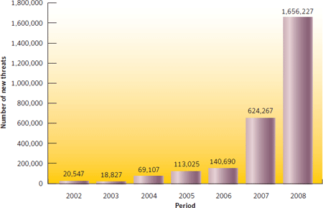
Economics of Malware
New malware threats have grown from 20K to 1.7M in the period 2002-2008
Most of the growth has been from 2006 to 2008
Number of new threats per year appears to be growing an exponential rate.
Current est: $114B/yr
$3000/day for recovery
Source:
Symantec Internet Security Threat Report, April 2009

Slide 36
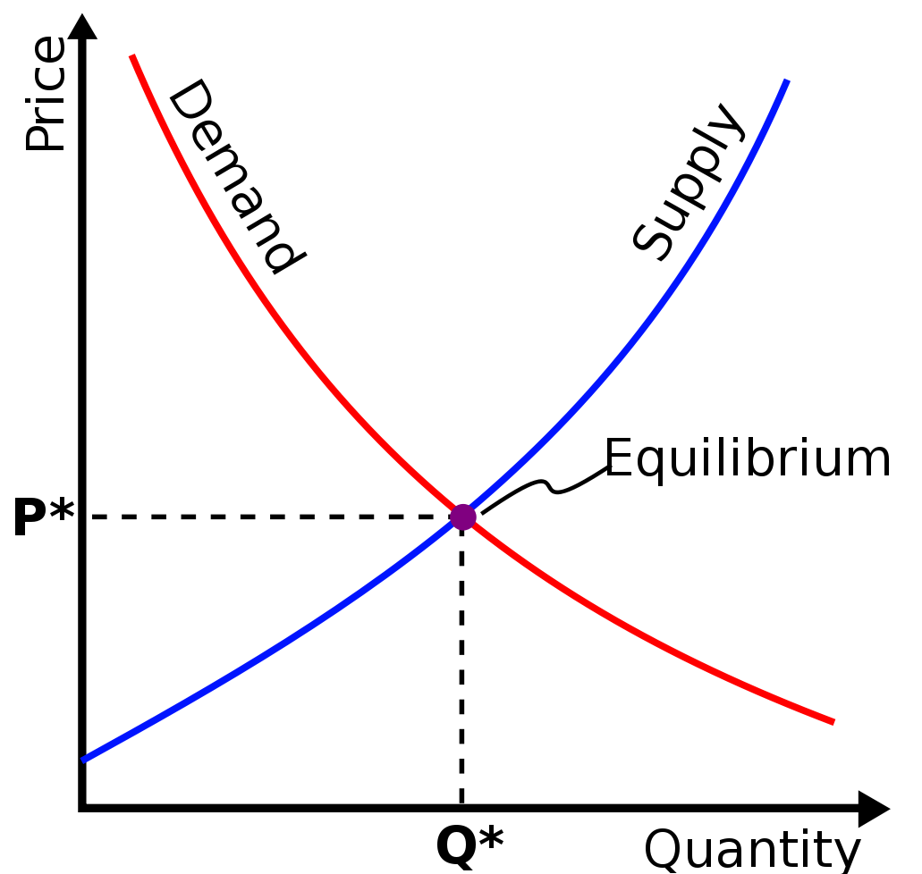
Professional Malware
Growth in professional cybercrime and online fraud has led to demand for professionally developed malware
New malware is often a custom-designed variations of known exploits, so the malware designer can sell different “products” to his/her customers.
Like every product, professional malware is subject to the laws of supply and demand.
  Recent studies put the price of a software keystroke logger at $23 and a botnet use at $225.
Image by User:SilverStar from http://commons.wikimedia.org/wiki/File:Supply-demand-equilibrium.svg
used by permission under the Creative Commons Attribution ShareAlike 3.0 License

Slide 37
Adware
Adware software payload
Computer user
Adware engine infects
a user’s computer
Adware engine requests
advertisements
from adware agent
Advertisers contract with
adware agent for content
Adware agent delivers
ad content to user
Adware agent
Advertisers

Slide 38
Spyware
Spyware software payload
Computer user
1. Spyware engine infects
a user’s computer.
2. Spyware process collects
keystrokes, passwords,
and screen captures.
3. Spyware process
periodically sends
collected data to
spyware data collection
agent.
Spyware data collection agent

Slide 39
Signatures: A Malware Countermeasure
Scan compare the analyzed object with a database of signatures
A signature is a virus (etc.) fingerprint
  E.g.,a string with a sequence of instructions specific for each virus (etc.)
  Different from a digital signature
A file is infected if there is a signature inside its code
  Fast pattern matching techniques to search for signatures
All the signatures together create the malware database that usually is proprietary

Slide 40
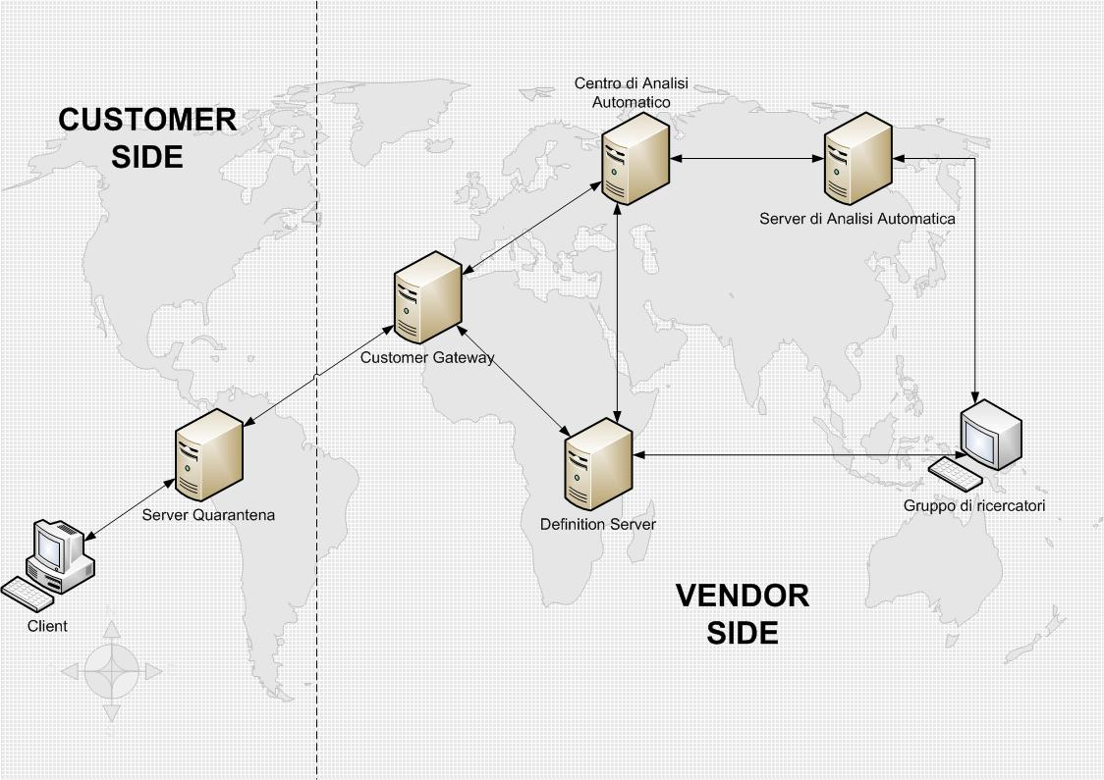
Signatures Database
Common Malware Enumeration (CME)
  aims to provide unique, common identifiers to new virus threats
  Hosted by MITRE
  http://cme.mitre.org/data/list.html
Digital Immune System (DIS)
  Automatically create new signatures
Notes:
While not completely standardized, virus naming follows a fairly standard convention
Viruses often have multiple names in standard usage, and names reported often depend on the detection software used.
Commonly used prefixes include:
@m: Worms or viruses propagating by e-mail
@mm: Mass mailer worms or viruses
Dr: Dropper programs
Family: A virus which shares characteristics with other viruses in a family
Gen: Similar to family
Int: An intended virus, a virus which failed
Worm: Sometimes used to indicate worms

Slide 41
Tripwire
Maintain database of cryptographic hashes for
  Operating system files
  Popular applications
  Known infected files
Compute hash of each file
Look up into database
Need to protect the integrity of the database

Slide 42
Heuristic Analysis
Useful to identify new and “zero day” malware
Code analysis
  Based on the instructions, the antivirus can determine whether or not the program is malicious, i.e., program contains instruction to delete system files,
Execution emulation
  Run code in isolated emulation environment
  Monitor actions that target file takes
  If the actions are harmful, mark as virus
Heuristic methods can trigger false alarms

Slide 43
Shield vs. On-demand
Shield
  Background process (service/daemon)
  Scans each time a file is touched (open, copy, execute, etc.)
On-demand
  Scan on explicit user request or according to regular schedule
  On a suspicious file, directory, drive, etc.
Performance test of scan techniques
  Comparative: check the number of already known viruses that are found and the time to perform the scan
    Retrospective: test the proactive detection of the scanner for unknown viruses, to verify which vendor uses better heuristics
  Anti-viruses are ranked using both parameters:
  http://www.av-comparatives.org/

Slide 44
Online vs Offline Anti Virus Software
Online
Free browser plug-in
Authentication through third party certificate (i.e. VeriSign)
No shielding
Software and signatures update at each scan
Poorly configurable
Scan needs internet connection
Report collected by the company that offers the service
Offline
Paid annual subscription
Installed on the OS
Software distributed securely by the vendor online or a retailer
System shielding
Scheduled software and signatures updates
Easily configurable
Scan without internet connection
Report collected locally and may be sent to vendor

Slide 45
Quarantine
A suspicious file can be isolated in a folder called quarantine:
  E.g,. if the result of the heuristic analysis is positive and you are waiting for db signatures update
The suspicious file is not deleted but made harmless: the user can decide when to remove it or eventually restore for a false positive
  Interacting with a file in quarantine it is possible only through the antivirus program
The file in quarantine is harmless because it is encrypted
Usually the quarantine technique is proprietary and the details are kept secret

Slide 46
Static vs. Dynamic Analysis
Static Analysis
Checks the code without trying to execute it
Quick scan in white list
Filtering: scan with different antivirus and check if they return same result with different name
Weeding: remove the correct part of files as junk to better identify the virus
Code analysis: check binary code to understand if it is an executable, e.g., PE (www.heaventools.com)
Disassembling: check if the byte code shows something unusual
Dynamic Analysis
Check the execution of codes inside a virtual sandbox
Monitor
  File changes
  Registry changes
  Processes and threads
  Networks ports

Slide 47
Anomaly Detection
Steps
Feature selection – what to measure
Feature reduction – space too big
Training – what is “normal”?
Training – what is known bad?
Classification – separate bad from good
Anomaly detection – NOT known to be good
Behavior space
Normal
observed
Behavior of
known attacks
unobserved
Issues
Feature space is too big
Getting clean training sets
What is normal changes over time
False positive rate

Slide 48
HIS-based Anomaly Detection
Human Immune System
Produce antibodies
Filter out those that recognize “self” (else get autoimmune disease!)
Release antibodies that recognize many, random proteins
When antibody recognizes a protein, must be foreign
Enlist troops – make more of same antibodies
Call killers over to foreigner
Computer/Network
Pick symbols (e.g., system calls)
Reduce symbols (e.g., ditch parameters)
Form long input string
Window words of length K over input string
Classify self/foreign words
Now window over W words
Set threshold – if > T foreign words in last W => alarm

Slide 49
HIS-based Anomaly Detection
Computer/Network
Pick symbols (e.g., system calls)
fd=fopen(“foo.txt”,RW);
fd2=fopen(“bar.txt”,R);
fread(fd2,1024,&buff);
fread(fd2,1024,&buff);
fread(fd2,1024,&buff);
fwrite(fd,&buff);
fclose(fd2);
fclose(fd);

Slide 50
HIS-based Anomaly Detection
Computer/Network
Pick symbols (e.g., system calls)
Reduce symbols (e.g., ditch parameters)
fopen
fopen
fread
fread
fread
fwrite
fclose
fclose
… fopen=15 … fread=17
… fwrite=18
… fclose=20 …

Slide 51
HIS-based Anomaly Detection
Computer/Network
Pick symbols (e.g., system calls)
Reduce symbols (e.g., ditch parameters)
Form long input string
Window words of length K over input string
Build set of “Self”
15 15 17 17 17 18 20 20
SELF
15 15 17 17
15 17 17 17
17 17 17 18
17 17 18 20
17 18 20 20

Slide 52
HIS-based Anomaly Detection
Computer/Network
Pick symbols (e.g., system calls)
Reduce symbols (e.g., ditch parameters)
Form long input string
Window words of length K over input string
Classify input words
x0 x1 x2 x3 x4 x5 x6 x7 x8 x9…
SELF
0
0 1
0 1 1
0 1 1 1
0 1 1 1 0
0 1 1 1 0 0
0 1 1 1 0 0 0
0 1 1 1 0 0 0 1
0 1 1 1 0 0 0 1 0
0 1 1 1 0 0 0 1 0 1…

Slide 53
HIS-based Anomaly Detection
Computer/Network
Pick symbols (e.g., system calls)
Reduce symbols (e.g., ditch parameters)
Form long input string
Window words of length K over input string
Classify input words
Now window over W words
0
0 1
0 1 2
0 1 2 3
0 1 2 3 3
0 1 2 3 3 3 2 2 1 2
0 1 1 1 0 0 0 1 0 1…

Slide 54
HIS-based Anomaly Detection
Computer/Network
Pick symbols (e.g., system calls)
Reduce symbols (e.g., ditch parameters)
Form long input string
Window words of length K over input string
Classify input words
Now window over W words
Set threshold – if > T foreign words in last W => alarm
Normal
# Non-self in last W
T
Input symbol
Abnormal
# Non-self in last W
T
Input symbol

Slide 55
Virus Detection is Undecidable
Theoretical result by Fred Cohen (1987)
Virus abstractly modeled as program that eventually executes infect
Code for infect may be generated at runtime
Proof by contradiction similar to that of the halting problem
Suppose program isVirus(P) determines whether program P is a virus
Define new program Q as follows:
  if (not isVirus(Q))
  infect
  stop
Running isVirus on Q achieves a contradiction
Notes:
Theoretically a class of viruses can be found for which there is no minimal detection algorithm
Can thus prove inability to find a perfect virus scanning algorithm and hence a perfect virus scanner
The signatures are behavioral signatures, changing registers, accessing certain memory locations
Signatures are expensive to generate, but cheap to compare against and distinguish between normal computer behavior and abnormal behavior
Virus detection technologies:
Activity monitors rely on monitoring current system activity, help in detecting malware by monitoring specific memory or service access
Signature scanners broadly check files and memory for known virus signatures
File authentication methods rely on authenticating files to make sure they are not really infected by viruses

Slide 56
Other Undecidable Detection Problems
Detection of a virus
  by its appearance
  by its behavior
Detection of a triggering mechanism
  by its appearance
  by its behavior
Detection of a virus detector
  by its appearance
  by its behavior
Detection of an evolution of
  a known virus
  a known triggering mechanism
  a virus detector
Notes:
Theoretically a class of viruses can be found for which there is no minimal detection algorithm
Can thus prove inability to find a perfect virus scanning algorithm and hence a perfect virus scanner
The signatures are behavioral signatures, changing registers, accessing certain memory locations
Signatures are expensive to generate, but cheap to compare against and distinguish between normal computer behavior and abnormal behavior

Slide 57
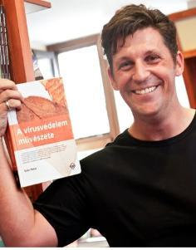
Resources
Computer Emergency Response Team (www.cert.org)
  Research center funded by the US federal government
  Vulnerabilities database
Symantec (www.symantec.com)
  Reports on malware trends
  Database of malware
Art of Computer Virus Research and
Defense by Peter Szor
(may he rest in peace)
(2005 Semantec Press)

