Slide 1
Filesystem Security

Slide 2
General Principles
Files and folders are managed by the operating system
Applications, including shells, access files through an API
Access control entry (ACE)
  Allow/deny a certain type of access to a file/folder by user/group
Access control list (ACL)
  Collection of ACEs for a file/folder
A file handle provides an opaque identifier for a file/folder
File operations
  Open file: returns file handle
  Read/write/execute file
  Close file: invalidates file handle
Hierarchical file organization
  Tree (Windows)
  DAG (Linux)

Slide 3
Discretionary Access Control (DAC)
Users can protect what they own
  The owner may grant access to others
  The owner may define the type of access (read/write/execute) given to others
DAC is the standard model used in operating systems
Mandatory Access Control (MAC)
  Alternative model not covered in this lecture
  Multiple levels of security for users and documents
  Read down and write up principles
Notes:
Ripasso DAC

Slide 4
Closed vs. Open Policy
Closed policy
  Also called “default secure”
Give Tom read access to “foo”
Give Bob r/w access to “bar
Tom: I would like to read “foo”
  Access allowed
Tom: I would like to read “bar”
  Access denied
Open Policy
Deny Tom read access to “foo”
Deny Bob r/w access to “bar”
Tom: I would like to read “foo”
  Access denied
Tom: I would like to read “bar”
  Access allowed
Notes:
Default sicuro

Slide 5
Closed Policy with Negative
Authorizations and Deny Priority
Give Tom r/w access to “bar”
Deny Tom write access to “bar”
Tom: I would like to read “bar”
  Access allowed
Tom: I would like to write “bar”
  Access denied
Policy is used by Windows to manage access control to the file system

Slide 6
Access Control Entries and Lists
An Access Control List (ACL) for a resource (e.g., a file or folder) is a sorted list of zero or more Access Control Entries (ACEs)
An ACE refers specifies that a certain set of accesses (e.g., read, execute and write) to the resources is allowed or denied for a user or group
Examples of ACEs for folder “Bob’s CS167 Grades”
  Bob; Read; Allow
  TAs; Read; Allow
  TWD; Read, Write; Allow
  Bob; Write; Deny
  TAs; Write; Allow

Slide 7
Linux vs. Windows
Linux
  Allow-only ACEs
  Access to file depends on ACL of file and of all its ancestor folders
  Start at root of file system
  Traverse path of folders
  Each folder must have execute (cd) permission
  Different paths to same file not equivalent
  File’s ACL must allow requested access
Windows
  Allow and deny ACEs
  By default, deny ACEs precede allow ones
  Access to file depends only on file’s ACL
  ACLs of ancestors ignored when access is requested
  Permissions set on a folder usually propagated to descendants (inheritance)
  System keeps track of inherited ACE’s

Slide 8
Linux File Access Control
File Access Control for:
  Files
  Directories
  Therefore…
    \dev\ : devices
    \mnt\ : mounted file systems
    What else? Sockets, pipes, symbolic links…
Notes:
Because of the way devices and mounted file systems are represented in Linux as part of the file system, they are also covered by the same access control scheme as normal files.

Slide 9
Linux File System
Tree of directories (folders)
Each directory has links to zero or more files or directories
Hard link
  From a directory to a file
  The same file can have hard links from multiple directories, each with its own filename, but all sharing owner, group, and permissions
  File deleted when no more hard links to it
Symbolic link (symlink)
  From a directory to a target file or directory
  Stores path to target, which is traversed for each access
  The same file or directory can have multiple symlinks to it
  Removal of symlink does not affect target
  Removal of target invalidates (but not removes) symlinks to it
  Analogue of Windows shortcut or Mac OS alias

Slide 10
Unix Permissions
Standard for all UNIXes
Every file is owned by a user and has an associated group
Permissions often displayed in compact 10-character notation
To see permissions, use ls –l
jk@sphere:~/test$ ls –l
total 0
-rw-r----- 1 jk ugrad 0 2005-10-13 07:18 file1
-rwxrwxrwx 1 jk ugrad 0 2005-10-13 07:18 file2

Slide 11
Permissions Examples (Regular Files)
-rw-r—r--
read/write for owner, read-only for everyone else
-rw-r-----
read/write for owner, read-only for group, forbidden to others
-rwx------
read/write/execute for owner, forbidden to everyone else
-r--r--r--
read-only to everyone, including owner
-rwxrwxrwx
read/write/execute to everyone

Slide 12
Permissions for Directories
Permissions bits interpreted differently for directories
Read bit allows listing names of files in directory, but not their properties like size and permissions
Write bit allows creating and deleting files within the directory
Execute bit allows entering the directory and getting properties of files in the directory
Lines for directories in ls –l output begin with d, as below:
jk@sphere:~/test$ ls –l
Total 4
drwxr-xr-x 2 jk ugrad 4096 2005-10-13 07:37 dir1
-rw-r--r-- 1 jk ugrad 0 2005-10-13 07:18 file1

Slide 13
Permissions Examples (Directories)
drwxr-xr-x
all can enter and list the directory, only owner can add/delete files
drwxrwx---
full access to owner and group, forbidden to others
drwx--x---
full access to owner, group can access known filenames in directory, forbidden to others
-rwxrwxrwx
full access to everyone

Slide 14
File Sharing Challenge
Creating and modifying groups requires root
Given a directory with permissions drwx------x and a file in it
  Give permission to write the file to user1, user2, user3, … without creating a new group
  Selectively revoke a user
Solution 1
  Give file write permission for everyone
  Create different random hard links: user1-23421, user2-56784, …
Problem! Selectively removing access: hard link can be copied
Solution 2
  Create random symbolic links
Problem! Symbolic link tells where it points
Notes:
Creating and adding users to groups in Linux requires root. Thus, groups, in a sense, are not “dynamic.” The example on this slide hints at a problem with this permission system: it is difficult to manage by-user access to files.

Slide 15
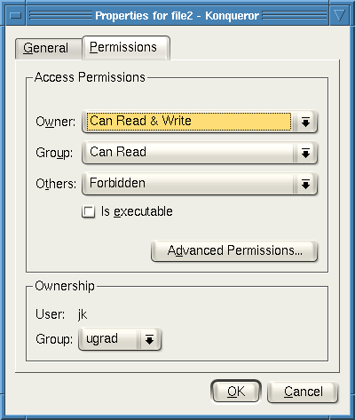
Working Graphically with Permissions
Several Linux GUIs exist for displaying and changing permissions
In KDE’s file manager Konqueror, right-click on a file and choose Properties, and click on the Permissions tab:
Changes can be made here
(more about changes later)

Slide 16
Special Permission Bits
Three other permission bits exist
  Set-user-ID (“suid” or “setuid”) bit
  Set-group-ID (“sgid” or “setgid”) bit
  Sticky bit

Slide 17
Set-user-ID
Set-user-ID (“suid” or “setuid”) bit
  On executable files, causes the program to run as file owner regardless of who runs it
  Ignored for everything else
  In 10-character display, replaces the 4th character (x or -) with s (or S if not also executable)
    -rwsr-xr-x: setuid, executable by all
    -rwxr-xr-x: executable by all, but not setuid
    -rwSr--r--: setuid, but not executable - not useful

Slide 18
Set-group-ID
Set-group-ID (“sgid” or “setgid”) bit
  On executable files, causes the program to run with the file’s group, regardless of whether the user who runs it is in that group
  On directories, causes files created within the directory to have the same group as the directory, useful for directories shared by multiple users with different default groups
  Ignored for everything else
  In 10-character display, replaces 7th character (x or -) with s (or S if not also executable)
    -rwxr-sr-x: setgid file, executable by all
    drwxrwsr-x: setgid directory; files within will have group of directory
    -rw-r-Sr--: setgid file, but not executable - not useful
Notes:
The setgid bit is used by many games. The executable files are in group games and are setgid. No users are in group games, but the high-score files are. Being setgid games allows games to update high scores!

Slide 19
Sticky Bit
On directories, prevents users from deleting or renaming files they do not own
Ignored for everything else
In 10-character display, replaces 10th character (x or -) with t (or T if not also executable)
  drwxrwxrwt: sticky bit set, full access for everyone
  drwxrwx--T: sticky bit set, full access by user/group
  drwxr--r-T: sticky, full owner access, others can read (useless)

Slide 20
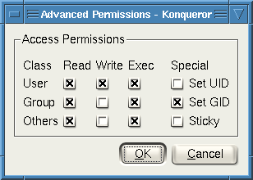
Working Graphically with Special Bits
Special permission bits can also be displayed and changed through a GUI
In Konqueror’s Permissions window, click Advanced Permissions:
Changes can be made here (more about changes later)

Slide 21
Root
“root” account is a super-user account, like Administrator on Windows
Multiple roots possible
File permissions do not restrict root
This is dangerous, but necessary, and OK with good practices
Notes:
There can be multiple root accounts, but root is the conventional name. Any account with user ID 0 has root powers. This is like the Windows Administrators group. As the system administrator, root can change any file’s owner, group, or permissions, or delete the file, regardless of who owns it or its permissions. This is clearly dangerous, but necessary, and in practice can be secure. Choosing a good root password is very important, as well as minimizing programs and commands which are run as root. Finally, root is the entity charged with making sure that permissions allow no other users to disrupt the system (accidentally or intentionally), but there is nobody doing oversight on root. Thus, it is wise to think twice before doing anything as root, to guard against mistakes.

Slide 22
Becoming Root
su
  Changes home directory, PATH, and shell to that of root, but doesn’t touch most of environment and doesn’t run login scripts
su -
  Logs in as root just as if root had done so normally
sudo <command>
  Run just one command as root
su [-] <user>
  Become another non-root user
  Root does not require to enter password
Notes:
To become root, type su or su - and put in the root password when prompted. Sudo functions similarly, but only for the duration of one command.

Slide 23
Changing Permissions
Permissions are changed with chmod or through a GUI like Konqueror
Only the file owner or root can change permissions
If a user owns a file, the user can use chgrp to set its group to any group of which the user is a member
root can change file ownership with chown (and can optionally change group in the same command)
chown, chmod, and chgrp can take the -R option to recur through subdirectories

Slide 24
Examples of Changing Permissions
chown -R root dir1
Changes ownership of dir1 and everything within it to root
chmod g+w,o-rwx file1 file2
Adds group write permission to file1 and file2, denying all access to others
chmod -R g=rwX dir1
Adds group read/write permission to dir1 and everything within it, and group execute permission on files or directories where someone has execute permission
chgrp testgrp file1
Sets file1’s group to testgrp, if the user is a member of that group
chmod u+s file1
Sets the setuid bit on file1. (Doesn’t change execute bit.)

Slide 25
Octal Notation
Previous slide’s syntax is nice for simple cases, but bad for complex changes
  Alternative is octal notation, i.e., three or four digits from 0 to 7
Digits from left (most significant) to right(least significant):
[special bits][user bits][group bits][other bits]
Special bit digit =
(4 if setuid) + (2 if setgid) + (1 if sticky)
All other digits =
(4 if readable) + (2 if writable) + (1 if executable)

Slide 26
Octal Notation Examples
644 or 0644
read/write for owner, read-only for everyone else
775 or 0775
read/write/execute for owner and group, read/execute for others
640 or 0640
read/write for owner, read-only for group, forbidden to others
2775
same as 775, plus setgid (useful for directories)
777 or 0777
read/write/execute to everyone (dangerous!)
1777
same as 777, plus sticky bit

Slide 27
Limitations of Unix Permissions
Unix permissions are not perfect
  Groups are restrictive
  Limitations on file creation
Linux optionally uses POSIX ACLs
  Builds on top of traditional Unix permissions
  Several users and groups can be named in ACLs, each with different permissions
  Allows for finer-grained access control
Each ACL is of the form type:[name]:rwx
  Setuid, setgid, and sticky bits are outside the ACL system
Notes:
27
Unix permissions are not perfect. There is, for instance, no way to have specific permissions for two or three users, groups, etc. There is also limited ability to set permissions on newly created files, and non-root users cannot create groups and may only use the groups provided by root. At some risk of giving away the next slide, an optional solution is provided in POSIX ACLs.
Linux supports Access Control Lists (ACLs) specified by a POSIX draft standard, which works with Linux filesystems such as Ext2, Ext3, XFS, JFS, and ReiserFS. ACLs build on top of traditional Unix permissions, which still work, but allow for finer-grained access control. Several users and groups can be named in ACLs, each with different permissions. POSIX ACLs also permits a default ACLs for new files within directories.

Slide 28
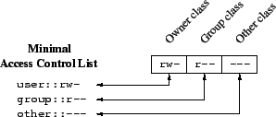
Minimal ACLs
In a file with minimal ACLs, name does not appear, and the ACLs with type “user” and “group” correspond to Unix user and group permissions, respectively.
  When name is omitted from a “user” type ACL entry, it applies to the file owner.
user : : r w –
group : : r – –
other : : – – –
Notes:
28

Slide 29
ACL Commands
ACLs are read with the getfacl command and set with the setfacl command.
Changing the ACLs corresponding to Unix permissions shows up in ls -l output, and changing the Unix permissions with chmod changes those ACLs.
Example of getfacl:
jimmy@techhouse:~/test$ ls -l
total 4
drwxr-x--- 2 jimmy jimmy 4096 2005-12-02 04:13 dir
jimmy@techhouse:~/test$ getfacl dir
# file: dir
# owner: jimmy
# group: jimmy
user::rwx
group::r-x
other::---
Notes:
29

Slide 30
More ACL Command Examples
jimmy@techhouse:~/test$ setfacl -m group::rwx dir
jimmy@techhouse:~/test$ ls -l
total 4
drwxrwx--- 2 jimmy jimmy 4096 2005-12-02 04:13 dir
jimmy@techhouse:~/test$ chmod 755 dir
jimmy@techhouse:~/test$ getfacl dir
# file: dir
# owner: jimmy
# group: jimmy
user::rwx
group::r-x
other::r-x
Notes:
30
Note that in the first example, the setfacl command changed the permissions just like chmod would. In the second, chmod's permissions change is reflected in the getfacl output.

Slide 31
Extended ACLs
ACLs that say more than Unix permissions are extended ACLs
  Specific users and groups can be named and given permissions via ACLs, which fall under the group class (even for for ACLs naming users and not groups)
With extended ACLs, mapping to and from Unix permissions is a bit complicated.
User and other classes map directly to the corresponding Unix permission bits
Group class contains named users and groups as well as owning group permissions. How to map?
Notes:
31

Slide 32
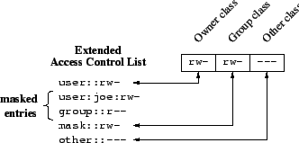
Mask-type ACLs
user : : r w –
user : joe : r w –
group : : r – –
mask: : r w –
other : : – – –
Notes:
32

Slide 33
Mask-type ACLs
Unix group permissions now map to an ACL of type “mask”, which is an upper bound on permissions for all group class ACLs.
All group class ACLs are logically and-ed with the mask before taking effect
  rw-—xrw- & r-x—x--- = r----x--
The ACL of type “group” with no name still refers to the Unix owning group
Mask ACLs are created automatically with the necessary bits such that they do not restrict the other ACLs at all, but this can be changed
Notes:
33

Slide 34
Extended ACL Example
jimmy@techhouse:~/test$ ls -l
total 4
drwxr-xr-x 2 jimmy jimmy 4096 2005-12-02 04:13 dir
jimmy@techhouse:~/test$ setfacl -m user:joe:rwx dir
jimmy@techhouse:~/test$ getfacl dir
# file: dir
# owner: jimmy
# group: jimmy
user::rwx
user:joe:rwx
group::r-x
mask::rwx
other::r-x
jimmy@techhouse:~/test$ ls -l
total 8
drwxrwxr-x+ 2 jimmy jimmy 4096 2005-12-02 04:13 dir
Notes:
34

Slide 35
Extended ACL Example Explained
The preceding slide grants the named user joe read, write, and execute access to dir.
  dir now has extended rather than minimal ACLs.
The mask is set to rwx, the union of the two group class ACLs (named user joe and the owning group).
In ls -l output, the group permission bits show the mask, not the owning group ACL
  Effective owning group permissions are the logical and of the owning group ACL and the mask, which still equals r-x.
  This could reduce the effective owning group permissions if the mask is changed to be more restrictive.
The + in the ls -l output after the permission bits indicates that there are extended ACLs, which can be viewed with getfacl.
Notes:
35

Slide 36
Default ACLs
The kind of ACLs we've mentioned so far are access ACLs.
A directory can have an additional set of ACLs, called default ACLs, which are inherited by files and subdirectories created within that directory.
  Subdirectories inherit the parent directory's default ACLs as both their default and their access ACLs.
  Files inherit the parent directory's default ACLs only as their access ACLs, since they have no default ACLs.
The inherited permissions for the user, group, and other classes are logically and-ed with the traditional Unix permissions specified to the file creation procedure.
Notes:
36

Slide 37
Default ACL Example
jimmy@techhouse:~/test$ setfacl -d -m group:webmaster:rwx dir
jimmy@techhouse:~/test$ getfacl dir
# file: dir
# owner: jimmy
# group: jimmy
user::rwx
user:joe:rwx
group::r-x
mask::rwx
other::r-x
default:user::rwx
default:group::r-x
default:group:webmaster:rwx
default:mask::rwx
default:other::r-x
Note how this starts the default ACLs out as equal to the existing access ACLs plus the specified changes.
Notes:
37

Slide 38
Default ACL Example Continued
jimmy@techhouse:~/test$ mkdir dir/subdir
jimmy@techhouse:~/test$ getfacl dir/subdir
# file: dir/subdir
# owner: jimmy
# group: jimmy
user::rwx
group::r-x
group:webmaster:rwx
mask::rwx
other::r-x
default:user::rwx
default:group::r-x
default:group:webmaster:rwx
default:mask::rwx
default:other::r-x
The default ACLs from the parent directory are both the access and default ACLs for this directory. Group webmaster has full access.
Notes:
38

Slide 39
Default ACL Example Continued
jimmy@techhouse:~/test$ touch dir/file
jimmy@techhouse:~/test$ ls -l dir/file
-rw-rw-r--+ 1 jimmy jimmy 0 2005-12-02 11:36 dir/file
jimmy@techhouse:~/test$ getfacl dir/file
# file: dir/file
# owner: jimmy
# group: jimmy
user::rw-
group::r-x #effective:r--
group:webmaster:rwx #effective:rw-
mask::rw-
other::r--
The default ACLs from the parent directory are the basis for the access ACLs on this file, but since touch creates files without any execute bit set, the user and other classes, and the group class as well via the mask ACL, have their execute bits removed to match.
Notes:
39

Slide 40

NTFS Permissions
ACL
NTFS Partition
Read
User 1
Read
ACE
User 1
Group 1
Full Control
ACE
User 2
Full Control
Group 1

Slide 41
Basic NTFS Permissions

Slide 42
Multiple NTFS permissions
NTFS permissions are cumulative
File permissions override folder permissions
Deny overrides Allow
User 1
Read
Read/Write
Folder A
Group B
Group B
Write
User 1
File1
File2
Group A
Group A
Write denied

Slide 43
NTFS: permission inheritance
Permission Inheritance
Read/Write
Folder A
Access allowed for File 1
File1
Block of Inheritance
Read/Write
Folder A
File1
Access denied for File 1

Slide 44


NTFS File Permissions
Explicit: set by the owner for each user/group.
Inherited: dynamically inherited from the explicit permissions of ancestor folders.
Effective: obtained by combining the explicit and inherited permission.
inherited
Determining effective permissions:
  By default, a user/group has no privileges.
  Explicit permissions override conflicting inherited permissions.
  Denied permissions override conflicting allowed permissions.
Rules
effective
explicit

Slide 45
Access Control Algorithm
The DACL of a file or folder is a sorted list of ACEs
  Local ACEs precede inherited ACEs
  ACEs inherited from folder F precede those inherited from parent of F
  Among those with same source, Deny ACEs precede Allow ACEs
Algorithm for granting access request (e.g., read and execute):
  ACEs in the DACL are examined in order
  Does the ACE refer to the user or a group containing the user?
  If so, do any of the accesses in the ACE match those of the request?
  If so, what type of ACE is it?
    Deny: return ACCESS_DENIED
    Allow: grant the specified accesses and if there are no remaining accesses to grant, return ACCESS_ALLOWED
  If we reach the end of the DACL and there are remaining requested accesses that have not been granted yet, return ACCESS_DENIED

Slide 46
Example
Customers Group
Write Folder1
Marketing Group Read Folder1
NTFS
Folder1
Customers Group
Customers Group
Read Folder1
Marketing Group Write Folder2
File1
User1
Folder2
Customers Group
Modify Folder1
File2 should only be accessible to Marketing Group, and only for read access
File2
Marketing Group

Slide 47
NTFS move vs. copy in same volume
Move
NTFS E:\
Copy
If you move a file or a folder inside the same volume your permission will be the same of the source folder
If you copy a file or a folder inside the same volume your permission will be the same of the destination folder

Slide 48
NTFS move vs. copy across volumes
NTFS C:\
NTFS E:\
Copy
NTFS D:\
Move
If you copy or move a file or a folder on different volumes your permission will be the same of the destination folder

Slide 49
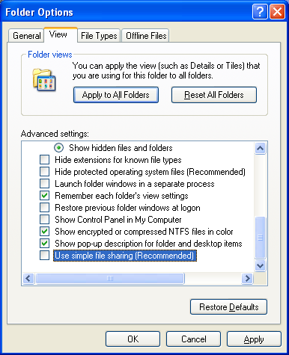
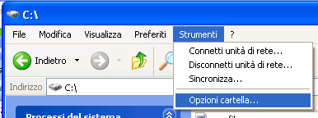
Setting File Permissions in Win XP
NTFS permissions in
Windows XP Pro are disabled by default.
Using Folder Options… from Tools menu inside Windows Explorer is possible to activate NTFS permission in windows by unchecking Use simple file sharing
Notes:
Qui devo cambiare le immagini dalla versione in inglese di windows

Slide 50
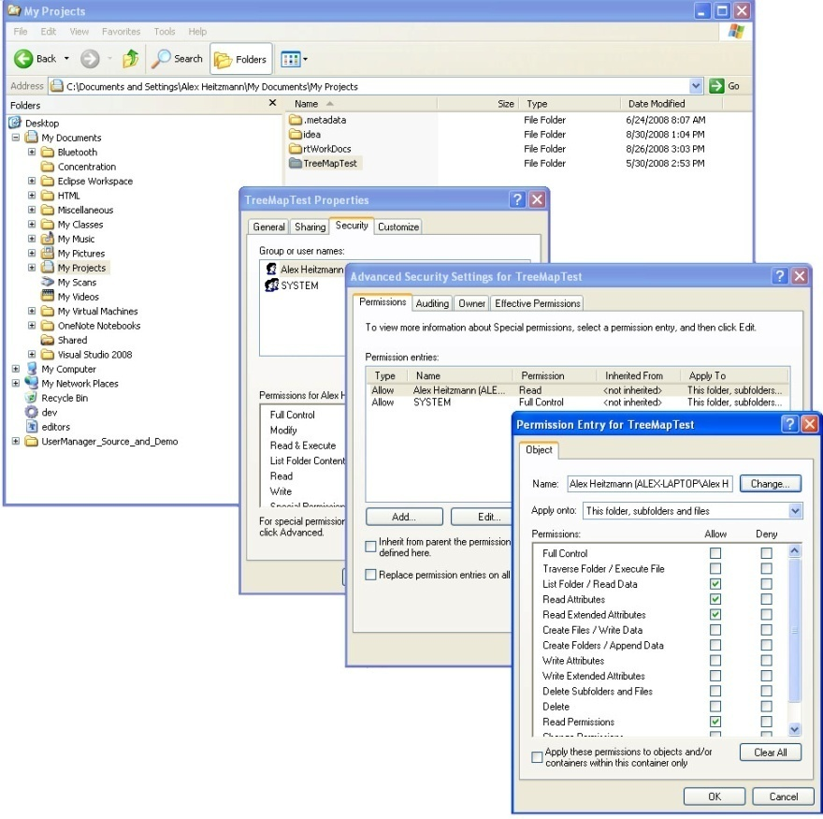
Windows Tools
Access control management tools provide detailed information and controls, across multiple dialogs.
Focus on single file/folders.
It is challenging for an inexperienced user, or a system administrator dealing with very large file structures, to gain a global view of permissions within the file system

Slide 51
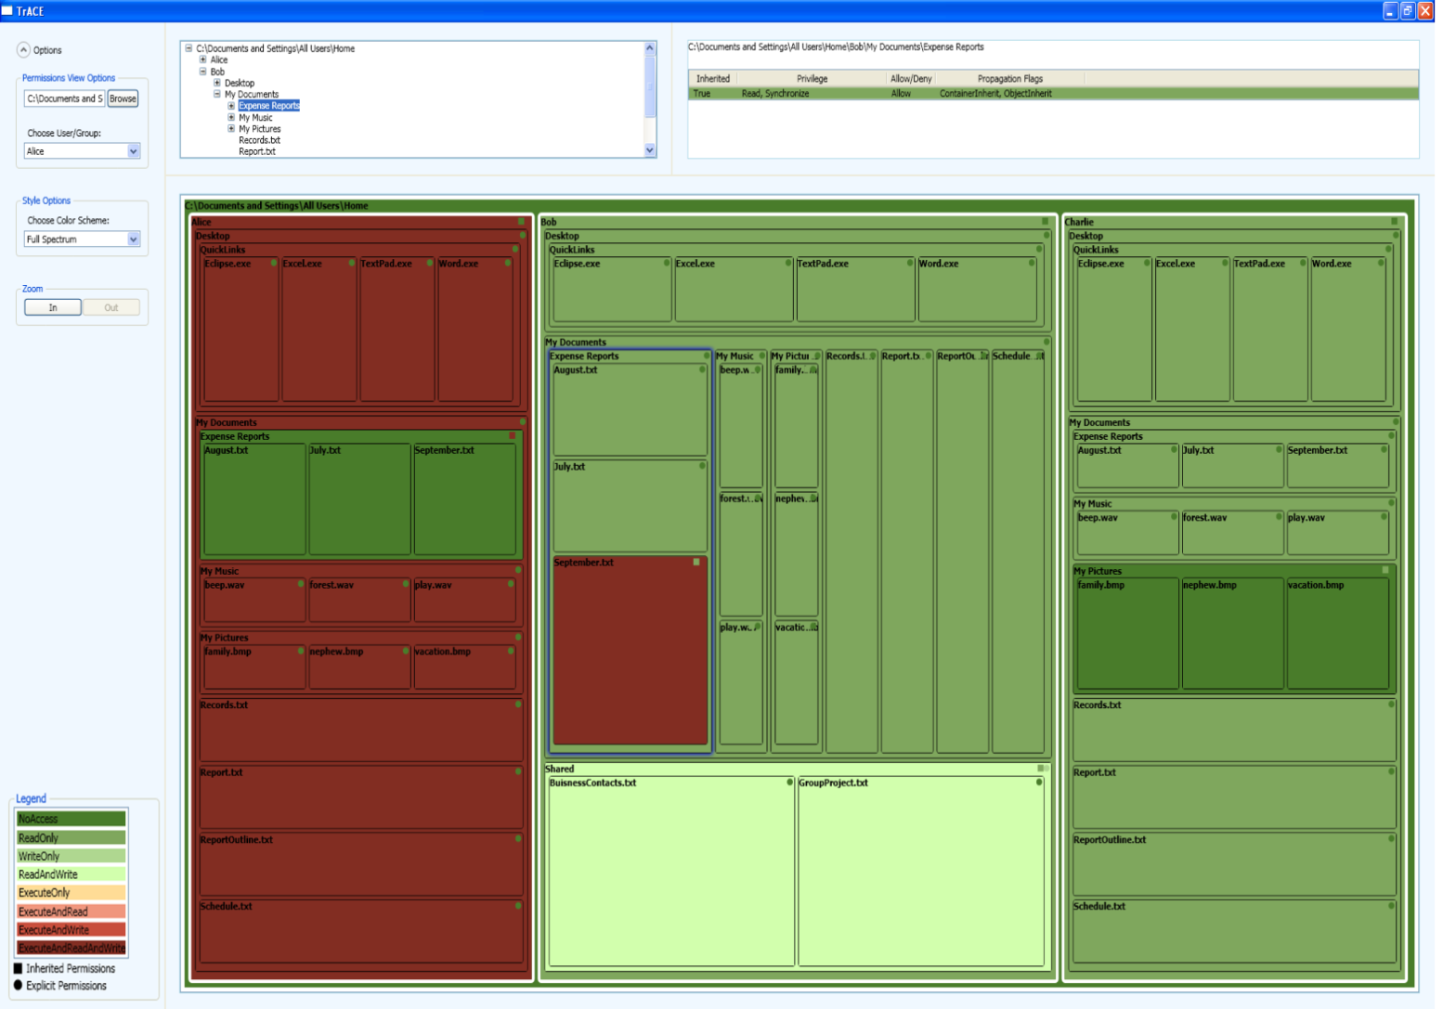





Treemap Access Control Evaluator (TrACE)
Alexander Heitzmann, Bernardo Palazzi, Charalampos Papamanthou, Roberto Tamassia. Effective Visualization of File System Access Control, VizSEC 2008
Sponsors:

Slide 52
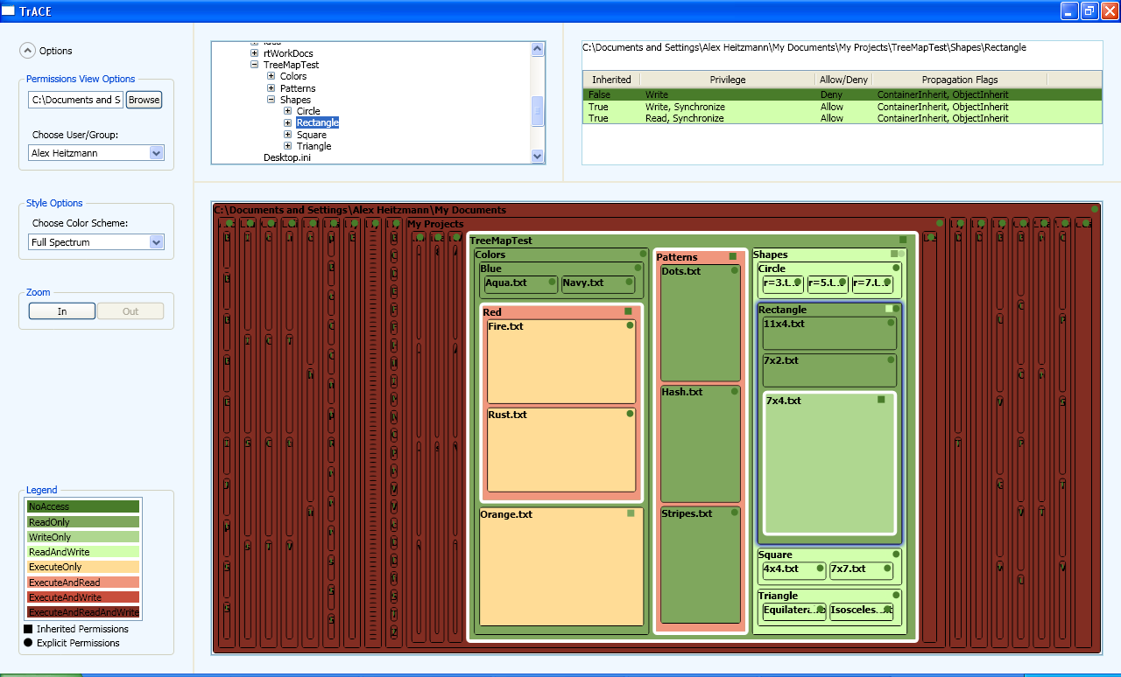
TrACE Highlights
At a glance, determine the explicit, inherited, and effective permissions of files and folders.
Understand access control relationships between files and their ancestors
Quickly evaluate large directory structures and find problem areas
Layout based on treemaps

Slide 53
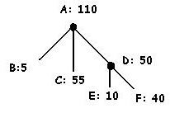
What is a Treemap?
A visualization method to display large hierarchical data structures (trees)
Layout based on nested rectangles.
Treemaps were introduced by Ben Shneiderman in “Tree visualization with tree-maps: 2-d space-filling approach”; TOG 1991
A
D
E
B
C
F

Slide 55
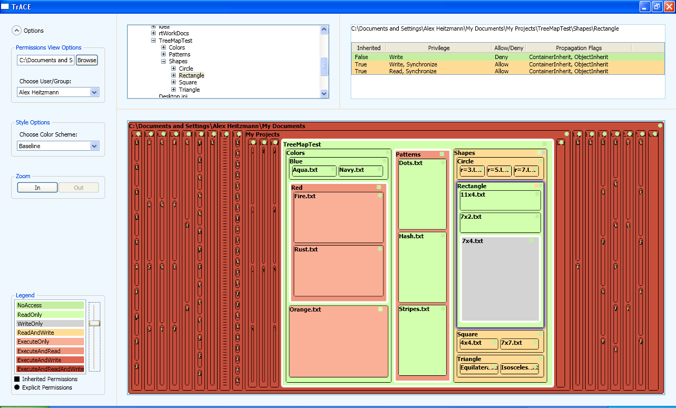

Slide 56
Acknowledgment
Much of these POSIX ACL slides are adapted (and some pictures are taken) from Andreas Grünbacher’s paper POSIX Access Control Lists on Linux, available online at:
http://www.suse.de/~agruen/acl/linux-acls/
Notes:
56

