Slide 1
Operating Systems Security

Slide 2
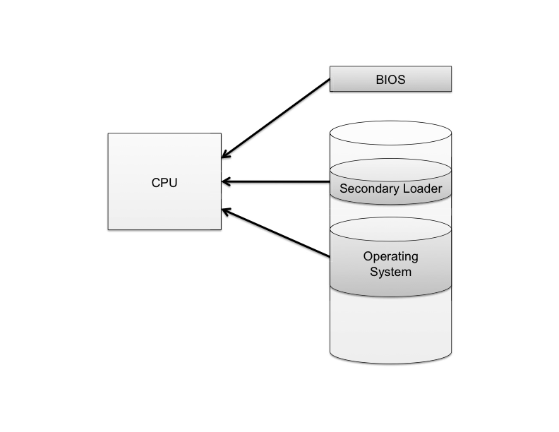
The Boot Sequence
The action of loading an operating system into memory from a powered-off state is known as booting or bootstrapping.
When a computer is turned on, it first executes code stored in a firmware component known as the BIOS (basic input/output system).
On modern systems, the BIOS loads into memory the second-stage boot loader, which handles loading the rest of the operating system into memory and then passes control of execution to the operating system.

Slide 3
BIOS Passwords
A malicious user could potentially seize execution of a computer at several points in the boot process.
To prevent an attacker from initiating the first stages of booting, many computers feature a BIOS password that does not allow a second-stage boot loader to be executed without proper authentication.

Slide 4
Hibernation
Modern machines have the ability to go into a powered-off state known as hibernation.
While going into hibernation, the OS stores the contents of machine’s memory into a hibernation file (such as hiberfil.sys) on disk so the computer can be quickly restored later.
But… without additional security precautions, hibernation exposes a machine to potentially invasive forensic investigation.
1. User closes a laptop computer,
putting it into hibernation.
2. Attacker copies the hiberfil.sys
file to discover any unencrypted
passwords that were stored
in memory when the computer
was put into hibernation.

Slide 5
Event Logging
Keeping track of what processes are running, what other machines have interacted with the system via the Internet, and if the operating system has experienced any unexpected or suspicious behavior can often leave important clues not only for troubleshooting ordinary problems, but also for determining the cause of a security breach.

Slide 6
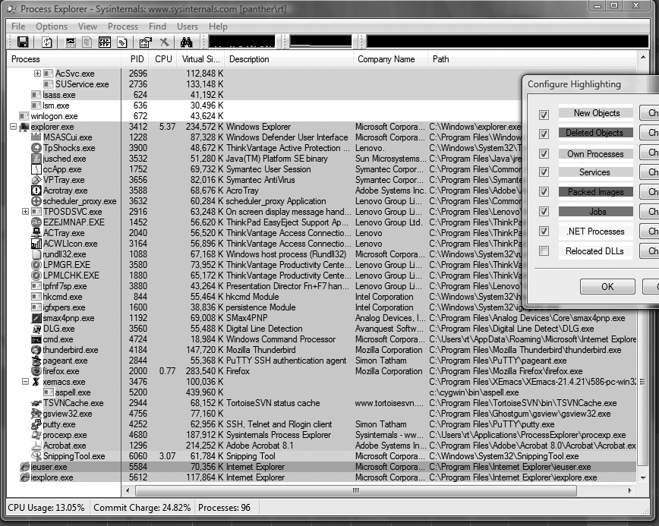
Process Explorer

Slide 7
Memory and File System Security
The contents of a computer are encapsulated in its memory and file system.
Thus, protection of a computer’s content has to start with the protection of its memory and its file system.

Slide 8
Password Security
The basic approach to guessing passwords from the password file is to conduct a dictionary attack, where each word in a dictionary is hashed and the resulting value is compared with the hashed passwords stored in the password file.
A dictionary of 500,000 “words” is often enough to discover most passwords.

Slide 9
Password Salt
One way to make the dictionary attack more difficult to launch is to use salt.
Associate a random number with each userid.
Rather than comparing the hash of an entered password with a stored hash of a password, the system compares the hash of an entered password and the salt for the associated userid with a stored hash of the password and salt.

Slide 10
How Password Salt Works
Without salt:
1. User types userid, X, and password, P.
2. System looks up H, the stored hash of X’s password.
3. System tests whether h(P) = H.
Password file:
…
X: H
…
With salt:
1. User types userid, X, and password, P.
2. System looks up S and H, where S is the random salt for userid X and H is stored hash of S and X’s password.
3. System tests whether h(S||P) = H.
Password file:
…
X: S, H
…

Slide 11
How Salt Increases Search Space Size
Assuming that an attacker cannot find the salt associated with a userid he is trying to compromise, then the search space for a dictionary attack on a salted password is of size
2^{B}*D,
where B is the number of bits of the random salt and D is the size of the list of words for the dictionary attack.
For example, if a system uses a 32-bit salt for each userid and its users pick passwords in a 500,000 word dictionary, then the search space for attacking salted passwords would be
2³² * 500,000 = 2,147,483,648,000,000,
which is over 2 quadrillion.
Also, even if an attacker can find a salt password for a userid, he only learns one password.

Slide 12
Hash Chains
Brute forcing one password at a time takes a lot of time
Alternative: precompute hash values for lots of passwords ahead of time, sort hashes, and then do a lookup for a given hash to find its password
  But this takes lots of space in addition to the precomputation time
Hellman showed how to use precomputation to reduce both time (when cracking a given hash) and space when doing brute force search for a password that produces a given hash
Idea is to form hash chains, alternating between password and hash value, and only store the last hash value in the chain
Then make many hash chains, and record the start point (a password) and the end point (a hash) for each chain

Slide 13
Hash Chains
Must alternate between potential password and hash to form chain
  Password to hash is easy – just use hash function
  Hash to possible password requires a “reduce” operation
Given a target hash value H
  See if H is in stored hashes
  If not, reduce H and hash again to form new hash H’ and repeat
  If H’ appears in stored hashes, go to corresponding starting password and reduce/hash enough times to get to H’, then take previous potential password as password

Slide 14
Hash Chains
Hash values
Hash values
Start values
Pos. PWs
End hashes
p11
h11
p12
h11
p1m
h1m
Table sorted
by end hashes
p21
h21
p22
h21
p2m
h2m
Hash | Start
h3m | p31
h27m | p27
him | pi
hjm | pj
p31
h31
p32
h31
p3m
h3m
pN1
hN1
pN2
hN1
pNm
hNm
hash
reduce
hash
… reduce
hash

Slide 15
Hash Chains
Start values
Pos. PWs
End hashes
p11
h11
p12
h11
p1m
h1m
Table sorted
by end hashes
p21
h21
p22
h21
p2m
h2m
p31
h31
p32
h31
p3m
h3m
Hash | Start
h3m | p31
h27m | p27
him | pi
hjm | pj
pN1
hN1
pN2
hN1
pNm
hNm
hash
reduce
hash
… reduce
hash
H0
P1
H1
Pk
Hk
Interesting hash H0
Check if H0 in table
… if not …
until get a match (or not)

Slide 16
Hash Chains
Suppose interesting hash H0 can be chained k times to produce hash
Hk that matches end hash h_{im} in table
Start value
Pos. PWs
End hash
Pi1
hi1
Pik’
hik’
Pim
him
hash
reduce
… reduce
hash
???
Pi1
hi1
Pik’
H0
P1
Pk
Hk
If it took k reduce/hash iterations to get from H0 to h_{im}
And it took 1 hash then m-1 reduce/hash iterations to get from P_{i1} to h_{im}
Then it should take how many hashes and reduce/hashes to get from
P_{i1} to H0?
1 hash and m-k-1 reduce/hash iterations

Slide 17
Hash Chain Problems
Hash chains may collide
This means that …
… may get false positive …
and table is less effective – has duplication
Search hashes to see if match while building table …
Pi1
hi1
Pik’
hik
Pim
him
Pij
hj1
Pjk’
Pjm
hjm

Slide 18
Rainbow Tables
Use different reduction at each step
p11
h11
p12
h11
p1m
h1m
p21
h21
p22
h21
p2m
h2m
p31
h31
p32
h31
p3m
h3m
pN1
hN1
pN2
hN1
pNm
hNm
hash
R₁
hash
… R_{m-1}
hash
H0
P1
H1
Pk
Hk
This forces collisions to happen in the same column
Which also means they will be caught at end

Slide 19
Rainbow Tables
How big is table?
  N starting points => N endpoints – O(N) storage
How long does it take to build it?
  M iterations per chain => O(NM) hash/reduce operations
  O(N log N) time to sort by hash value
How long does it take to apply to a hashed password?
  At most M reduce/hash operations
  Search for each one is O(log N)
  Each “hit” takes O(M) hash/reduce operations
  So total of at most O(M (M + log N))
  but practically O(M log N) since hits are rare

Slide 20
Rainbow Tables
How effective is it?
  If no collisions, cover NM possible passwords
  So at best NM/S probability of success,
  where S = total number of possible passwords
With collisions, accounting is more complicated
Tradeoff in increasing N and M to obtain greater chances of success vs. decreasing returns due to collisions
Bottom line:
Rainbow Tables allow for trading off precomputation time and storage vs. time taken during attack
In practice, can be very effective

Slide 21
Rainbow Tables
How to defeat them?
  Can’t really defeat per se
  But can make them less useful
Larger password space
Larger hash size
More expensive hash function
Most of all …
salts!
Why?
  Must make a separate table for each salt value
  Multiplies precomputation by number of salt values!
  Make big salt values!

