Slide 1
<number>
Chapter 2 – Physical Security
Digital security often begins with physical security…
Notes:
<number>

Slide 2
<number>
Why Physical Security?
Notion of boundaries
Physical
Temporal
Logical
Cryptographic
There may be several of each type
These may be interleaved
Even the most secure system may be vulnerable if physical access is obtained

Slide 3
<number>
What is Physical Security?
Use of physical measure for protection
Aspects:
Location – behind walls, locks
Physical intrusion detection
Hardware attacks
Eavesdropping
Physical interface attacks

Slide 4
<number>
What Is Physical Security?
Any physical object that creates a barrier to unauthorized access
This includes: locks, latches, safes, alarms, guards, guard dogs, doors, windows, walls, ceilings, floors, fences, door strikes, door frames and door closers, motion detectors, light beam detectors, sound detectors, scent detectors, etc.
May also include environmental arrangement
Visibility – open spaces, no hiding places
Lighting

Slide 5
<number>
Is Physical Security An IT Concern?
You have been working hard to secure your network from cyber attacks
Redundant layers of antivirus programs, firewalls and intrusion detection systems should protect against every possible electronic method of entry
But what if an attacker gains access to the server room or network wiring closet ...
Is your network still safe?
BS 7799 and ISO/IEC 27002
http://www.praxiom.com/iso-27002.htm

Slide 6
<number>
Section 2.2 – Locks and Keys
Digital security often begins with physical security…
Notes:
<number>

Slide 7
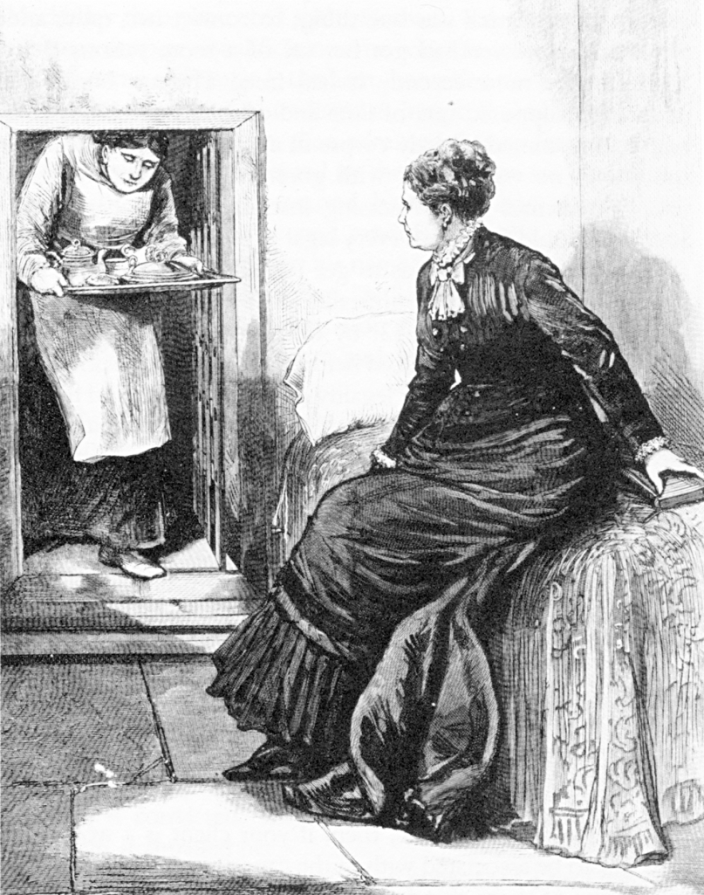
<number>
Legal Notice
Laws regarding lock picking vary significantly state-by-state
In most states purchase and possession of dedicated lock picking tools is legal
Penalties are raised significantly if you get caught using them in the commission of a crime
Public domain image from http://commons.wikimedia.org/wiki/File:Madame_Restell_in_jail.jpg

Slide 8
<number>
Destructive vs. Nondestructive Entry
Destructive entry
Involves using force to defeat physical security
Methods involve crowbars, bolt cutters and sledge hammers
http://www.upgrademylock.com/home-security/threats/default.asp
Negative impact on IT resources is apparent
Remediation steps also obvious
Nondestructive entry
Compromises security without leaving signs of a breach
Defeats intrusion detection
Greater and long-term threat
No insurance coverage! http://www.access2.com/Page/MasterkeyTruthAboutSecure.aspx

Slide 9
<number>
Standards
ANSI/BHMA A156.2-2011
Establishes requirements for bored and preassembled locks and latches, and includes operation, durability, safety and security, and appearance
cycle tests (e.g., 1 million cycles, 10 lb axial load),
strength tests (e.g., 1200 in-lbf torque),
operational tests (ease of opening when not locked),
material evaluation tests (corrosion resistance),
finish tests, and
dimensional criteria
Grades 1-3 (highest to lowest)
http://www.medeco.com/en/site/medeco/products/deadbolts/

Slide 10
<number>
Standards
European Standards:EN 1303, PAS 23/24
http://www.upgrademylock.com/upgrade-my-lock/what/
British Standards:
BS EN 1303 - cylinders for locks
BS EN 12209 - locks and latches – mechanically operated locks, latches and locking plates
BS EN 12320 - padlocks and padlock fittings
http://www.uniononline.co.uk/en/site/union-online/standards-and-legislation/bs-en-12209/
http://www.cpni.gov.uk/Documents/Publications/2013/2013012-security_doorsets_locking_hardware.pdf
BS EN 3621 (etc.) - Mortise locks
http://thecrimepreventionwebsite.com/security-door-locks-hardware-and-fittings/561/mortice-mortise-locks/

Slide 11
<number>
Compromising Locks
For centuries, the lock has been one of the cornerstones of physical security
We rely on dozens of them every day to protect people and assets
The trust most people place in locks is unwarranted
Most locks can be easily compromised with nondestructive methods
Sometimes within seconds and with readily available tools
“Locks keep honest people honest”

Slide 12
<number>
Lock Picking
Lock picking had been the exclusive art of locksmiths, professional thieves, spies and magicians for hundreds of years
http://www.slate.com/articles/life/crime/features/2013/the_lock_pickers/alfred_c_hobbs_the_american_who_shocked_victorian_england_by_picking_the.html
However, with the advent of the Internet, information about lock picking methods and tools has become readily available
E.g., YouTube has many lock picking videos

Slide 13
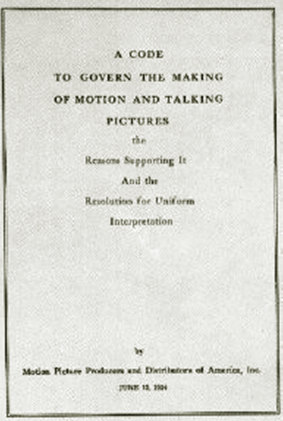
Lock Picking in Movies
<number>
Genuine lock picking in movies used to be prohibited
Before 1967, the Hays code (Motion Picture Production Code) required censorship of Hollywood movies
“All detailed (that is, imitable) depiction of crime must be removed, such as lock picking or mixing of chemicals to make explosives”
Public domain image from http://commons.wikimedia.org/wiki/File:Motion_Picture_Production_Code.gif

Slide 14
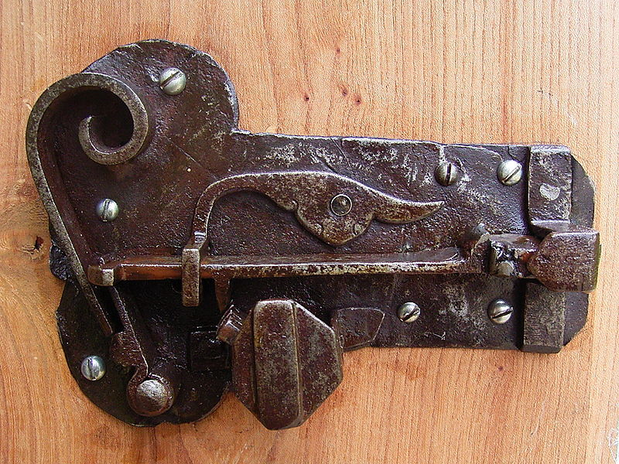
<number>
LOCK TYPES
Image from http://commons.wikimedia.org/wiki/File:Ancient_warded_lock_open.jpg used with permission under Gnu Free Documentation License 1.2

Slide 15
<number>
TSA Lock
The U.S. government has established a set of rules for the inspection of baggage without the presence of passengers
Special TSA-approved locks allow both inspection and protection against theft
An important element is that the inspection must be easily verifiable by the user
Public domain government image

Slide 16
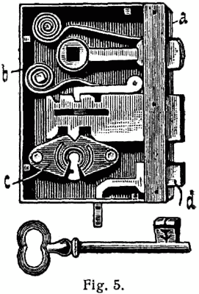
<number>
Warded Locks
Locks of this type were used in ancient times
The key moves the bolt assisted by a support spring
Security relies on the fact that not all keys pass through the key hole
Notes:
Usually in old style doors or desks
Different concentric obstructions
Easy to lock pick with Skeleton keys
<number>

Slide 17
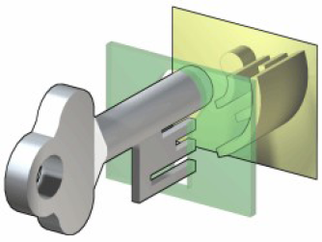
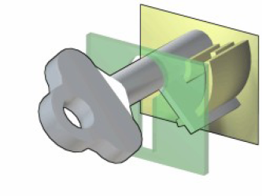
<number>
Skeleton Key
Usually in old style doors
or desks
Different concentric obstructions
Easy to lock pick with Skeleton keys
They come from ancient Rome
Images from http://en.wikipedia.org/wiki/File:Warded_locked.png used by permission under Gnu free documentation license 1.2
Notes:
<number>

Slide 18
<number>
Pick vs. Bypass
Break open a lock in a nondestructive manner can be achieved either through:
Pick: acting on the lock mechanism simulating the operation of the key
Bypass: manipulation of the bolt without using the lock

Slide 19
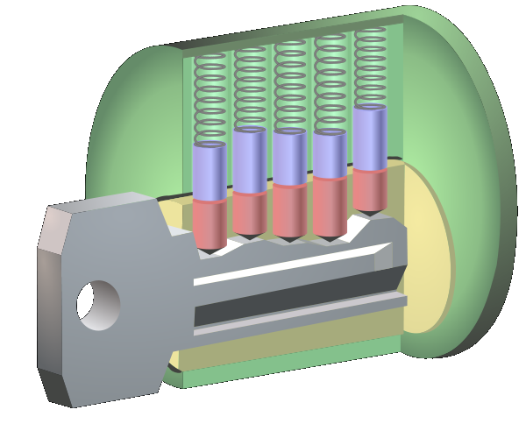
1860: Yale Pin Tumbler Lock
Modern version of the Egyptian single-pin design
Utilizes two pins for locking
Public domain image of Linus Yale, Jr.
Double-detainer theory of locking
Created shear line
Image from http://en.wikipedia.org/wiki/File:Pin_tumbler_with_key.svg used with permission under Gnu Free Documentation License 1.2
<number>
Notes:
<number>

Slide 20
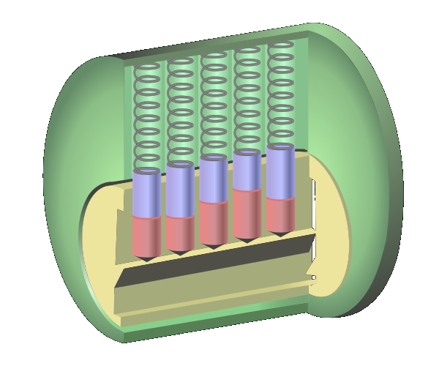
<number>
Terminology
driver
shell or hull
top or driver
tumbler
spring
pin
sheer line
bottom or key
cylinder or plug
keyway
Image from http://en.wikipedia.org/wiki/File:Pin_tumbler_with_key.svg used with permission under Gnu Free Documentation License 1.2

Slide 21
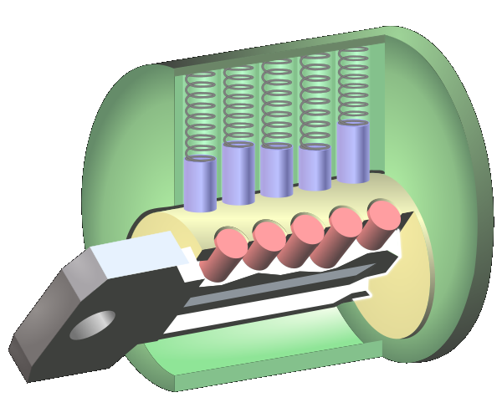
<number>
How Does a Pin Tumbler Lock Work?
When a key is not present, the pin stacks are pushed down by the springs so that the driver (top) pins span the plug and the outer casing, preventing the plug from rotating.
Images from http://en.wikipedia.org/wiki/File:Pin_tumbler_with_key.svg used with permission under Gnu Free Documentation License 1.2

Slide 22
<number>
How Does a Pin Tumbler Lock Work?
2. When the correct key is inserted, the ridges of the key push up the pin stacks so that the cuts of the pin stacks are aligned with the shear line.
3. The alignment of the cuts with the shear line allows the plug to be rotated.
Images from http://en.wikipedia.org/wiki/File:Pin_tumbler_with_key.svg used with permission under Gnu Free Documentation License 1.2

Slide 23
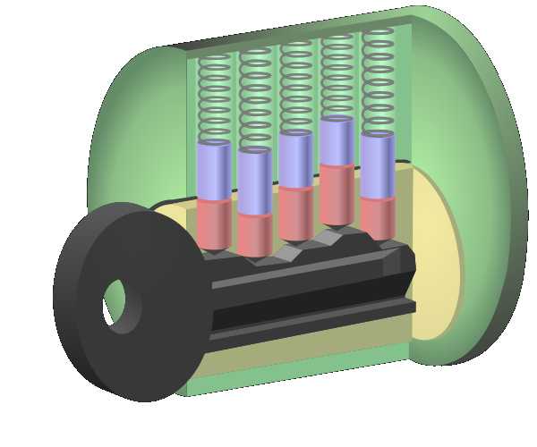
<number>
How Does a Pin Tumbler Lock Work?
If an inappropriate key is inserted, then the pins do not align along the shear line and the lock does not turn.
Image from http://en.wikipedia.org/wiki/File:Pin_tumbler_with_key.svg used with permission under Gnu Free Documentation License 1.2

Slide 24
<number>
LOCK PICKING
Photo by Dan Rosenberg included with permission.

Slide 25
<number>
Terminology
driver
shell or hull
top or driver
tumbler
spring
pin
sheer line
bottom or key
cylinder or plug
keyway
Image from http://en.wikipedia.org/wiki/File:Pin_tumbler_with_key.svg used with permission under Gnu Free Documentation License 1.2

Slide 26
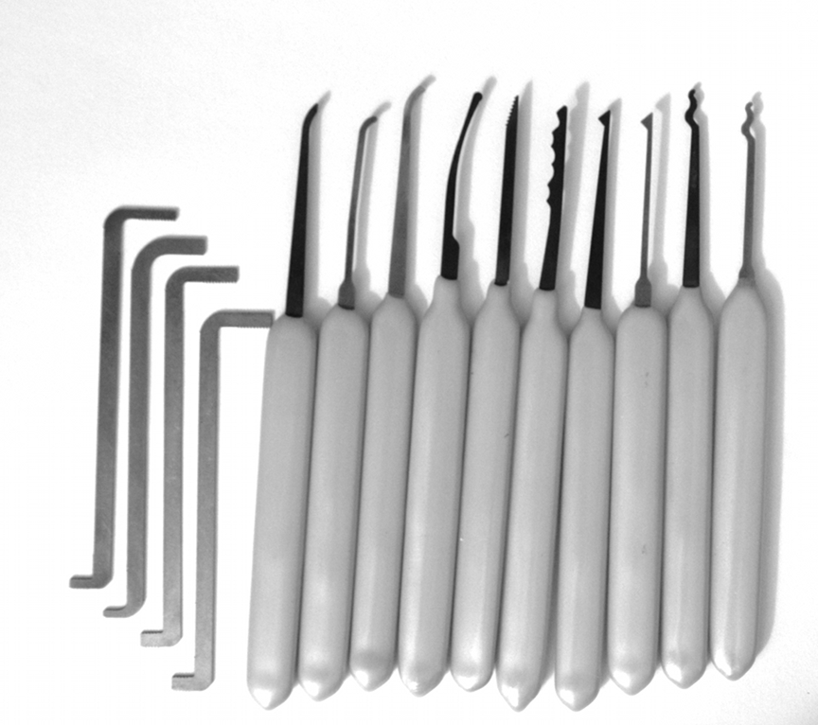
Lockpicking Tools
Feelers
Scrubbers
Tension tools
Photo by Jennie Rogers included with permission.
<number>

Slide 27
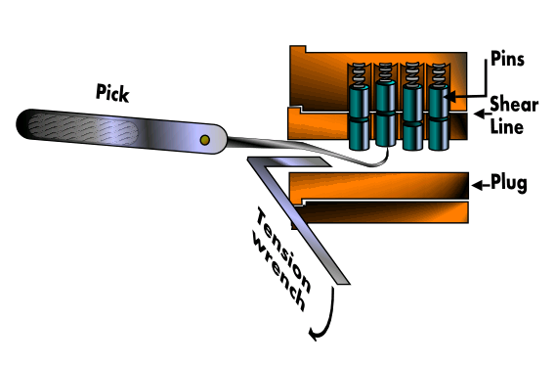
<number>
Feeler Picking
Apply light tension
Lift one pin at a time
Identify binding pin
Lift binding pin until it reaches the shear line
Setting the binding pin will rotate the lock slightly
Find next pin and repeat the process
General principle?
Divide & conquer!
Image from http://commons.wikimedia.org/wiki/File:Pin_and_tumbler_lock_picking.PNG used with permission under Gnu Free Documentation License 1.2

Slide 28
<number>
Scrubbing / Raking
Apply light tension
Work over pins back to front in a circular motion
attempting to pop them into the shear line with the combination of tension
Good for beginners
Usually employ snake pick or half diamond
Photo by Jennie Rogers included with permission.

Slide 29
<number>
The Math of Lock Picking
Suppose we have
40 different kinds of key blanks
7 pin positions
8 different possible pin heights
Then the total number of possible locks is
40 x 87 = 83,886,080
Not all these are possible, however, as it is difficult to put long teeth next to small teeth.

Slide 30
<number>
Master Keyed Systems
Change key unlocks one lock
Master key unlocks all locks
Pin stack has spacer pin between driver and key pin
If either line between driver and spacer pins, or the line between spacer and key pins lines up with the shear line for all pins, then the plug will turn
A Master key is enabled by making a single sequence of heights work for all locks

Slide 31
<number>
Rights Amplification in
Master Keyed Systems
Published by Matt Blaze at Penn
Reverse engineer master key from change key
Each lock has P pins, with D potential cut heights
Create D-1 test keys for each pin position p
Cut all pin positions except p as known change key

Slide 32
<number>
Rights Amplification (continued)
Query the lock until you find each pin position
i.e. To determine first key cut depth insert each of the D-1 test keys and determine which one does not bind to the pin
Repeat for each pin

Slide 33
Rights Amplification Statistics
<number>
Consumes P(D-1) blanks
Can reduce to P blanks and file down on the fly
But this looks suspicious
Search space is practically pruned by manufacturer specs
maximum distance limit in legal adjacent cuts
Older installations sometimes require MKs to be higher on the pin stack

Slide 34
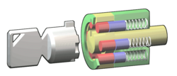
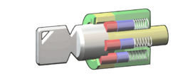
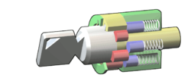
<number>
Tubular lock
Usually on car alarms or vending machines
6-8 pins
Easy to pick with special tool
The tool could become a new key
Images from http://en.wikipedia.org/wiki/File:Tubular_locked.png used with permission under Gnu Free Documentation License 1.2
Notes:
<number>

Slide 35
<number>
Statistics
4-6 pins, 4-10 levels
106 = 1,000,000 possible keys!
The angular positions of the cylinders allow to obtain about 180 different positions (180⋅10)6 = 3.4012224 × 1019
(Un) fortunately there is a need for some tolerance in locks
Notes:
<number>
<number>

Slide 36
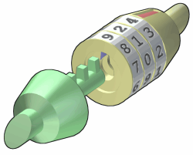
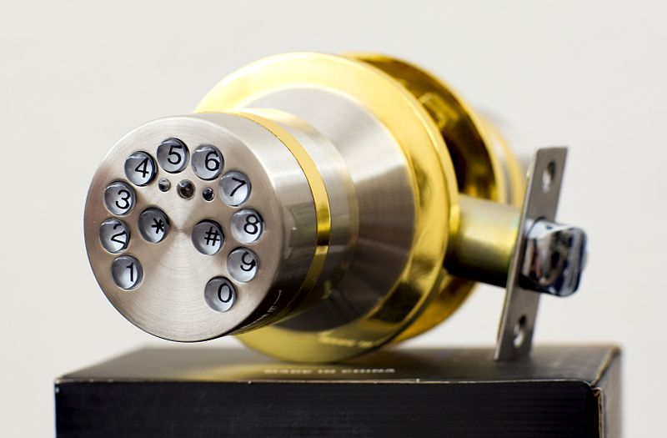
Combination Locks
There are locks that do not require a physical key to be opened but a code
Number of combinations is
Number of digits
to the power of
Length of combination
Images from http://en.wikipedia.org/wiki/File:Combination_unlocked.png and
http://commons.wikimedia.org/wiki/File:Electronic_lock_yl88.jpg used with permission under Gnu Free Documentation License 1.2
<number>
Notes:
<number>

Slide 37
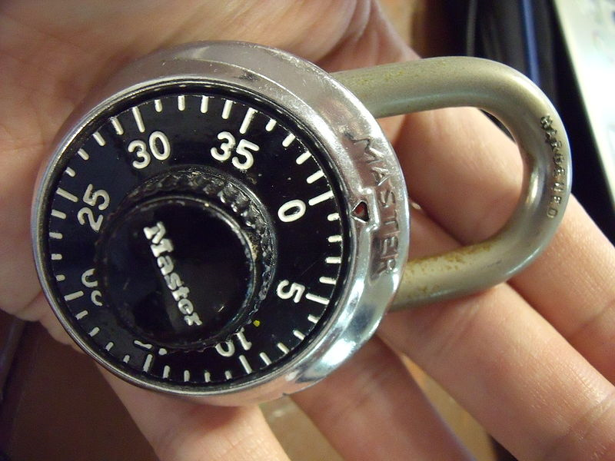
Combination Locks
Inexpensive combination padlocks allow attacks based on reducing the space of possible combinations to try
The gears have a higher tolerance of the external disk combination
Nominal number of combinations is 403 = 64,000
Possibilities can be reduced to about 80 by detecting critical gear points
Public domain image from http://commons.wikimedia.org/wiki/File:Lock.JPG
E.g., see http://www.wikihow.com/Crack-a-%22Master-Lock%22-Combination-Lock
<number>
Notes:
<number>

Slide 38
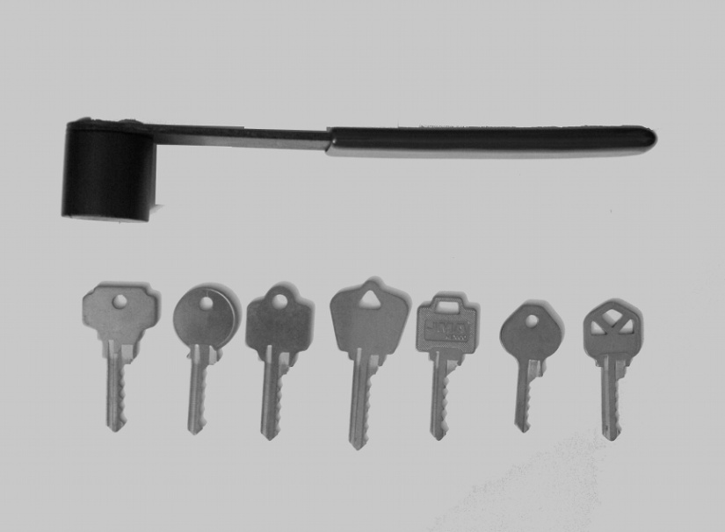
<number>
Bumping
A different way of picking locks
Virtually all traditional Yale and similar locks can be opened by bumping
What lock pickers say about bumping:
RELIABLE
REPEATABLE
SIMPLE TO LEARN
Photo by Jennie Rogers included with permission.
Notes:
<number>

Slide 39
Bump Keys
Driver pins “jump” higher than the cylinder just for an instant
If a light rotational force is applied, the cylinder will turn
Lock bumping is a very fast method for opening the lock
The lock is not damaged
in any way
Few key-pin locks cannot
be bumped
Photo by Jennie Rogers included with permission.
<number>

Slide 40
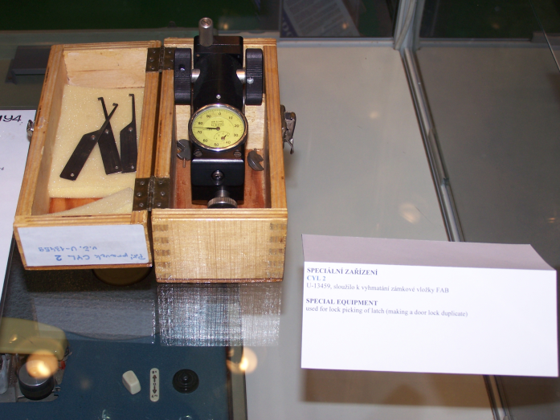
Pick Gun
Manual and electronic pick guns are a popular method for quick and easy ways of opening up doors
The pick gun is used in a similar way to bumping but usually has a trigger that creates an upward movement that must be repeated rapidly to open the lock
Public domain image from http://en.wikipedia.org/wiki/File:IDET2007_lock_picking_device.jpg
<number>

Slide 41
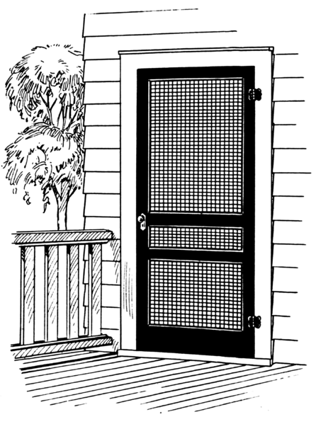
<number>
Side Channel Attacks
Cheap hinges
Rather than attempting to directly bypass security measures, an attacker instead goes around them by exploiting other vulnerabilities not protected by the security mechanisms.
Side channel attacks are sometimes surprisingly simple to perform.
High security lock
Public domain image by Pearson Scott Foresman from http://en.wikipedia.org/wiki/File:Screen2_%28PSF%29.png

