Slide 1
Increasing Anonymity in Crowds via Dummy Jondos
By: Benjamin Winninger

Slide 2
Introduction and Problem Faced
When it comes to crowds, bigger is always better, as most anonymity metrics are directly dependent on crowd size.
I was attempting to include “dummy jondos” to bolster crowd size and increase resistance against three common attacks:
  Local eavesdropper
  End server
  Collaborating jondo

Slide 3
How To Determine If Dummy Jondos Improve Crowds
In order to determine if dummy jondos are even worth utilizing, we need to compare:
  The likelihood of a degree of anonymity being provided against a class of attacker in the traditional and new crowd schemes.

Slide 4
Crowds: Technical Overview
Collection of users, each represented by their jondo processes.
Jondos contact blender server to request admission to the crowd.
Once in the crowd, a user sends a request:
  The jondo forwards the request to another jondo with probability p_{f} (virtual circuit created)
  Or to the end server with probability 1-p_{f}

Slide 5
Dummy Jondos: Original Concept
The crowd organizer can add an arbitrary amount of jondos to the crowd, thereby increasing the size of the crowd n to a large value.
Chance of a local eavesdropper getting lucky drops significantly.
This makes the amount of collaborators c required to perform a collaborating jondo attack (possibly unachievably) large.

Slide 6
Dummy Jondos: Original Concept Problems
Sounds like we’ve beaten the system, but…
  If the organizer is corrupt, he is now in the perfect position to perform the collaborating jondo attack!
  How can the organizer properly set up and control proxies that he might not own?

Slide 7
Dummy Jondos: New Concept
Rather than introducing outside “users” to the crowd, make better use of the registered users.
We can no longer add an arbitrary number of jondos, but try to bring in registered (inactive) jondos.
Daemon process activated on computer startup: bring user’s jondo into the crowd in dummy mode.

Slide 8
Dummy Jondos: New Concept
Consider that it is entirely possible that a user may never request to use the Web.
  Paths generated for the crowd will never include this jondo.
  User may be using a text editor, fiddling with a virtual machine, developing a program, etc.
  We would have submaximal n without them!

Slide 9
Dummy Jondos: Dummy Mode vs. User Mode
A jondo in user mode will act the same as the jondos in a traditional crowd.
The jondo establishes a path, sends out requests, receives responses, forwards requests for others, and so on.
After a period of inactivity within a percentage of a user defined timeout, switch to dummy mode.

Slide 10
Dummy Jondos: Dummy Mode vs. User Mode
A dummy jondo should theoretically mimic what the user does:
  Store a list of previous requests from user mode and randomly repeat them?
    No… :
      If a user made a payment, they would be scratching their head when they check their bank account or bitcoin wallet!
      Anonymity for a request subject to compromise when it is sent multiple times!

Slide 11
Dummy Jondos: Dummy Mode vs. User Mode
Create a list of common servers (Google, Facebook, YouTube, etc.).
Create a set of commands to execute on these servers (ping, whois, nslookup).
Randomly execute one of the commands on one of the servers after a bounded random time interval (all editable values in a config file).

Slide 12
Dummy Jondos: Dummy Mode vs. User Mode
If an attacker sees that a dummy jondo sent a request to Google for example, it wouldn’t be particularly informative since Google is the most popular website in America.
Even if a request wasn’t to a popular server, the commands aren’t being given by a user (shouldn’t compromise anonymity) so who cares if they are compromised?

Slide 13
Red Circles: Collaborating Jondos
Red Squares:
Corrupt Servers
Purple Circles:
Dummy Jondos
Green Squares:
Good Servers
Green Circles: Good Jondos

Slide 14
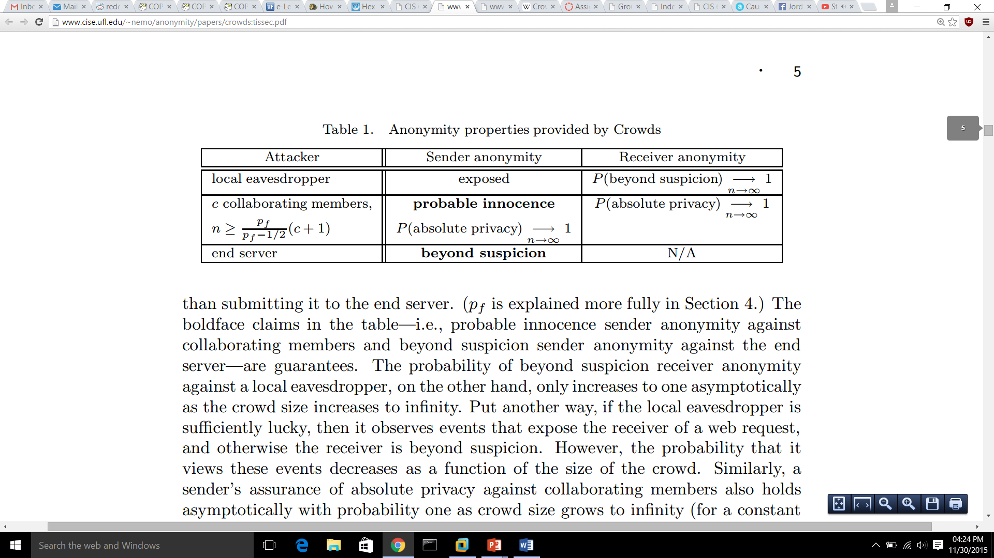
Degrees of Anonymity for Crowds

Slide 15
Local Eavesdropper Attack
Local Eavesdropper: An attacker who can view all communication to and from a user.
If the eavesdropper gets lucky and listens to the sender who submits to the server, then the sender is exposed! Otherwise, the receiver is beyond suspicion.
As the size of the crowd increases, the probability of a local eavesdropper getting lucky decreases.

Slide 16
Dummy Jondos and the Local Eavesdropper Attack
The probability of a jondo submitting its request to the end server is 1/n
The same logic applies to a crowd with dummy jondos, but the size is now (n+d), where d represents the number of dummy jondos.
The resulting probabilities are therefore 1/n ≥ 1/(n+d).
Guarantee to provide no less anonymity than original crowd.

Slide 18
End Server Attack
End Server: The web server to which the jondo’s request is sent.
Since the server can see traffic to and from itself, receiver anonymity isn’t possible! Also, since any jondo could have forwarded the request, it is impossible to determine the originator.
As the size of the crowd increases, the probability of determining which jondo forwarded the request decreases.

Slide 19
Dummy Jondos and the End Server Attack
Unsurprisingly, there is almost no difference between a traditional crowd and one that uses dummy jondos.
The crowd naturally strongly resists the end server attack.
The only difference might be a crowd with dummy jondos could increase a crowd of size 1 or 2 to a more reasonable size.

Slide 21
Collaborating Jondo Attack
Collaborating Jondos: A group of crowd members that can view all communication to and from “collaborating” users and pool this information together to find the sender of a request.
If the inequality n ≥ (p_{f}*(c+1))/(p_{f}-(1/2)) is satisfied, then the sender has probable innocence.
As the size of the crowd increases, the number of collaborating jondos that it can resist also increases!

Slide 22
Dummy Jondos and the Collaborating Jondo Attack
Two ways to try and manipulate n ≥ (p_{f}*(c+1))/(p_{f}-(1/2)):
  We can increase n, via dummy jondos
  We can try and “minimize” p_{f}/(p_{f}-(1/2))

Slide 23
Dummy Jondos: Increasing n
As we’ve seen in the local eavesdropper attack: dummy jondos increase the size of the crowd from n to (n+d).
Can rewrite inequality as (n+d) ≥ (p_{f}*(c+1))/(p_{f}-(1/2))
Same guarantee as the local eavesdropper attack: the crowd with dummy jondos will provide no less anonymity.

Slide 24
Dummy Jondos (Aside): Increasing Path Length
While manipulating p_{f} isn’t specifically the responsibility of dummy jondos, it is worth considering to combat the collaborating jondo attack.
No true minimum for p_{f}/(p_{f}-(1/2)), instead look for where increase in p_{f} no longer becomes “worth it”.
  Clearly a subjective measure.

Slide 25
Dummy Jondos (Aside): Increasing Path Length
It appears that “sweet spot” for p_{f} for maximizing anonymity is somewhere in the range of [0.75,0.85].
However, as n grows this p_{f} may not be sustainable for latency’s sake.
Thus, it might be desirable to have a sliding scale type of function for the pf in which the value is initially somewhere in the range of [0.75,0.85], but then drops slightly over time to accommodate growing/shrinking crowd size.

Slide 27
Conclusions
Dummy jondos no longer set up a crowd to be attacked, but attempt to get an optimal crowd size relative to the number of registered users.
Dummy jondos offer the promise of improved anonymity over traditional crowds with the guarantee of being no worse.

Slide 28
Conclusions
The behavior of a dummy jondo should be relatively human-like, and so a more realistic behavioral model could likely be developed.
When I begin implementing this system (eventually), I will be able to get real data to prove or refute initial ideas from this research (e.g. latency vs. p_{f}).
I will also be able to redefine various aspects as (inevitable) conflicts arise.

Slide 29
Why Does This Even Matter?
With the recent leaks about NSA data collection, possibly now more than ever people are concerned with their e-privacy.
Crowds offer scalability and good performance for Internet users while defending against several classes of attackers.
Thus any improvement on crowds could make them more viable for mass usage.

Slide 30
References
Diaz, Claudia, and Bart Preneel. "Taxonomy of Mixes and Dummy Traffic.". University of Leuven. Web. <http://freehaven.net/anonbib/cache/taxonomy- dummy.pdf>.
Newman, Richard E. "Anonymity – Crowds." CIS 6930/4930 Cryptographic Anonymity. University of Florida. Web. 22 Nov. 2015. <http://www.cise.ufl.edu/~nemo/anonymity/lectures/lect04aCrowds.ppt>.
Reiter, Michael K., and Aviel D. Rubin. "Crowds: Anonymity for Web Transactions." ACM Transactions on Information and System Security 1 1.1 (1998): 66-92. CIS 6930/4930 Cryptographic Anonymity. University of Florida. Web. 20 Nov. 2015. <http://www.cise.ufl.edu/~nemo/anonymity/papers/crowds:tissec.pdf>.
Shields, Clay, and Brian Neil Levine. "A Protocol for Anonymous Communication Over the Internet.“ Georgetown University. Web. 28 Nov. 2015. <http://people.cs.georgetown.edu/~clay/research/pubs/hordes-ccsfinal.pdf>.
Wright, Matthew K.; Adler, Micah; Levine, Brian Neil; and Sheilds, Clay, "The Predecessor Attack: An Analysis of a Threat to Anonymous Communications Systems" (2002). Computer Science Department Faculty Publication Series. Paper 164. <http://scholarworks.umass.edu/cs_faculty_pubs/164>.

