Slide 1
Effectiveness of Blending Attacks on Mixes
Meng Tang

Slide 2
Project Topics
Steps of a blending attack
Attack model
Attack effectiveness
  Anonymity set size, chance of success, etc.
Factors affecting the attack
Ways to defend

Slide 3
blending attack
Block incoming traffic
Mix
good
target
good
good

Slide 4
blending attack
good
Block incoming traffic
Flush legitimate messages
bad
good
good
Mix
bad
bad
target
bad
bad

Slide 5
blending attack
good
Block incoming traffic
Flush legitimate messages
Insert target message
bad
good
good
Mix
bad
bad
bad
bad
target

Slide 6
blending attack
good
Block incoming traffic
Flush legitimate messages
Insert target message
Flush target message
bad
good
good
Mix
bad
bad
bad
bad
target
bad

Slide 7
blending attack
Pool flushing
  Flush the memory of the mix
Target flushing
  Flush the target message

Slide 8
From the attacker’s point of view…
What is important
  Number of non-spurious messages left in mix
    Determines anonymity set size
  Mix batching strategy and parameter
    Determines difficulty to flush a message, affects time consumption
What is irrelevant
  Spurious messages
    Purely for the purpose to flush a mix
  Timed/threshold
    Attacker can make a threshold (pool) mix behave like a timed (pool) mix

Slide 9
Transform a threshold pool mix into a timed pool mix
Threshold pool mix
  Pool size: N (possibly 0)
  Threshold: h
Attacker
  Inserts spurious message at a constant rate f
Mix behaves like a timed pool mix
  Pool size: N
  T=h/f

Slide 10
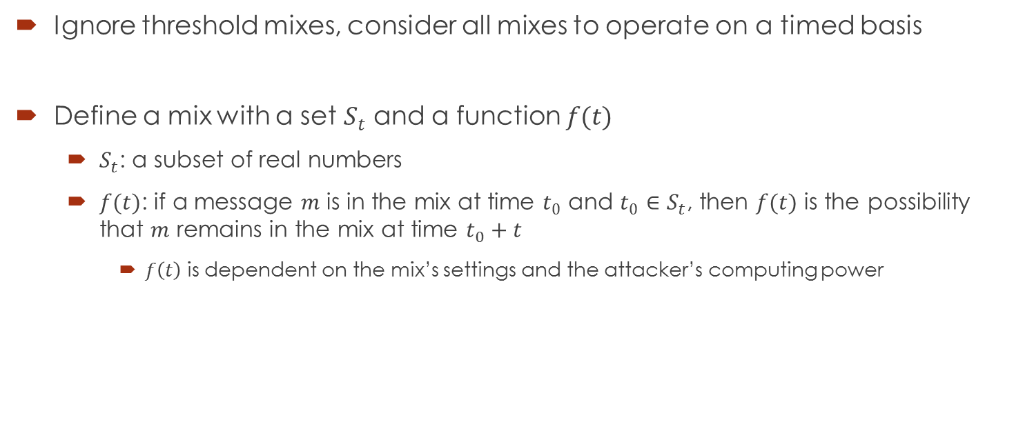
Description of mixes
Ignore threshold mixes, consider all mixes to operate on a timed basis
Define a mix with a set $S_{t}$ and a function $f(t)$
  $S_{t}$: a subset of real numbers
  $f(t)$: if a message $m$ is in the mix at time $t_{0}$ and $t_{0}$ $∈S_{t}$, then $f(t)$ is the possibility that $m$ remains in the mix at time $t_{0}+t$
    $f\left(t\right)$ is dependent on the mix’s settings and the attacker’s computing power

Slide 11
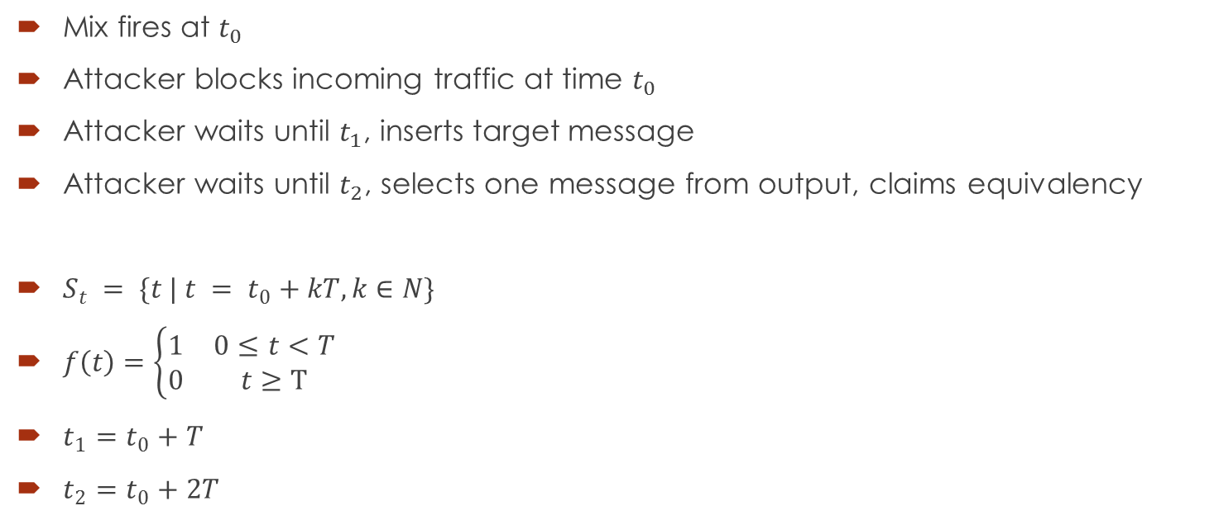
Attack on timed mix
Mix fires at $t_{0}$
Attacker blocks incoming traffic at time $t_{0}$
Attacker waits until $t_{1}$, inserts target message
Attacker waits until $t_{2}$, selects one message from output, claims equivalency
$S_{t} = \{t | t = t_{0}+kT, k∈N\}$
$f\left(t\right)=\left\{\begin{matrix}1 & 0≤t<T \\ 0 & t≥T\end{matrix}\right.$
$t_{1}=t_{0}+T$
$t_{2}=t_{0}+2T$

Slide 12
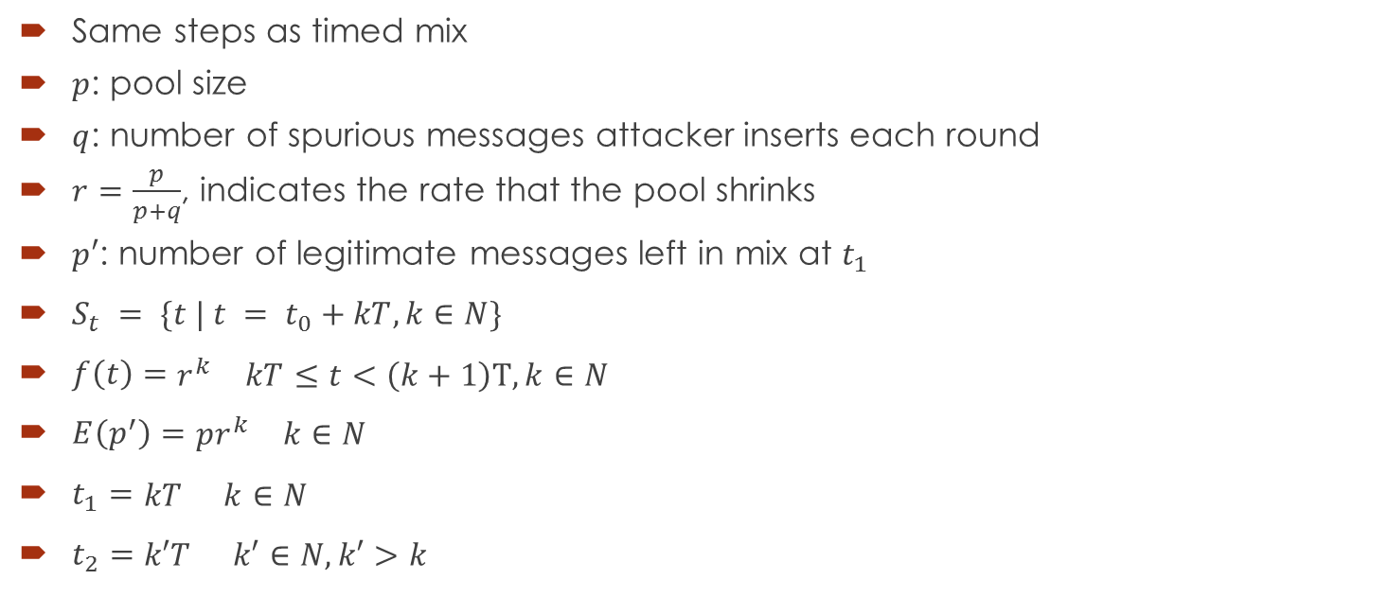
Attack on timed pool mix
Same steps as timed mix
$p$: pool size
$q$: number of spurious messages attacker inserts each round
$r=\frac{p}{p+q}$, indicates the rate that the pool shrinks
$p′$: number of legitimate messages left in mix at $t_{1}$
$S_{t} = \{t | t = t_{0}+kT, k∈N\}$
$f\left(t\right)=\begin{matrix}r^{k} & kT≤t<\left(k+1\right)T, k∈N\end{matrix}$
$E\left(p^{′}\right)=\begin{matrix}pr^{k} & k∈N\end{matrix}$
$t_{1}=\begin{matrix}kT & k∈N\end{matrix}$
$t_{2}=\begin{matrix}k′T & k′∈N,k′>k\end{matrix}$

Slide 13
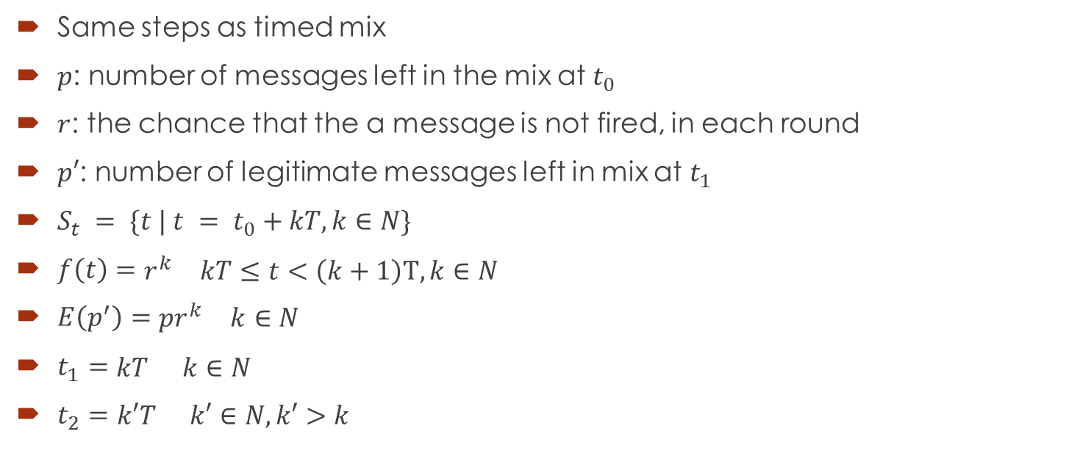
Attack on binomial mix
Same steps as timed mix
$p$: number of messages left in the mix at $t_{0}$
$r$: the chance that the a message is not fired, in each round
$p′$: number of legitimate messages left in mix at $t_{1}$
$S_{t} = \{t | t = t_{0}+kT, k∈N\}$
$f\left(t\right)=\begin{matrix}r^{k} & kT≤t<\left(k+1\right)T, k∈N\end{matrix}$
$E\left(p^{′}\right)=\begin{matrix}pr^{k} & k∈N\end{matrix}$
$t_{1}=\begin{matrix}kT & k∈N\end{matrix}$
$t_{2}=\begin{matrix}k′T & k′∈N,k′>k\end{matrix}$

Slide 14
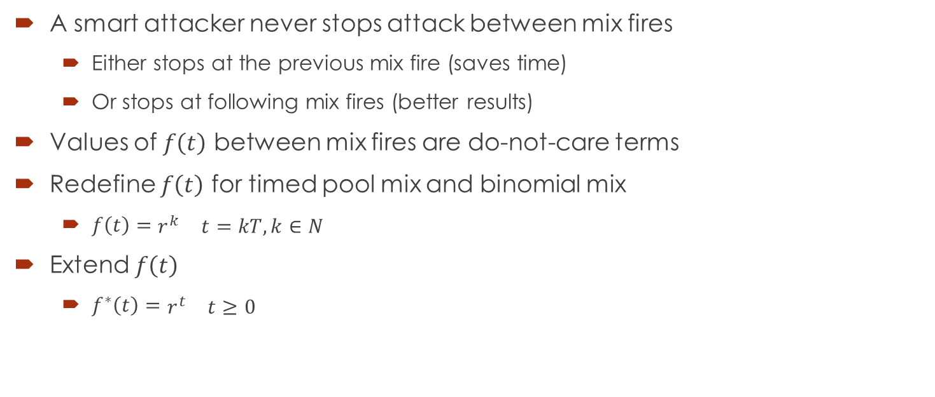
Simplifying assumption
A smart attacker never stops attack between mix fires
  Either stops at the previous mix fire (saves time)
  Or stops at following mix fires (better results)
Values of $f\left(t\right)$ between mix fires are do-not-care terms
Redefine $f\left(t\right)$ for timed pool mix and binomial mix
  $f\left(t\right)=\begin{matrix}r^{k} & t=kT, k∈N\end{matrix}$
Extend $f\left(t\right)$
  $f^{∗}\left(t\right)=\begin{matrix}r^{t} & t≥0\end{matrix}$

Slide 15
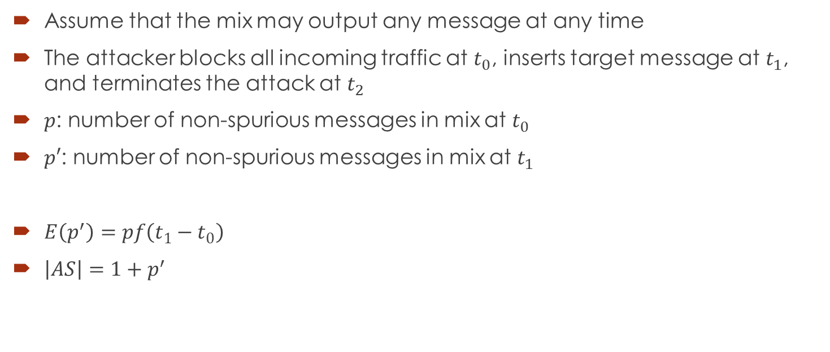
Analysis – anonymity set size
Assume that the mix may output any message at any time
The attacker blocks all incoming traffic at $t_{0}$, inserts target message at $t_{1}$, and terminates the attack at $t_{2}$
$p$: number of non-spurious messages in mix at $t_{0}$
$p′$: number of non-spurious messages in mix at $t_{1}$
$E\left(p^{′}\right)=pf\left(t_{1}−t_{0}\right)$
${\left|AS\right|=1+p}^{′}$

Slide 16

Analysis – effectiveness evaluation
If the attacker has limited time, then there is a chance that there’re no message output between $t_{1}$ and $t_{2}$
$P_{f}={(f\left(t_{2}−t_{1}\right))}^{|AS|}$
Attacker’s overall chance of success
  $P_{s}=\frac{1−P_{f}}{|AS|}=\frac{1−{(f\left(t_{2}−t_{1}\right))}^{|AS|}}{|AS|}$

Slide 17
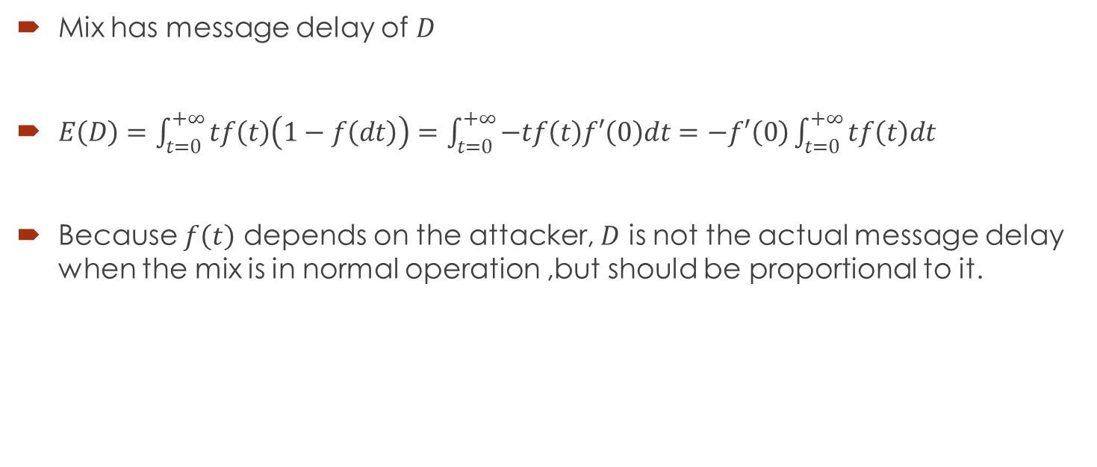
Analysis – message delay
Mix has message delay of $D$
$E\left(D\right)=\int_{t=0}^{+∞}{tf\left(t\right)\left(1−f\left(dt\right)\right)}=\int_{t=0}^{+∞}{−tf\left(t\right)f′\left(0\right)dt}=−f′\left(0\right)\int_{t=0}^{+∞}{tf\left(t\right)dt}$
Because $f\left(t\right)$ depends on the attacker, $D$ is not the actual message delay when the mix is in normal operation ,but should be proportional to it.

Slide 18
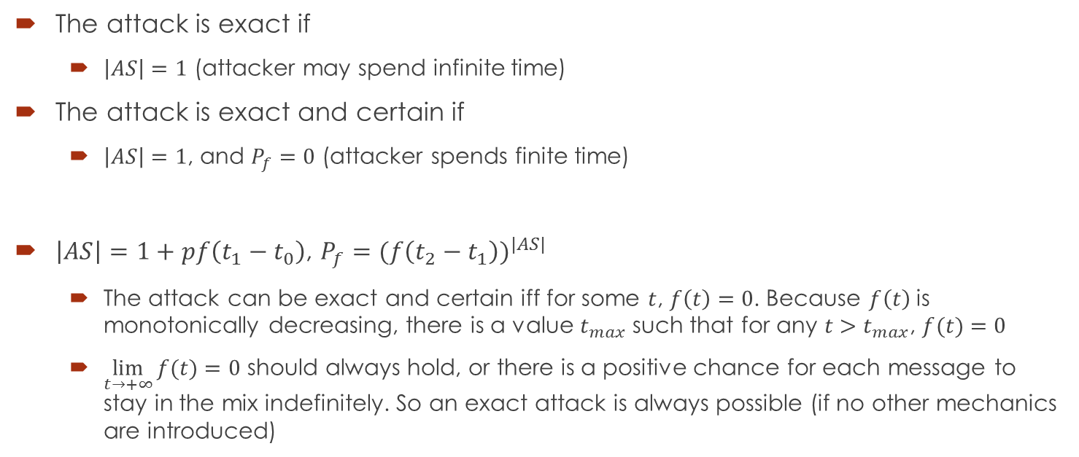
Analysis – exact/certain attack
The attack is exact if
  $\left|AS\right|=1$ (attacker may spend infinite time)
The attack is exact and certain if
  $\left|AS\right|=1$, and $P_{f}=0$ (attacker spends finite time)
$\left|AS\right|=1+pf\left(t_{1}−t_{0}\right)$, $P_{f}={(f\left(t_{2}−t_{1}\right))}^{|AS|}$
  The attack can be exact and certain iff for some $t$, $f\left(t\right)=0$. Because $f\left(t\right)$ is monotonically decreasing, there is a value $t_{max}$ such that for any $t>t_{max}$, $f(t)=0$
  $\lim_{t→+∞}{f(t)}=0$ should always hold, or there is a positive chance for each message to stay in the mix indefinitely. So an exact attack is always possible (if no other mechanics are introduced)

Slide 19
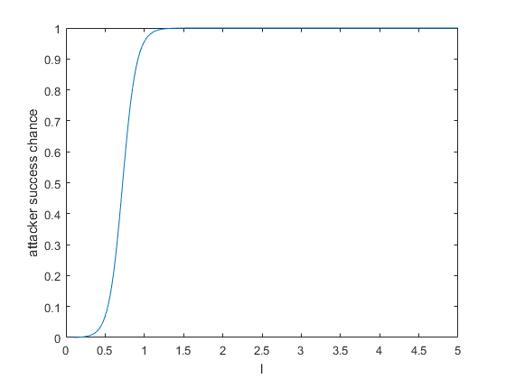
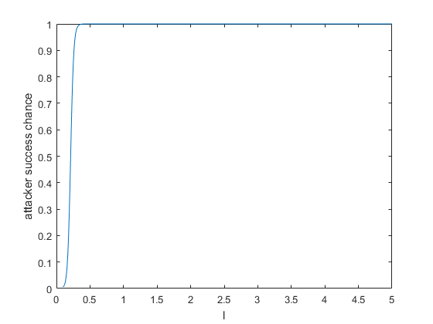
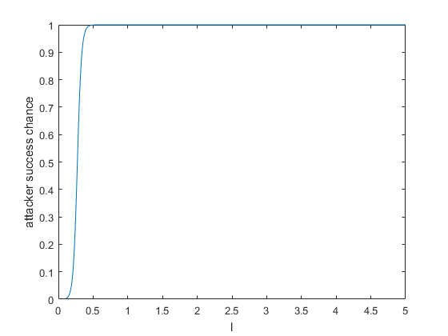
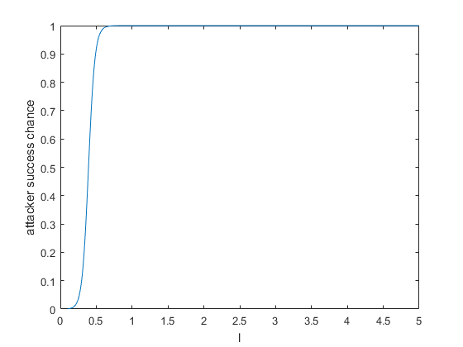

Example
$f\left(t\right)=\begin{matrix}e^{−lt} & l>0\end{matrix}$
Plot of $P_{s}$ as a function of $l$

Slide 20
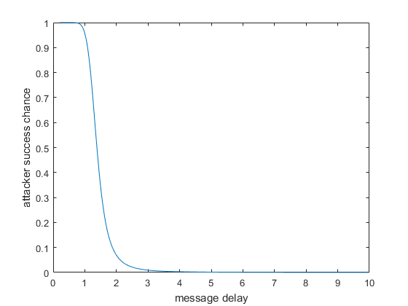
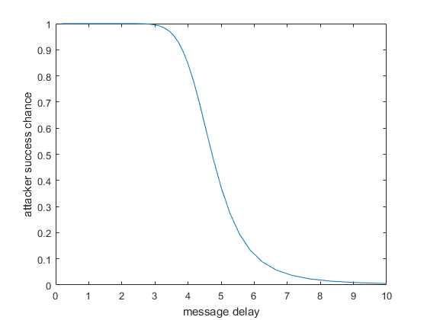
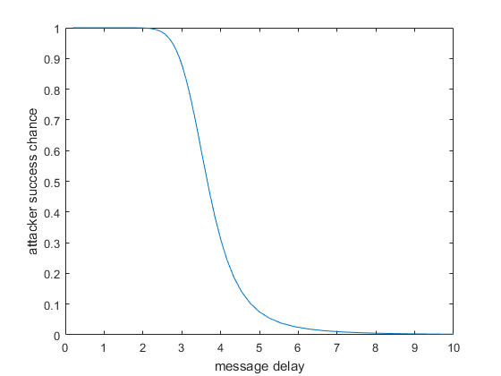
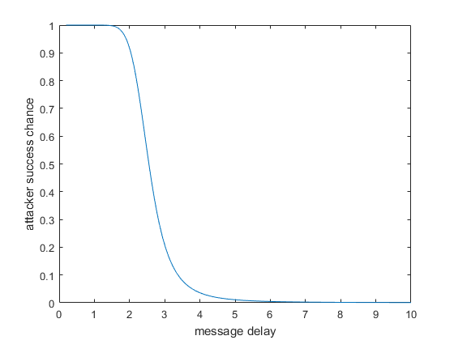

Example
Plot of $P_{s}$ as a function of $E\left(D\right)$

Slide 21
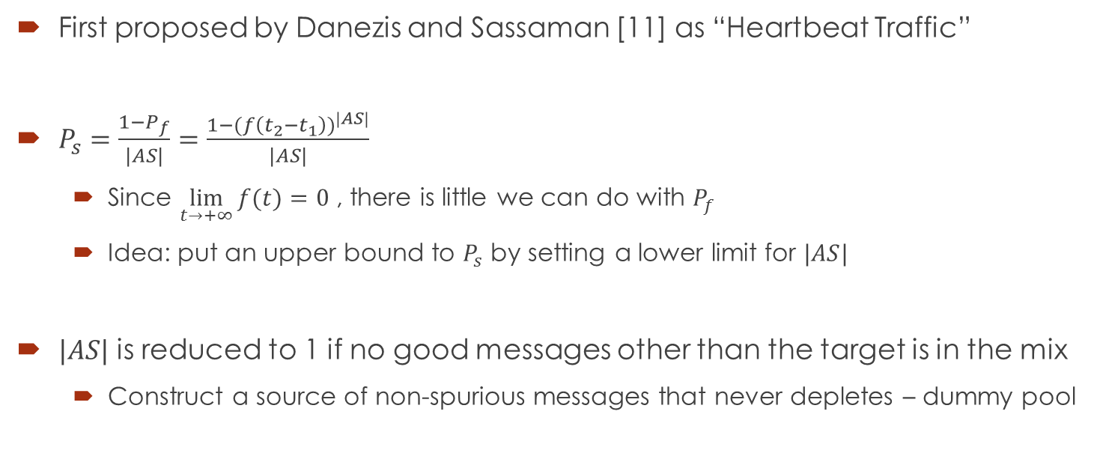
Mixes that utilize dummy message
First proposed by Danezis and Sassaman [11] as “Heartbeat Traffic”
$P_{s}=\frac{1−P_{f}}{|AS|}=\frac{1−{(f\left(t_{2}−t_{1}\right))}^{|AS|}}{|AS|}$
  Since $\lim_{t→+∞}{f(t)}=0$ , there is little we can do with $P_{f}$
  Idea: put an upper bound to $P_{s}$ by setting a lower limit for $|AS|$
$|AS|$ is reduced to 1 if no good messages other than the target is in the mix
  Construct a source of non-spurious messages that never depletes – dummy pool

Slide 22
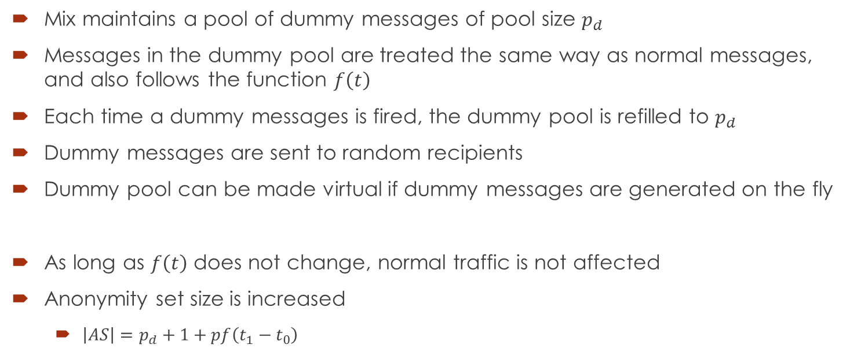
Mixes that utilize dummy message
Mix maintains a pool of dummy messages of pool size $p_{d}$
Messages in the dummy pool are treated the same way as normal messages, and also follows the function $f\left(t\right)$
Each time a dummy messages is fired, the dummy pool is refilled to $p_{d}$
Dummy messages are sent to random recipients
Dummy pool can be made virtual if dummy messages are generated on the fly
As long as $f\left(t\right)$ does not change, normal traffic is not affected
Anonymity set size is increased
  $\left|AS\right|=p_{d}+1+pf\left(t_{1}−t_{0}\right)$

Slide 23
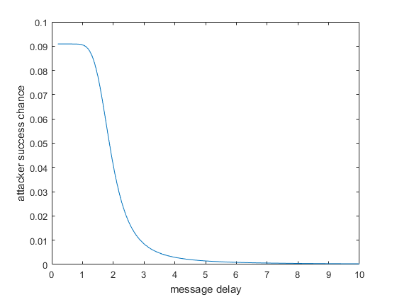
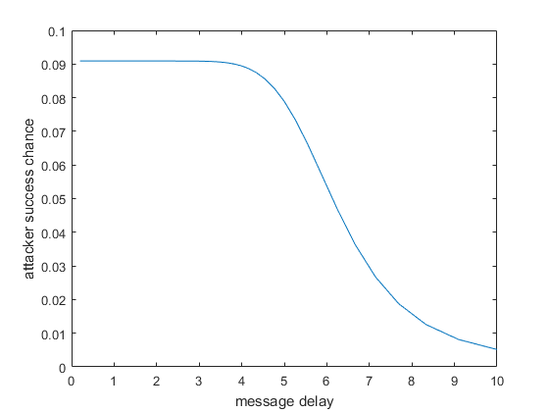
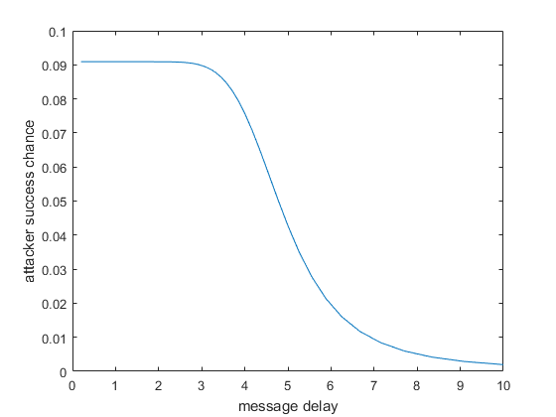
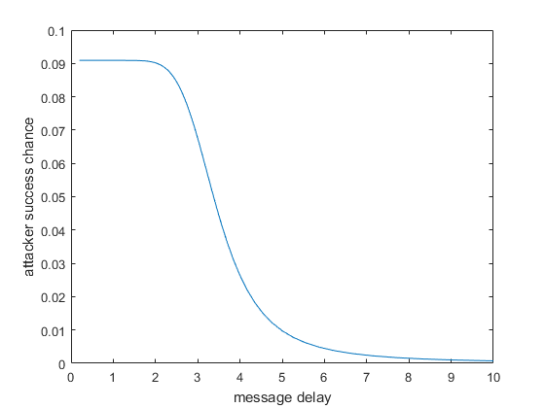

Example
Plot of $P_{s}$ as a function of $E\left(D\right)$
  $p_{d}=10$

Slide 24
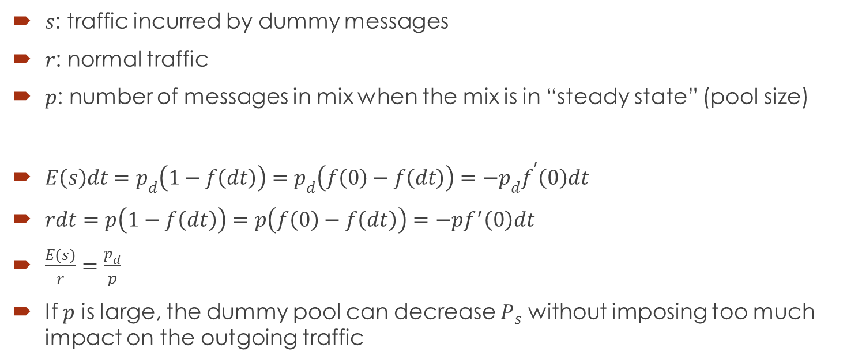
Traffic overhead
$s$: traffic incurred by dummy messages
$r$: normal traffic
$p$: number of messages in mix when the mix is in “steady state” (pool size)
$E\left(s\right)dt=p_{d}\left(1−f\left(dt\right)\right)=p_{d}\left(f\left(0\right)−f\left(dt\right)\right)={−p}_{d}f^{′}\left(0\right)dt$
$rdt=p\left(1−f\left(dt\right)\right)=p\left(f\left(0\right)−f\left(dt\right)\right)=−pf^{′}\left(0\right)dt$
$\frac{E(s)}{r}=\frac{p_{d}}{p}$
If $p$ is large, the dummy pool can decrease $P_{s}$ without imposing too much impact on the outgoing traffic

Slide 25
references
[1] Andreas Pfitzmann, Michael Waidner, “Networks Without User Observability”, in Computers and Security, 1987, pp. 158-166
[2] Brian N. Levine, Michael K. Reiter, Chenxi Wang, Matthew Wright, “Timing Attacks in Low-Latency Mix Systems”, in Financial Cryptography, 2004, pp. 251-265
[3] Claudia Diaz, Andrei Serjantov, “Generalising Mixes”, in Privacy Enhacing Technologies
[4] David Chaum, “Untraceable electronic mail, return addresses, and digital pseudonyms”, in Communications of the ACM, 1981
[5] David M. Goldschlag, Michael G. Reed, Paul F. Syverson, “Hiding Routing Information”, in Proceedings of the First International Workshop on Information Hiding, 1996, pp. 137-150
[6] George Danezis, “Designing and attacking anonymous communication systems”, (UCAM-CL-TR-594)
[7] Luke O'Connor, “On Blending Attacks For Mixes with Memory Extended Version”, in 7th International Workshop, 2005, pp. 39-52
[8] Oliver Berthold, Andreas Pfitzmann, Ronny Standtke, “The disadvantages of free MIX routes and how to overcome them”, in Proceedings of Designing Privacy Enhancing Technologies: Workshop on Design Issues in Anonymity and Unobservability, pp. 30-45
[9] Parvathinathan Venkitasubramaniam, Venkat Anantharam, “On the Anonymity of Chaum Mixes”, in Proceedings 2008 IEEE international symposium on information theory, 2008, pp. 534-538
[10] Claudia Diaz, Bart Preneel, “Reasoning about the Anonymity Provided by Pool Mixes that Generate Dummy Traffic”, in Information Hiding: 6th International Workshop, 2004, pp. 309-325
[11] George Danezis, Len Sassaman, “Heartbeat Traffic to Counter (n-1) attacks”, in Proceedings of the 2003 ACM workshop on Privacy in the electronic society, 2003, pp. 89-93

