Slide 1
Bit Coins And Anonymity
Karan Mirani

Slide 2
Do bitcoins provide complete anonymity ?
If yes, then how is it achieved?
If no, then are there any methods which could be used to provide anonymity ?
Approach - Extensive research about the working, advantages, drawbacks and improvements to the bitcoin system.
Evaluation : Finding and studying a protocol which could provide anonymity to bitcoins.

Slide 3
Bitcoin Overview
What is Bitcoin?
Bitcoin is a P2P electronic payment system.
It is also called Cryto-currency
Why should we use Bitcoin over other forms of payments?
Privacy (Pseudoymity) - Nobody knows A sent money to B.
Working of Bitcoin
Double spending avoided by bitcoin miners(specific set of nodes in P2P network). All previously unrecorded transaction are recorded in a transaction block
Handled by bitcoin client or third party
Advantages of accepting Bitcoin are :
-More merchants who accept bitcoins
-. Bitcoin exchanges accept bitcoins for currencies egs BitStamp
The values fluctuates .Currently it is $387.
User does not need a bank account or a credit card to transact with Bitcoin (Approx 8% of population in USA do not have bank accounts)
It’s decentralized hence no third party is involved
Benefits include:
-No single entity can control or reverse the transaction /flow of money.
-Validation can be done by other modes in the process of transactions
-Cash/Credit card can be traced back to the user
Block includes proof of work(sequence of numbers), transaction fee and information about previous transactions which makes it a transaction block chain.
TBC is broadcasted and once it is verified, nodes on a network start appending new TBC.
Considers only greatest TBC.
All new nodes consider the greatest TBC as sacrosanct
Transactions represents an entry in a global ledger

Slide 4
Example: Working of the Bitcoin
Alice specifies a number of bitcoins to send to Bob
Say Alice starts with 50 bitcoins. She wants to send 30 bitcoins to Bob. she specifies 18 to be returned to her and 2 are transaction fee
Alice takes transaction details and applies her digital signature to it
Alice broadcasts the transaction details to all nodes in P2P network

Slide 5
Cryptographic Hash Functions
Cryptographic Hash Functions
Examples: MDS, SHA-1, SHA-256
What is cryptographic hash function?
It is a mathematical function. Takes an input(message) and applies a set of mathematical transformation to produce a single output called as digest, tag or hash or fingerprint.
Desired properties
Should be computationally efficient i.e. should not take a long time to produce output.
Output should look random
First known applications : Digital signatures, pseudo random numbers etc
Message can be as long as you want but output will be of same length.
Cryptographic hash functions are deterministic i.e. one input will have only one output.
2 inputs should never produce same output i.e. should be collision resistant.
(ideally not possible but 2 such messages should be difficult to time or should take astronomical time to find 2 such messages)
Hide info about IP given the output ie. should not be able to give away any info about IP

Slide 6
Digital Signature
What is Digital Signature?
Electronic analog of physical signature.
Example: RSA signature scheme, DSS(Digital Standard Signatures)
How does it work?
Alice generates 2 keys :
1. Signing Key (Private Key)
2. Verification Key (Public Key)
Both keys will have a mathematical relationship
Alice applies a mathematical transformation to message and signing key K.
Resulting output will be a combination of message M and Signing Key which will be unique. Digital signature can only be produced by the holder of the signing key
What is the verification scheme?
Inputs : Message M, digital signature and verification key(public key)
Outputs : Yes/No
Usage of the Digital Signature:
Mathematical transformation will take the cryptographic hash
of the message and signing key as its input.
Every message will have a different signature.

Slide 7
Transaction records
Transaction is a digitally signed declaration by one party of its intent to send
a certain number of coins it possesses to another party.
Transactions in the bitcoin ecosystem are atomic i.e. if I received 10 bitcoins then I can only send 10 bitcoins i.e.I cannot send 5 bitcoins. However, If I want to send only 5 bitcoins, I mention the amount to send and the amount to receive back as change. I get the change back after the transaction
What are Transactions ?
When we say Alice wants to send coins to Bob, in the bitcoin ecosystem, Alice is only known by her pseudonym i.e. public verification key and so is Bob.
Suppose Alice received 25 bitcoins from Carol and 20 bitcoins from Ted and 20 from Ted. These transactions are already public.
Alice applies a cryptographic hash function to these transactions to get their corresponding digests Dc, Dd and Dt.T
These digests are also made public.
The other nodes then apply the same cryptographic hash function to verify that the digests correspond to those transactions i.e. they verify whether Alice actually is the owner of those bitcoins which she claims are her
Inputs to the transaction are : Dc, Dt, Dd,Bob's public key, the amount to send, her own public key, the amount to receive as change.
Point to note here is that: change + amount to send is not equal to the amount , Alice has i.e. some amount will be charged as a transaction fee by the other nodes for their efforts.
Alice then digitally signs these inputs which essentially binds her identity to the transaction
All the data will be broadcasted to all the other nodes in the system
Example

Slide 8
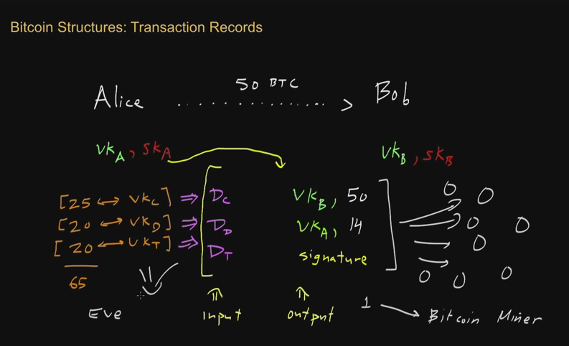

Slide 9
Transaction records
Since bitcoin system is decentralised, we need some way of verifying the flow of coins and validating transactions.
Also, we need to check for double spending
Why is the transaction fee charged
All these tasks are done by the bitcoin miners which take efforts in terms of time and processing power for which these nodes need to be compensated
Task performed by the Miners

Slide 10
Proof of Work
What is proof of work
They are analogous to puzzles i.e. they are not easy to solve and require serious computation
The work done i.e. the puzzle will be moderately hard on the requester side but easy to check for the service provider.
Types of Proof of Work schemes
Challenge response
These have been out there for a long time.
Egs: They are used to deter Ddos and spam email
Examples
The prover has a challenge string and has to come up with a proof string.
A good cryptographic hash function will require the prover to use a brute force
2. Solution - verification : The problem must be self-imposed before a solution is sought by the requester, and the provider must check both the problem choice
and the found solution. used in HashCash. Bitcoin uses a similar protocol
The challenge string and the proof string are concatenated and applied to a cryptographic hash function like SHA-256.
This output of the concatenated string has a specific property when it is applied to the cryptographic hash function like the first 42 bits of the output will be 0's
technique to come up with the desired
proof string.
The average work required is exponential in the number of zero bits required and
can be verified by executing a single hash

Slide 11
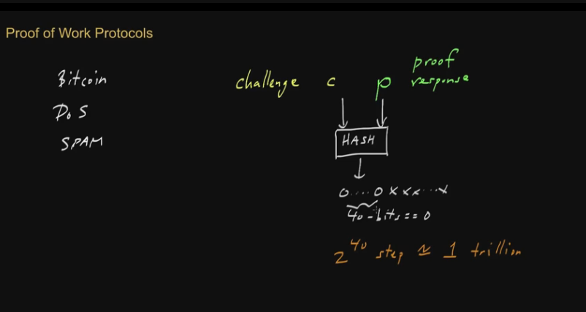

Slide 12
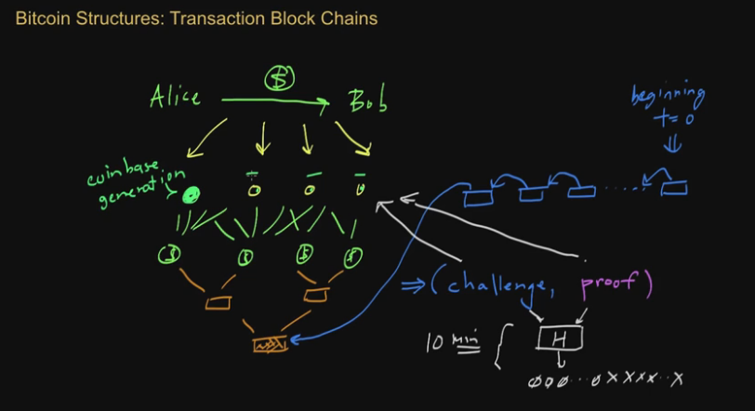

Slide 13
Money Supply
•Only 21million bitcoins will ever be generated. After that, nodes will not be allowed to generate coin base.
•However, they will still get transaction fees.
•The sender will then have to set an appropriate transaction fee for the nodes so that they do all the required work.
•All bitcoins will have been generated by 2140.
•Every 2016 blocks are generated, the network measures the time required to generate those blocks.
•If it's significantly greater than 2 weeks, then proof of work will be calibrated to be a bit easier and vice versa.
After 210,000 blocks are generated the reward is halved.
It takes approximately 4 years to generate 210,000 blocks.
Jan 2009 -> Each winning bitcoin miner gets 50 bitcoins
In May,2013 reward was 25 bitcoins.

Slide 14
The Bitcoin Network
New transactions are broadcast to all nodes
Each node collects new transactions into a block
Each node works on finding a difficult proof-of-work for its block.
When a node finds a proof-of-work, it broadcasts the block to all nodes
Nodes accept the block only if all transactions in it are valid and not
already spent
Nodes express their acceptance of the block by working on creating the next block in the chain, using the hash of the accepted block as the previous hash
Steps to run the Bitcoin network

Slide 15
Advantages and Drawbacks
Drawbacks of BitCoin System :
-Bitcoin does not provide true anonymity: transactions involve pseudonymous addresses, meaning a users transactions can often be easily linked together
-Further, if any one of those transactions is linked to the user’s identity all of her transactions may be exposed
Advantages of the MixCoin Protocol
1.Accountability: Mixcoin mixes issue signed warranties to users regarding the transaction. A user can then confidently send funds to the mix, knowing that if the mix misbehaves she can publish this warranty, damaging the mix reputation and (presumably) its business model.
2.Mix indistinguishability: Although users interact with specific mixes, single-use mix addresses enable a surprising property that passive adversaries cant determine which mix a user is interacting with.
3.Mix networks for Bitcoin: Against an active attacker who can break mix indistinguishability, chaining multiple mixes together still provide strong anonymity.

Slide 16
The Mixcoin Protocol
Core Protocol
Prior to mixing, the mix gives Alice a signed warranty which will enable her to unambiguous prove if the mix has misbehaved.
The availability of multiple mixesMi, each represented by a warranty signing key KMi
Assumptions
As for profit enterprises, mixes are motivated to build and maintain a reputation in KMi, so it must be used consistently.
Unlike Mixes, Alice does not need to maintain any long term public key nor any public reputation. Alice must be able to negotiate with the mix over an anonymous and confidential channel. In practice, this will likely to be realized by mixes running a dedicated Tor hidden service
Dishonest mixes will quickly have their reputation destroyed and lose business
Alice needs to split her funds into multiple chunks and perform multiple sequential rounds of mixing each
For effective anonymity, chunk sizes should be standardized.

Slide 17
Steps to the Mixing Protocol
Step 1
-Alice contacts the mix over an anonymous channel and proposes a set of mixing parameters
-V the value (chunk size) to be mixed
-T1 the deadline by which Alice must send funds to the mix
-T2 the deadline by which funds must return to Alice
-Kout the address where Alice wishes to transfer her funds
-ρ the mixing fee rate Alice will pay
-n a nonce, used to determine payment of randomized mixing fees
-w the number of blocks the mix requires to confirm Alice’s payment
Step 2a
-(If the mix accepts these terms): It generates a fresh escrow address Kesc and sends back a warranty containing all of Alice’s parameters plus Kesc, signed using KM.
Step 2b
-(If the mix rejects these terms): The mix may also reject Alice’s request for any reason though in practice we expect that a reputable mix will abide by a published policy for acceptable terms. Alice similarly has no obligation to transfer funds after receiving a warranty. If Alice declines (or forgets) to do so by the deadline
-t1 the mix may delete its records and move on.

Slide 18
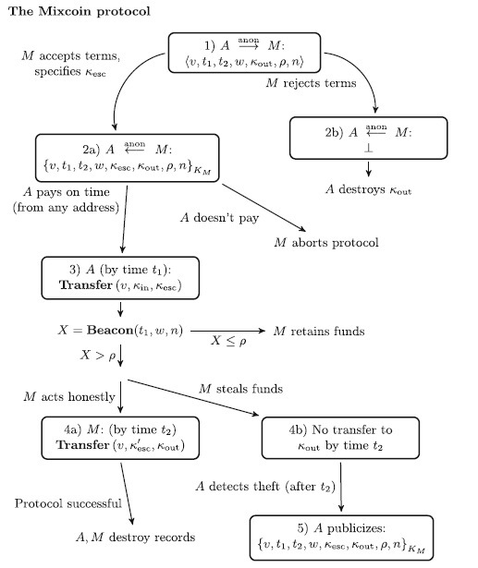

Slide 19
Steps to the Mixing Protocol
Step 3:
If Alice does transfer the agreed value v to κesc by the deadline t1 then the mix is obligated to transfer an equal value to κout by time t2. If Alice doesn't pay, the Mix aborts the protocol.
Step 4a:
f the mix does so faithfully, then both parties should destroy their records to ensure forward anonymity against future data breaches.
Step 4b:
If the mix fails to transfer the value v to Kout by time t2,5 then step 5
Step 5:
Alice publishes her warranty. Because the warranty is signed by the mix’s long-term key KM and all Bitcoin
transactions are publicly logged, anybody can verify that the mix cheated

Slide 20
Mixing fees
Working of Mixing fees
Mixing fees are randomized whereby with probability I……., the mix retains the entire value as V as a fee, and with probability……… takes no fee at all. This produces an expected mixing rate fee of …… and leaves knout with either nothing or fully V.
The mix must use a publicly verifiable mechanism to randomly choose which chunks to retain as mixing fees. Specifically, the mix must generate a (……….) random bit which neither party can predict for fairness. This can be done with a public source of randomness called a beacon.

Slide 21
Sequential Mixing
What is Sequential mixing
Given the above Mixcoin protocol for interacting with a single mix, Alice will most likely want to send her funds through N independent mixes to protect her anonymity against the compromise of an individual mix.
To do so, Alice can choose a sequence of N mixes M1, . . .MN and execute the Mixcoin protocol with each of them in reverse order, instructing each mix Mi to forward her funds to the escrow address Îºesci+1 which she previously received from mix Mi+1.
After obtaining N signed warranties,11 Alice then transfers her chunk to Îºesc1 and if any mix in the sequence fails to transfer it she can prove it with the
appropriate warranty

Slide 22
Threat Model
Because the Bitcoin block chain is a permanent, public record of all transactions,every attacker is trivially a global passive adversary.
Replay attacks are impossible in Mixcoin due to the double spending prevention in Bitcoin.
The Passive Adversary’s View with Mix Indistinguishability:
The best-case scenario for Mixcoin is a passive adversary. We assume this adversary can reliably determine with high probability which Bitcoin transactions are mix traffic, given their size v and their use of one-time escrow addresses. However, due to their one-time nature, this simple adversary may be unable to link escrow addresses to specific mixes, a novel property with no apparent precedent in communication mixes which we call mix indistinguishability.
If this is the case, the adversary is left to observe a sea of apparently identical escrow addresses and the system appears to function as one universal mix consisting of all participants using the chunk size v.
Active Adversaries and Distinguishable Mixes:
When Alice sends a chunk from κin to M via κesc, the client who ultimately receives this chunk will learn that κin interacted with M. Similarly, the client who sends the chunk to Kesc esc which is eventually sent to κout will also learn that Alice interacted with M. An active adversary can exploit this in a flooding attack, learning up to two other addresses interacting with the same mix for each chunk sent through that mix.
Against such a strong active attacker who can link every escrow address to its originating mix, the system appears similar to be a traditional communication mix network with mixes behaving as stop-and-go mixes with limited pooling
due to the block size.

