Slide 1
How Many Messages are You Anonymous For:
Analyzing intersection attacks on mix networks
Contributors: Connor McCoy

Slide 2
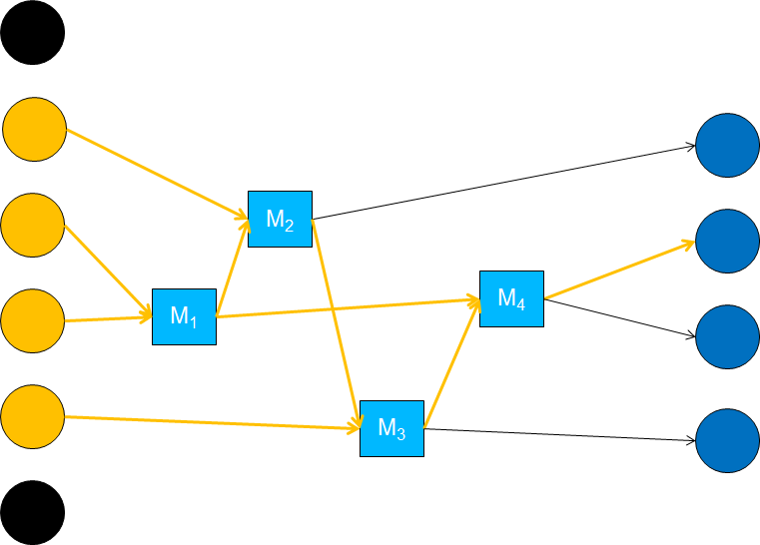
Overview
Problem
Problem
Objectives
Approach
Metrics
Demo
Results
Ramifications
Sources
Questions

Slide 3
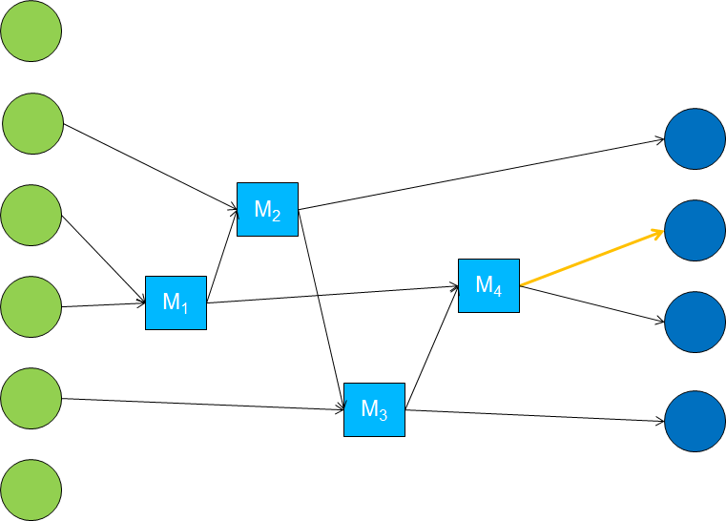
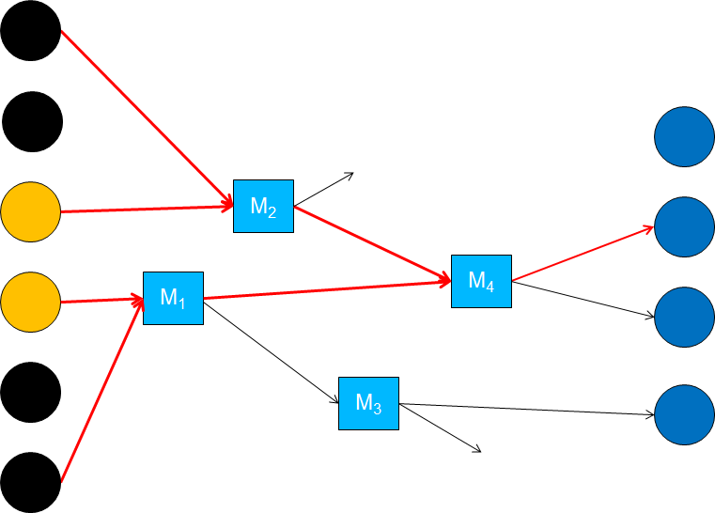
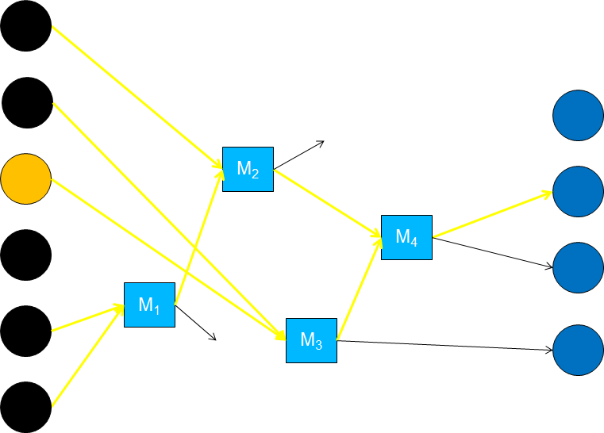
Problem 1
Problem
Because mix networks have no structure, they are flexible, scalable, and extendable.
But… mix networks inherently are vulnerable to intersection attacks.
*Illustrations from Lecture 5.
Notes:
Can say a lot here: compare to crowds, onions, cascades.

Slide 4
Problem 2
Problem
Original Question:
Given a limited number of messages N, can a number of mixes M be found to guarantee an Anonymity Set of a desired size?
Revised Question:
Given as much input as possible, can an Anonymity Set of S size be guaranteed for N messages?
**If it’s not possible, or viable, to gather sufficient input to make a guarantee, which parameters are troublesome? Does a reasonable solution exist?
Notes:
Initial thoughts, reason for changes.

Slide 5
Objectives
Project Focus
Explore the variables influencing a sender’s anonymity on a mix network.
Develop an algorithm NumSafeMessages(|AS|min, ...)

Slide 6
Approach
Method of Approach
Part 1:
Write a windows desktop application in C#/XAML to simulate intersection attacks on mix networks customized with the aforementioned input parameters.
* If possible, using a diagramming library, visually depict the simulation in progress.
Part 2:
I’ll use the software developed in Part 1 to answer the question “How many messages are you anonymous for?”.

Slide 7
Metrics 1
Method of Approach
Part 1:
The software usefully simulates an intersection attack given input parameters.
The simulation returns a global passive attacker’s view of the sender’s anonymity set after each round.

Slide 8
Metrics 2
Method of Approach
Part 2:
Analysis aided by Part 1 results in a function which given the needed input parameters returns the number of messages for which a desired anonymity set size holds.

Slide 9
Demo
Progress
Overview of UI
Scenario 1: mix cascade
Scenario 2: mix network
-------------- redux

Slide 10
Preliminary Results 1
Progress
Traffic by other senders is unpredictable. Therefore, a guarantee is impossible without active measures (dummy messages).
However, if average traffic is known w.r.t. targeted sender, approximations can be made.
Let Ps be the probability of sender s in St’s AS sending a message in the same round St sends one. Then,
Entropy = - Sum Ps log2(Ps)
2^Entropy = AS for next round.
AS for round R = 2^Entropy where Ps,r = Ps^r
Notes:
Holds for simple case where every message goes through at least 1 honest mix. EAS must be performed otherwise.

Slide 11
Preliminary Results 2
Progress
f = NumSafeMessages(|AS|min, AS, Ps) = ?
g = |AS|min(R) = 2^[- Sum (Psn^R) log2(Psn^R)]
f = g⁻¹, given EAS = AS
Notes:
Holds for simple case where every message goes through at least 1 honest mix. EAS must be performed otherwise.

Slide 12
Possible Ramifications
Progress
Knowing enough Ps’s and enough about network configuration (relation of number of messages to rounds, that every message goes through 1 mix) can provide a conservative estimate of AS for a message… but that’s not practical!
The only party that really knows a sender’s AS on a mix network is a GPA…
Closing Question:
Is it viable to implement a friendly, GPA such that it can warn users when their degree of anonymity becomes below their desired level?
Can the risk of this GPA providing a single point of failure be mitigated?
Notes:
Holds for simple case where every message goes through at least 1 honest mix. EAS must be performed otherwise.

Slide 13
References
Resources and References
Generalising Mixes by Diaz and Serjantov (Mix Types)
Crowds: Anonymity for Web Transactions by Michael Reiter and Aviel Rubin. (Degree of Anonymity)
The Disadvantages of Free MIX Routes and How to Overcome Them by Berthold, Pfitzmann, and Standtke (Mix Network)

Slide 15
Excerpt (Reference 3) Back
4.1 Motivation
There still exists a controversial discussion, which kind of a MIX configuration is the better one. The advocates of the MIX-network are always pointing out that there are the following advantages: Each user can decide on his own, which MIXes he wants to trust. Because an attacker has the best chance to observe a user, if he controls as many MIXes as possible (or even all MIXes), it seems that a MIX cascade is extremely unsuitable.
1. In this case an attacker knows exactly which MIXes he has to control in order to observe a user successfully. But if the user can choose his own route, he can exclude MIXes, which seem untrustworthy to him and an attacker has to control much more MIXes in order to achieve the same probability to attack successfully. The community of users could publish which MIXes are not trustworthy and so would prevent attacks.
2. Because a MIX network could theoretically grow up to an infinite number of MIXes, the anonymity group could also raise to an infinite size. Every user can choose an arbitrary route of MIXes and so an observer could not detect, messages of which users a MIX currently processes.
3. There exists no structure, so a MIX network is very flexible, scalable and extendable. It could be realised as a fault-tolerant network. The only thing, that must be done, is to publish, when a MIX is inserted into or removed from the network. Such a system would be predestined for usage in the Internet.
Notes:
The Disadvantages of Free MIX Routes and How to Overcome Them by Berthold, Pfitzmann, and Standtke (Mix Network)

