Slide 1
Making the Neutral Traffic Matrix More Meaningful
Joseph Choi

Slide 2
Goal: Hide Traffic Patterns from a Global Passive Adversary, who knows:
Source and destination of all messages
Number of messages passing along each link
Assumptions of the Neutral Traffic Matrix Approach:
Messages are indistinguishable
Same message length
The same message should not be resent
Further assume:
No node compromise by an attacker
Fully connected graph (direct path between each pair of nodes)

Slide 3
Neutral Traffic Matrix
Receiver
 | Node 1 | Node 2 | Node 3 | ... | Node k
Node 1 | TM(1, 1) | TM(1, 2) | TM(1,3) | ... | TM(1, k)
Node 2 | TM(2, 1) | TM(2, 2) | TM(2, 3) | ... | TM(2, k)
Node 3 | TM(3, 1) | TM(3, 2) | TM(3, 3) | ... | TM(3, k)
... | ... | ... | ... | ... | ...
Node k | TM(k, 1) | TM(k, 2) | TM(k, 3) | ... | TM(k, k)
Sender

Slide 4
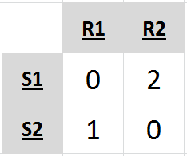
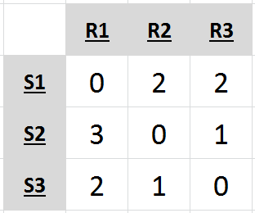
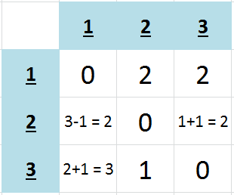
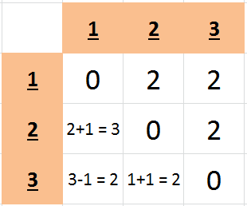
Two nodes:
Padding = send 1 more message from 2 to 1
RR = through oneself is not done
Three nodes:
Strictly padding = make each non-diagonal 3 (additional cost: 7)
RR = Convert one of 2 → 1 into 2 → 3 → 1 [need +6 padding]
(additional cost: 1RR + 6PAD = 7)
Convert one of 3 → 1 into 3 → 2 → 1 [need +5 padding]
(additional cost: 2RR + 5PAD = 7)

Slide 5
Splitting Transform Scheme 1
Consider two nodes: A and B A wishes to send one message, m, to B A splits m into two parts: m₁ and m₂ m₁ and m₂ are padded to reach full message length
Each part of the split message behaves like a full message.
m
m₁
PADDING
m₂
PADDING
m₁
m₂

Slide 6
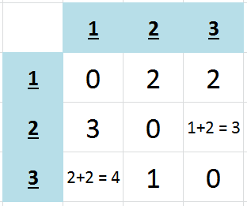
Splitting by Scheme 1
Node 2 is sending 3 messages to Node 1
Take two messages, call them a & b
Split a in half → Message a.1 & a.2
Split b in half → Message b.1 & b.2
Reroute a.2 and b.2 through node 3
Send a.1 and a.2 to node 1 directly.

Slide 7
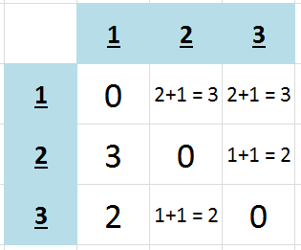
Splitting by Scheme 1
Node 1 is sending 2 messages to Node 2
Take a message, call it a
Split a in half → Message a.1 & a.2
Send a.1 directly; Reroute a.2 thru node 3
Node 1 is sending 2 messages to Node 3
Take a message, call it b
Split b in half → Message b.1 & b.2
Send b.1 directly; Reroute b.2 thru node 2

Slide 8
Splitting Transform Scheme 2
Consider two nodes: A and B A wishes to send one message, m, to B A splits m into two parts: m₁ and m₂ m₁ and m₂ are not padded → remain ½ full length
At least two messages must be split at once to get four halves, which are combined to form messages of the full length.
m
n
m₁
m₂
n₁
n₂
m₁
n₁
m₂
n₂

Slide 9

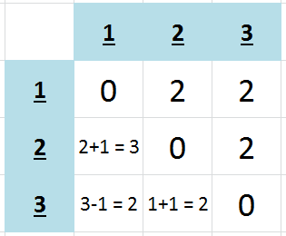
Splitting by
Scheme 2
Node 2 wants to send 3 msgs to Node 1
Node 2 wants to send 1 msg to Node 3
Split one of the messages directed to Node 1 and another message directed to Node 3. Interchange parts and send to 3
Perhaps then split
A message from 3 to 1, and from 3 to 2.
Interchange the parts and send to 2.

Slide 10
Splitting Complications
Each part must ultimately be received by its destination
Effectively adds another layer of rerouting
Less flexibility than, say, sending dummy messages
Solution: Michael Rabin’s IDA (Information Dispersal Algorithm)?
If splitting into more than 2 pieces
In what order should messages be chosen for splitting?
Specific to Scheme 1:
Link cost is only ever increased
Specific to Scheme 2:
Recognize split messages at intermediate nodes

Slide 11
Alternative: Control Messages
Every once in a while, nodes will negotiate the number of messages to be sent out in subsequent time windows
One message sent by each node to all other nodes
Contains value: expected # of messages it intends to send
nodes will send messages according to the minimum of these
Pros: If nodes regularly send many messages to every other node,
then one more will be tolerable
no need to send dummy messages
Cons: If node activity is usually low, this adds considerable cost

Slide 12
Resources:
Richard E. Newman, Ira S. Moskowitz, Paul Syverson and Andrei Serjantov. “Metrics for Traffic Analysis Prevention,” In PET 2003, Dresden, March 2003.
R.E. Newman-Wolfe and B.R. Venkatraman. “High Level Prevention of Traffic Analysis,” Seventh Annual Computer Security and Applications Conference, San Antonio, Texas, December 2-6, 1991, pp. 102-109.
B.R. Venkatraman and R.E. Wolfe. “Capacity Estimation and Auditability of Network Covert Channels,” 1995 IEEE Computer Society Symp. Security and Privacy, pp. 186-198.
X. Fu, B. Graham, Y. Guan, R. Bettati and W. Zhao. “NetCamo: Camouflaging Network Traffic for Real-Time Applications,” Texas Workshop Security of Information Systems, April 2003.
Yin Zhang, Matthew Roughan, Carsten Lund, and David Donoho. “An information-theoretic approach to traffic matrix estimation,” 2003 Conference on Applications, Technologies, Architectures, and Protocols for Computer Communications, Karlsruhe, Germany, August 25-29, 2003.
Michael Rabin. “Efficient Dispersal of Information for Security, Load Balancing, and Fault Tolerance,” In ACM April 1989, pp.335-348.

