Slide 1
Modified Onion Routing
GyanRANJAN Hazarika And Karan mirani

Slide 2
Onion Routing
Provides measures against traffic analysis.
Provides protection against eavesdropping.
Provides bi-directional anonymous communication.
Provides anonymous socket connection through a proxy server for easy deployment.

Slide 3
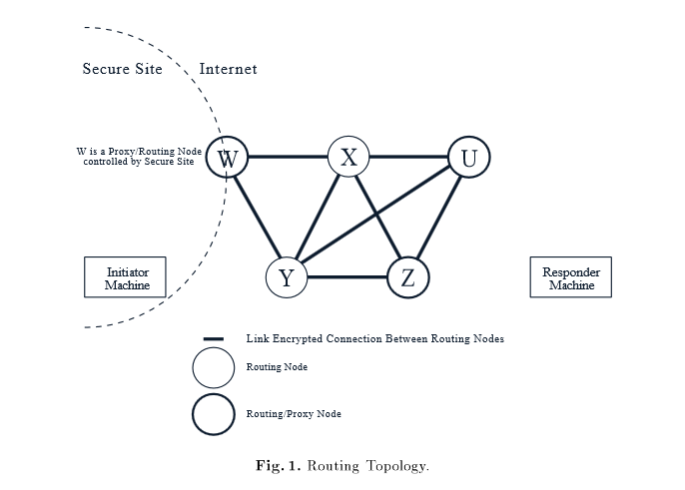
Implementation Overview
Routing Topology
Consists of the initiator, it’s proxy server,
the responder’s proxy server, the responder
and the nodes on the route between
the initiator and responder
Creates an anonymous, bi-directional, real-time VC between initiator and responder.
Each node (except initiator’s proxy server)
knows nothing but the previous and the next
hops in the communication chain
Information is hidden by making
a data stream pass through the anonymous
circuit en route to its destination

Slide 4
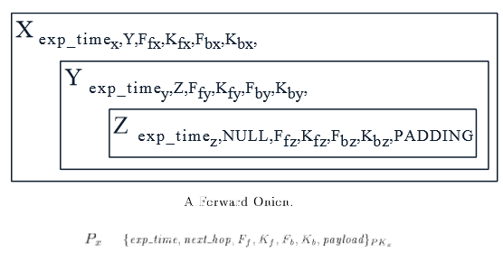
Onion Structure
Initiator’s proxy identifies a series of routing nodes forming a route through the network.
It then creates an onion which encapsulates the route.
The basic onion structure depends on the route to the responder chosen by the initiators proxy.
Based on this route the initiator’s proxy encrypts first for the responder’s proxy, then for the preceding node on the route and so on back to the first routing node to whom the onion will be sent

Slide 5
Formation & Delivery of Onion
Sende(S)r
S’s Proxy
Router 1
Router 2
R’s Proxy
Receiver(R)

Slide 6
Limitations
It is assumed that the public key certificates for each node have been distributed to all others prior to operations.
No mechanism of checking message authenticity.
Single point of failure: If proxy server is compromised, then the entire system fails.
Two level encryptions for the header and each layer of onion.
No way to authenticate a returning participant in the network.
It is assumed that the proxy/routing nodes and the intermediate routing nodes know about each other in advance.

Slide 7
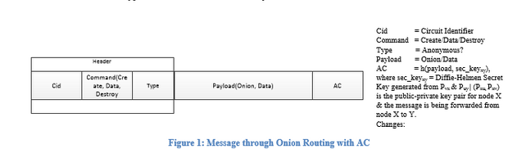
Proposed Modifications
Remove proxy servers
Use authentication code with message to protect against message corruption by an attacker
Use ‘Type’ field indicationg whether message can tolerate delay or not. If it can, then each routing node assumes the functionality of BINOMIAL MIX !!
Encrypt message with sec_keyxy rather than encrypting header and payload separately
Eliminate need of random bits in message by use of sex_keyxy

Slide 8
Thank You

