Slide 1
How Many Mixes are Enough?
Contributors: Connor McCoy

Slide 2
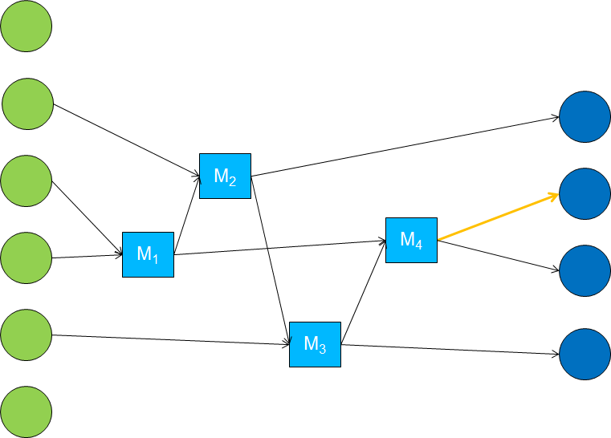
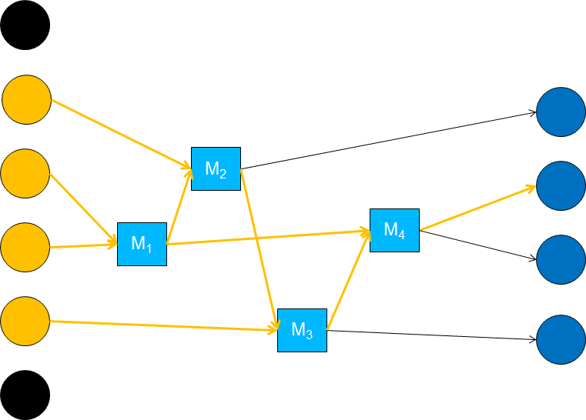
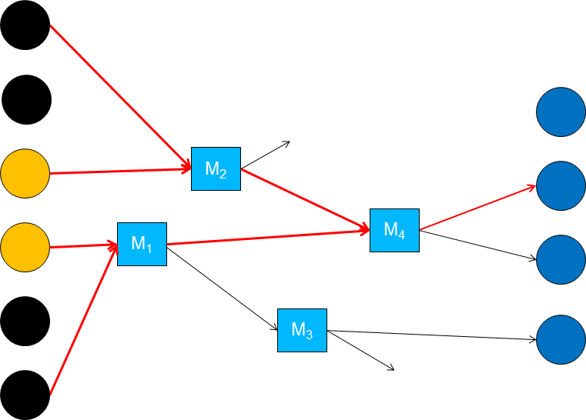
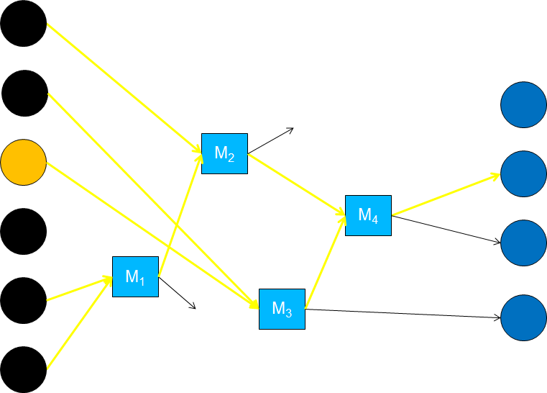
Problem
Problem
Because mix networks have no structure, they are flexible, scalable, and extendable.
But… mix networks inherently are vulnerable to intersection attacks.
*Illustrations from Lecture 5.
Given a limited number of messages N, can a number of mixes M be found to guarantee an Anonymity Set of a desired size?
Notes:
Illustrations from Lecture 5.

Slide 3
Project Focus
Project Focus
I want to investigate the question of “How many mixes are enough?” given the input parameters:
max path length
time/size threshold (depending on mix type)
number of messages sent
configuration of mixes
Then, I want to find a function which accepts the above input and predicts the number of mixes needed to achieve a desired degree of anonymity (or declares it impossible).

Slide 4
Method of Approach
Method of Approach
Part 1:
Write a windows desktop application in C#/XAML to simulate intersection attacks on mix networks customized with the aforementioned input parameters.
* If possible, using a diagramming library, visually depict the simulation in progress.
Part 2:
I’ll use the software developed in Part 1 to answer the question “How many mixes are enough?” as a function of the input parameters.

Slide 5
Progress
Progress
Windows 10 desktop application with skeleton UI
Pondering how to mathematically describe mix configuration...

Slide 6
References
Resources and References
Generalising Mixes by Diaz and Serjantov (Mix Types)
Crowds: Anonymity for Web Transactions by Michael Reiter and Aviel Rubin. (Degree of Anonymity)
The Disadvantages of Free MIX Routes and How to Overcome Them by Berthold, Pfitzmann, and Standtke (Mix Network)

