Slide 1
The Tor Network
By: Conor Doherty and Kenneth Cabrera

Slide 2
Project Topics
What is the Tor Network?
How does Tor function?
How does Tor work to preserve anonymity?
What are the limits and weaknesses of Tor?
How much more secure is Tor than normal internet browsing?

Slide 3
What is the Tor Network?
“The Onion Router”
A distributed volunteer-based network which uses random pathways and encryption to prevent traffic analysis.
“The Tor network is a group of volunteer-operated servers that allows people to improve their privacy and security on the Internet.” – The Tor Project Website

Slide 4
What is the Tor Network?
Developed in the mid 1990’s by US Naval Research employees.
Remember the reading:
Hiding Routing Information by David M. Goldschlag, Michael G. Reed, and Paul F. Syverson
Outlines the idea of Onion Routing to prevent traffic analysis
http://www.freehaven.net/anonbib/cache/onion-routing:ih96.pdf

Slide 5
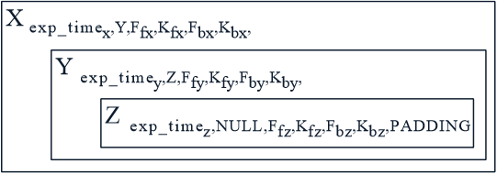
The Onion
The encrypted message is called an ‘Onion’ because of the layers of encryption it has
The message (the core) has padding
Encrypted for each pathway along the circuit
Each part of the path peels of a layer until the message reaches the receiver (i.e. no more layers left)

Slide 6
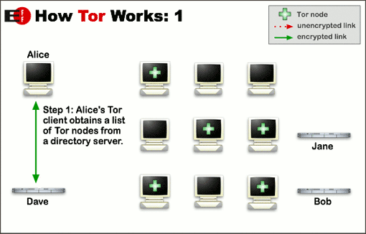
How does Tor work?

Slide 7
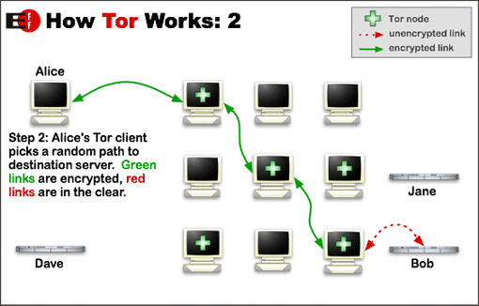
How does Tor work?

Slide 8
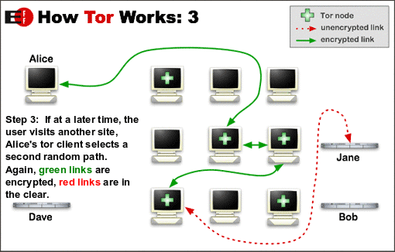
How does Tor work?

Slide 9
How does Tor preserve Anonymity?
Keys
Encryption
Authentication
Coordination
Entry Guards
Circuit Change

Slide 10
Limitations of Tor
No application-level security
Can’t use plugins (Flash, Java, etc.)
No protection outside of the Tor Network
Egotistical girraffe
Prevents traffic analysis but not traffic confirmation

Slide 11
Tor v. Normal Browsing
Tor v. SSL/TLS (Secure Socket Layer/Transport Layer Security)
Censorship-circumvention
Browsers of Tor can access hidden or exclusive services
Can be exploited
Silk Road, Arms Dealers, etc.

Slide 12
Conclusions
Most normal users don’t need Tor
Can be a useful tool for preserving anonymity online
Some limitations
Much better than normal browsing

Slide 13
Sources
https://www.torproject.org/about/overview.html.en
https://www.torproject.org/getinvolved/volunteer.html.en
https://www.torproject.org/docs/faq.html.en#FacingLegalTrouble
https://blog.torproject.org/category/tags/traffic-confirmation
https://hal.inria.fr/file/index/docid/471556/filename/TorBT.pdf
http://www.theguardian.com/world/2013/oct/04/tor-attacks-nsa-users-online-anonymity
https://archive.org/stream/ACLU_-_egotistical-giraffe/ACLU_-_egotistical-giraffe_djvu.txt
http://www.theguardian.com/world/interactive/2013/oct/04/egotistical-giraffe-nsa-tor-document
https://developer.mozilla.org/en-US/docs/Archive/Web/E4X
http://www.freehaven.net/anonbib/cache/onion-routing:ih96.pdf
https://www.eff.org/torchallenge/what-is-tor.html
http://www.tomsguide.com/us/what-is-tor-faq,news-17754.html

