Slide 1
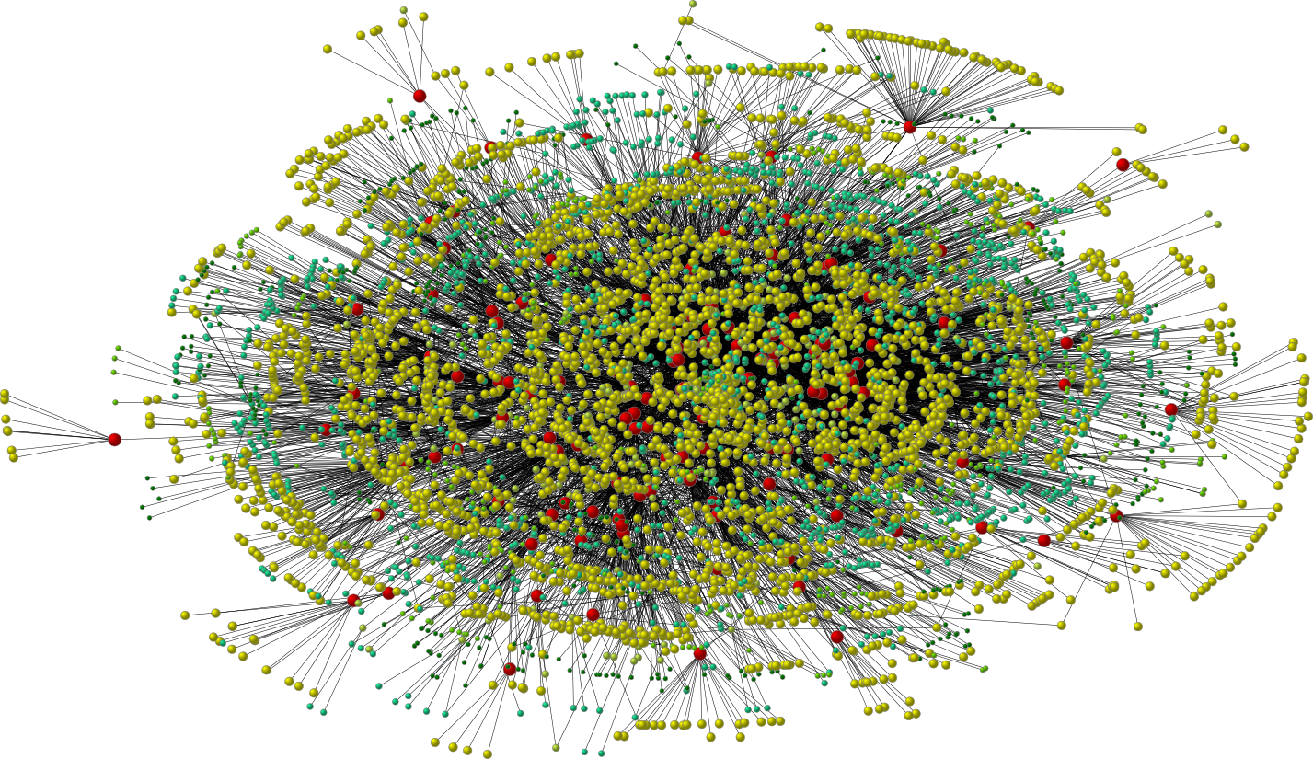

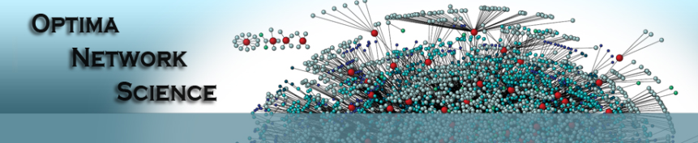
Security and Privacy in OSNs
My T. Thai
mythai@cise.ufl.edu
http://www.cise.ufl.edu/~mythai

Slide 2

Protecting User Data
Protection From Other Users:
  Direct Access:
    Privacy setting:
      hard for new users
      Research suggested new scheme to automatically build the privacy setting based on existing information
      Encryption
  Indirect Access
    Leaking problems to unintended audience
      Testing on twitter data reveals that 4.42 million re-tweets are tweets that leak
      Minimize vulnerability -> Maximize Circle of Trust
      Identify vulnerable friends

Slide 3
Protection from Application
Third party apps (API) can access data of users, usually obtain more than what they need
Approaches:
  FAITH Architecture:
    Instead of users accessing data directly through the social network, all the API calls are routed through the FAITH server.
    This server can decide, based on users specification, what information to expose to this application at this time
  Ask Apps to specify what data they need to collect

Slide 4
Protection from Advertisers
Many ads out there
Research focuses on block ads that fit into any of the following categories:
  Counterfeit goods, misleading or inaccurate claims
  Phishing, malware
Machine learning approaches:
  Natural languages features: individual terms
  String based features: target international misspelling, typo manipulation
  Structural features: actual layout of the landing page? Where is the ad placed

Slide 5
Protection from the Provider
Data being sold
Users place their trust on OSN providers (with ignorance)
Approaches:
  Distributed OSNs (like Bit torrent)
  Data stored on users’ machines (rather than at the provider levels)
  Encryption
No intensive for providers to adopt these

Slide 6
Protecting Location Information
Locations are being leaked
Can we really be able to protect this?
Users’ information and behaviors can be tracked. Can we protect this?

Slide 7
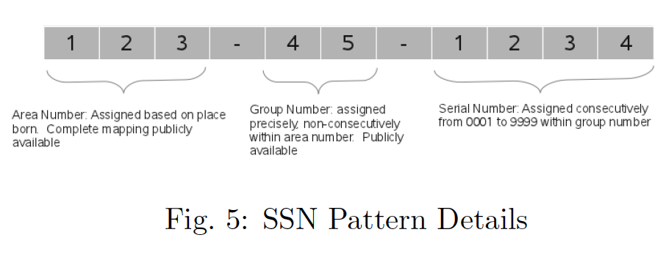
Data Inference
Too many data available out there. With some inference tools, we can infer many sensitive information
Inferring Users Attributes
  SSN: Guess an entire SSN in < 1,000 attempts

Slide 8
Inferring User Attributes
Infer sensitive information about a user
  Classify users as either “democrat” or “republican”:
    Machine learning algorithm with a training set of known to be either democrat or republican
    Recognize many attributes -> classify new users
User’s interest
User’s behavior, workplace, vacation, etc…
Many works focused on link prediction

Slide 9
Maintain Proper OSN Operations
Sybil Attacks:
  Fake accounts to obtain information, send spam, influence rating systems…
Methods:
  Clone profile: obtain enough information and fake another account of Bob, for example, and try to make connection to all his friends
  Manually or Automatically: Incorporate a metho to break CAPTCHAs
Many methods to defend sybil attacks:
  Main point: small cut to separate them

Slide 10
Anonymization
Anonymization: giving data to publish without revealing the personal information of any entity
De-anonymization: a reverse process
A well-studied in software engineering:
  Software testing to third party (outsourced) with database
  Need to anonymize the database
  A dataset is said k-anonymous if given any entity in the dataset, this entity is indistinguishable from at least k other entities
  Easy to handle: strict access or simply replace unique entity identifies with unique pseudonyms

Slide 11
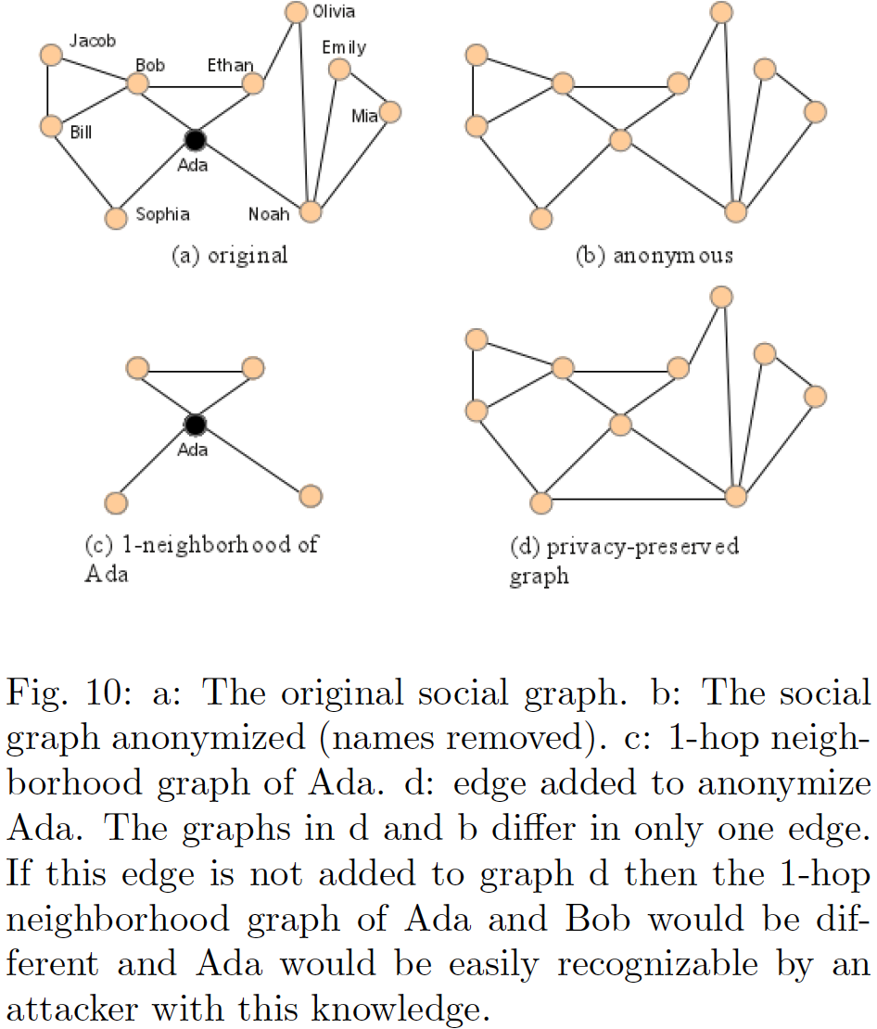
Anonymization in OSNs
Challenges:
  Network structures and network inferences

Slide 12
Data Explosion
Too many data, including mis-information
How to detect/predict outbreak?
Limit mis-information

Slide 13
Exploiting Vulnerability to Secure User Privacy on Social Networking Site
Pritam Gundecha, Geoffrey Barbier, Huan Liu
Arizona State University
KDD 2011 Oral presentation + poster
Representer: Lei Pan

Slide 14





Privacy protection problem
As (one's) social network expands, a user's privacy protection goes beyond his privacy settings and becomes a social networking problem.
Estimated Unique Monthly Visitors
65,000,000
750,000,000
110,000,000
70,500,000
250,000,000

Slide 15



?
?
?
Would the highest privacy settings guarantee a secure protection?
Is it possible to manage one's privacy protection?
How can one figure out an effective approach to balance between vulnerability and privacy?
Protect the privacy!
picture
video
?
blog
location
vulnerable friend leak
profile
vulnerable friend leak
Notes:
Would the highest privacy settings guarantee a secure protection?
Given the open nature of social networking sites, is it possible to manage one's privacy protection?
With the diversity of one's social media friends, how can one figure out an effective approach to balance between vulnerability and privacy?

Slide 16
Vulnerability
A vulnerable friend is defined by
  whether or not the user's friends' security and privacy settings protect the friend and the individual's network of friends (which includes the user).
An individual is vulnerable if any friend in the network of friends has insufficient security and privacy settings to protect the entire network of friends.
Whether an individual is vulnerable or not depends on himself as well as his friends (or his social networks).
Notes:
Thus, whether or not an individual reciprocates security and privacy settings with their friends within a friend network can impact the entire network.

Slide 17
Vulnerability
Malicious individuals or groups may take advantage of openness and naivety of users by exploring vulnerability.
Such exploration can cause physical and emotional distress to users, sometimes with dire consequences.
Many a time, a user is unaware that he poses a threat to his friends or one of his friends does so.

Slide 18
Related Work
User privacy on social networking sites is an active area of research in recent years
  [Narayanan et al.’08, ’09], [Wondracek et al.’10], [Krishnamurthy et al.’10], [Squicciarani et al.’09], [Fang et al.’10], [Zhelva et al.’09], [Baden et al.’09]
Most approaches either suggest the fundamental changes to social networking site’s existing architecture or try to show how vulnerable users are on social networking sites.

Slide 19
In this paper…
This paper identifies vulnerable friends of a user, and provide a mechanism to help secure users without suggesting any fundamental changes to social networking sites.
We are interested to know
  (1) how vulnerable a user is
  (2) how we can find our vulnerable friends.

Slide 20
Importance to a Social Networking Site
Users share a large amount of personal information through profile, status updates, messages, comments, etc.
Not only a user but his friends also have responsibility to protect their privacy.
  When a user shares personal information with friends, she implicitly places a certain degree of trust.
User privacy depends on both individual attributes and community attributes
  Individual attributes: gender, birth-date, phone number, address, etc.
  Community attributes: photo tagging, wall interactions, friends trace, etc.
Notes:
Both types of attributes are always accessible to friends but may not to other users.
Using privacy and security settings of a profile, a user can control the visibility of most individual attributes but cannot control the visibility of most community attributes.
a Facebook user can control traceable link information about friends but cannot control exposure of friends through photo tagging and wall interactions.

Slide 21
More questions
How to define vulnerable users and find them?
Are there vulnerable friends on a social networking site?
Why is it important to find them?
What measures can one take for effective protection?
Can we make users less vulnerable without suggesting fundamental changes to its architecture?
What is the impact of new friends on the vulnerability of a user? Or can we trust a new user?

Slide 22
To answer the questions
We have four indices:
  I-index (individual index)
  C-index (community index)
  P-index (publicity)
  V-index (user vulnerability)

Slide 23
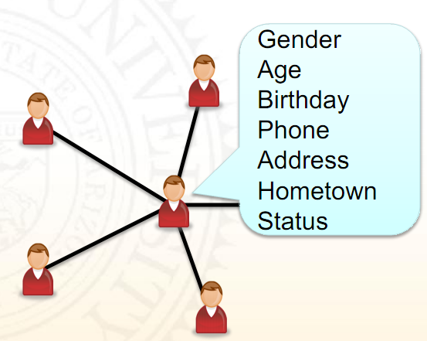
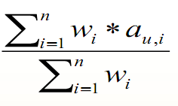
I-Index (Individual Index)
It estimates how much risk to privacy a user can have by allowing individual attributes to be visible to other users
I-index for user, u , is given by,
I_{u} = F(A_{u}) =
*Taken from Pritam’s slides
Notes:
Au is I-attribute set for user u and a_{u,i} is a status of a i-th I-attribute for user u.
a_{u;i} = 1 indicates user u has enabled i-th I-attribute to be visible otherwise non-visible (may be sensitive).
We used normalized weighted average to estimate I-index on our Facebook dataset.
Iu = 1 indicates user u has selected all I-attributes as visible.
On the other hand, Iu = 0 indicates that user u has selected all attributes to be non-visible.

Slide 24
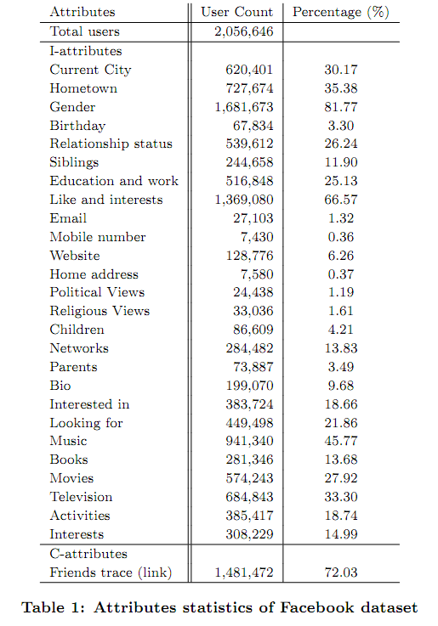
Facebook dataset of 2,056,646 users.
Define the sensitivity (weight), of an attribute as a percentage of non-visibility.
Notes:
The last column in the table lists the percentage of people who enable the particular attribute to be visible.
For example, 7,430 (0.36%) Facebook users enabled their mobile phone numbers to be visible.
Hence, the sensitivity of a mobile phone number according to our Facebook dataset is 99.64. This means that users do not usually disclose their mobile phone number to other users.
Users that do disclose phone numbers have a propensity to vulnerability because they disclose more sensitive information in their profiles.

Slide 25
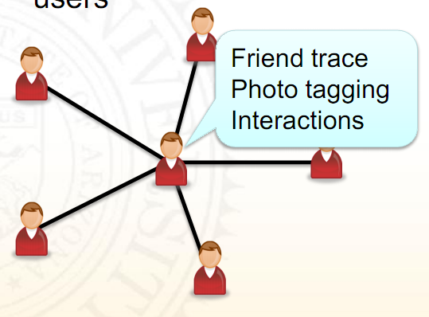
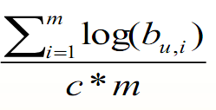

C-Index (Community Index)
It estimates how much threat a user can pose to their friends by making community attributes visible to their users
C-index of user u is given by,
C_{u} = G(B_{u}) =
*Taken from Pritam’s slides
Notes:
C-index is defined as a function of community attributes (C-attributes).
Bu is C-attributes set for user u.
b_{u;i} indicates the number of friends affected when a corresponding C-attribute is manifested.
We ignore attributes marked as non-visible.
Facebook dataset has only one C-attribute (see Table 1) which suggests how many friends are traceable (via a friend relationship) from an individual user.

Slide 26
C-Index (Community Index)
C_{u} = G(B_{u}) =
log (base 10) function to estimate the penalty for each user based on the number friends placed at risk by each C-attribute
average the C-index with constant c.
a large portion of users are either not careful or not aware of the security and privacy concerns of their friends.
Notes:
1,481,472 (72.03%) Facebook users in the dataset allowed friends trace to other users.
b_{u;i} indicates the number of friends at risk when corresponding C-attribute marked as visible.
Cu ∈[0; 1].
Cu > 0 indicates user u has allowed friends to trace friends to others though their own profile.
On the other hand, Cu = 0 indicates that all the friends (except one) of a user u are non-traceable through a profile.

Slide 27
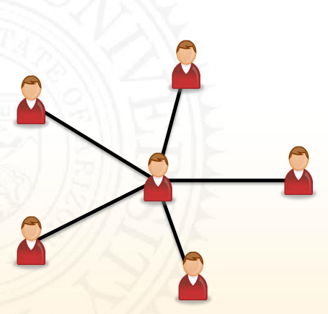


P-Index (Publicity)
It estimates how public (visible) or private (non-visible) a user is on a social networking site
  also indicates how much an individual user aims to protect self as well as their friends.
P-index of a user u is given by,
simple weighted average function
where
Tunable parameter α can be set to address a range of users.
*Taken from Pritam’s slides
Notes:
Different users may have different priorities about friends and may have different perspective about vulnerability.
gregarious users may use choose alpha < 0.5 to deemphasize the individual attributes visibility.
On the other hand, reclusive users may choose alpha > 0.5 to emphasize the individual attributes visibility.

Slide 28
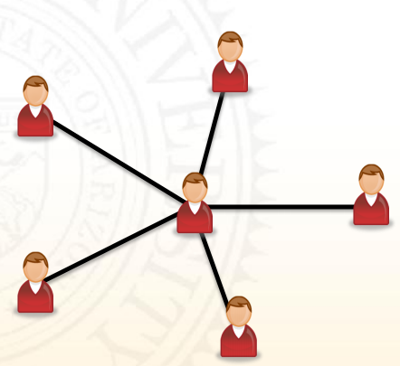
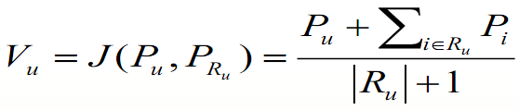
V-index (User Vulnerability)
It estimates how vulnerable a user is on a social networking site
V-index of a user u is given by,
where R_{u} is the set of friends of user u
*Taken from Pritam’s slides
Notes:
On a social networking site, vulnerability of a user depends on security and privacy settings of self, friends, their friends, and so on.
Intuitively, as the distance between a user and other users on a social networking site increases
The vulnerability risk contributed decreases rapidly the further away a user is from a vulnerable user.
Hence we only consider a user and friends in estimating the vulnerability of a user.

Slide 29
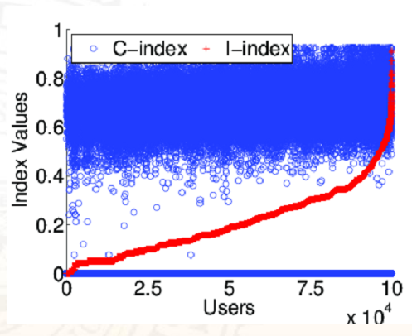
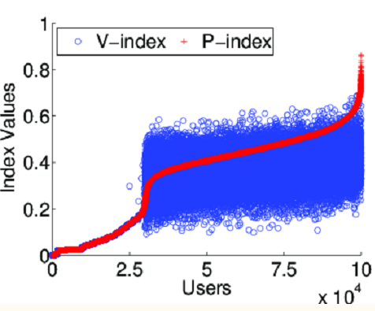
Relationships among Indexes
*Taken from Pritam’s slides

Slide 30
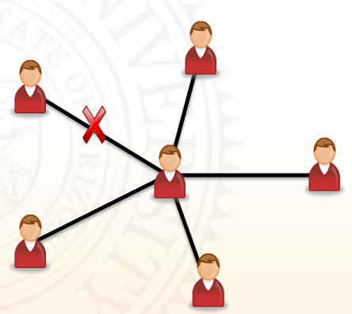
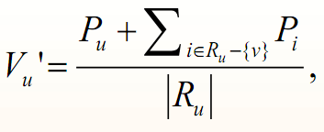


Vulnerable Friend
A vulnerable friend of a user is defined as a friend whose removal (unfriending) will lower the V-index score of a user.
The V-index of a user, u, upon removing the vulnerable friend, v, is given by
and
Can prove
*Taken from Pritam’s slides
Notes:
Vu < Pv means that P-index of a vulnerable node is always greater than V-index of a user before unfriending.

Slide 31
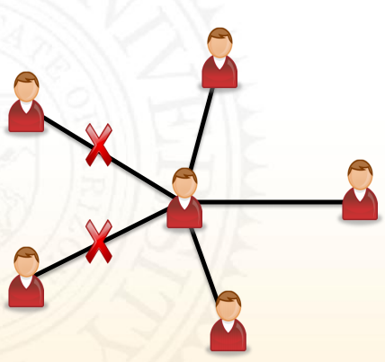
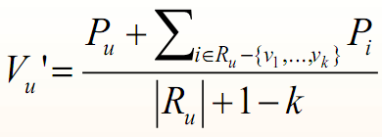

K-Vulnerable Friends
k-vulnerable friends of a user are k friends whose removal (unfriending) will lower the V-index score of a user.
The V-index of a user, u, upon removing the k-vulnerable friends, v₁,v₂,…,v_{k}, is given by
and
can prove that
*Taken from Pritam’s slides
Notes:
The definition of vulnerable friends can be generalized to k-Vulnerable friends.
This means that average P-index of k-vulnerable nodes is always greater than V-index of a user before unfriending.

Slide 32
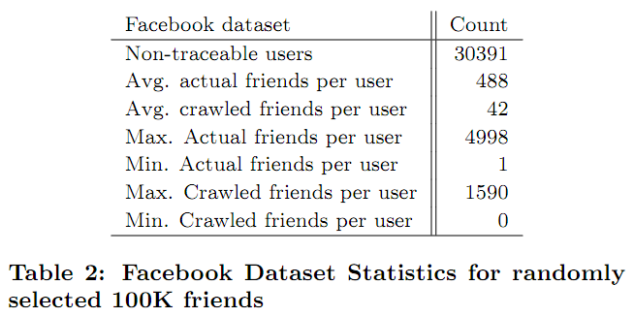
Facebook Data
created by crawling Facebook user profiles
Notes:
The dataset contains profile information for 2,056,646 users.
Profile information includes attribute information for users such as age, gender, mobile phone number, address, etc.
For convenience, 100K Facebook users were randomly selected from the dataset for the experiments.
The findings are validated using all 2M+ users.

Slide 33
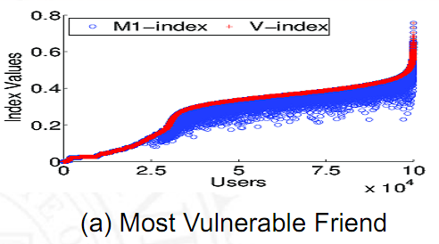
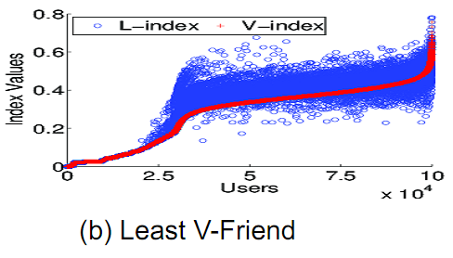
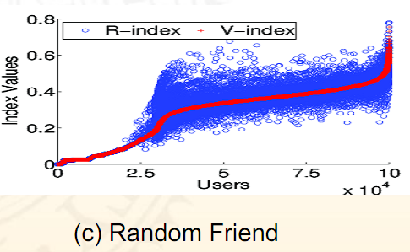
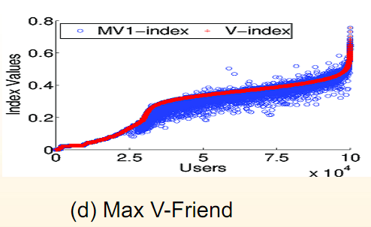
Performance Comparisons for Unfriending
*Taken from Pritam’s slides
Notes:
A Max vulnerable friend. For a user, the max vulnerable friend is the one whose removal lowers the V-index score the most.
A Two Max vulnerable friends. If we sort all of user's vulnerable friends in ascending order based on their new V-indexes (after unfriending), the top two in the list are the two max vulnerable friends.
A Min V-friend. For each user, we chose the friend whose V-index is lowest among all friends to unfriend.
This friend is the Min V-friend. V-index values increased for 65% of 100K users, and increased for 43% of the 2M+ users, in comparison with V-index values before unfriending with a random friend.
Vu’ > Vu for some users because, Pb < Vu where Pb is the P-index of the min V-friend. Unfriending with min V-friend does not make all users insecure.
A Random friend. For each user, we randomly chose a friend to unfriend. V-index values increased for 24% of 100K users, and increased for 23.5% of the 2M+ users, in comparison with V-index values before unfriending with random friend.

Slide 34
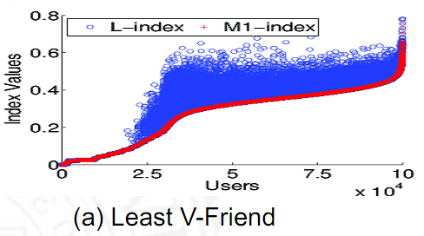
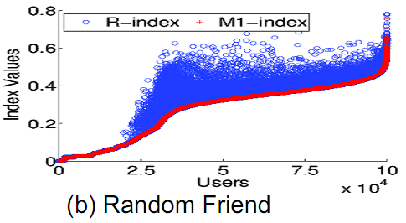
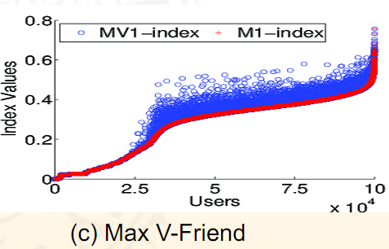
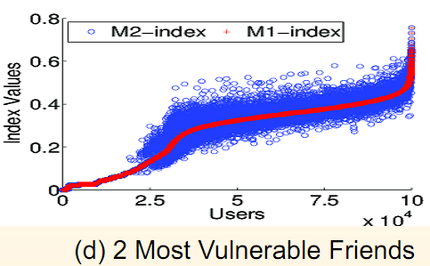
Comparing Unfriending Schemes with M1
*Taken from Pritam’s slides
Notes:
A Max V-friend. For each user, we choose a friend whose V-index is highest among all friends to unfriend.
V-index values for 3.6% of the test set of 100K users, and increased for 5% of the 2M+ users, in comparison with V-index values before unfriending with max V-friend.
Vu’ > Vu for some users because, Pg < Vu where Pg is the P-index of the max V-friend. Unfriending with max V-friend makes majority of users more secure.

Slide 35
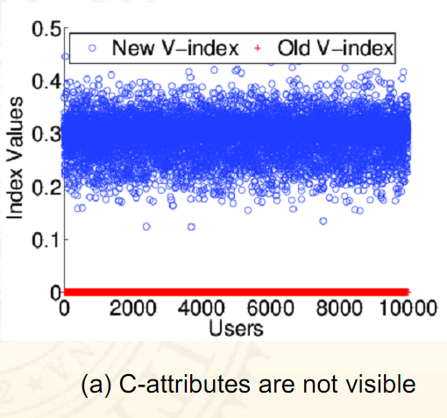
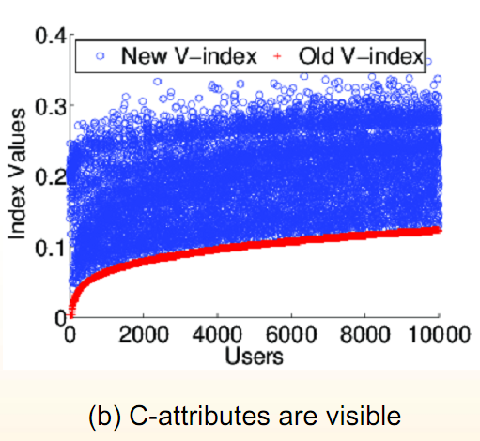
Impact of New Friends
*Taken from Pritam’s slides
Notes:
investigated the impact of vulnerable users and secure users on each other when new friends are introduced into a user's existing friend network.
This confirms less vulnerable users can become vulnerable if they are careless about new friends.

Slide 36
Conclusions
The authors proposed a feasible approach to a novel problem of identifying a user’s vulnerable friends, which allows for experimenting with various scenarios.
Privacy related efforts have concentrated on protecting mainly individual attributes.
  Users can be vulnerable through community attributes.
Unfriending vulnerable friends can help protect users against security risks.
Less vulnerable users can become more vulnerable if they are not cautious when making new friends.

Slide 37
Future Work
Many further directions to pursue. Some examples below.
  Can removing vulnerable friends from a user’s network decrease the utility of a social networking site?
  Can we suggest alternative/optimal strategies for unfriending vulnerable friends?
  What will be the impact of K-hop or fringe users on a user’s vulnerability?
  Exploring the tradeoff between a user’s degree of risk aversion and his public exposure.

Slide 38
discussion
How to set the tunable parameter α?
How can general social network users calculate the vulnerabilities of their friend without knowing the global network condition?
How do you decide whether to add a new friend or not without knowing his or her indices?
Does it make sense to use the V-index to show the result?

Slide 39

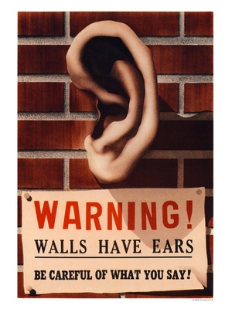
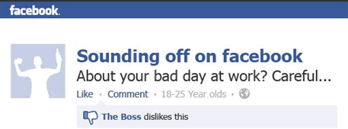
The Walls Have Ears:
Optimize Sharing for
Visibility & Privacy
in Online Social Networks
image via vinmag.com
image via AVG Tech.
Thang N. Dinh*, Yilin Shen, and My T. Thai
Dept. of Comp. & Info. Sci. and Eng., University of Florida,
Gainesville, Florida, USA 32611

Slide 40

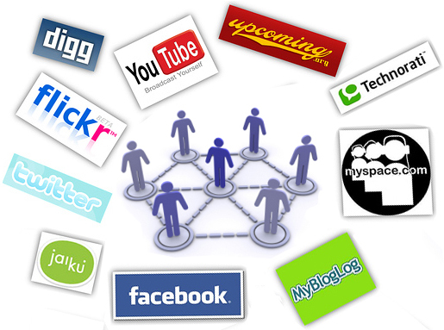
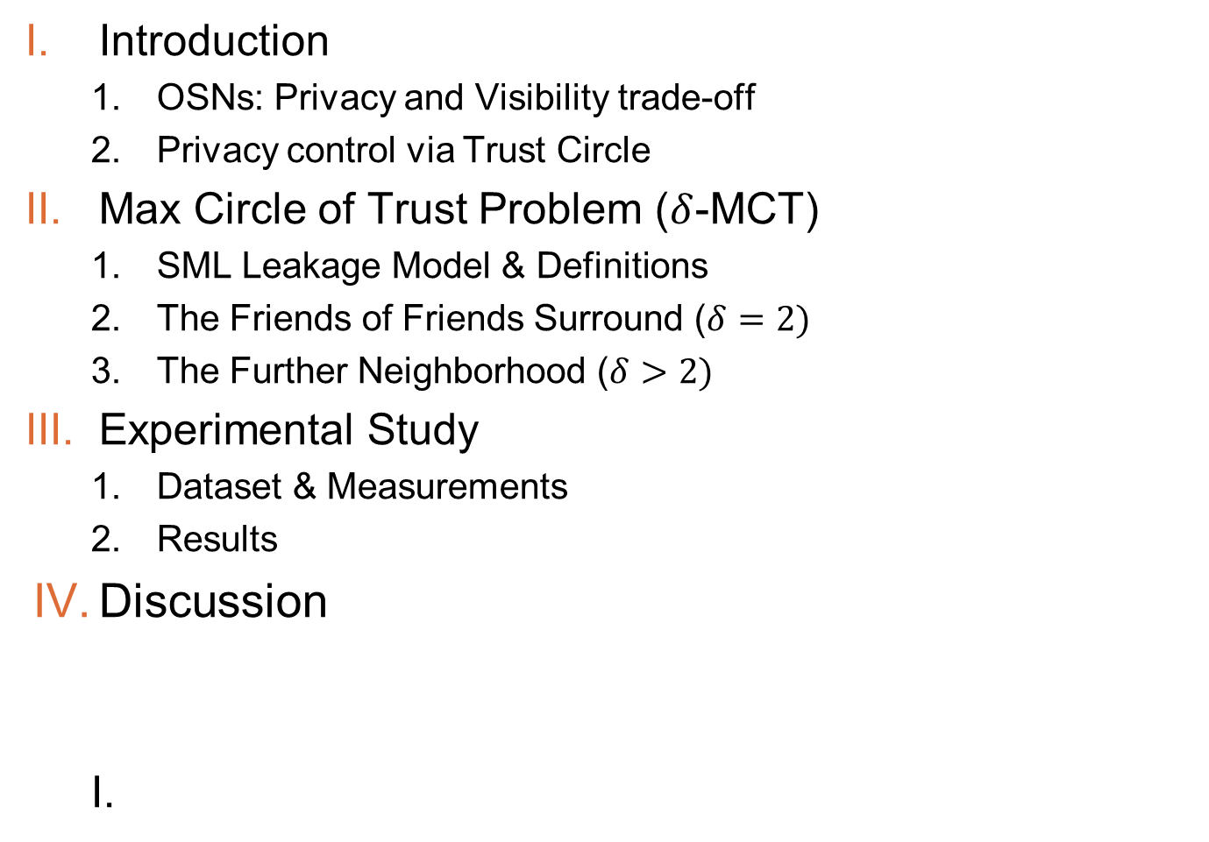
Outline
Introduction
  OSNs: Privacy and Visibility trade-off
  Privacy control via Trust Circle
Max Circle of Trust Problem ($δ$-MCT)
  SML Leakage Model & Definitions
  The Friends of Friends Surround ($δ=2)$
  The Further Neighborhood ($δ>2)$
Experimental Study
  Dataset & Measurements
  Results
Discussion
More visibility
More privacy

Slide 41
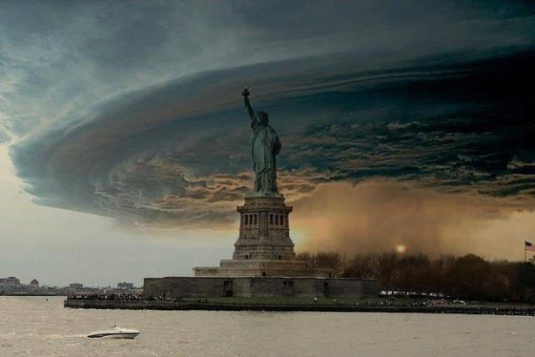

1.1 OSNs: Privacy-Visibility Trade-off
I. Introduction
Online Social Networks (OSNs):
  Keep friends & family & fans updated
  Networking, collaborating
  Promote brand name, product, etc.
  …
  Spread of misinformation
  Private information gets exposed to
  unwanted targets!
  …
Image via www.wikispaces.com
500,000 shares over 2 days
Girls Robbed After Posting Photo of Grandma’s Saving on Facebook
Dailymail, UK, May’12
Notes:
Misinformation: Wrong information gets to Right people
Privacy breach : Right information gets to Wrong people

Slide 42
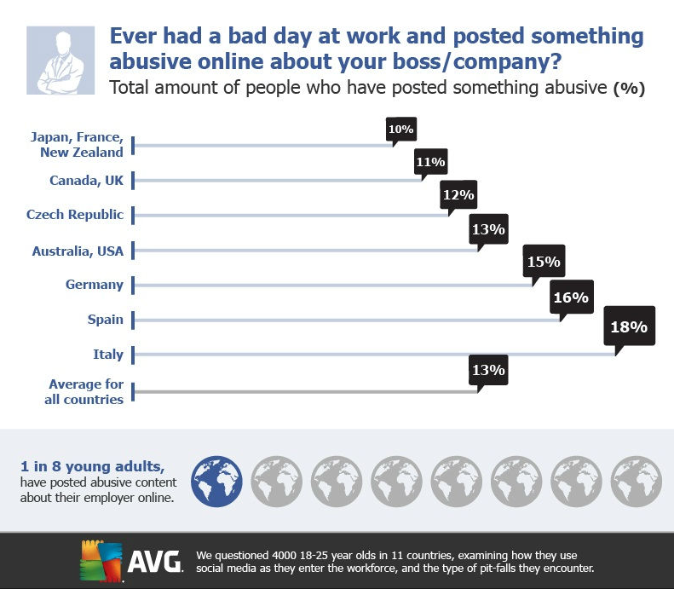
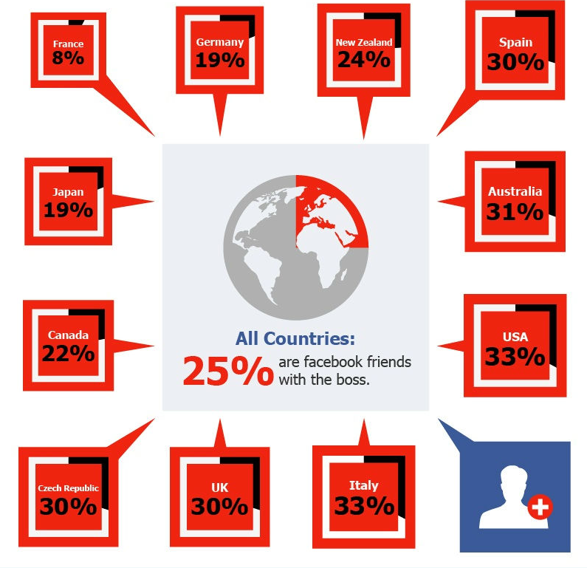
1.1 OSNs: Privacy-Visibility…(cont’d)
I. Introduction
Much of shared information is sensitive
  Location, pet name, car (security questions),
  your hobbies, interests
  Photos of Last Friday Night party
Unwanted targets (UTs)
  Criminal, sexual offender, etc
  OR “Less legitimate”: Parents, Bosses, etc. ☺
  OR users with weak privacy-settings who can expose your personal information
Unfriend with all unwanted targets?

Slide 43
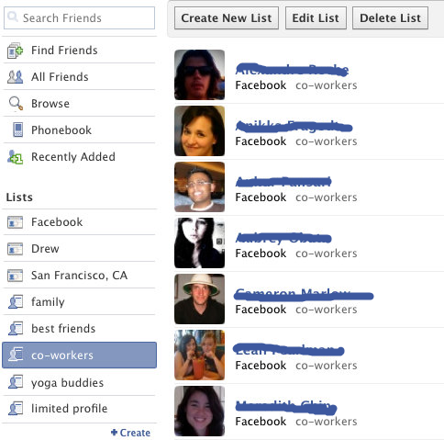
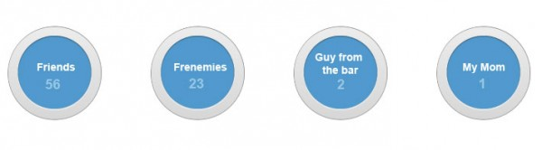
1.1 OSNs: Privacy-Visibility…(cont’d)
I. Introduction
Visibility – Privacy trade-off
  Do NOT use OSNs
  View-only: share-nothing accounts
  Selective sharing:
    Circles (Google +)
    Friend groups (Facebook)
Privacy
Visibility
Image via blogads.com
Image via blog.facebook.com

Slide 44
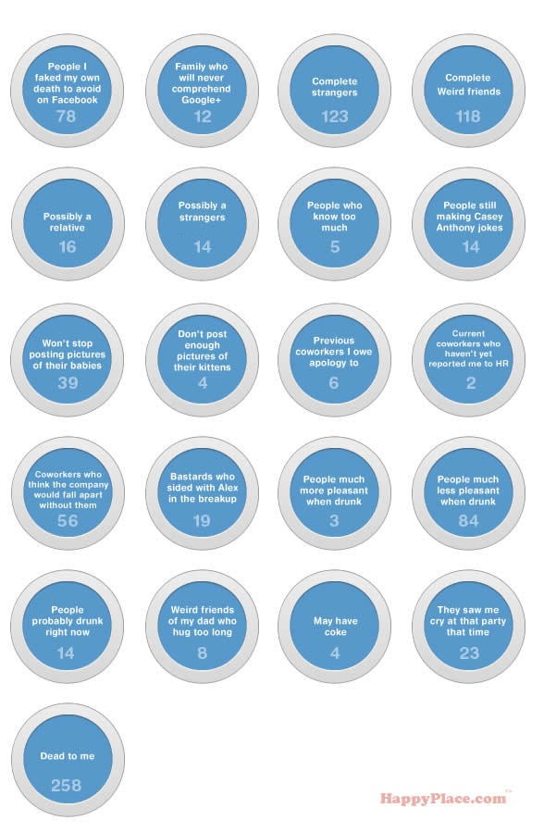
1.1 OSNs: Privacy-Visibility…(cont’d)
I. Introduction
Limitation of Selective Sharing:
  Manual customization for specific situation.
  Often do NOT consider connection pattern beyond the first hop.
  Unwanted targets might be hard to detect manually (access to criminal record, privacy-settings, etc.)
EXTREME
CIRCLING
Image via happyplace.com (with minor modification )

Slide 45
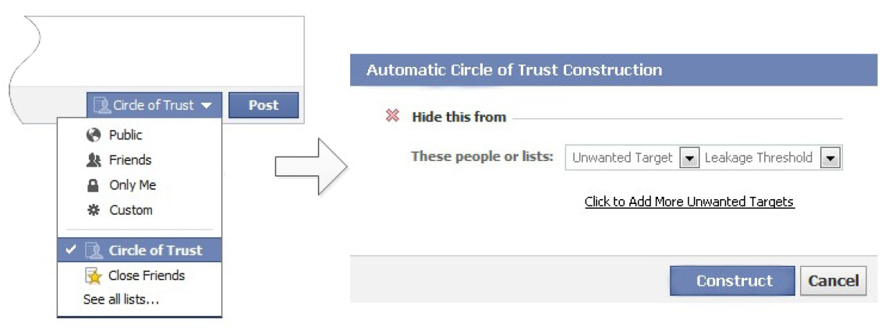
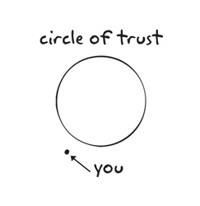

1.2 Privacy control via Trust Circle
I. Introduction
Our approach:
  Construct on-the-fly Trust Circle
Input:
  Unwanted targets
  A risk level $τ$of privacy breach
Output
  A trust circle (list of friends) that
    MAXIMIZE the visibility of the message
    The exposure risk to unwanted targets does not exceeds $τ$
Privacy
Visibility

Slide 46
1.2 Privacy control via Trust Circle
I. Introduction
Coming next !
  How the information leaks from the source?
  Method to compute the leakage probability w.r.t. particular unwanted target.
  On-the-fly algorithms to construct the trust circle for large OSNs.

Slide 47
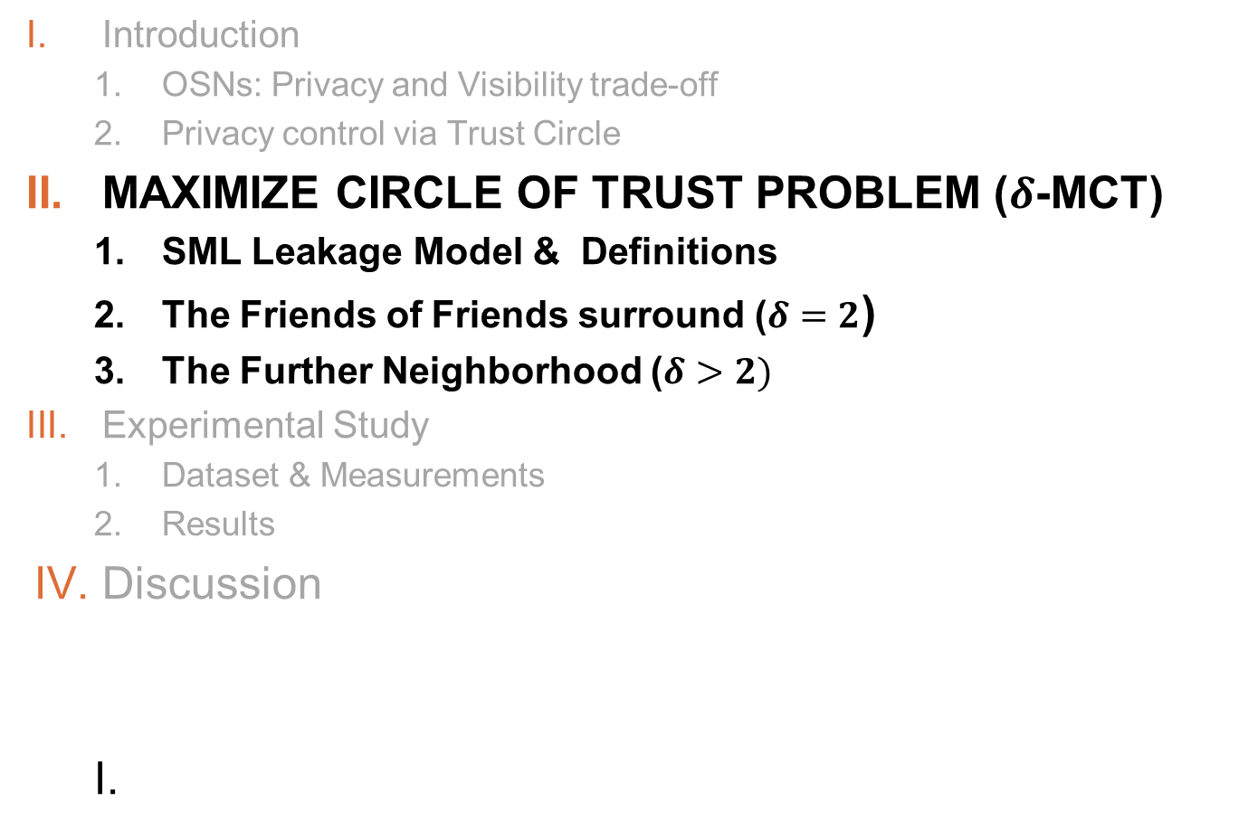
Outline
Introduction
  OSNs: Privacy and Visibility trade-off
  Privacy control via Trust Circle
MAXIMIZE CIRCLE OF TRUST PROBLEM ($δ$-MCT)
  SML Leakage Model & Definitions
  The Friends of Friends surround ($δ=2$)
  The Further Neighborhood ($δ>2)$
Experimental Study
  Dataset & Measurements
  Results
Discussion

Slide 48
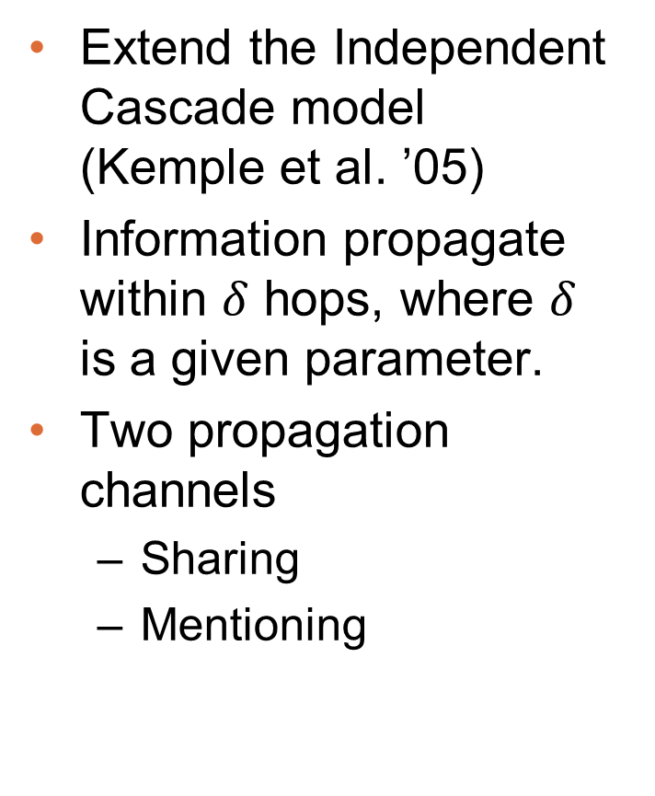
2.1 SML Leakage Model & Definitions
II. Max. Tr. Cir.
Extend the Independent Cascade model (Kemple et al. ’05)
Information propagate within $δ$ hops, where $δ$ is a given parameter.
Two propagation channels
  Sharing
  Mentioning

Slide 49
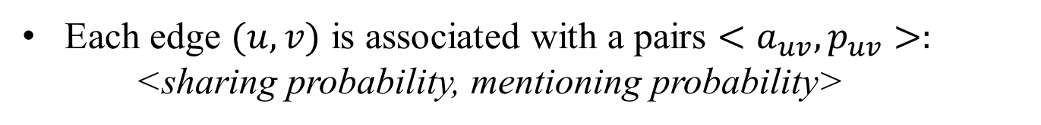
2.1. SML Model & Defs (cont’d)
II. Max. Tr. Cir.
Each edge $(u, v)$ is associated with a pairs $<a_{uv}, p_{uv}>:$
<sharing probability, mentioning probability>
Sharing
Mentioning
Provided by OSNs e.g. “Retweet”, “Sharing”, “Reply”.
The message is duplicated.
Can be tracked or prohibited by OSNs provider
Retype the message or part.
Paraphrasing
Might be challenging to track

Slide 50
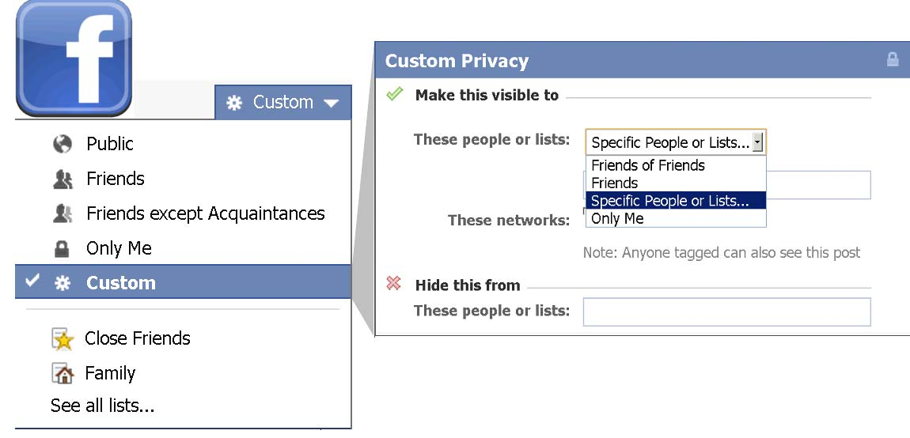
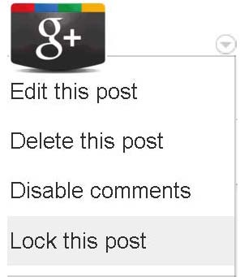

2.1. SML Model & Defs (cont’d)
II. Max. Tr. Cir.
Information leaks from the source to an unwanted target via a leakage path.
Leakage path: a path $<s=v_{0}, v_{1},v_{2},…,v_{l}=t>$ in which each edge $\left(v_{i}, v_{i+1}\right)$ is either
  A sharing edge: if $v_{i+1}$learns about the message from $v_{i}$ via sharing
  A mentioning edge: if $v_{i+1}$ learns about the message from $v_{i}$ via mentioning.
Facebook: ‘Hide this from’ function → A leakage path must have at least one mentioning edge.
Google+: ‘Lock this post’ function → The second edge on any leakage path must be an mentioning edge.

Slide 51
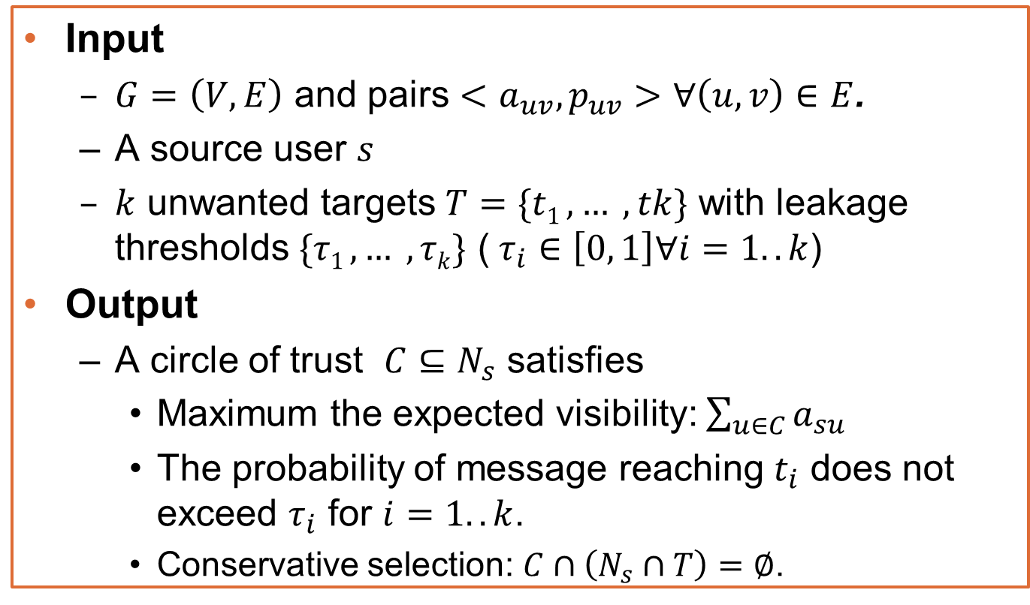
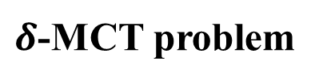
2.1. SML Model & Defs (cont’d)
II. Max. Tr. Cir.
$δ$-MCT problem
Input
  $G=\left(V, E\right)$ and pairs $<a_{uv}, p_{uv}>$ $∀\left(u, v\right)∈E$.
  A source user $s$
  $k$ unwanted targets $T=\{t1 , … , tk\}$ with leakage thresholds $\{τ1 , … , τk\}$ ($τ_{i}∈\left[0, 1\right]∀i=1..k$)
Output
  A circle of trust $C⊆N_{s}$ satisfies
    Maximum the expected visibility: $\sum_{u∈C}{a_{su}}$
    The probability of message reaching $t_{i}$ does not exceed $τ_{i}$ for $i=1..k$.
    Conservative selection: $C∩\left(N_{s}∩T\right)=∅$.

Slide 52

Single-2-MCT Problem
Bad News: NP-hard
Idea of proof: reduced from SUBSET SUM PROBLEM
Two terminal nodes s, t and n nodes N_{i} for each item in I
For each node N_{i} , add an edge from s to it with $a_{si}=−\frac{z_{i}}{\sum_{i}{z_{i}}}$ and $p_{si}=1−e^{−\frac{z_{i}}{\sum_{i}{z_{i}}}}$
For each node N_{i} , add an edge from it to t with $a_{si}=p_{si}=1$
Leakage threshold $τ=1−e^{−\frac{z_{i}}{\sum_{i}{z_{i}}}}$

Slide 53


Single-2-MCT Problem(Cont’d)
Good News: FPTAS algorithm
Idea of Algorithm:
Dynamic programming
L_{i}(a) be the minimum leakage probability of a subset of s’s first i friends with the circle of trust of size equal to a

Slide 54

Single-2-MCT Problem(Cont’d)
Lemma 1: Algorithm 1 is a (1-ε)-approximation algorithm of Single-2-MCT.
Lemma 2: Algorithm 1 has the running time of$O\left(\frac{{S_{n}}_{}^{3}}{ε}\right)$ .
Theorem 1: Algorithm 1 is an FPTAS approximation algorithm for Single-2-MCT.

Slide 55

Bounded-2-MCT Problem for k≥2
Bad News: No FPTAS algorithm
Idea of proof: reduced from EQUIPARTITION PROBLEM
A source node s, two unwanted targets t₁ and t₂ and n nodes N_{i} for each item in I
For each node N_{i} , add an edge from s to it with $a_{si}=p_{si}=1$
For each node N_{i} , add an edge from it to t₁ and t₂ with mention probability $p_{i1}=1−e^{−\frac{π_{i}}{\sum_{i}{π_{i}}}}$ and $p_{i2}=1−e^{−\frac{{π_{max}−π}_{i}}{{nπ}_{max}−\sum_{i}{π_{i}}}}$
Leakage threshold $τ_{1}=τ_{2}=1−e^{−\frac{1}{2}}$

Slide 56

Bounded-2-MCT Problem(Cont’d)
Good News: PTAS algorithm
Integer Linear Programming (ILP) formulation

Slide 57


Bounded-2-MCT Problem(Cont’d)
Two-Phase Algorithm:
$β=min\left\{\left\lceil \frac{k}{ε}\right\rceil −\left(k−1\right),\left|N(s)\backslash T\right|\right\}$
When the number of visible neighbors of s is less than β, enumerate and select a feasible solution with a maximum visibility
Otherwise, for each combination of size β, solve the LP on each combination and update the solution if it is better

Slide 58

Bounded-2-MCT Problem(Cont’d)
Lemma 3: Algorithm 2 is a (1-ε)-approximation algorithm of Bounded-2-MCT.
Lemma 4: Algorithm 2 has the running time of$O\left({S_{n}}_{}^{\left\lceil \frac{k}{ε}\right\rceil }\right)$ .
Theorem 2: Algorithm 2 is an PTAS approximation algorithm for Bounded-2-MCT.

Slide 59



2.2 The Friends of Friends Surround
II. Max. Tr. Cir.
$δ=2$: Leakage path = one sharing edge followed by one mentioning edge.
Leakage probability at each UT can be computed exactly. Leakage constraint:
2-MCT as an Integer Linear Programming

Slide 60


2.2 The Friends of Friends Surround
II. Max. Tr. Cir.
Polynomial time solvable for $δ=2$?
No, still NP-hard.
Even worse
A gap-reduction from the Max-clique problem, which is NP-hard to approximate within $n^{1/2−ε}$ (Hastad).
The more UTs, the harder the problem!
Theorem 1. For any $ε>0$, 2-MCT is hard to be approximated within a factor
$k^{1/4−ε}$, unless P = NP
$k^{1/2−ε}$, unless P = ZPP (Las Vegas algorithms)

Slide 61


2.2 The Friends of Friends Surround
II. Max. Tr. Cir.
Good news: Randomized algorithm with a performance guarantee $O(1/k)$.
Two-phase Algorithm:
  Phase 1: Solve LP relaxation and select $u∈N_{s}$ with probability $\frac{x_{u}}{4k}$ ; Output temp. circle $C_{}$
  Phase 2: Make the rounded solution feasible by iteratively remove the neighbor that causes leakage. Output trust circle $C′⊆C_{}.$
Theorem 2. $C^{′}$ is a trust circle with probability one, and $C′$ has the expected visibility at least $O(1/k)$ times the optimal expected visibility.

Slide 62





2.2 The Friends of Friends Surround
II. Max. Tr. Cir.
$C′$ is valid with
probability one.
The expected
visibility:

Slide 63

General δ-MCT Problem
How hard is this problem when allowing more than 2 hops propagation? Bad News: #P-hard
Idea of proof: reduced from 3-Conn₂ PROBLEM
Two terminal nodes s, t
For each edge e in G, set its$a_{e}=\frac{1}{N(s)}+ε$ and $p_{e}$ as the probability in the instance of 3-Conn₂
Add a two-hop disjoint path between s and t onto the graph G with the intermediate node u with $a_{su}=a_{ut}=p_{su}=1$ and $p_{ut}=r^{′}$ for some arbitrary $r^{′}$

Slide 64



2.3 Further Neighborhood $(δ>2)$
II. Max. Tr. Cir.
$δ>2:$ Given a trust circle $C$, compute the leakage probability at an UT $t_{j}$ is #P-hard.
Assume an oracle that estimate $l_{j}(C)$ the leakage probability at $t_{j}$.
General Iterative Greedy (IGC) for $δ$-MCT:
  Growing the circle from empty
  Pick the `candidate’ which maximize
  Stop when cannot select any more ‘candidate’.

Slide 65


2.3 Further Neighborhood $(δ>2)$
II. Max. Tr. Cir.
Greedy function
$l_{j}^{(v)}=l_{j}(C+\{v\})/τ_{j}$ is the normalized leakage level at $t_{j}$ after adding $v$.
$1−l_{j}^{(v)}$: Leakage tolerance at $t_{j}$
$\sum_{u∈L}{l_{j}^{u}−l_{j}^{(v)}}$: Potential leakage to $t_{j}$, adding $v$

Slide 66

2.3 Further Neighborhood $(δ>2)$
II. Max. Tr. Cir.
Oracles to estimate leakage: Key procedure in IGC, decide both solution quality and running time.
Proposed oracles:
  Bi-state Sampling Estimation: High quality | Slow
  Cut-based Estimation: Low quality | vFast
  Hybrid-approach: High quality | Fast
Bi-state Sampling Estimation:
  Generate sample of the graph, state for each edge:
  < sharing | mentioning >
  Count samples with Leakage path(s) using a modified BFS.
  Running time : $O( S \left(m+n\right))$, where $S$ : # sampling

Slide 67



2.3 Further Neighborhood $(δ>2)$
II. Max. Tr. Cir.
Cut-based Estimation: An upper-bound for the leakage probability.
Find disjoint cut-sets that leave
no leakage path in the graph.
Time complexity:
$O(m+n)$.
Important for stop criteria

Slide 68

2.3 Further Neighborhood $(δ>2)$
II. Max. Tr. Cir.
Hybrid approach:
  Construct $C$ using IGC with Cut-based Estimation
  Sort ${u∈N}_{s}∖C$ in non-decreasing order of $a_{su}$
  Add node to $C$ in that order while possible, using
  bi-state sampling to estimate leakage.
Reduce # sampling substantially!!!
Fix the “early stop” problem.

Slide 69

Outline
Introduction
  OSNs: Privacy and Visibility trade-off
  Privacy control via Trust Circle
Max Circle of Trust Problem ($δ$-MCT)
  SML Leakage Model & Definitions
  The Friends of Friends Surround ($δ=2)$
  The Further Neighborhood ($δ>2)$
EXPERIMENTAL STUDY
  Dataset & Measurements
  Results
Discussion

Slide 70
3.1 Dataset & measures
III. Experiments
Dataset
Dataset | Nodes | Edges | Avg Degree | Source
Facebook | 63,731 | 905,565 | 4.46 | Ref [18]
Twitter | 88,484 | 2,364,322 | 3.02 | Sampling in [5]
Foursquare | 44,832 | 1,664,402 | 8.28 | Our data
Facebook: undirected network
Twitter and Foursquare: directed networks

Slide 71



3.1 Dataset & measures
III. Experiments
Algorithms:
  Sampling: IGC + Bi-state Sampling Estimation
  Non-sampling: IGC + Cut-based Estimation
  Hybrid: IGC + Hybrid approach
  Randomized-Rounding ($δ=2)$: Approx. Algo.
  Optimal ($δ=2)$: Optimal solution by solving the Integer Program using CPLEX
  Removal-greedy: Our previous sampling algorithm.
Measurement:
  Visibility (%): Percentage of visibility i.e.
  CT size (%): Fraction of users i.e.

Slide 72


3.2 Results: Performance
III. Experiments

Slide 73


3.2 Results: Ties’ strength + celebrity
III. Experiments

Slide 74

3.2 Results: Common friends & Celebrity friends
III. Experiments

Slide 75
4. Discussion
Discussion
  The proposed solution can be adapted to
  other propagation models.
  Determine sharing/mentioning probabilities (e.g. using influence probabilities estimation methods Anagnostopoulos et al., Tang et al., Goyal et al., etc.)
  Apply selective sharing concept to other information control problems.

Slide 76
Social Network Sensors for Early Detection of Contagious Outbreaks
Nicholas A. Christakis1,2*, James H. Fowler3,4
1 Faculty of Arts & Sciences, Harvard University, Boston, Massachusetts, United States of America,
2 Health Care Policy Department, Harvard Medical School, Boston, Massachusetts, United States of America,
3 School of Medicine, University of California San Diego, La Jolla, California, United States of America,
4 Division of Social Sciences, University of California San Diego, La Jolla, California, United States of America

Slide 77



Slide 78


Slide 79
Local Approach
Friendship Paradox: Your friends have more friends than you do
Monitor friends of randomly chosen people to provide early detection
Data:
  Collect data from Sept 1, 2009 to Dec 31, 2009 at Harvard
  Randomly select 319 students from 6,650 students (for group 1)
  Group 2: friends of these 319 students

Slide 80



Slide 81


Slide 82





Towards Real Time Epidemic Vigilance through Online Social Networks
SNEFT – Social Network Enabled Flu Trends
    Lingji Chen [1]
    Harshavardhan Achrekar [2]
    Benyuan Liu [2]
    Ross Lazarus [3]
[1] Scientific Systems Company Inc , Woburn, MA
[2] Computer Science Department, University of Massachusetts Lowell
[3] Department of Population Medicine - Harvard Medical School
MobiSys 2010, San Francisco, CA, USA

Slide 83
Outline
    Background
    Related Work
    Our Approach
    SNEFT System Architecture
    Detection and Prediction
    Initial Stage Results
    Conclusion

Slide 84


Seasonal flu
  Influenza (flu) is contagious respiratory illness caused by influenza viruses.
  Seasonal - wave occurrence pattern.
  5 to 20 % of population gets flu
  ≈ 200,000 people are hospitalized from flu related complications.
  36,000 people die from flu every year in USA.
  worldwide death toll is 250,000 to 500,000.
  Epidemiologists use early detection of disease outbreak to reduce no. of people affected.

Slide 85

Historical Background
Historical Data | Flu Pandemic /1918 Spanish flu | SARS | Swine Flu/H1N1
Cause | overreaction of body’s immune system | SARS coronavirus | Swine Influenza Virus
Origin | USA & France before getting to Spain. | Guangdong, China | USA and Mexico
Infected Masses/Areas | predominant in healthy young adults as opposed to juvenile,elderly or weak. | 37 countries including USA | 207 countries
Timeline | Mar 1918 - Jun 1920 {World war I} | Nov 2002 - Jul 2003 | Aug 2009 onwards
Infected cases | 500 million {1/3 of world’s population} | 8,273 | 622,482 so far
Deaths | 50 million (3% of world’s population) {1.6 billion at that time} | 775 | 15,174 so far

Slide 86


Related Work :- Google Flu Trends
  Certain Web Search terms are good Indicators of flu activity.
  Google Trend uses Aggregated search data on flu indicators.
  Estimate current flu activity around the world in real time.
  Accuracy of data
  {not every person who searches for “Flu” is sick}
Link:- www.google.com/flutrends
CDC stands for Center for Disease Control

Slide 87


Our Approach
  OSN emerged as popular platform for people to make connections,share information and interact.
  OSN represent a previously untapped data source for detecting onset of an epidemic and predicting its spread.
  {“i am down with flu”, “get well soon”} msg exchange between users provide early ,robust predictions.
  Twitter/Facebook mobile users tweet/posts updates with their geo-location updates. helps in carrying out refined analysis.
  User demographics like age, gender, location, affiliated networks.,etc can be inferred from data.
  snapshot of current epidemic condition and preview on what to expect next on daily or hourly bases.
User Population (in millions)
  FaceBook:- 400 ,
  Myspace:- 200 ,
  Twitter:- 80

Slide 88
System Architecture of SNEFT
Data Collection Engine
ILI
Pre-
diction
downloader
ILI
Data
ARMA Model
Internet
Novelty
Detector
Flu
Warn-
ing
crawler
OSN
Data
Filter /
Predictor
State
Esti-
mate
OSN models
Math models
ILI stands for Influenza-Like Illness

Slide 89
Components of SNEFT Architecture
  Data Collection
    Downloader :- stores CDC ILI data/reports into ILI Database.
    Crawler :- collect publicly available data from online social networking sites.
      choose a list of keywords that are likely to be of significant.
      use OSN public search interfaces to collect relative keyword frequencies.
      store relevant information in a OSN spatio-temporal database.
  Novelty Detection
    Detecting transition from "normal" baseline situation to a pandemic in real time by monitoring volume and content of OSN data.
    provide timely {early stage} warning to public health authorities for investigations.

Slide 90
Components of SNEFT Architecture
    ILI prediction / ARMA [Auto-regressive Moving Average] Model
      build ARMA model to predict ILI incidence as a linear function of current and past OSN data and past ILI data.
      provide valuable ‘‘preview’’ of ILI cases well ahead of CDC reports.
    Integration with mathematical models
      Mathematical models to understand dynamics of influenza spread & effects of intervention. parameters are obtained by fitting historical data.
      build an "OSN sensor model" which describes what would be observed on OSN if the population is infected as such and such."
      integrate real time OSN data with the prediction of mathematical models, to obtain a posterior estimate of the " infected state" of the population.
      possible parameter values not consistent with OSN observations are weighted less, while those consistent are weighted more.
      OSN data "sharpen" the prediction of mathematical models.

Slide 91
OSN Data Collection
Result Set
(Public Posts)
containing Keywords
HTML Content
Scrapper
Facebook
Search
API
Content , Timestamp
Database
Profile Id
Facebook Profile
Scan Engine
Individual Users
Profile Info , Location Details
Organizations
Community
Design of the Facebook data collection engine / Crawler

Slide 92


Facebook Data Collection / Crawler
Facebook Search Engine
  sign-in with a valid account.
  enter keyword to search with "Post by everyone" option to retrieve status updates and posts of users containing the keyword.
Result Set containing Keyword
  Privacy settings :- user can publish his post/update to friends, group, or everyone.
  The "everyone" option (default setting) makes corresponding updates available to public and searchable by Facebook search engine.
  Results are available for public viewing for limited time span.

Slide 93
Facebook Data Collection / Crawler
    HTML Content Scrapper
      a screen scrapper for web pages.
      extract useful information out of posts that are returned as result set from the keyword search.
      Search response HTML content is input onto DOM Parser/Regular expression matcher and techniques of pattern matching are applied.
      retrieve
        profile ID
        time-stamp of the post
        post content {with story_id}.

Slide 94
Facebook Data Collection / Crawler
    Facebook Profile Scan Engine
      Given a profile ID, we will retrieve the detailed information of the profile
        name
        gender
        age
        affiliations (school, work, region)
        birthday
        location
        education history
        friends count.
        Profile last update time.
      profile may belong to an individual user, an organization, or a community.

Slide 95
Constraints in OSN Data Collection
    Search Rate Limit
    Return Result Limit
    User Activity Pattern
      disparities in user activities
        different hours of the day
        days of a week
        special holidays.
    Continuous Data Collection/ prevent Data Loss
      schedule search time to guarantee complete set of blog posts containing the keywords, no gap in the collected data.

Slide 96
Mitigation
    Search Rate Limit Constraint Resolution
      launch multiple concurrent search sessions from different IP addresses.
      to coordinate among themselves and collect data at different time intervals so that each session is within the search rate limit.
    Return Result Limit
      continuous http request and store response.
    Continuous Data Collection mechanism

Slide 97
Exponentially Weighted Moving Average (EWMA) scheme in OSN Data Collection
  EWMA Scheduling Mechanism to prevent data Loss
    volume of returned search results determine no. of active search sessions .
    Denote the estimated average and current search result volume at search round k by v(k) and u(k), respectively, α is the smoothing factor that reflects the weight of the previous estimate. EWMA(search result volume) is computed as follows:
    v(k) = αv(k-1) + (1 - α)u(k)
    If the required rate exceeds the rate limit, new search sessions will be triggered to share the load.
    When the search result volume becomes lighter, the number of active search sessions will be reduced.

Slide 98
Detection and Prediction (SIR Model)
Susceptible-Infectious-Removed (SIR) model where the dynamics of the population in each compartment is described by
dS = -βSI;
dt
dI = βSI -ϒI;
dt
R = N - S - I;
N being the total population, β the transmission rate , ϒ the recovery rate.
let x(t) be the "state" of the population, which in this case is given by x = [S,I]^{T} . θ be the parameter vector used in model, which is given by θ= [β,ϒ] ^{T} .
Transition Probability of disease spread
Susceptible
Loss of
immunity
Infection
Removed
Infectious
Recovery
(or death)
Prob(x(t+1) |x(t), θ)

Slide 99


Initial Stage Results

Slide 100
Conclusion and Future Work
  achieve faster and near real time detection.
  predict emergence and spread of influenza epidemic.
  presented the design of a system called SNEFT, for collecting and aggregating OSN data, extracting information from it, and integrating it with mathematical models of influenza.
  OSN data - individually noisy but collectively revealing.
  potential use - disaster relief, supply chain management , epidemic vigilance.

Slide 101

Deceptive Messages!
Everything is on OSNs, including deceptive messages, which quickly propagate through the network
  recent shootings at Fort Hood, Texas, when a soldier inside the base sent out messages via Twitter as the event unfolded. Her incorrect reports of multiple shooters and shooting locations quickly spread through the social networks and even to the mass media
  the spread of misinformation on swine flu in Twitter. The spread of misinformation in this case reached a very large scale causing panic in the population

Slide 102


Misinformation (bad) effects

Slide 103

Difficulties
OSNs are of large-scales …
  Millions users & billions of connections
  Immunization: which tweets/posts are bad?
  From whom should we fix the misinformation?
Time constraint
  Correct misinformation before it is too late
A potential approach
  Let good information “fix” misinformation

Slide 104
Information campaigns
Good information spread
  By authorized users
  By multiple direct activations
Campaign scenarios
  Good info first
    Immunization
  Misinformation first
    Good info “corrects” misinfo accordingly
  Simultaneously?
    Good info “wins over” misinfo

Slide 105

What we study
How can misinformation be effectively contained?
    What is the tightest set S of people whose dissemination with “good info” achieves a desired (1- β) misinformation containment ratio?
      When source set I is known or unknown.
      When time T is constrained or unconstrained.
β^{I}_{T}-Node Protector
|S| = 4
|S| = 1

Slide 106
What we study (cont’d)
The goodness of the greedy solution
  A linear additive error
  An (experimentally) better lower bound of the optimal solution
The effect of network community structure
  A more intuitive & faster method
  Competitive node selection results

Slide 107


Graph model
An OSN is modeled as a directed graph
  Nodes ← users, edges ← relationships
  Nodes are either active or inactive
  An active node can further activate its neighbors

Slide 108


Diffusion models
Independent cascade
A
B
B
0.2
0.5
0.6
0.4
t
(t+1)
Linear threshold
0.2
0.25
B
B
0.1
0.1
0.3
0.25
0.2
θ = 0.5
t
(t+1)

Slide 109
Diffusion models (cont’d)
Dissemination model
  The same as the diffusion model
Assumption
  Good information wins over bad info

Slide 110

β^{I}_{T}-Node Protector
    In the presence of misinformation spread out from a source set I. Find the smallest set S of nodes whose dissemination with “good info” expectedly achieves a desired decontamination ratio β after T time steps.
      β-NP: I is unknown, T is unconstrained
      β^{I}-NP: I is known, T is unconstrained
      β_{T}-NP: I is unknown, T is constrained
      β^{I}_{T}-NP: I is known, T is constrained
All β^{I}_{T}-Node Protectors are NP-hard

Slide 111
Differences from
Influence Maximization
No k-node budget
  Instead, we have the desired ratio β
  Good & bad information campaigns
Time constraint T.
The knowledge of the source set I.

Slide 112


β-NP: A greedy approach
Greedy (Hill-Climbing) Algorithm
At every step, include the node u having the maximum marginal gain
to the solution S_{k}, until σ(S_{k}) ≥ βN.
HC offers a (1-1/e)-approximation factor to Influence Maximization problem
  How about in Node Protector problems?

Slide 113


β-NP: Solution analysis
Goyal et al. [2]
Bigger β → more nodes to include and vice versa
Greedy solution selects ≤ 36% of βN
  The bigger δ → the tighter the additive error.
A (better) observation on the lower bound of the Optimal solution

Slide 114

β^{I}_{T}-NP: Inapproximability
A reduction from Set Cover problem
×
|S_{A}|
Nonexistence of any logarithmic approximation algorithm A for β^{I}_{T}-NP
|OPT|
(min)
clnN×|OPT|

Slide 115





β^{I}_{T}-NP: Greedy solution
T is constrained: look for N_{T}(u)
I is known: look for N_{T}(I)
Apply the greedy algorithm on G_{NT(I)}

Slide 116
Experimental Setup
Datasets
  NetHEPT: 15233 nodes – 31398 links
  Facebook: 63731 nodes – 1.6M links
Other methods (ref [3])
  Random
  High degree
  DiscountIC
  Page Rank

Slide 117



Results for β-Node Protector
NetHEPT
NetHEPT_WC
Facebook

Slide 118



Results for β^{I}₅-Node Protector
NetHEPT
NetHEPT_WC
Facebook

Slide 119
A community-based approach
HC greedy algorithm is ...
  Good but (too) slow
  Not ideal for large-scale networks
Why community structure?
  A common property of OSNs
    Natural structure of the networks
  A quicker method with comparative results

Slide 120

Community structure
Network communities
  Densely connected inside
  Less connections crossing communities
Community structure detection
  The identification of network communities
+ Strong influence within each community
+ Less influence across communities

Slide 121
A social-based method
Detect network communities
  Using Blondel’s method [1]
  Fast and with high reliability
High influential node selection
  Apply greedy alg. in each community
    Strong influence within each community
    Less influence across communities
    Quick

Slide 122


Results

Slide 123
Summary
Greedy HC algorithm is good
  Best solutions with approximation guarantee(s) for
  β^{I}_{T}-Node Protectors.
  Slow & ideal for small-sized networks
Another point of view into the lower bound of the optimal solution
Community structure is helpful
  Explores the natural structure of the network
  Expedites the execution with good results

Slide 124
Stop Misinformation
Method: Via the social networks by sending corrected messages
Goal: limit the number of people that adopt the deceptive message at the end of both propagation processes by selecting the minimum number of nodes to be “disinfected” initially
Note: It is different with the immunization problem in epidemiology since the immunization process is not propagated in this setting

