Slide 1
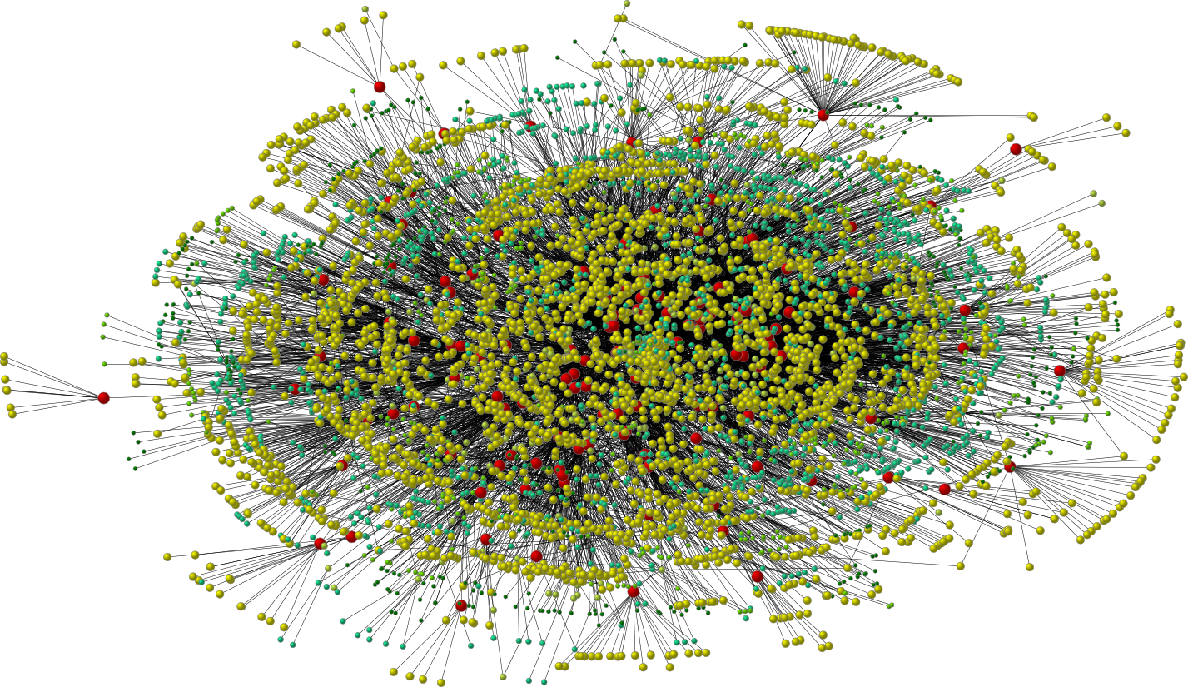

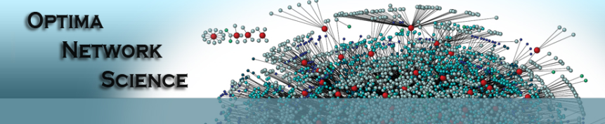
Social influence: models & analysis
My T. Thai
mythai@cise.ufl.edu
http://www.cise.ufl.edu/~mythai

Slide 2



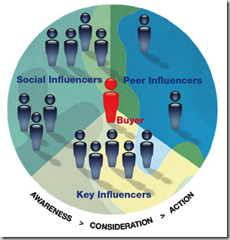

OSNs are Everywhere
OSNs have been exploited as a platform for spreading INFLUENCE
Making friends
Political campaigns
Viral marketing
Movies trailers
Armature artists promote their songs and artworks

Slide 3
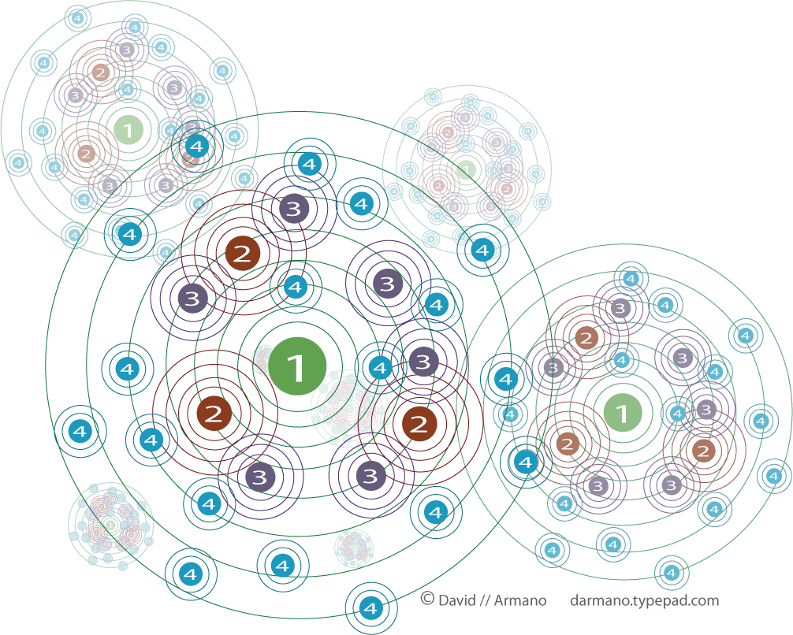
Information Propagation
It is widely believed that through the “word of mouth” effects, influence will spread widely and quickly throughout the network.
Notes:
Source: http://www.informing-arts.biz/blog/social-influence-marketing/

Slide 4
Influence Behaviors?
General operational view:
  A social network is represented as a graph, with each user as a node
  Nodes start either active or inactive
  An active node may trigger activation of neighboring nodes
First mathematical models
  [Schelling '70/'78, Granovetter '78]
Large body of subsequent work:
  [Rogers '95, Valente '95, Wasserman/Faust '94]
1
0
1
1
1
0
1
2
2
Notes:
Schelling introduced a multi-agent model to describe the segregation dynamics that may occur with individuals having only weak preferences for “similar” neighbors.
Granovetter '78: His theory on the spread of information in social networks known as "The Strength of Weak Ties" (1973).
Assumption: node can switch to active from inactive, but does not switch in the other direction
Exp: Influence propagation within d=2 hops.

Slide 5
Linear Threshold Model
A node v has random threshold θ_{v} ~ U[0,1]
A node v is influenced by each neighbor w according to a weight b_{vw} such that
A node v becomes active when at least
(weighted) θ_{v} fraction of its neighbors are active
originally proposed by Lopez-Pintado
Adapted from http://www.cs.washington.edu/affiliates/meetings/talks04/kempe.pdf
Notes:
Given a random choice of thresholds, and an initial set of
active nodes A0 (with all other nodes inactive), the diffusion process
unfolds deterministically in discrete steps: in step t, all nodes
that were active in step t-1 remain active, and we activate any
node v for which the total weight of its active neighbors is at least
Theta(v)

Slide 6
Example
Inactive Node
0.6
Active Node
0.3
0.2
0.2
Threshold
X
Active neighbors
0.1
0.4
U
0.5
0.3
Stop!
0.2
w
0.5
v

Slide 7
Generalized…
Our models: Linear Threshold
  v is activated if there are ≥ ρ_{v} d(v) active neighbors.
  d(v): degree of v; 0 < ρ_{v} < 1.
Half of my friends use iPhone, why shouldn’t I?
The threshold function might not be linear
  log d(v), √ d(v), etc.
Notes:
Node thresholds are highly correlated with their degree. Higher degree, more influencers to be influenced.
We represent threshold in fraction of a node’s degree.

Slide 8
Independent Cascade Model
When node v becomes active, it has a single chance of activating each currently inactive neighbor w.
The activation attempt succeeds with probability p_{vw} .
Notes:
We again start with an initial set of active nodes A0, and the process unfolds in discrete steps according to
the following randomized rule. When node v first becomes active
in step t, it is given a single chance to activate each currently inactive
neighbor w; it succeeds with a probability pv;w —a parameter
of the system — independently of the history thus far. (If w has
multiple newly activated neighbors, their attempts are sequenced in
an arbitrary order.) If v succeeds, then w will become active in step
t+1; but whether or not v succeeds, it cannot make any further attempts
to activate w in subsequent rounds. Again, the process runs
until no more activations are possible.

Slide 9

Example
0.6
Inactive Node
0.3
0.2
0.2
Active Node
X
U
Newly active
node
0.1
0.4
Successful
attempt
0.5
0.3
0.2
Unsuccessful
attempt
w
0.5
v
Stop!

Slide 10
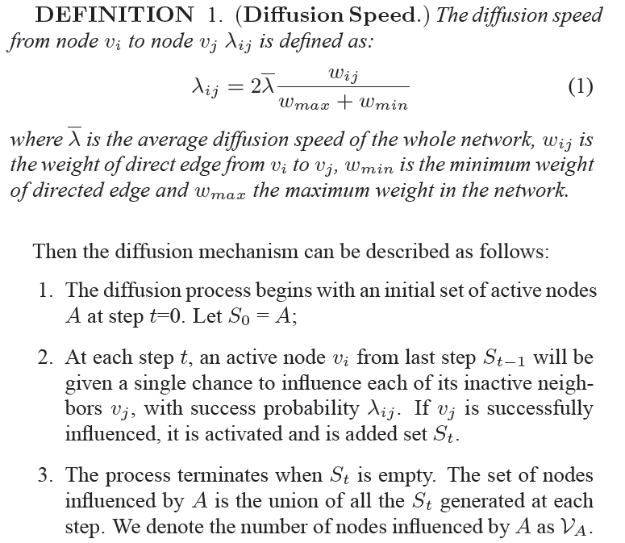
Extended IC Model
Consider edge weight

Slide 11
An Example

Slide 12
Adoption vs Influence
Two classical influence propagation models§:
  Independent cascades
  Linear threshold
    Each user is initially inactive, the seed set is activated (influenced)
    When the influence from the set of active friends exceeds a threshold for a user v, the user activates
Influence is used as a proxy for adoption
Adapted slides from the authors: Maximizing product adoption in social networks

Slide 13



Influence ⇏ Adoption
Observation: Only a subset of influenced users actually adopt the marketed product
Influenced
Adopt
Awareness/information spreads in an epidemic-like manner while adoption depends on factors such as product quality and price§
§S. Kalish. A new product adoption model with price, advertising, and uncertainty. Management Science, 31(12), 1985.

Slide 14
Influence ⇏ Adoption
Moreover we found that there exist users who help in information propagation without actually adoption the product – tattlers.

Slide 15

Adoption Model (LT-C)
Active Friends
User v
Model Parameters
  A is the set of active friends
  f_{v}(A) is the activation function
  r_{u,i} is the (predicted) rating for product i given by user u
  α_{v} is the probability of user v adopting the product
  β_{v} is the probability of user v promoting the product

Slide 16
SIR Model
http://www.cise.ufl.edu/courses/2012/cis6930/Notes/SIR.pdf

Slide 17
Influence Maximization Problem
Influence of node set S: f(S)
  expected number of active nodes at the end, if set S is the initial active set
Problem:
  Given a parameter k (budget), find a k-node set S to maximize f(S)
  Constrained optimization problem with f(S) as the objective function
Notes:
the influence of a set of nodes A: the expected number of active nodes at the end of the process.

Slide 18
f(S): properties (to be demonstrated)
Non-negative (obviously)
Monotone:
Submodular:
  Let N be a finite set
  A set function is submodular iff
  (diminishing returns)
Notes:
A function f maps a finite ground set U to non-negative real numbers, and satisfies a natural “diminishing returns” property, then f is a submodular function.
Diminishing returns property:
The marginal gain from adding an element to a set S is at least as high as the marginal gain from adding the same element to a superset of S.

Slide 19
Bad News
For a submodular function f, if f only takes non-negative value, and is monotone, finding a k-element set S for which f(S) is maximized is an NP-hard optimization problem[GFN77, NWF78].
It is NP-hard to determine the optimum for influence maximization for both independent cascade model and linear threshold model.
Notes:
Known results:
For a submodular function f, if f only takes non-negative value, and is monotone.
Finding a k-element set S for which f(S) is maximized is an NP-hard optimization problem[GFN77, NWF78].

Slide 20
Good News
We can use Greedy Algorithm!
  Start with an empty set S
  For k iterations:
    Add node v to S that maximizes f(S +v) - f(S).
How good (bad) it is?
  Theorem: The greedy algorithm is a (1 – 1/e) approximation.
  The resulting set S activates at least (1- 1/e) > 63% of the number of nodes that any size-k set S could activate.
Notes:
The algorithm that achieves this performance guarantee is a natural greedy hill-climbing strategy
selecting elements one at a time, each time choosing an element that provides
the largest marginal increase in the function value.
f(S) >= (1-1/e) f(S*)
This algorithm approximate the optimum within a factor of (1-1/e) ( where e is the base of the natural logarithm).

Slide 21
Key 1: Prove submodularity

Slide 22
Submodularity for Independent Cascade
0.6
Coins for edges are flipped during activation attempts.
0.3
0.2
0.2
0.1
0.4
0.5
0.3
0.5

Slide 23
Submodularity for Independent Cascade
0.6
Coins for edges are flipped during activation attempts.
Can pre-flip all coins and reveal results immediately.
0.3
0.2
0.2
0.1
0.4
0.5
0.3
0.5
Active nodes in the end are reachable via green paths from initially targeted nodes.
Study reachability in green graphs
Notes:
Our proof deals with these difficulties by formulating an equivalent
view of the process, which makes it easier to see that there
is an order-independent outcome, and which provides an alternate
way to reason about the submodularity property.
From the point of view of the process, it clearly does not matter whether the
coin was flipped at the moment that v became active, or whether it
was flipped at the very beginning of the whole process and is only
being revealed now. With all the coins flipped in advance, the process can be viewed
as follows. The edges in G for which the coin flip indicated an
activation will be successful are declared to be live; the remaining
edges are declared to be blocked. If we fix the outcomes of the coin
flips and then initially activate a set A, it is clear how to determine
the full set of active nodes at the end of the cascade process:
CLAIM 2.3. A node x ends up active if and only if there is a
path from some node in A to x consisting entirely of live edges.
(We will call such a path a live-edge path.)

Slide 24
Submodularity, Fixed Graph
Fix “green graph” G. g(S) are nodes reachable from S in G.
Submodularity: g(T +v) - g(T) g(S +v) - g(S) when S T.
g(S +v) - g(S): nodes reachable from S + v, but not from S.
From the picture: g(T +v) - g(T) g(S +v) - g(S) when S T (indeed!).
Notes:
g(S +v) - g(S): Exactly nodes reachable from v, but not from S.

Slide 25
Submodularity of the Function
Fact: A non-negative linear combination of submodular functions is submodular
g_{G}(S): nodes reachable from S in G.
Each g_{G}(S): is submodular (previous slide).
Probabilities are non-negative.

Slide 26
Submodularity for Linear Threshold
Use similar “green graph” idea.
Once a graph is fixed, “reachability” argument is identical.
How do we fix a green graph now?
Each node picks at most one incoming edge, with probabilities proportional to edge weights.
Equivalent to linear threshold model (trickier proof).

Slide 27
Key 2: Evaluating f(S)
Notes:
Both in choosing the nodes to target with the greedy algorithm,
and in evaluating the performance of the algorithms, we need to
compute the value (A). It is an open question to compute this
quantity exactly by an efficient method, but very good estimates
can be obtained by simulating the random process

Slide 28
Evaluating ƒ(S)
How to evaluate ƒ(S)?
Still an open question of how to compute efficiently
But: very good estimates by simulation
  repeating the diffusion process often enough (polynomial in n; 1/ε)
  Achieve (1± ε)-approximation to f(S).
Generalization of Nemhauser/Wolsey proof shows: Greedy algorithm is now a (1-1/e- ε′)-approximation.

Slide 29
Experiment Data
A collaboration graph obtained from co-authorships in papers of the arXiv high-energy physics theory section
co-authorship networks arguably capture many of the key features of social networks more generally
Resulting graph: 10748 nodes, 53000 distinct edges

Slide 30
Experiment Settings
Linear Threshold Model: multiplicity of edges as weights
  weight(v→ω) = C_{vw} / dv, weight(ω→v) = C_{wv} / dw
Independent Cascade Model:
  Case 1: uniform probabilities p on each edge
  Case 2: edge from v to ω has probability 1/ dω of activating ω.
Simulate the process 10000 times for each targeted set, re-choosing thresholds or edge outcomes pseudo-randomly from [0, 1] every time
Compare with other 3 common heuristics
  (in)degree centrality, distance centrality, random nodes.
Notes:
Independent Cascade Model:
If nodes u and v have cu;v parallel edges, then
we assume that for each of those cu;v edges, u has a chance of p
to activate v, i.e. u has a total probability of 1 - (1 - p)cu;v of
activating v once it becomes active.
The independent cascade model with uniform probabilities p on
the edges has the property that high-degree nodes not only have
a chance to influence many other nodes, but also to be influenced
by them. Motivated by this, we chose to also consider an alternative interpretation, where edges
into high-degree nodes are assigned smaller probabilities. We study
a special case of the Independent Cascade Model that we term
“weighted cascade”, in which each edge from node u to v is assigned
probability 1/dv of activating v.
The high-degree heuristic chooses nodes v in order of decreasing
degrees dv.
“Distance centrality” buildg on the assumption that a node with short
paths to other nodes in a network will have a higher chance of influencing
them. Hence, we select nodes in order of increasing average
distance to other nodes in the network. As the arXiv collaboration
graph is not connected, we assigned a distance of n — the number
of nodes in the graph — for any pair of unconnected nodes. This
value is significantly larger than any actual distance, and thus can
be considered to play the role of an infinite distance. In particular,
nodes in the largest connected component will have smallest
average distance.

Slide 31
Results: linear threshold model
Notes:
The greedy algorithm outperforms the high-degree node heuristic by about 18%, and the central node
heuristic by over 40%. (As expected, choosing random nodes is
not a good idea.) This shows that significantly better marketing
results can be obtained by explicitly considering the dynamics of
information in a network, rather than relying solely on structural
properties of the graph.
When investigating the reason why the high-degree and centrality
heuristics do not perform as well, one sees that they ignore such
network effects. In particular, neither of the heuristics incorporates
the fact that many of the most central (or highest-degree) nodes
may be clustered, so that targeting all of them is unnecessary.

Slide 32
Independent Cascade Model – Case 1
P = 1%
P = 10%
Notes:
The graph for the independent cascade model with probability 1%, seems very similar to the previous two at
first glance. Notice, however, the very different scale: on average, each targeted node only activates three additional nodes. Hence, the network effects in the independent cascade model with very
small probabilities are much weaker than in the other models.
This suggests that the network effects observed for the linear threshold and weighted cascade models rely heavily on
low-degree nodes as multipliers, even though targeting high-degree nodes is a reasonable heuristic. Also notice that in the independent cascade model, the heuristic of choosing random nodes performs significantly better than in the previous two models.
The improvement in performance of the “random nodes” heuristic is even more pronounced for the independent cascade model with probabilities equal to 10%. In that model, it starts to outperform both the high-degree and the central nodes heuristics when more than 12 nodes are targeted. The first targeted node, if chosen somewhat judiciously, will activate a large fraction of the network, in our case almost 25%. However, any additional nodes will only reach a small additional fraction of the network. In particular, other central or high-degree nodes are very likely to be activated by the initially chosen one, and thus have hardly any marginal gain. This explains the shapes of the
curves for the high-degree and centrality heuristics, which leap up to about 2415 activated nodes, but make virtually no progress afterwards. The greedy algorithm, on the other hand, takes the effect of the first chosen node into account, and targets nodes with smaller marginal gain afterwards. Hence, its active set keeps growing, although
at a much smaller slope than in other models.

Slide 33
Independent Cascade Model – Case 2
Reminder: linear threshold model
Notes:
Notice the striking similarity to the linear threshold model; the scale
is slightly different (all values are about 25% smaller), but the
behavior is qualitatively the same, even with respect to the exact
nodes whose network influence is not reflected accurately by their
degree or centrality. The reason is that in expectation, each node is
influenced by the same number of other nodes in both models (see
Section 2), and the degrees are relatively concentrated around their
expectation of 1.

Slide 34
Maximizing Product Adoption
Problem: Given a social network and product ratings, find k users such that by targeting them the expected spread (expected number of adopters) under the LT-C model is maximized
Problem is NP-hard
The spread function is monotone and submodular yielding a 1-1/e approximation to the optimal using a greedy approach

Slide 35
Community-based Greedy Algorithm for Mining Top-K Influential Nodes in Mobile Social Networks
Has two phases:
  Partition a network into communities by taking into account the information diffusion.
  Using a dynamic programming algorithm for selecting communities to find influential nodes.

Slide 36
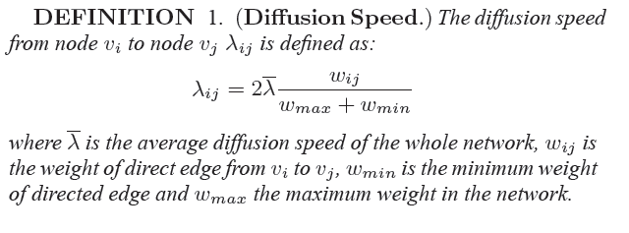
Diffusion Speed

Slide 37
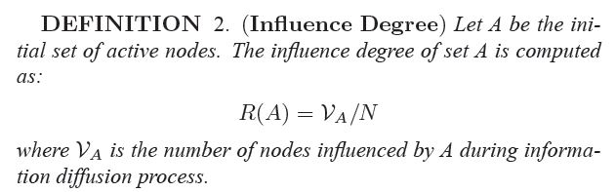
Influence Degree
Mine a set of top-K influential nodes S on the network such that R(S) is maximized using the extended Independent Cascade information diffusion model.

Slide 38
Community Detection Algorithm
Goal:
  Detect communities based on the influences between nodes, rather than only the connection between nodes
  the influence degree of nodes within a community can be as close as that in the whole network.
Consists of 2 Phases:
  Partition
    Using label propagation method
  Combination
    Combination Entropy
    combine communities such that the difference between influence degree of a node in its community and its influence degree in the whole network is restricted.

Slide 39

Community Partition
Initially, each node is assigned a unique community label from 1 to N
For each node, compute the set of its influenced neighbors using Independent Cascade diffusion model.
We iteratively propagate the labels through the network in finite iterations.
Principle:
  A node v should belong to the community that contains the maximum number of its influence neighbors

Slide 40
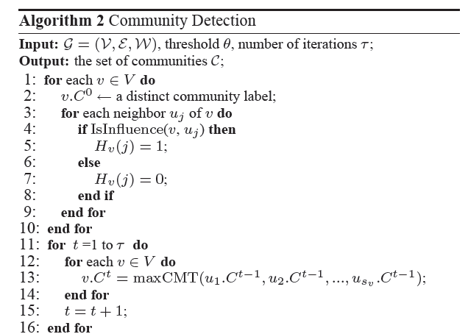
Community Partition

Slide 41

Community Combination
Expect:
  The difference between the node’s influence degree in its community and its influence degree in the whole network is small.
Combination Entropy:
  If a node v influences (activates) its neighbor u, we label the edge evu as live. If evu is live and v belongs to community Cm, but u belongs to a different community Cl, we say that u is a live node of Cm. Let L[Cm] be the set of live nodes of Cm.

Slide 42
CombinationEntropy
Combination entropy measures the difference of diffusion spread of a node v (v in Cm) between in the community and in the whole network through a node in L[Cm].
The difference reflects the precision loss due to diffusion within communities.
If the combination entropy CoEntropy of community Cm to community Cl is bigger than θ, then Cm and Cl will be combined.

Slide 43
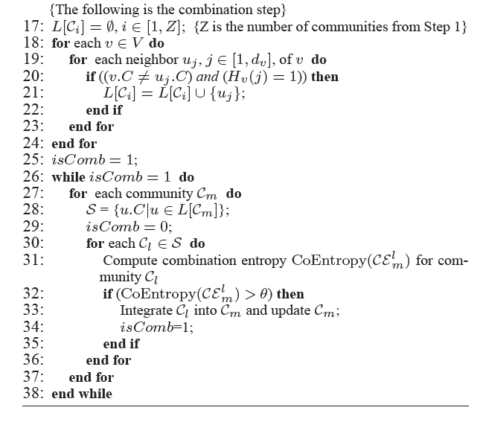
Community Combination

Slide 44
CGA: Community-Based Greedy Algorithm
Use a dynamic programming algorithm to choose which community to find the k-th influential node.
The influence degree Rm(.) is computed with regard to the community Cm rather than the whole network

Slide 45
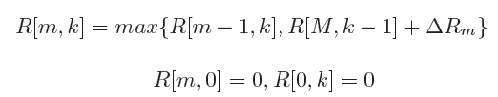
CGA
R[m, k] (m ∈ [1,M] and k ∈ [1,K]) be the influence degree of mining the kth influential node in the first m communities.
If the influence degree of mining the kth node in the first m-1 communities is smaller than that of mining the kth node in Cm, we mine the kth node in Cm; otherwise, we mine it in the former m-1 communities.

Slide 46
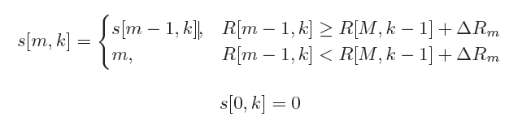
CGA
s[m, k]:the selected community is represented by a sign function s[m, k].
To find the kth, k ∈ [1,K], influential node, we choose the community s[M,k] (Note that these sign functions s[m, k],m < M, are used to compute s[M,k]).
Use MixedGreedy to find the kth influential node in community s[M,k].

Slide 47
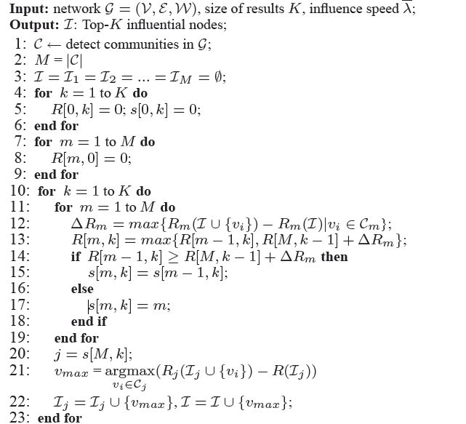
CGA

Slide 48
CGA - Discussion
Is the algorithm good?
Example:
We mine top-2 nodes from a network. Assume that the network is partitioned into three communities C1,C2, and C3, and based on Independent Cascade model we have: the maximal influence degree increment, denoted by ΔR1, ΔR2 andΔR3 for each community, is 0.2, 0.3, 0.1, respectively, for each community; and the second most maximal influence degree increment is 0.08, 0.06, 0.04, respectively, for each community.

Slide 49
mine top-1 node
R[1, 1] = max{R[0, 1],R[3,0] + ΔR1} = 0.2, s[1, 1] =C1;
R[2, 1] = max{R[1, 1],R[3,0] + ΔR2} = max{0.2, 0 +0.3} = 0.3, s[2, 1] = C2;
R[3, 1] = max{R[2, 1],R[3, 0] + ΔR3}= max{0.3, 0.1}= 0.3, s[3, 1] = C2;
Hence, we mine the top-1 node in community C2 because s[3, 1] = C2 is the result.

Slide 50
mine top-2 node
Next, R[1, 2] = max{R[0, 2],R[3, 1] + ΔR1} = max{0,0.3 + 0.2} = 0.5, s[1, 2] = C1;
R[2, 2] = max{R[1, 2], R[3, 1]+ΔR2} = max{0.5, 0.3+0.06} = 0.5, s[2, 2] = C1;
R[3, 2] = max{R[2, 2],R[3, 1]+ΔR3} = max{0.5, 0.3+0.1} = 0.5, s[3, 2] = C1.
Note that ΔR2 in this step is 0.06, but not 0.3. We mine the second node in community C1 because s[3, 2] = C1.

Slide 51
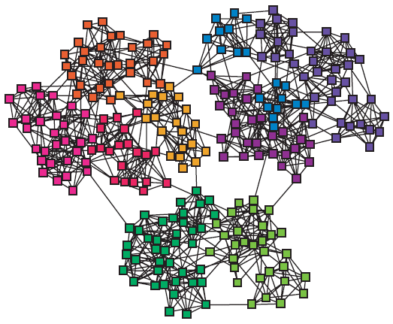
Community-Based Greedy Algorithm
Choose communities to find the Top-1 influential node
C1
C2
ΔR1=0.2
ΔR2=0.3
    R[1,1]=max{R[0,1], R[3,0]+ΔR1}=0.2
    s[1,1]=C1;
    R[2,1]=max{R[1,1], R[3,0]+ ΔR2}=0.3
    s[2,1]=C2;
    R[3,1]=max{R[2,1], R[3,0]+ ΔR3}=0.3
    s[3,1]=C2;
    So we mine top-1 node in C2
ΔR3=0.1
C3

Slide 52
Community-Based Greedy Algorithm
Choose communities to find the Top-2 influential node
C1
C2
ΔR1=0.2
ΔR2=0.06
    Note ΔR2 is 0.06, but not 0.3.
    R[1,2]= max{R[0,2], R[3,1]+ΔR1}=0.5
    s[1,2]=C1;
    R[2,2]= max{R[1,2], R[3,1]+ΔR2}=0.5
    s[2,2]=C1;
    R[3,2]= max{R[2,2], R[3,1]+ΔR3}=0.5
    s[3,2]=C1;
    We mine the second node in C1
ΔR3=0.1
C3

Slide 53

Approximation Analysis of CGA
Let I∗ be the set of K nodes that maximize the influence degree, i.e. the optimal solution to our problem
Let I be the set of K nodes discovered by our algorithm; let R(I∗) and R(I) be the influence degree of the two sets, respectively.
$R\left(I\right)≥(1 −e^{−\frac{1}{1+Δdθ} }$) R(I*)
  Where \theta is the threshold used in the community combination step, \Delta d is the maximal difference between the number of nodes affected by a node in network G and that in community Cm

Slide 54
Experiments
Data Sets
  Extract a Mobile Social Network from a three-month CDR (call detailed record) data of a city from China Mobile
  Node number: 723,201
  Average degree: 13.4

Slide 55
Community distribution
  largest community size: 95,690

Slide 56
Experiments
Top-k Nodes Mining Methods
  MixedGreedy Algorithm
  NewGreedy Algorithm
  DegreeDiscount
  Random Method
  CGA
  SPCGA
Parameter study:
  k, diffusion speed λ, data size

Slide 57
Results
Influence degree and time vs K

Slide 58
Results
Influence degree and time vs diffusion speed λ
Notes:
the efficiency
of MixedGreedy drops quickly (almost exponentially) while CGA is a lot better.

Slide 59
Results
Influence degree and time vs network size
Notes:
the influence degree is relatively stable

Slide 60
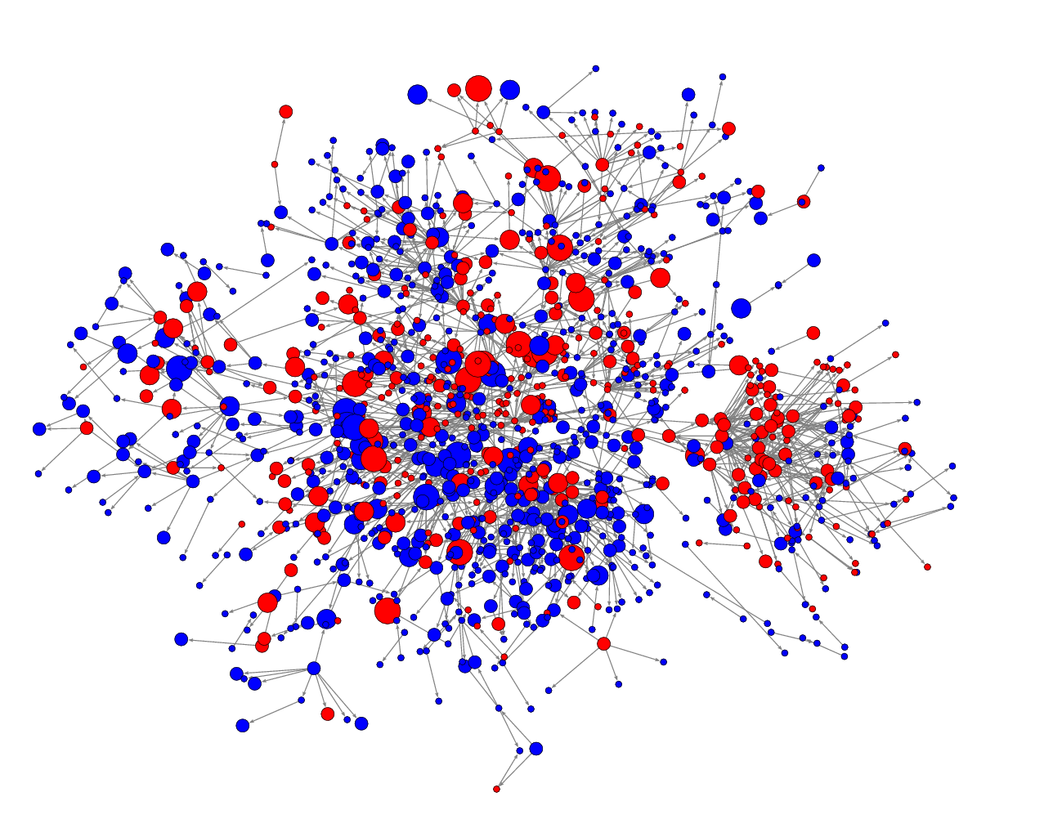
Fast Influence Spreading Problem
Given
  Network G=(V, E).
  The maximum number of propagation hops d.
Goal
  Spread the influence into the whole network within d hops (e.g. dominate a particular market)
Question
  What is the minimum set of individuals to target at?
Can be weighted to model the negative/positive impacts and the degree of influence
Notes:
Source: Inferring Networks of Diffusion and Influence, Manuel Gomez Rodriguez^{1,2} Jure Leskovec¹ Andreas Krause³

Slide 61
Direct Influence – d = 1
Given: A graph G=(V, E) and a constant 0 < ρ_{v} < 1 . A node v ∈ V has an influence threshold ρ_{v} d(v)
Problem: Find a minimum set P ⊆ V, so that after d = 1 hop, all nodes are activated.
1
0
1
1
1
0
0
1
1
Notes:
ρ = 1/3.

Slide 62
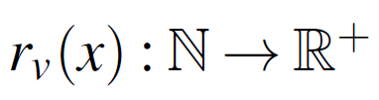
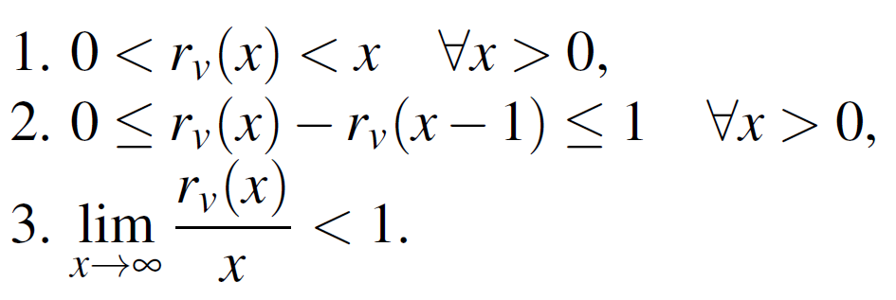
Generalized Threshold Function
The threshold function might not be linear
  log d(v), √ d(v), etc.
Characteristics of a threshold function:
  A node v is activated if ≥ r_{v} (d(v)) active neighbors.
  Monotone increasing function

Slide 63
Bad News
The direct influence problem cannot be approximated within
  ln Δ - O(ln ln Δ), unless P = NP where Δ is the maximum degree of G=(V,E).
  (1/2 - ε) ln n, unless NP ⊂ DTIME(n^{o(log log n)} ) where n = |V|
  ln B - O(ln ln B), unless P = NP, in graphs with degrees bounded by B

Slide 64
Good News
It is approximated within H((1+ρ )Δ), where
H(n)=1+1/2+…+1/n is the Harmonic function.
In trees: Optimal solution in linear time.

Slide 65

Inapproximability
Reduction from Bounded Set Cover using k provers proof system
Involve many tweaking of Feige’s (1-o(1)) ln n threshold proof
e₁
x'₁
x₁
S₁
e₂
. . . . . . . .
S₂
x'_{i}
x_{i}
e₃
S₃
e₄
. . . . . . . .
. . . .
e₅
x'_{t}
x_{t}
S_{|S|}
. . . .
e_{|U|}
D’
D
S
U

Slide 66
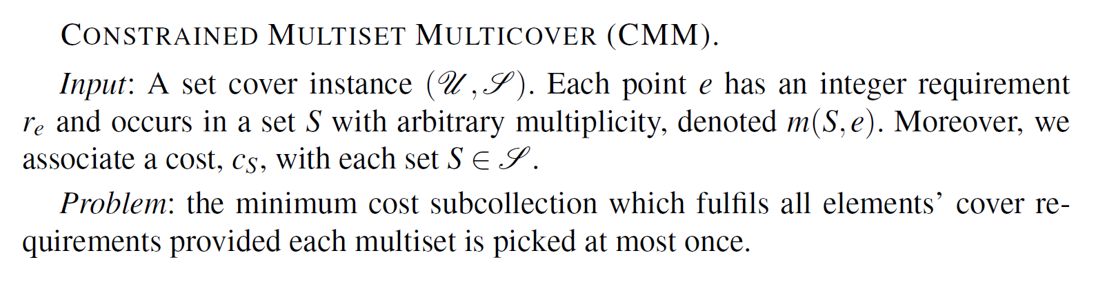
Approximation Algorithms
Reduce to
Obtain an H((1+ρ )Δ) ratio

Slide 67
Multi-hops Influence – d > 1
Bad News
  Cannot be approximated within
  Cannot be approximated within

Slide 68
Inapproximability: d < 4
Gap Reduction
Direct Influence (d=1) | d-hop influence
An edge | A transmitter from

Slide 69
Inapproximability: d < 4
Transmitter: A gadget to slow down the propagation
are shared by all transmitters. They are initially selected.
If u is selected at first, then v will be influenced by uv_{d-1}
after d - 1 rounds
. . .
w₁
w₂
W_{c(ρ)}
. . .
u
uv₁
uv₂
uv_{d-1}
v

Slide 70
Inapproximability: d < 4
Direct Influence (d=1)
d-hop influence
A solution of size k → A solution of size
An optimal solution ⬅ An optimal solution
. . .
w₁
w₂
W_{c(ρ)}
c
c
. . .
a
b
a
. . .
b
. . .
d
. . .
d
Notes:
+ Adding “hairs” to force the selection of the green vertices
+ Auxiliary vertices should not ever be selected in an optimal solution.

Slide 71
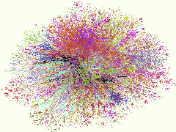
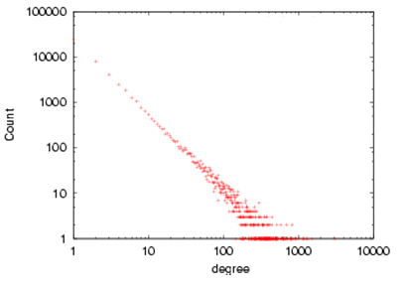
Any Good News?
Many OSNs follow the power-law distribution:
The number of nodes having k
connections is proportional to
k^{-β}
β is a parameter whose value is
typically in the range 2 < β < 3
Many Low Degree Nodes
Few High Degree Nodes
Internet in December 1998

Slide 72
Shall We Try to Analyze in PLNs?
Does the power-law distribution impact the inapproximability factors?
Intuitively, the answer should be “yes” !
Shall we reinvestigate the problem in
Power-Law Networks (PLNs)?

Slide 73
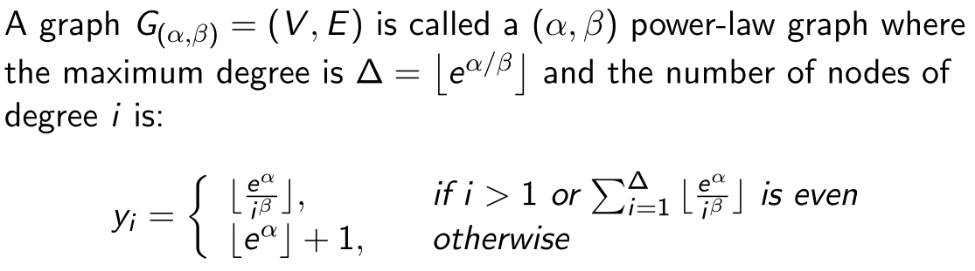
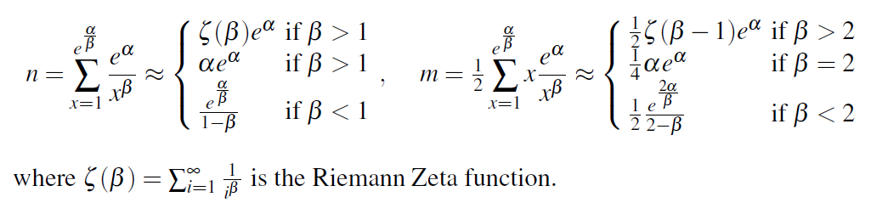
PLNs Model P(α, β)
Size of networks:

Slide 74
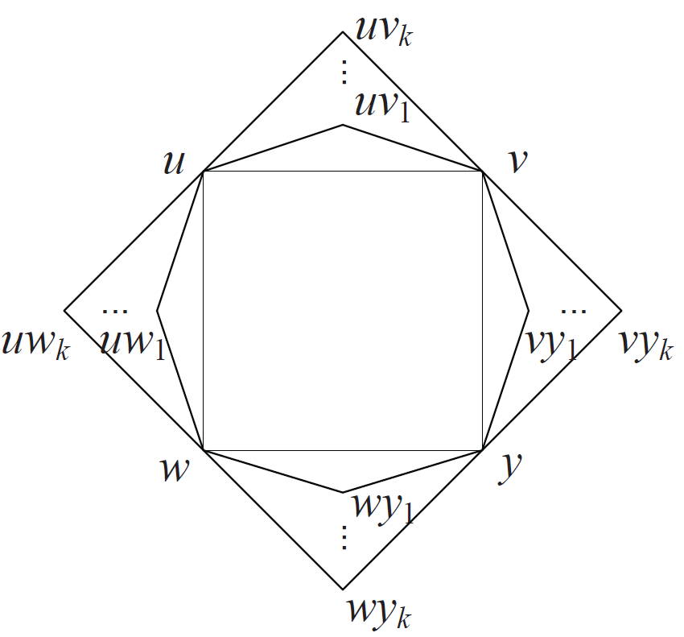
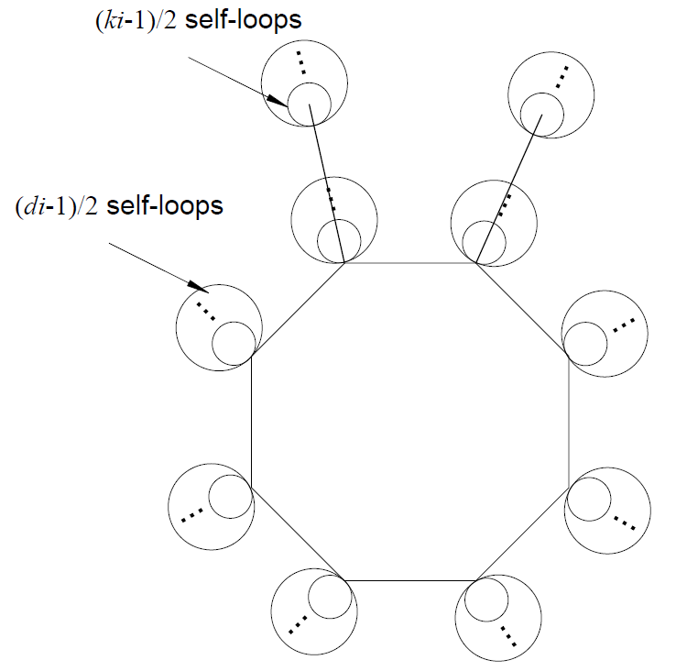
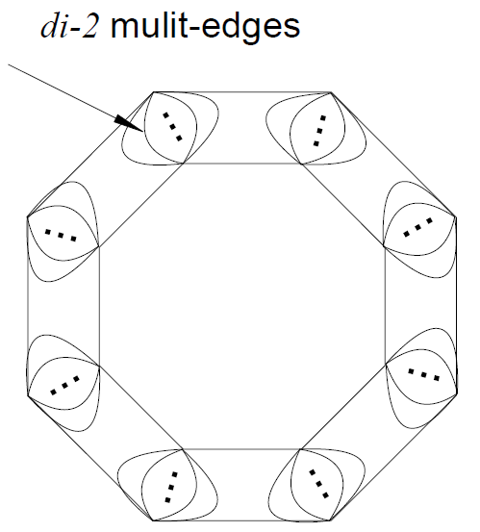
Bad News
Multi-hops influence is still NP-hard in PLNs.
Proof: The idea is to reduce from vertex cover on d-bounded graphs.
Power-Law Graph

Slide 75
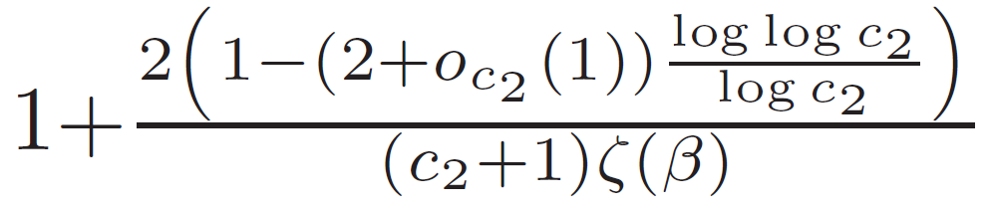

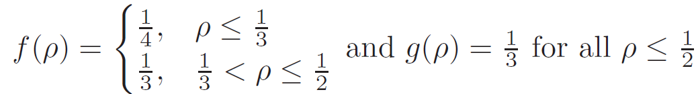
Good News - Inapproximability
Multi-hops influence is UG-hard to be approximated into
on power-law graphs.
-Completeness:

Slide 76
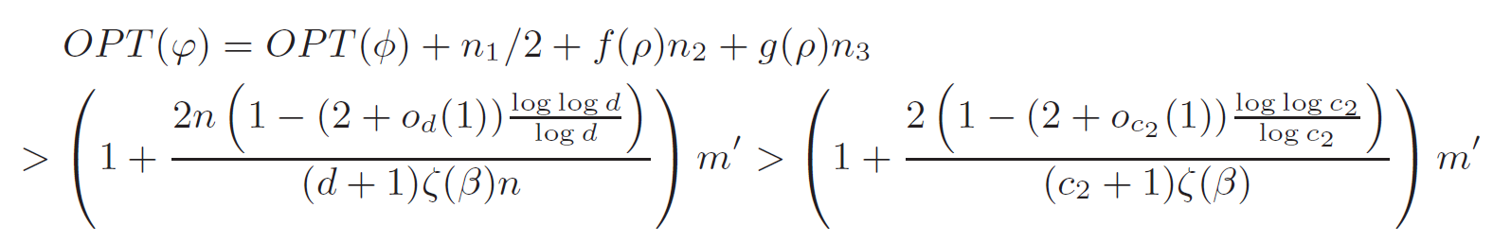
-Soundness:
The inequality holds since the function
is monotonously decreasing when f (x) > 0 for any x.

Slide 77
Great News – Constant Ratio
Observation:
  An initial influence set has size at least Ω(|V|)!!!
  Trivial constant approximation algorithm.
Agree with the NOT WIDELY propagation observation
  Require a large number of initial targets to propagate to the whole networks.

Slide 78

Approximation in PLNs
A small set of vertices can influence many other vertices
BUT…
To influence the whole network or a fraction of the network ?
  Might requires a large fraction of selected vertices
  For some cases, any solution is a constant factor approximation of the optimal solutions.

Slide 79
Approximation in PLNs
We have:
Sum up all above inequalities for all t and with some algebra, we obtain

Slide 80
Approximation in PLNs

Slide 81
Efficient Heuristics for Large Scale Networks
VirAds-Fast-Spreading Algorithm
  A priority queue of nodes:
  priority = # affected vertices + #affected edges.
  Pickup vertex with highest priority
  Recalculate priority, and select the vertex if the new priority is still the highest, repeat otherwise
  Update the number of activated vertices with the selected node
  Lazy update: Update priority for only vertices that are “affected” by the selected vertex. Repeat!
Notes:
Affected = change the domination requirements.

Slide 82
Heuristics for Large Scale Networks
Datasets: Facebook
  New Orleans City: 90 K vertices, ~4M edges.
  Orkut social network: 3 M vertices, 220 M edges
Competitors:
  Max degree selector
  Virads: One-hop greedy selector
  Virads-Full-Spreading:
    Expensive multi-hop greedy
    Cannot run for large networks (e.g. Orkut)

Slide 83
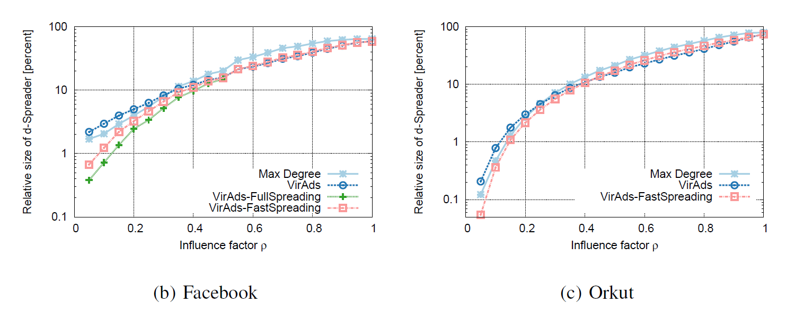
Experiments Results
Running time on Orkut (220 M edges):
  Virads-Fast-Spreading: Few minutes
  Virads-Full-Spreading: >> weeks.
Quality is on par with the expensive multihop-greedy.
Notes:
Virads-Fast-Spreading is on par with the expensive multihop-greedy algorithm

Slide 84
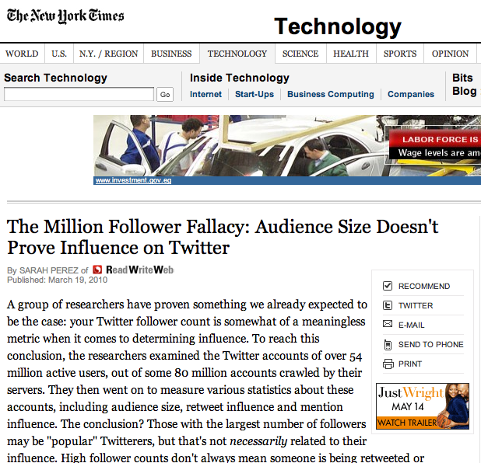
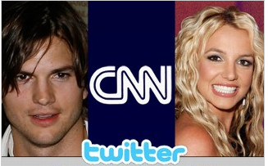
What More? Users’ Engagement
Problem: If a person has no
interest in a topic, he is not going
to retweet it
Solution: Target to interest
matching users.
Challenging: Most of users’
profiles are inaccessible due to
privacy issues
Followers
rank 1
3.3M
rank 4
2.6M
rank 2
3.1M
Retweets
rank 7
rank 24
-

Slide 85
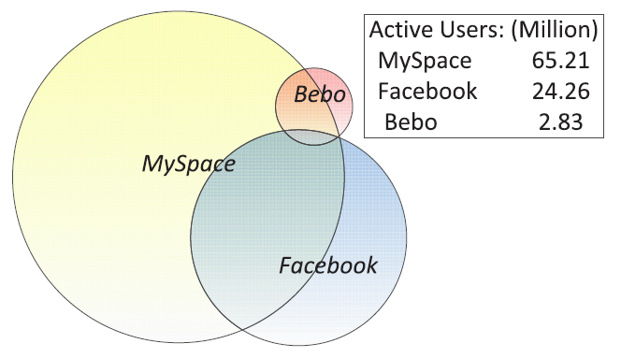
What More? – Multiple Sites
Many users now have multiple accounts on several OSNs
Shall we pay more attention on these users, called crossing-users

Slide 86
MTSIP Problem Definition
Minimum Total Seed multi-Information Propagation

Slide 87
Solution Approach
Network Coupling
Interest-matching Users Prediction
Seed User Identification

Slide 88
Network Coupling
Objective: to reinforce the effects of crossing users
Method:
  merge each crossing node in all networks
  The new neighbors of each crossing node include its neighbors in all k networks
  The weight of an edge in the coupling network is the sum of all its weights on these networks

Slide 89
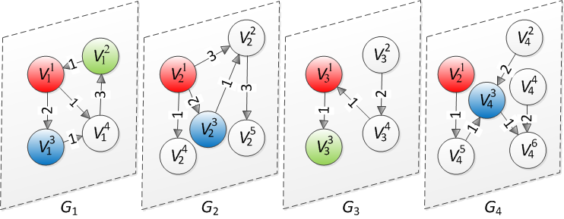
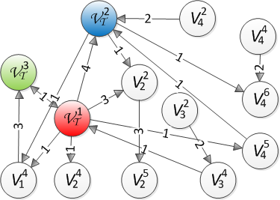
Coupling Example
An Instance of multiple networks (G₁,G₂,G₃,G₄)
Coupling Graph G_{T}
All crossing nodes are colored
The weights of node V_{T}¹, V_{T}² and V_{T}³ in the coupling graph G_{T} are 4, 3 and 2 respectively and all other nodes have weight 1

Slide 90
Interest-matching Users Prediction
Objective: minimize the penalty function P_{T} with respect to the incorrect predictions
Method:
  Using Semi-Supervised Learning.
  To formulate the Penalty Function P_{T}, we construct a Bipartite Graph Γ_{T} on top of the coupled graph

Slide 91
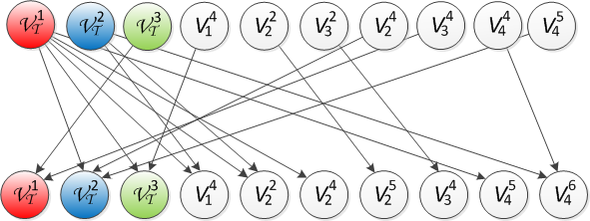
Bipartite Graph
Γ_{T} = (H_{T} ,F_{T}; L_{T})
  Hub Users H_{T}: At least one follower
  Follower Users F_{T}: At least follow one hub user
  A user can be both a hub user and a follower user
Coupling Graph G_{T}
Bipartite Graph Γ_{T}

Slide 92

  Penalty Function P_{T}
Loss Function: forces the interest-matching users close to the interest-available users (given some large constant Ω_{P})
Regularizer: the penalties of the incorrect predictions
  Objective: Minimize P_{T}
interest-prediction label vector
interest-available label vector
some large constant

Slide 93

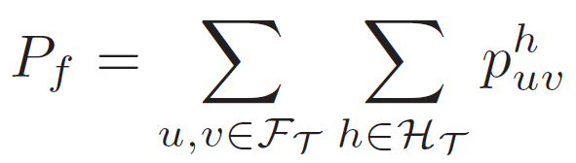
Regularizer P
Combination of follower user penalties P_{f} and hub user penalties P_{h}
Follower user penalty P_{f} : consider the sum of penalties for all pairs of follower users
(Similar as hub user penalties P_{h})
a normalized parameter (0,1)
The penalty of incorrect predictions between followers

Slide 94
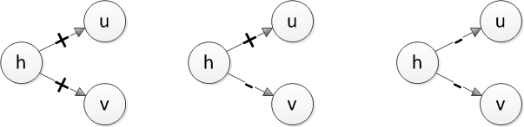
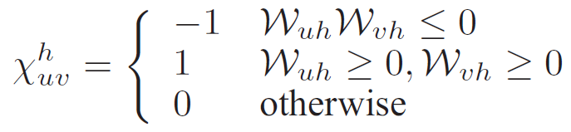
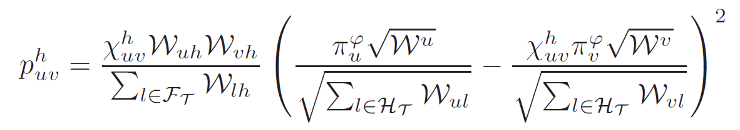
Penalty Function for (u,v,h)
Use on the coupling graph G_{T} as the interest similarity of u and v to h
Normalize by degrees
node weight in coupling graph
edge weight in coupling graph

Slide 95
Seed User Identification
Objective:
  Minimize the seed costs
  Maximize the influence interest-matching users
Method:
  Use Iterative Semi-Supervised Learning (ISSL) approach

Slide 96
Iterative Semi-Supervised Learning
Objective function is three-fold
  Loss Function: force the influenced users after d rounds to be the predicted interest-matching users
  Iteration Function: force the identified seed users remaining as they are in next iteration
  Regularizer: the number of seed users
the current solution after each iteration
d-round influenced label vector
y is a seed vector

Slide 97


Constraints
Message Propagation
Influence Irreversibility
Influenced Users after d Rounds
Consistence of Crossing User Labels
diag ( A₁ , …, A_{k} )
appearance vector to indicate which networks u belongs to

Slide 98
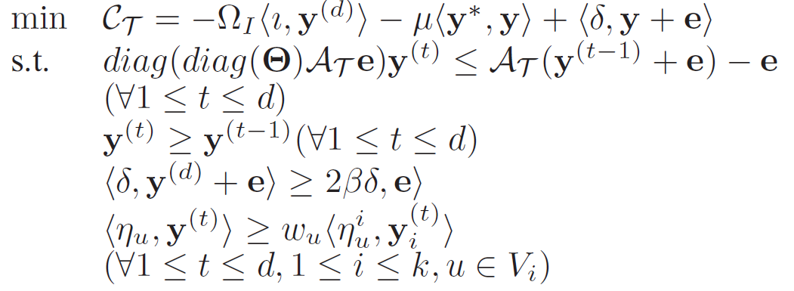
Convert QP to LP
Based on the fact ||y||=1 and linear number of constraints

Slide 99
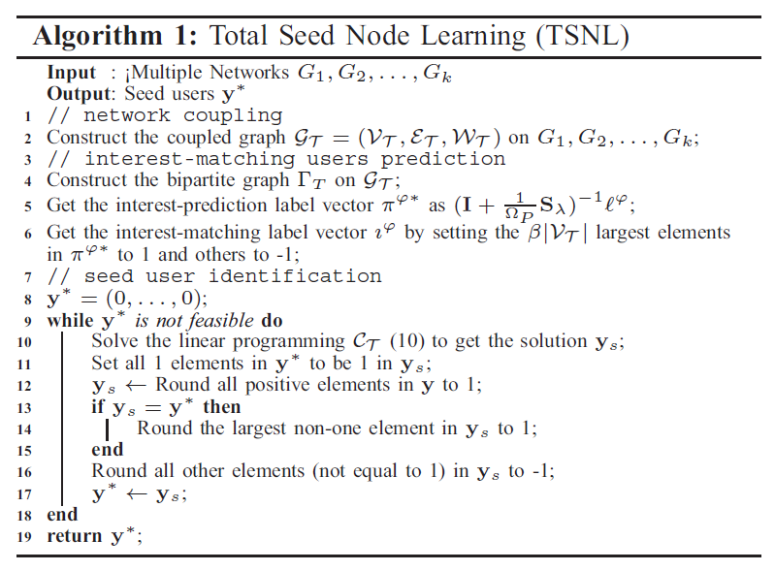
The TSNL Algorithm

Slide 100
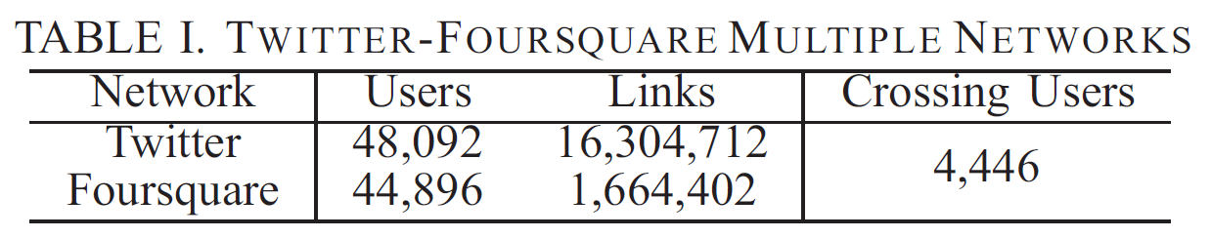
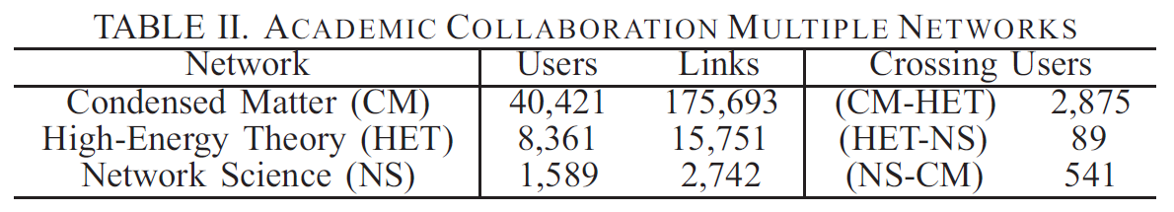
Experiments on Real Datasets

Slide 101
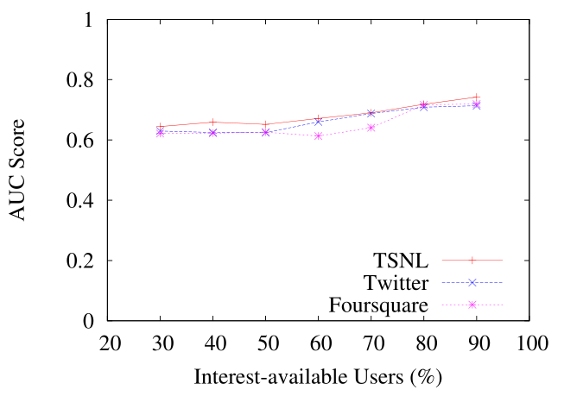
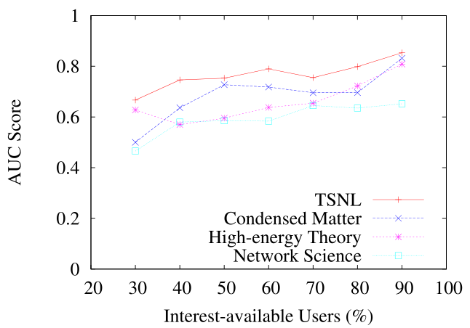
Interest-matching User Prediction
We compare the AUC scores between the prediction and the ground-truth.
The AUC score is the area under ROC curve, which has its x-axis as False Positive Rate and y-axis as True Positive Rate
Better prediction when the network contain more information
Better Prediction using the information on all networks than individual ones

Slide 102
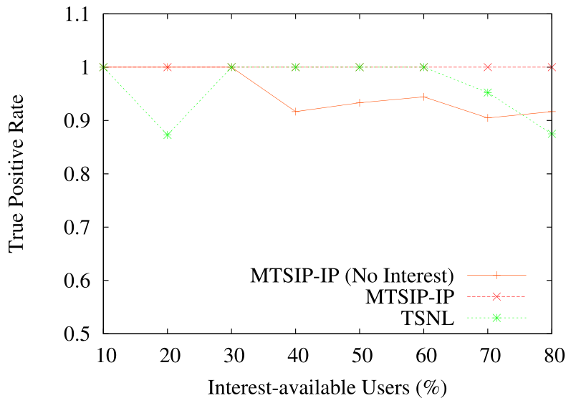
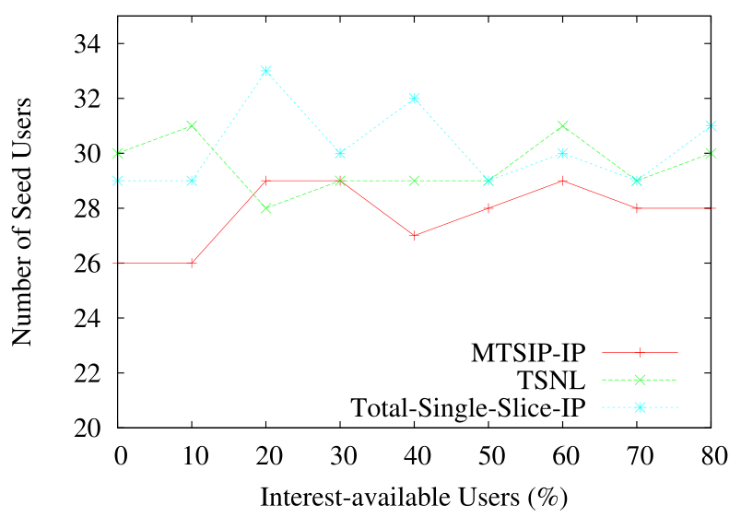
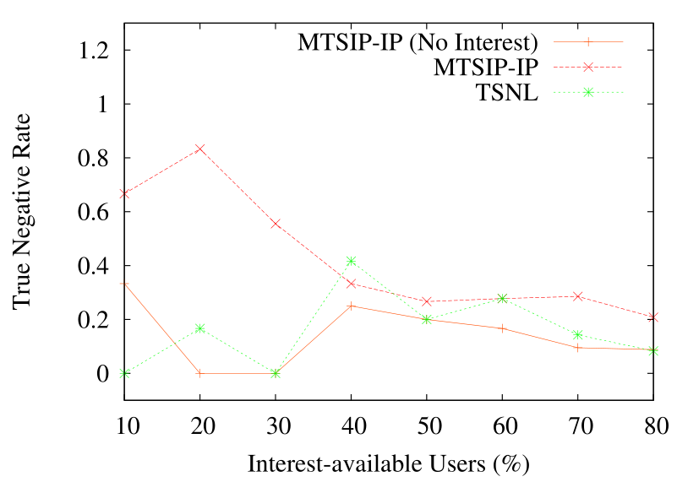
Seed Identification
Compare with optimal Solution
Notes:
MTSIP-IP: the integral (optimal) solution of the first equation (MTSIP problem)
(2) MISIP-IP: the integral (optimal) solution of the second equation (MISIP problem)
(3) Total-Single-IP: the sum of integral solution on all networks
Most of the time our TSNL and ISNL solutions are very close to the optimal solutions of MTSIP-IP and MISIP-IP and even outperforms the Total-Single-IP. It implies that the existence of crossing users essentially helps to provide a more effective information diffusions by sharing their messages on multiple social networks.
MTSIP-IP-No-Interest and MISIP-IP-No-Interest have comparatively lowest TPR and TNR although they can identify smallest size of seed users. (Without considering interest-matching users)
The true negative rate drops sharply with the increase of interest-matching users since the users who are not interested in the message cannot be successfully avoided when more users are required to be influenced.

Slide 103
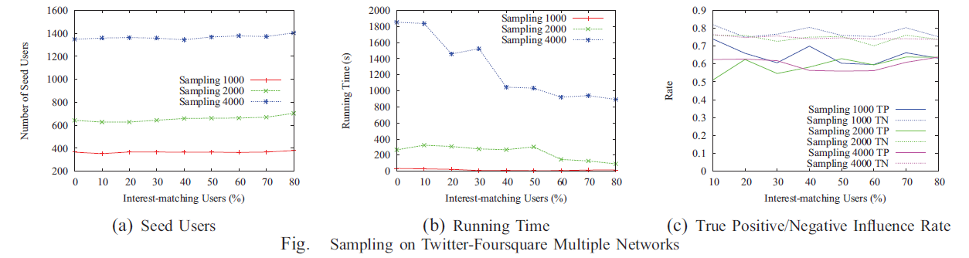
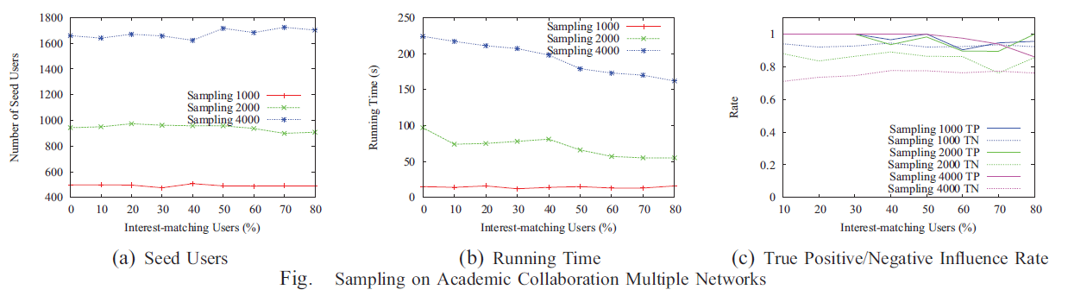
Seed Identification
Notes:
We measure the seed user identification using TSNL approach since these two networks are closely coupled in practice, i.e. individual foursquare check-ins will be automatically shown on the Twitter stream after the proper settings.
The number of seed users almost keep the same while the running time decreases rapidly and the TPR and TFR remain quite high after increasing the number of interest-matching users.
This, essentially, reveals the importance of interest-matching users. By correctly predicting more interest-matching users, we can improve both effectiveness and efficiency of information propagation.
Due to the distinct functions in multiple networks, we couple this dataset using ISNL approach. When the number of interest-matching users increases, the difference between the number of seed users with and without interest-matching users is, again, very slight along with the decreasing running time and high TPR/TFR rates.

Slide 104
Deceptive Messages!
Everything is on OSNs, including deceptive messages, which quickly propagate through the network
  recent shootings at Fort Hood, Texas, when a soldier inside the base sent out messages via Twitter as the event unfolded. Her incorrect reports of multiple shooters and shooting locations quickly spread through the social networks and even to the mass media
  the spread of misinformation on swine flu in Twitter. The spread of misinformation in this case reached a very large scale causing panic in the population

Slide 105
Stop Misinformation
Method: Via the social networks by sending corrected messages
Goal: limit the number of people that adopt the deceptive message at the end of both propagation processes by selecting the minimum number of nodes to be “disinfected” initially
Note: It is different with the immunization problem in epidemiology since the immunization process is not propagated in this setting

Slide 106
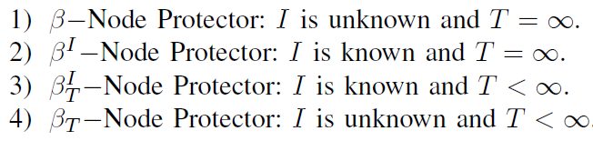
Node Protector Models
Definition:
  Suppose that deceptive message is spreading from an initial set I.
  Find the minimum number of nodes to disinfect so that the disinfection rate after T time is at least β percent

Slide 107
Results
Bad News:
  NP-hard in both Independent Cascade and Linear Threshold models
  β^{I}_{T} Node Protector cannot be approximated in polynomial time to a factor of c lnn, where c is some constant, unless P = NP
Good News
  Constant-extra bounded solutions for β and β^{I} –Node Protectors
  Optimal solution for β-Node Protector on Trees

Slide 108


Constant-Extra Approximation
Basic idea:
At each iteration, add a node v having the maximal marginal σ(S u {v}) to the current set S until fraction of safe nodes is obtained.

Slide 109


Information Propagation - The Truth
M. Cha et al. WWW’09, Propagation in Flickr.
How widely does information propagate in the social network?
Not widely – within two yards
How quickly does information propagate?
Not quickly, it takes a long time.
The average delay in information propagation across social links is about 140 days!!!
Notes:
Widely: Distance from fans to picture owners.
Quickly: After the first few (10-20) days, most pictures, in aggregate, enter a period of steady linear growth

