Slide 1
Community Structures

Slide 2
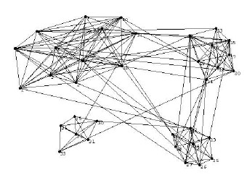
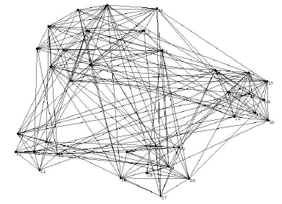
What is Community Structure
Definition:
A community is a group of nodes in which:
There are more edges (interactions) between nodes within the group than to nodes outside of it

Slide 3
Why Community Structure (CS)?
Many systems can be expressed by a network, in which nodes represent the objects and edges represent the relations between them:
Social networks: collaboration, online social networks
Technological networks: IP address networks, WWW, software dependency
Biological networks: protein interaction networks, metabolic networks, gene regulatory networks

Slide 4
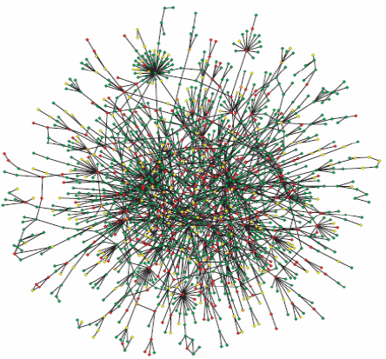
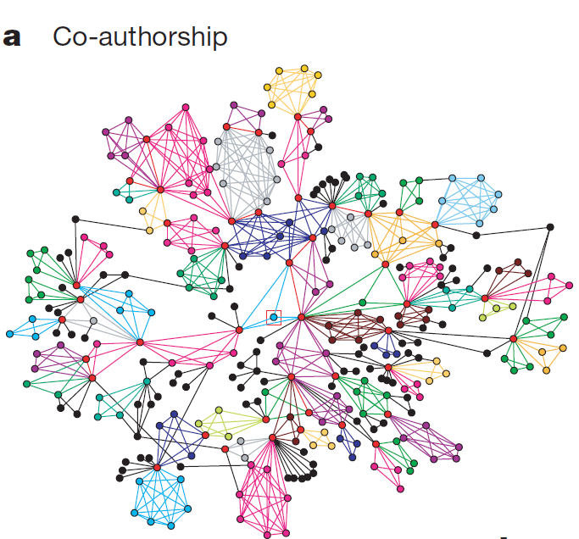
Why CS?
Yeast Protein interaction
networks

Slide 5
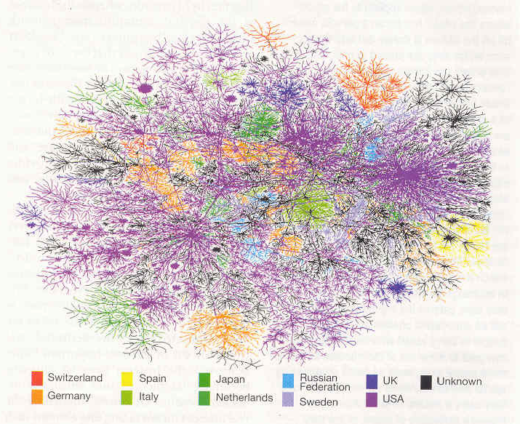
Why CS?
IP address network

Slide 6
Why Community Structure?
Nodes in a community have some common properties
Communities represent some properties of a networks
Examples:
In social networks, represent social groupings based on interest or background
In citation networks, represent related papers on one topic
In metabolic networks, represent cycles and other functional groupings

Slide 7
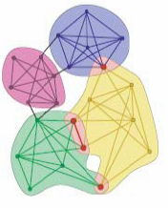
An Overview of Recent Work
Disjoint CS
Overlapping CS
Centralized Approach
Define the quantity of modularity and use the greedy algorithms, IP, SDP, Spectral, Random walk, Clique percolation
Localized Approach
Handle Dynamics and Evolution
Incorporate other information

Slide 8
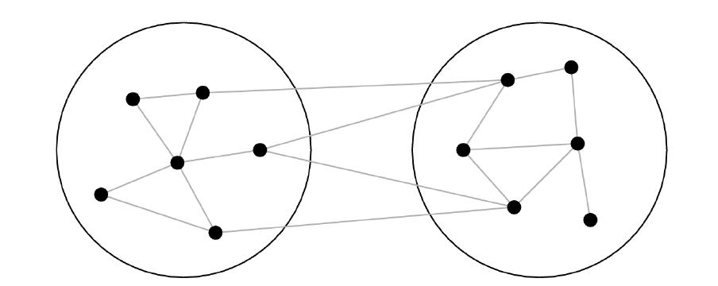
Graph Partitioning? It’s not
Graph partitioning algorithms are typically based on minimum cut approaches or spectral partitioning

Slide 9
Graph Partitioning
Minimum cut partitioning breaks down when we don’t know the sizes of the groups
- Optimizing the cut size with the groups sizes free puts all vertices in the same group
Cut size is the wrong thing to optimize
- A good division into communities is not just one where there are a small number of edges between groups
There must be a smaller than expected number edges between communities

Slide 10
Edge Betweeness
Focus on the edges which are least central, i.e.,, the edges which are most “between” communities
Instead of adding edge to G = (V, emptyset), progressively removing edges from an original graph G = (V,E)

Slide 11
Edge Betweeness
Definition:
For each edge (u,v), the edge betweeness of (u,v) is defined as the number of shortest paths between any pair of nodes in a network that run through (u,v)
betweeness(u,v) = | { P_{xy} | x, y in V, P_{xy} is a shortest path between x and y, and (u,v) in P_{xy}}|

Slide 12
Why Edge Betweeness

Slide 13
Algorithm
Initialize G = (V,E) representing a network
while E is not empty
Calculate the betweeness of all edges in G
Remove the edge e with the highest betweeness, G = (V, E – e)
Indeed, we just need to recalculate the betweeness of all edges affected by the removal

Slide 14
Time Complexity
Let |V| = n and |E| = m
Calculate the betweeness of all edges: O(mn)
Since we need to recalculate each time we remove an edge: O(m²n)

Slide 15
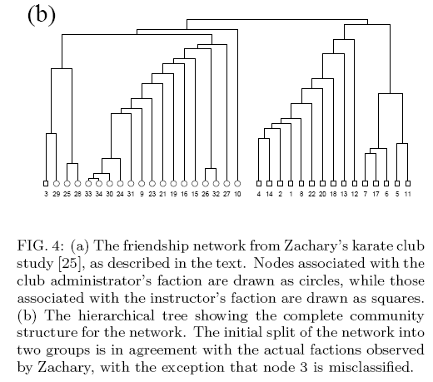
An Example

Slide 16
Disadvantages/Improvements
Can we improve the time complexity?
The communities are in the hierarchical form, can we find the disjoint communities?

Slide 17
Define the quantity (measurement) of modularity Q and find an approximation algorithm to maximize Q

Slide 18
Finding community structure in very large networks Authors: Aaron Clauset, M. E. J. Newman, Cristopher Moore 2004
Consider edges that fall within a community or between a community and the rest of the network
Define modularity:
if vertices are in the same community
probability of an edge between
two vertices is proportional to their degrees
adjacency matrix
For a random network, Q = 0
the number of edges within a community is no different from what you would expect

Slide 19
Finding community structure in very large networks Authors: Aaron Clauset, M. E. J. Newman, Cristopher Moore 2004
Algorithm
start with all vertices as isolates
follow a greedy strategy:
successively join clusters with the greatest increase ΔQ in modularity
stop when the maximum possible ΔQ <= 0 from joining any two
successfully used to find community structure in a graph with > 400,000 nodes with > 2 million edges
Amazon’s people who bought this also bought that…
alternatives to achieving optimum ΔQ:
simulated annealing rather than greedy search

Slide 20
Extensions to weighted networks
Betweenness clustering?
Will not work – strong ties will have a disproportionate number of short paths, and those are the ones we want to keep
Modularity (Analysis of weighted networks, M. E. J. Newman)
weighted edge
reuters new articles keywords

Slide 21
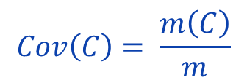

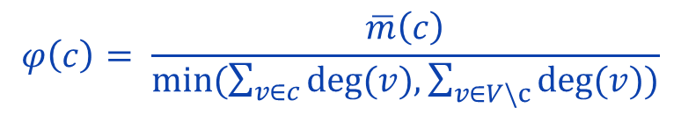
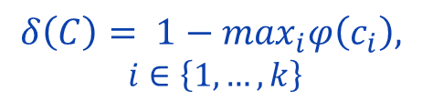
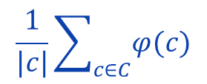
Structural Quality
Coverage
Modularity
Conductance
Inter-cluster conductance
Average conductance
There is no single perfect quality function. [Almedia et al. 2011]

Slide 22
Resolution Limit
l_{s} : # links inside module s
L : # links in the network
d_{s} : The total degree of the nodes in module s
: Expected # of links in module s

Slide 23
The Limit of Modularity
Modularity seems to have some intrinsic scale of order , which constrains the number and the size of the modules.
For a given total number of nodes and links we could build many more than modules, but the corresponding network would be less “modular”, namely with a value of the modularity lower than the maximum

Slide 24
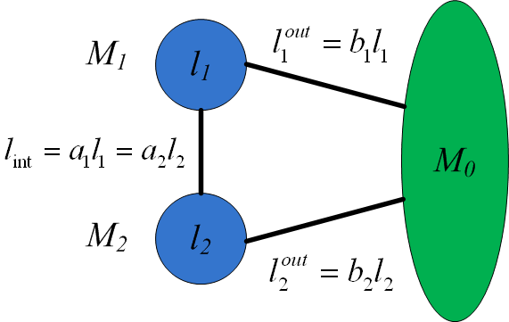
The Resolution Limit
Since M₁ and M₂ are constructed modules, we have

Slide 25
The Resolution Limit (cont)
Let’s consider the following case
Q_{A} : M₁ and M₂ are separate modules
Q_{B} : M₁ and M₂ is a single module
Since both M₁ and M₂ are modules by construction, we need
That is,

Slide 26
The Resolution Limit (cont)
Now let’s see how it contradicts
the constructed modules M₁ and M₂
We consider the following two scenarios: ( )
The two modules have a perfect balance between internal and external degree (a₁+b₁=2, a₂+b₂=2), so they are on the edge between being or not being communities, in the weak sense.
The two modules have the smallest possible external degree, which means that there is a single link connecting them to the rest of the network and only one link connecting each other (a₁=a₂=b₁=b₂=1/l).

Slide 27
Scenario 1 (cont)
When and , the right side of
can reach the maximum value
In this case, may happen.

Slide 28
Scenario 2 (cont)
a₁=a₂=b₁=b₂=1/l

Slide 29
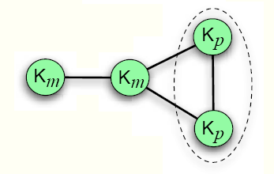
Schematic Examples (cont)
For example, p=5, m=20
The maximal modularity of the network corresponds to the partition in which the two smaller cliques are merged

Slide 30
Fix the resolution?
Uncover communities of different sizes

Slide 31
Community Detection Algorithms
Blondel (Louvian method), [Blondel et al. 2008]
Fast Modularity Optimization
Hierarchical clustering
Infomap, [Rosvall & Bergstrom 2008]
Maps of Random Walks
Flow-based and information theoretic
InfoH (InfoHiermap), [Rosvall & Bergstrom 2011]
Multilevel Compression of Random Walks
Hierarchical version of Infomap

Slide 32
Community Detection Algorithms
RN, [Ronhovde & Nussinov 2009]
Potts Model Community Detection
Minimization of Hamiltonian of an Potts model spin system
MCL, [Dongen 2000]
Markov Clustering
Random walks stay longer in dense clusters
LC, [Ahn et al. 2010]
Link Community Detection
A community is redefined as a set of closely interrelated edges
Overlapping and hierarchical clustering

Slide 33
Blondel et al
Two Phases:
Phase 1:
Initially, we have n communities (each node is a community)
For each node i, consider the neighbor j of i and evaluate the modularity gain that would take place by placing i in the community of j.
Node i will be placed in one of the communities for which this gain is maximum (and positive)
Stop this process when no further improvement can be achieved
Phase 2:
Compress each community into a node and thus, constructing a new graph representing the community structures after phase 1
Re-apply Phase 1

Slide 34
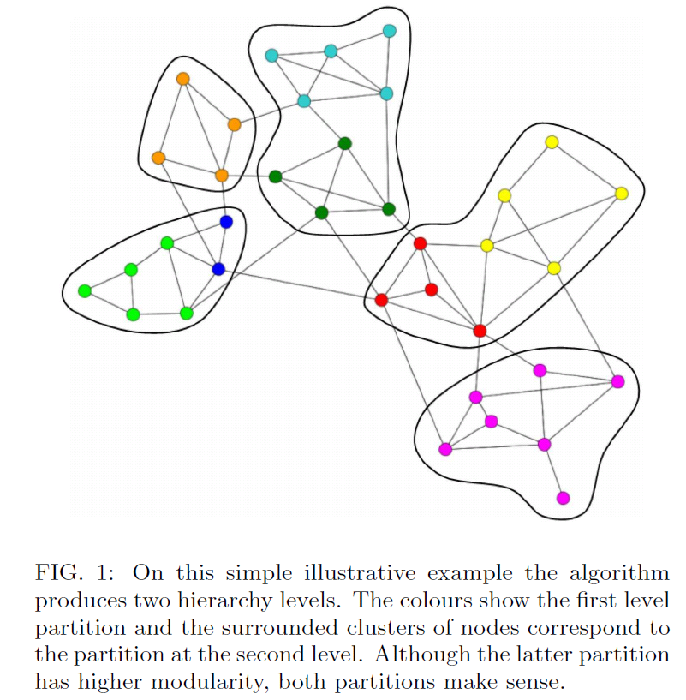

Slide 35
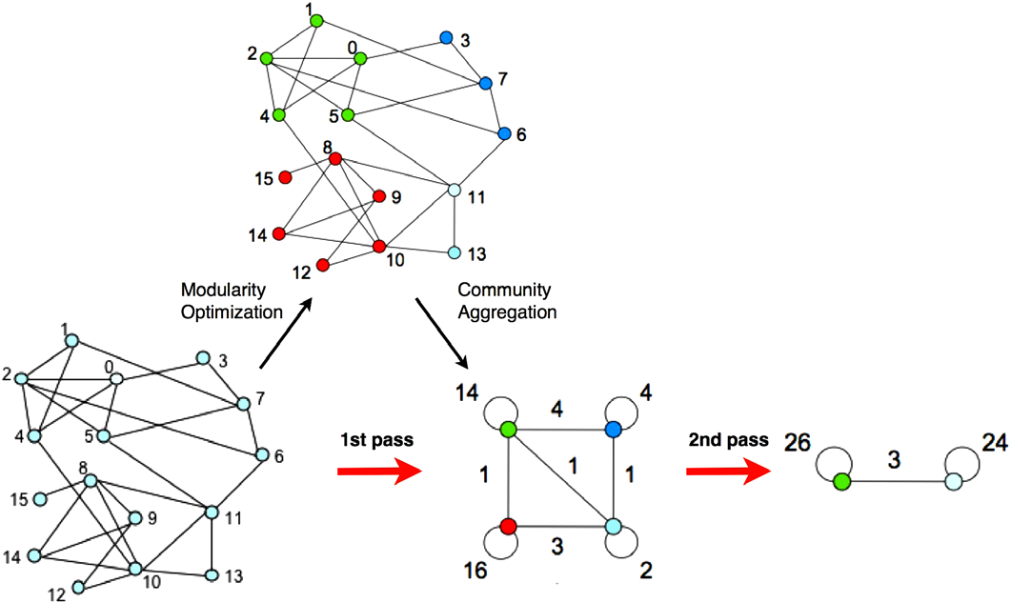
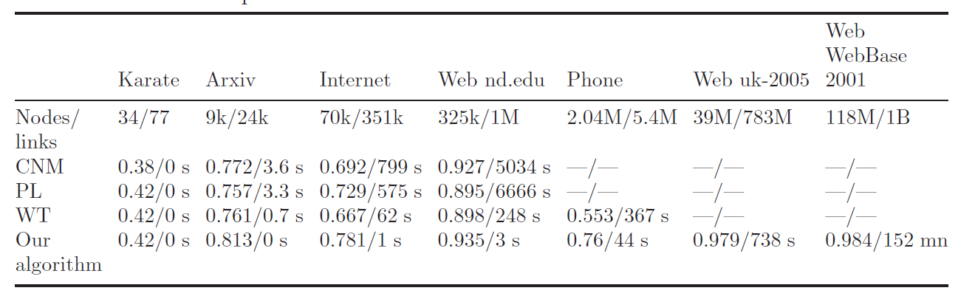

Slide 36

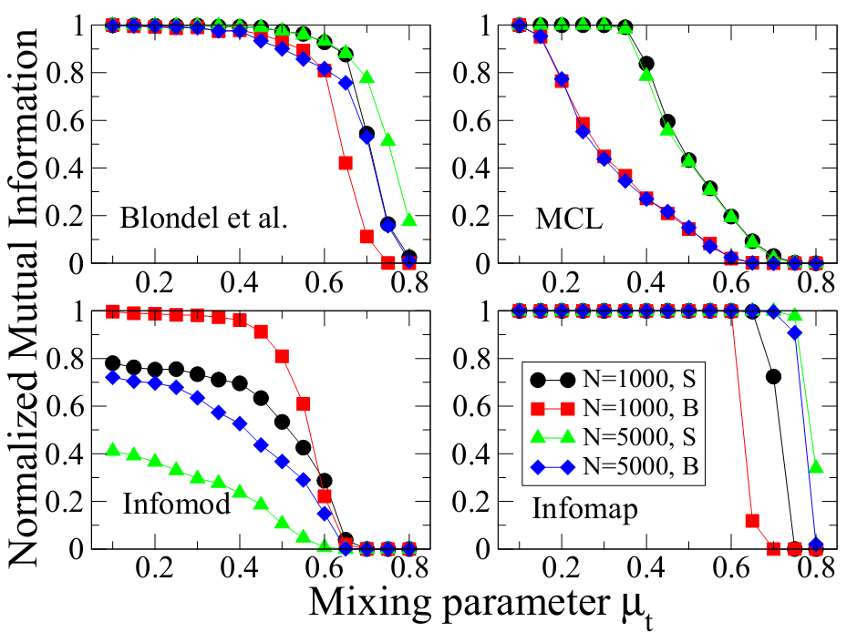
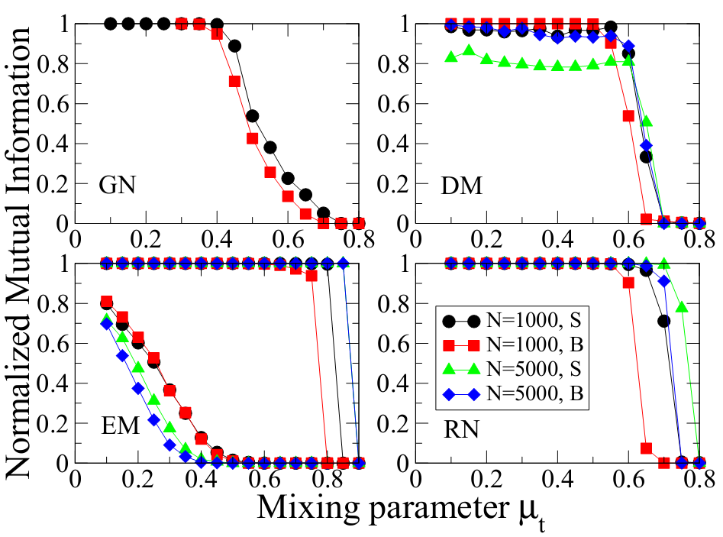
State-of-the-art methods
Evaluated by Lancichinetti, Fortunato, Physical Review E 09
Infomap[Rosvall and Bergstrom, PNAS 07]
Blondel’s method [Blondel et. al, J. of Statistical Mechanics: Theory and Experiment 08]
Ronhovde & Nussinov’s method (RN) [Phys. Rev. E, 09]
Many other recent heuristics
OSLOM, QCA…
No Provable Performance Guarantee
Need Approximation Algorithms

Slide 37
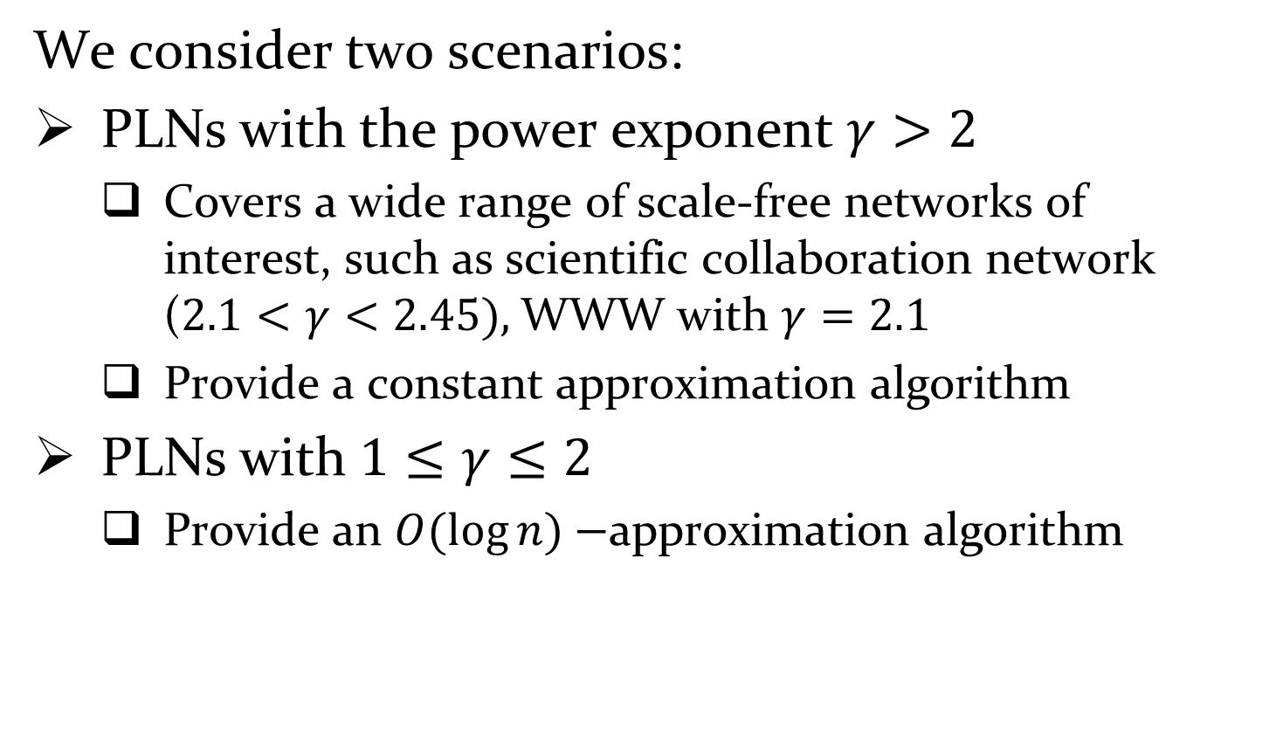
Power-Law Networks
We consider two scenarios:
PLNs with the power exponent $γ>2$
Covers a wide range of scale-free networks of interest, such as scientific collaboration network ($2.1<γ<2.45),$WWW with $γ=2.1$
Provide a constant approximation algorithm
PLNs with $1≤γ≤2$
Provide an $O(\log{n)}−$approximation algorithm

Slide 38
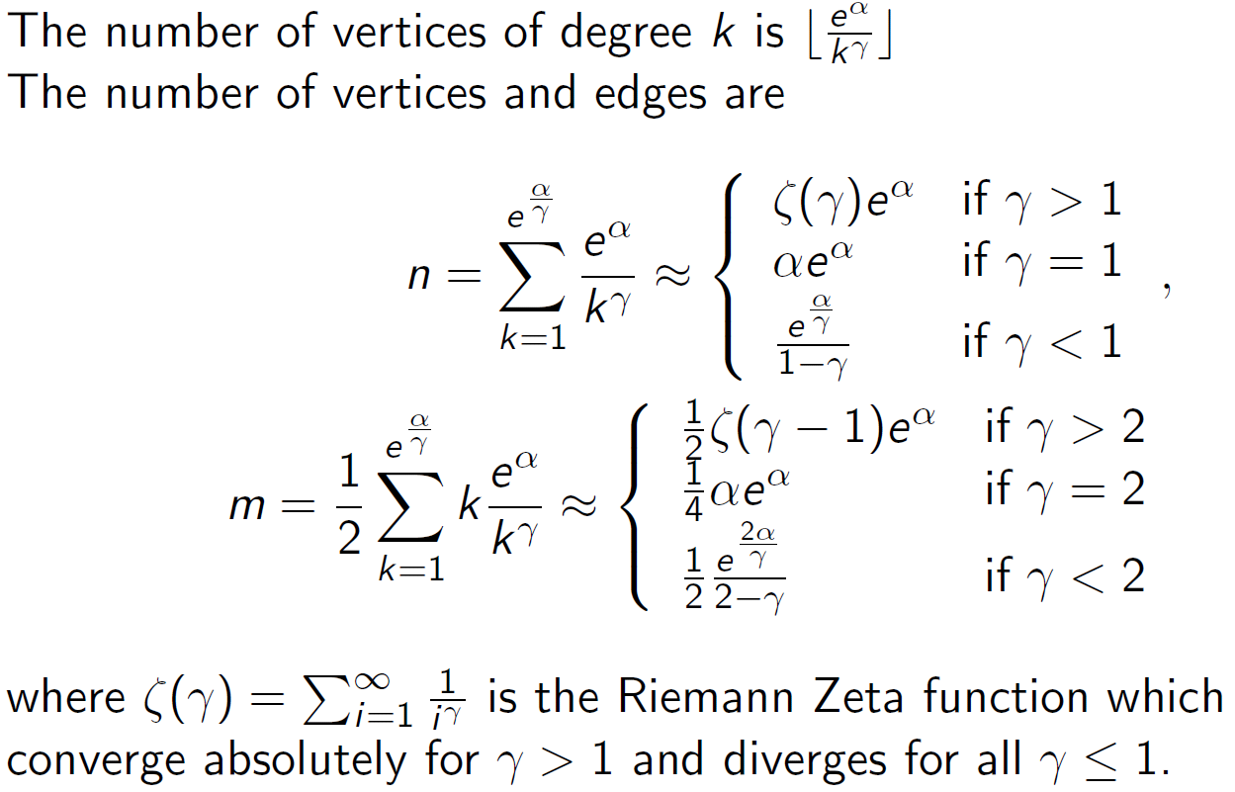
PLNs Model P(α, β)

Slide 39
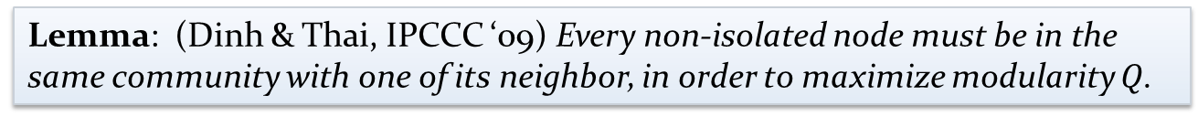
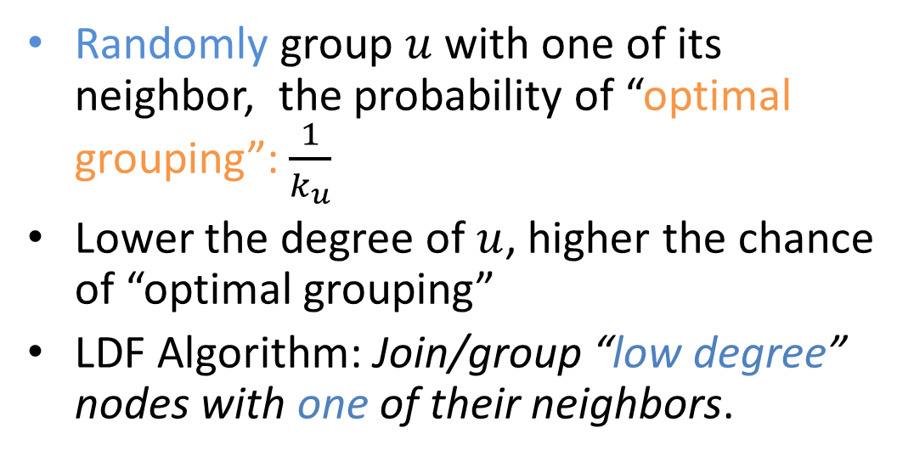
LDF Algorithm – The Basis
Lemma: (Dinh & Thai, IPCCC ‘09) Every non-isolated node must be in the same community with one of its neighbor, in order to maximize modularity $Q$.
Randomly group $u$ with one of its neighbor, the probability of “optimal grouping”:$\frac{1}{k_{u}}$
Lower the degree of $u$, higher the chance of “optimal grouping”
LDF Algorithm: Join/group “low degree” nodes with one of their neighbors.
w
v
x
u
y
z

Slide 40
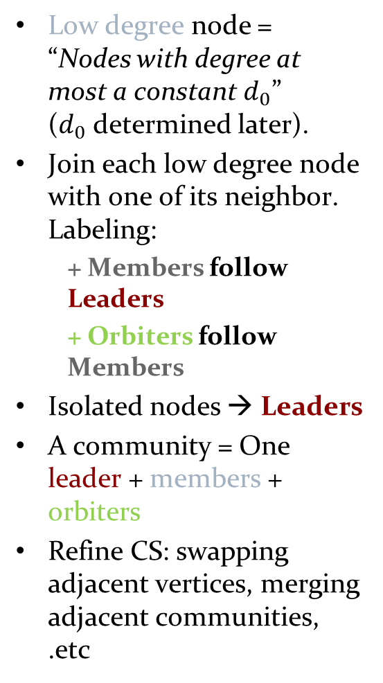

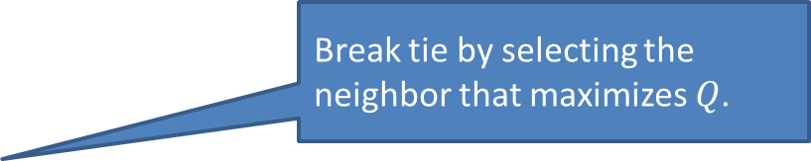
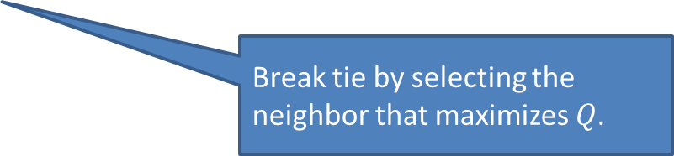
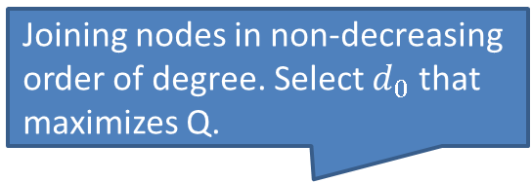
LDF Algorithm
Joining nodes in non-decreasing order of degree. Select $d_{0}$ that maximizes Q.
Low degree node = “Nodes with degree at most a constant $d_{0}$” ($d_{0}$determined later).
Join each low degree node with one of its neighbor. Labeling:
+ Members follow Leaders
+ Orbiters follow Members
Isolated nodes → Leaders
A community = One leader + members + orbiters
Refine CS: swapping adjacent vertices, merging adjacent communities, .etc
Algorithm 1. Low-degree Following Algorithm
(Parameter $d_{0}∈ N^{+}$)
$L≔∅; M :=∅;O ≔∅;$
for each $i∈ V$with $k_{i}≤d_{0}$ do
if ($i ∈V∖(L∪M$) then
if $∃ j∈ N\left(i\right)∖M$ then
$M = M∪ \left\{i\right\},$
$L=L∪ \left\{j\right\}, { p}_{j}=i$
else
Select $t∈N\left(i\right)$
$O=O∪\left\{t\right\}, p_{t}=i$
L:= $V∖\left(M∪ O\right),$ $CS ≔∅$
for each $i∈L$ do
$C_{i}:=\left\{i\right\}∪\left\{j \right| p_{j}=i or p\left(p_{j}\right)=i\}$
$CS := CS∪ \{C_{i}\}$
Optional: Refine $CS$ + Post-optimization
return $CS$
Break tie by selecting the neighbor that maximizes $Q$.
Break tie by selecting the neighbor that maximizes $Q$.

Slide 41
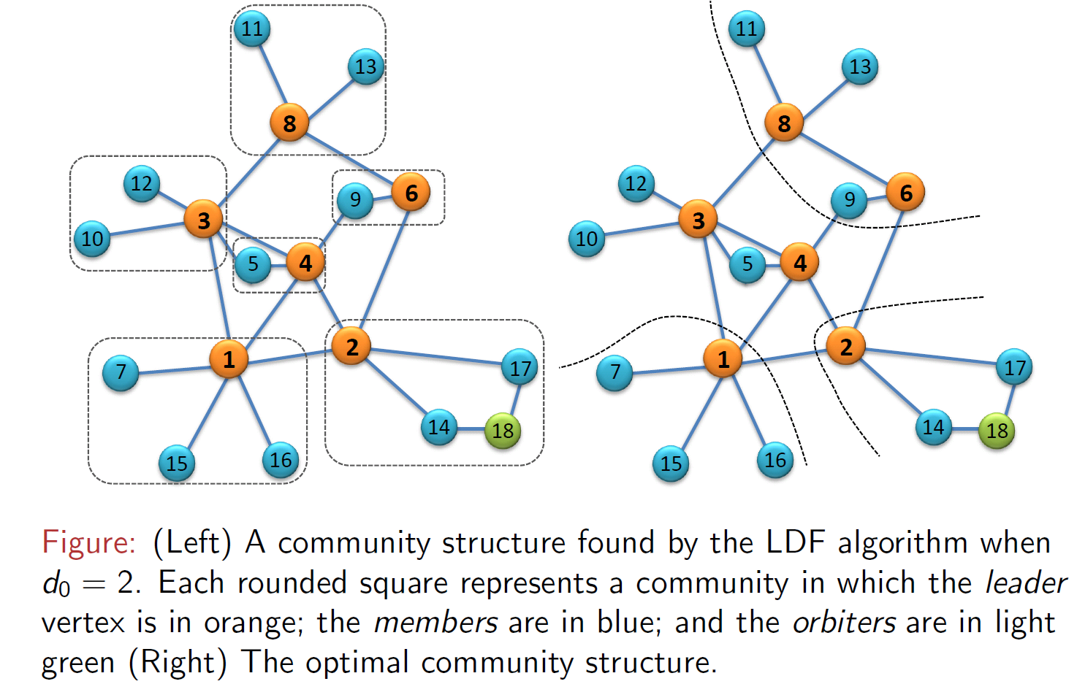
An Example of LDF

Slide 42
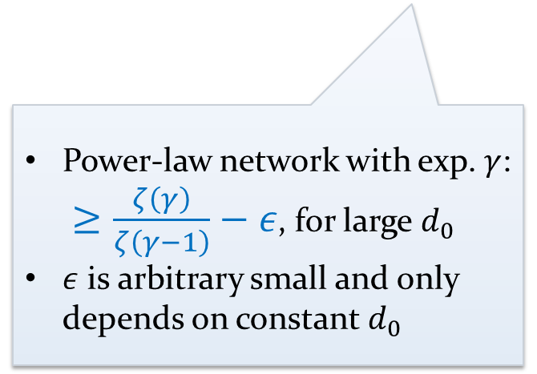
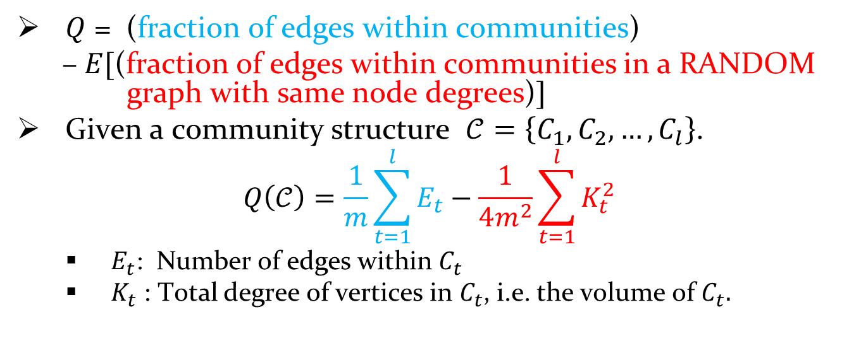
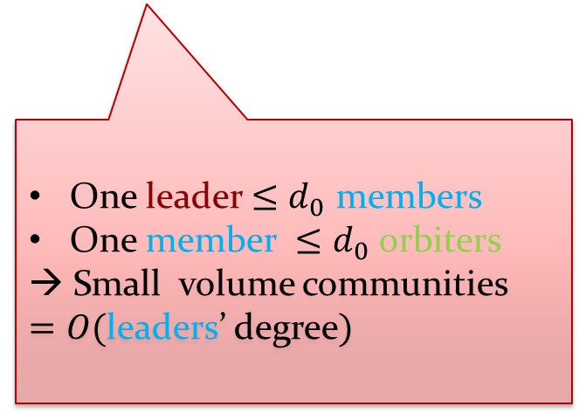
Theorem: Sketch of the proof
$Q$ = (fraction of edges within communities)
–$E[$(fraction of edges within communities in a RANDOM graph with same node degrees)$]$
Given a community structure $𝒞=\left\{C_{1},C_{2},…,C_{l}\right\}$.
$$Q\left(𝒞\right)=\frac{1}{m}\sum_{t=1}^{l}{E_{t}}−\frac{1}{4m^{2}}\sum_{t=1}^{l}{K_{t}^{2 }}$$
$E_{t}$: Number of edges within $C_{t}$
$K_{t}$ : Total degree of vertices in $C_{t}$, i.e. the volume of $C_{t}.$
One leader $≤d_{0}$ members
One member $≤d_{0}$ orbiters
→ Small volume communities $=O($leaders’ degree$)$
Power-law network with exp. $γ$: $≥\frac{ζ\left(γ\right)}{ζ\left(γ−1\right)}−ε$, for large $d_{0}$
$ε$ is arbitrary small and only depends on constant $d_{0}$

Slide 43
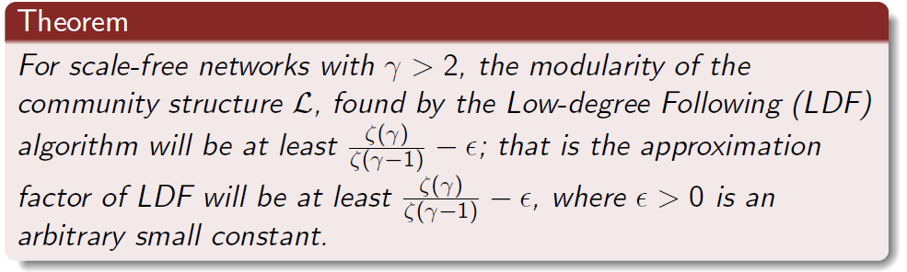
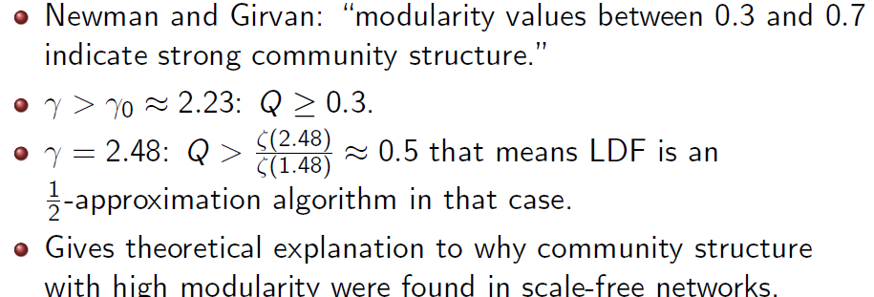
LDF Undirected -Theorem

Slide 44
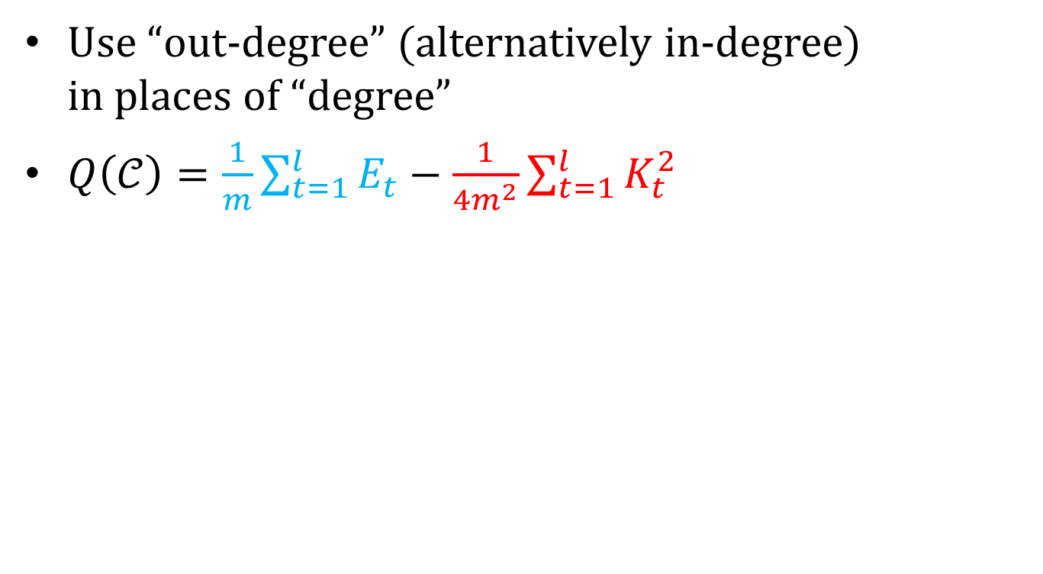
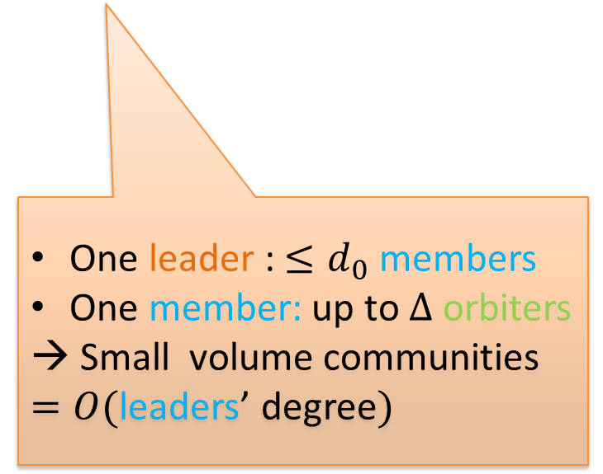
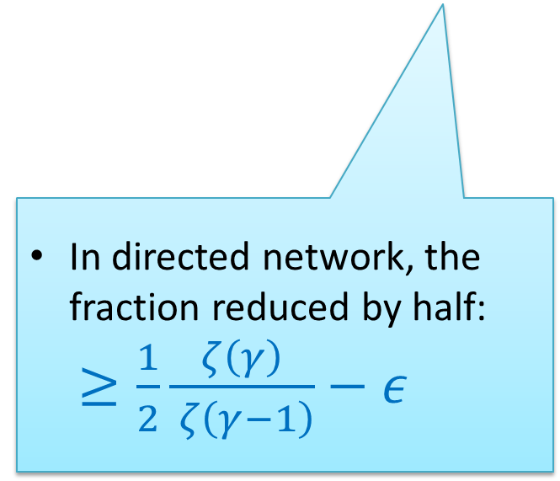
D-LDF – Directed Networks
Use “out-degree” (alternatively in-degree) in places of “degree”
$Q\left(𝒞\right)=\frac{1}{m}\sum_{t=1}^{l}{E_{t}}−\frac{1}{4m^{2}}\sum_{t=1}^{l}{K_{t}^{2 }}$
v
u
In directed network, the fraction reduced by half: $≥\frac{1}{2}\frac{ζ\left(γ\right)}{ ζ\left(γ−1\right)}−ε$
One leader : $≤d_{0}$ members
One member: up to $Δ$ orbiters
→ Small volume communities $=O($leaders’ degree$)$
Notes:
\Delta is maximum (in-out) degree

Slide 45

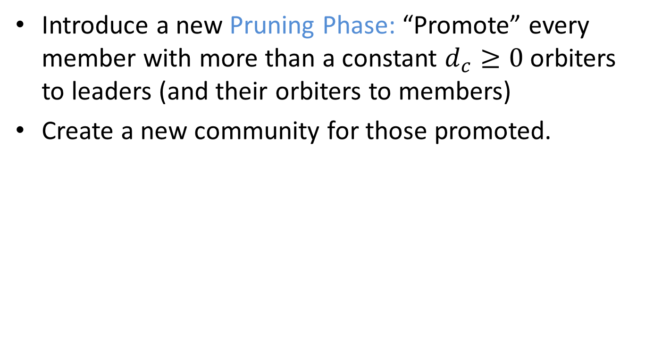
D-LDF – Directed Networks
Introduce a new Pruning Phase: “Promote” every member with more than a constant $d_{c}≥0$ orbiters to leaders (and their orbiters to members)
Create a new community for those promoted.
v
v
u
u
$$d_{c}=4$$

Slide 46
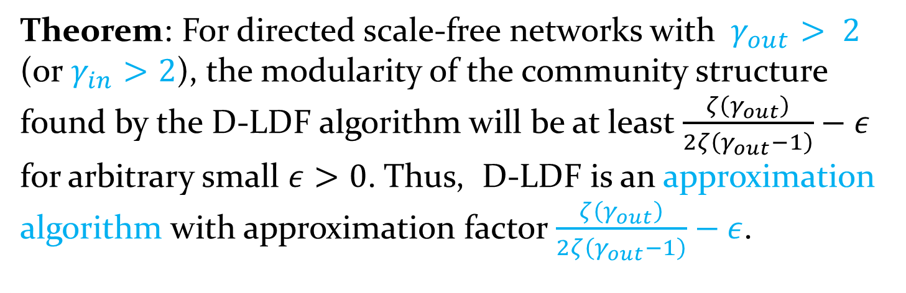
LDF-Directed Networks
Theorem: For directed scale-free networks with $γ_{out}> 2$ (or $γ_{in}>2$), the modularity of the community structure found by the D-LDF algorithm will be at least $\frac{ζ\left(γ_{out}\right)}{2ζ\left(γ_{out}−1\right)}−ε$ for arbitrary small $ε>0$. Thus, D-LDF is an approximation algorithm with approximation factor $\frac{ζ\left(γ_{out}\right)}{2ζ\left(γ_{out}−1\right)}−ε$.

Slide 47
Dynamic Community Structure
merge
move
more edges
Time
t
t+1
t+2
Network evolution

Slide 48
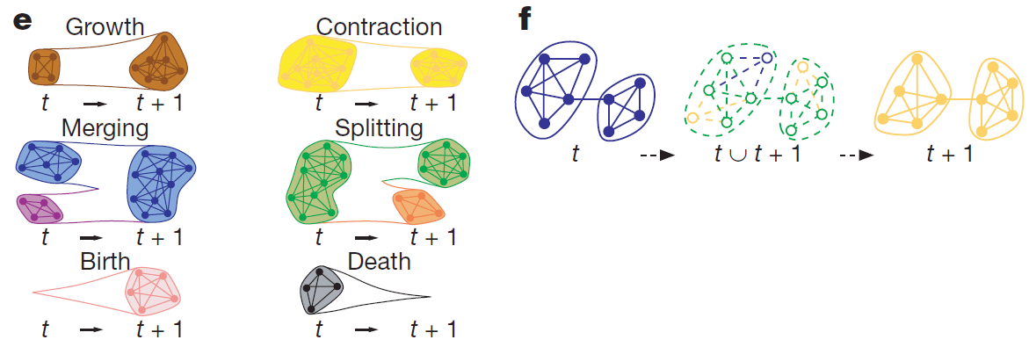
Quantifying social group evolution (Palla et. al – Nature 07)
Developed an algorithm based on clique percolation -> allows to investigate the time dependence of overlapping communties
Uncover basic relationships characterizing community evolution
Understand the development and self-optimization

Slide 49
Findings
Fundamental diffs b/w the dynamics of small and large groups
Large groups persists for longer; capable of dynamically altering their membership
Small groups: their composition remains unchanged in order to be stable
Knowledge of the time commitment of members to a given community can be used for estimating the community’s lifetime

Slide 50
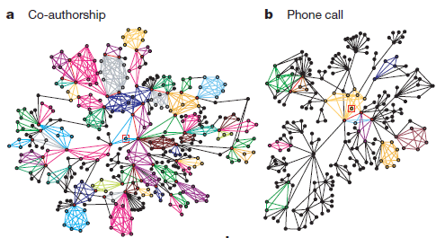
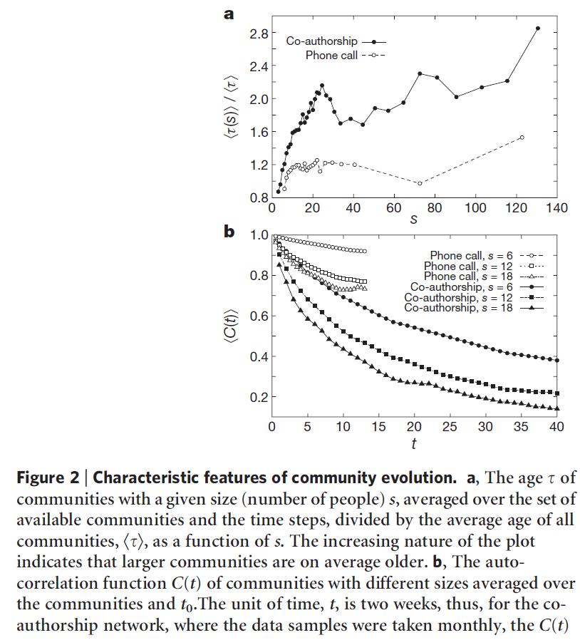
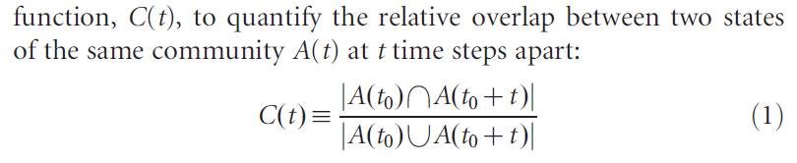

Slide 51
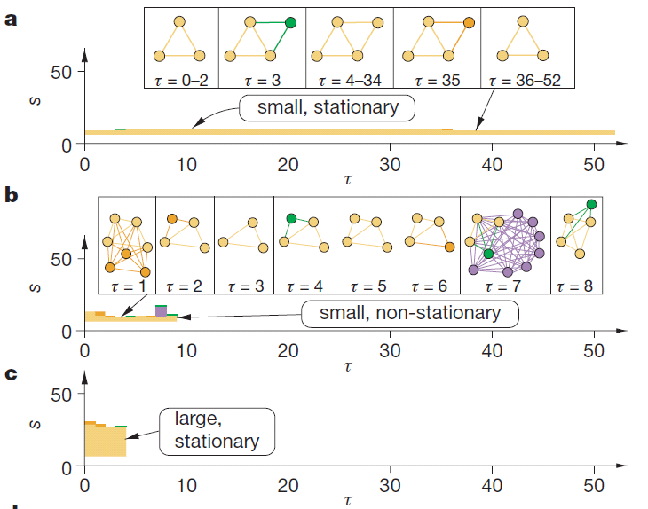
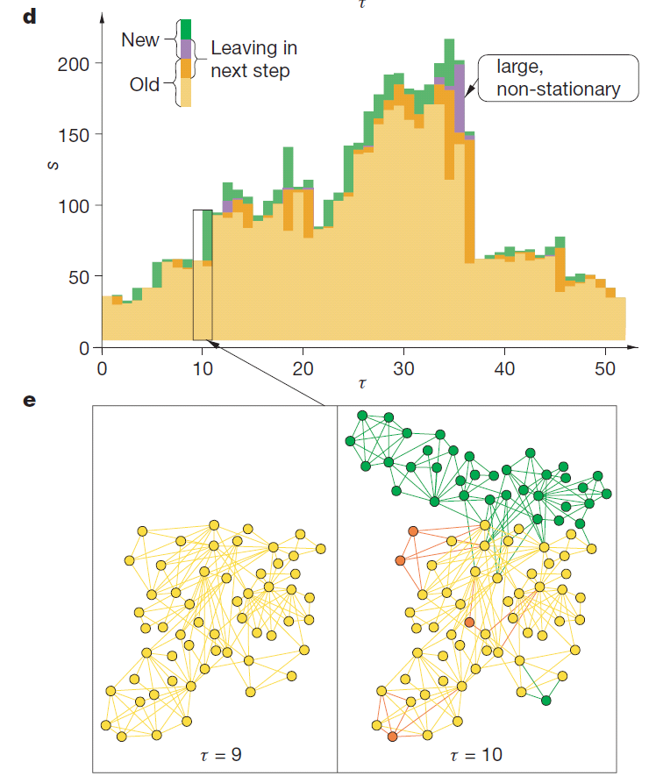
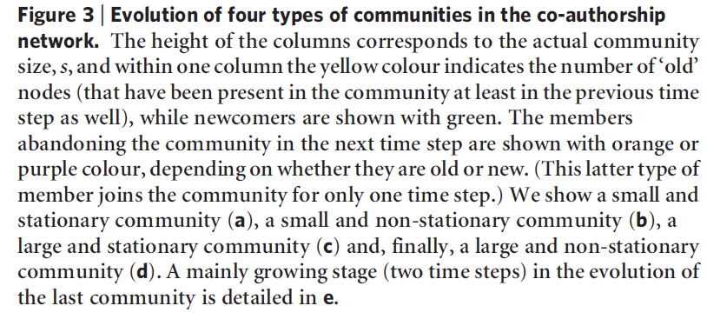

Slide 52
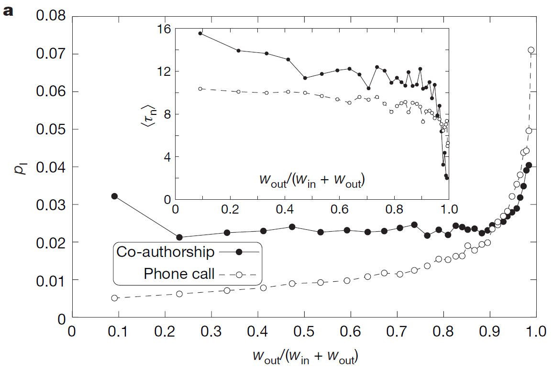
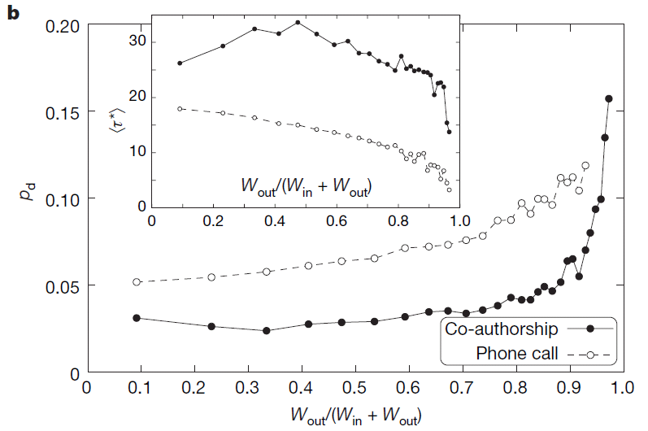
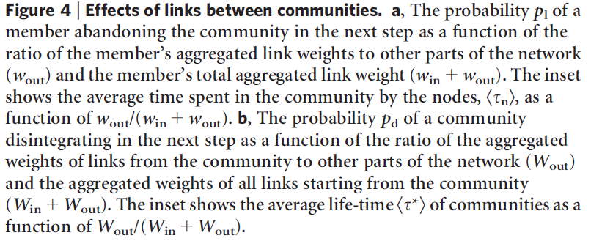

Slide 53
Research Problems
How to update the evolving community structure (CS) without re-computing it
Why?
Prohibitive computational costs for re-computing
Introduce incorrect evolution phenomena
How to predict new relationships based on the evolving of CS

Slide 54






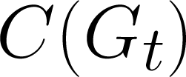

An Adaptive Model
Input network
Basic CS
:
:
Need to handle
Node insertion
Edge insertion
Node removal
Edge removal
Network changes
Basic communities
Updated communities

Slide 55
Related Work in Dynamic Networks
GraphScope [J. Sun et al., KDD 2007]
FacetNet [Y-R. Lin et al., WWW 2008]
Bayesian inference approach [T. Yang et al., J. Machine Learning, 2010]
QCA [N. P. Nguyen and M.T. Thai, INFOCOM 2011]
OSLOM [A. Lancichinetti et al., PLoS ONE, 2011]
AFOCS [Nguyen at el, Mobicom 2011]

Slide 56
An Adaptive Algorithm for Overlapping
Input network
Phase 1: Basic CS detection (β)
Our solution:
AFOCS: A 2-phase and limited input dependent framework
Phase 2: Adaptive CS update (β)
Network changes
Basic communities
Updated communities
N. Nguyen and M. T. Thai, ACM MobiCom 2011

Slide 57


Phase 1: Basic Communities Detection
Basic communities
Dense parts of the networks
Can possibly overlap
Bases for adaptive CS update
Duties
Locates basic communities
Merges them if they are highly overlapped

Slide 58



Phase 1: Basic Communities Detection
Locating basic communities: when Ψ(C) ≥ τ(C)
Ψ(C) = 0.9 ≥ τ(C) =0.725
Merging: when OS(C_{i}, C_{j}) ≥ β
OS(C_{i}, C_{j}) = 1.027 ≥ β = 0.75

Slide 59


Phase 1: Basic Communities Detection

Slide 60
Phase 2: Adaptive CS Update
Update network communities when changes are introduced
Need to handle
Adding a node/edge
Removing a node/edge
Basic communities
Network changes
Updated communities
+ Locally locate new local communities
+ Merge them if they highly overlap with current ones

Slide 61



Phase 2: Adding a New Node
u
u
u

Slide 62


Phase 2: Adding a New Edge

Slide 63
Phase 2: Removing a Node
Identify the left-over structure(s) on C\{u}
Merge overlapping substructure(s)

Slide 64
Phase 2: Removing an Edge
Identify the left-over structure(s) on C\{u,v}
Merge overlapping substructure(s)

Slide 65

AFOCS performance: Choosing β

Slide 66

AFOCS v.s. Static Detection
+ CFinder [G. Palla et al., Nature 2005]
+ COPRA [S. Gregory, New J. of Physics, 2010]

Slide 67

AFOCS v.s. Other Dynamic Methods
+ iLCD [R. Cazabet et al., SOCIALCOM 2010]

Slide 68



Adaptive CS Detection in Dynamic Networks
Running time is proportional to the amount of changes
Can be locally employed
More consistent community structure: Critical for applications such as routing.
START
1. Initial Network
2. CS Detection Algorithm $A_{1}$
3. Refine CS
4. Changes in the Network
5. Output
CS
Significantly reduce the size of the network
Allow higher quality (often more expensive) Algorithm in place of $A_{2}$
6. Compact Representation Graph (CRG)
7. CS Detection Algorithm $A_{2}$

Slide 69


Adaptive CS Detection in Dynamic Networks
10
20
20
10
28
10
2
2
2
y
y
y
x
3
y
x
z
z
x
2
2
z
2
x
12
a
12
z
a
16
a
a
b
b
t
t
2
b
2
t
t
b
Initial network
Detect CS with Algo. $A_{1}$
Compress each community into a single node; self-loops represents the weights of the within community edges.
Update changes in the network
Affected nodes = Nodes incident to changed edges/nodes
Construct CRG by “pulling out” affected nodes from their communities
Find CS of the CRG with Algo. $A_{2}$

Slide 70


A-LDF – Dynamic Network Algorithm
START
Both selected as the LDF algorithm (without the refining phase)
Compact representation:
Label nodes that represents communities with leader.
Unlabel all pulled out nodes (nodes that are incident to changes).
Initial Network
CS Detection Algorithm $A_{1}$
Refine CS
Changes in the Network
Output
CS
Compact Representation Graph
CS Detection Algorithm $A_{2}$

Slide 71

A-LDF – Dynamic Network Algorithm
For dynamic scale-free networks with $γ> 2$,
A-LDF algorithm:
$Q≥\frac{ζ\left(γ\right)}{ζ\left(γ−1\right)}−ε$ for $ε>0$.
$\frac{ζ\left(γ\right)}{ζ\left(γ−1\right)}−ε$ Approximation algorithm.
Running time $O( \sum_{v∈AF}{ k_{v})}$ where $AF$ is the set of “affected nodes”.

Slide 72

Experimental Results
Datasets
Static data sets: Karate Club, Dolphin, Twitter, Flickr, .etc
Dynamic social networks:
Facebook (New Orleans): 63 K nodes, 1.5 M edges
ArXiv Citation network: 225 K articles, ~40 K new each year
Metrics
Modularity $Q$
Number of communities
Running time
Normalized Mutual Information (NMI)
Notes:
Blondel’s method is the short name of the static method that we used to compare to.
Since we don’t have a proper ground-truth, we compare the performance of our adaptive method with the static method at each snapshot.
Metric: NMI, it tell you how good you are in comparison

Slide 73
Static Networks Size
# |  | Vertices | Edges
1 | Karate | 34 | 78
2 | Dolphin | 62 | 159
3 | Les Miserables | 77 | 254
4 | Political Books | 105 | 441
5 | Ame. Col. Fb. | 115 | 613
6 | Elec. Cir. S838 | 512 | 819
7 | Erdos Scie. Collab. | 6,100 | 9,939
8 | Foursquare | 44,832 | 1,664,402
9 | Facebook | 63,731 | 905,565
10 | Twitter | 88,484 | 2,364,322
11 | Fllickr | 80,513 | 5,899,882

Slide 74
Performance Evaluation

Slide 75
Evaluation in Dynamic Networks

Slide 76
Evaluation in Dynamic Networks

Slide 77


Incorporate other information
Social connections
Friendship (mutal) relation (Facebook, Google+)
Follower (unidirectional) relation (Twitter)

Slide 78


Incorporate other information
The discussed topics
Topics that people in a group are mostly interested

Slide 79


Incorporate other information
Social interactions types
Wall posts, private or group messages (Facebook)
Tweets, retweets (Twitter)
Comments

Slide 80






In rich-content social networks
Not only the topology that matters
But also,
User interests
A user may interested in many communities
Community interests
A community may interested in different topics

Slide 81
In rich-content social networks
Communities = “groups of users who are interconnected and communicate on shared topics”
interconnected by social connection and interaction types
Given a social network with
Network topology
Users and their social connections and interactions
Topics of interests
How can we find meaningful communities as well as their topics of interests?

Slide 82
Approaches
Use Bayesian models to extract latent communities
Topic User Community Model
Posts/Tweets can be broadcasted
Topic User Recipient Community Model
Posts/Tweets are restricted to desired users only
Full Topic User Recipient Community Model
A post/tweet generated by a user can be based on multiple topics

Slide 83
Assumptions
A user can belong to multiple communities
A community can participate in multiple topics
For TUCM and TURCM
Posts in general discuss one topic only
Full TURCM
Posts can discuss multiple topics

Slide 84

Background
Multinormial distribution – Mult(.)
n trials
k possible outcomes with prob. p₁, p₂,…, p_{k} sum up to 1
X₁, X₂,.., X_{k} (X_{i} denote the number of times outcome #i appears in n trials)

Slide 85

Multinormal distribution

Slide 86


Symmetric Dirichlet Distribution
Dir_{K}(α) where α = (α₁, …, α_{K}) on variable
x₁, x2, …, x_{K} where x_{K} = 1 – (x₁+..+x_{K-1}) has prob.

Slide 87

Notations
Observation variables
Latent variables
U ← the set of users
R_{i} ← the neighbors (recipients) of u_{i}
For any u_{i} $∈$ U, u_{j} $∈$ Ri,
P_{ij} ← {posts/tweets u_{i} → u_{j}}
P_{i} ← $∪$ P_{ij}, $∀$u_{j} $∈$ R_{i}
P = $∪$ P_{i}$, ∀$ u_{i} $∈$ U
N_{p} ← # of words in a post p $∈$ P
W_{p} ← the set of words in p
X_{p} ← the type of p
c ← a community; z ← a topic

Slide 88

Notations (cont’d)
Z ← the number of topics
C ← the number of communities
V ← the size of the vocabulary from which the communications between users are composed
X ← the number of different type of communications
G(U, E) ← the social network
E ← set of edges
Dir_{Y}(α)
Mult(.)
$η_{u_{i}}$← multinormal distribution represents ui’s interest in each topic

Slide 89

Topic User Community Model
Social Interaction Profile - SIP(u_{i})
The SIP of users is represented as random mixtures over latent community variables
Each community is in turn defined as a distribution over the interaction space

Slide 90


Topic User Community Model
1
2

Slide 91


Topic User Community Model
3a
3b

Slide 92

TUCM
Model presentation
A Bayesian decomposition

Slide 93

TUCM – Parameter Estimation
$N_{w}^{p}$ ← number of times a given word w occurs in p
C_{-p}, X_{-p}, Z_{-p} and W_{-p} ← community, post type, topic assignments and set of words except post p

Slide 94

TUCM – Parameter Estimation

Slide 95

TUCM – Parameter Estimation

Slide 96
Topic User Recipient Community
This model
Does not allow mass messaging
The sender typically sends out messages to his/her acquaintances
The post are on a topic that both sender and recipient are interested in.
In the same spirit of TUCM
Now we have user u_{j} for all u_{j} in R_{i}

Slide 97

TURC

Slide 98
Full TURC Model
Previous models
Assume that each post generated by a user is based on a single topic
Full TURC
Relaxes this requirement
Communities how have a higher relationship to authors

Slide 99


Full TURC Model
2
1
3

Slide 100


Full TURC Model

Slide 101
Experiments
Data
6 month of Twitter in 2009
5405 nodes, 13214 edges, 23043 posts
Enron email
150 nodes, ~300K emails in total
Number of communities C = 10
Number of topics = 20
Competitor methods: CUT and CART

Slide 102


Results

Slide 103




Results

Slide 104


Results

