Slide 1
PCPs and Inapproximability
Introduction

Slide 2
Why Approximation Algorithms
Problems that we cannot find an optimal solution in a polynomial time
Eg: Set Cover, Bin Packing
Need to find a near-optimal solution:
Heuristic
Approximation algorithms:
This gives us a guarantee approximation ratio

Slide 3
Combinatorial Optimization
The study of finding the “best” object from within some finite space of objects, eg:
Shortest path: Given a graph with edge costs and a pair of nodes, find the shortest path (least costs) between them
Traveling salesman: Given a complete graph with nonnegative edge costs, find a minimum cost cycle visiting every vertex exactly once
Maximum Network Lifetime: Given a wireless sensor networks and a set of targets, find a schedule of these sensors to maximize network lifetime

Slide 4
In P or not in P?
Informal Definitions:
The class P consists of those problems that are solvable in polynomial time, i.e. O(n^{k}) for some constant k where n is the size of the input.
The class NP consists of those problems that are “verifiable” in polynomial time:
Given a certificate of a solution, then we can verify that the certificate is correct in polynomial time

Slide 5
In P or not in P: Examples
In P:
Shortest path
Minimum Spanning Tree
Not in P (NP):
Vertex Cover
Traveling salesman
Minimum Connected Dominating Set

Slide 6
Approximation Algorithms
An algorithm that returns near-optimal solutions in polynomial time
Approximation Ratio ρ(n):
Define: C* as a optimal solution and C is the solution produced by an approximation algorithm
max (C/C*, C*/C) <= ρ(n)
Maximization problem: 0 < C <= C*, thus C*/C shows that C* is larger than C by ρ(n)
Minimization problem: 0 < C* <= C, thus C/C* shows that C is larger than C* by ρ(n)

Slide 7
Approximation Algorithms (cont)
PTAS (Polynomial Time Approximation Scheme): A (1 + ε)-approximation algorithm for a NP-hard optimization П where its running time is bounded by a polynomial in the size of instance I
FPTAS (Fully PTAS): The same as above + time is bounded by a polynomial in both the size of instance I and 1/ε

Slide 8
Hardness of Approximation
Informally, how hard can we approximate?
Hardness results usually falls into the following 3 classes:
Constant ( > 1)
Ω(log n)
n^{ε}

Slide 9
Proving Hardness of Approximation
Show if we have a ρ approximation to problem A, we could solve the NP-hard problem B exactly
The only inapproximability results that can be proved with such reductions are for problems that remain NP-hard even restricted to instances where the optimum is a small constant.
Want to use already proved hardness of approximation results to prove new results (objective of the course)

Slide 10
An Example (k-center)
≤

Slide 11
2-Approx

Slide 12
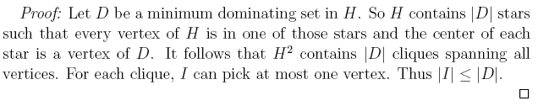

Slide 14
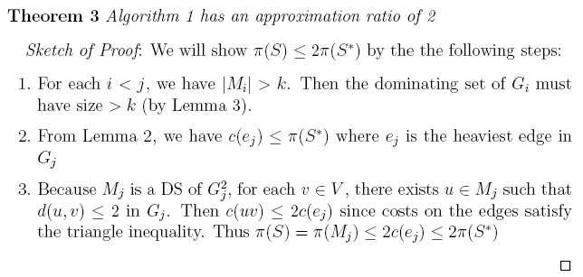
Analysis

Slide 15
Hardness of Approximation (k-center)

Slide 16
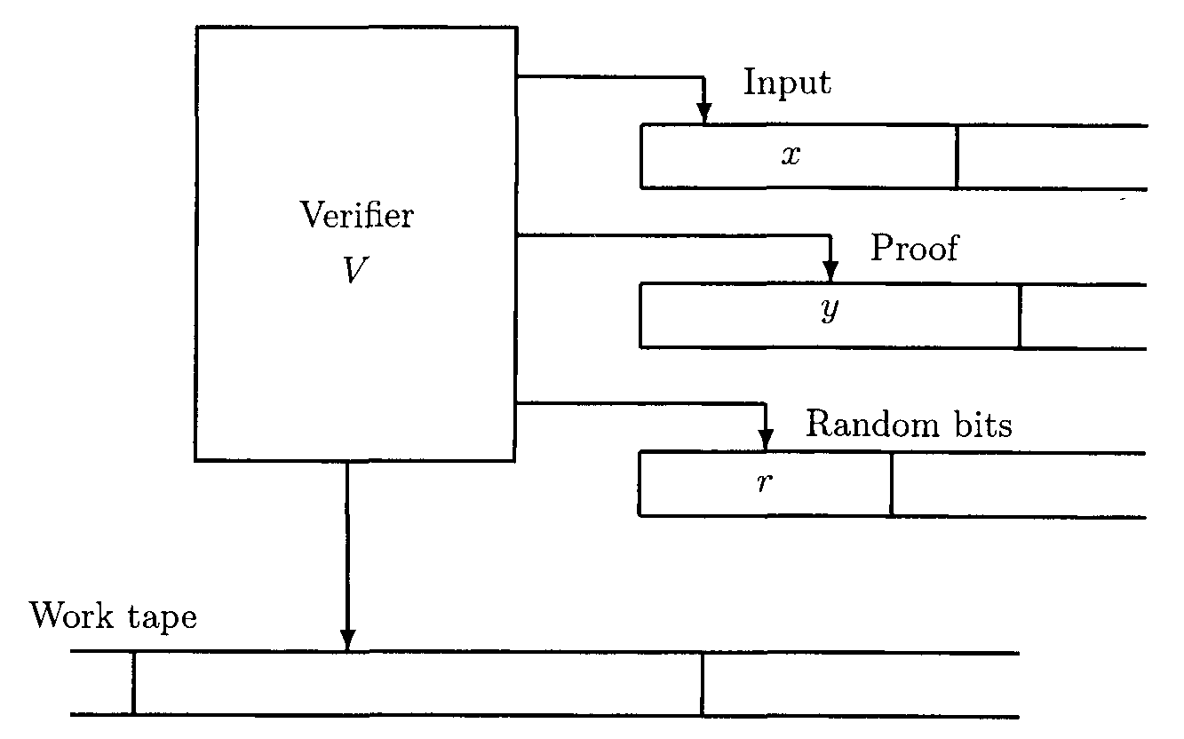
The PCP System

Slide 17
The PCP System
Use the familiar concept of a verifier and a proof
PCP system comes with two parameters: the number of random bits required by the verifier; the number of bits that the verifier is allowed to examine
The most useful setting of these parameters is O(log n) and O(1) respectively. This defines the class PCP(log n, 1)

Slide 18
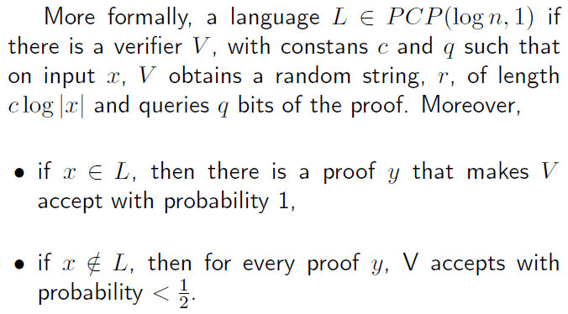
The PCP System

Slide 19
Connection to Inapproximability
Theorem: NP = PCP[log n, 1]
Informally, the PCP theorem states that every NP-statement has a probabilistically checkable proof, i.e. a proof which can be "spot-checked" by reading only a constant number of bits from the proof. These bits are selected by a randomized process using a very limited amount of randomness. The checking process always accepts a correct proof of a correct statement and rejects any cheating proof of an incorrect statement with high probability.
If you verify k times, then the probability for a YES answer of a wrong proof is at most ½^k

Slide 20
Brief History
Intractability of many combinatorial optimization problems was observed in the 60s
R.L. Graham. Bounds for certain multiprocessing anomalies. Bell System Technology Journal, 45:1563–1581, 1966.
Introduce the theory of NP-completeness (CLK)
S.A. Cook. The complexity of theorem proving procedures. In Proceedings of the 3rd ACM Symposium on Theory of Computing, pages 151–158, 1971
L. A. Levin. Universal search problems. Problemi Peredachi Informatsii, 9:265–266,1973
R.M. Karp. Reducibility among combinatorial problems. In R.E. Miller and J.W.Thatcher, editors, Complexity of Computer Computations, pages 85–103. Plenum Press, 1972

Slide 21
Brief History
In 1973, Johnson gave a foundation to the field of the design and analysis of approximation algorithms
Now, come to an exciting era (leading to PCPs and Inapproximability)
The story of the PCP Theorem begins at MIT in the early 1980s

Slide 22
Brief History
STOC 85: The Knowledge Complexity of Interactive Proof System by Goldwasser, Micali, and Rackoff
Introduced Interactive Proofs
In an interactive proof, a randomized poly-time verifier with private coin tosses interacts with an all-powerful prover; they send messages back and forth in poly many rounds. Correct statements should have proofs accepted with probability 1 (‘completeness’) and incorrect statements should be rejected, regardless of the proof, which probability at least ½ (‘soundness’)
(Independently with Babai et. al)

Slide 23
Brief History
In 1991, Feige et al discovered that probabilistic proof systems could give a robust model for NP that could be used to prove an inapproximability for the Independent Set problem
A year later, Arora et al proved the PCP Theorem (NP = PCP[log n, 1]) and showed how to use the PCP Theorem to prove that Max 3SAT does not have PTAS

Slide 24
