Slide 1
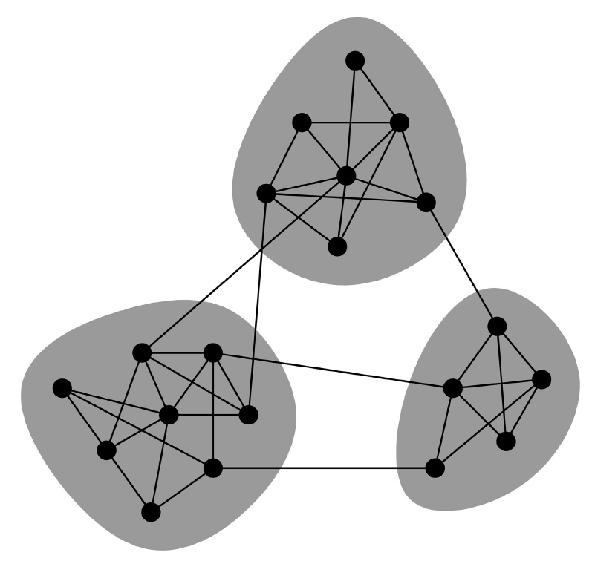
Modularity and Community Structure in Networks*
M.E.J Newman in PNAS 2006

Slide 2
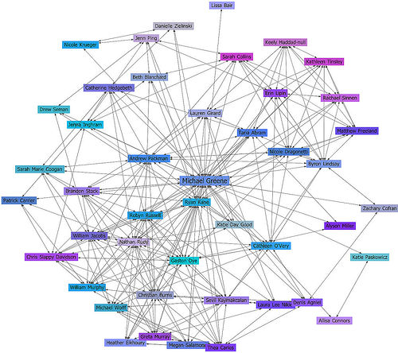
Networks
A network: presented by a graph G(V,E):
V = nodes, E = edges (link node pairs)
Examples of real-life networks:
  social networks (V = people)
  World Wide Web (V= webpages)
  protein-protein interaction networks
  (V = proteins)

Slide 3
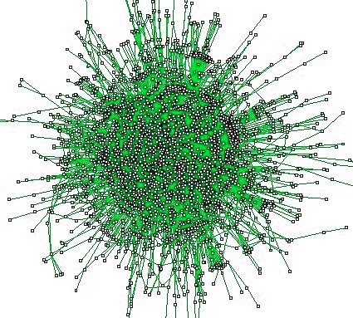
Protein-protein Interaction Networks
Nodes – proteins (6K), edges – interactions (15K).
Reflect the cell’s machinery and signaling pathways.

Slide 4
Communities (clusters) in a network
A community (cluster) is a densely connected group of vertices, with only sparser connections to other groups.

Slide 5
Searching for communities in a network
There are numerous algorithms with different "target-functions":
  "Homogenity" - dense connectivity clusters
  "Separation"- graph partitioning, min-cut approach
Clustering is important for Understanding the structure of the network
  Provides an overview of the network

Slide 6
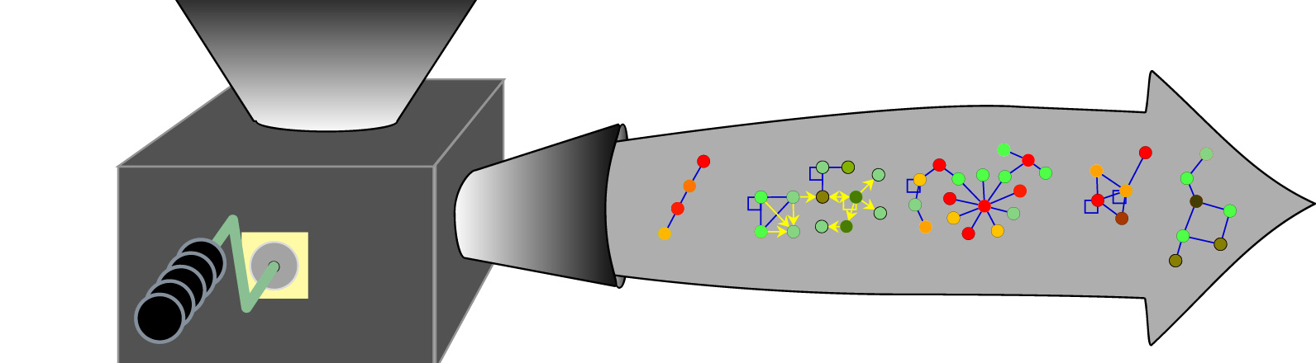
Distilling Modules from Networks
Motivation: identifying protein complexes responsible for certain functions in the cell

Slide 7
Modularity (Newman)

Slide 8
Modularity of a division (Q)
Q = #(edges within groups) - E(#(edges within groups in a
RANDOM graph with same node degrees))
Trivial division: all vertices in one group
==> Q(trivial division) = 0
k_{i} = degree of node i
M = ∑k_{i} = 2|E|
Aij = 1 if (i,j)∈E, 0 otherwise
Eij = expected number of edges between i and j in a random graph with same node degrees.
Lemma: Eij ≈ k_{i}*k_{j} / M
Edges within groups
Q = ∑(Aij - ki*kj/M | i,j in the same group)

Slide 9

Modularity
Are two definitions of modularity equivalent ?

Slide 10
Methods to Optimize Q
Fast modularity
  Greedily iterative agglomeration of small communities
  Choosing at each step the join that results in the greatest increase (or smallest decrease) in Q
  Can be generalized to weighted networks
Extreme methods: Simulated Annealing, GA
Heuristic algorithm
Spectral Partitioning

Slide 11
Important features of Newman's clustering algorithm
The number and size of the clusters are determined by the algorithm
Attempts to find a division that maximizes a modularity score Q
  heuristic algorithm
Notifies when the network is non-modular

Slide 12
Algorithm 1: Division into two groups
(1)
Q = ∑(Aij - ki*kj/M | i,j in the same group)
Suppose we have n vertices {1,...,n}
s - {±1} vector of size n.
Represent a 2-division:
  si == sj iff i and j are in the same group
  ½ (si*sj+1) = 1 if si==sj, 0 otherwise
==>

Slide 13
Algorithm 1: Division into two groups (2)
Since
B = the modularity matrix
- symmetric
- row sum = 0
0 is an eigvenvalue
of B
where

Slide 14
Modularity matrix: example

Slide 15
Algorithm 1: Division into two groups (3)
B is symmetric ⇒ B is diagonalizable (real eigenvalues)
B's eigen values
B's corresponding eigen vectors
Bu_{i} = β_{i}u_{i}
n=||s||² =Σa_{i}²
Which vector s maximizes Q?
  clearly s ~ u1 maximizes Q, but u1 may not be {±1} vector
  Greedy heuristic: choose s ~ u1: si= +1 if ui>0, si=-1 otherwise

Slide 17
Example: a 2-division of a social network
known group
leaders
known group
leader
Color matches the entries of the eigen vector u1:
light = positive entry (si=1)
dark: negative (si=-1)
A network showing relationships between people in a karate club which eventually split into 2. The division algorithm predicts exactly the two groups after the split

Slide 18
Dividing into more than 2
(1)
How to compute into more than 2?
Idea: apply the algorithm recursively on every group.
Bij
0|1
=1 iff i and j are in the same group, 0 otherwise
Splitting a group
==>update Q
{i,j} pairs that needs to be updated in Q

Slide 19
Dividing into more than 2
(2)
g - a group of n_{g} vertices
s - a {±1} vector of size n_{g}
Compute ΔQ for a 2-division of g
Bij
0|1
New: elements of g are split into two subgroups (corresponding to s)
Old: all the elements of g are within one group (g)

Slide 20
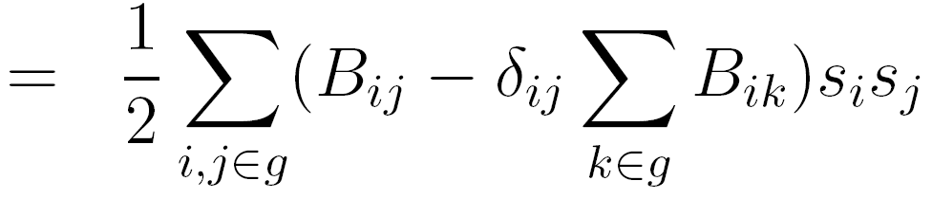
Dividing into more than 2
(3)
B[g] = the submatrix of B defined by g
where
f_{i}^{(g)} = sum of ith row B[g]
f_{i}^{({1,...,n})} = 0
generalized modularity matrix

Slide 21
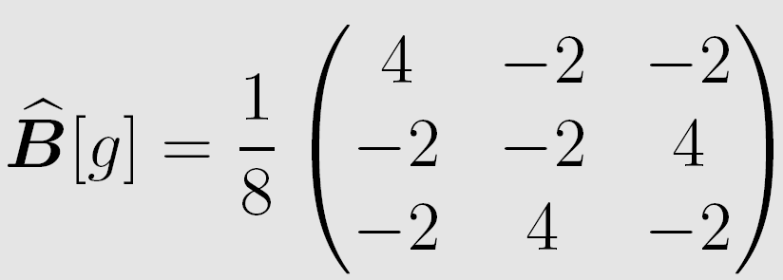
Generalized modularity matrix: example
g = {1, 4, 5}
(1 is the minimal index)
What is [{1...5}]?

Slide 22
A "generalized" 2-division algorithm (divides a group in a network)

Slide 24
Further techniques for modularity maximization
(Combined with Neman's "generalized' 2-division algorithm)

Slide 25
A heuristic for 2-division
The last iteration produces a 2-division which equals the initial 2-division
{g1, g2} - an initial 2-division of g
While there is an unmoved node:
  Let v be an unmoved node, whose moving between g1 and g2 maximizes ΔQ
  Move v between g1 and g2
From the n_{g} 2-divisions generated in the previous step - let {g1, g2} be the one with maximum ΔQ
If ΔQ>0 ==> go to 1

Slide 26
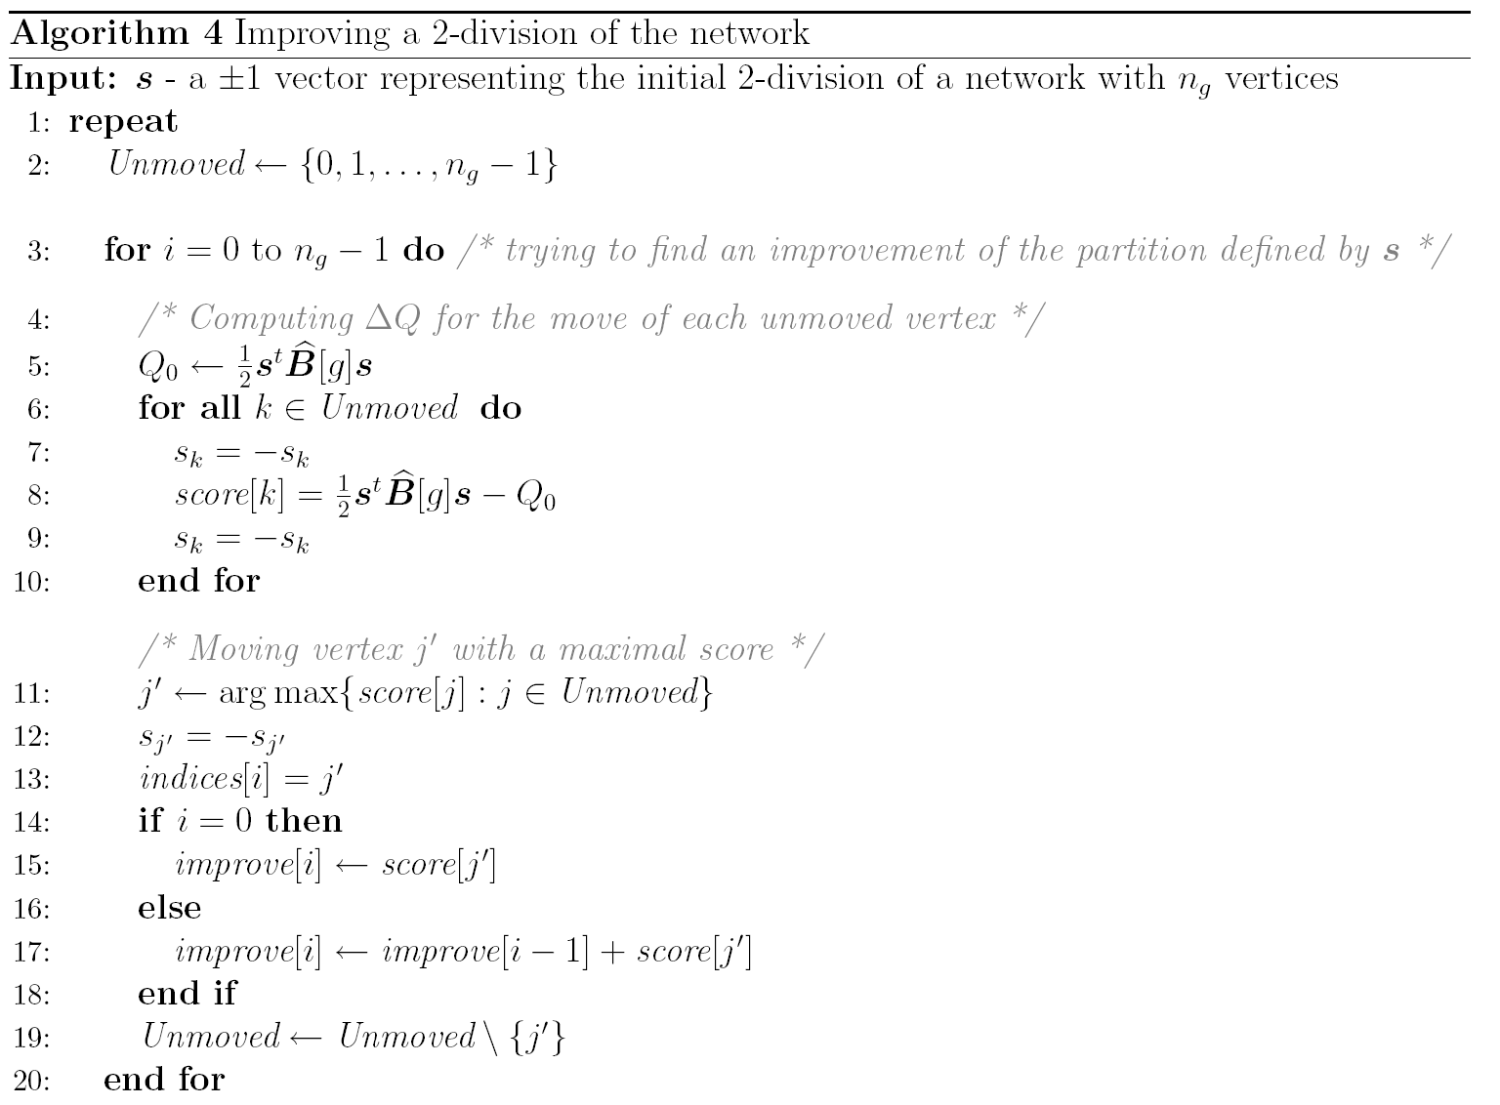
Computing ΔQ for each node
Choosing j' with maximum ΔQ
moving j' and storing its ΔQ
2.While there is an unmoved node:
1. Let v be an unmoved node,
whose moving between g1 and g2
maximizes ΔQ
2. Move v between g1 and g2

Slide 27
Algorithm 4 -cont.
3. From the n_{g} 2-divisions generated in
the previous step - let {g1, g2} be
the one with maximum ΔQ
4. If ΔQ>0 ==> go to 1

Slide 28
Finding the leading eigen-pair
The power method

Slide 29
The Power Method (1)
A - a diagonalizable matrix
Let (λ₁,V₁),..., (λ_{n},V_{n}) be n eigenpairs of A where
|λ₁| > |λ₂| ≥ |λ₃|≥...≥ |λ_{n}|
The power method finds the dominant eigenpair of A, i.e. (V₁, λ₁) (Note that λ₁ is not necessarily the leading eigenvalue)
X₀ = any vector.
➔ X₀ = c₁V₁+... +c_{n}V_{n} , where c_{i} = X₀•V_{i}

Slide 30
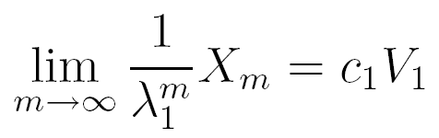
The Power Method (2)
X₁=AX₀ = A (c₁V₁+... +c_{n}V_{n}) = c₁AV₁+... +c_{n}AV_{n} =
c₁λ₁V₁+....+ c_{n}λ_{n}V_{n}
X₂=A²X₀ = AX₁= A (c₁λ₁V₁+....+ c_{n}λ_{n}V_{n})
= c₁λ₁²V₁+....+ c_{n}λ_{n}²V_{n}
...
X_{m}=A^{m}X₀ = AX_{m-1}= A (c₁λ₁^{m-1}V₁+....+ c_{n}λ_{n}^{m-1}V_{n})
= c₁λ₁^{m}V₁+....+ c_{n}λ_{n}^{m}V_{n}
~ c1 λ₁^{m}V₁
If m is large enough ➔

Slide 31
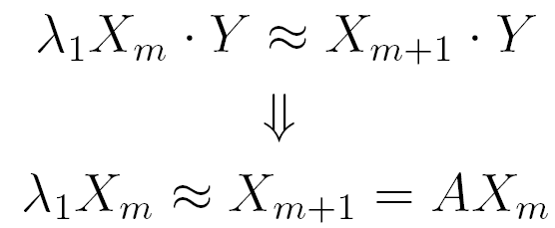

Power Method (3)
X_{m} = AX_{m-1} = A^{m}X₀
Suppose V₁•Y≠0. For m large enough:
For simplicity,
Y=X_{m}

Slide 32
Power method - Example
Example:
We perform only matrix-vector multiplications!
≈
Convergence usually occurs within O(n) iterations

Slide 33
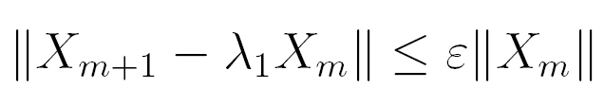
Power method – convergence condition
The desired precision
To avoid numerical problems due to large numbers –
normalize X_{i} before computing X_{i+1} = A X_{i}
X₀ = X / ||X||
X₁ = AX₀ / ||AX₀||
X₂ = AX₁ / || AX₁||
....

Slide 34
Finding the leading eigenpair using matrix shifting
Let be the eigenvalues of A, and U₁,...,U_{n} their corresponding eigenvectors
Let ||A||₁ = ≥max |λ_{i}| (exercise)
Q: What is the dominant eigenpair of A+||A||₁I?
A: (λ1+ ||A||₁, U1)

Slide 35
Implementation
Robustness and Efficiency

Slide 36
Checking "positiveness"
#define IS_POSITIVE(X) ((X) > 0.00001)
Instead "x>0"
==> use IS_POSITIVE(X)

Slide 37
Efficient multiplications in the (extended) modularity matrix:
O(n) instead O(n²)
multiplication in a sparse matrix
"matrix shifting"
inner product
∑f^{(g)}_{i}x_{i}
("matrix shifting")

Slide 38
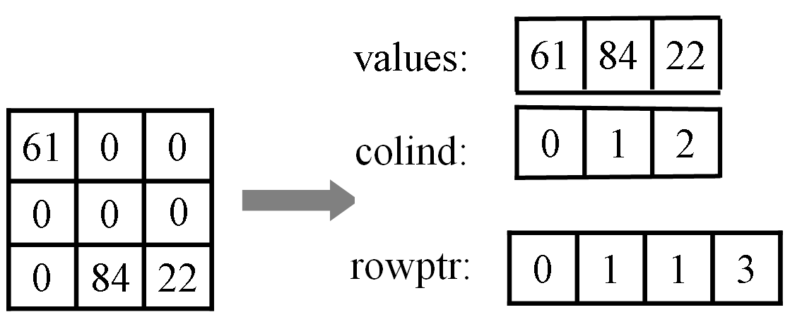
sparse_matrix_arr
typedef struct{
int n; /* matrix size */
elem* values; /* the non zero elements ordered by rows*/
int* colind; /* column indices */
int* rowptr; /* pointers to where rows begin in the values
array. */
} sparse_matrix_arr;

Slide 39
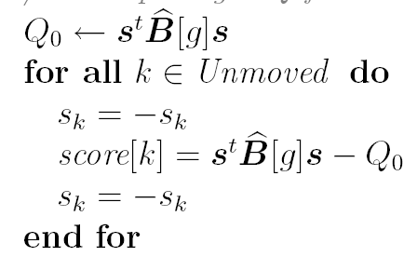
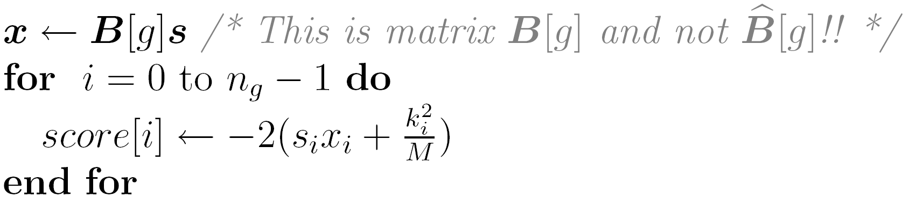
Fast score computations
Algorithm 4
Computing ΔQ for each node ==>O(n²)
Computing ΔQ for each node in O(n)
before moving 1st node
Updating the score AFTER a move of a node k (s is already updated)

Slide 40
Project specifications

Slide 41
programs
computing a
2-division
for the power method
sparse_mlpl < matrix_vec.in
modularity_mat <adj_matrix> <group>
spectral_div <adj_matrix> <group> <precision>
improve_div < adj_matrix> <group> <subgroup>
cluster <adj_matrix> <precision>
for the power method
The complete clustering algorithm (including the improvement)

Slide 42
Implementation process
Read and understand the document
Design ALL programs:
  Data structures
  Functions used by more than one program
Check your code
  "Toy" examples on website - easy to debug
  Your own created LARGE examples
Run your code on yeast/fly networks

Slide 43
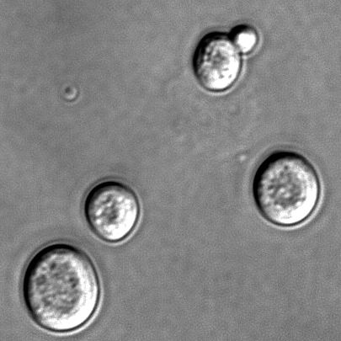
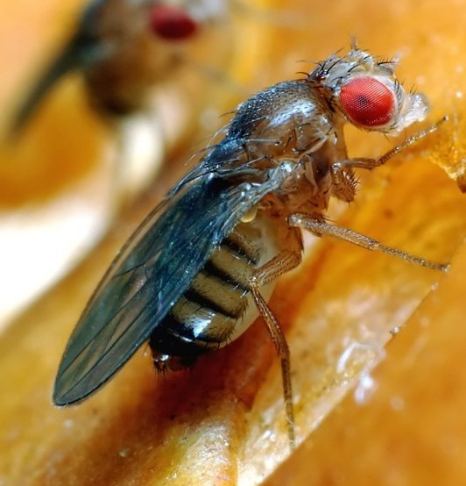
Analyzing clusters in yeast and fly protein-protein interaction networks
Input: true PPI network + 2 random networks
Task 1: infer the true network
Solution: the true network is more modular
Task 2: compute associated functions (using cytoscape + BiNGO)
Saccharomyces cerevisiae
drosophila melanogaster

Slide 44
Cytoscape, BiNGO
www.cytoscape.com (version 2.5.1)
  A framework for analyzing networks
  Provides visualization of networks and clusters
http://www.psb.ugent.be/cbd/papers/BiNGO/
  Finding functions associated with gene cluster
  Runs from cytoscape
  Version 2.3 is not suitable for our project!!! (due to a bug) ==> use version 2.4 (when available) or version 2.0 (available under ~ozery/public/cytoscape-v2.5.1/plugins/BiNGO.jar).

Slide 45
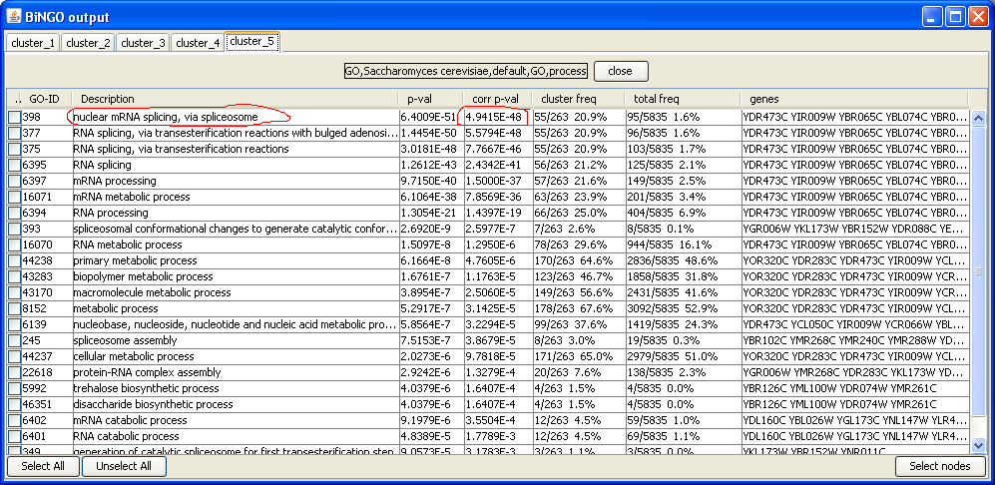
BiNGO output (GO = Gene Ontology)

Slide 46
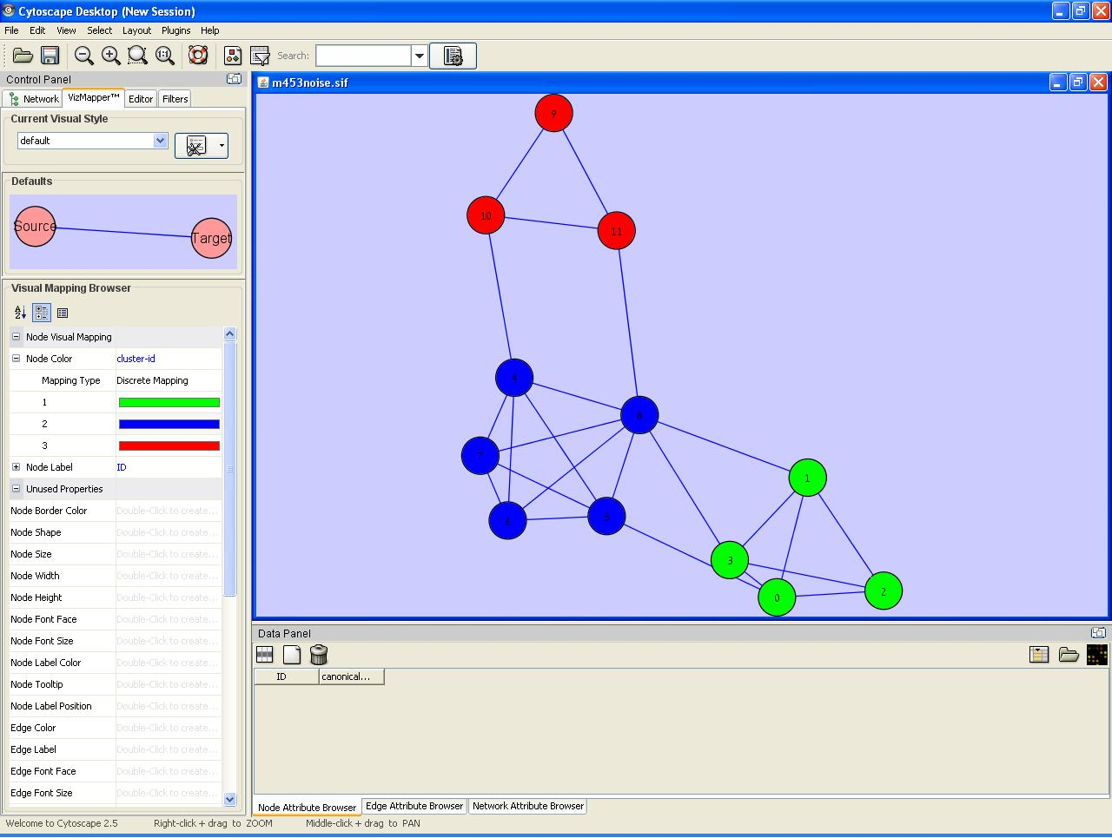
Visualization with cytoscape

Slide 47
How is the project checked?
Most checks (points): "BLACK BOX"
  The common checks in "real world"
  Running with fixed input files, comparing to fixed output files
  Score = #(successful checks) / #(total checks)
"WHITE BOX" checks: code review (10 points maximum)
  code simplicity / efficiency

Slide 48
A simple data structure for maintaining a division
#nodes in the network
typedef struct Division_{
int n;
int* group-ids;
int numGroups;
double Q;
} Division;
for each node - its group id (initially 0 - all nodes within on group)
Complexity:
  Finding all the elements of a group: O(n)
  Splitting a group into 2: O(n)

Slide 49
Maintaining the generalized modularity matrix
Should we maintain the modularity matrix?
  No: 1) we do not use it explicitly
  2) it is a dense matrix - consumes a large memory space
  Yes: 1) Despite its large size - can be kept in memory
  2) Can simplify code (e.g. deriving B[g] from B,
  computing the L1-norm)
  3) Can be used in validating the correctness of
  optimized multiplications (debug mode only!)

Slide 50
Suggestion for modules
Sparse matrices:
Data structure: sparse_matrix_lst
Reading a sparse matrix ( file / stdin)
Multiplication in a vector
Computing A[g]
Methods hiding the inner structure (allows a simple replacement of sparse_matrix_lst with another data structure for holding sparse matrices)
The improvement algorithm
Group
Division
The generalized modularity matrix:
Data structure: A[g], k[g], M, f[g], L1-norm
Multiplication in a vector
Computing Q
printing the modularity matrix
The spectral algorithm:
2-division
full-division

Slide 51


Good luck!
(and have fun...)

