Slide 1
Decomposition of overlapping protein complexes: A graph theoretical method for analyzing static and dynamic protein associations
Algorithms for Molecular Biology, 2006
Team 1
Presenter: Ferhat Ay

Slide 2
Function in PPI networks
A functional group is either a maximal clique or a set of alternative variants of such complexes/cliques.
A functional module is a union of
overlapping functional groups.

Slide 3
Clique trees can be constructed only for chordal graphs
Chord = an edge connecting two non-consecutive nodes of a cycle
Chordal graph – every cycle of length at least four has a chord.
Every chordal graph has a corresponding clique tree representation.

Slide 4
Naïve representation VS Tree of Complexes Representation
Which protein in which complex interacts with each other?
Dynamics of the interactions
How to identify functional groups?
A set of maximum cliques containing a node are connected?
Size of overlap

Slide 5
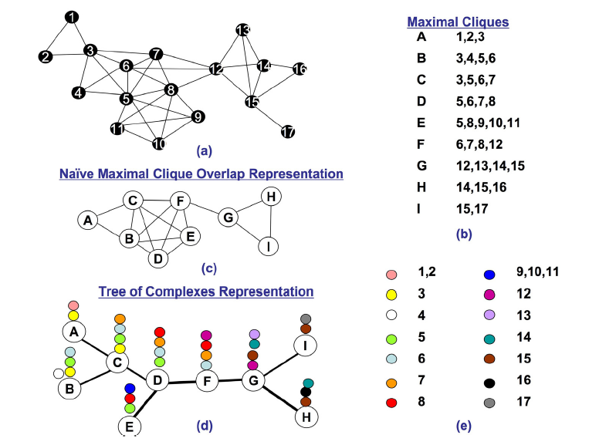
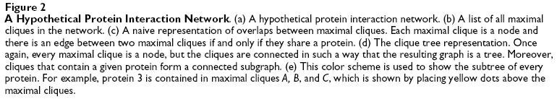

Slide 6
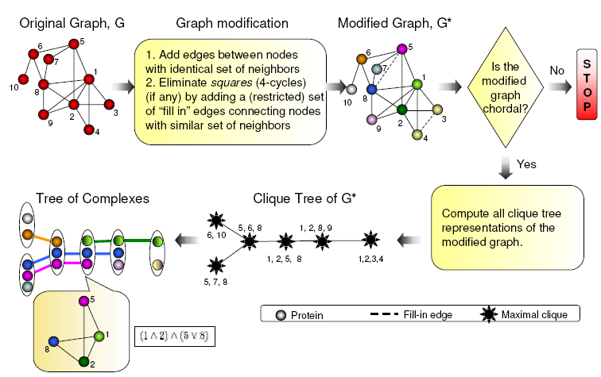
Complex Overlap Decomposition

Slide 7
Representing functional groups by Boolean expressions
A
(A B C) v (D E)
C
D
V
V
V
E
B
Cographs : Graphs which can be represented by Boolean expressions
P₄

Slide 8
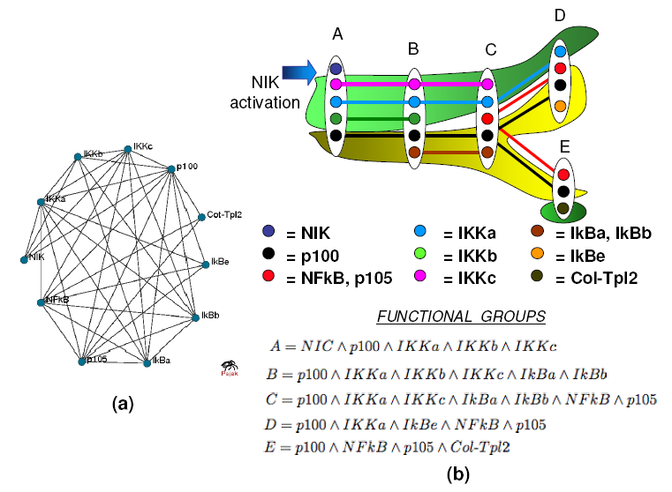

Slide 9
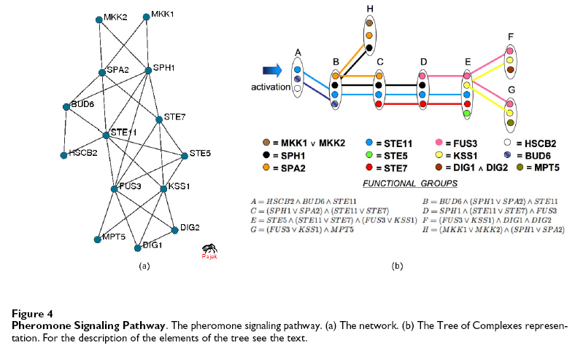

Slide 10
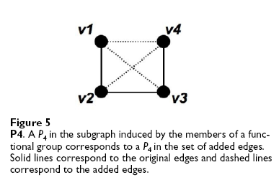


Edge Addition

Slide 11
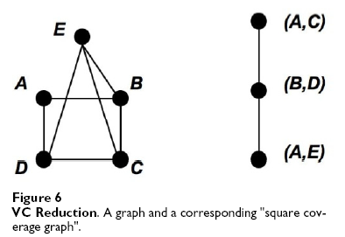
Reduction to Minimum Vertex Cover

Slide 12
When it works?
Algorithm is not guaranteed to produce the Tree of Complexes representation.
Conjectured that the algorithm will succeed for chordal graphs and cographs.
Applicable to PPI networks that do not contain long (longer than four node) chordless cycles.
Not appropriate for analyzing large PPI networks with long cycles.

Slide 13
Summary
A new method delineating functional groups and representing their overlaps
Each functional group is represented as a Boolean expression
If functional groups represent dynamically changing protein associations, the method can suggest a possible order of these dynamic changes
For static functional groups it provides compact tree representation of overlaps between such groups
Can be used for predicting protein-protein interactions and putative associations and pathways
Uses chordal graph theory and cograph theory to build new graph-theoretical results.

