Slide 1
Cluster analysis of networks generated through homology: automatic identification of important protein communities involved in cancer metastasis Jonsson et al, BMC Bioinformatics, 2006
Team 1
Author: Kirill Osipov
Presenter: Ferhat Ay

Slide 2
Background
Metastasis is an event associated with a poor prognosis in cancer patients
Metastasising cancer cells
break away from the primary tumor
acquire increased motility and invasiveness
make cancer more difficult to treat
Networks of protein-protein interactions (PPI) create metastasising cancer cells
Notes:
Metastasis is an event associated with a poor prognosis in cancer patients
Upon reaching metastasis, cancer cells develop the ability to break away from the primary tumour and move to different organs, making the cancer more difficult to treat.
Metastasising cancer cells acquire properties, such as increased motility and invasiveness.
Cancer cells reach Metastasis through a network of cascading protein-protein interactions which have to be understood if an effective treatment is to be developed.

Slide 3
PPI network analysis methods
Experimental, biochemical analysis
Microarray gene expression data
provides correlation between gene expressions
lacks information on protein interaction mechanism
Genome survey
High throughput but error prone
In-depth but time-consuming & expensive
Computational analysis
Complements biochemical analysis
Can predict protein-protein interactions
Aggregates data from many sources
Notes:
There are gaps in understanding of PPI networks. Generally, the networks are understood either through an experimental, biochemical approach or through computational analysis of existing data.
There are certain strengths and weaknesses in relying on an experimental approach. For example, microarray experiments can show correlations between the expression patterns of genes, they do not reveal the exact protein interaction mechanism. In general, experimental genome survey methods provide large quantities of data but have a high level of error; the data has high fidelity but is time consuming and expensive to produce.
To date, most of the available data on protein-protein interactions has been produced using experimental, biochemical methods. The experimental approaches do not have a satisfactory level of accuracy.
Computational methods can complement experimental biochemical methods. A number of computational methods, either based on sequence or structural features, have been developed to complement experimental approaches to predicting protein-protein interactions.

Slide 4
Computational PPI analysis
Protein interaction network is composed of predictions of individual PPIs
prediction score is assigned to each interaction
higher score => higher prediction confidence
Computational protein network construction
Collect data on
gene expression
gene ontologies
phenotypic profiling
functional similarities
Apply Bayesian regression to deduce PPI
Identify communities of protein interaction
e.g. using clique percolation method
Notes:
protein networks are composed of predicted individual interactions, each of which is assigned a score which indicates the strength of the prediction
Protein network analysis is dependent on a reliable assignment of protein-protein interactions.
The computational methods are based on deducing protein-protein interaction networks by using data based on
gene expression
gene ontologies
phenotypic profiling
functional similarities
processing data via Bayesian regression methods to infer protein-protein interaction networks.

Slide 5
Paper(Jonsson et al) Overview
Created a protein interaction network, "interactome" for a rat
used computational and homology* approaches
developed a scoring function based on
homology sequence similarity
amount of experimental data for every PPI in the network
implemented an automated solution for building a network of interacting proteins
Demonstrated utility of the interactions predicted by interactome
Mapped predicted interactions to tumor expression data
Confirmed interactome predicting protein networks involved in the cancer processes
*Homology approaches study data from organisms sharing an ancestry. Assume that interacting protein modules in one organism may be considered to be interacting in a related organism
Notes:
Created an extensive protein interaction network, "interactome" for a rat
used a computational and homology approaches
developed a scoring function based on
sequence similarity
the amount of experimental data for every protein-protein interaction in the network
implemented an automated solution for building a network of interacting proteins
Demonstrated utility of the interactions predicted by interactome
Mapped predicted interactions to tumour expression data
Confirmed interactome predicting protein networks involved in the cancer processeses
Homology based approaches examine data available from organisms sharing an ancenstry based on a principle that interacting protein modules in one organism may be considered to be interacting in a related organism (Cabusora et al.). For example a protein interaction map can be based upon the principle that interacting protein modules in one organism may be fused into a single chain in another.

Slide 6
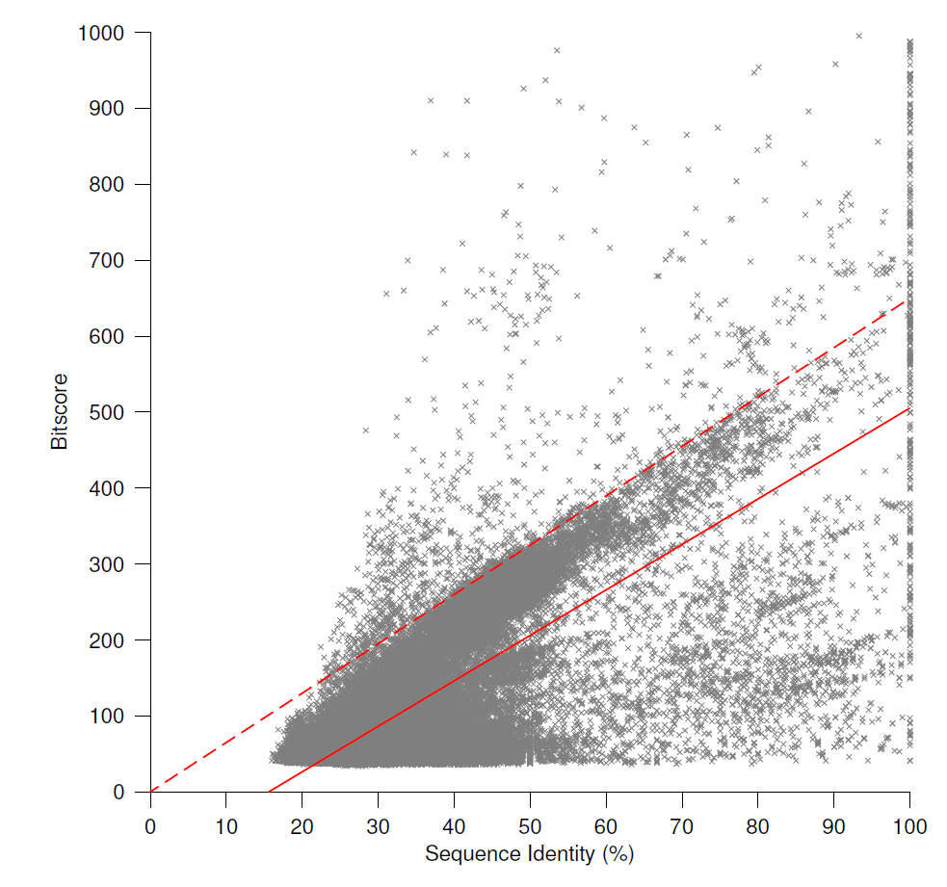
Homology-based data selection
Homology data used for scoring is bounded by red box
Notes:
The method of constructing networks in the paper is based on homology to known interactions. It is important to ensure that when using protein interaction data from different, but related species, that the data has a minimum level of homology whereby the structural and functional similarity of the interacting proteins is retained. The figure illustrates how the homology data was incorporated into the scoring function.
Russell et al. [26] have previously examined the relationship between sequence and structural divergence of interacting proteins. They found that pairs of interacting proteins can be considered structurally similar if their sequence identity is no lower than 30%. The solid red line shows the best linear fit to the data and shown in dotted red is a line, starting at the origin, which contains 97% of the data in the area below it. Reading from these lines at 30% sequence identity gives scores of 86 and 177 respectively.

Slide 7
Scoring function verification
Checked scores against highly reliable X-ray crystallographic evidence.
Confirmed that highly reliable interactions identified by X-ray crystallography correlate with high scores of the scoring function.
Identified communities of protein interaction in cellular processes.
Confirmed high scores for intra-community processes , i.e. interactions between proteins within the same cellular processes
Confirmed low scores for inter-community processes, i.e. those between proteins that are not believed to have any interactions.
Validated high scores for protein interactions within same cellular compartment and low scores for separate cellular compartments
Used localization data from Gene Ontology Consortium

Slide 8
Analysis Overview
Collected data from a microarray analysis of cell lines with different potential for metastatic state
Constructed networks based on interactions directly with originating proteins and then including 2nd order interactions relative to originating proteins
10,628 interactions
Used clique percolation method to identify communities of protein interactions
37 protein communities
313 proteins
1,094 interactions
Majority of communities are associated with cancer metastasising processes

Slide 9
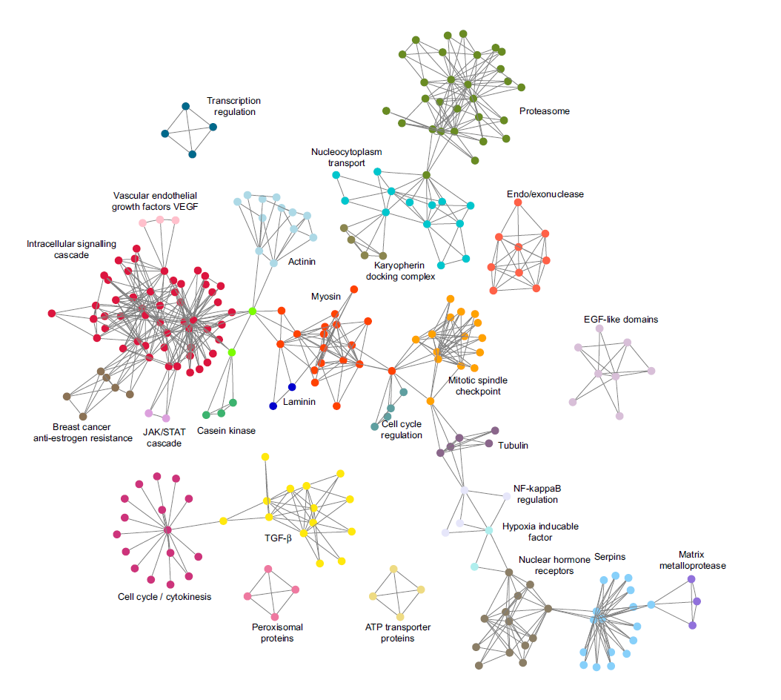
Protein communities identified by cluster analysis
Notes:
The communities identified by clusteranalysis performed on the predicted genome-wide rat protein network. The communities are distinguished by different colors and labeled by the overall function or the dominating protein class.
The majority of the communities have been associated with cancer and metastasis. Some show a degree of overlap and are linked, the most prominent link running through the centre of the figure and containing 17 communities linked in a chain-like manner.
Others are not linked, for example, the transcription regulation, which consists of only four proteins.

Slide 10
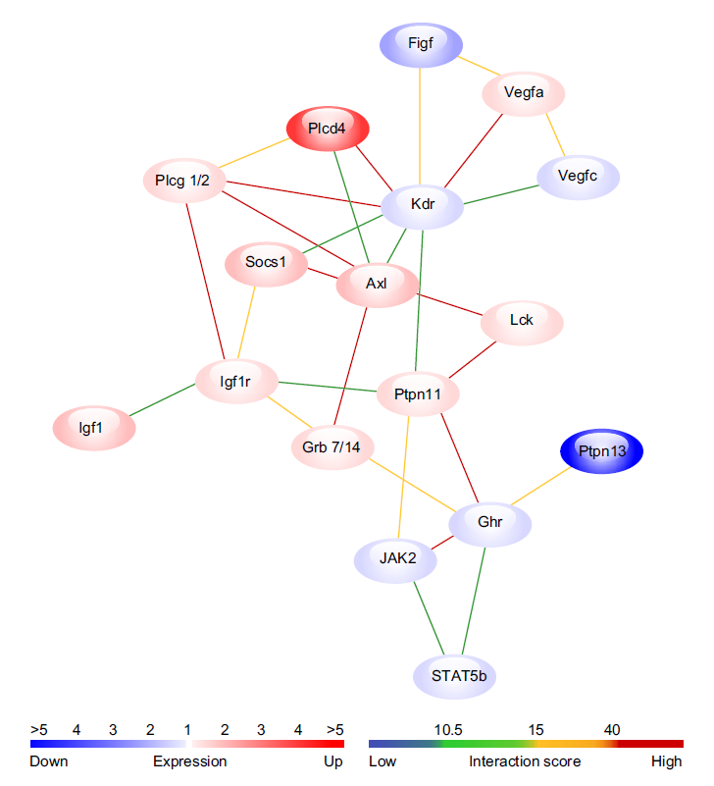
Example: Intracellular signaling cascade community
Zoom in
Notes:
The intracellular signalling cascade constitutes the head of a chain of communities on the previous slide. The figure on the right shows a detailed view of some of the interactions within the intracellur signaling cascade community, focused on the intersection with the vascular endothelial growth factors (VEGFs). Three separate groups of proteins are distinguishable: vascular endothelial growth factors (Vegfa, Vegfc, Figf) and the receptor (Kdr), which play a principle role in tumour progression and angiogenesis and which have also been associated with tumour metastasis.
Igf1 has also been shown to enhance adhesion and motility of cancer cells however, the exact role of Igf1r in the metastatic process has not been established.
The few examples shown here illustrate the value of the approach in terms of revealing potential pathways and interactions that play a part in cancer metastasis, but further experimental work will be needed to confirm the
validity of these predictions.

Slide 11
Summary
The approach proposed by Jonsson et al departs from ealier methods of using expression data in community networks
The authors generated the networks first, mapped the expression data on top of the networks and then performed a clustering.
The approach allowed to bypass obstacles involved in traditional microarray analysis, e.g. clustering gene expression patterns
The approach focused on metastatis-related interactions by using the clique method to highlights hubs of highly interconnected protein communities
The complex parts of the network are considered by the clique method but simple linear pathways do not get included in analysis

