Slide 1

COP2800 – Computer Programming Using JAVA
University of Florida Department of CISE Spring 2013
Lecture 39 – Command Line Args & Recursion
Webpage: www.cise.ufl.edu/~mssz/JavaNM/Top-Level.html

Slide 2
COP2800 – Programming in JAVA
Course Objectives
  Basic Knowledge of Computers & Programming
  Specific Knowledge of JAVA Programming
  Practical Programming Projects Build Skills
Today’s Class
  Overview of How to Get Command-Line Args
  More on Recursion (“Chalk Talk”)
    Examples
    Recursion vs. Iteration

Slide 3
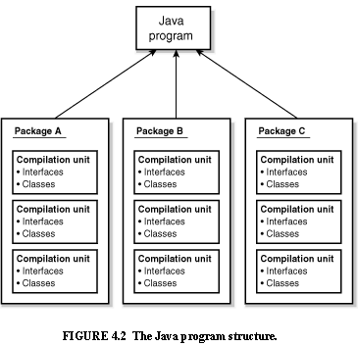
Review: Java Program Structure
HIGH-LEVEL VIEW
JAVA Units:
Packages
Classes
(Instances)
Methods
Instructions
Variables
PICTURE CREDIT: http://www.webbasedprogramming.com/JAVA-Developers-Guide/ch4.htm

Slide 4
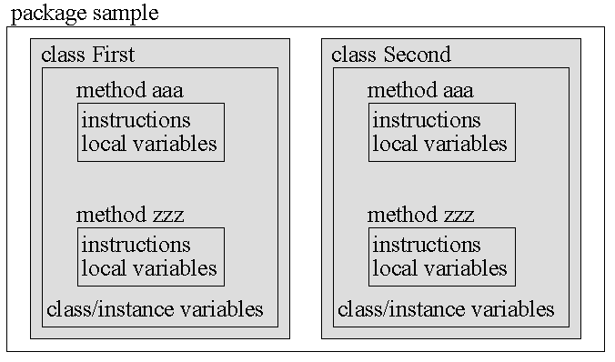
Review: Java Package Structure
PICTURE CREDIT: http://users.soe.ucsc.edu/~charlie/book/notes/summary1-4/sld016.htm

Slide 5
Command Line Arguments
Concept:
Command Line Arguments are data that appear to the right of the program name on the command line.
Example: java Sort names.txt
where java denotes java runtime module
Sort is a string-sorting program
names.txt is a file of names

Slide 6
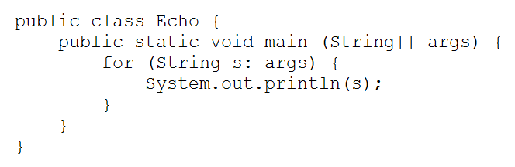
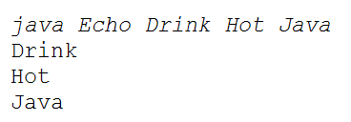
Command Line Args (cont’d)
Java Code:
Example Results:
Loop through arguments
Get an argument
Print the argument
Source: http://docs.oracle.com/javase/tutorial/essential/environment/cmdLineArgs.html

Slide 7
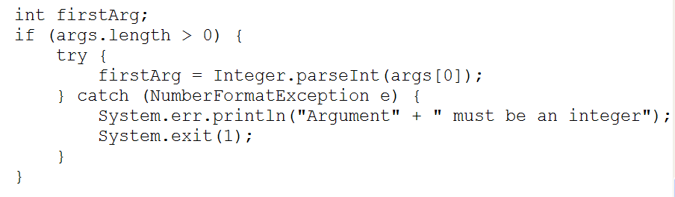
Command Line Args (cont’d)
Java Code: What if the argument is a number?
Explanation: If args[0] is not int, parseInt throws a NumberFormatException that is caught and translated to an error message. Else, args[0] is translated into an int.
parseInt attempts to convert args[0] to an integer. Each number datatype class has a parse method: Float.parseFloat, Double.parseDouble …
Source: http://docs.oracle.com/javase/tutorial/essential/environment/cmdLineArgs.html

Slide 8

This Week: End of Classes ☺
Wednesday 24 Apr 2013:
Final Exam Review – IN CLASS
Help with Assignment #6
Wednesday 1 May 2013:
FINAL EXAM – 7.30am – CSE/E220
5 Regular Questions
2 Extra Credit Problems

