Slide 1

COP2800 – Computer Programming Using JAVA
University of Florida Department of CISE Spring 2013
Lecture 37 –Java Web Programming with JApplets
Webpage: www.cise.ufl.edu/~mssz/JavaNM/Top-Level.html

Slide 2
COP2800 – Programming in JAVA
Course Objectives
  Basic Knowledge of Computers & Programming
  Specific Knowledge of JAVA Programming
  Practical Programming Projects Build Skills
Today’s Class
  Java Programming for the Web
  Java Design for a Simple JApplet
    Importing and Extending the Classes
    Integrating Components into a JApplet

Slide 3
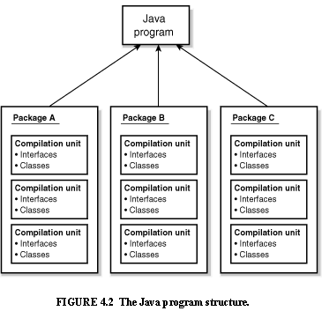
Review: Java Program Structure
HIGH-LEVEL VIEW
JAVA Units:
Packages
Classes
(Instances)
Methods
Instructions
Variables
PICTURE CREDIT: http://www.webbasedprogramming.com/JAVA-Developers-Guide/ch4.htm

Slide 4
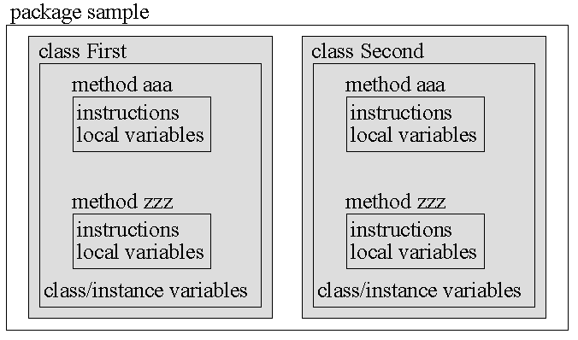
Review: Java Package Structure
PICTURE CREDIT: http://users.soe.ucsc.edu/~charlie/book/notes/summary1-4/sld016.htm

Slide 5
How Does Java Work with Web?
Three Principal Technologies:
JavaScript
Java Servlet
Java Applet
  A Java applet is a program delivered to users as Java bytecode (platform independent). Java applets can be executed by browsers for many platforms, including Microsoft Windows, Unix, OS X and Linux.
Source: http://en.wikipedia.org/wiki/Java_applet

Slide 6
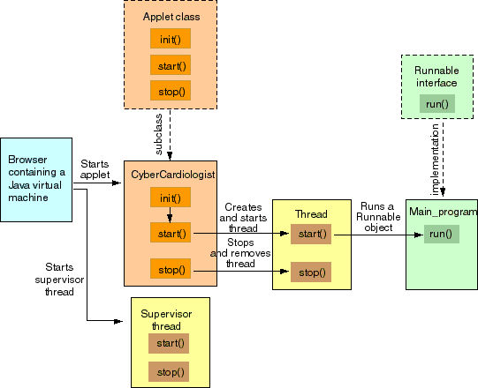
Java Working with Web (cont’d)
ARCHITECTURE OF AN APPLET
APPLET
Image Credit: sandriabudiendra.blogspot.com

Slide 7
Review: Hello World Applet
Step 1. Create Java Code for “Hello World” Applet
import java.applet.Applet;
import java.awt.Graphics;
public class HelloWorld extends Applet {
public void paint(Graphics g) {
g.drawString("Hello world!", 50, 25);
}
}
Step 2. Compile the file HelloWorld.java
Compiler creates HelloWorld.class in the same directory (folder) as the Java source file (HelloWorld.java).
http://journals.ecs.soton.ac.uk/java/tutorial/getStarted/applet/

Slide 8
Rvw: Hello World Applet (cont’d)
Step 3. Create HTML file named Hello.html
with the following text, in the same directory that contains HelloWorld.class :
<HTML>
<HEAD> <TITLE> HelloWorld Program </TITLE> </HEAD>
<BODY>
Here is the output of my program: <APPLET CODE="HelloWorld.class" WIDTH=150 HEIGHT=25> </APPLET>
</BODY>
</HTML>
http://journals.ecs.soton.ac.uk/java/tutorial/getStarted/applet/

Slide 9
Rvw: Hello World Applet (cont’d)
Step 4. Run the “Hello World” Applet:
Load Hello.html into an application that runs Java applets:
  Java-compatible browser
    URL = file:/home/username/HTML/Hello.html
  Java applet viewing program
  Applet Viewer in JDK
The browser window will show a message similar to this:
Here is the output of my program: Hello world!
http://journals.ecs.soton.ac.uk/java/tutorial/getStarted/applet/

Slide 10

JApplets
What is a JApplet?
A JApplet is:
  a Java Swing public class designed for developers - usually written in Java.
  JApplet is generally in the form of Java bytecode
    runs with the help of a Java virtual machine (JVM) or
    runs with Applet viewing program
Source: http://www.techopedia.com/definition/25252/japplet

Slide 11
Japplets (cont’d)
What does a Japplet do?
  With JApplets, you put swing Components into Containers just as you would do for a JFrame.
  With Applets, you are responsible for painting a
  Graphics context yourself

Slide 12
Example of a JApplet
Step 1 – Start with a basic applet class JAppletTutorial:
public class JAppletTutorial {
public JAppletTutorial() {
}
}
Source: http://forum.codecall.net/topic/38297-java-japplet/

Slide 13
Example Japplet (cont’d)
Step 2 – Import Java Swing and Extend JApplet class:
import javax.swing.JApplet;
public class JAppletTutorial extends Japplet {
public JAppletTutorial() {
}
public void init() {
}
}
Note: Applets do not use as main method the construct
public static void main(String args[])
Instead, applets use the init construct
Source: http://forum.codecall.net/topic/38297-java-japplet/

Slide 14
Example Japplet (cont’d)
Step 3 – Insert Components (in this case, a button):
import javax.swing.JApplet;
public class JAppletTutorial extends Japplet {
public JAppletTutorial() {
}
public void init() {
button = new JButton("Click Me");
add(button);
}
}
Insert Component(s) into the init() method
Source: http://forum.codecall.net/topic/38297-java-japplet/

Slide 15
HelloWorld Japplet
Our TA Bill wrote this JApplet for “Hello World!”:
import javax.swing.*;
public class HelloWorld extends JApplet {
public void init() {
JLabel label = new JLabel("Hello World");
add(label);
}
}

Slide 16
How We will Use Applets
Assignment 6:
Given IntelligentTTT Game and GUI Code
(from Assignments 4 and 5 – work in groups)
  Make a Java JApplet and compile it
  Run the Java JApplet on a Web Browser
    All the Features of Assignment 5
    We will help you with GUI and JApplet code ☺
  … and more …

Slide 17
Roadmap: JApplets, Exam Review
Friday 19 Apr 2013:
Assignment #6 Hands-On Experience w/ JApplet
Coding Examples (LAPTOPS)
Monday 22 Apr 2013:
A Few Miscellaneous Topics in Java
Questions about Assignment #6
Wednesday 24 Apr 2013:
Final Exam Review

