Slide 1
COP2800 – Computer Programming Using JAVA
University of Florida Department of CISE Spring 2013
Lecture 32 – Java Graphical User Interfaces (GUIs)
Webpage: www.cise.ufl.edu/~mssz/JavaNM/Top-Level.html

Slide 2
COP2800 – Programming in JAVA
Course Objectives
Basic Knowledge of Computers & Programming
Specific Knowledge of JAVA Programming
Practical Programming Projects Build Skills
Today’s Class
Overview of GUIs
Java Code for a Simple GUI
Making the Components
Integrating Components into a GUI

Slide 3
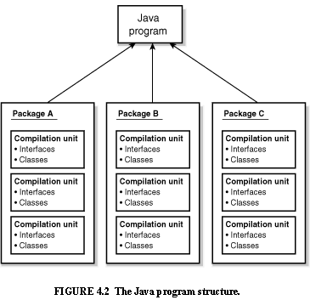
Review: Java Program Structure
HIGH-LEVEL VIEW
JAVA Units:
Packages
Classes
(Instances)
Methods
Instructions
Variables
PICTURE CREDIT: http://www.webbasedprogramming.com/JAVA-Developers-Guide/ch4.htm

Slide 4
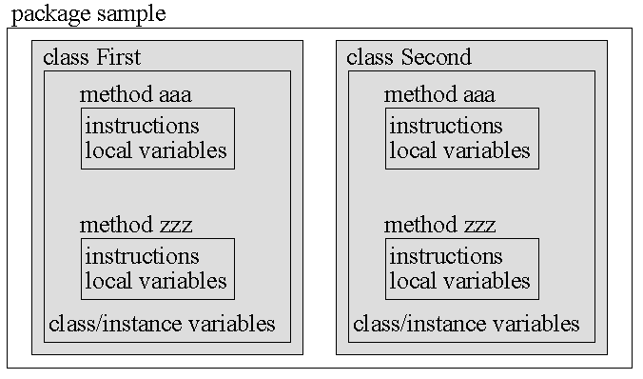
Review: Java Package Structure
PICTURE CREDIT: http://users.soe.ucsc.edu/~charlie/book/notes/summary1-4/sld016.htm

Slide 5
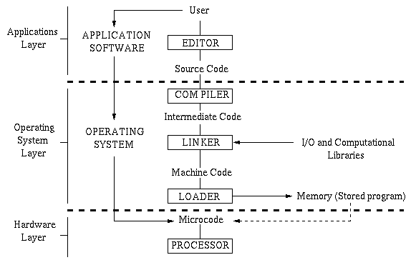
What is a GUI?
G U I
Graphical
User
Interface
G U I

Slide 6
Anatomy of a GUI
FRAME
COP2800-S13-L32-Java-IntroGUIs
TITLE BAR
File Edit View Insert View
Text Box
Shapes
Object …
:
TOP BAR
PULL-DOWN MENU
CANVAS
or –
PANEL
or –
PANE
BUTTON
SCROLL BAR

Slide 7
GUIs and Java
Let’s Build a Simple GUI:
1. Make a frame 2. Set up the content panel 3. Make our components and put in panel 4. Add our components to the GUI 5. Set up event handlers
WHAT’s THIS?

Slide 8
GUIs and Java (cont’d)
Step 1. Make a Frame
Import these:
import javax.swing.Jframe;
import java.awt.event.*;
import java.awt.*;
To make a frame, our class has to extend Jframe:
public class RectangleProgram extends JFrame

Slide 9
GUIs and Java (cont’d)
Step 1 – Frame - Here’s the basic Java code:
Code Credits (entire lesson): http://www.dreamincode.net/forums/topic/17705-basic-gui-concepts/

Slide 10
GUIs and Java (cont’d)
Step 2. Create a Content Pane
a. Use a Container object to
manipulate the content pane
b. Use a cool statement: getContentPane()
c. class Container has two methods
add (we use this later)
setLayout
d. setLayout calls the Layout Manager to create a simple grid layout with 4 rows and 2 columns.

Slide 11
GUIs and Java (cont’d)
Step 2. Create a Content Pane
Here’s the Java code:

Slide 12
GUIs and Java (cont’d)
Step 3. Make Components:
Label TextField Button

Slide 13
GUIs and Java (cont’d)
Step 4. Put Components In Pane
Here’s the Java code:

Slide 14
GUIs and Java (cont’d)
Step 5. Create Event Handlers

Slide 15
GUIs and Java (cont’d)
Basic GUI Program

Slide 16
GUIs and Java (cont’d)
Basic GUI Program (cont’d)

Slide 17
GUIs and Java (cont’d)
Basic GUI Program (cont’d)

Slide 18
GUIs and Java (cont’d)
Basic GUI Program (cont’d)

Slide 19
GUIs and Java (cont’d)
Basic GUI Program (cont’d)

Slide 20
How We will Use GUIs
Assignment 5:
Add GUI to Intelligent TicTacToe Game
(use your Assignment-4 program)
Playing Canvas = Expandable N x N array
Components Include
Buttons for Start NextPlayer Continue End
Text Fields for CurrentPlayer Move Winner
… and more …

Slide 21
This Week: Sets, Collections, Lists…
Wednesday 3 Apr 2013:
More GUIs in JAVA
Coding Examples
Friday 5 Apr 2013:
How to do Assignment #5, Part II (LAPTOPS)
EXAM #2 – Wednesday 10 April – IN CLASS

