Slide 1
COP2800 – Computer Programming Using JAVA
University of Florida Department of CISE Spring 2013
Lecture 24 – Java Lists and Queues
Webpage: www.cise.ufl.edu/~mssz/JavaNM/Top-Level.html

Slide 2
COP2800 – Programming in JAVA
Course Objectives
Basic Knowledge of Computers & Programming
Specific Knowledge of JAVA Programming
Practical Programming Projects Build Skills
Today’s Class
Review of Collections
Lists and Queues
ArrayList and LinkedList
Specialization for Assignment-4

Slide 3
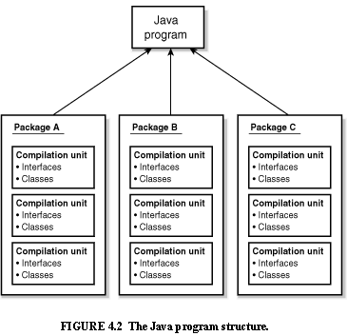
Review: Java Program Structure
HIGH-LEVEL VIEW
JAVA Units:
Packages
Classes
(Instances)
Methods
Instructions
Variables
PICTURE CREDIT: http://www.webbasedprogramming.com/JAVA-Developers-Guide/ch4.htm

Slide 4
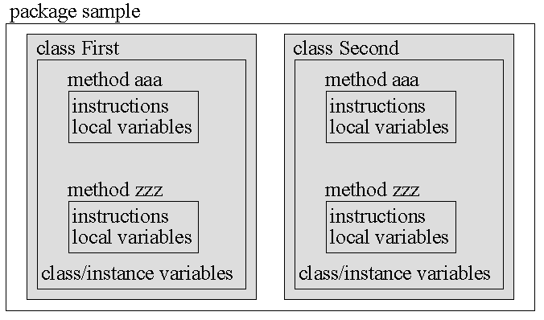
Review: Java Package Structure
PICTURE CREDIT: http://users.soe.ucsc.edu/~charlie/book/notes/summary1-4/sld016.htm

Slide 5
Review: Inheritance
Example:
SUPERCLASS PERSON
extends
extends
extends
SUBCLASS #1 GOLFER
SUBCLASS #2 STUDENT
. . .
SUBCLASS #n ELECTRICIAN
Subclass
Variables:
swing
stance
grip
score
Subclass
Variables:
gpa
health_status
major
extracurriculars
Subclass
Variables:
availability
hourly_rate
company
unionized
ADD
NEW
PROP-ERTIES
. . .

Slide 6
Review: Polymorphism
NEW WORD: Overloading
Example:
int + int integer addition
int + float decimal addition
string + string concatenation
We say the “+” operator is overloaded
because one operator performs many functions

Slide 7
Polymorphism (cont’d)
JAVA: One function to act on many objects
Example: length() method
Class #1 object1 = <value>
Class #2 object2 = <value>
object.length()
object.length()

Slide 8
New Concept: Collections
JAVA: Collection is a typed grouping of objects.
Example:
Suppose we have a Collection <Type> c
where <Type> denotes a datatype
We write according to this pattern:
List <Type> list = new
ArrayList<Type>(c);

Slide 9
Collections (cont’d)
Code
Example
OUTPUT:
Collection Example!
Collection data: Blue White Green Yellow
Collection size: 4
Code Example: http://www.tutorialspoint.com/javaexamples/collection_size.htm

Slide 10
New Concept: Lists
JAVA: ArrayList and LinkedList.
ArrayList: (expandable)
Like a vector or array but faster…
public ArrayList <type>
extends AbstractList <type>
LinkedList: (expandable, can be traversed)
public ArrayList <type>
extends AbstractSequentialList <type>

Slide 11
Example: Array List
Pre-existing Java Classes that must be imported
If I/O Error on InputStreamReader
Polymorphic “add” operation:
<class>.add(<arg>)
Code Credit: http://www.anyexample.com/programming/java/java_arraylist_example.xml

Slide 12
Example: Array List (cont’d)
Read Name and calc. its Length
Error Handler
Reference array element by index
Code Credit: http://www.anyexample.com/programming/java/java_arraylist_example.xml

Slide 13
Review: Linked List
Image Credit: http://www.mycstutorials.com/articles/data_structures/linkedlists

Slide 14
Example: Linked List
Java Packages and Predefined Java Classes that must be imported
Define Constructor for Method
Polymorphic add
Code Credit: http://alvinalexander.com/blog/post/java/java-linkedlist-example-code

Slide 15
Example: Linked List (cont’d)
Polymorphic add
Cycle thru List (in order of insertion)
Output Strings Stored in List (in-order)
Code Credit: http://www.anyexample.com/programming/java/java_arraylist_example.xml

Slide 16
How We will Use Lists
Assignment 4:
Add “Intelligence” to TicTacToe Game
Defensive Move(s): Block Opponent
Insert Your Symbol (X,O) into a Row/Col that
has been marked with an opponent’s symbol
Keep a History List of Moves (Knowledge Base)
Offensive Move(s): Complete Row/Col/Diag
Your opponent misses an opportunity to block
You can add more of your symbols to R/C/Diag

Slide 17
Looking Ahead …
Friday 15 Mar 2013:
How to do Assignment #4, Part II
Defensive Strategy
Discuss Assignment #4, Part III
Offensive Strategy (MORE CHALLENGING)
Monday 18 Mar 2013:
More Concepts (Analysis of Algorithms)
How to Apply Analysis to Assignment #4, Part IV

