Slide 1
COP2800 – Computer Programming Using JAVA
University of Florida Department of CISE Spring 2013
Lecture 22 – Java Collections, Sets, and Lists
Webpage: www.cise.ufl.edu/~mssz/JavaNM/Top-Level.html

Slide 2
COP2800 – Programming in JAVA
Course Objectives
Basic Knowledge of Computers & Programming
Specific Knowledge of JAVA Programming
Practical Programming Projects Build Skills
Today’s Class
Review of Inheritance and Polymorphism
Collections, Sets, Lists
How Collections can Generalize Data Structures
Specialization into Sets and Lists

Slide 3
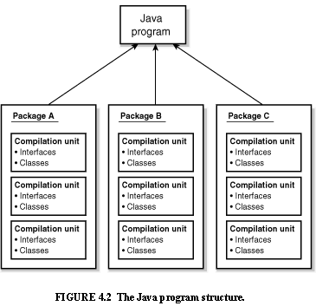
Review: Java Program Structure
HIGH-LEVEL VIEW
JAVA Units:
Packages
Classes
(Instances)
Methods
Instructions
Variables
PICTURE CREDIT: http://www.webbasedprogramming.com/JAVA-Developers-Guide/ch4.htm

Slide 4
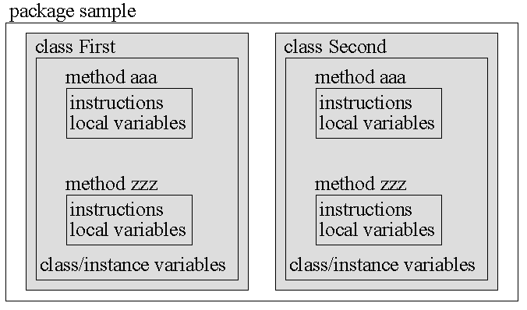
Review: Java Package Structure
PICTURE CREDIT: http://users.soe.ucsc.edu/~charlie/book/notes/summary1-4/sld016.htm

Slide 5
Review: Classes and Objects
Example:
String greeting = "Hello world!";
CLASS NAME: String
VARIABLE NAME: greeting
CLASS DESCRIPTION
Instance-of
Instance-of
Instance-of
OBJECT #1
OBJECT #2
. . .
OBJECT #n

Slide 6
Review: Inheritance
Example:
class Golfer extends Person;
SUBCLASS NAME: Golfer
SUPERCLASS NAME: Person
SUPERCLASS DESCRIPTION
extends
extends
extends
SUBCLASS #1 DESCRIPTION
SUBCLASS #2 DESCRIPTION
. . .
SUBCLASS #n DESCRIPTION

Slide 7
Review: Inheritance
Example:
SUPERCLASS PERSON
extends
extends
extends
SUBCLASS #1 GOLFER
SUBCLASS #2 STUDENT
. . .
SUBCLASS #n ELECTRICIAN
Subclass
Variables:
swing
stance
grip
score
Subclass
Variables:
gpa
health_status
major
extracurriculars
Subclass
Variables:
availability
hourly_rate
company
unionized
ADD
NEW
PROP-ERTIES
. . .

Slide 8
New Concept: Polymorphism
Meaning: Poly = many Morph = shape
Example:
“+” operator can do many things
int + int integer addition
int + float decimal addition
string + string concatenation

Slide 9
Polymorphism (cont’d)
NEW WORD: Overloading
Example:
int + int integer addition
int + float decimal addition
string + string concatenation
We say the “+” operator is overloaded
because one operator performs many functions

Slide 10
Polymorphism (cont’d)
Polymorphism in programming:
Strategies:
1 – Write many functions to do many things
2 – Write one polymorphic function to do many things
OBJECT-ORIENTED DESIGN

Slide 11
Polymorphism (cont’d)
Write one function to do many things (cont’d)
Example: length() method
Class #1
… length method specification…
Class #2
… length method specification…

Slide 12
Polymorphism (cont’d)
JAVA: One function to act on many objects
Example: length() method
Class #1 object1 = <value>
Class #2 object2 = <value>
object.length()
object.length()

Slide 13
New Concept: Collections
JAVA: Collection is a typed grouping of objects.
Example:
Suppose we have a Collection <Type> c
where <Type> denotes a datatype
We write according to this pattern:
List <Type> list = new
ArrayList<Type>(c);

Slide 14
Collections (cont’d)
Code
Example
OUTPUT:
Collection Example!
Collection data: Blue White Green Yellow
Collection size: 4
Code Example: http://www.tutorialspoint.com/javaexamples/collection_size.htm

Slide 15
How We will Use Collections
Assignment 4:
Add “Intelligence” to TicTacToe Game
Defensive Move(s): Block Opponent
Insert Your Symbol (X,O) into a Row/Col that
has been marked with an opponent’s symbol
Keep a History List of Moves (Knowledge Base)
Offensive Move(s): Complete Row/Col/Diag
Your opponent misses an opportunity to block
You can add more of your symbols to R/C/Diag

Slide 16
This Week: Sets, Collections, Lists…
Wednesday 13 Mar 2013:
Lists and Queues in JAVA
Coding Examples
Friday 15 Mar 2013:
How to do Assignment #4, Part II (LAPTOPS)

