Slide 1
COP2800 – Computer Programming Using JAVA
University of Florida Department of CISE Spring 2013
Lecture 12 – Arrays in Java
Webpage: www.cise.ufl.edu/~mssz/JavaNM/Top-Level.html

Slide 2
COP2800 – Programming in JAVA
Course Objectives
Basic Knowledge of Computers & Programming
Specific Knowledge of JAVA Programming
Practical Programming Projects Build Skills
Today’s Class
What are Arrays and How Do We Use Arrays?
Declaring and Using Arrays in Java
Typecasting Arrays
Indexing Arrays and Using For Loops

Slide 3
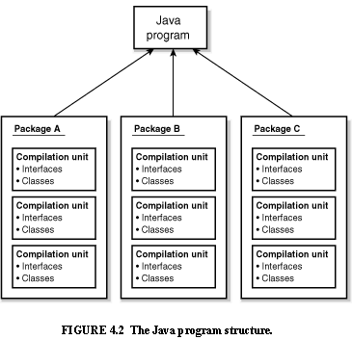
Review: Java Program Structure
HIGH-LEVEL VIEW
JAVA Units:
Packages
Classes
(Instances)
Methods
Instructions
Variables
PICTURE CREDIT: http://www.webbasedprogramming.com/JAVA-Developers-Guide/ch4.htm

Slide 4
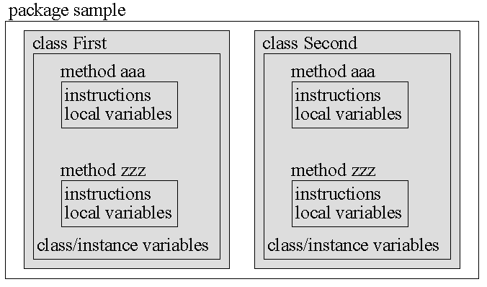
Review: Java Package Structure
PICTURE CREDIT: http://users.soe.ucsc.edu/~charlie/book/notes/summary1-4/sld016.htm

Slide 5
What Is An Array?
Arrays Are
Regular, periodic data structures
1-D : A vector of values (1,4,37,3)
2-D : A matrix (like mailboxes at the Post Office)
Arrays Are Used For
Storing Values for Regular Accessibility
Representing Signals (Audio) and Images
Representing Physical Systems

Slide 6
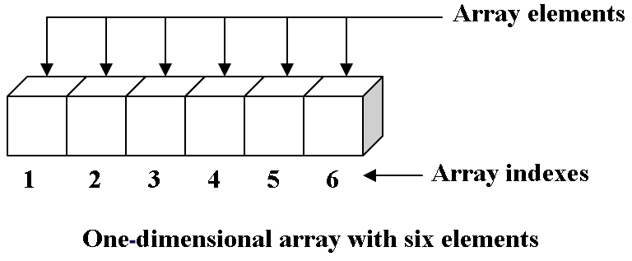
What Is a 1-D Array?
One-Dimensional Array:
Array Name = “a”
4 13 35 2 19 8
ARRAY ELEMENT VALUES
0 1 2 3 4 5
JAVA Arrays Are Zero-Indexed:
0, 1, …, N-1
a[1] = 13
a[5] = 8
Image Credit: 123codegenerator.blogspot.com

Slide 7
Let’s Do a 1-D Array in Java
One-Dimensional Array:
Array Name = “a”
// Technique 1: Declare datatype then size
int a ;
a = new int[6] ;
// Technique 2: Declare datatype and size
int a[] = new int[6] ;
0 1 2 3 4 5

Slide 8
Let’s Do a 1-D Array with For Loop
One-Dimensional Array:
Array Name = “a”
// Declare the array (1-D, 6 elements)
int a[] = new int[6] ;
// Put the loop index into the array
for (int i = 0, i < 6, i++)
{ a[i] = 2 * i;
}
RESULT: a = (0, 2, 4, 6, 8, 10)

Slide 9
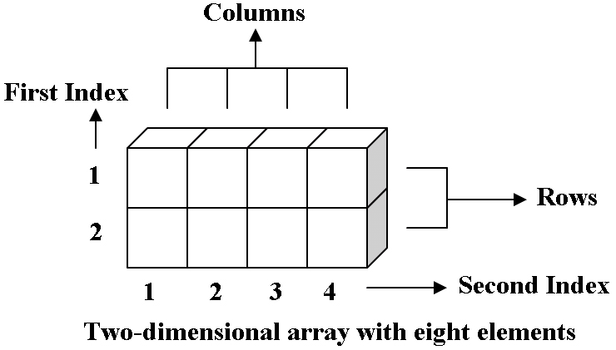
What Is a 2-D Array?
Two-Dimensional Array:
Array Name = “a2”
a2[0,2] = 49
ARRAY ELEMENT VALUES
0
1
27 4 49 3
6 8 13 77
JAVA Arrays Are Zero-Indexed:
0, 1, …, N-1
0 1 2 3
Image Credit: 123codegenerator.blogspot.com

Slide 10
Let’s Do a 2-D Array in Java
Two-Dimensional Array:
Array Name = “a2”
// Technique: Declare datatype and size
int a2[][] = new int[2][4] ;
4
JAVA Arrays Are Zero-Indexed:
0, 1, …, N-1
2
0
1
0 1 2 3

Slide 11
Let’s Do a 2-D Array with For Loop
One-Dimensional Array:
Array Name = “a2”
// Declare the array (2-D, 2 rows x 4 cols)
int a2[][] = new int[2][4] ;
// Put the sum of loop indices into array
for (int i = 0, j < 2, i++)
{ for (int j = 0, j < 4, j++)
{ a2[i][j] = i + j;
}
}
RESULT: Row 0 of a2 = (0, 1, 2, 3)
Row 1 of a2 = (1, 2, 3, 4)

Slide 12
This Week: Arrays and Java
READING ASSIGNMENT: D. Liang: Chapters 6 & 7
Next Class (Wednesday 06 February)
Details about Java ARRAYS
Programming Array Operations in Asn. #2
Next Class (Friday 08 February)
How to Do Assignment #2 – Part III
More on Multidimensional Arrays in Java

