Slide 1
COP2800 – Computer Programming Using JAVA
University of Florida Department of CISE Spring 2013
Lecture 11 – How to Get Started on Assignment #2
Webpage: www.cise.ufl.edu/~mssz/JavaNM/Top-Level.html

Slide 2
COP2800 – Programming in JAVA
Course Objectives
Basic Knowledge of Computers & Programming
Specific Knowledge of JAVA Programming
Practical Programming Projects Build Skills
Today’s Class
How to Program Assignment #2
Developing Code for Assignment #2
Compiling and Running
How to e-Submit Your Code by 15 February 2013

Slide 3
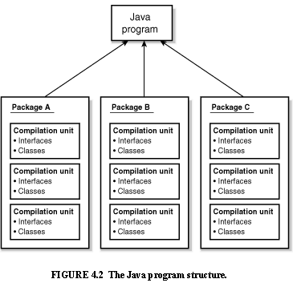
Review: Java Program Structure
HIGH-LEVEL VIEW
JAVA Units:
Packages
Classes
(Instances)
Methods
Instructions
Variables
PICTURE CREDIT: http://www.webbasedprogramming.com/JAVA-Developers-Guide/ch4.htm

Slide 4
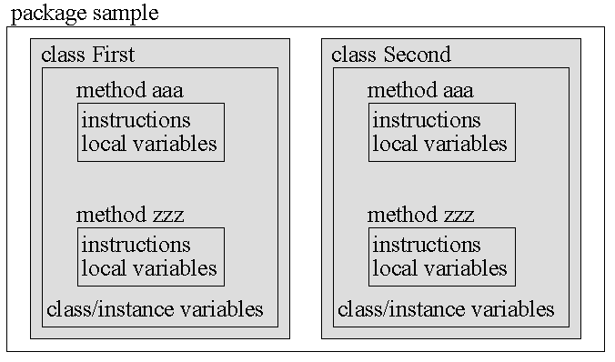
Review: Java Package Structure
PICTURE CREDIT: http://users.soe.ucsc.edu/~charlie/book/notes/summary1-4/sld016.htm

Slide 5
Assignment #2 : Number Filtering
Objectives
Put numbers into bins based on magnitude
Learn how to use Java arrays
Learn how to use Typecasting
Learn how to use Flow Control Structures
Things You Will Need
Java Software Loaded onto Your Laptop
Assignment #2 PDF from Course Website
(contains pseudocode and some Java code)

Slide 6
Structure of Assignment #2
Part I – Vocabulary Questions
Part II – Build a Simple Java Program TODAY!!
Next Week (Friday):
Part III – Enhance Your Java Program
Make Class BetterNumberFilter
Use inheritance to help structure the program
Make methods for processing input and printing the output

Slide 7
Let’s Get Started…
Visit our COP2800 Class Website and…
1. Download Assignment #2 Description:
www.cise.ufl.edu/~mssz/JavaNM/COP2800-S13-HW2-Assignment.pdf

Slide 8
Next Week: Java Programming
Next Class (Monday 04 February)
Details about Java ARRAYS
Programming Array Operations with Loops
Next Class (Wednesday 05 February)
More on Loops and Arrays
Multidimensional Arrays

Slide 9
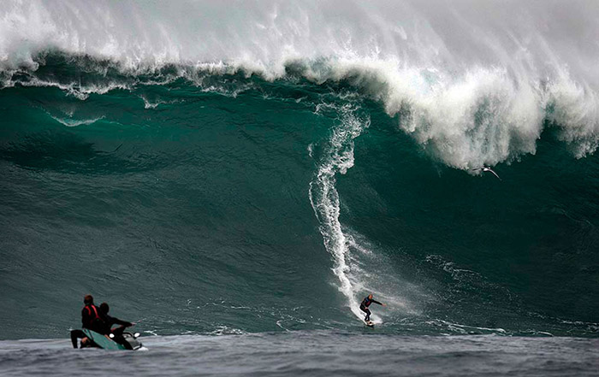
Enjoy the Weekend !!
Photo Credit: http://forum.ebaumsworld.com/showthread.php?355305-Big-wave-surfing-pictures-and-videos

