Slide 1
COP2800 – Computer Programming Using JAVA
University of Florida Department of CISE Spring 2013
Lecture 06 – How to Get Started on Assignment #1
Webpage: www.cise.ufl.edu/~mssz/JavaNM/Top-Level.html

Slide 2
COP2800 – Programming in JAVA
Course Objectives
Basic Knowledge of Computers & Programming
Specific Knowledge of JAVA Programming
Practical Programming Projects Build Skills
Today’s Class
How to Program Assignment #1
Demo of Code for Assignment #1
Compiling and Running
How to e-Submit Your Code by 1 February 2013

Slide 3
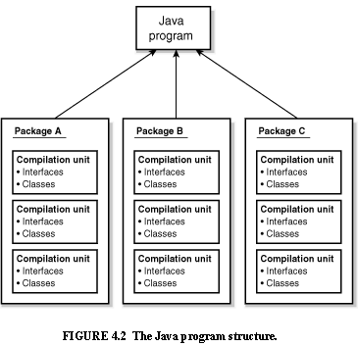
Review: Java Program Structure
HIGH-LEVEL VIEW
JAVA Units:
Packages
Classes
(Instances)
Methods
Instructions
Variables
PICTURE CREDIT: http://www.webbasedprogramming.com/JAVA-Developers-Guide/ch4.htm

Slide 4
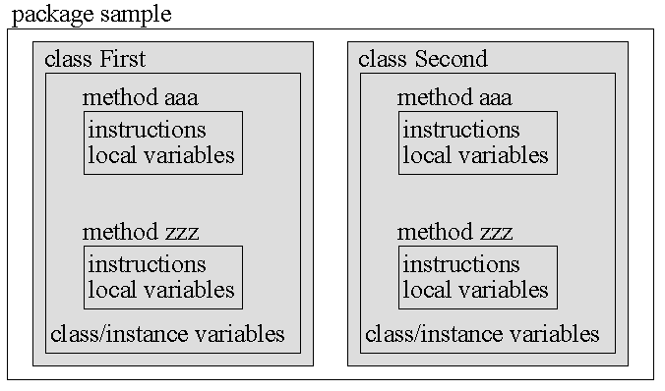
Review: Java Package Structure
PICTURE CREDIT: http://users.soe.ucsc.edu/~charlie/book/notes/summary1-4/sld016.htm

Slide 5
Assignment #1 : F2C, C2F
Objectives
Convert degrees F to degrees C, also C to F
Learn how to write a Java Program
Learn how to specify a Java Class
Learn how to design & code a Java Method
Things You Will Need
Java Software Loaded onto Your Laptop
Assignment #1 PDF from Course Website
Java Code for Asn#1 from Course Website

Slide 6
Structure of Assignment #1
Part I – Vocabulary Questions
Part II – Build a Simple Java Program TODAY!!
Next Week:
Part III – Enhance Your Java Program
Make Superclass TemperatureConverter
Superclass has abstract method convert
Make Subclasses F2C and C2F
Subclasses have methods that instantiate convert

Slide 7
Let’s Get Started…
Visit our COP2800 Class Website and…
1. Download Java Code for Assignment #1:
www.cise.ufl.edu/~mssz/JavaNM/COP2800-S13-Assignment1-PartII-JavaCode.java
2. Download Assignment #1 Description:
www.cise.ufl.edu/~mssz/JavaNM/COP2800-S13-HW1-Assignment.pdf

Slide 8
Next Week: Java Programming
Next Class (Wednesday 23 Jan)
Java Datatypes
Examples of Programming with Flow Control
Next Class (Friday 25 Jan)
We will Work on Part III of Assignment #1
Converting the Methods from Part II into Subclasses of the Superclass TemperatureConverter

Slide 9
Enjoy the Weekend !!

