Slide 1
COP2800 – Computer Programming Using JAVA
University of Florida Department of CISE Spring 2013
Instructor: Dr. Mark Schmalz (mssz@cise.ufl.edu)
Webpage: www.cise.ufl.edu/~mssz/JavaNM/Top-Level.html

Slide 2
COP2800 – Programming in JAVA
Course Objectives
Basic Knowledge of Computers & Programming
Specific Knowledge of JAVA Programming
Practical Programming Projects Build Skills
Course Evaluation
Six Programming Projects @ 7 pct of score 42%
Two Midterm Exams @ 18 pct of score 36%
One Final Exam @ 22 pct of score 22%
Total Score 100%

Slide 3
COP2800 – Programming in JAVA
Grading Scale
Standard UF Grading Scale
No Curving ➔ Reduces Cheating
Academic Honesty
No Copying of Assignments
Studying Together is Recommended
How to Succeed
Download & Read Viewgraphs, Attend Class
Do Assigned Projects, Study for and Take Exams

Slide 4
COP2800 – Programming in JAVA
Organization of Course
Weeks 1-2 Intro to computers, programming concepts
History and Features of Java
Weeks 2-4 Programming in Java - Basic Control Flow
Weeks 5-6 Programming arithmetic calculations
Weeks 7-10 Developing object-oriented software in Java
Weeks 10-12 Developing programs that talk to each other
Weeks 12-13 Programming small business applications in Java
Weeks 13-16 Java programming for the Internet

Slide 5
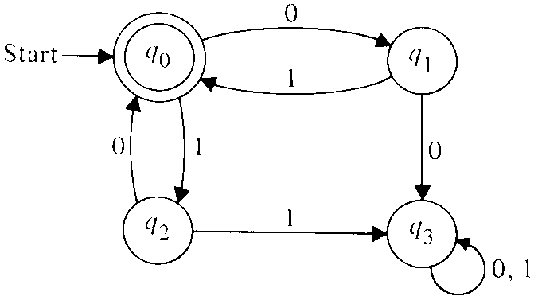
What is a Computer?
Machine that
Changes Its State
How is State Represented?
Zeroes and Ones : 0010101011000101101…
Called a “State Map”
Why are Computers Important?
Transform State Map to User-Friendly Display
Transform State Map to Hardware Control Signals
Control Useful Things (TVs, Cars, Telephones…)

Slide 6
What is Programming?
Computer Hardware (HW) is Equipment
CPU, Memory, Mouse, Printer, Flat-Panel Display…
Hardware Must Be Controlled by Software (SW)
Computer Program (SW) Controls Hardware
You Determines Desired Function of Hardware
You Describe Hardware Function in Program
You Compile Program
Hardware Computes (“executes”) Program
You Modifies Program, go to Step 3
When Program Works, You Document It!!

Slide 7
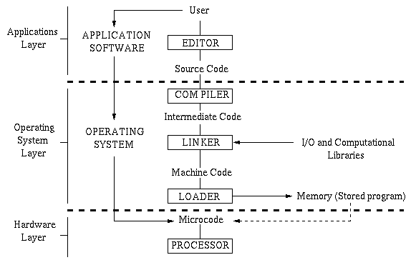
How Computer Programming Works
JAVA

Slide 8
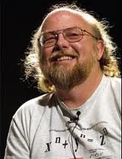
How Was JAVA Developed?
INTELLIGENCE REPORT:
Java was developed
by Jim Gosling →→→>
Mike Sheridan, and
Pat Naughton at Sun Microsystems 1991-95
CURRENT STATUS
As-of May 2007, JAVA is part of the GNU suite of free programming tools.

Slide 9
Why Was JAVA Developed?
Object-Oriented Language Was Needed
"simple, object-oriented and familiar“
"robust and secure“
"architecture-neutral and portable“
execute with "high performance“
"interpreted, threaded, and dynamic"
Write-Once, Run Anywhere
Write a Program in JAVA
Compile to Intermediate Representation (IR)
IR Can Be Input to Any Java Virtual Machine (JVM)
IR Can Be Run by Any Java Runtime Environment (JRE)

Slide 10
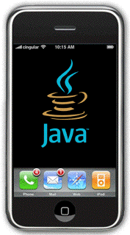
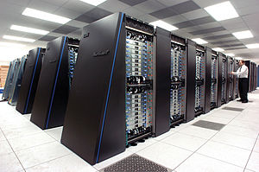
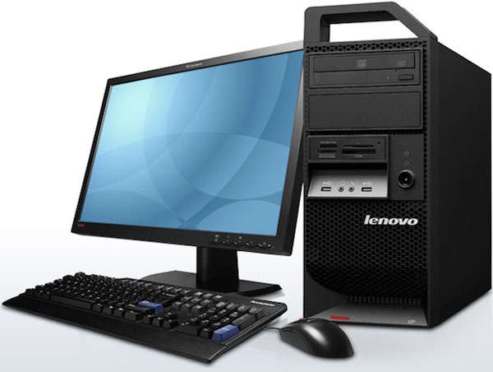
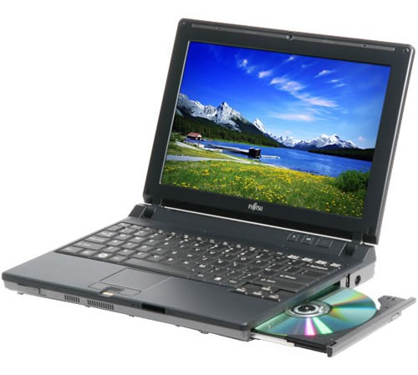
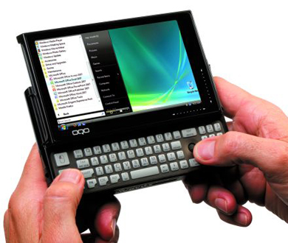
Why is Portability Important?
More Economical
Write one JAVA Application : Don’t Need to Reprogram Every Time New HW is Acquired
Runs on any JVM/JRE
Runs on Web (Javascript) as Applet

Slide 11
On a Piece of Paper…
Print CLEARLY:
Your Name and Email Address
Last 4 Digits of Your UFID
Your Major and Year (3EG, etc.)
Have You Programmed Before? What Language(s)?
Have you taken other computer courses?
If so, which ones?
Why did you register for COP2800?
What are your Goals for this course?

