Slide 1

Chapter 5 Link Layer and LANs
Computer Networking: A Top Down Approach 4th edition. Jim Kurose, Keith Ross Addison-Wesley, July 2007.
Computer Networking: A Top Down Approach 5th edition. Jim Kurose, Keith Ross Addison-Wesley, April 2009.

Slide 2
Chapter 5: The Data Link Layer
Our goals:
understand principles behind data link layer services:
error detection, correction
sharing a broadcast channel: multiple access
link layer addressing
reliable data transfer, flow control: done!
instantiation and implementation of various link layer technologies

Slide 3
Link Layer
5.1 Introduction and services
5.2 Error detection and correction
5.3Multiple access protocols
5.4 Link-layer Addressing
5.5 Ethernet
5.6 Link-layer switches
5.7 PPP
5.8 Link virtualization: ATM, MPLS

Slide 4

Link Layer: Introduction
Some terminology:
hosts and routers are nodes
communication channels that connect adjacent nodes along communication path are links
wired links
wireless links
LANs
layer-2 packet is a frame, encapsulates datagram
data-link layer has responsibility of
transferring datagram from one node
to adjacent node over a link

Slide 5
Link layer: context
datagram transferred by different link protocols over different links:
e.g., Ethernet on first link, frame relay on intermediate links, 802.11 on last link
each link protocol provides different services
e.g., may or may not provide rdt over link

Slide 6
Link Layer Services
framing, link access:
encapsulate datagram into frame, adding header, trailer
channel access if shared medium
“MAC” addresses used in frame headers to identify source, dest
different from IP address!
reliable delivery between adjacent nodes
we learned how to do this already (chapter 3)!
seldom used on low bit-error link (fiber, some twisted pair)
wireless links: high error rates
Q: why both link-level and end-end reliability?

Slide 7
Link Layer Services (more)
flow control:
pacing between adjacent sending and receiving nodes
error detection:
errors caused by signal attenuation, noise.
receiver detects presence of errors:
signals sender for retransmission or drops frame
error correction:
receiver identifies and corrects bit error(s) without resorting to retransmission
half-duplex and full-duplex
with half duplex, nodes at both ends of link can transmit, but not at same time

Slide 8
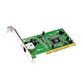
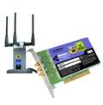
Where is the link layer implemented?
in each and every host
link layer implemented in “adaptor” (aka network interface card NIC)
Ethernet card, PCMCI card, 802.11 card
implements link, physical layer
attaches into host’s system buses
combination of hardware, software, firmware
host schematic
application
transport
network
link
cpu
memory
link
physical
host
bus
(e.g., PCI)
controller
physical
transmission
network adapter
card

Slide 9
Adaptors Communicating
datagram
datagram
controller
controller
sending host
receiving host
datagram
frame
sending side:
encapsulates datagram in frame
adds error checking bits, reliable data transfer (rdt), flow control, etc.
receiving side
looks for errors, rdt, flow control, etc
extracts datagram, passes to upper layer at receiving side

Slide 10
Link Layer
5.1 Introduction and services
5.2 Error detection and correction
5.3Multiple access protocols
5.4 Link-layer Addressing
5.5 Ethernet
5.6 Link-layer switches
5.7 PPP
5.8 Link Virtualization: ATM. MPLS

Slide 11
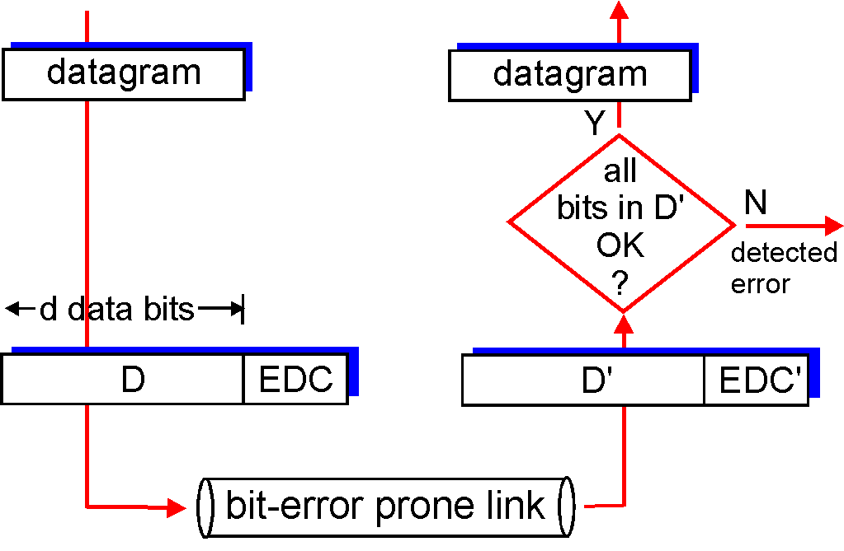
Error Detection
EDC= Error Detection and Correction bits (redundancy)
D = Data protected by error checking, may include header fields
Error detection not 100% reliable!
protocol may miss some errors, but rarely
larger EDC field yields better detection and correction
otherwise

Slide 12
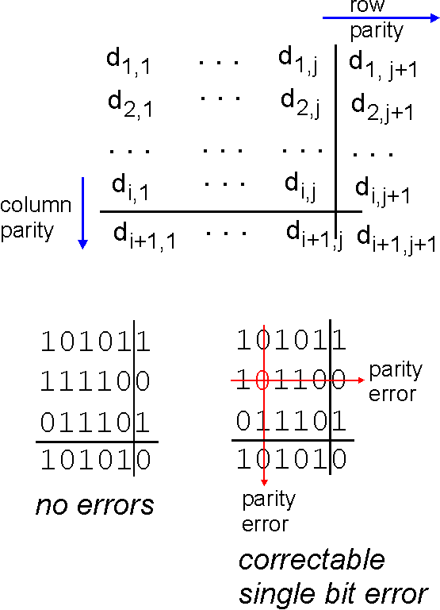
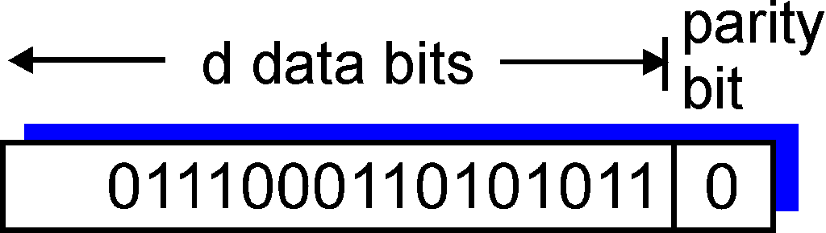
Parity Checking
Single Bit Parity:
Detect single bit errors
Two Dimensional Bit Parity:
Detect and correct single bit errors
Odd parity scheme
Parity bit value is chosen such that number of 1’s send is odd.
Ex. 9 1’s in the data, so the parity bit is ‘0’.
0
0
(even parity)

Slide 13
Internet checksum (review)
Goal: detect “errors” (e.g., flipped bits) in transmitted packet (note: used at transport layer only)
Sender:
treat segment contents as sequence of 16-bit integers
checksum: addition (1’s complement sum) of segment contents
sender puts checksum value into UDP checksum field
Receiver:
compute checksum of received segment
check if computed checksum equals checksum field value:
NO - error detected
YES - no error detected. But maybe errors nonetheless?

Slide 14
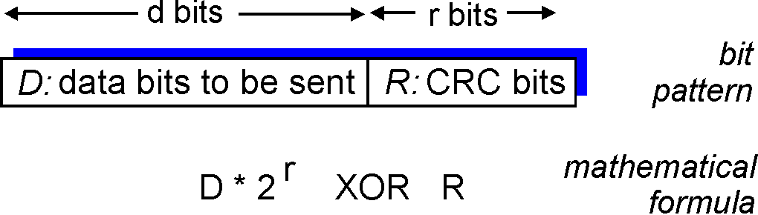
Checksumming: Cyclic Redundancy Check
view data bits, D, as a binary number
choose r+1 bit pattern (generator), G
goal: choose r CRC bits, R, such that
<D,R> exactly divisible by G (modulo 2)
receiver knows G, divides <D,R> by G. If non-zero remainder: error detected!
can detect all burst errors less than r+1 bits
widely used in practice (802.11 WiFi, ATM)

Slide 15
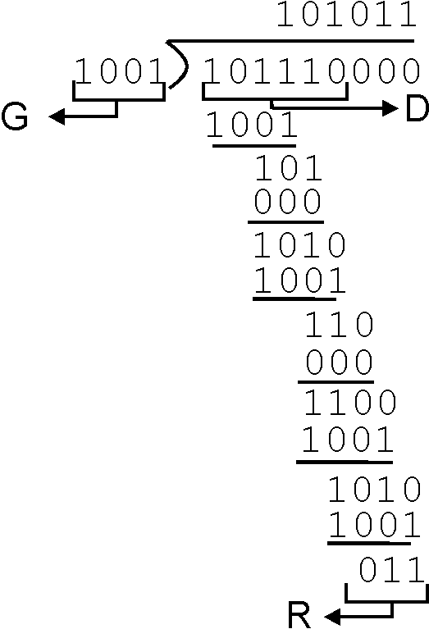
CRC Example
Want:
D.2^{r} XOR R = nG
equivalently:
D.2^{r} = nG XOR R
equivalently:
if we divide D.2^{r} by G, want remainder R
D.2^{r}
G
R = remainder[ ]

Slide 16
Link Layer
5.1 Introduction and services
5.2 Error detection and correction
5.3Multiple access protocols
5.4 Link-layer Addressing
5.5 Ethernet
5.6 Link-layer switches
5.7 PPP
5.8 Link Virtualization: ATM, MPLS

Slide 17


Multiple Access Links and Protocols
Two types of “links”:
point-to-point
PPP for dial-up access
point-to-point link between Ethernet switch and host
broadcast (shared wire or medium)
old-fashioned Ethernet
upstream HFC (hybrid fiber-coaxial cable)
802.11 wireless LAN
humans at a
cocktail party
(shared air, acoustical)
shared wire (e.g.,
cabled Ethernet)
shared RF
(e.g., 802.11 WiFi)
shared RF
(satellite)

Slide 18
Multiple Access protocols
single shared broadcast channel
two or more simultaneous transmissions by nodes: interference
collision if node receives two or more signals at the same time
multiple access protocol
distributed algorithm that determines how nodes share channel, i.e., determine when node can transmit
communication about channel sharing must use channel itself!
no out-of-band channel for coordination

Slide 19
Ideal Multiple Access Protocol
Broadcast channel of rate R bps
1. when one node wants to transmit, it can send at rate R.
2. when M nodes want to transmit, each can send at average rate R/M
3. fully decentralized:
no special node to coordinate transmissions
no synchronization of clocks, slots
4. simple

Slide 20
MAC Protocols: a taxonomy
Three broad classes:
Channel Partitioning
divide channel into smaller “pieces” (time slots, frequency, code)
allocate piece to node for exclusive use
Random Access
channel not divided, allow collisions
“recover” from collisions
“Taking turns”
nodes take turns, but nodes with more to send can take longer turns

Slide 21
Channel Partitioning MAC protocols: TDMA
TDMA: time division multiple access
access to channel in "rounds"
each station gets fixed length slot (length = pkt trans time) in each round
unused slots go idle
example: 6-station LAN, 1,3,4 have pkt, slots 2,5,6 idle
6-slot
frame
1
3
4
1
3
4

Slide 22
Channel Partitioning MAC protocols: FDMA
FDMA: frequency division multiple access
channel spectrum divided into frequency bands
each station assigned fixed frequency band
unused transmission time in frequency bands go idle
example: 6-station LAN, 1,3,4 have pkt, frequency bands 2,5,6 idle
time
frequency bands
FDM cable

Slide 23
Random Access Protocols
When node has packet to send
transmit at full channel data rate R.
no a priori coordination among nodes
two or more transmitting nodes ➜ “collision”,
random access MAC protocol specifies:
how to detect collisions (e.g., no Ack, or bad reception)
how to recover from collisions (e.g., via delayed retransmissions)
Examples of random access MAC protocols:
ALOHA
slotted ALOHA
CSMA: Carrier Sense Multiple Access,
CSMA/CD (Ethernet): CSMA with collision detection
CSMA/CA (WiFi 802.11): CSMA with collision avoidance

Slide 24
Random MAC (Medium Access Control) Techniques
ALOHA (‘70) [packet radio network]
A station sends whenever it has a packet/frame
Listens for round-trip-time delay for Ack
If no Ack then re-send packet/frame after random delay
too short ⇒ more collisions
too long ⇒ under utilization
No carrier sense is used
If two stations transmit about the same time frames collide
Utilization of ALOHA is low ~18%

Slide 25
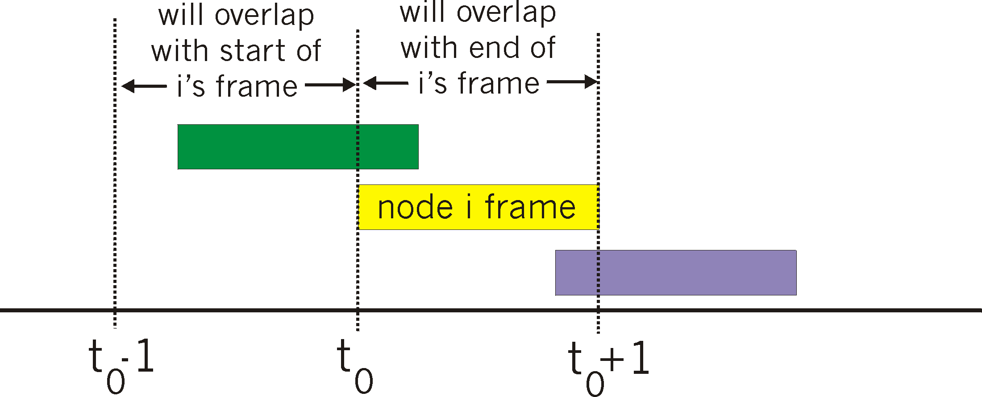
Pure (unslotted) ALOHA
unslotted Aloha: simple, no synchronization
when frame first arrives
transmit immediately
collision probability increases:
frame sent at t₀ collides with other frames sent in [t₀-1,t₀+1]

Slide 26
Pure Aloha efficiency
P(success by given node) = P(node transmits) .
P(no other node transmits in [t₀-1,t₀] .
P(no other node transmits in [t₀,t₀+1]
= p . (1-p)^{N-1 .} (1-p)^{N-1}
= p . (1-p)^{2(N-1)}
… choosing optimum p and then letting n -> infty ...
^{= 1/(2e) = .18}
Very bad, can we do better?

Slide 27
Slotted ALOHA
Assumptions:
all frames same size
time divided into equal size slots (time to transmit 1 frame)
nodes start to transmit only slot beginning
nodes are synchronized
if 2 or more nodes transmit in slot, all nodes detect collision
Operation:
when node obtains fresh frame, transmits in next slot
if no collision: node can send new frame in next slot
if collision: node retransmits frame in each subsequent slot with prob. p until success

Slide 28
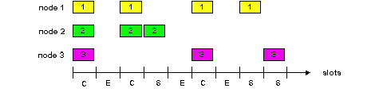
Slotted ALOHA
Pros
single active node can continuously transmit at full rate of channel
highly decentralized: only slots in nodes need to be in sync
simple
Cons
collisions, wasting slots
idle slots
nodes may be able to detect collision in less than time to transmit packet
clock synchronization

Slide 29
Slotted Aloha efficiency
Efficiency : long-run fraction of successful slots (many nodes, all with many frames to send)
max efficiency: find p* that maximizes Np(1-p)^{N-1}
for many nodes, take limit of Np*(1-p*)^{N-1} as N goes to infinity, gives:
Max efficiency = 1/e = .37
suppose: N nodes with many frames to send, each transmits in slot with probability p
prob that given node has success in a slot = p(1-p)^{N-1}
prob that any node has a success = Np(1-p)^{N-1}
At best: channel
used for useful
transmissions 37%
of time!
!

Slide 30
CSMA (Carrier Sense Multiple Access)
CSMA: listen before transmit:
If channel sensed idle: transmit entire frame
If channel sensed busy, defer transmission

Slide 31
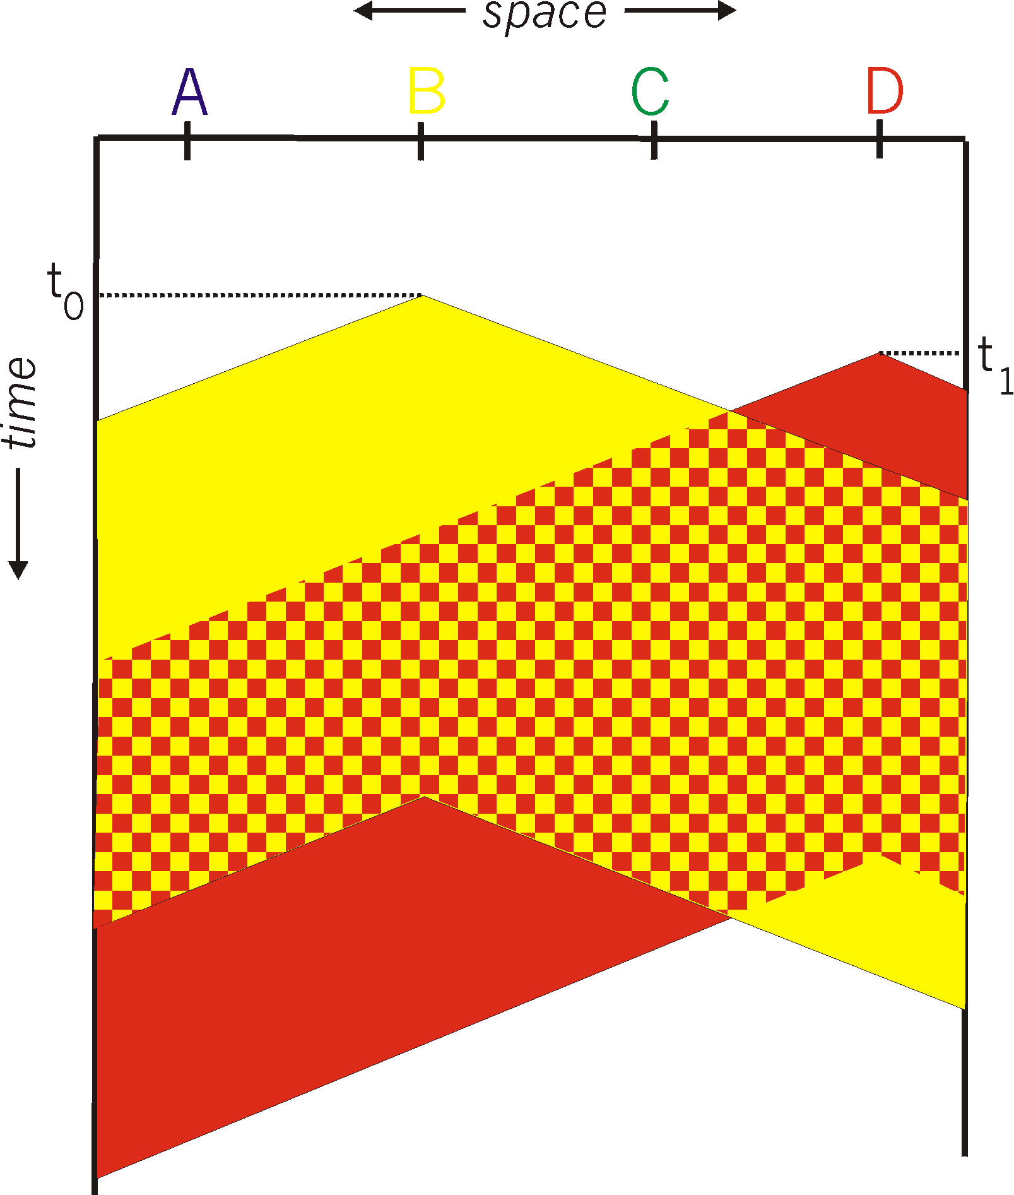
CSMA collisions
spatial layout of nodes
collisions can still occur:
propagation delay means
two nodes may not hear
each other’s transmission
collision:
entire packet transmission
time wasted
note:
role of distance & propagation delay in determining collision probability

Slide 32
CSMA/CD (Collision Detection)
CSMA/CD: carrier sensing, deferral as in CSMA
collisions detected within short time
colliding transmissions aborted, reducing channel wastage
collision detection:
easy in wired LANs: measure signal strengths, compare transmitted, received signals
difficult in wireless LANs: received signal strength overwhelmed by local transmission strength (use CSMA/CA: we’ll get back to that in Ch 6)
human analogy: the polite conversationalist

Slide 33
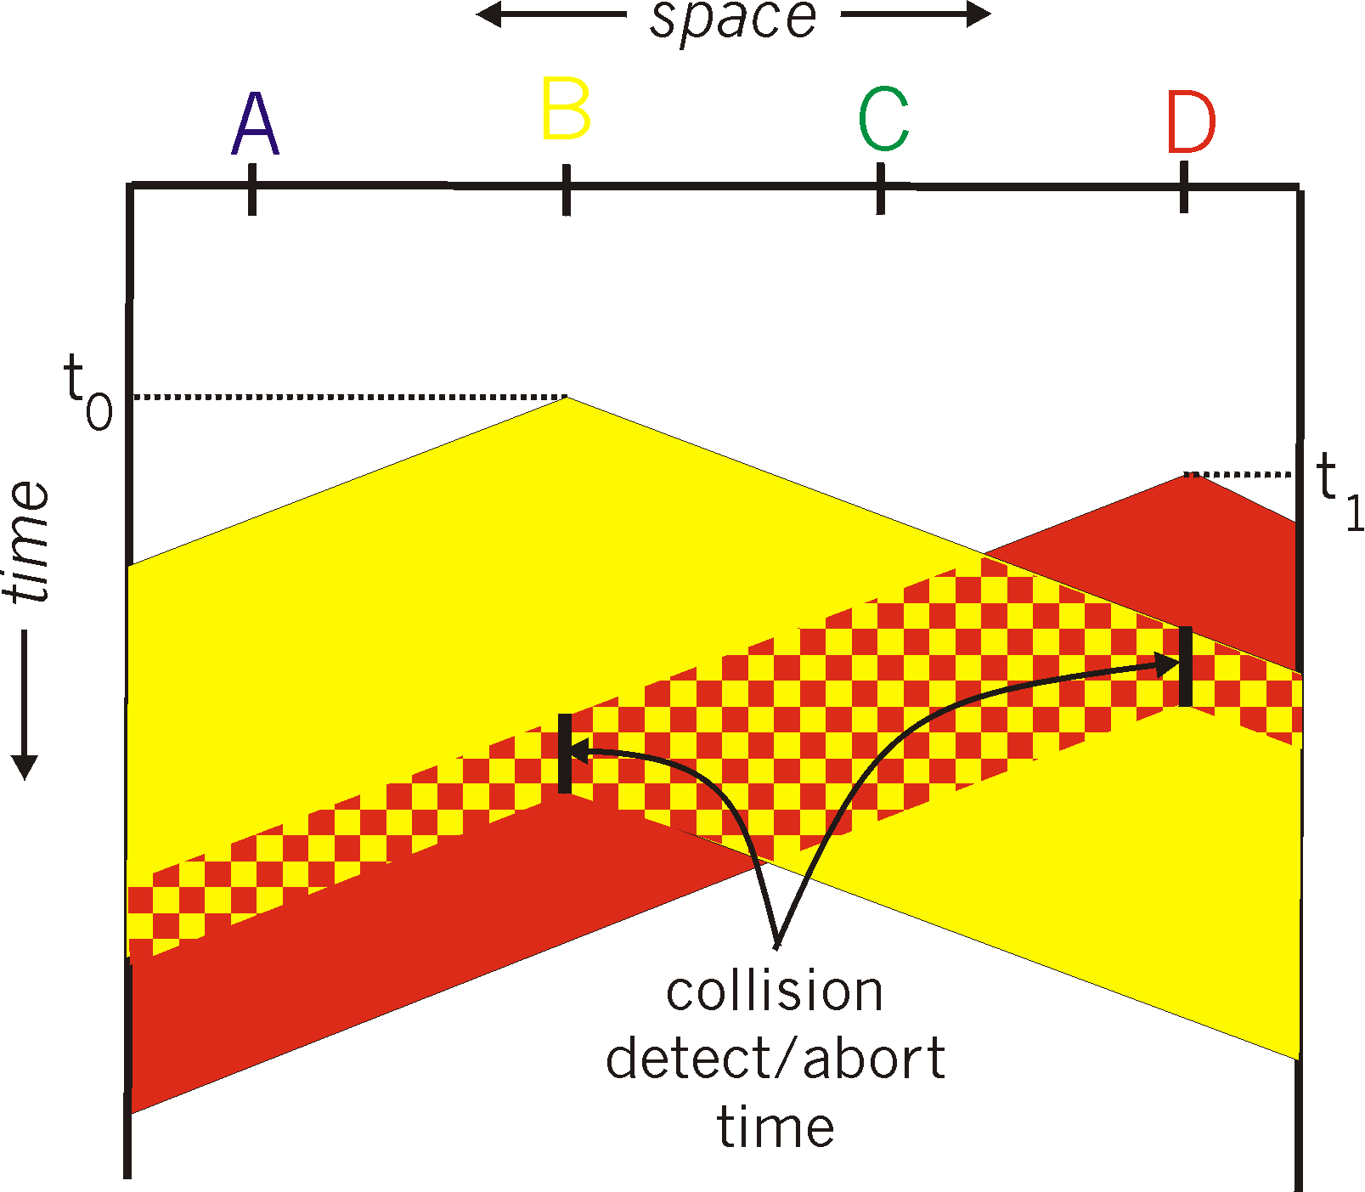
CSMA/CD collision detection
CSMA/CD
CSMA

Slide 34
Shared meduim bus

Slide 35
More on CSMA/CD and Ethernet
uses broadcast and filtration: all stations on the bus receive the frame, but only the station with the appropriate data link D-L (MAC) destination address picks up the frame. For multicast, filteration may be done at the D-L layer or at the network layer (with more overhead)

Slide 36

Analyzing CSMA/CD
Collision
Collision
Success
Av. Time wasted ~ 5 Prop
TRANS
Utilization or ‘efficiency’ is fraction of the time used for useful/successful data transmission

Slide 37
u=TRANS/(TRANS+wasted)=TRANS/(TRANS+5PROP)=1/(1+5a), where a=PROP/TRANS
if a is small, stations learn about collisions and u increases
if a is large, then u decreases

Slide 38
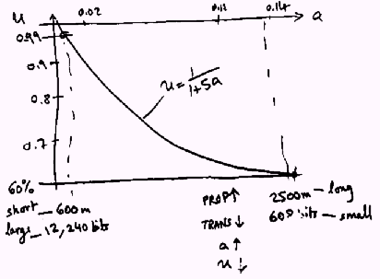

Slide 39
Collision detection in Wireless
Need special equipment to detect collision at receiver
We care about the collision at the reciever
1. no-collision detected at sender but collision detected at receiver
2. collision at sender but no collision at receiver
Neighborhood of sender and receiver are not the same (it’s not a shared wire, but define relatively (locally) to a node [hidden terminal problem]
… more later

Slide 40
“Taking Turns” MAC protocols
channel partitioning MAC protocols:
share channel efficiently and fairly at high load
inefficient at low load: delay in channel access, 1/N bandwidth allocated even if only 1 active node!
Random access MAC protocols
efficient at low load: single node can fully utilize channel
high load: collision overhead
“taking turns” protocols
look for best of both worlds!

Slide 41
“Taking Turns” MAC protocols
Polling:
master node “invites” slave nodes to transmit in turn
typically used with “dumb” slave devices
concerns:
polling overhead
latency
single point of failure (master)
data
poll
master
data
slaves

Slide 42
“Taking Turns” MAC protocols
Token passing:
control token passed from one node to next sequentially.
token message
concerns:
token overhead
latency
single point of failure (token)
T
(nothing
to send)
T
data

Slide 43

Release after reception: utilization analysis
Prop
Prop
token
Prop N→1
Prop 1→2
u=useful time/total time(useful+wasted)
u=T1+T2+…+TN/[T1+T2+..+TN+(N+1)PROP]
a=PROP/TRANS=PROP/E(Tn), where E(Tn) is the expected (average) transmission of a node

Slide 44
u=∑Ti/(∑Ti+(N+1)PROP)
~1/(1+PROP/E(Tn)), where E(Tn)= ∑Ti/N
u=1/(1+a) for token ring
[compared to Ethernet u=1/(1+5a)]

Slide 45
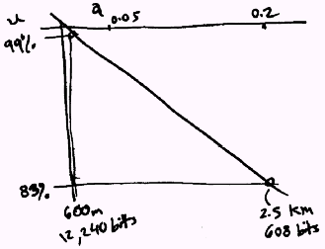

Slide 46
As the number of stations increases, less time for token passing, and u increases
for release after transmission u=1/(1+a/N), where N is the number of stations

Slide 47
Summary of MAC protocols
channel partitioning, by time, frequency or code
Time Division, Frequency Division
random access (dynamic),
ALOHA, S-ALOHA, CSMA, CSMA/CD
carrier sensing: easy in some technologies (wire), hard in others (wireless)
CSMA/CD used in Ethernet
CSMA/CA used in 802.11
taking turns
polling from central site, token passing
Bluetooth, FDDI, IBM Token Ring

Slide 48
LAN technologies
Data link layer so far:
services, error detection/correction, multiple access
Next: LAN technologies
Ethernet
addressing
switches
PPP

Slide 49
Link Layer
5.1 Introduction and services
5.2 Error detection and correction
5.3Multiple access protocols
5.4 Link-Layer Addressing
5.5 Ethernet
5.6 Link-layer switches
5.7 PPP
5.8 Link Virtualization: ATM and MPLS

Slide 50
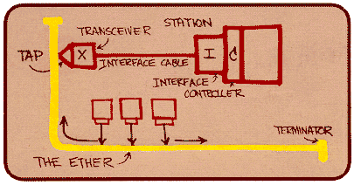
Ethernet
“dominant” wired LAN technology:
cheap $20 for NIC
first widely used LAN technology
simpler, cheaper than token LANs and ATM
kept up with speed race: 10 Mbps – 10 Gbps
Metcalfe’s Ethernet
sketch

Slide 51
Star topology
bus topology popular through mid 90s
all nodes in same collision domain (can collide with each other)
today: star topology prevails
active switch in center
each “spoke” runs a (separate) Ethernet protocol (nodes do not collide with each other)
switch
bus: coaxial cable
star

Slide 52

Ethernet Frame Structure
Sending adapter encapsulates IP datagram (or other network layer protocol packet) in Ethernet frame
Preamble:
7 bytes with pattern 10101010 followed by one byte with pattern 10101011
used to synchronize receiver, sender clock rates

Slide 53
Ethernet Frame Structure (more)
Addresses: 6 bytes
if adapter receives frame with matching destination address, or with broadcast address (eg ARP packet), it passes data in frame to network layer protocol
otherwise, adapter discards frame
Type: indicates higher layer protocol (mostly IP but others possible, e.g., Novell IPX, AppleTalk)
CRC: checked at receiver, if error is detected, frame is dropped

Slide 54
Ethernet: Unreliable, connectionless
connectionless: No handshaking between sending and receiving NICs
unreliable: receiving NIC doesn’t send acks or nacks to sending NIC
stream of datagrams passed to network layer can have gaps (missing datagrams)
gaps will be filled if app is using TCP
otherwise, app will see gaps
Ethernet’s MAC protocol: unslotted CSMA/CD

Slide 55
Ethernet CSMA/CD algorithm
1. NIC receives datagram from network layer, creates frame
2. If NIC senses channel idle, starts frame transmission. If NIC senses channel busy, waits until channel idle, then transmits.
3. If NIC transmits entire frame without detecting another transmission, NIC is done with frame !

Slide 56
Ethernet CSMA/CD algorithm (contd.)
4. If NIC detects another transmission while transmitting, aborts and sends jam signal
5. After aborting, NIC enters exponential backoff: after mth collision, NIC chooses K at random from {0,1,2,…,2^{m}-1}.
NIC waits K·512 bit times, returns to Step 2 (channel sensing)

Slide 57
Ethernet’s CSMA/CD (more)
Jam Signal: make sure all other transmitters are aware of collision; 48 bits
Bit time: .1 microsec for 10 Mbps Ethernet ; for K=1023, wait time is about 50 msec
Exponential Backoff:
Goal: adapt retransmission attempts to estimated current load
heavy load: random wait will be longer
first collision: choose K from {0,1}; delay is K· 512 bit transmission times
after second collision: choose K from {0,1,2,3}…
after ten collisions, choose K from {0,1,2,3,4,…,1023}
See/interact with Java
applet on AWL Web site:
highly recommended !

Slide 58
CSMA/CD efficiency
T_{prop} = max prop delay between 2 nodes in LAN
t_{trans} = time to transmit max-size frame
efficiency increases (goes to 1) as
t_{prop} decreases (goes to 0)
t_{trans} increases (goes to infinity)
[what if we increase bandwidth from 10Mbps to 100Mbps?]
better performance than ALOHA: and simple, cheap, decentralized!

Slide 59
802.3 Ethernet Standards: Link & Physical Layers
many different Ethernet standards
common MAC protocol and frame format
different speeds: 2 Mbps, 10 Mbps, 100 Mbps, 1Gbps, 10G bps
different physical layer media: fiber, cable
Switched Ethernet: use frame bursting to increase utilization. Still CSMA/CD compatible
application
transport
network
link
physical
MAC protocol
and frame format
100BASE-TX
100BASE-T2
100BASE-FX
100BASE-T4
100BASE-SX
100BASE-BX
copper (twister
pair) physical layer
fiber physical layer

Slide 60
Shared meduim bus

Slide 61
Shared medium hub

Slide 62
Switching hub

Slide 65
Link Layer
5.1 Introduction and services
5.2 Error detection and correction
5.3Multiple access protocols
5.4 Link-Layer Addressing
5.5 Ethernet
5.6 Link-layer switches
5.7 PPP
5.8 Link Virtualization: ATM, MPLS

Slide 66
MAC Addresses and ARP
32-bit IP address:
network-layer address
used to get datagram to destination IP subnet
MAC (or Ethernet) address:
function: get frame from one interface to another physically-connected interface (same network)
48 bit MAC address (for most LANs)
burned in NIC ROM, also sometimes software settable

Slide 67
LAN Addresses and ARP
Each adapter on LAN has unique LAN address
1A-2F-BB-76-09-AD
Broadcast address =
FF-FF-FF-FF-FF-FF
LAN
(wired or
wireless)
= adapter
71-65-F7-2B-08-53
58-23-D7-FA-20-B0
0C-C4-11-6F-E3-98

Slide 68
LAN Address (more)
MAC address allocation administered by IEEE
manufacturer buys portion of MAC address space (to assure uniqueness)
analogy:
(a) MAC address: like Social Security Number
(b) IP address: like postal address
MAC flat address ➜ portability
can move LAN card from one LAN to another
IP hierarchical address NOT portable
address depends on IP subnet to which node is attached

Slide 69
ARP: Address Resolution Protocol
Question: how to determine
MAC address of B
knowing B’s IP address?
Each IP node (host, router) on LAN has ARP table
ARP table: IP/MAC address mappings for some LAN nodes
< IP address; MAC address; TTL>
TTL (Time To Live): time after which address mapping will be forgotten (typically 20 min)
137.196.7.78
1A-2F-BB-76-09-AD
137.196.7.23
137.196.7.14
LAN
71-65-F7-2B-08-53
58-23-D7-FA-20-B0
0C-C4-11-6F-E3-98
137.196.7.88

Slide 70
ARP protocol: Same LAN (network)
A wants to send datagram to B, and B’s MAC address not in A’s ARP table.
A broadcasts ARP query packet, containing B's IP address
dest MAC address = FF-FF-FF-FF-FF-FF
all machines on LAN receive ARP query
B receives ARP packet, replies to A with its (B's) MAC address
frame sent to A’s MAC address (unicast)
A caches (saves) IP-to-MAC address pair in its ARP table until information becomes old (times out)
soft state: information that times out (goes away) unless refreshed
ARP is “plug-and-play”:
nodes create their ARP tables without intervention from net administrator

Slide 71
DHCP: Dynamic Host Configuration Protocol
Goal: allow host to dynamically obtain its IP address from network server when joining network
support for mobile users joining network
host holds address only while connected and “on” (allowing address reuse)
renew address already in use
DHCP overview:
1. host broadcasts “DHCP discover” msg
2. DHCP server responds with “DHCP offer” msg
3. host requests IP address: “DHCP request” msg
4. DHCP server sends address: “DHCP ack” msg

Slide 72
DHCP client-server scenario
A
223.1.1.1
DHCP
223.1.2.1
server
223.1.1.2
223.1.1.4
223.1.2.9
B
223.1.2.2
E
arriving DHCP
client needs
address in this
(223.1.2/24) network
223.1.1.3
223.1.3.27
223.1.3.1
223.1.3.2

Slide 73
DHCP client-server scenario
DHCP server: 223.1.2.5
arriving
client
DHCP discover
src : 0.0.0.0, 68
dest.: 255.255.255.255,67
yiaddr: 0.0.0.0
transaction ID: 654
DHCP offer
src: 223.1.2.5, 67
dest: 255.255.255.255, 68
yiaddrr: 223.1.2.4
transaction ID: 654
Lifetime: 3600 secs
DHCP request
src: 0.0.0.0, 68
dest:: 255.255.255.255, 67
yiaddrr: 223.1.2.4
transaction ID: 655
Lifetime: 3600 secs
time
DHCP ACK
src: 223.1.2.5, 67
dest: 255.255.255.255, 68
yiaddrr: 223.1.2.4
transaction ID: 655
Lifetime: 3600 secs

Slide 74
Addressing: routing to another LAN
walkthrough: send datagram from A to B via R
assume A knows B’s IP address
two ARP tables in router R, one for each IP network (LAN)
74-29-9C-E8-FF-55
88-B2-2F-54-1A-0F
A
E6-E9-00-17-BB-4B
222.222.222.221
111.111.111.111
1A-23-F9-CD-06-9B
222.222.222.220
222.222.222.222
111.111.111.110
B
111.111.111.112
R
49-BD-D2-C7-56-2A
CC-49-DE-D0-AB-7D

Slide 75
A creates IP datagram with source A, destination B
A uses ARP to get R’s MAC address for 111.111.111.110
A creates link-layer frame with R's MAC address as dest, frame contains A-to-B IP datagram
A’s NIC sends frame
R’s NIC receives frame
R removes IP datagram from Ethernet frame, sees its destined to B
R uses ARP to get B’s MAC address
R creates frame containing A-to-B IP datagram sends to B
74-29-9C-E8-FF-55
88-B2-2F-54-1A-0F
A
E6-E9-00-17-BB-4B
222.222.222.221
111.111.111.111
1A-23-F9-CD-06-9B
222.222.222.220
222.222.222.222
111.111.111.110
B
111.111.111.112
R
49-BD-D2-C7-56-2A
CC-49-DE-D0-AB-7D

Slide 76
Link Layer
5.1 Introduction and services
5.2 Error detection and correction
5.3 Multiple access protocols
5.4 Link-layer Addressing
5.5 Ethernet
5.6 Link-layer switches
5.7 PPP
5.8 Link Virtualization: ATM, MPLS

Slide 77
Hubs
… physical-layer (“dumb”) repeaters:
bits coming in one link go out all other links at same rate
all nodes connected to hub can collide with one another
no frame buffering
no CSMA/CD at hub: host NICs detect collisions
twisted pair
hub

Slide 78
Switch
link-layer device: smarter than hubs, take active role
store, forward Ethernet frames
examine incoming frame’s MAC address, selectively forward frame to one-or-more outgoing links when frame is to be forwarded on segment, uses CSMA/CD to access segment
transparent
hosts are unaware of presence of switches
plug-and-play, self-learning
switches do not need to be configured

Slide 79
Switch: allows multiple simultaneous transmissions
A
hosts have dedicated, direct connection to switch
switches buffer packets
Ethernet protocol used on each incoming link, but no collisions; full duplex
each link is its own collision domain
switching: A-to-A’ and B-to-B’ simultaneously, without collisions
not possible with dumb hub
C’
B
1
2
6
3
5
4
C
B’
A’
switch with six interfaces
(1,2,3,4,5,6)

Slide 80
Switch Table
A
Q: how does switch know that A’ reachable via interface 4, B’ reachable via interface 5?
A: each switch has a switch table, each entry:
(MAC address of host, interface to reach host, time stamp)
looks like a routing table!
Q: how are entries created, maintained in switch table?
something like a routing protocol?
C’
B
1
2
6
3
5
4
C
B’
A’
switch with six interfaces
(1,2,3,4,5,6)

Slide 81
Self-learning, forwarding: example
Source: A
Dest: A’
A
A A’
C’
B
frame destination unknown:
1
2
flood
6
3
A A’
A A’
A A’
A A’
A A’
5
4
destination A location known:
C
selective send
A’ A
B’
A’
MAC addr interface TTL
A
1
60
Switch table
(initially empty)
A’
4
60

Slide 82
Interconnecting switches
switches can be connected together
S₄
S₁
S₃
A
S₂
F
I
B
C
D
E
G
H
Q: sending from A to F - how does S₁ know to forward frame destined to F via S₄ and S₃?
A: self learning! (works exactly the same as in single-switch case!)

Slide 83
Example Institutional network
mail server
to external
network
router
web server
IP subnet

Slide 84
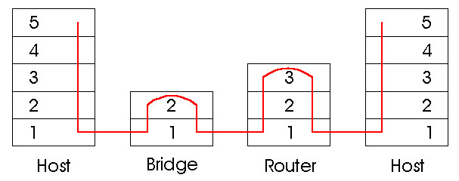
Switches vs. Routers
both store-and-forward devices
routers: network layer devices (examine network layer headers)
switches are link layer devices
routers maintain routing tables, implement routing algorithms
switches maintain switch tables, implement filtering, learning algorithms

Slide 85
Summary comparison

Slide 86
Link Layer
5.1 Introduction and services
5.2 Error detection and correction
5.3Multiple access protocols
5.4 Link-Layer Addressing
5.5 Ethernet
5.6 Hubs and switches
5.7 PPP
5.8 Link Virtualization: ATM and MPLS

Slide 87
Cerf & Kahn’s Internetwork Architecture
What is virtualized?
two layers of addressing: internetwork and local network
new layer (IP) makes everything homogeneous at internetwork layer
underlying local network technology
cable
satellite
56K telephone modem
today: ATM, MPLS
… “invisible” at internetwork layer. Looks like a link layer technology to IP!

Slide 88
ATM and MPLS
ATM, MPLS separate networks in their own right
different service models, addressing, routing from Internet
viewed by Internet as logical link connecting IP routers
just like dialup link is really part of separate network (telephone network)
ATM, MPLS: of technical interest in their own right

Slide 89
Asynchronous Transfer Mode: ATM
1990’s/00 standard for high-speed (155Mbps to 622 Mbps and higher) Broadband Integrated Service Digital Network architecture
Goal: integrated, end-end transport of carry voice, video, data
meeting timing/QoS requirements of voice, video (versus Internet best-effort model)
“next generation” telephony: technical roots in telephone world
packet-switching (fixed length packets, called “cells”) using virtual circuits

Slide 90
Circuit switching vs. Packet switching vs. Virtual circuit
Circuit switching
Example: Telephone network
constant bit rate
limits heterogeneity
uses TDM => wastes bandwidth
routing is done at call setup
failures need tear down and re-establishment
all data follow the same path
processing at each node is minimum

Slide 91
Packet switching
Example: Internet, IP
store & forward
accommodates heterogeneity and data rate conversion
statistical multiplexing => higher efficiency
routing information is added
overhead with respect to processing and bandwidth

Slide 92
Packet switching (contd.)
dynamic routing
more robust to failures
may introduce jitter if packets follow different paths
store & forward introduce queuing delays
can provide priorities and differentiated services

Slide 93
Virtual circuit
Example: ATM
routing at call set-up, prior to data transfer
path is not dedicated, still uses store & forward, statistical multiplexing
no routing decision per packet
packets follow same path

Slide 94
ATM architecture
AAL
AAL
ATM
ATM
ATM
ATM
physical
physical
physical
physical
end system
switch
switch
end system
adaptation layer: only at edge of ATM network
data segmentation/reassembly
roughly analagous to Internet transport layer
ATM layer: “network” layer
cell switching, routing
physical layer

Slide 95
ATM: network or link layer?
Vision: end-to-end transport: “ATM from desktop to desktop”
ATM is a network technology
Reality: used to connect IP backbone routers
“IP over ATM”
ATM as switched link layer, connecting IP routers
IP
network
ATM
network

Slide 96
ATM Adaptation Layer (AAL)
ATM Adaptation Layer (AAL): “adapts” upper layers (IP or native ATM applications) to ATM layer below
AAL present only in end systems, not in switches
AAL layer segment (header/trailer fields, data) fragmented across multiple ATM cells
analogy: TCP segment in many IP packets
AAL
AAL
ATM
ATM
ATM
ATM
physical
physical
physical
physical
end system
switch
switch
end system

Slide 97
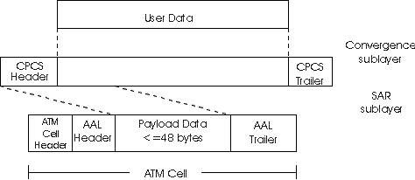
ATM Adaptation Layer (AAL) [more]
Different versions of AAL layers, depending on ATM service class:
AAL1: for CBR (Constant Bit Rate) services, e.g. circuit emulation
AAL2: for VBR (Variable Bit Rate) services, e.g., MPEG video
AAL5: for data (eg, IP datagrams)
User data
AAL PDU
ATM cell

Slide 98
ATM Layer
Service: transport cells across ATM network
analogous to IP network layer
very different services than IP network layer
Network
Architecture
Internet
ATM
ATM
ATM
ATM
Service
Model
best effort
CBR
VBR
ABR
UBR
Guarantees ?
Congestion
feedback
no (inferred
via loss)
no
congestion
no
congestion
yes
no
Bandwidth
none
constant
rate
guaranteed
rate
guaranteed
minimum
none
Loss
no
yes
yes
no
no
Order
no
yes
yes
yes
yes
Timing
no
yes
yes
no
no
(studied earlier)

Slide 99
ATM Layer: Virtual Circuits
VC transport: cells carried on VC from source to dest
call setup, teardown for each call before data can flow
each packet carries VC identifier (not destination ID)
every switch on source-dest path maintain “state” for each passing connection
link,switch resources (bandwidth, buffers) may be allocated to VC: to get circuit-like perf.
Permanent VCs (PVCs)
long lasting connections
typically: “permanent” route between to IP routers
Switched VCs (SVC):
dynamically set up on per-call basis

Slide 100
ATM VCs
Advantages of ATM VC approach:
QoS performance guarantee for connection mapped to VC (bandwidth, delay, delay jitter)
Drawbacks of ATM VC approach:
Inefficient support of datagram traffic
one PVC between each source/dest pair) does not scale (n.(n-1) connections needed)
SVC introduces call setup latency, processing overhead for short lived connections
VCI: VC Identifier, used for routing/switching
Has local significance (unlike IP addresses)
Identifies a segment of a path for a flow (or bundle of flows, called virtual path VP), to simplify switching
May change from one link to another

Slide 101

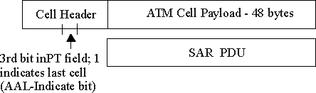
ATM Layer: ATM cell
5-byte ATM cell header
48-byte payload
Why?: small payload -> short cell-creation delay for digitized voice
halfway between 32 and 64 (compromise!)
(5 bytes)
Cell header
(53 bytes)
Cell format

Slide 102
ATM cell header
VCI: virtual channel ID
will change from link to link through the network
PT: Payload type (e.g. RM cell versus data cell)
CLP: Cell Loss Priority bit
CLP = 1 implies low priority cell, can be discarded if congestion
HEC: Header Error Checksum
cyclic redundancy check

Slide 103
IP-Over-ATM
IP over ATM
replace “network” (e.g., LAN segment) with ATM network
ATM addresses, IP addresses
Classic IP only
3 “networks” (e.g., LAN segments)
MAC (802.3) and IP addresses
ATM
network
Ethernet
LANs
Ethernet
LANs

Slide 104
IP-Over-ATM
app
transport
IP
AAL
ATM
phy
app
transport
IP
Eth
phy
IP
AAL
ATM
phy
Eth
ATM
phy
phy
ATM
phy
Border
Router/switch

Slide 105
Datagram Journey in IP-over-ATM Network
at Source Host:
IP layer maps between IP, ATM dest address (using ARP)
passes datagram to AAL5
AAL5 encapsulates data, segments cells, passes to ATM layer
ATM network: moves cell along VC to destination
at Destination Host:
AAL5 reassembles cells into original datagram
if CRC OK, datagram is passed to IP

Slide 106
IP-Over-ATM
Issues:
IP datagrams into ATM AAL5 PDUs
from IP addresses to ATM addresses
just like IP addresses to Ethernet MAC addresses!
ATM
network
Ethernet
LANs

Slide 107
Multiprotocol label switching (MPLS) [to cover with network (IP) layer]
initial goal: speed up IP forwarding by using fixed length label (instead of IP address) to do forwarding
borrowing ideas from Virtual Circuit (VC) approach
but IP datagram still keeps IP address!
PPP or Ethernet
header
IP header
remainder of link-layer frame
MPLS header
label
Exp
S
TTL
20
3
1
5

Slide 108
MPLS capable routers
a.k.a. label-switched router
forward packets to outgoing interface based only on label value (do not inspect IP address)
MPLS forwarding table distinct from IP forwarding tables
signaling protocol needed to set up forwarding
RSVP-TE
forwarding possible along paths that IP alone would not allow (e.g., source-specific routing) !!
use MPLS for traffic engineering
must co-exist with IP-only routers

Slide 109
MPLS forwarding tables
in out out
label label dest interface
10 A 0
in out out
label label dest interface
12 D 0
8 A 1
10 6 A 1
12 9 D 0
R6
0
0
D
1
1
R4
R3
R5
0
0
A
R2
in out out
label label dest interface
R1
in out out
label label dest interface
6 - A 0
8 6 A 0

Slide 110
Chapter 5: Summary
principles behind data link layer services:
error detection, correction
sharing a broadcast channel: multiple access
link layer addressing
instantiation and implementation of various link layer technologies
Ethernet
switched LANS
PPP
virtualized networks as a link layer: ATM, MPLS

Slide 111
Chapter 5: let’s take a breath
journey down protocol stack complete (except routing, PHY)
solid understanding of networking principles, practice
….. could stop here …. but lots of interesting topics!
Wireless mobile networks … among others!

