Slide 1

Chapter 4 Network Layer
Computer Networking: A Top Down Approach 4th edition. Jim Kurose, Keith Ross Addison-Wesley, July 2007.
Computer Networking: A Top Down Approach 5th edition. Jim Kurose, Keith Ross Addison-Wesley, April 2009.

Slide 2

Network layer
transport segment from sending to receiving host
on sending side encapsulates segments into datagrams
on rcving side, delivers segments to transport layer
network layer protocols in every host, router
router examines header fields in all IP datagrams passing through it
application
transport
network
data link
physical
network
data link
physical
network
data link
physical
network
data link
physical
network
data link
physical
network
data link
physical
network
data link
physical
network
data link
physical
network
data link
physical
network
data link
physical
application
transport
network
data link
physical
network
data link
physical
network
data link
physical

Slide 3
Two Key Network-Layer Functions
1. forwarding: move packets from router’s input to appropriate router output
2. routing: determine route taken by packets from source to dest.
routing algorithms
before packets arrive
3. connection setup: for some connection-oriented architectures (ATM, x.25)
Before datagrams flow
Establishes a virtual circuit (VC)

Slide 4
Network service model
Q: What service model for “channel” transporting datagrams from sender to receiver?
Example services for individual datagrams:
guaranteed delivery
guaranteed delivery with less than 40 msec delay
Example services for a flow of datagrams:
in-order datagram delivery
guaranteed minimum bandwidth to flow
restrictions on changes in inter-packet spacing

Slide 5
Network layer service models:
Network
Architecture
Internet
ATM
ATM
ATM
ATM
Service
Model
best effort
CBR
VBR
ABR
UBR
Guarantees ?
Congestion
feedback
no (inferred
via loss)
no
congestion
no
congestion
yes
no
Bandwidth
none
constant
rate
guaranteed
rate
guaranteed
minimum
none
Loss
no
yes
yes
no
no
Order
no
yes
yes
yes
yes
Timing
no
yes
yes
no
no

Slide 6
Virtual circuits
“source-to-dest path behaves much like telephone circuit”
performance-wise
network actions along source-to-dest path
call setup, teardown for each call before data can flow
each packet carries VC identifier (not destination host address)
every router on source-dest path maintains “state” for each passing connection
link, router resources (bandwidth, buffers) may be allocated to VC (dedicated resources = predictable service)
Yet still uses statistical multiplexing

Slide 7
Forwarding table
VC number
12
22
32
1
3
2
Forwarding table in
northwest router:
interface
number
Incoming interface Incoming VC # Outgoing interface Outgoing VC #
1 12 3 22
2 63 1 18
3 7 2 17
1 97 3 87
… … … …
Routers maintain connection state information!

Slide 8
Virtual circuits: signaling protocols
used to setup, maintain teardown VC
used in ATM, frame-relay, X.25
not used in today’s Internet
application
transport
network
data link
physical
5. Data flow begins
6. Receive data
application
transport
network
data link
physical
4. Call connected
3. Accept call
1. Initiate call
2. incoming call

Slide 9
Datagram networks
no call setup at network layer
routers: no state about end-to-end connections
no network-level concept of “connection”
packets forwarded using destination host address
packets between same source-dest pair may take different paths
application
transport
network
data link
physical
application
transport
network
data link
physical
1. Send data
2. Receive data

Slide 10
Datagram or VC network: why?
Internet (datagram)
data exchange among computers
“elastic” service, no strict timing req.
“smart” end systems (computers)
can adapt, perform control, error recovery
simple inside network, complexity at “edge”
many link types
different characteristics
uniform service difficult
ATM (VC)
evolved from telephony
human conversation:
strict timing, reliability requirements
need for guaranteed service
“dumb” end systems
telephones
complexity inside network

Slide 11
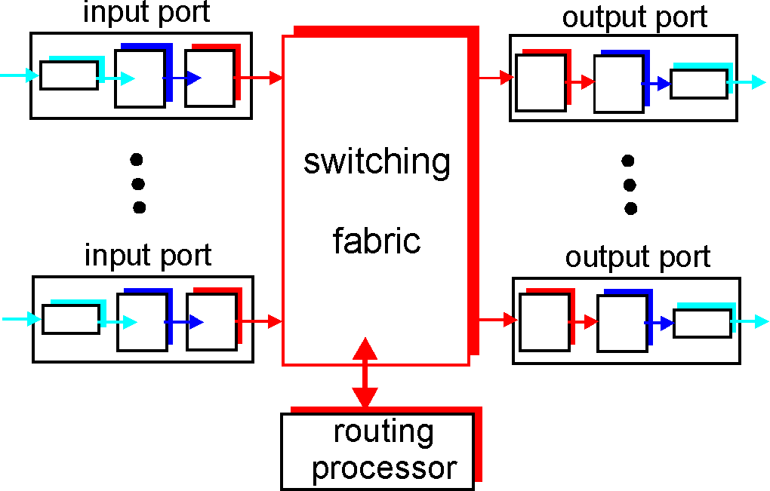
Router Architecture Overview
Two key router functions:
run routing algorithms/protocol (RIP, OSPF, BGP)
forwarding datagrams from incoming to outgoing link

Slide 12
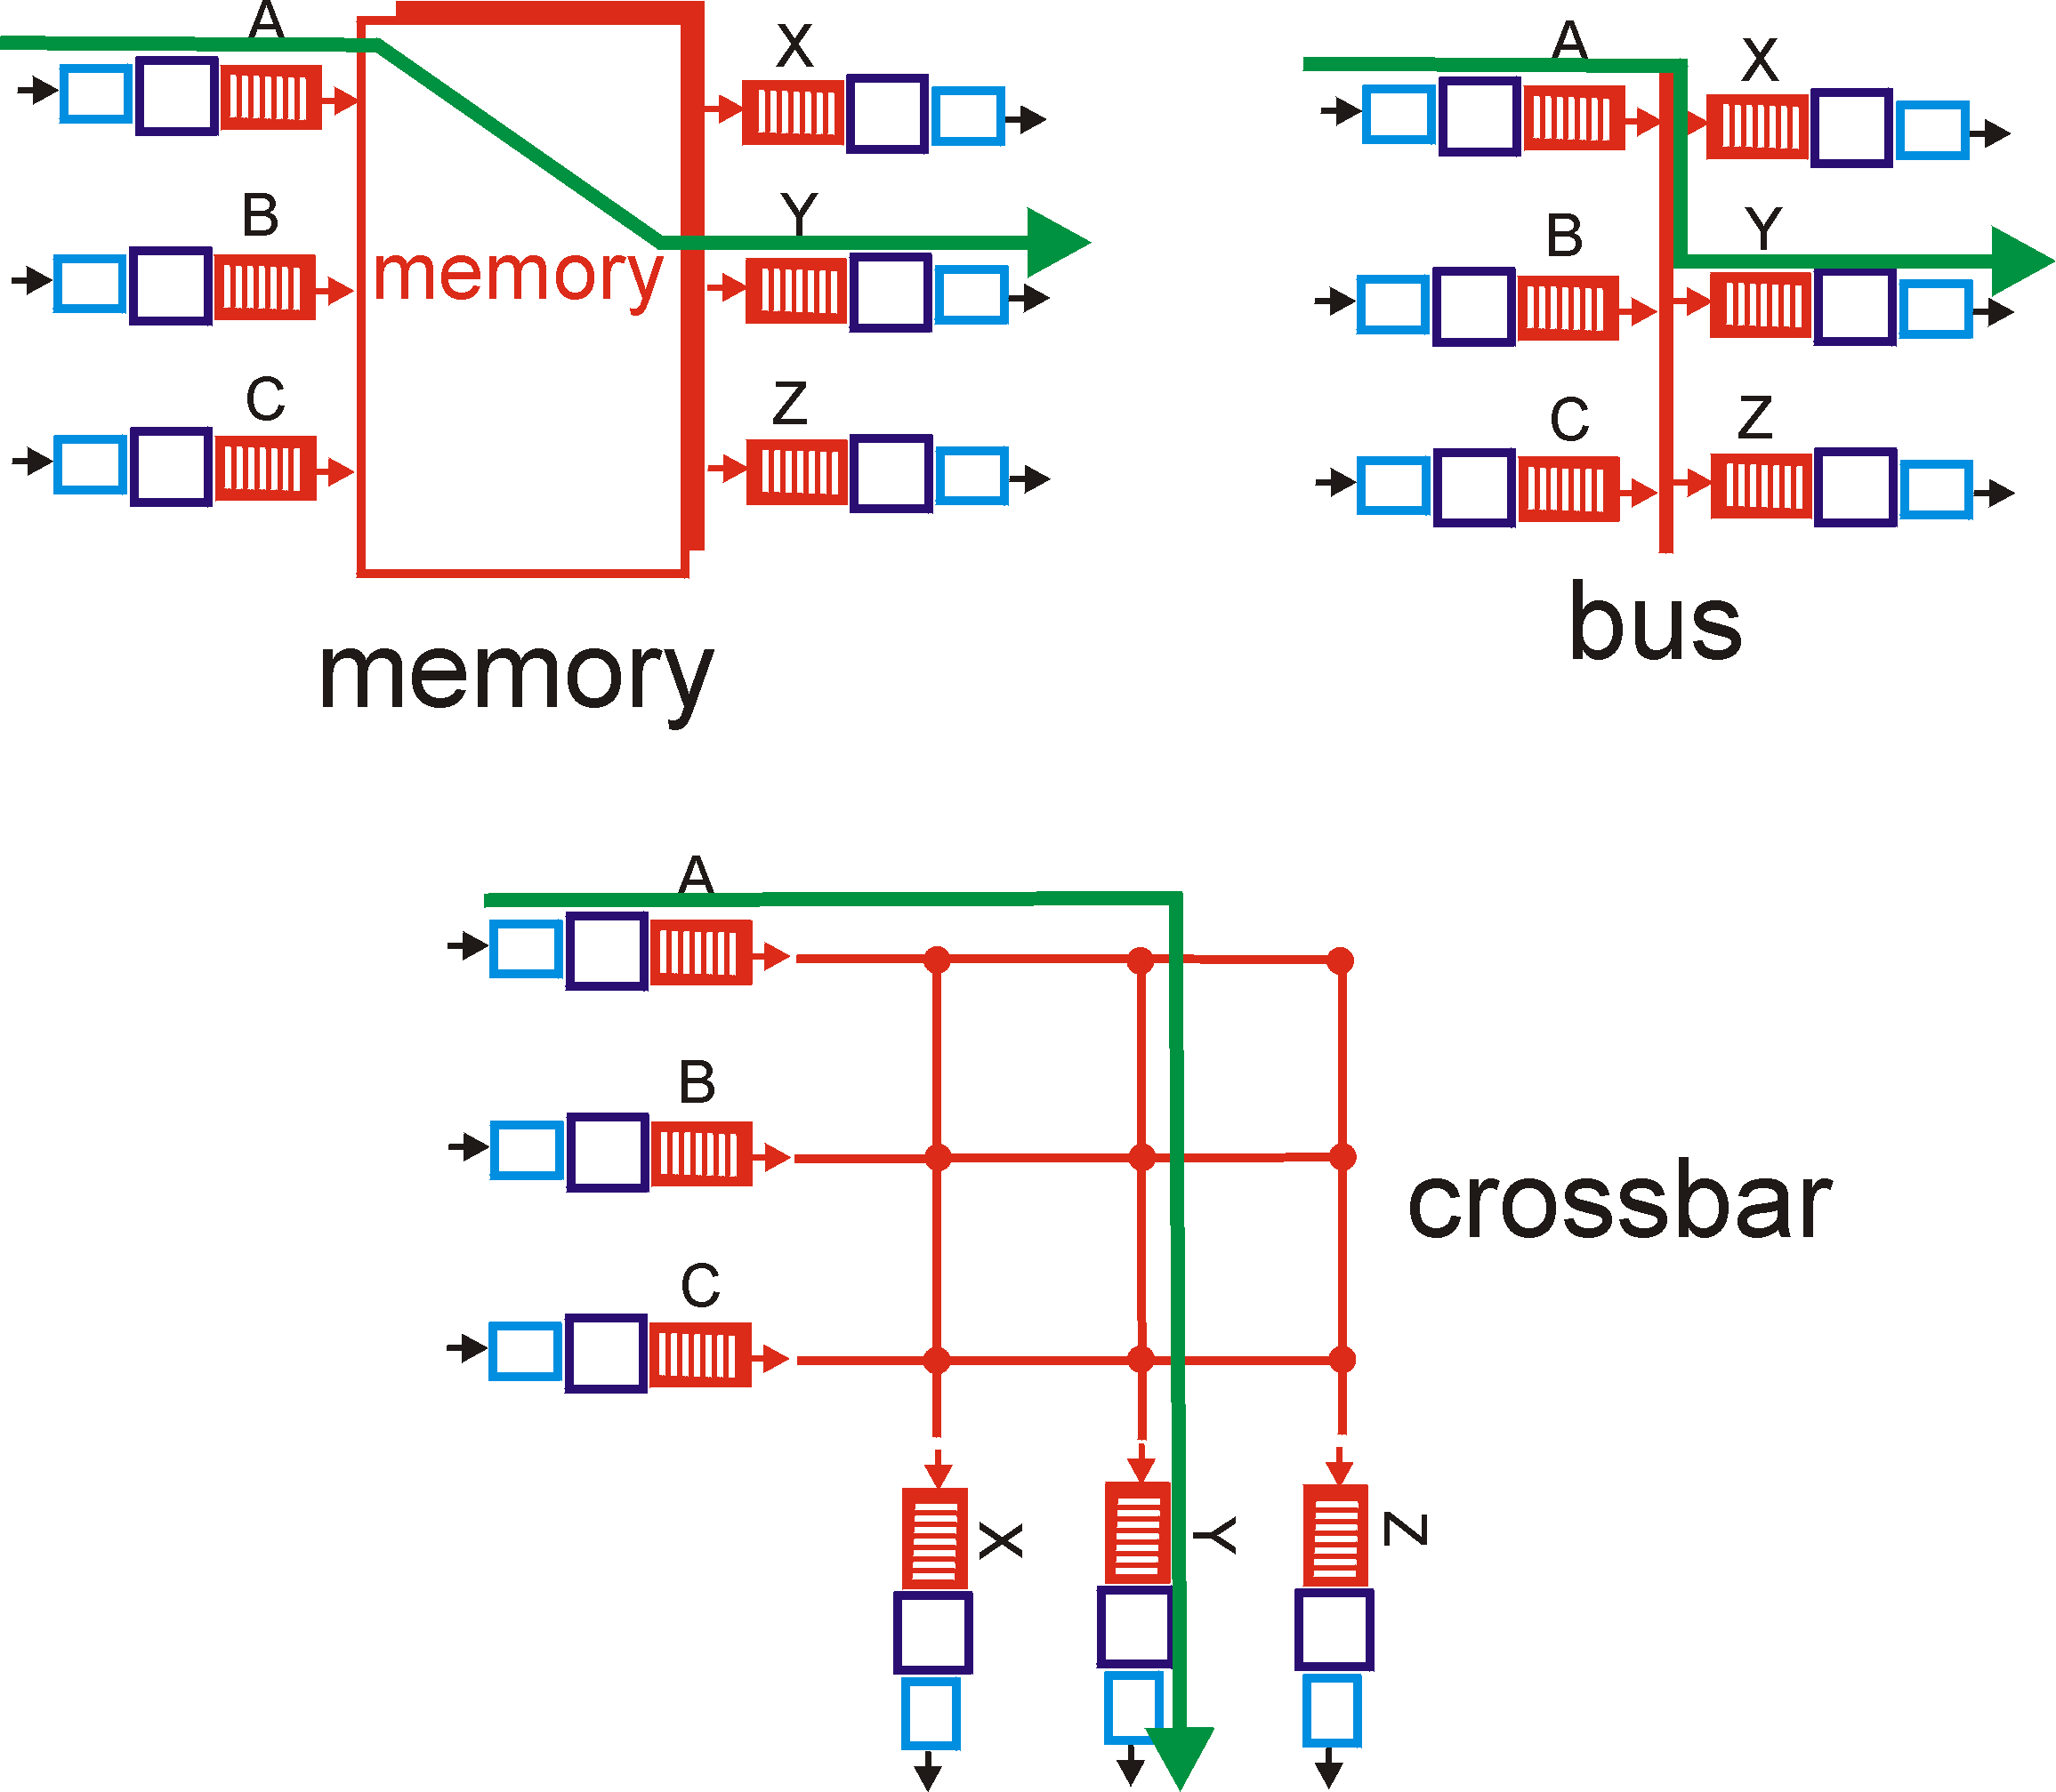
Three types of switching fabrics
1st generation, memory bottleneck, limited speed
Bus bottleneck, 32Gbps
Interconnection network, 60Gbps

Slide 13
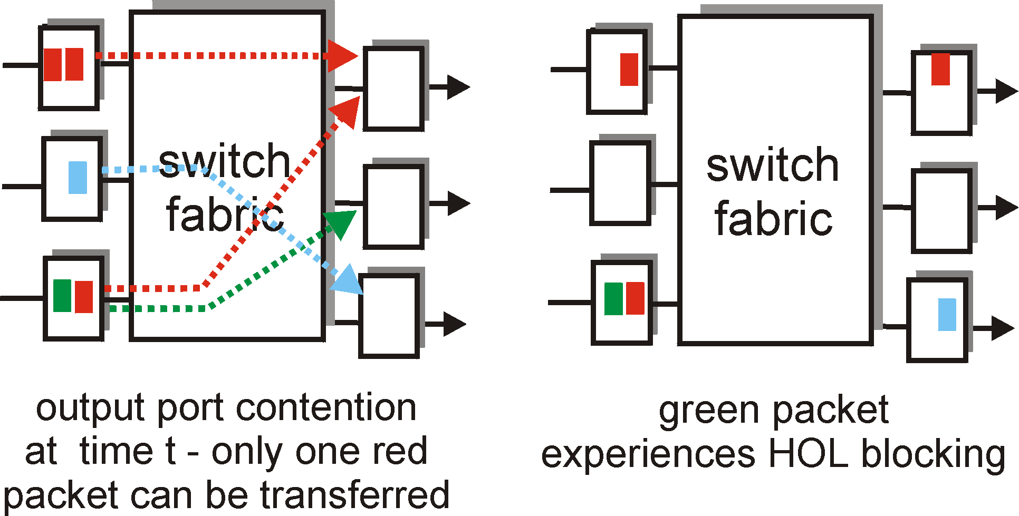
Input Port Queuing
Fabric slower than input ports combined -> queueing may occur at input queues
Head-of-the-Line (HOL) blocking: queued datagram at front of queue prevents others in queue from moving forward
queueing delay and loss due to input buffer overflow!

Slide 14
The Internet Network layer
Host, router network layer functions:
Transport layer: TCP, UDP
Routing protocols
path selection
RIP, OSPF, BGP
IP protocol
addressing conventions
datagram format
packet handling conventions
Network
layer
forwarding
table
ICMP protocol
error reporting
router “signaling”
Link layer
physical layer

Slide 15
IP datagram format
IP protocol version
number
32 bits
total datagram
length (bytes)
header length
(bytes)
head.
len
type of
service
ver
length
for
fragmentation/
reassembly
“type” of data
flgs
fragment
offset
16-bit identifier
max number
remaining hops
(decremented at
each router)
time to
live
upper
layer
header
checksum
32 bit source IP address
upper layer protocol
to deliver payload to
32 bit destination IP address
Options (if any)
E.g. timestamp,
record route
taken, specify
list of routers
to visit.
how much overhead with TCP?
20 bytes of TCP
20 bytes of IP
= 40 bytes + app layer overhead
data
(variable length,
typically a TCP
or UDP segment)

Slide 16
IP Fragmentation & Reassembly
network links have MTU (max.transfer size) - largest possible link-level frame.
different link types, different MTUs
large IP datagram divided (“fragmented”) within net
one datagram becomes several datagrams
“reassembled” only at final destination
IP header bits used to identify, order related fragments
fragmentation:
in: one large datagram
out: 3 smaller datagrams
reassembly

Slide 17
IP Fragmentation and Reassembly
length
=4000
ID
=x
fragflag
=0
offset
=0
Example
4000 byte datagram
MTU = 1500 bytes
One large datagram becomes
several smaller datagrams
length
=1500
ID
=x
fragflag
=1
offset
=0
1480 bytes in data field
length
=1500
ID
=x
fragflag
=1
offset
=185
offset =
1480/8
length
=1040
ID
=x
fragflag
=0
offset
=370

Slide 18
IP Addressing: introduction
IP address: 32-bit identifier for host, router interface
interface: connection between host/router and physical link
router’s typically have multiple interfaces
host typically has one interface
IP addresses associated with each interface
223.1.1.1
223.1.2.1
223.1.1.2
223.1.1.4
223.1.2.9
223.1.2.2
223.1.1.3
223.1.3.27
223.1.3.1
223.1.3.2
223.1.1.1 = 11011111 00000001 00000001 00000001
223
1
1
1

Slide 19
Subnets
IP address:
subnet part (high order bits)
host part (low order bits)
What’s a subnet ?
device interfaces with same subnet part of IP address
can physically reach each other without intervening router
223.1.1.1
223.1.2.1
223.1.1.2
223.1.1.4
223.1.2.9
223.1.1.3
223.1.2.2
223.1.3.27
subnet
223.1.3.1
223.1.3.2
network consisting of 3 subnets

Slide 20
IP addressing: CIDR
CIDR: Classless InterDomain Routing
subnet portion of address of arbitrary length
address format: a.b.c.d/x, where x is # bits in subnet portion of address
subnet
part
host
part
11001000 00010111 00010000 00000000
200.23.16.0/23

Slide 21
IP addresses: how to get one?
Q: How does host get IP address?
hard-coded by system admin in a file
Wintel: control-panel->network->configuration->tcp/ip->properties
UNIX: /etc/rc.config
DHCP: Dynamic Host Configuration Protocol: dynamically get address from as server
“plug-and-play”

Slide 22
Hierarchical addressing: route aggregation
Hierarchical addressing allows efficient advertisement of routing
information:
Organization 0
200.23.16.0/23
Organization 1
200.23.18.0/23
“Send me anything
with addresses
beginning
200.23.16.0/20”
Organization 2
200.23.20.0/23
.
Fly-By-Night-ISP
.
.
.
.
Internet
Organization 7
.
200.23.30.0/23
ISPs-R-Us
“Send me anything
with addresses
beginning
199.31.0.0/16”

Slide 23
NAT: Network Address Translation
NAT translation table
WAN side addr LAN side addr
1: host 10.0.0.1
sends datagram to
128.119.40.186, 80
2: NAT router
changes datagram
source addr from
10.0.0.1, 3345 to
138.76.29.7, 5001,
updates table
138.76.29.7, 5001 10.0.0.1, 3345
…… ……
S: 10.0.0.1, 3345
D: 128.119.40.186, 80
10.0.0.1
1
2
S: 138.76.29.7, 5001
D: 128.119.40.186, 80
10.0.0.4
10.0.0.2
138.76.29.7
S: 128.119.40.186, 80
D: 10.0.0.1, 3345
4
S: 128.119.40.186, 80
D: 138.76.29.7, 5001
3
10.0.0.3
4: NAT router
changes datagram
dest addr from
138.76.29.7, 5001 to 10.0.0.1, 3345
3: Reply arrives
dest. address:
138.76.29.7, 5001

Slide 24
NAT: Network Address Translation
16-bit port-number field:
60,000 simultaneous connections with a single LAN-side address!
NAT is controversial:
routers should only process up to layer 3
violates end-to-end argument
NAT possibility must be taken into account by app designers, eg, P2P applications
address shortage should instead be solved by IPv6

Slide 25
NAT traversal problem
client want to connect to server with address 10.0.0.1
server address 10.0.0.1 local to LAN (client can’t use it as destination addr)
only one externally visible NATted address: 138.76.29.7
Solutions: 1. statically configure NAT to forward incoming connection requests at given port to server
e.g., (138.76.29.7, port 2500) always forwarded to 10.0.0.1 port 25000
2. use UPnP to automate 1
3. use relay: used in p2p
10.0.0.1
Client
?
10.0.0.4
138.76.29.7
NAT
router

Slide 26


NAT traversal problem
solution 3: relaying (used in Skype)
NATed server establishes connection to relay
External client connects to relay
relay bridges packets between to connections
2. connection to
relay initiated
by client
1. connection to
relay initiated
by NATted host
10.0.0.1
3. relaying
established
Client
138.76.29.7
NAT
router

Slide 27
IPv6
Initial motivation: 32-bit address space soon to be completely allocated.
Additional motivation:
header format helps speed processing/forwarding
header changes to facilitate QoS
IPv6 datagram format:
fixed-length 40 byte header
no fragmentation allowed

Slide 28
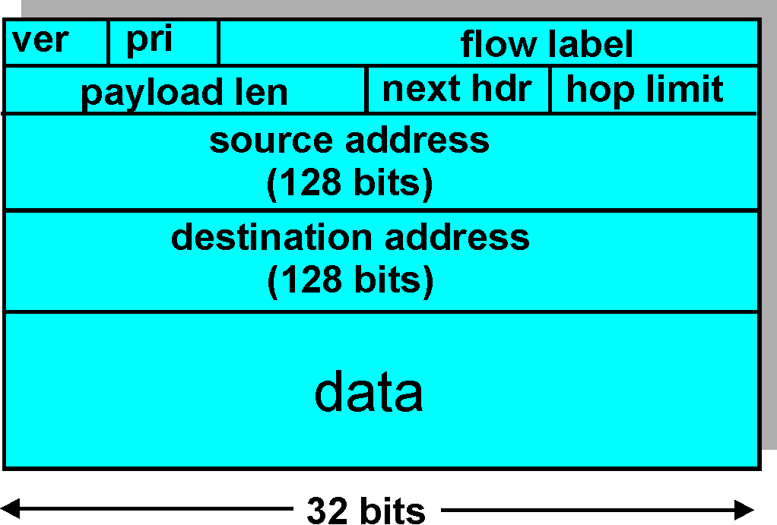
IPv6 Header (Cont)
Priority: identify priority among datagrams in flow
Flow Label: identify datagrams in same “flow.”
(concept of“flow” not well defined).
Next header: identify upper layer protocol for data

Slide 29
Transition From IPv4 To IPv6
Not all routers can be upgraded simultaneously
How will the network operate with mixed IPv4 and IPv6 routers?
Tunneling: IPv6 carried as payload in IPv4 datagram among IPv4 routers

Slide 30
Tunneling
A
B
E
F
Logical view:
tunnel
IPv6
IPv6
IPv6
IPv6
A
B
C
D
E
F
Physical view:
IPv6
IPv6
IPv4
IPv4
IPv6
IPv6
Flow: X
Src: A
Dest: F
data
Src:B
Dest: E
Src:B
Dest: E
Flow: X
Src: A
Dest: F
data
Flow: X
Src: A
Dest: F
data
Flow: X
Src: A
Dest: F
data
A-to-B:
IPv6
B-to-C:
IPv6 inside
IPv4
B-to-C:
IPv6 inside
IPv4
E-to-F:
IPv6

Slide 31
Interplay between routing, forwarding
routing algorithm
local forwarding table
header value
output link
0100
0101
0111
1001
3
2
2
1
value in arriving
packet’s header
0111
1
3
2

Slide 32
Graph abstraction
5
v
3
w
2
5
u
2
1
z
3
1
2
x
y
1
Graph: G = (N,E)
N = set of routers = { u, v, w, x, y, z }
E = set of links ={ (u,v), (u,x), (v,x), (v,w), (x,w), (x,y), (w,y), (w,z), (y,z) }
Remark: Graph abstraction is useful in other network contexts
Example: P2P, where N is set of peers and E is set of TCP connections

Slide 33
Graph abstraction: costs
5
c(x,x’) = cost of link (x,x’)
- e.g., c(w,z) = 5
cost could always be 1, or
inversely related to bandwidth,
or inversely related to
congestion
v
3
w
2
5
u
2
1
z
3
1
2
x
y
1
Cost of path (x₁, x₂, x₃,…, x_{p}) = c(x₁,x₂) + c(x₂,x₃) + … + c(x_{p-1},x_{p})
Question: What’s the least-cost path between u and z ?
Routing algorithm: algorithm that finds least-cost path

Slide 34
Routing Algorithm classification
Global or decentralized information?
Global:
all routers have complete topology, link cost info
“link state” algorithms
Decentralized:
router knows physically-connected neighbors, link costs to neighbors
iterative process of computation, exchange of info with neighbors
“distance vector” algorithms
Static or dynamic?
Static:
routes change slowly over time
Dynamic:
routes change more quickly
periodic update
in response to link cost changes

Slide 35
A Link-State Routing Algorithm
Dijkstra’s algorithm
net topology, link costs known to all nodes
accomplished via “link state broadcast”
all nodes have same info
computes least cost paths from one node (‘source”) to all other nodes
gives forwarding table for that node
iterative: after k iterations, know least cost path to k dest.’s
Notation:
c(x,y): link cost from node x to y; = ∞ if not direct neighbors
D(v): current value of cost of path from source to dest. v
p(v): predecessor node along path from source to v
N': set of nodes whose least cost path is definitively known

Slide 36
Dijsktra’s Algorithm
1 Initialization:
2 N' = {u}
3 for all nodes v
4 if v adjacent to u
5 then D(v) = c(u,v)
6 else D(v) = ∞
7
8 Loop
9 find w not in N' such that D(w) is a minimum
10 add w to N'
11 update D(v) for all v adjacent to w and not in N' :
12 D(v) = min( D(v), D(w) + c(w,v) )
13 /* new cost to v is either old cost to v or known
14 shortest path cost to w plus cost from w to v */
15 until all nodes in N'

Slide 37
Dijkstra’s algorithm: example
Step
0
1
2
3
4
5
N'
u
ux
uxy
uxyv
uxyvw
uxyvwz
D(v),p(v)
2,u
2,u
2,u
D(w),p(w)
5,u
4,x
3,y
3,y
D(x),p(x)
1,u
D(y),p(y)
∞
2,x
D(z),p(z)
∞
∞
4,y
4,y
4,y
5
v
3
w
2
5
u
2
1
z
3
1
2
x
y
1

Slide 38
Distance Vector Algorithm
Bellman-Ford Equation (dynamic programming)
Define
d_{x}(y) := cost of least-cost path from x to y
Then
d_{x}(y) = min {c(x,v) + d_{v}(y) }
where min is taken over all neighbors v of x
v

Slide 39
Distance vector algorithm (4)
Basic idea:
Each node periodically sends its own distance vector estimate to neighbors
When a node x receives new DV estimate from neighbor, it updates its own DV using B-F equation:
D_{x}(y) ← min_{v}{c(x,v) + D_{v}(y)} for each node y ∊ N

Slide 40
Distance Vector Algorithm (5)
Iterative, asynchronous: each local iteration caused by:
local link cost change
DV update message from neighbor
Distributed:
each node notifies neighbors only when its DV changes
neighbors then notify their neighbors if necessary
Each node:
wait for (change in local link cost or msg from neighbor)
recompute estimates
if DV to any dest has changed, notify neighbors

Slide 41
D_{x}(y) = min{c(x,y) + D_{y}(y), c(x,z) + D_{z}(y)} = min{2+0 , 7+1} = 2
D_{x}(z) = min{c(x,y) + D_{y}(z), c(x,z) + D_{z}(z)}
= min{2+1 , 7+0} = 3
node x table
cost to
cost to
x y z
x y z
x
0 2 7
x
0
2
3
y
y
from
∞
∞
∞
from
2 0 1
z
∞
∞
∞
z
7 1 0
node y table
cost to
x y z
y
2
1
x
∞
∞
z
∞
2 0 1
x
y
7
from
z
∞
∞
∞
node z table
cost to
x y z
x
∞ ∞ ∞
y
from
∞
∞
∞
z
7
1
0
time

Slide 42
D_{x}(y) = min{c(x,y) + D_{y}(y), c(x,z) + D_{z}(y)} = min{2+0 , 7+1} = 2
D_{x}(z) = min{c(x,y) + D_{y}(z), c(x,z) + D_{z}(z)}
= min{2+1 , 7+0} = 3
node x table
cost to
cost to
cost to
x y z
x y z
x y z
x
0 2 7
x
0 2 3
x
0 2 3
y
y
from
∞
∞
∞
from
2 0 1
y
from
2 0 1
z
∞
∞
∞
z
7 1 0
z
3 1 0
node y table
cost to
cost to
cost to
x y z
x y z
x y z
y
2
1
x
∞
∞
x
0 2 7
z
∞
2 0 1
x
0 2 3
x
y
y
7
from
from
2 0 1
y
from
2 0 1
z
∞
∞
∞
z
7 1 0
z
3 1 0
node z table
cost to
cost to
cost to
x y z
x y z
x y z
x
∞ ∞ ∞
x
0 2 7
x
0 2 3
y
y
2 0 1
y
from
2 0 1
from
from
∞
∞
∞
z
z
3 1 0
z
3 1 0
7
1
0
time

Slide 43
Comparison of LS and DV algorithms
Message complexity
LS: with n nodes, E links, O(nE) msgs sent
DV: exchange between neighbors only
convergence time varies
Speed of Convergence
LS: O(n²) algorithm requires O(nE) msgs
may have oscillations
DV: convergence time varies
may be routing loops
count-to-infinity problem
Robustness: what happens if router malfunctions?
LS:
node can advertise incorrect link cost
each node computes only its own table
DV:
DV node can advertise incorrect path cost
each node’s table used by others
error propagate thru network

Slide 44
Hierarchical Routing
Our routing study thus far - idealization
all routers identical
network “flat”
… not true in practice
scale: with 200 million destinations:
can’t store all dest’s in routing tables!
routing table exchange would swamp links!
administrative autonomy
internet = network of networks
each network admin may want to control routing in its own network

Slide 45
Hierarchical Routing
aggregate routers into regions, “autonomous systems” (AS)
routers in same AS run same routing protocol
“intra-AS” routing protocol
routers in different AS can run different intra-AS routing protocol
Gateway router
Direct link to router in another AS

Slide 46
Interconnected ASes
3c
3a
2c
3b
2a
AS3
2b
1c
AS2
1a
1b
1d
AS1
forwarding table configured by both intra- and inter-AS routing algorithm
intra-AS sets entries for internal dests
inter-AS & Intra-As sets entries for external dests
Intra-AS
Routing
algorithm
Inter-AS
Routing
algorithm
Forwarding
table

Slide 47
Example: Setting forwarding table in router 1d
suppose AS1 learns (via inter-AS protocol) that subnet x reachable via AS3 (gateway 1c) but not via AS2.
inter-AS protocol propagates reachability info to all internal routers.
router 1d determines from intra-AS routing info that its interface I is on the least cost path to 1c.
installs forwarding table entry (x,I)
…
x
3c
3a
2c
3b
2a
AS3
2b
1c
AS2
1a
1b
I
1d
AS1

Slide 48
Intra-AS Routing
also known as Interior Gateway Protocols (IGP)
most common Intra-AS routing protocols:
RIP: Routing Information Protocol
OSPF: Open Shortest Path First
IGRP: Interior Gateway Routing Protocol (Cisco proprietary)

Slide 49
RIP ( Routing Information Protocol)
distance vector algorithm
included in BSD-UNIX Distribution in 1982
distance metric: # of hops (max = 15 hops)
From router A to subsets:
u
v
destination hops
u 1
v 2
w 2
x 3
y 3
z 2
A
B
w
x
z
C
D
y

Slide 50
RIP advertisements
distance vectors: exchanged among neighbors every 30 sec via Response Message (also called advertisement)
ech advertisement: list of up to 25 destination nets within AS
If no advertisement heard after 180 sec --> neighbor/link declared dead
routes via neighbor invalidated
new advertisements sent to neighbors
neighbors in turn send out new advertisements (if tables changed)

Slide 51
OSPF (Open Shortest Path First)
“open”: publicly available
uses Link State algorithm
LS packet dissemination
topology map at each node
route computation using Dijkstra’s algorithm
OSPF advertisement carries one entry per neighbor router
advertisements disseminated to entire AS (via flooding)
carried in OSPF messages directly over IP (rather than TCP or UDP

Slide 52
OSPF “advanced” features (not in RIP)
security: all OSPF messages authenticated (to prevent malicious intrusion)
multiple same-cost paths allowed (only one path in RIP)
For each link, multiple cost metrics for different TOS (e.g., satellite link cost set “low” for best effort; high for real time)
integrated uni- and multicast support:
Multicast OSPF (MOSPF) uses same topology data base as OSPF
hierarchical OSPF in large domains.

Slide 53
Internet inter-AS routing: BGP
BGP (Border Gateway Protocol): the de facto standard
BGP provides each AS a means to:
Obtain subnet reachability information from neighboring ASs.
Propagate reachability information to all AS-internal routers.
Determine “good” routes to subnets based on reachability information and policy.
allows subnet to advertise its existence to rest of Internet: “I am here”

Slide 54
BGP basics
pairs of routers (BGP peers) exchange routing info over semi-permanent TCP connections: BGP sessions
BGP sessions need not correspond to physical links.
when AS2 advertises prefix to AS1:
AS2 promises it will forward any addresses datagrams towards that prefix.
AS2 can aggregate prefixes in its advertisement
eBGP session
3c
iBGP session
2c
3a
3b
2a
AS3
2b
1c
AS2
1a
1b
AS1
1d

Slide 55
Path attributes & BGP routes
advertised prefix includes BGP attributes.
prefix + attributes = “route”
two important attributes:
AS-PATH: contains ASs through which prefix advertisement has passed: e.g, AS 67, AS 17
NEXT-HOP: indicates specific internal-AS router to next-hop AS. (may be multiple links from current AS to next-hop-AS)
when gateway router receives route advertisement, uses import policy to accept/decline.

Slide 56
Why different Intra- and Inter-AS routing ?
Policy:
Inter-AS: admin wants control over how its traffic routed, who routes through its net.
Intra-AS: single admin, so no policy decisions needed
Scale:
hierarchical routing saves table size, reduced update traffic
Performance:
Intra-AS: can focus on performance
Inter-AS: policy may dominate over performance

Slide 57
Broadcast & Multicast Routing
deliver packets from source to group of nodes
source duplication is inefficient:
duplicate
duplicate
creation/transmission
R1
R1
duplicate
R2
R2
R3
R4
R3
R4
source duplication
in-network
duplication
source duplication: how does source know recipients?
To scale: don’t require the source to know all receivers
Rendezvous problem: how do sources/receivers meet?
1. Broadcast and Prune
2. Send to a common intermediate node/center

Slide 58
In-network duplication
flooding: when node receives brdcst pckt, sends copy to all neighbors
Problems: cycles & broadcast storm
controlled flooding: node only brdcsts pkt if it hasn’t brdcst same packet before
Node keeps track of pckt ids already brdcsted
Or reverse path forwarding (RPF): only forward pckt if it arrived on shortest path between node and source
spanning tree
No redundant packets received by any node

Slide 59
Spanning Tree
First construct a spanning tree
Nodes forward copies only along spanning tree
A
A
B
B
c
c
D
D
F
E
F
E
G
G
(a) Broadcast initiated at A
(b) Broadcast initiated at D

Slide 60
Multicast Routing: Problem Statement
Goal: find a tree (or trees) connecting routers having local mcast group members
One spanning tree: not all paths between routers used
source-based trees: different tree from each sender to rcvrs
shared-tree: same tree used by all group members
Shared tree
Source-based trees
Notes:
Notes:
3.3 Network Layer: Multicast Routing Algorithms 3-9

Slide 61
Approaches for building mcast trees
Approaches:
source-based tree: one tree per source
shortest path trees
reverse path forwarding
group-shared tree: group uses one tree
minimal spanning (Steiner)
center-based trees
…we first look at basic approaches, then specific protocols adopting these approaches
Notes:
Notes:
3.3 Network Layer: Multicast Routing Algorithms 3-11

Slide 62
Shortest Path Tree
mcast forwarding tree: tree of shortest path routes from source to all receivers
Dijkstra’s algorithm (used in MOSPF where OSPF routers already have a global net view)
S: source
LEGEND
R1
2
1
R4
router with attached
group member
R2
5
3
router with no attached
group member
4
R5
R3
6
i
link used for forwarding,
i indicates order link
added by algorithm
R6
R7
Notes:
Notes:
3.3 Network Layer: Multicast Routing Algorithms 3-12

Slide 63
Reverse Path Forwarding
Used in DVMPR and PIM-DM that do not have a global net view
rely on router’s knowledge of unicast shortest path from it to sender
each router has simple forwarding behavior:
if (mcast datagram received on incoming link on shortest path back to center)
then flood datagram onto all outgoing links
else ignore datagram
Notes:
Notes:
3.3 Network Layer: Multicast Routing Algorithms 3-13

Slide 64
Reverse Path Forwarding: example
S: source
LEGEND
R1
R4
router with attached
group member
R2
router with no attached
group member
R5
R3
datagram will be forwarded
R6
R7
datagram will not be
forwarded
result is a source-specific reverse SPT
may be a bad choice with asymmetric links
Notes:
Notes:
3.3 Network Layer: Multicast Routing Algorithms 3-14

Slide 65
Reverse Path Forwarding: pruning
forwarding tree contains subtrees with no mcast group members
no need to forward datagrams down subtree
“prune” msgs sent upstream by router with no downstream group members
S: source
LEGEND
R1
router with attached
group member
R4
R2
router with no attached
group member
P
R5
P
prune message
R3
P
links with multicast
forwarding
R6
R7
Notes:
Notes:
3.3 Network Layer: Multicast Routing Algorithms 3-15

Slide 66
Shared-Tree: Steiner Tree
Steiner Tree: minimum cost tree connecting all routers with attached group members
problem is NP-complete
excellent heuristics exists
not used in practice:
computational complexity
information about entire network needed
monolithic: rerun whenever a router needs to join/leave
Notes:
Notes:
1. See L. Wei and D. Estrin, “A Comparison of multicast trees and algorithms,” TR USC-CD-93-560, Dept. Computer Science, University of California, Sept 1993 for a comparison of heuristic approaches.
3.3 Network Layer: Multicast Routing Algorithms 3-16

Slide 67
Center-based trees
single delivery tree shared by all
one router identified as “center” of tree
to join:
edge router sends join-msg addressed to center router
join-msg “processed” by intermediate routers and forwarded towards center
join-msg either hits existing tree branch for this center, or arrives at center
path taken by join-msg becomes new branch of tree for this router
Notes:
Notes:
1. It’s always nice to see a PhD dissertation with impact. The earliest discussion of center-based trees for multicast appears to be D. Wall, “Mechanisms for Broadcast and Selective Broadcast,” PhD dissertation, Stanford U., June 1980.
3.3 Network Layer: Multicast Routing Algorithms 3-17

Slide 68
Center-based trees: an example
Suppose R6 chosen as center:
LEGEND
R1
router with attached
group member
R4
3
R2
router with no attached
group member
2
R5
1
path order in which join messages generated
R3
1
R6
R7
Notes:
Notes:
3.3 Network Layer: Multicast Routing Algorithms 3-18

Slide 69
Internet Multicasting Routing: DVMRP
DVMRP: distance vector multicast routing protocol, RFC1075
flood and prune: RPF, source-based tree
RPF tree based on DVMRP’s own routing tables constructed by communicating DVMRP routers
no assumptions about underlying unicast
initial datagram to mcast group flooded via RPF
routers not wanting group: send upstream prune
soft state: DVMRP router periodically (1 min.) times out prune state [robust]:
mcast data again flows down unpruned branch
downstream router: reprune or continue to rcv
Notes:
Notes:
D. Waitzman, S. Deering, C. Partridge, “Distance Vector Multicast Routing Protocol,” RFC 1075, Nov. 1988. The version of DVMRP in use today is considerably enhanced over the RFC1075 spec.
A more up-to-date “work-in-progress” defines a version 3 of DVMRP: T. Pusateri, “Distance Vector Multicast Routing Protocol,” work-in-progress, draft-ietf-idmr-v3-05.ps
3.4 Network Layer: Internet Multicast Routing Algorithms 3-20

Slide 70
PIM: Protocol Independent Multicast
not dependent on any specific underlying unicast routing algorithm (works with all)
two different multicast distribution scenarios :
Dense (PIM-DM):
group members densely packed, in “close” proximity.
bandwidth more plentiful
Similar to DVMRP: uses broadcast/prune
Sparse (PIM-SM):
# networks with group members small wrt # interconnected networks
group members “widely dispersed”
bandwidth not plentiful
Notes:
Notes:
a very readable discussion of the PIM architecture is S. Deering, D. Estrin, D. Faranacci, V. Jacobson, C. Liu, L. Wei, “The PIM Architecture for Wide Area Multicasting,” IEEE/ACM Transactions on Networking, Vol. 4, No. 2, April 1996.
D. Estrin et al, PIM-SM: Protocol Specification, RFC 2117, June 1997
S. Deering et al, PIM Version 2, Dense Mode Specification, work in progress, draft-ietf-idmr-pim-dm-05.txt
PIM is implemented in Cisco routers and has been deployed in UUnet as part of their streaming multimedia delivery effort. See S. LaPolla, “IP Multicast makes headway among ISPs,” PC Week On-Line, http://www.zdnet.com/pcweek/news/1006/06isp.html
3.4 Network Layer: Internet Multicast Routing Algorithms 3-25

Slide 71
PIM - Sparse Mode
center-based approach
router sends join msg to rendezvous point (RP)
intermediate routers update state and forward join
after joining via RP, router can switch to source-specific tree
increased performance: less concentration, shorter paths
R1
R4
join
R2
join
R5
join
R3
R7
R6
all data multicast
from rendezvous
point
rendezvous
point
Notes:
Notes:
3.4 Network Layer: Internet Multicast Routing Algorithms 3-28

Slide 72
PIM - Sparse Mode
sender(s):
unicast data to RP, which distributes down RP-rooted tree
RP can extend mcast tree upstream to source
RP can send stop msg if no attached receivers
“no one is listening!”
Issues of choosing the RP!!
Use a bootstrap mechanism
(advanced topic)
R1
R4
join
R2
join
R5
join
R3
R7
R6
all data multicast
from rendezvous
point
rendezvous
Point (RP)
Notes:
Notes:
3.4 Network Layer: Internet Multicast Routing Algorithms 3-29

