Slide 1

Chapter 3 Transport Layer
Computer Networking: A Top Down Approach, 5th edition. Jim Kurose, Keith Ross Addison-Wesley, April 2009.
Computer Networking: A Top Down Approach 4th edition. Jim Kurose, Keith Ross Addison-Wesley, July 2007.

Slide 2
Chapter 3: Transport Layer
Our goals:
understand principles behind transport layer services:
Multiplexing, demultiplexing
reliable data transfer
flow control
congestion control
learn about transport layer protocols in the Internet:
UDP: connectionless transport
TCP: connection-oriented transport
TCP congestion control

Slide 3
Chapter 3 outline
3.1 Transport-layer services
3.2 Multiplexing and demultiplexing
3.3 Connectionless transport: UDP
3.4 Principles of reliable data transfer
3.5 Connection-oriented transport: TCP
segment structure
reliable data transfer
flow control
connection management
3.6 Principles of congestion control
3.7 TCP congestion control

Slide 4

Transport services and protocols
application
transport
network
data link
physical
provide logical communication between app processes running on different hosts
transport protocols run in end systems
send side: breaks app messages into segments, passes to network layer
rcv side: reassembles segments into messages, passes to app layer
more than one transport protocol available to apps
Internet: TCP and UDP
logical end-end transport
application
transport
network
data link
physical

Slide 5
Internet transport-layer protocols
reliable, in-order delivery to app: TCP
congestion control
flow control
connection setup
unreliable, unordered delivery to app: UDP
no-frills extension of “best-effort” IP
services not available:
delay guarantees
bandwidth guarantees
application
transport
network
data link
physical
network
data link
physical
network
data link
physical
logical end-end transport
network
data link
physical
network
data link
physical
network
data link
physical
network
data link
physical
application
transport
network
data link
physical

Slide 6
Chapter 3 outline
3.1 Transport-layer services
3.2 Multiplexing and demultiplexing
3.3 Connectionless transport: UDP
3.4 Principles of reliable data transfer
3.5 Connection-oriented transport: TCP
segment structure
reliable data transfer
flow control
connection management
3.6 Principles of congestion control
3.7 TCP congestion control

Slide 7
Multiplexing/demultiplexing
Demultiplexing at rcv host:
Multiplexing at send host:
delivering received segments
to correct socket
gathering data from multiple
sockets, enveloping data with
header (later used for
demultiplexing)
= socket
= process
application
application
application
P4
P3
P1
P2
P1
transport
transport
transport
network
network
network
link
link
link
physical
physical
physical
host 1
host 2
host 3

Slide 8
How demultiplexing works: General for TCP and UDP
host receives IP datagrams
each datagram has source, destination IP addresses
each datagram carries 1 transport-layer segment
each segment has source, destination port numbers
host uses IP addresses & port numbers to direct segment to appropriate socket, process, application
32 bits
source port #
dest port #
other header fields
application
data
(message)
TCP/UDP segment format

Slide 9
Connectionless demultiplexing
When host receives UDP segment:
checks destination port number in segment
directs UDP segment to socket with that port number
IP datagrams with different source IP addresses and/or source port numbers directed to same socket
Create sockets with port numbers:
DatagramSocket mySocket1 = new DatagramSocket(12534);
DatagramSocket mySocket2 = new DatagramSocket(12535);
UDP socket identified by two-tuple:
(dest IP address, dest port number)

Slide 10
Connectionless demux (cont)
DatagramSocket serverSocket = new DatagramSocket(6428);
P2
P1
P3
P1
SP: 6428
SP: 6428
DP: 9157
DP: 5775
SP: 9157
SP: 5775
client
IP: A
DP: 6428
server
IP: C
DP: 6428
Client
IP:B
SP provides “return address”

Slide 11
Connection-oriented demux
TCP socket identified by 4-tuple:
source IP address
source port number
dest IP address
dest port number
recv host uses all four values to direct segment to appropriate socket
Server host may support many simultaneous TCP sockets:
each socket identified by its own 4-tuple
Web servers have different sockets for each connecting client
non-persistent HTTP will have different socket for each request

Slide 12
Connection-oriented demux (cont)
P1
P4
P5
P6
P2
P1
P3
SP: 5775
DP: 80
S-IP: B
D-IP:C
SP: 9157
SP: 9157
client
IP: A
DP: 80
server
IP: C
DP: 80
Client
IP:B
S-IP: A
S-IP: B
D-IP:C
D-IP:C

Slide 13
Chapter 3 outline
3.1 Transport-layer services
3.2 Multiplexing and demultiplexing
3.3 Connectionless transport: UDP
3.4 Principles of reliable data transfer
3.5 Connection-oriented transport: TCP
segment structure
reliable data transfer
flow control
connection management
3.6 Principles of congestion control
3.7 TCP congestion control

Slide 14
UDP: User Datagram Protocol [RFC 768]
“no frills,” “bare bones” transport protocol
“best effort” service, UDP segments may be:
lost
delivered out of order to app
connectionless:
no handshaking between UDP sender, receiver
each UDP segment handled independently
Why is there a UDP?
no connection establishment (which can add delay)
simple: no connection state at sender, receiver
small segment header
no congestion control: UDP can blast away as fast as desired (more later on interaction with TCP!)

Slide 15
UDP: more
often used for streaming multimedia apps
loss tolerant
rate sensitive
other UDP uses
DNS
SNMP (net mgmt)
reliable transfer over UDP: add reliability at app layer
application-specific error recovery!
used for multicast, broadcast in addition to unicast (point-point)
32 bits
Length, in
bytes of UDP
segment,
including
header
source port #
dest port #
length
checksum
Application
data
(message)
UDP segment format

Slide 16
Chapter 3 outline
3.1 Transport-layer services
3.2 Multiplexing and demultiplexing
3.3 Connectionless transport: UDP
3.4 Principles of reliable data transfer
3.5 Connection-oriented transport: TCP
segment structure
reliable data transfer
flow control
connection management
3.6 Principles of congestion control
3.7 TCP congestion control

Slide 17
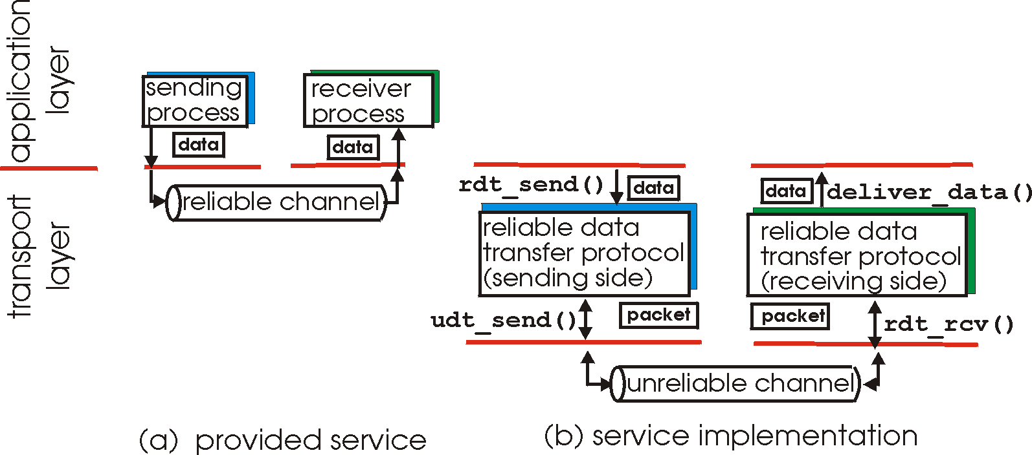
Principles of Reliable data transfer
important in app., transport, link layers
top-10 list of important networking topics!
characteristics of unreliable channel will determine complexity of reliable data transfer protocol (rdt)

Slide 18
Principles of Reliable data transfer
important in app., transport, link layers
top-10 list of important networking topics!
characteristics of unreliable channel will determine complexity of reliable data transfer protocol (rdt)

Slide 19
Principles of Reliable data transfer
important in app., transport, link layers
top-10 list of important networking topics!
characteristics of unreliable channel will determine complexity of reliable data transfer protocol (rdt)

Slide 20
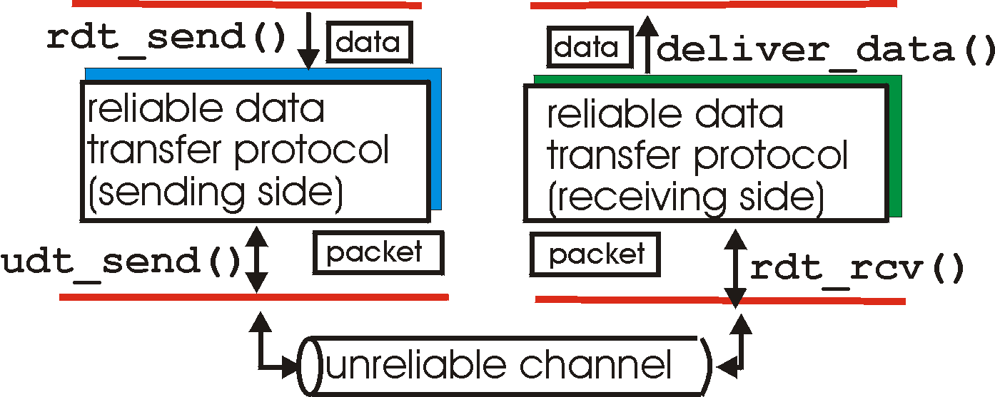
Reliable data transfer: getting started
rdt_send(): called from above, (e.g., by app.). Passed data to
deliver to receiver upper layer
deliver_data(): called by rdt to deliver data to upper
send
side
receive
side
udt_send(): called by rdt,
to transfer packet over
unreliable channel to receiver
rdt_rcv(): called when packet arrives on rcv-side of channel

Slide 21
Flow Control
End-to-end flow and Congestion control study is complicated by:
Heterogeneous resources (links, switches, applications)
Different delays due to network dynamics
Effects of background traffic
We start with a simple case: hop-by-hop flow control

Slide 22
Hop-by-hop flow control
Approaches/techniques for hop-by-hop flow control
Stop-and-wait
sliding window
Go back N
Selective reject

Slide 23
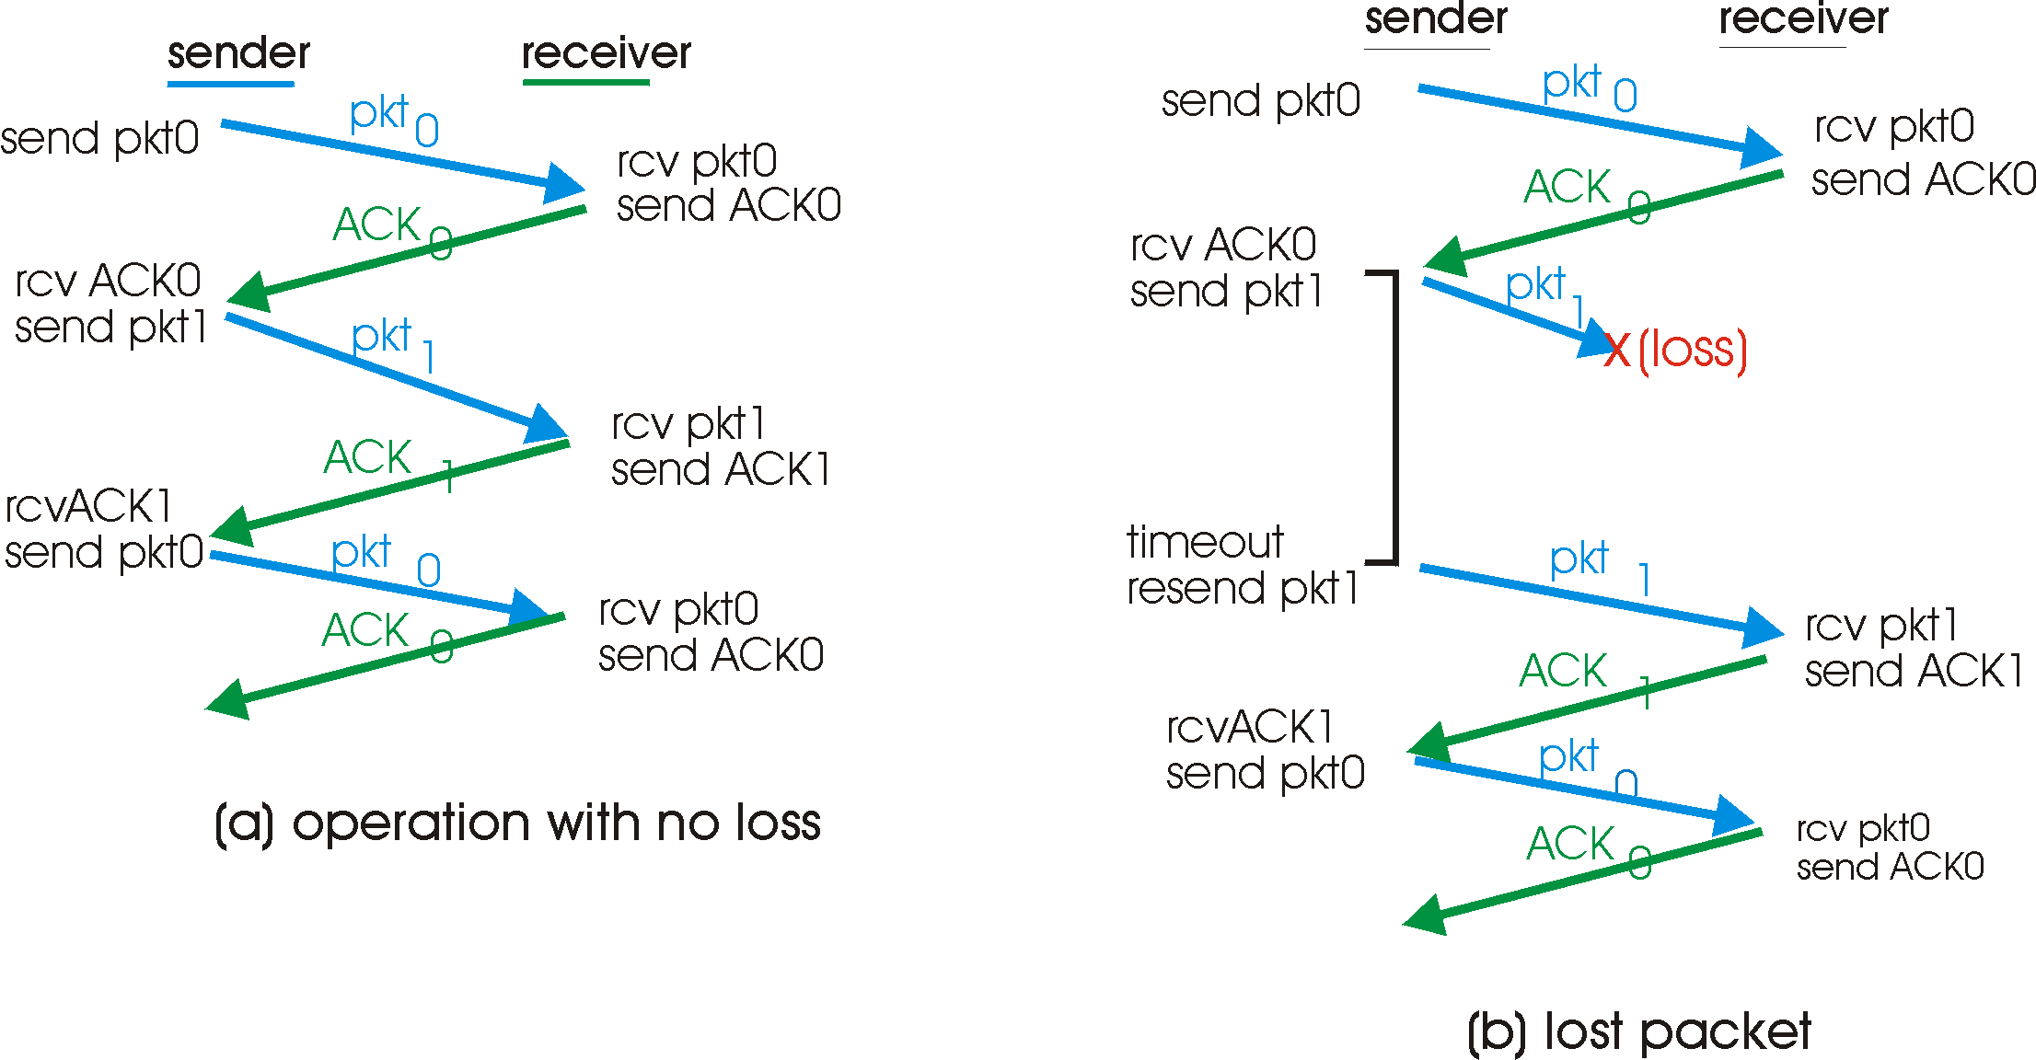
Stop-and-wait: reliable transfer over a reliable channel
underlying channel perfectly reliable
no bit errors, no loss of packets
stop and wait
Sender sends one packet,
then waits for receiver
response

Slide 24
channel with bit errors
underlying channel may flip bits in packet
checksum to detect bit errors
the question: how to recover from errors:
acknowledgements (ACKs): receiver explicitly tells sender that pkt received OK
negative acknowledgements (NAKs): receiver explicitly tells sender that pkt had errors
sender retransmits pkt on receipt of NAK
new mechanisms for:
error detection
receiver feedback: control msgs (ACK,NAK) rcvr->sender

Slide 25
Stop-and-wait: Corrupt ACK/NACK
What happens if ACK/NAK corrupted?
sender doesn’t know what happened at receiver!
can’t just retransmit: possible duplicate
Handling duplicates:
sender retransmits current pkt if ACK/NAK garbled
sender adds sequence number to each pkt
receiver discards (doesn’t deliver up) duplicate pkt

Slide 26
discussion
Sender:
seq # added to pkt
two seq. #’s (0,1) will suffice. Why?
must check if received ACK/NAK corrupted
Receiver:
must check if received packet is duplicate
state indicates whether 0 or 1 is expected pkt seq #
note: receiver can not know if its last ACK/NAK received OK at sender

Slide 27
channels with errors and loss
New assumption: underlying channel can also lose packets (data or ACKs)
checksum, seq. #, ACKs, retransmissions will be of help, but not enough
Approach: sender waits “reasonable” amount of time for ACK
retransmits if no ACK received in this time
if pkt (or ACK) just delayed (not lost):
retransmission will be duplicate, but use of seq. #’s already handles this
receiver must specify seq # of pkt being ACKed
requires countdown timer

Slide 28
Stop-and-wait operation Summary
Stop and wait:
sender awaits for ACK to send another frame
sender uses a timer to re-transmit if no ACKs
if ACK is lost:
A sends frame, B’s ACK gets lost
A times out & re-transmits the frame, B receives duplicates
Sequence numbers are added (frame0,1 ACK0,1)
timeout: should be related to round trip time estimates
if too small → unnecessary re-transmission
if too large → long delays

Slide 29
Stop-and-wait with lost packet/frame

Slide 30
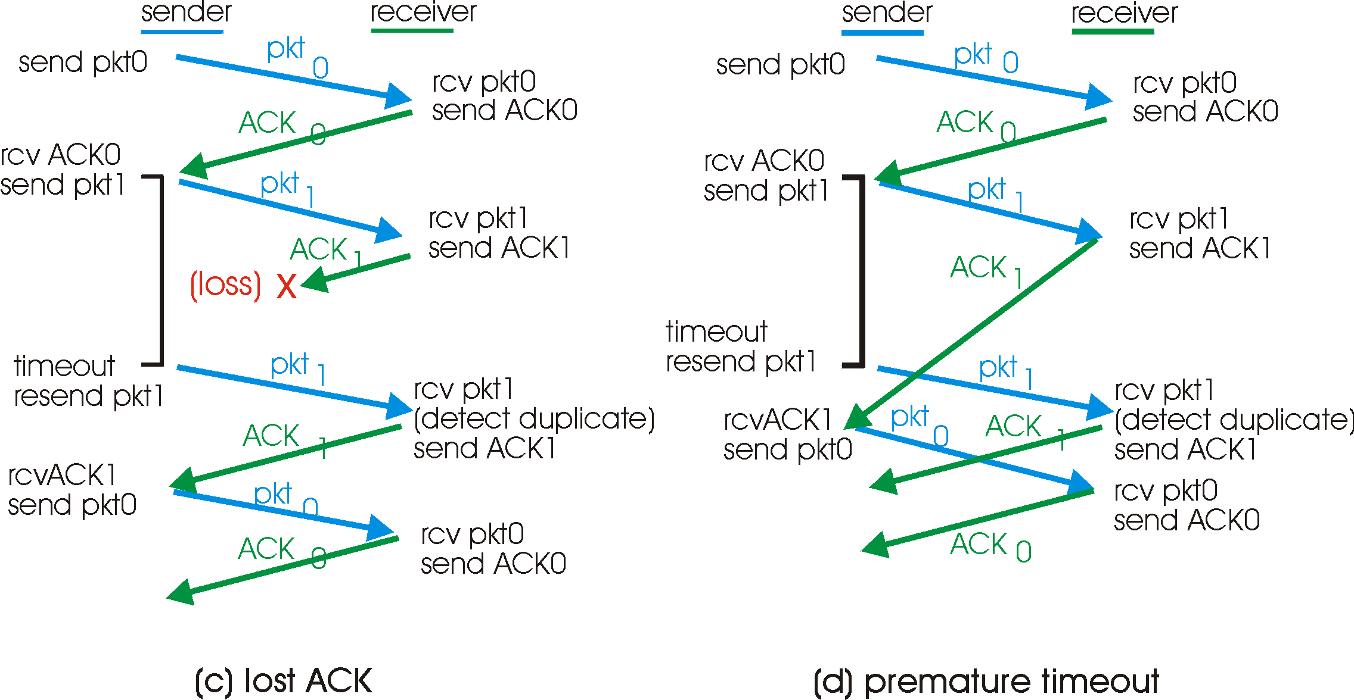

Slide 31
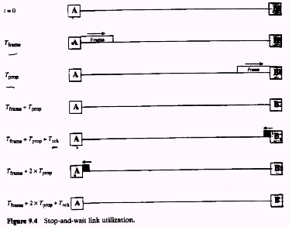

Slide 32
Stop and wait performance
utilization – fraction of time sender busy sending
ideal case (error free)
u=Tframe/(Tframe+2Tprop)=1/(1+2a), a=Tprop/Tframe

Slide 33
Performance of stop-and-wait
example: 1 Gbps link, 15 ms e-e prop. delay, 1KB packet:
T
=
L (packet length in bits)
8kb/pkt
transmit
=
= 8 microsec
R (transmission rate, bps)
10**9 b/sec
U _{sender}: utilization – fraction of time sender busy sending
1KB pkt every 30 msec -> 33kB/sec thruput over 1 Gbps link
network protocol limits use of physical resources!

Slide 34
rdt3.0: stop-and-wait operation
sender
receiver
first packet bit transmitted, t = 0
last packet bit transmitted, t = L / R
first packet bit arrives
RTT
last packet bit arrives, send ACK
ACK arrives, send next
packet, t = RTT + L / R

Slide 35
consider losses
assume Timeout ~ 2 Tprop
on average need Nx attempts to get the frame through
p is the probability of frame being in error
Pr[k attempts are made before the frame is transmitted correctly]=p^{k-1}.(1-p)
Nx=ΣkPr[k]=1/(1-p)
For stop-and-wait U=Tframe/[Nx.(Tframe+2.Tprop)]=1/Nx(1+2a) U=[1-p]/(1+2a)
stop and wait is a conservative approach to flow control but is wasteful

Slide 36
Sliding window techniques
TCP is a variant of sliding window
Includes Go back N (GBN) and selective repeat/reject
Allows for outstanding packets without Ack
More complex than stop and wait
Need to buffer un-Ack’ed packets & more book-keeping than stop-and-wait

Slide 37
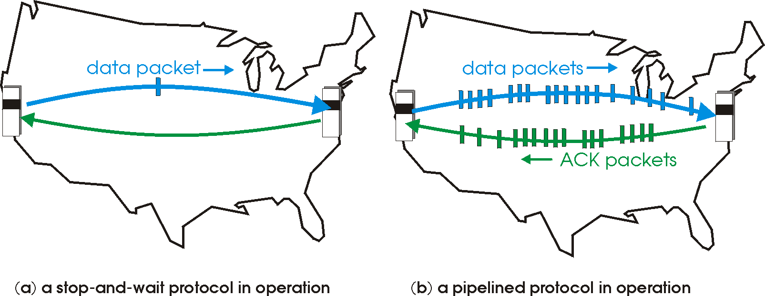
Pipelined (sliding window) protocols
Pipelining: sender allows multiple, “in-flight”, yet-to-be-acknowledged pkts
range of sequence numbers must be increased
buffering at sender and/or receiver
Two generic forms of pipelined protocols: go-Back-N, selective repeat

Slide 38
Pipelining: increased utilization
sender
receiver
first packet bit transmitted, t = 0
last bit transmitted, t = L / R
first packet bit arrives
RTT
last packet bit arrives, send ACK
last bit of 2nd packet arrives, send ACK
last bit of 3rd packet arrives, send ACK
ACK arrives, send next
packet, t = RTT + L / R
Increase utilization
by a factor of 3!

Slide 39
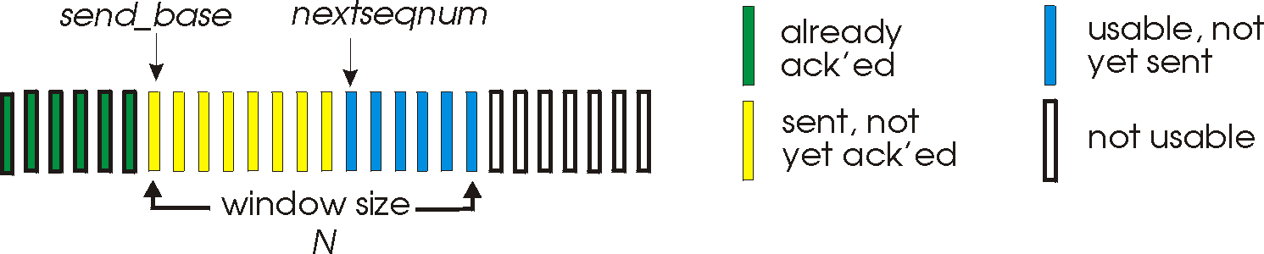
Go-Back-N
Sender:
k-bit seq # in pkt header
“window” of up to N, consecutive unack’ed pkts allowed
ACK(n): ACKs all pkts up to, including seq # n - “cumulative ACK”
may receive duplicate ACKs (more later…)
timer for each in-flight pkt
timeout(n): retransmit pkt n and all higher seq # pkts in window

Slide 40
GBN: receiver side
ACK-only: always send ACK for correctly-received pkt with highest in-order seq #
may generate duplicate ACKs
need only remember expected seq num
out-of-order pkt:
discard (don’t buffer) -> no receiver buffering!
Re-ACK pkt with highest in-order seq #

Slide 41
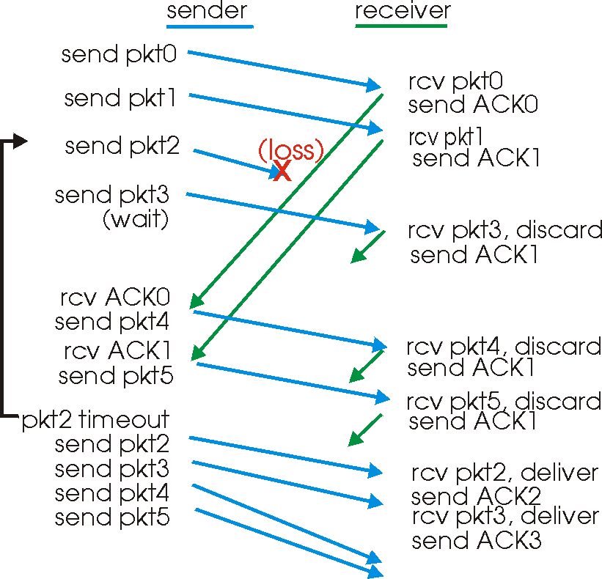
GBN in action

Slide 42
Selective Repeat
receiver individually acknowledges all correctly received pkts
buffers pkts, as needed, for eventual in-order delivery to upper layer
sender only resends pkts for which ACK not received
sender timer for each unACKed pkt
sender window
N consecutive seq #’s
limits seq #s of sent, unACKed pkts

Slide 43
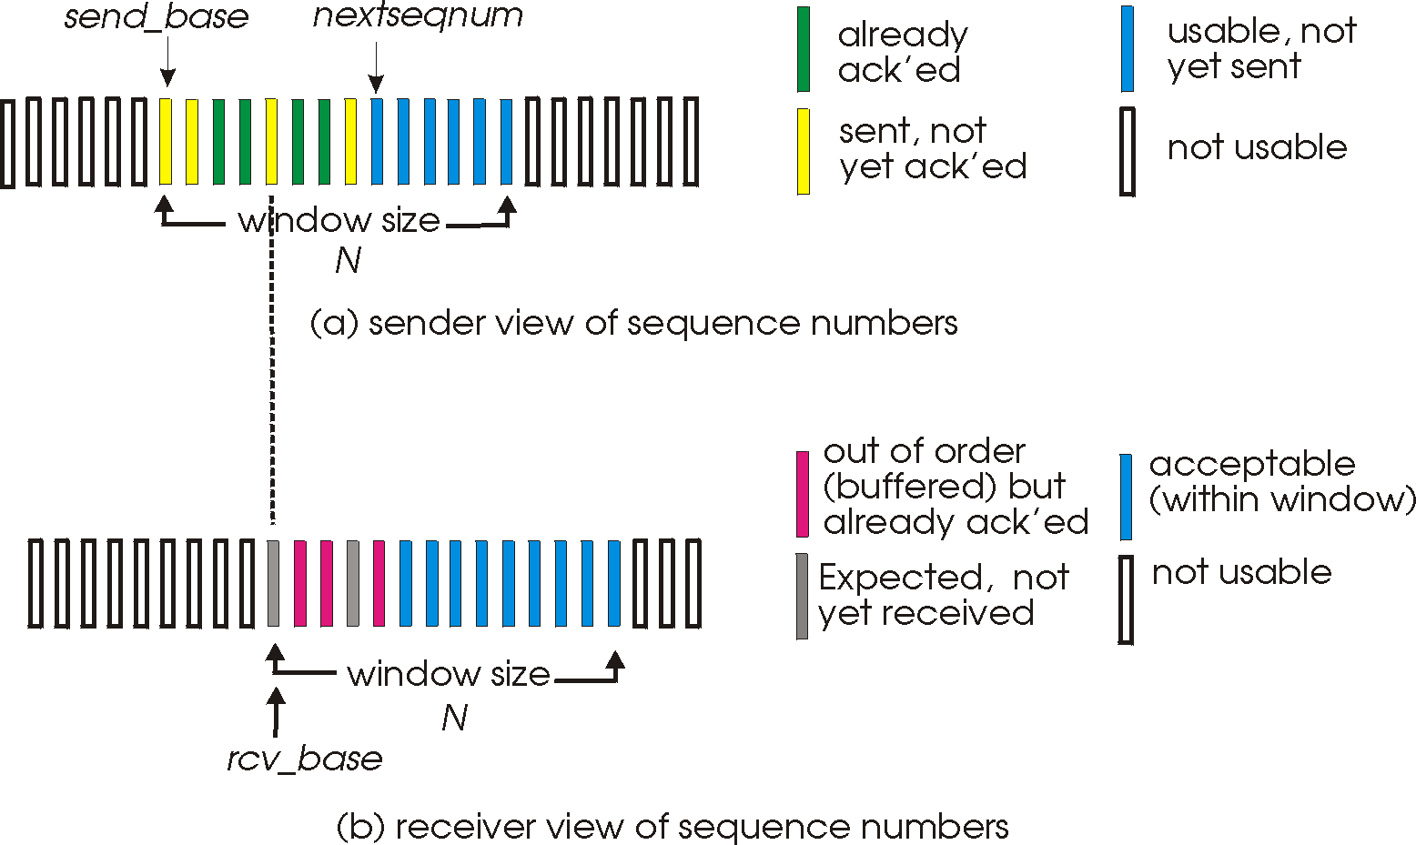
Selective repeat: sender, receiver windows

Slide 44
Selective repeat
sender
receiver
data from above :
if next available seq # in window, send pkt
timeout(n):
resend pkt n, restart timer
ACK(n) in [sendbase,sendbase+N]:
mark pkt n as received
if n smallest unACKed pkt, advance window base to next unACKed seq #
pkt n in [rcvbase, rcvbase+N-1]
send ACK(n)
out-of-order: buffer
in-order: deliver (also deliver buffered, in-order pkts), advance window to next not-yet-received pkt
pkt n in [rcvbase-N,rcvbase-1]
ACK(n)
otherwise:
ignore

Slide 45
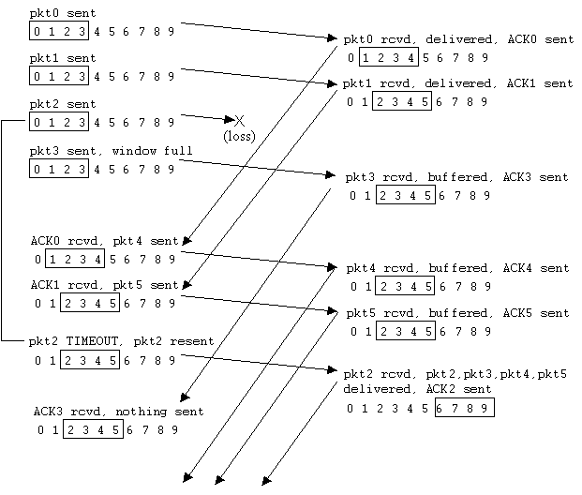
Selective repeat in action

Slide 46
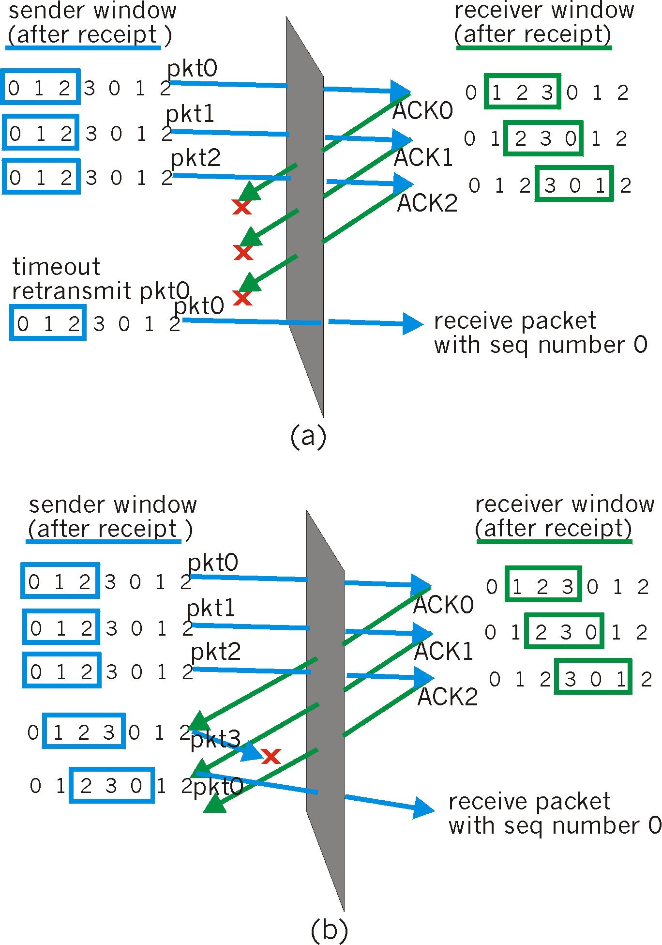
Selective repeat: dilemma
Example:
seq #’s: 0, 1, 2, 3
window size=3
receiver sees no difference in two scenarios!
incorrectly passes duplicate data as new in (a)
Q: what relationship between seq # size and window size?
(check hwk), (try applet)

Slide 47
performance:
selective repeat:
error-free case:
if the window is w such that the pipe is full→U=100%
otherwise U=w*Ustop-and-wait=w/(1+2a)
in case of error:
if w fills the pipe U=1-p
otherwise U=w*Ustop-and-wait=w(1-p)/(1+2a)

Slide 48
Chapter 3 outline
3.1 Transport-layer services
3.2 Multiplexing and demultiplexing
3.3 Connectionless transport: UDP
3.4 Principles of reliable data transfer
3.5 Connection-oriented transport: TCP
segment structure
reliable data transfer
flow control
connection management
3.6 Principles of congestion control
3.7 TCP congestion control

Slide 49
TCP: Overview RFCs: 793, 1122, 1323, 2018, 2581
point-to-point:
one sender, one receiver
reliable, in-order byte steam:
no “message boundaries”
pipelined:
TCP congestion and flow control set window size
send & receive buffers
full duplex data:
bi-directional data flow in same connection
MSS: maximum segment size
connection-oriented:
handshaking (exchange of control msgs) init’s sender, receiver state before data exchange
flow controlled:
sender will not overwhelm receiver

Slide 50
TCP segment structure
32 bits
source port #
dest port #
counting
by bytes
of data
(not segments!)
sequence number
acknowledgement number
head
len
not
used
U
Receive window
A
P
R
S
F
# bytes
rcvr willing
to accept
checksum
Urg data pnter
Options (variable length)
application
data
(variable length)

Slide 51
TCP segment structure
32 bits
URG: urgent data
(generally not used)
counting
by bytes
of data
(not segments!)
source port #
dest port #
sequence number
ACK: ACK #
valid
acknowledgement number
head
len
not
used
U
Receive window
A
P
R
S
PSH: push data now
(generally not used)
F
# bytes
rcvr willing
to accept
checksum
Urg data pnter
RST, SYN, FIN:
connection estab
(setup, teardown
commands)
Options (variable length)
application
data
(variable length)
Internet
checksum
(as in UDP)

Slide 52
TCP seq. #’s and ACKs
Seq. #’s:
byte stream “number” of first byte in segment’s data
ACKs:
seq # of next byte expected from other side
cumulative ACK
Q: how receiver handles out-of-order segments
A: TCP spec doesn’t say, - up to implementor
Host A
Host B
User
types
‘C’
Seq=42, ACK=79, data = ‘C’
host ACKs
receipt of
‘C’, echoes
back ‘C’
Seq=79, ACK=43, data = ‘C’
host ACKs
receipt
of echoed
‘C’
Seq=43, ACK=80
time
simple telnet scenario

Slide 53
Reliability in TCP
Components of reliability
1. Sequence numbers
2. Retransmissions
3. Timeout Mechanism(s): function of the round trip time (RTT) between the two hosts (is it static?)

Slide 54
TCP Round Trip Time and Timeout
Q: how to set TCP timeout value?
longer than RTT
but RTT varies
too short: premature timeout
unnecessary retransmissions
too long: slow reaction to segment loss
Q: how to estimate RTT?
SampleRTT: measured time from segment transmission until ACK receipt
ignore retransmissions
SampleRTT will vary, want estimated RTT “smoother”
average several recent measurements, not just current SampleRTT

Slide 55
TCP Round Trip Time and Timeout
EstimatedRTT(k) = (1- α)*EstimatedRTT(k-1) + α*SampleRTT(k)
=(1- α)*((1- α)*EstimatedRTT(k-2)+ α*SampleRTT(k-1))+ α *SampleRTT(k)
=(1- α)^{k} *SampleRTT(0)+ α(1- α)^{k-1} *SampleRTT)(1)+…+ α *SampleRTT(k)
Exponential weighted moving average
influence of past sample decreases exponentially fast
typical value: α = 0.125

Slide 56
Example RTT estimation:

Slide 57
TCP Round Trip Time and Timeout
Setting the timeout
EstimtedRTT plus “safety margin”
large variation in EstimatedRTT -> larger safety margin
1. estimate of how much SampleRTT deviates from EstimatedRTT:
DevRTT = (1-β)*DevRTT +
β*|SampleRTT-EstimatedRTT|
(typically, β = 0.25)
2. set timeout interval:
TimeoutInterval = EstimatedRTT + 4*DevRTT
3. For further re-transmissions (if the 1st re-tx was not Ack’ed)
- RTO=q.RTO, q=2 for exponential backoff
- similar to Ethernet CSMA/CD backoff

Slide 58
Chapter 3 outline
3.1 Transport-layer services
3.2 Multiplexing and demultiplexing
3.3 Connectionless transport: UDP
3.4 Principles of reliable data transfer
3.5 Connection-oriented transport: TCP
segment structure
reliable data transfer
flow control
connection management
3.6 Principles of congestion control
3.7 TCP congestion control

Slide 59
TCP reliable data transfer
TCP creates reliable service on top of IP’s unreliable service
Pipelined segments
Cumulative acks
TCP uses single retransmission timer
Retransmissions are triggered by:
timeout events
duplicate acks
Initially consider simplified TCP sender:
ignore duplicate acks
ignore flow control, congestion control

Slide 60
TCP sender events:
data rcvd from app:
Create segment with seq #
seq # is byte-stream number of first data byte in segment
start timer if not already running (think of timer as for oldest unacked segment)
expiration interval: TimeOutInterval
timeout:
retransmit segment that caused timeout
restart timer
Ack rcvd:
If acknowledges previously unacked segments
update what is known to be acked
start timer if there are outstanding segments

Slide 61
TCP: retransmission scenarios
Host A
Host B
Host A
Host B
Seq=92, 8 bytes data
Seq=92, 8 bytes data
Seq=100, 20 bytes data
timeout
ACK=100
Seq=92 timeout
X
ACK=100
loss
ACK=120
Seq=92, 8 bytes data
Sendbase
= 100
Seq=92, 8 bytes data
SendBase
= 120
Seq=92 timeout
ACK=120
ACK=100
SendBase
= 100
SendBase
= 120
premature timeout
time
time
lost ACK scenario

Slide 62
TCP retransmission scenarios (more)
Host A
Host B
Seq=92, 8 bytes data
ACK=100
timeout
Seq=100, 20 bytes data
X
loss
SendBase
= 120
ACK=120
time
Cumulative ACK scenario

Slide 63
Fast Retransmit
Time-out period often relatively long:
long delay before resending lost packet
Detect lost segments via duplicate ACKs.
Sender often sends many segments back-to-back
If segment is lost, there will likely be many duplicate ACKs.
If sender receives 3 ACKs for the same data, it supposes that segment after ACKed data was lost:
fast retransmit: resend segment before timer expires

Slide 64
Chapter 3 outline
3.1 Transport-layer services
3.2 Multiplexing and demultiplexing
3.3 Connectionless transport: UDP
3.4 Principles of reliable data transfer
3.5 Connection-oriented transport: TCP
segment structure
reliable data transfer
flow control
connection management
3.6 Principles of congestion control
3.7 TCP congestion control

Slide 65
(Self-clocking)

Slide 66
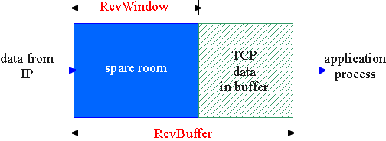
TCP Flow Control
flow control
sender won’t overflow
receiver’s buffer by
transmitting too much,
too fast
receive side of TCP connection has a receive buffer:
speed-matching service: matching the send rate to the receiving app’s drain rate
app process may be slow at reading from buffer

Slide 67
TCP Flow control: how it works
Rcvr advertises spare room by including value of RcvWindow in segments
Sender limits unACKed data to RcvWindow
guarantees receive buffer doesn’t overflow
(Suppose TCP receiver discards out-of-order segments)
spare room in buffer
= RcvWindow
= RcvBuffer-[LastByteRcvd - LastByteRead]

Slide 68
TCP segment structure
32 bits
source port #
dest port #
counting
by bytes
of data
(not segments!)
sequence number
acknowledgement number
head
len
not
used
U
Receive window
A
P
R
S
F
# bytes
rcvr willing
to accept
checksum
Urg data pnter
Options (variable length)
application
data
(variable length)

Slide 69
Chapter 3 outline
3.1 Transport-layer services
3.2 Multiplexing and demultiplexing
3.3 Connectionless transport: UDP
3.4 Principles of reliable data transfer
3.5 Connection-oriented transport: TCP
segment structure
reliable data transfer
flow control
connection management
3.6 Principles of congestion control
3.7 TCP congestion control

Slide 70
TCP Connection Management
Recall: TCP sender, receiver establish “connection” before exchanging data
initialize TCP variables:
seq. #s
buffers, flow control info (e.g. RcvWindow)
client: connection initiator
Socket clientSocket = new Socket("hostname","port number");
server: contacted by client
Socket connectionSocket = welcomeSocket.accept();
Three way handshake:
Step 1: client host sends TCP SYN segment to server
specifies initial seq #
no data
Step 2: server host receives SYN, replies with SYNACK segment
server allocates buffers
specifies server initial seq. #
Step 3: client receives SYNACK, replies with ACK segment, which may contain data

Slide 71
TCP Connection Management (cont.)
Closing a connection:
client closes socket: clientSocket.close();
Step 1: client end system sends TCP FIN control segment to server
Step 2: server receives FIN, replies with ACK. Closes connection, sends FIN.
client
server
close
FIN
ACK
close
FIN
ACK
timed wait
closed

Slide 72
TCP Connection Management (cont.)
Step 3: client receives FIN, replies with ACK.
Enters “timed wait” - will respond with ACK to received FINs
Step 4: server, receives ACK. Connection closed.
Note: with small modification, can handle simultaneous FINs.
client
server
closing
FIN
ACK
closing
FIN
ACK
timed wait
closed
closed

Slide 73
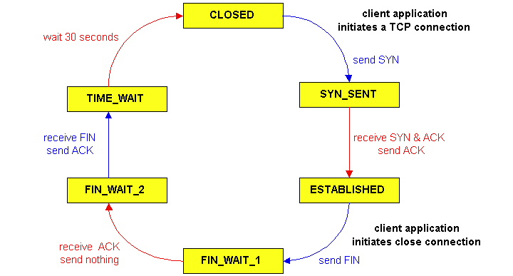
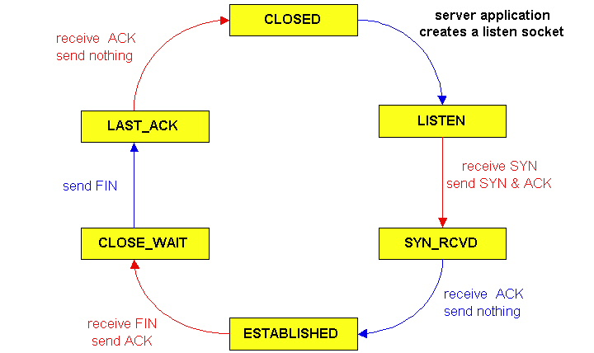
TCP Connection Management (cont)
TCP server
lifecycle
TCP client
lifecycle

Slide 74
Chapter 3 outline
3.1 Transport-layer services
3.2 Multiplexing and demultiplexing
3.3 Connectionless transport: UDP
3.4 Principles of reliable data transfer
3.5 Connection-oriented transport: TCP
segment structure
reliable data transfer
flow control
connection management
3.6 Principles of congestion control
3.7 TCP congestion control

Slide 75
Principles of Congestion Control
Congestion:
informally: “too many sources sending too much data too fast for network to handle”
different from flow control!
manifestations:
lost packets (buffer overflow at routers)
long delays (queueing in router buffers)
a top-10 problem!

Slide 76
Congestion Control & Traffic Management
Does adding bandwidth to the network or increasing the buffer sizes solve the problem of congestion?
No. We cannot over-engineer the whole network due to:
Increased traffic from applications (multimedia,etc.)
Legacy systems (expensive to update)
Unpredictable traffic mix inside the network: where is the bottleneck?
Congestion control & traffic management is needed
To provide fairness
To provide QoS and priorities

Slide 77
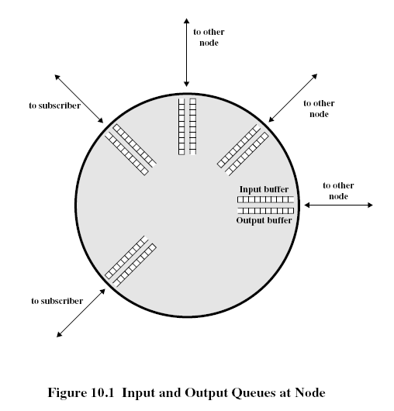
Network Congestion
Modeling the network as network of queues: (in switches and routers)
Store and forward
Statistical multiplexing

Slide 78
Propagation of congestion
if flow control is used hop-by-hop then congestion may propagate throughout the network

Slide 79
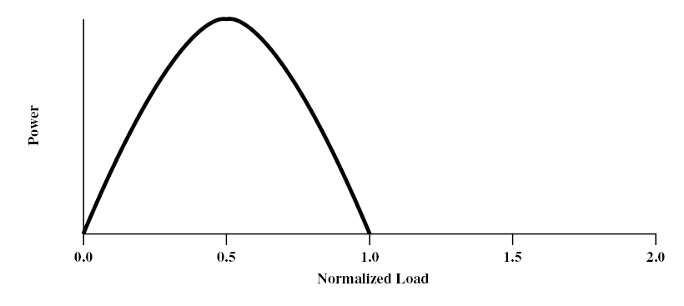
congestion phases and effects
ideal case: infinite buffers,
Tput increases with demand & saturates at network capacity
Delay
Tput/Gput
Network Power = Tput/delay
Representative of Tput-delay design trade-off

Slide 80
practical case: finite buffers, loss
no congestion --> near ideal performance
overall moderate congestion:
severe congestion in some nodes
dynamics of the network/routing and overhead of protocol adaptation decreases the network Tput
severe congestion:
loss of packets and increased discards
extended delays leading to timeouts
both factors trigger re-transmissions
leads to chain-reaction bringing the Tput down

Slide 81
(I)
(II)
(III)
(I) No Congestion
(II) Moderate Congestion
(III) Severe Congestion (Collapse)
What is the best operational point and how do we get (and stay) there?

Slide 82
Congestion Control (CC)
Congestion is a key issue in network design
various techniques for CC
1.Back pressure
hop-by-hop flow control (X.25, HDLC, Go back N)
May propagate congestion in the network
2.Choke packet
generated by the congested node & sent back to source
example: ICMP source quench
sent due to packet discard or in anticipation of congestion

Slide 83
Congestion Control (CC) (contd.)
3.Implicit congestion signaling
used in TCP
delay increase or packet discard to detect congestion
may erroneously signal congestion (i.e., not always reliable) [e.g., over wireless links]
done end-to-end without network assistance
TCP cuts down its window/rate

Slide 84
Congestion Control (CC) (contd.)
4.Explicit congestion signaling
(network assisted congestion control)
gets indication from the network
forward: going to destination
backward: going to source
3 approaches
Binary: uses 1 bit (DECbit, TCP/IP ECN, ATM)
Rate based: specifying bps (ATM)
Credit based: indicates how much the source can send (in a window)

Slide 86
Chapter 3 outline
3.1 Transport-layer services
3.2 Multiplexing and demultiplexing
3.3 Connectionless transport: UDP
3.4 Principles of reliable data transfer
3.5 Connection-oriented transport: TCP
segment structure
reliable data transfer
flow control
connection management
3.6 Principles of congestion control
3.7 TCP congestion control

Slide 87
TCP congestion control: additive increase, multiplicative decrease
Approach: increase transmission rate (window size), probing for usable bandwidth, until loss occurs
additive increase: increase rate (or congestion window) CongWin until loss detected
multiplicative decrease: cut CongWin in half after loss
Saw tooth
behavior: probing
for bandwidth
congestion window size
time

Slide 88
TCP Congestion Control: details
sender limits transmission:
LastByteSent-LastByteAcked
≤ CongWin
Roughly,
CongWin is dynamic, function of perceived network congestion
How does sender perceive congestion?
loss event = timeout or duplicate Acks
TCP sender reduces rate (CongWin) after loss event
three mechanisms:
AIMD
slow start
conservative after timeout events
CongWin
rate =
Bytes/sec
RTT

Slide 89
TCP window management
At any time the allowed window (awnd): awnd=MIN[RcvWin, CongWin],
where RcvWin is given by the receiver (i.e., Receive Window) and CongWin is the congestion window
Slow-start algorithm:
start with CongWin=1, then CongWin=CongWin+1 with every ‘Ack’
This leads to ‘doubling’ of the CongWin with RTT; i.e., exponential increase

Slide 90
TCP Slow Start
When connection begins, CongWin = 1 MSS
(MSS: Maximum Segment Size)
Example: MSS = 500 bytes & RTT = 200 msec
initial rate = 20 kbps
available bandwidth may be >> MSS/RTT
desirable to quickly ramp up to respectable rate
When connection begins, increase rate exponentially fast until first loss event

Slide 91
TCP Slow Start (more)
When connection begins, increase rate exponentially until first loss event:
double CongWin every RTT
done by incrementing CongWin for every ACK received
Summary: initial rate is slow but ramps up exponentially fast
Host A
Host B
one segment
RTT
two segments
four segments
time

Slide 92
TCP congestion control
Initially we use Slow start:
CongWin = CongWin + 1 with every Ack
When timeout occurs we enter congestion avoidance:
ssthresh=CongWin/2, CongWin=1
slow start until ssthresh, then increase ‘linearly’
CongWin=CongWin+1 with every RTT, or
CongWin=CongWin+1/CongWin for every Ack
additive increase, multiplicative decrease (AIMD)

Slide 93
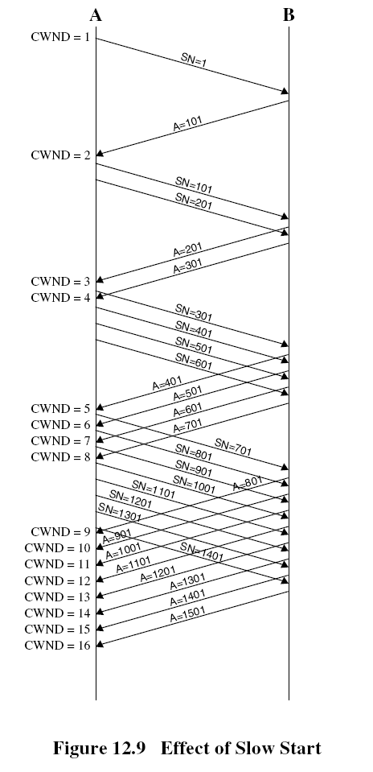

Slide 95
Slow start
Exponential increase
Congestion Avoidance
Linear increase
CongWin
(RTT)

Slide 96
Refinement: inferring loss (How far should we back off?)
After 3 dup ACKs:
CongWin is cut in half
window then grows linearly
But after timeout event:
CongWin instead set to 1 MSS;
window then grows exponentially
to a threshold, then grows linearly
Philosophy:
3 dup ACKs indicates network capable of delivering some segments
timeout indicates a “more alarming” congestion scenario

Slide 97
Fast Retransmit & Recovery
Fast retransmit:
receiver sends Ack with last in-order segment for every out-of-order segment received
when sender receives 3 duplicate Acks it retransmits the missing/expected segment
Fast recovery: when 3rd dup Ack arrives
ssthresh=CongWin/2
retransmit segment, set CongWin=ssthresh+3
for every duplicate Ack: CongWin=CongWin+1
(note: beginning of window is ‘frozen’)
after receiver gets cumulative Ack: CongWin=ssthresh
(beginning of window advances to last Ack’ed segment)
CongWin

Slide 99
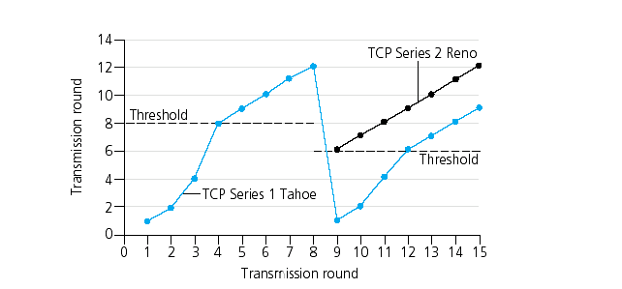
Fast Recovery
CongWin

Slide 100
(I)
(II)
(III)
(I) No Congestion
(II) Moderate Congestion
(III) Severe Congestion (Collapse)
Where does TCP operate on this curve?

Slide 101
Summary: TCP Congestion Control
When CongWin is below Threshold, sender in slow-start phase, window grows exponentially.
When CongWin is above Threshold, sender is in congestion-avoidance phase, window grows linearly.
When a triple duplicate ACK occurs, Threshold set to CongWin/2 and CongWin set to Threshold.
When timeout occurs, Threshold set to CongWin/2 and CongWin is set to 1 MSS.

Slide 102
TCP Fairness
Fairness goal: if K TCP sessions share same bottleneck link of bandwidth R, each should have average rate of R/K
TCP connection 1
TCP
connection 2
bottleneck
router
capacity R

Slide 103
Fairness (more)
Fairness and UDP
Multimedia apps often do not use TCP
do not want rate throttled by congestion control
Instead use UDP:
pump audio/video at constant rate, tolerate packet loss
Research area: TCP friendly protocols!
Fairness and parallel TCP connections
nothing prevents app from opening parallel connections between 2 hosts.
Web browsers do this
Example: link of rate R supporting 9 connections;
new app asks for 1 TCP, gets rate R/10
new app asks for 11 TCPs, gets R/2 !

Slide 104
Congestion Control with Explicit Notification
TCP uses implicit signaling
ATM (ABR) uses explicit signaling using RM (resource management) cells
ATM: Asynchronous Transfer Mode, ABR: Available Bit Rate
ABR Congestion notification and congestion avoidance
parameters:
peak cell rate (PCR)
minimum cell rate (MCR)
initial cell rate(ICR)

Slide 105
Case study: ATM ABR congestion control
ABR: available bit rate:
“elastic service”
if sender’s path “underloaded”:
sender should use available bandwidth
if sender’s path congested:
sender throttled to minimum guaranteed rate
RM (resource management) cells:
sent by sender, interspersed with data cells
bits in RM cell set by switches (“network-assisted”)
NI bit: no increase in rate (mild congestion)
CI bit: congestion indication
RM cells returned to sender by receiver, with bits intact

Slide 106
ABR uses resource management cell (RM cell) with fields:
CI (congestion indication)
NI (no increase)
ER (explicit rate)
Types of RM cells:
Forward RM (FRM)
Backward RM (BRM)

Slide 107
Congestion notification using RM cells
RM cell every Nrm-1 data cells
If congestion:
The switch may set EFCI (explicit forward congestion indication) in ATM cell header. Then the destination sets the CI=1 in RM cell going back to the source (ER) is modified.
The switch may set CI & NI bits in the RM cell and either send RM cell to destination (FRM) or send BRM back to the source (with decreased latency)
The switch sets ER field in BRM

Slide 109
Congestion Control in ABR
The source reacts to congestion notification by decreasing its rate (rate-based vs. window-based for TCP)
Rate adaptation algorithm:
If CI=0,NI=0
Rate increase by factor ‘RIF’ (e.g., 1/16)
Rate = Rate + PCR/16
Else If CI=1
Rate decrease by factor ‘RDF’ (e.g., 1/4)
Rate=Rate-Rate*1/4

Slide 111
Which VC to notify when congestion occurs?
FIFO, if Qlength > 80%, then keep notifying arriving cells until Qlength < lower threshold (this is unfair)
Use several queues: called Fair Queuing
Use fair allocation = target rate/# of VCs = R/N
If current cell rate (CCR) > fair share, then notify the corresponding VC

Slide 112
What to notify?
CI
NI
ER (explicit rate) schemes perform the steps:
Compute the fair share
Determine load & congestion
Compute the explicit rate & send it back to the source
Should we put this functionality in the network?

Slide 113
Chapter 3: Summary
principles behind transport layer services:
multiplexing, demultiplexing
reliable data transfer
flow control
congestion control
TCP, ATM ABR
Next:
leaving the network “edge” (application, transport layers)
into the network “core”

