Slide 1
Group 1
Aswin, Prithvi, Subramaniam, Valampuri

Slide 2
MI-VANET : A New Mobile Infrastructure Based VANET Architecture for Urban Environment
Paper 1

Slide 3
Summary
Traditional VANETS
Author’s observations about VANETS
Experiments
Improved architecture
Routing
Performance analysis
MI-VANET : A New Mobile Infrastructure Based VANET Architecture for Urban Environment

Slide 4
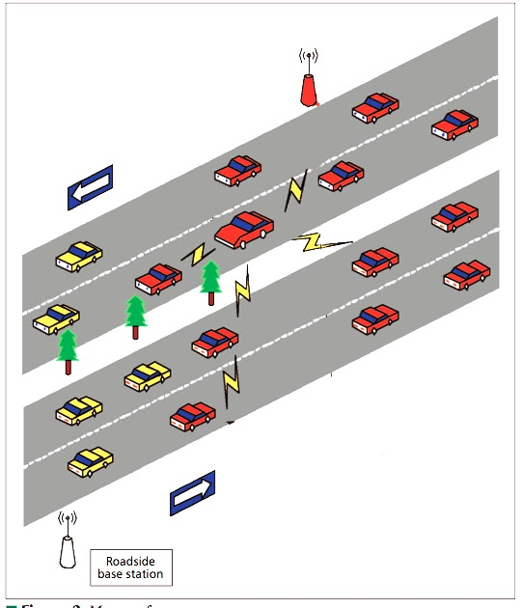
Traditional Vanets
MANET instance
IVC
RVC
MI-VANET : A New Mobile Infrastructure Based VANET Architecture for Urban Environment

Slide 5
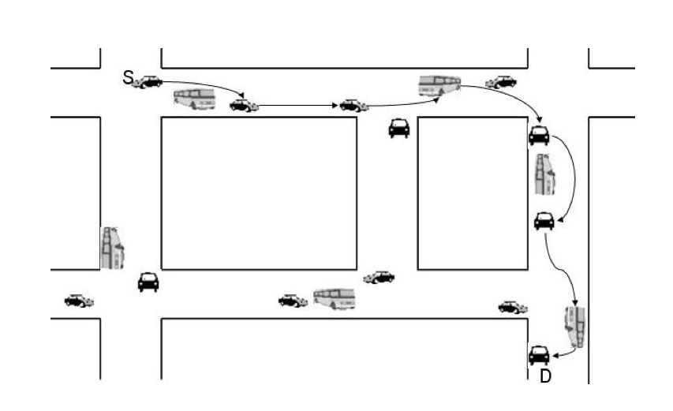
Traditional Vanets
Routing
MI-VANET : A New Mobile Infrastructure Based VANET Architecture for Urban Environment

Slide 6
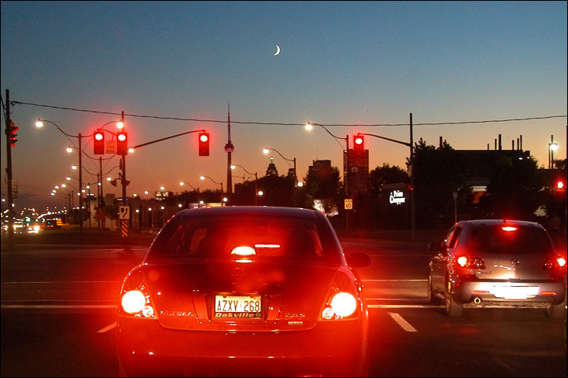
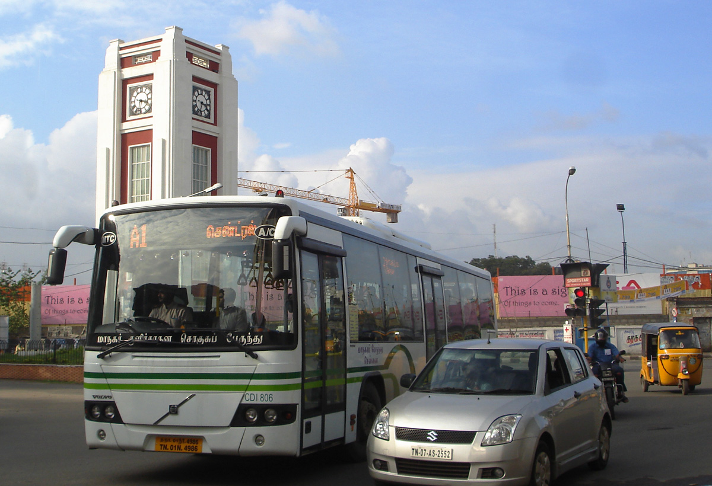
Observations
MI-VANET : A New Mobile Infrastructure Based VANET Architecture for Urban Environment

Slide 7
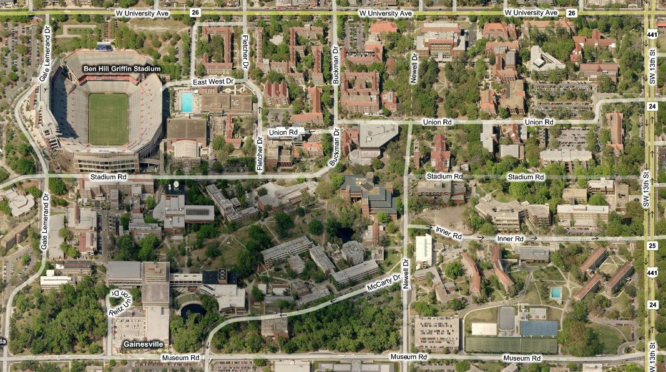
Observations
Traffic light patterns
Vehicle type
Constrained movement
Clusters have more connection time than roadside units
MI-VANET : A New Mobile Infrastructure Based VANET Architecture for Urban Environment

Slide 8
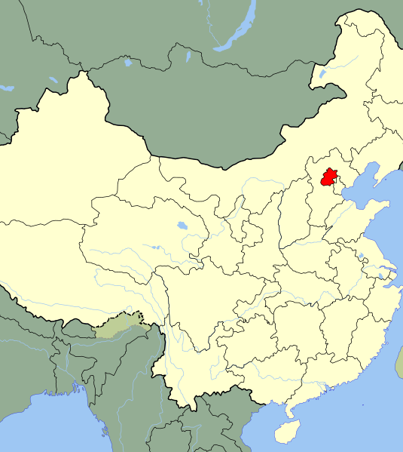
Experiments
80 cars:20 buses
Sample undisclosed
MI-VANET : A New Mobile Infrastructure Based VANET Architecture for Urban Environment

Slide 9
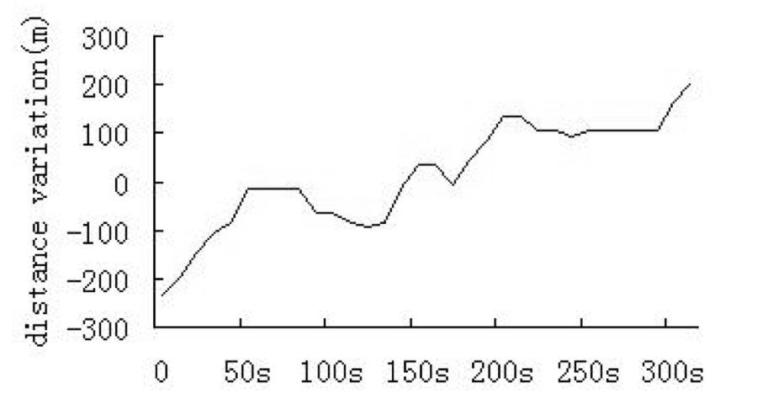
Experiments
Communication range, Connection time
200m, 250s
150m, 200s
MI-VANET : A New Mobile Infrastructure Based VANET Architecture for Urban Environment

Slide 10
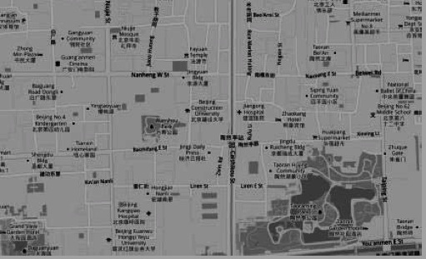
Experiments
10 buses
Avg. speed = 15 km/h
Top speed = 50 km/h
MI-VANET : A New Mobile Infrastructure Based VANET Architecture for Urban Environment

Slide 11
Improved architecture
2 tiered
High tier – buses
Low tier – cars
Buses have 2 radio interfaces
Low power for c2b
High power for b2b
MI-VANET : A New Mobile Infrastructure Based VANET Architecture for Urban Environment

Slide 12
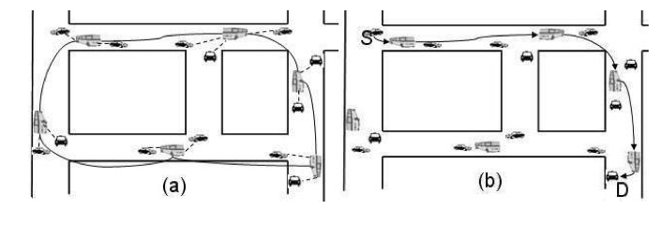
Improved architecture
(a) MI-VANET architecture example (b) An example of message delivery in MI-VANET
MI-VANET : A New Mobile Infrastructure Based VANET Architecture for Urban Environment

Slide 13
The Register and The Routing
Register [MIRG]
  Low tier nodes register on buses
  Wait for beacon from bus
  Compute expected connection time
MI-VANET : A New Mobile Infrastructure Based VANET Architecture for Urban Environment

Slide 14
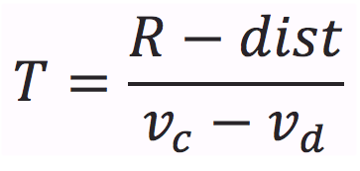
The Register and The Routing
R : Radio Range
dist : Distance b/w car and bus
T : Expected Connection time
S : Score
MI-VANET : A New Mobile Infrastructure Based VANET Architecture for Urban Environment

Slide 15
The Register and The Routing
Routing [MIRT]
  Select optimal route
  Efficiently forward packets
MI-VANET : A New Mobile Infrastructure Based VANET Architecture for Urban Environment

Slide 16
The Register and The Routing
Routing [MIRT]
  Select optimal route
    Road Segment based routing approach
      Select best neighboring road segment
      Uses min hop count as the deciding metric
      Buses have fixed routes and timings
      Hop count is related to bus density and road length
MI-VANET : A New Mobile Infrastructure Based VANET Architecture for Urban Environment

Slide 17
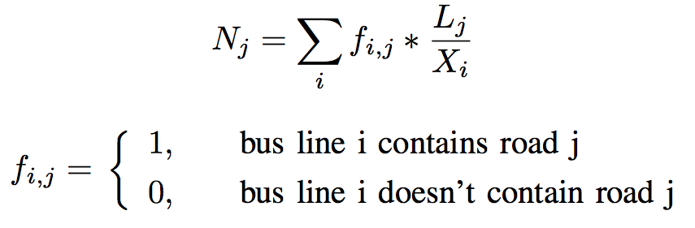
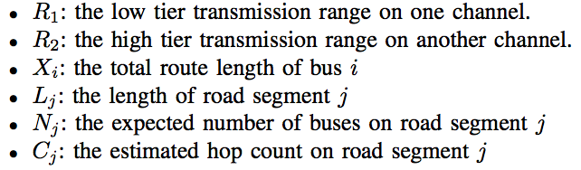
The Register and The Routing
MI-VANET : A New Mobile Infrastructure Based VANET Architecture for Urban Environment

Slide 18
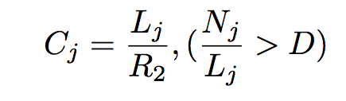
The Register and The Routing
MI-VANET : A New Mobile Infrastructure Based VANET Architecture for Urban Environment

Slide 19
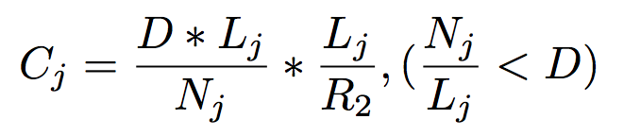
The Register and The Routing
MI-VANET : A New Mobile Infrastructure Based VANET Architecture for Urban Environment

Slide 20
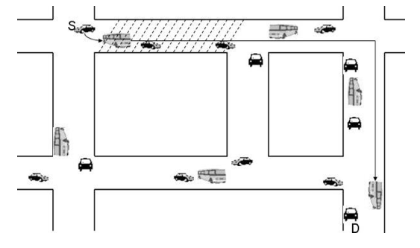
The Register and The Routing
Route selection in MI-VANET
MI-VANET : A New Mobile Infrastructure Based VANET Architecture for Urban Environment

Slide 21
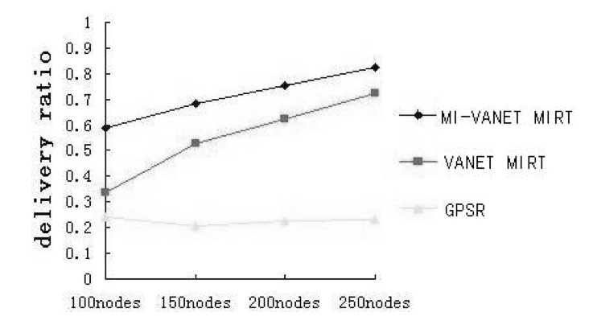
Performance Evaluation
MI-VANET : A New Mobile Infrastructure Based VANET Architecture for Urban Environment

Slide 22
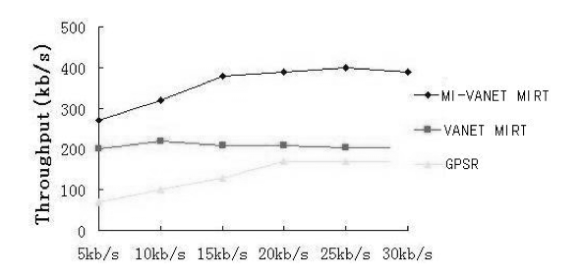
Performance Evaluation
MI-VANET : A New Mobile Infrastructure Based VANET Architecture for Urban Environment

Slide 23
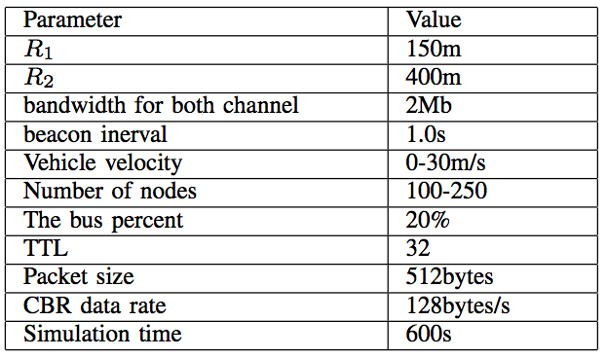
Performance Evaluation
Simulation parameters
MI-VANET : A New Mobile Infrastructure Based VANET Architecture for Urban Environment

Slide 24
Performance Evaluation
Software used
  VanetMobiSim
    Area 1700m*1000m
  NS2
MI-VANET : A New Mobile Infrastructure Based VANET Architecture for Urban Environment

Slide 25
Drawbacks
Local minima ?
  Would carry and forward work
Data set, real world testing
Bunching of buses, service interruptions
Potentially unused computing resources
MI-VANET : A New Mobile Infrastructure Based VANET Architecture for Urban Environment

Slide 26
Providing Consistent Global Sharing Services over VANET
Pejman Panahi
Iranian Academic Center For Education, Culture And Research, Department Of Computer, Urmia, Iran.

Slide 27
MOTIVATION
Peer to peer technology over Internet has boosted the file sharing services.
Implementing P2P over a mobile ad hoc network and VANET in specific is a challenging task.
Many architectures for P2P over Vehicular ad hoc network like Car-Torrent have been proposed.
Opportunistic file sharing protocols (car-torrent) have limitations like absence of support for information sharing between distant vehicles.
Providing Consistent Global Sharing Services over VANET : Pejman Panahi

Slide 28
INTRODUCTION
An infrastructure based approach is proposed in this paper which connects all vehicles in the network.
Data transfer between distant vehicles is made possible by taking advantage of the predictable and restricted mobility of vehicles along their paths on fixed streets.
Goal : Provide information globally among all vehicles rather than relying on opportunistic meetings, which improves peer to peer techniques proposed earlier.
Providing Consistent Global Sharing Services over VANET : Pejman Panahi

Slide 29
MODEL ARCHITECTURE
Role of access points are extended beyond direct communication to cars.
Access points behave like stationary cars communicating with each other to determine the vehicles possessing the information requested.
The end access point fetches the information and transmits it to the vehicle which requested it through other intermediate access points.
Providing Consistent Global Sharing Services over VANET : Pejman Panahi

Slide 30
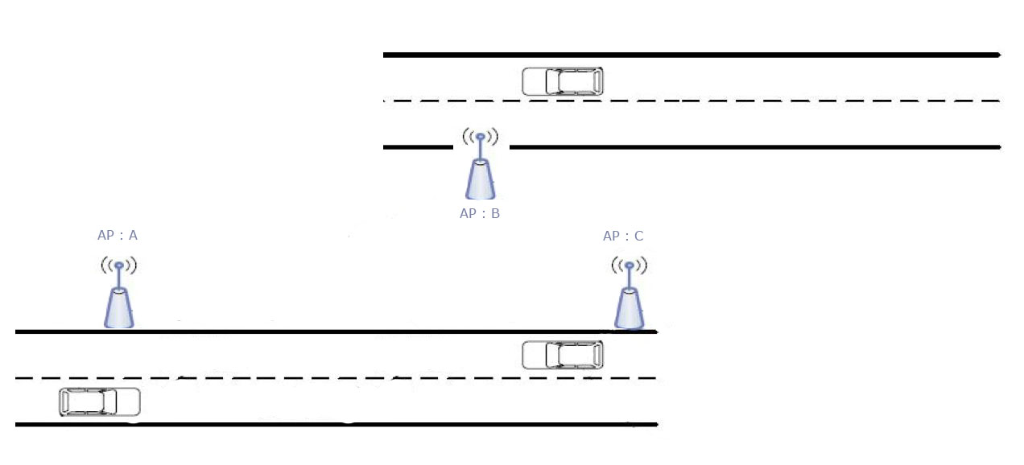
Providing Consistent Global Sharing Services over VANET : Pejman Panahi

Slide 31
Providing Consistent Global Sharing Services over VANET : Pejman Panahi

Slide 32
Providing Consistent Global Sharing Services over VANET : Pejman Panahi

Slide 33
Providing Consistent Global Sharing Services over VANET : Pejman Panahi

Slide 34
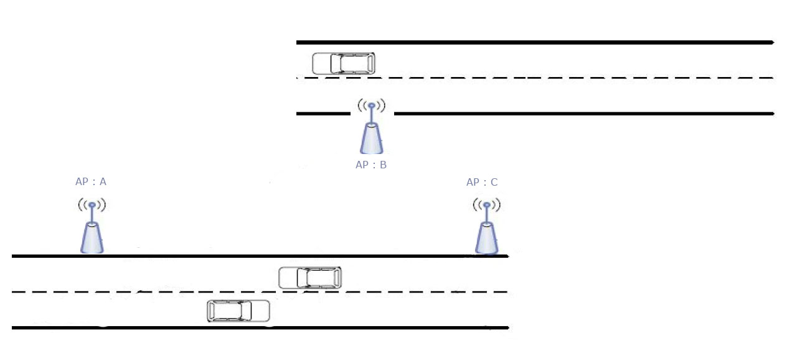
Providing Consistent Global Sharing Services over VANET : Pejman Panahi

Slide 35
Overlay Protocol
The dynamicity of the vehicular network and the high mobility of the nodes demand for a distributed management of file-requests.
The author proposes Chord protocol to decentralize the service.
Chord uses consistent hashing to map nodes onto an m-bit circular identifier space and each node holds a fraction of the data.
Providing Consistent Global Sharing Services over VANET : Pejman Panahi

Slide 36
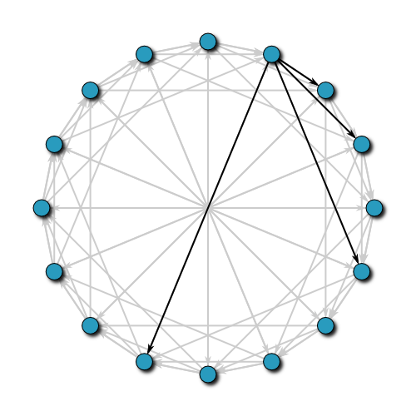
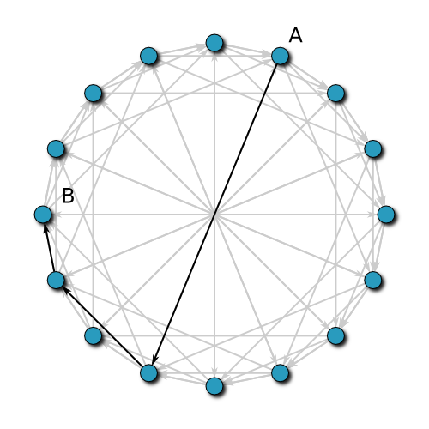
CHORD
Providing Consistent Global Sharing Services over VANET : Pejman Panahi

Slide 37
CHORD
The peers are arranged in a logical ring topology.
Each retrieval operation is forwarded to a node that is closer to the location until the location is found.
Each node holds a finger table containing the addresses of nodes which are 1/2^{i} -way around the ring (with i = 1. . . m).
When a node receives a query, it forwards it to the node in its finger table with the highest ID not exceeding hash(key).
The number of nodes that must be contacted to find a successor in an N-node network is O(logN).
Providing Consistent Global Sharing Services over VANET : Pejman Panahi

Slide 38
CHORD
Providing Consistent Global Sharing Services over VANET : Pejman Panahi

Slide 39
CLUSTER & CLUSTER HEADS
Chord-model with a single ring would result in heavy message-overhead for the updating of car positions.
The author introduces the concept of clustering to organize the access points.
Cluster heads or super nodes handles the management of the position of vehicles.
Each cluster is responsible for indexing a partial range of the file indices.
The management of indices within a cluster is still done according the Chord protocol
Providing Consistent Global Sharing Services over VANET : Pejman Panahi

Slide 40
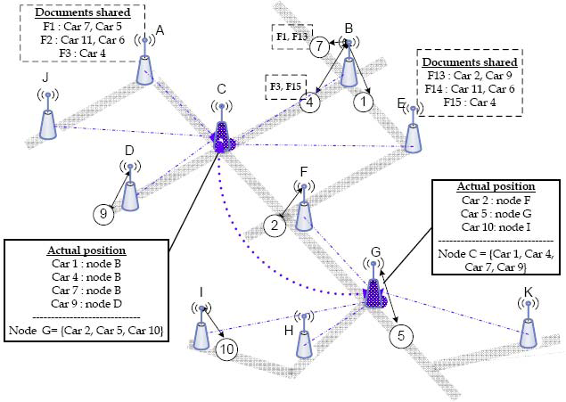
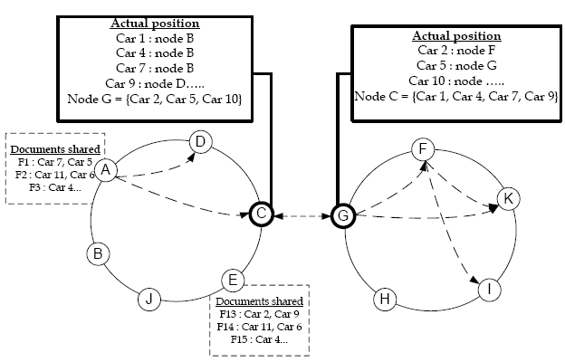
Providing Consistent Global Sharing Services over VANET : Pejman Panahi

Slide 41
CLUSTERING
Cluster heads are chosen while satisfying the criteria of minimizing overhead.
This implies that inter-cluster vehicle-traffic should be minimized which will reduce the inter-cluster head message overhead.
Cluster heads are chosen from locations where vehicular traffic is dense.
With such a design, clusters will have the most possible maximum coherence and the most possible minimum coupling to other clusters (traffic from one cluster to another one should be minimized).
k-medoid clustering algorithm is used to build clusters.
Providing Consistent Global Sharing Services over VANET : Pejman Panahi

Slide 42
k – medoid clustering algorithm
Choose k points to be the initial cluster-heads (Medoids)
Assign each node to the closest Medoid.
When all nodes have been assigned, try swapping cluster-nodes with their cluster-heads and see if the costs are decreased.
Repeat Steps 2 and 3 until the Medoids no longer move.
Providing Consistent Global Sharing Services over VANET : Pejman Panahi

Slide 43
CLUSTERING
The coherence of a cluster is measured by the traffic of vehicles inside it rather than distances between its nodes.
Two access points are (virtually) close to each other if the traffic between them is high.
Cluster heads have to be the most central nodes not regarding the spatial repartition of the gateways belonging to their clusters but regarding the cars traffic in their clusters.
The best known type of centrality that corresponds to this idea is the Betweenness-Centrality.
Betweenness centrality : Nodes are somehow central to the degree they stand between other nodes on the paths of communication.
Providing Consistent Global Sharing Services over VANET : Pejman Panahi

Slide 44
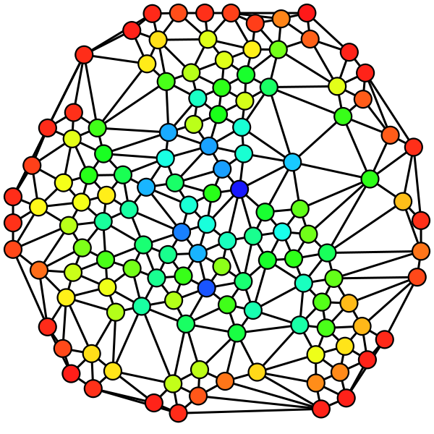
Betweenness centrality
Providing Consistent Global Sharing Services over VANET : Pejman Panahi

Slide 45
Synchronization of requests
The synchronization of equivalent requests has a direct impact on the scalability of proposed architecture.
Equivalent requests refers to search-requests looking for the same file on different cars, apart from being generated from one car-request (when the file is shared by more than one car) or issued from many cars.
Synchronization of requests is done at file indices since a request consults a file index to get the list of cars sharing the requested file.
Providing Consistent Global Sharing Services over VANET : Pejman Panahi

Slide 46
Synchronization of requests
Requests for each file have to be temporarily registered in the corresponding file-index.
As soon as a gateway retrieves a file, it sends a message to clear the list of requests registered for this file (or check whether it has already been cleared).
If the requests-list is empty this gateway abandons the delivery of this file otherwise it takes into responsibility to transmit the retrieved file to all requesting cars.
From time to time, gateways have to check whether the non yet retrieved files have been already retrieved by another gateway by checking the requests-cache.
Providing Consistent Global Sharing Services over VANET : Pejman Panahi

Slide 47
Prediction of Next-Car-Positions
The prediction of next car positions is used in a first stage to avoid flooding access points with file-requests
In the second stage it is used to accelerate the deliverance of files to cars by forwarding the retrieved files to probable next positions of requesting cars.
Any prediction strategy should be based on the knowledge about the current car-position, this prediction is done at cluster heads.
A classified list of next-possible gateways could be dynamically built at cluster heads for each gateway belonging to its cluster, by counting the vehicular traffic between gateways.
After a learning period of time, the system predicts out good estimations for the next-probable positions on most gateways while adapting to traffic shape at different moments of a day.
Providing Consistent Global Sharing Services over VANET : Pejman Panahi

Slide 48
SIMULATION
To evaluate proposed architecture, generating car traffic based on the Manhattan mobility model were done.
Some intersection points of the streets were chosen to place access points.
A grid of 5 blocks at both the horizontal and the vertical axis, where each block represents 1 km.
Cars have a speed of about 50km/h with a turn probability of 0.7.
The number of access points were varied from 13 to 23 and thereof 2 to 6 cluster heads should be chosen.
All nodes use IEEE 802.11b MAC operating at 5 Mbps.
The transmission range is about 250 m.
Providing Consistent Global Sharing Services over VANET : Pejman Panahi

Slide 49
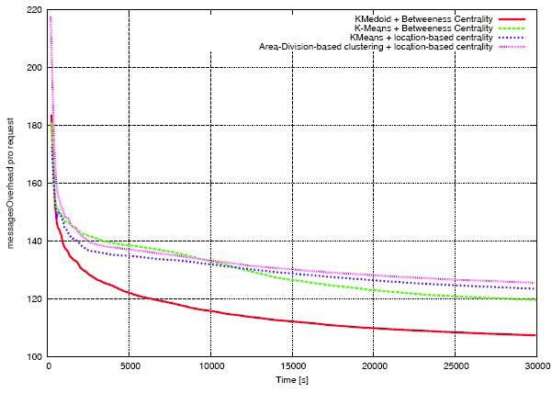
Messages overhead for each clustering strategy

Slide 50
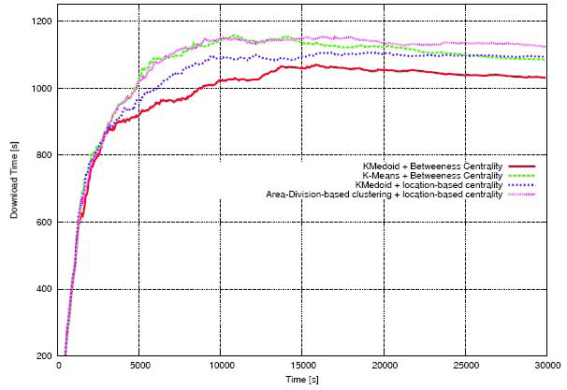
Download time for each clustering strategy

Slide 51
Effect of concurrent requests on the download time

Slide 52
CONCLUSION
An architecture that enhances the efforts made in the field of vehicular ad hoc networks to support realistic P2P services between cars.
File sharing services cannot be achieved without connecting all cars of the network for that purpose.
Simulation results and analysis proves suggested architecture is efficient over the previous proposed techniques.
Providing Consistent Global Sharing Services over VANET : Pejman Panahi

Slide 53
Strength
Using traffic information for k-medoid algorithm for clustering and betweeness centrality for cluster head selection proves to be a more realistic solution over the previous proposed ideas.
The previously presented MI-VANET relies on public transports, absence of which could fail the whole architecture. The proposed architecture is based on access points with cluster heads being elected according to the traffic density.
Weakness
The prediction technique for next-car-position needs to be refined. The suggested model should best work in a city where we have same set of vehicles appearing in the clusters. Profile cast techniques could further enhance the probability of predicting the next-car-position correctly.
Providing Consistent Global Sharing Services over VANET : Pejman Panahi

Slide 54
Small Scale routing in Vehicular Ad-hoc Networks
Wenjing Wang, Fei Xie and Mainak Chatterjee,Small Scale and large scale routing in Vehicular Ad-hoc Networks IEEE Transactions on Vehicular Technology, Nov. 2009, Vol. 58, No. 9, pp. 5200-5213.

Slide 55
VANET Routing issues
Highly dynamic topology
Hard delay constraints
Frequently disconnected network
Sufficient energy and storage
Mobility modeling

Slide 56
Routing Protocols Discussed
Table driven/On demand
Position Based

Slide 57
Mobility Model
Saha and Johnson
Simulator framework
Shortest Path
Random Src/Dest
Speed limit +/- 5Mph
NS2 Scenarios

Slide 58
STRAW
TIGER database
Traffic control/Car following
Probability to turn
Support for stop signs/Traffic lights

Slide 59
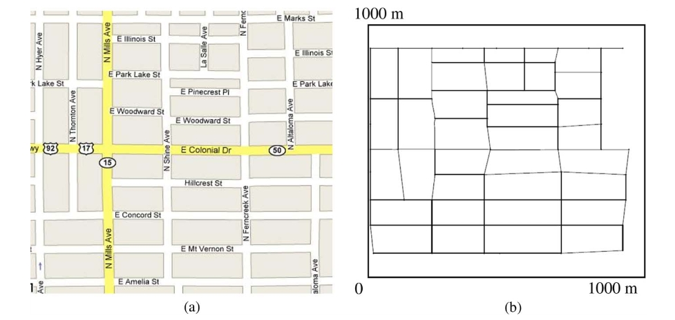

Slide 60
Proposed Model
NS2 Scenarios
Maps from Orlando Downtown and residential area (1000m x 1000m) for simulation
Shortest Path from Random Source/Destination with Random senders
New set of senders/Receivers every 50 SECs

Slide 61
Road Specs
Speed Limits
Overtaking with a probability ‘p’/ Acceleration ‘a’ defined for overtaking for a vehicle less than d meters ahead
Car following for Vehicle greater than d meters

Slide 62
Intersection Specs
Deceleration of ‘b’ towards a traffic light/Stop sign
Waiting time at intersection computed using Straw
Acceleration of ‘a’ until the speed limit arrives after which the Road mobility model takes over

Slide 63
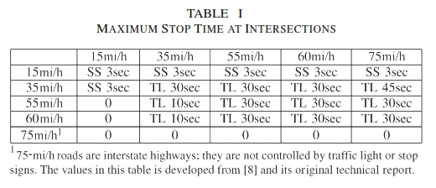

Slide 64
Routing Protocols.
CBRF
Connection Based like AODV
RREQ/RREP cycles
RADIO RANGE R
Nodes within a range r<R are forced not to broadcast
Avoid broadcast by nodes in r to Nodes in R-r
Carry and Run instead of RERR
Routing Overhead / Delivery ratio

Slide 65
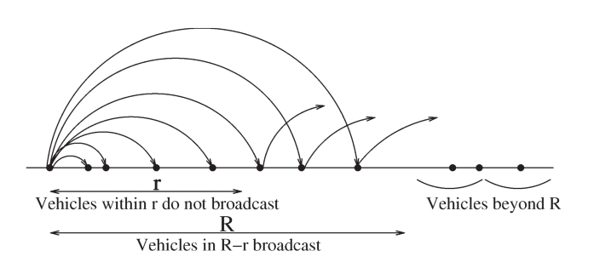

Slide 66
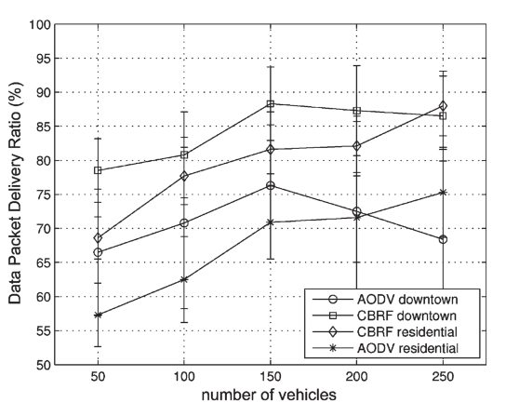
Packet Delivery Ratio

Slide 67
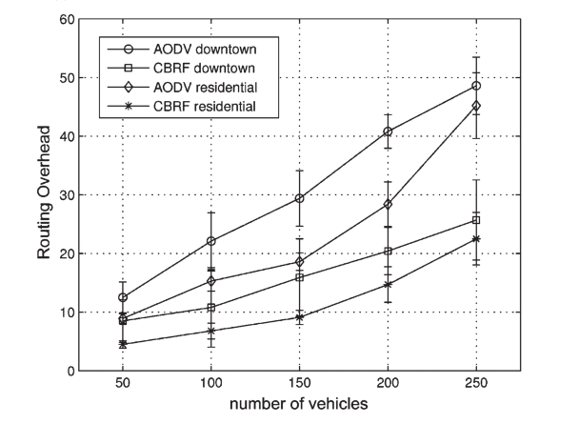
Routing overhead

Slide 68
CLGF
Location Based Routing
GPSR - Progressively Closest Node To the Destination
CLGF - Progressively Closest Node to the Destination with manageable Congestion
MAC layer Queue size/buffer length ratio with HELLO packets to set threshold
TOCTOU???

Slide 69
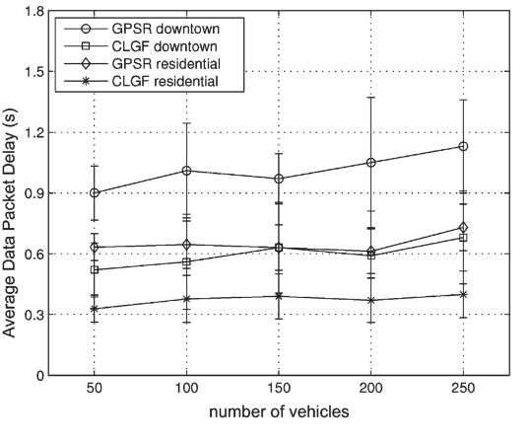
Average Delay

Slide 70
Observations
Layout/Intersections and Speed limit had the highest impact
Following Distance, Deceleration, Acceleration, Overtaking Probability etc did not make much of an impact

Slide 71
Comments
Obstacles in downtown/how to simulate
Performance of one of the Protocols in both STRAW and the New model as a proper comparison instead of Average speed
Simulation of one flow to actually see the impact of the Acceleration/Deceleration
Different Maps

Slide 72
?

Slide 73
Security of Vehicular ad Hoc Networks

Slide 74
Need for Security
Essential to make sure that life-critical information cannot be inserted or modified by an attacker;
The system should be able to help establish the liability of drivers; but at the same time, it should protect as far as possible the privacy of the drivers and passengers.

Slide 75
Application categories
Safety-related applications, such as collision avoidance, cooperative driving, and traffic optimization
Other applications, including payment services (e.g., toll collection), location-based services (e.g., finding the closest fuel station), infotainment (e.g., Internet access).

Slide 76
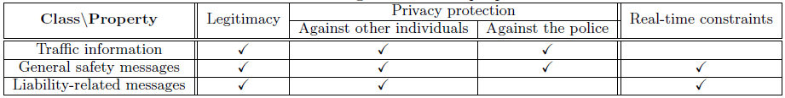
Safety messages

Slide 77
Attacker’s model
Insider vs. Outsider
Malicious vs. Rational
Active vs. Passive

Slide 78
Specific attacks
Bogus information
Cheating with positioning information
ID disclosure
Denial of Service
Masquerade

Slide 79
Security Model
Requirements
  Authentication
  Verification of data consistency
  Availability
  Non-repudiation
  Privacy
  Real-time constraints

Slide 80
Security Model
Securing messages
  V → * : M, SigPrK_{V} [M|T],Cert_{V}
  where
  V : Sending Vehicle
  M : Message
  * : all the receivers
  SigPrKv : Signed with private key
  M | T : Message concatenated with Timestamp
  Certv : Digital Signature for V

Slide 81
Security Model
Tamper-proof device
  storing the secret information
  signing outgoing messages
Key management
  Electronic License Plate (ELP)
  Electronic Chassis Number (ECN)
  Anonymous key pairs
  Key bootstrapping and rekeying
  Key certification
    Cert_{V} [PuK_{i}] = PuK_{i}|SigPrK_{CA}[PuK_{i}|ID_{CA}]

Slide 82
Security Model
Compliance with the security requirements
  DoS resilience
  Verification by correlation
  Non-repudiation
    ELPs cannot be forged
    Usage of anonymous key pairs

Slide 83
Security Model
Implementation issues
  Certificate lifetime
  Anonymous key set size
  Signature size
    T_{oh}(M) = T_{sign}(M) + T_{tx}(M|SigPrK_{V} [M]) + T_{verify}(M)

Slide 84
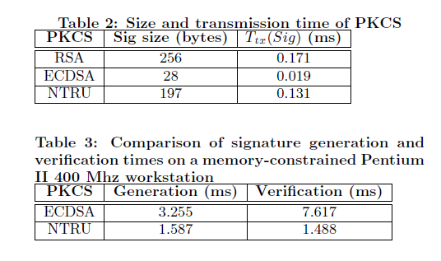
Security Model

Slide 85
Security Model
Simulations
Scenario 1:
A highway with 6 lanes (3 in each direction) of 3 m each. We assume a uniform presence of vehicles, with an inter-vehicle space of 30 m. Vehicles are mobile and trasmit DSRC messages every 300 ms over a 300 m communication range.
Scenario 2:
We consider the same highway as in the previous case but this time vehicles are very slow or stopped (congestion scenario) and spaced by 5 m (including the vehicle length). Each vehicle transmits a safety message over a range of 15 m every 100 ms.

Slide 86
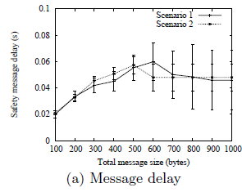
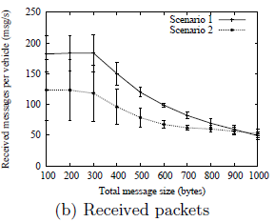
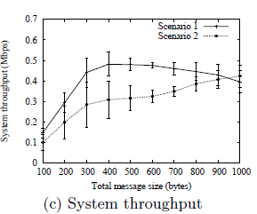
Security Model

Slide 87
Disadvantages
Key-revocation
Updating keys periodically

