Slide 1
CIS4930/CIS6930 Mobile Networking
Ahmed Helmy
www.cise.ufl.edu/~helmy
helmy@ufl.edu
Spring 2011
www.cise.ufl.edu/~helmy/cis6930-11

Slide 2
Course Structure
Three main components:
Lecture sessions/class participation
Assignments & experiments
Major Semester Project
(check syllabus for more details)
Web site: www.cise.ufl.edu/~helmy/cis6930-11
also check prev. years from CIS6930,EE579/599/499
‘Student-centered, seminar-like, hands-on, thought-provoking, advanced research’ course in networking, with networking and wireless lab.

Slide 3
Course Components
A. Project:
4 milestones
(1) Initial proposal
(2) Refined proposal
(3) Initial report
(4) Final report
& Demo
C. Experiments &
Assignments (3)
Wireless & mobility tracing (encounter nets)
Friendship and trust measurements
(socializer games & apps)
Participatory mobile networking scenarios (project driven!)
B. Presentations
& discussions:
- Topic presentation
- Project presentation
- Paper readings,
reviews
& discussions
Attendance, discussion & 4 Reviews : 10%
Experiments: 3 x 10%= 30%
Project & Presentations: 60%
- Topic Presentation: 15%
- Project Presentation & Demo: 15%
- Written Proposal, Report, Demo: 30%

Slide 4
Milestones
Forming groups for experiments/projects (1st 2 weeks)
Paper reviews: 4 at least [distribute throughout!]
Experiments: 3 (one every ~month)
Initial Project Proposal (~5th week)
Final Project Proposal (~8th week)
Initial Project Report (~11th week)
Final Project Report/demos (last week of class)
Class presentations (sign up)
Project presentations (accdg to time, sign up)

Slide 5
Course Team
Teaching and Lab Assistants:
TA: Udayan Kumar (ukumar@cise.ufl.edu)
Lab/Ph.D.: Gautam, Saeed, Jeeyoung, Yibin, Sungwook
= Student Groups:
- Around 5-7 groups, each of ‘4-6’ students
(experiment groups, project groups)
= Sessions:
- Lectures (initial: T 1:55-2:45 R 1:55-3:50) may change
Experiments (TBA) [all wireless/mobile]
Prof. Ahmed Helmy www.ufl.edu/cise/~helmy
(email: helmy@ufl.edu)

Slide 6
Course Content
The main emphasis of the course is on measurements, protocols, modeling, analysis & apps for Mobile Ad Hoc Networks (MANets).
The material discussed will be mainly based on carefully selected research papers, book chapters.
Book "Ad Hoc Networking“, C. Perkins. Good collection of research papers [not required].
The Prof. will present the first few lectures then the students will present their topics.
This course is seminar-like & is student-driven.

Slide 7
Intro to Ad Hoc Networks
What is an ad hoc network?
Pure ad hoc
Homogeneous vs. heterogeneous nodes
Wired-wireless heterogeneous networks

Slide 8
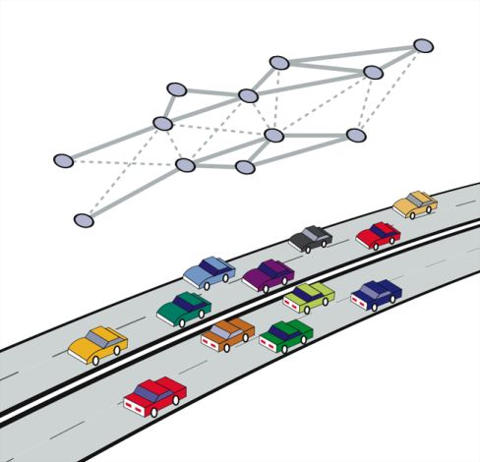
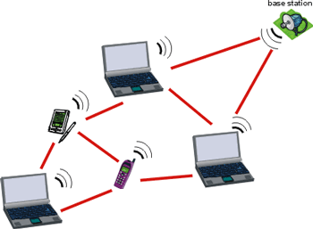
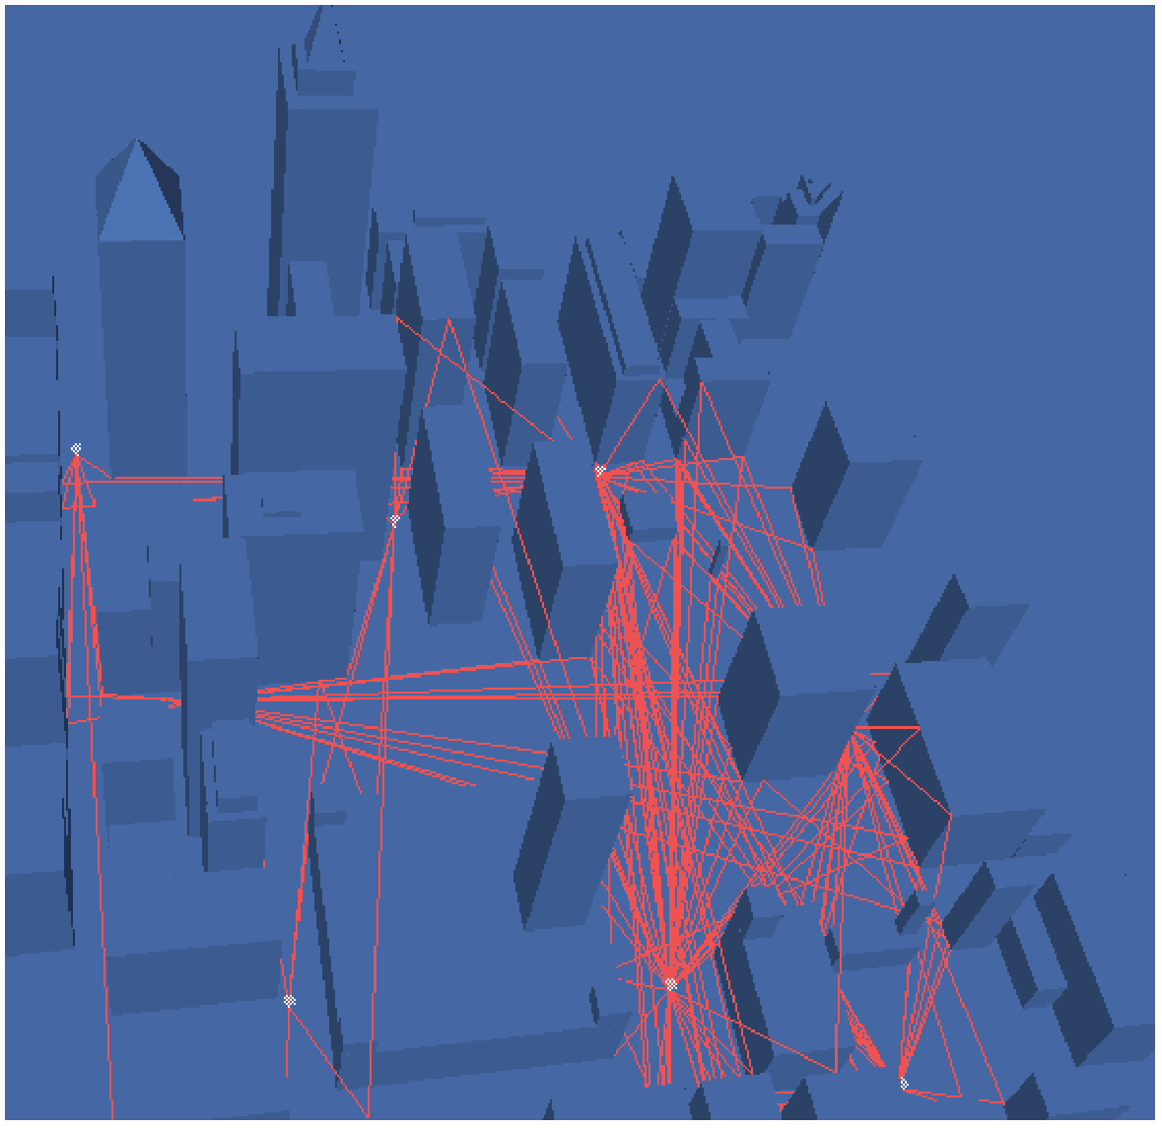
Example Ad hoc Networks
Mobile devices (laptop, PDAs)
Vehicular Networks on Highways
Hybrid urban ad hoc network (vehicular, pedestrian, hot spots,…)

Slide 9
What are characteristics of ad hoc vs. wired nets?
mobility and dynamics
higher BER and losses
power-constraints
infrastructure-less
Scale
Continuous change of location (addressing?) [wired is physically based]
Connectivity function of relative positions, radio power. May be asymmetric. (spatial vs. relational graph)
other?...

Slide 10
Implications of the Ad hoc environment on protocols?
Many routes may become invalid without ever being used
Protocols need to deal with higher losses and more dynamic environment
Need resource discovery and rendezvous mechanisms (no DNS or AS-based routing hierarchy)
Others…

Slide 11
Implications (contd.)
Unicast routing:
table-driven (LS & DV) vs. on-demand (DSR, AODV)
possible multi-path routing for increased robustness
Multicast routing
use of meshes instead of trees
Geographic routing
location-based routing
Security:
No notion of secure gateways or firewalls
Distributed, dynamic, scalable security. Harder!
Others … (loose hierarchy)

Slide 12
Sensor nets vs. ad hoc nets
mobility!
security!
node capabilty and power-constraints!
data-centric nature (vs. human/node centric)
mission/application specific
sensors may be dispensable

Slide 13
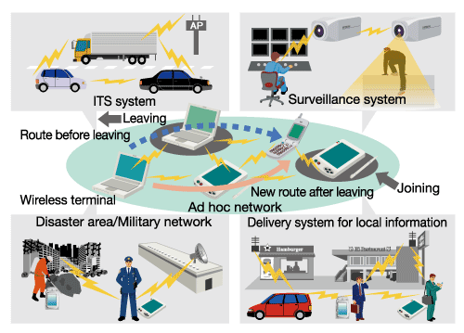
Networked Mobile Societies Everywhere, Anytime
Transportation/Vehicular Networks
Sensor Networks
Disaster & Emergency alerts
Mobile Ad hoc, Sensor and Delay Tolerant Networks

Slide 14
Topics
What is included in the "Ad Hoc Networking" book?
Edited chapters by the original authors on:
Unicast routing for ad hoc networks (DSDV, DSR, AODV/MAODV, TORA),
cluster-based routing and hierarchy,
zone routing (ZRP),
efficient link-state/broadcast.

Slide 15
Topics (contd.)
What is not included in the book but may be covered in class?
Multicast routing for ad hoc networks
Geographic (location-based) routing
Mobility modeling
Resource discovery.
Other topics (that are not specific to ad hoc networks) include:
Small worlds - peer-to-peer networks
IP mobility - STRESS.

Slide 16
General Network Design Framework

Slide 17
Network Protocol Architecture Methodology
Define the design space/domain parameters (the target environment)
Design requirements
Scale: #users, #systems, #sessions or calls
Reliability (availability)
Robustness (proper operation in presence of failure)
Performance: throughput, delay, jitter, overhead, etc.
Environment:
Topology (LAN, WAN) and connectivity
Characteristics of media:
wireless (high BER) vs fiber, mobile vs static, etc.
Demand, traffic, applications

Slide 18
Design: determine initial parameters of the network or/and protocol
Specification: state/stipulate clearly, crisply and formally, the rules that govern the operation of the network or protocol
Representation:
Finite state machine (FSM), pseudo code, English!
Observation:
Much of the spec deals with failures/anomalies
Most protocols (esp. network/mac layer) do not have clear robustness performance claims !
How can we evaluate/test them?

Slide 19
Evaluate the design:
Evaluation criteria
Performance (e.g., overhead, response time, throughput)
Correctness (e.g., absence of deadlocks or duplicates)
Evaluation/modeling methodology
Analysis (mathematical model) [e.g. blocking/cell delay in 1 switch]
Simulation
Hybrid [e.g. # of retransmissions of 100 TCP connections over 1000 node network]

Slide 20
Elements of Network Evaluation Studies*
Evaluation metrics:
correctness, performance [need clear definition]
Evaluation Methodology:
Analytical (queuing theory)
Network simulation (e.g., VINT/NS)
FSM search (e.g., STRESS)
Experimentation/measurements
Analysis of results and conclusions
* These are extremely important elements to define for the projects

Slide 21
Birds-Eye View: Research in the Mobile Networking Lab at UFL
Architecture & Protocol Design
Methodology & Tools
Robust Geographic Wireless Services (Geo-Routing, Geocast, Rendezvous)
Test Synthesis (STRESS)
Query Resolution in Wireless Networks (ACQUIRE & Contacts)
Protocol Block Analysis (BRICS)
Gradient Routing (RUGGED)
Mobility Modeling
(IMPORTANT)
Multicast-based Mobility (M&M)
Worms, Traceback in Mobile Networks
Behavioral Analysis in Wireless Networks
(IMPACT & MobiLib)
Mobility-Assisted Protocols (MAID)
Socially-Aware Networks (AWARE)
iTrust, iCast (profile-cast), iTest

Slide 22
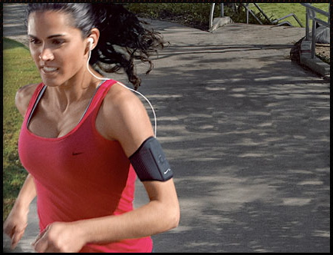
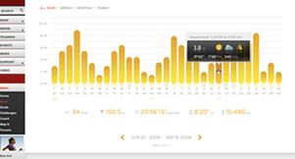
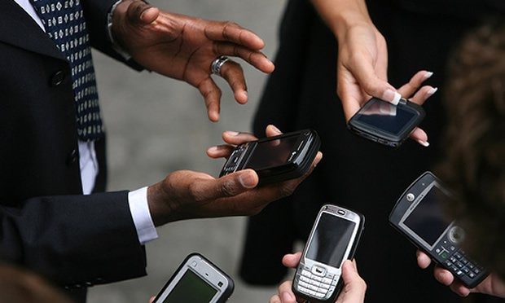
Emerging Behavior-Aware Services
Tight coupling between users, devices
Devices can infer user preferences, behavior
Capabilities: comm, comp, storage, sensing
New generation of behavior-aware protocols
Behavior: mobility, interest, trust, friendship,…
Apps: interest-cast, participatory sensing, crowd sourcing, mobile social nets, alert systems, …
New paradigms of communication?!

Slide 23
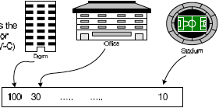
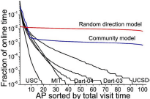
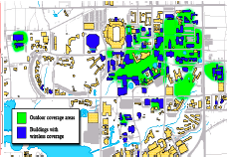
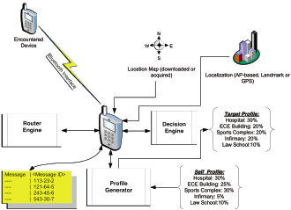
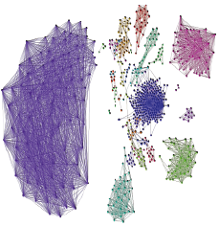
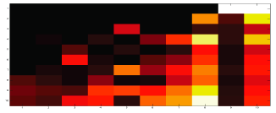
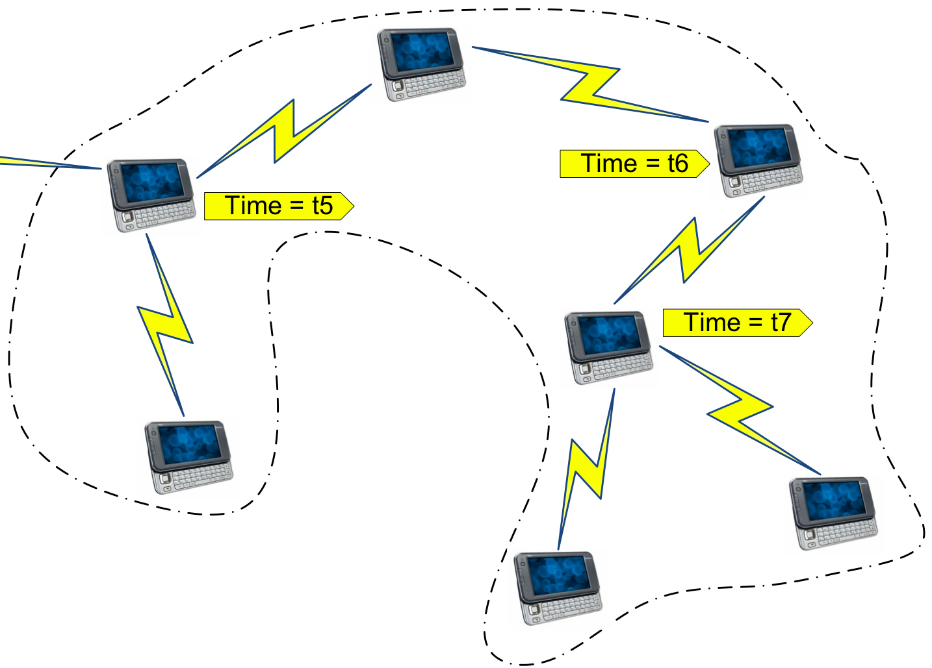
The TRACE framework
MobiLib
Analyze
Trace
Represent
Employ
(Modeling, Protocol Design)
Characterize, Cluster

Slide 24
Possible Projects: Mobility modeling:
Suggest a new mobility model and study its effects on a class of ad hoc networking protocols
Suggest a new mobility metric and use it to measure and study characteristics of mobility models and ad hoc networking protocols
Study effects of different mobility models on various ad hoc networking protocols, including (but not limited to) ad hoc:
unicast routing (e.g., DSR, DSDV, AODV, TORA, etc.)
multicast routing (e.g., ODMRP, CAMP, MAODV, etc.)
geographic routing (e.g., Geocast, GPSR, Grid/GLS, GeoTora)
hierarchical routing (e.g., ZRP, LANMAR, cluster-based, etc.)
others (Mobility-assisted protocols: EASE, FRESH, MARQ..)
Use stress-like approach to synthesize worst-case mobility scenarios
Helpful references: papers on IMPORTANT, BRICS, PATHS, MAID, IMPACT, MILMAN, Stress papers,… EASE/FRESH, Mobility increases...

Slide 25
Mobility Modeling and Analysis (contd.)
Use the mobility library of traces (MobiLib)
To analyze and understand characteristics of realistic mobility
Compare realistic (trace-based) mobility to ‘synthetic’ mobility models
Construct new models that are trace-based and extract their parameters from the traces
Contribute to extending the mobility library
By collecting traces of mobility based on surveys, observations, or other methods (with cis6930, ee555 students, etc.)
Are there fundamental characteristics of WLAN traces that do not change with technology (e.g., they apply to future ad hoc networks)?
Study human mobility/behavior for non-wireless traces or non-network traces and compare the characteristics
Suggest another way to investigate such question
References: IMPACT, MAID, other trace pprs, … TVC, Mining Behavioral Profiles

Slide 26
Context & Socially-aware Networks, Services & Apps
New services in encounter-based networks:
Peer-to-peer mobile networks of handhelds
Apps to identify friends, profiles, locations, etc.
Behavioral pattern recognition & prediction
Interest, gender, location & class-based services
Activity, role & trust identification
Message relaying & routing techniques
Network architecture for emergency and education
Refs. Profile-cast, gender-based analysis, predication, visualization posters & papers from lab students …

Slide 27
Resource discovery and query resolution:
Study and analyze a contact-based approach for resource discovery in large-scale ad hoc networks (use detailed simulations in NS-2)
Suggest modifications of ZRP to implement efficient resource discovery
Suggest ways in which (partial or approximate) geographic information can improve contact-based architectures
Suggest ways in which contact-based archiectures can improve partial or inaccurate geographic routing
Helpful references: papers on CARD, MARQ, TRANSFER, ACQUIRE, Small large-scale wireless networks, ...

Slide 28
Storage-retrieval and rendezvous:
Suggest ways in which rendezvous regions (RRs) may be used for storage-retrieval in large-scale ad hoc networks
Propose a mixed RRs and contacts architecture for cases of imprecise location information
Compare RRs-based architecture to other approaches (e.g., GHT and Grid) qualitatively and quantitatively
Helpful references: papers on large-scale multicast in ad hoc nets, GHT, data-centric, Grid, Rendezvous Regions…

Slide 29
Geographic/location-based routing with partial or imprecise location information
Measuring and estimating inaccuracies in location measurement techniques (GPS and GPS-less) [this may easily include experimental lab part]
Correctness analysis of geographic/location-based protocols in presence of inaccuracies
Performance analysis of geographic/location-based protocols in presence of inaccuracies
Helpful references: papers on Goecast, Grid, GPSR, GeoTora, GPS-less location estimation , … others

Slide 30
Small worlds & Social Adhoc Networks
Small worlds in Wireless Networks
Show protocols and conditions for achievability and applicability of small worlds in ad hoc networks
Suggest new ways in which small worlds may be used in ad hoc networks
Use "small worlds of trust" as a basis for a security architecture in ad hoc networks
Helpful references: papers/books on small worlds, six degrees of separation, small large-scale wireless nets, BEBA, TESLA, Ariadne, On nodel encounters, …

Slide 31
Network Security for Wireless Networks
Trace-back techniques for Mobile Networks
Develop reasonable models for DoS/DDoS attacks in future ad hoc (potentially mobile) networks
Utilize mobility prediction mechanisms and countermeasures to alleviate such the attacks
Worm/Virus propagation models for wireless networks
Analyze the adequacy of epidemic models for modeling propagation of worms in wireless/mobile networks (e.g., using realistic mobility/encounter models/traces)
Develop defense techniques against such attacks
Examine feasibility of the Vaccine paradigm with counter worms
References: SWAT, ATTENTION, ART, VACCINE, other wireless security papers, … Sapon, Yongjin

Slide 32
Themes of Concentration
Mobile Devices as Human Sensors
Human Society as Sensor Network (Participatory Networking)
Behavior-based Networking & mSocial Nets
Examples:
iCast, Profile-cast
iTrust
iTest
Overall: designing, analyzing and implementing the new killer mobile App!!

Slide 33
Related websites:
www.cise.ufl.edu/~helmy
Teaching: ee499, ee599-03, cis6930 07, 08, 09
nile.cise.ufl.edu/MobiLib, nile.cise.ufl.edu/important
Publications (journals, conferences, book chapters)
Projects:
AWARE project
MARS project
M&M project - STRESS project
VINT project (the network simulator NS/NAM)
PIM project
Lab: nile.cise.ufl.edu

