Slide 1
Outline
Vehicular Networking
Self-driving as Enabler
Vehicular Mobility Modeling
  Planet-Scale Vehicular Mobility (imagery data)
  Systematic Vehicular Simulations (En-Route)
Future Directions
Notes:
V. High level (mainly personal notes) on Vehicular networking and how’s it’s being facilitated and enabled even further via autonomous (or self) driving
Then my vision on designing a new class of services and protocols in the mobile society, and it is data-driven, … I’ll introduce a framework (called TRACE) to realize our data-driven design approach
This is followed by somewhat in-depth discussion of our efforts so far in vehicular mobility measurements and modeling, at planet-scale
Then I’ll talk about what I perceive to be a new communication-paradigm called profile-cast… this may bear a lot of future research in this area

Slide 2
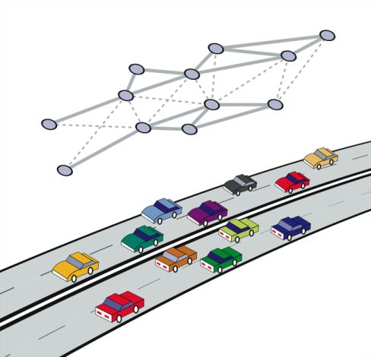
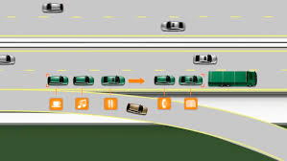
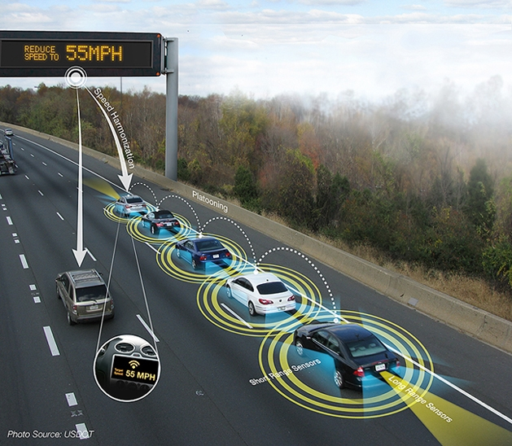
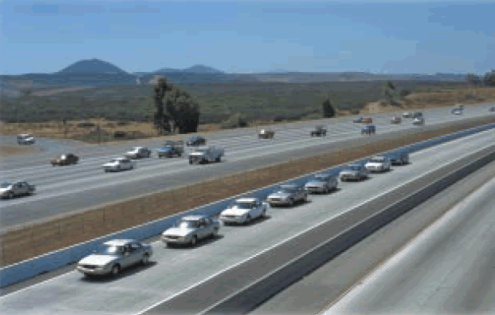
Vehicular Networking: Early Vision
Vehicular Networks on Highways
Platooning: Essential for Future VANET?!
Notes:
In the early days (a decade or even 2 decades ago), the vision started with sketches like these perhaps, where cars on highways and roads form networks and coordinate entry/exit to/from highway ramps, share infotainment data, and use connections to keep a safe distance.
Then there were early experiments with Platooning, I think this was near San Diego, a stretch of intelligent highway, with cars controlling distance, speed, etc. but not lots of dynamics/merging/splitting, etc. And another vision of having the platoon be informed from the road-side units (of speed limits, etc.).
There were certainly many visions and this is just a small sample of it, and not the focus of the talk really. But to see how things are changing in this area.

Slide 3
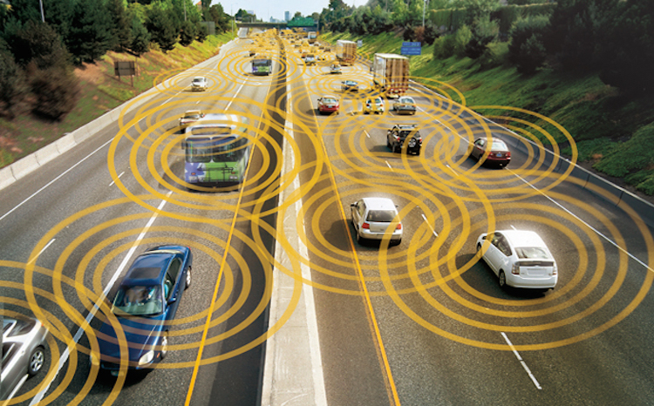
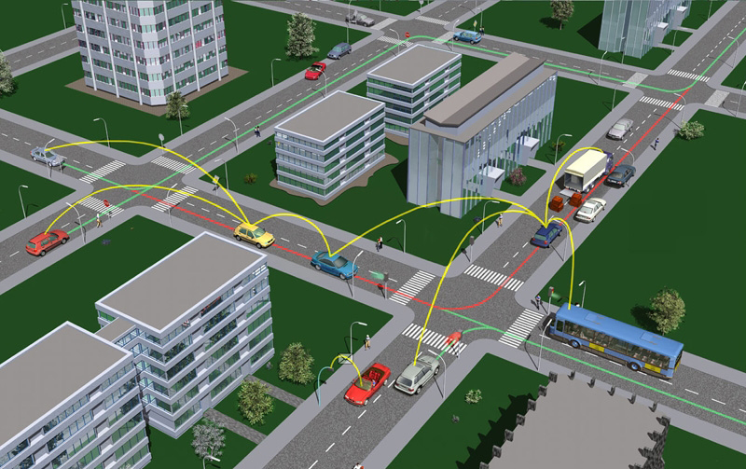
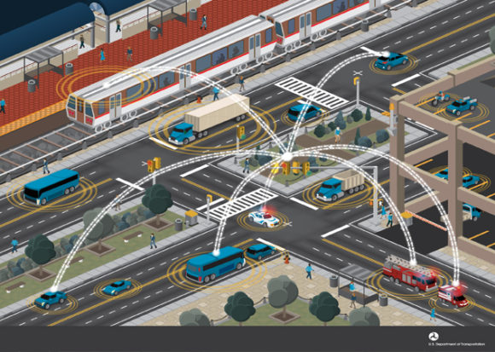
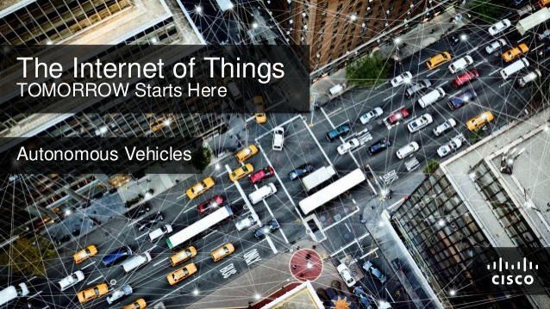
Vehicular Networking: Evolving Vision
Local Vehicular Sensing
Vehicle-to-Vehicle (V2V) Connection
Vehicle-to-Infrastructure Connection
Vehicle-to-Cloud/Edge/Fog Connection
Notes:
The vision evolved over time and parts of it are becoming reality, with extensive sensing being added to cars (without the cars being necessarily connected). Then the connection happens between vehicles (for safety, infotainment, info sharing, etc.). Then the vehicles (cars, buses, trains, etc.) being connected to an infrastructure (remains to be seen what that will be, I expect it will have various architectures). Ironically, this picture was used in a cybersecurity conf (perhaps including the CIA) to exemplify vulnerability of connected-transportation!
Finally, the connectivity is expected to become ubiquitous (and it is doing so in many instances). This is one vision from Cisco and I first heard about this from Flavio Bonomi (one former head of research there, while it existed) at the ACM MobiCom conf. keynote, when he was talking about cloudlets and ‘fog’ (perhaps the red and bright dots there), to form a semi-decentralized (or semi-centralized, depending on how you look at it) localized cloud to serve the vehicular network communication, computation and data access. You notice of course the ‘autonomous’ or self-driving vehicles being an essential part of the Internet of Things (IoT).
So these changes, evolutions and visions cannot be ignored, they’re slowly becoming part of reality, and we need to capture them in our design and evaluation frameworks moving forward.

Slide 4
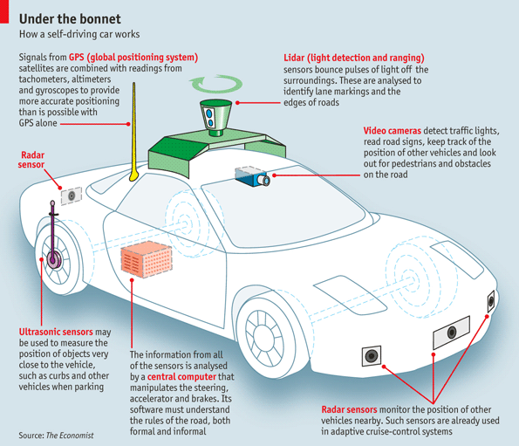
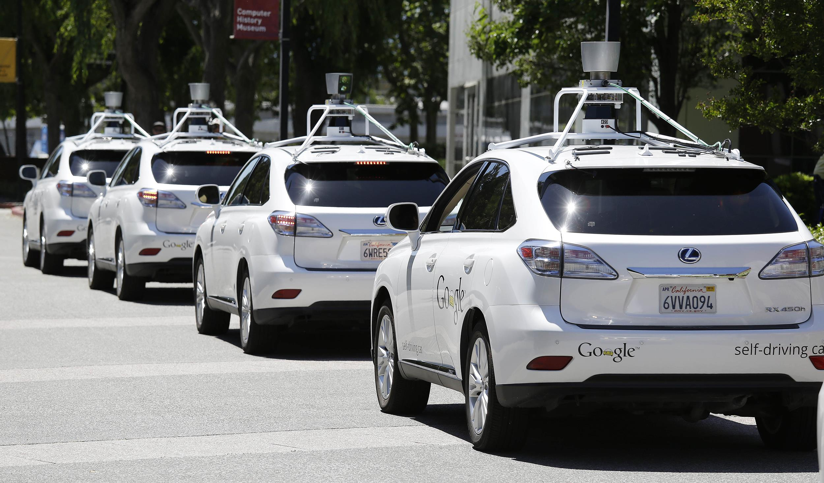
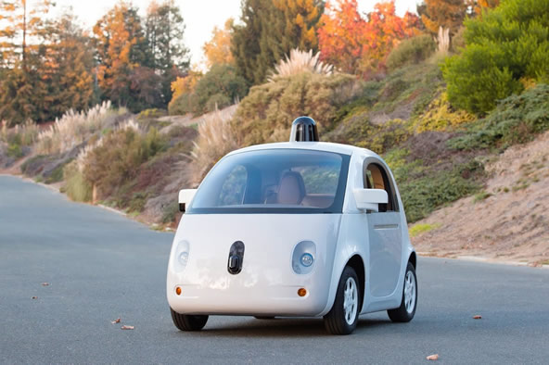
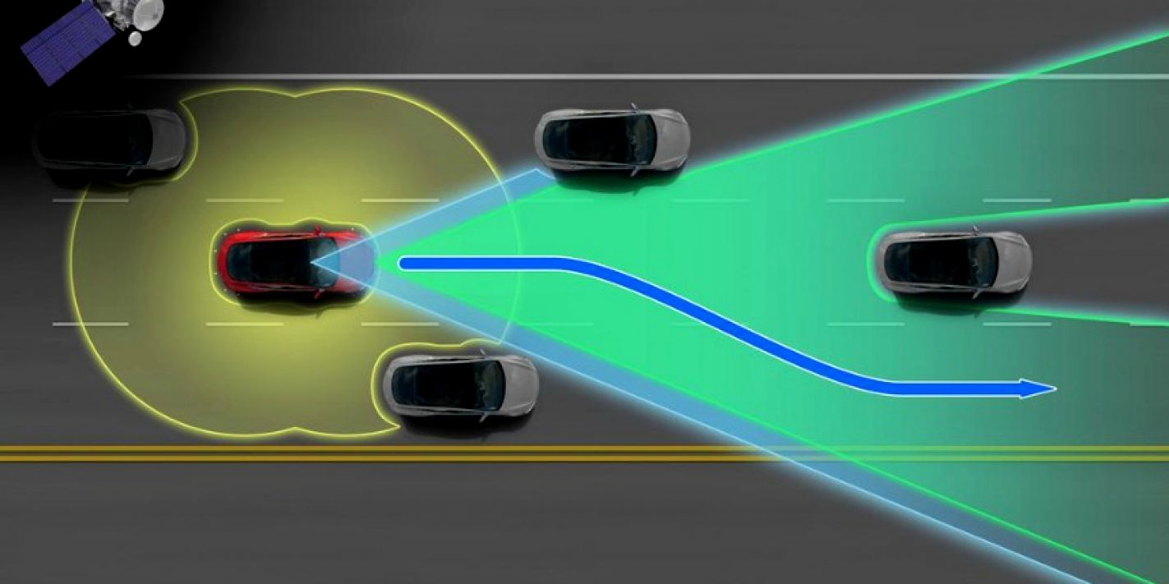
Self-driving as Platoon Enabler
Self-driving Sensors
Self-driving Concept Fleet
Self-driving steering-less Concept
Notes:
So, this is not a talk about autonomy (there are probably several experts in the room on this), but the technology I think will facilitate new modes of vehicular mobility (e.g., they’re likely to enable platoons). So sensors (Lidar, Radar, Cameras, ultra-sound, etc.) coupled with on-board computation and (perhaps) communication, will enable neighborhood awareness and forward vision. We’ve seen some of that for years with the Google fleet, and the (now-discontinued) self-driving car without the steering wheel from Google (that faced a lot of regulatory issues, where regulators are not ready yet for this!).

Slide 5
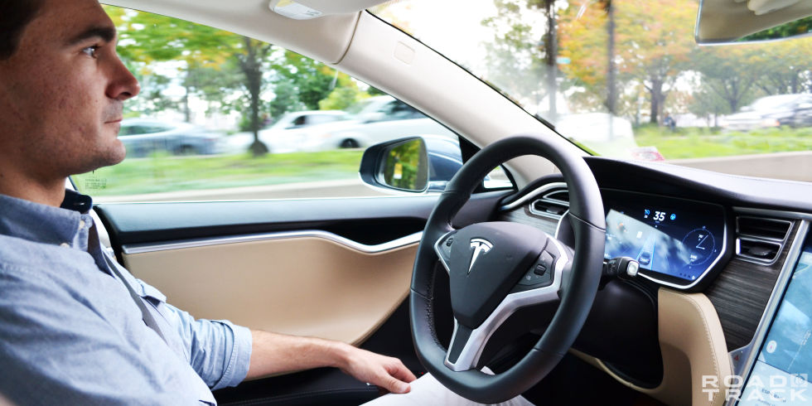
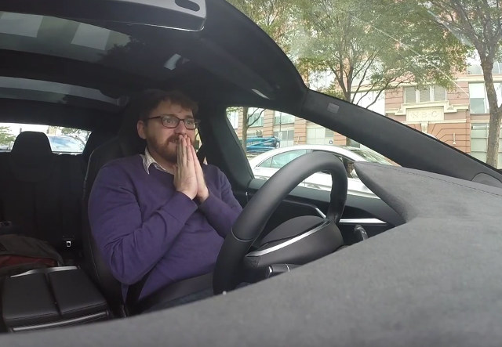
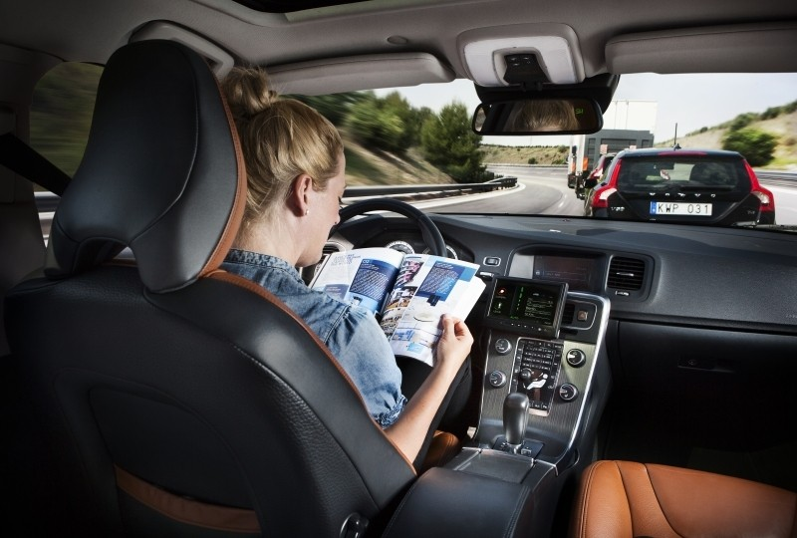
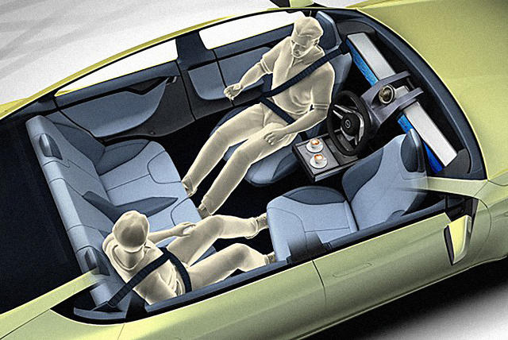
Self-driving Phases!
Attentive
Praying!
Careless
Out-of-the-loop!
Notes:
The self-driving vision is also evolving… and here’s my simplistic illustration of this… first we’re attentive and expect to be responsible (hold the wheel as take over in emergencies), then we’re praying that the car will take the right decisions, then we’re more trusting and careless,… then we’re out of the loop when the car is doing everything and we’re expected to just enjoy the ride and not even face forward (we’re not there yet, but maybe we’re heading there!).

Slide 6

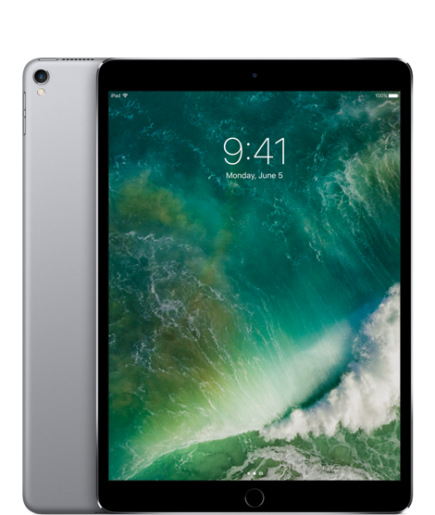
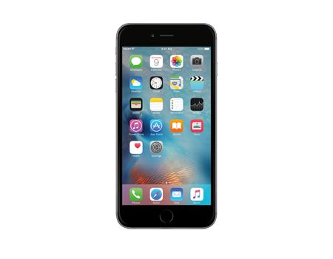
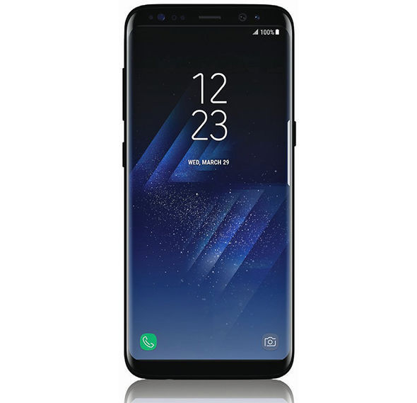
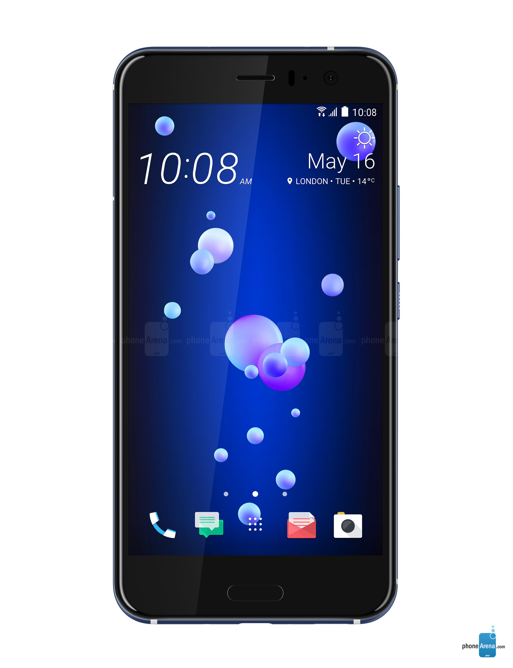
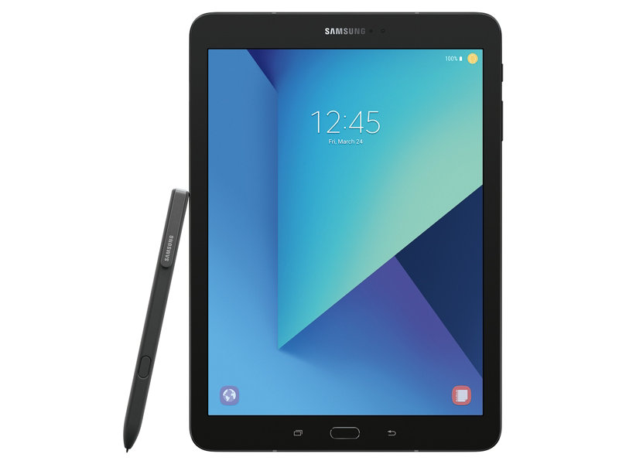
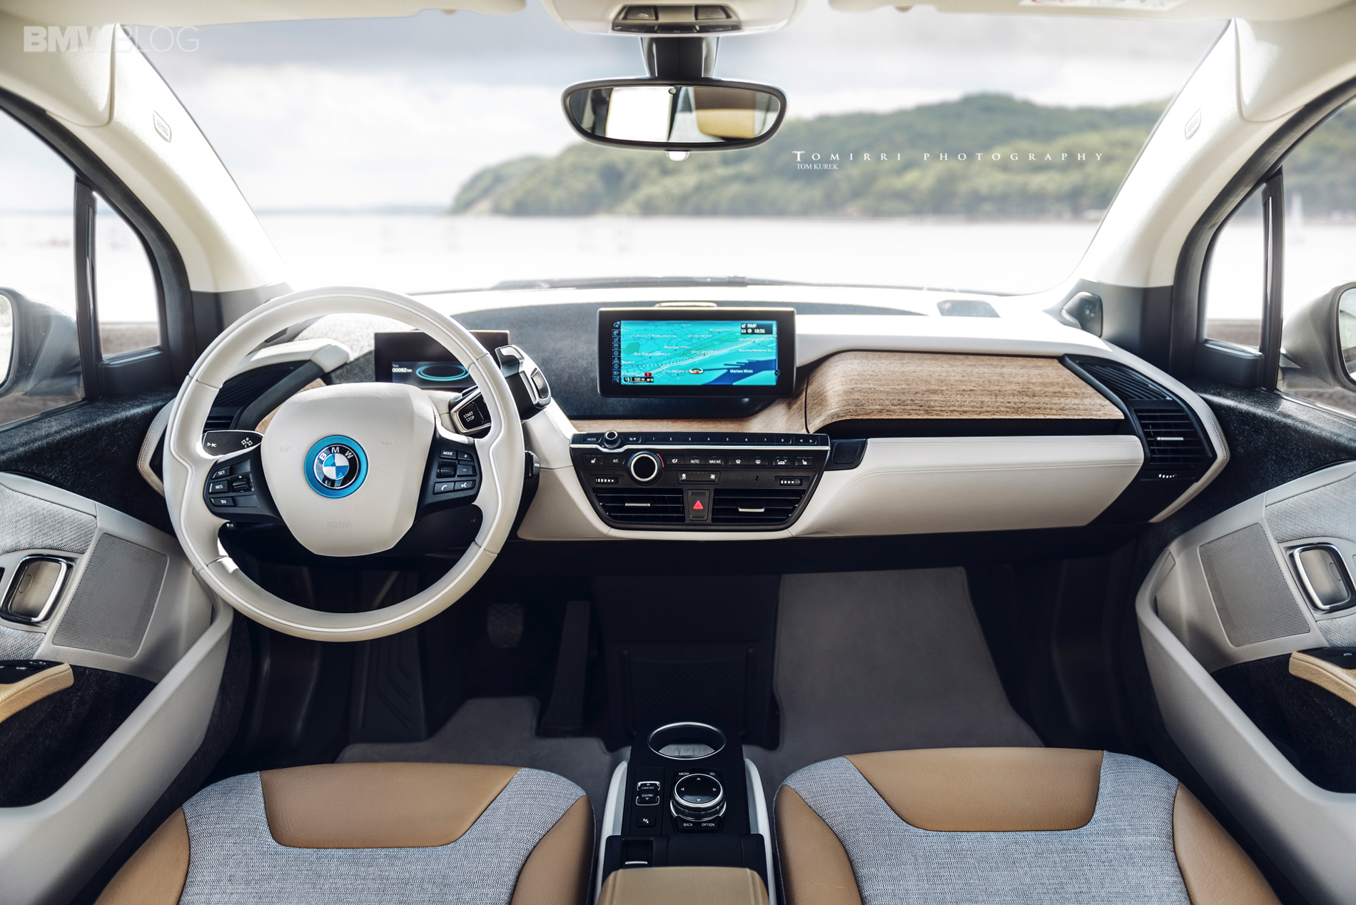
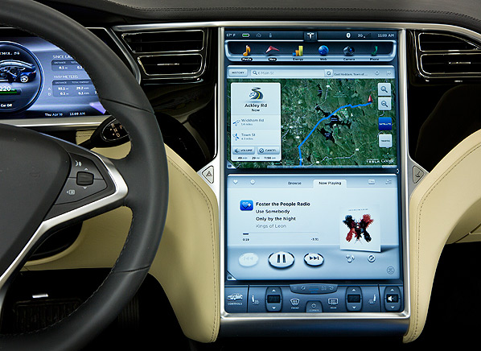
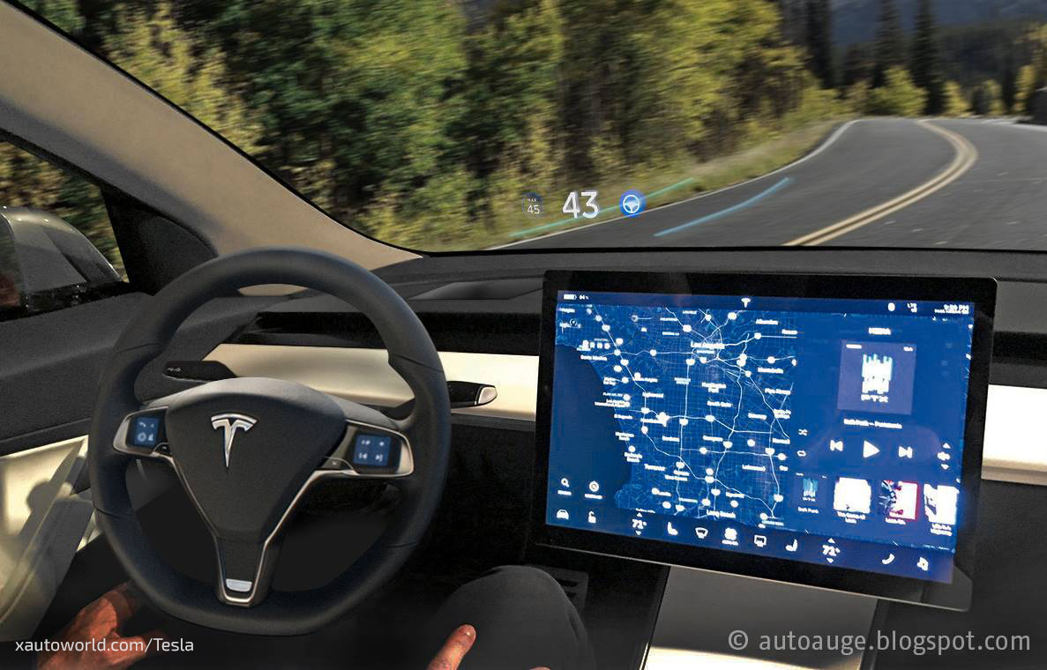
New Generations of Powerful Mobile Devices
Scale in numbers:
~7.37 Billion mobile network subscriptions globally !!
~2.3B smartphones worldwide and growing fast (2017)
Capabilities of mobile devices:
I- Sensors: accelerometer, gyro, proximity, compass, barometer, camera(s), mic, touch, GPS, heart rate, temperature, humidity …
II- Storage:1-6 GB RAM, Internal Mem: 16-128 GB, External Mem: 32-256 GB
III- Computing: quad/octa-core 1-2.5GHz CPU, GPU
IV- Communication: cellular 4G/LTE/5G, WiFi-AP/direct/adhoc, Bluetooth, NFC, DSRC!
Tight coupling between devices & users:
  - Digital breadcrumbs, behavioral signatures (profiles!)
Notes:
Along with these changes on the transportation side, there’s been a revolution in the mobile device side that is evident everyday.
With great growth (really explosion) in smartphone technology, other ultra—portable devices (e.g., tablets), and even connected devices in cars!
The scale has been enormous in terms of numbers, capabilities and integration in everyday life, which created unprecedented coupling between the devices and their users… we (as users) leave digital breadcrumbs and create behavioral signatures (that I refer to as profiles)… and the question is, how can we utilize this data and these profiles to improve future networks and services!

Slide 7
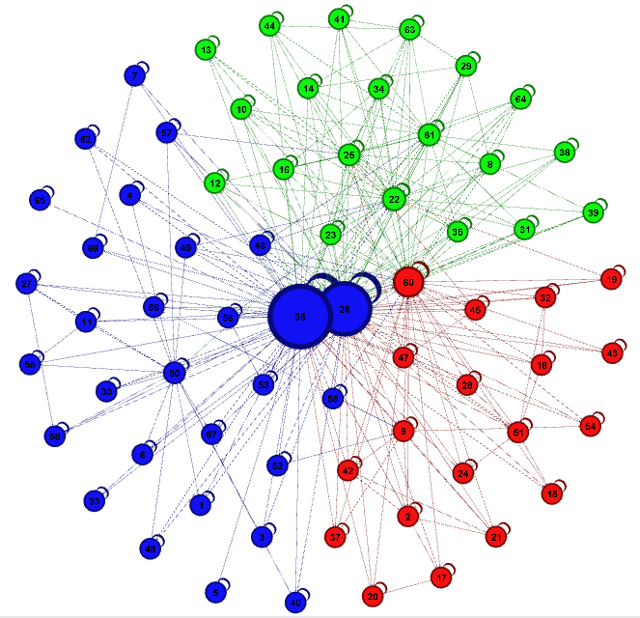
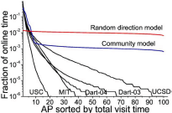

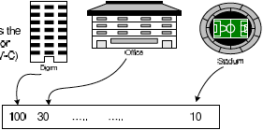
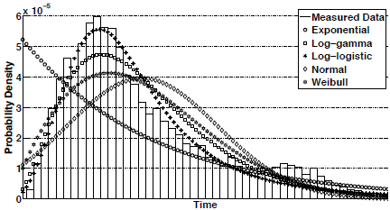
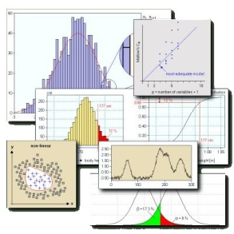
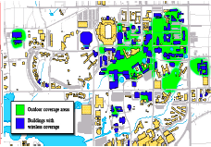
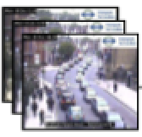
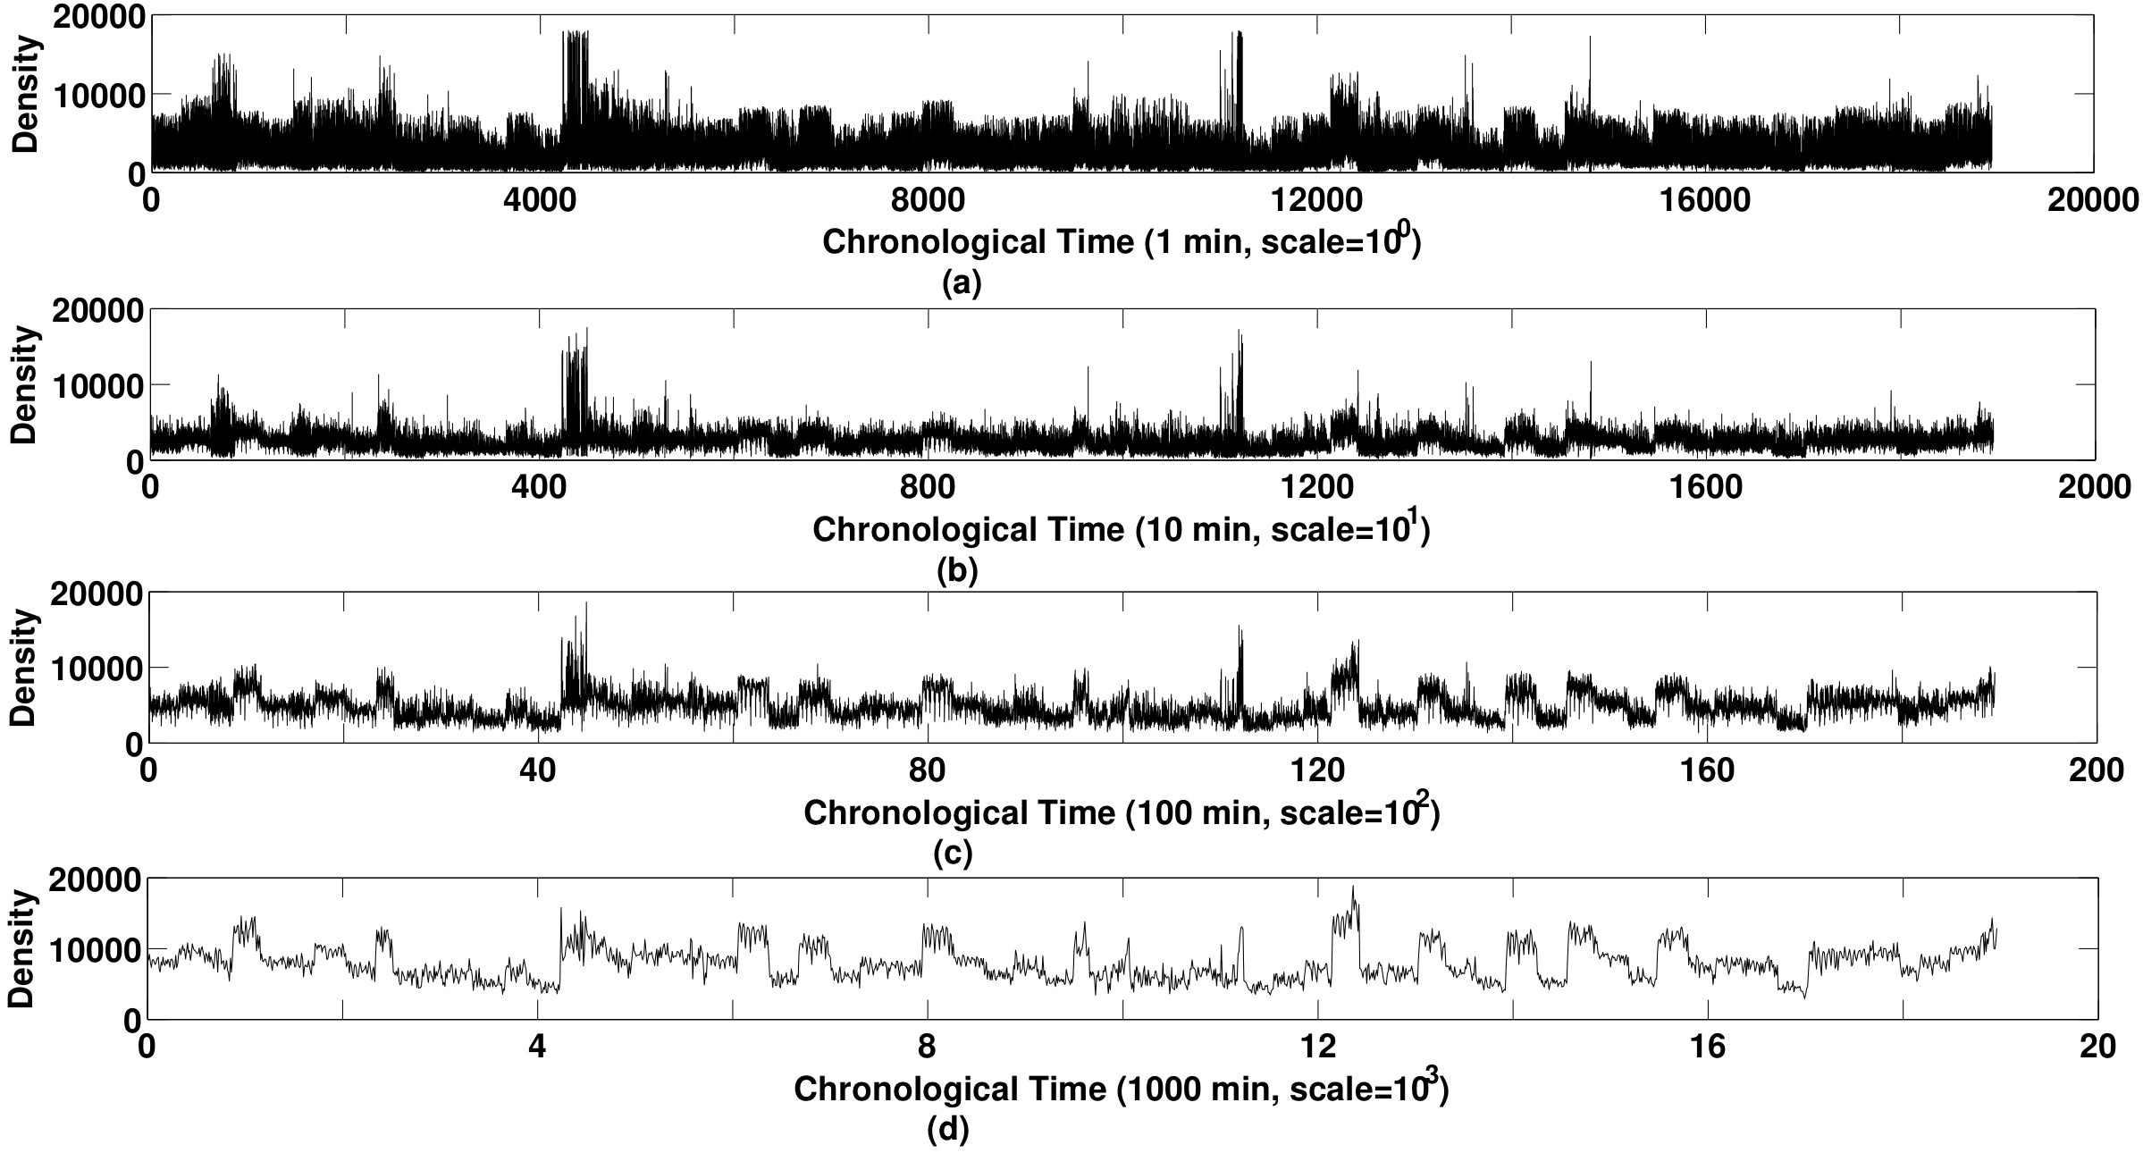
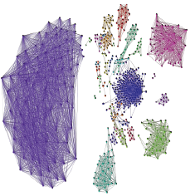
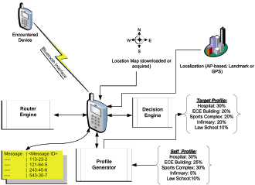
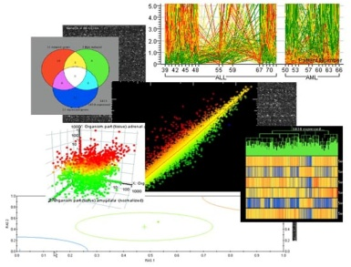
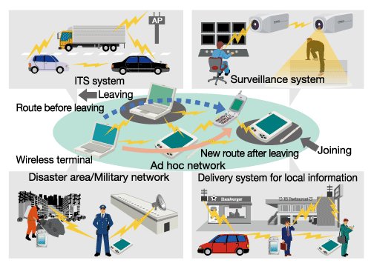
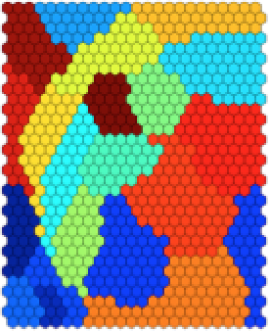

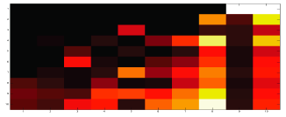
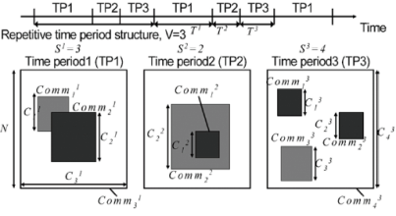
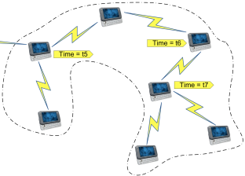



Systematic TRACE framework
Data-driven Mobile Network Mining, Modeling and Design
Billions of traces since 2004
MobiLib
Analyze
Trace
Represent
Characterize, Cluster
Employ(Model, Design)
- Mobility Modeling
- Adhoc & Sensor Network Design

Slide 8
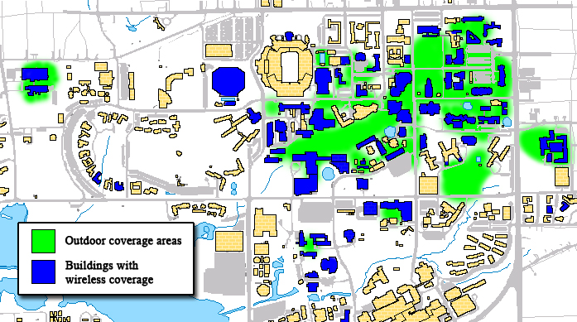
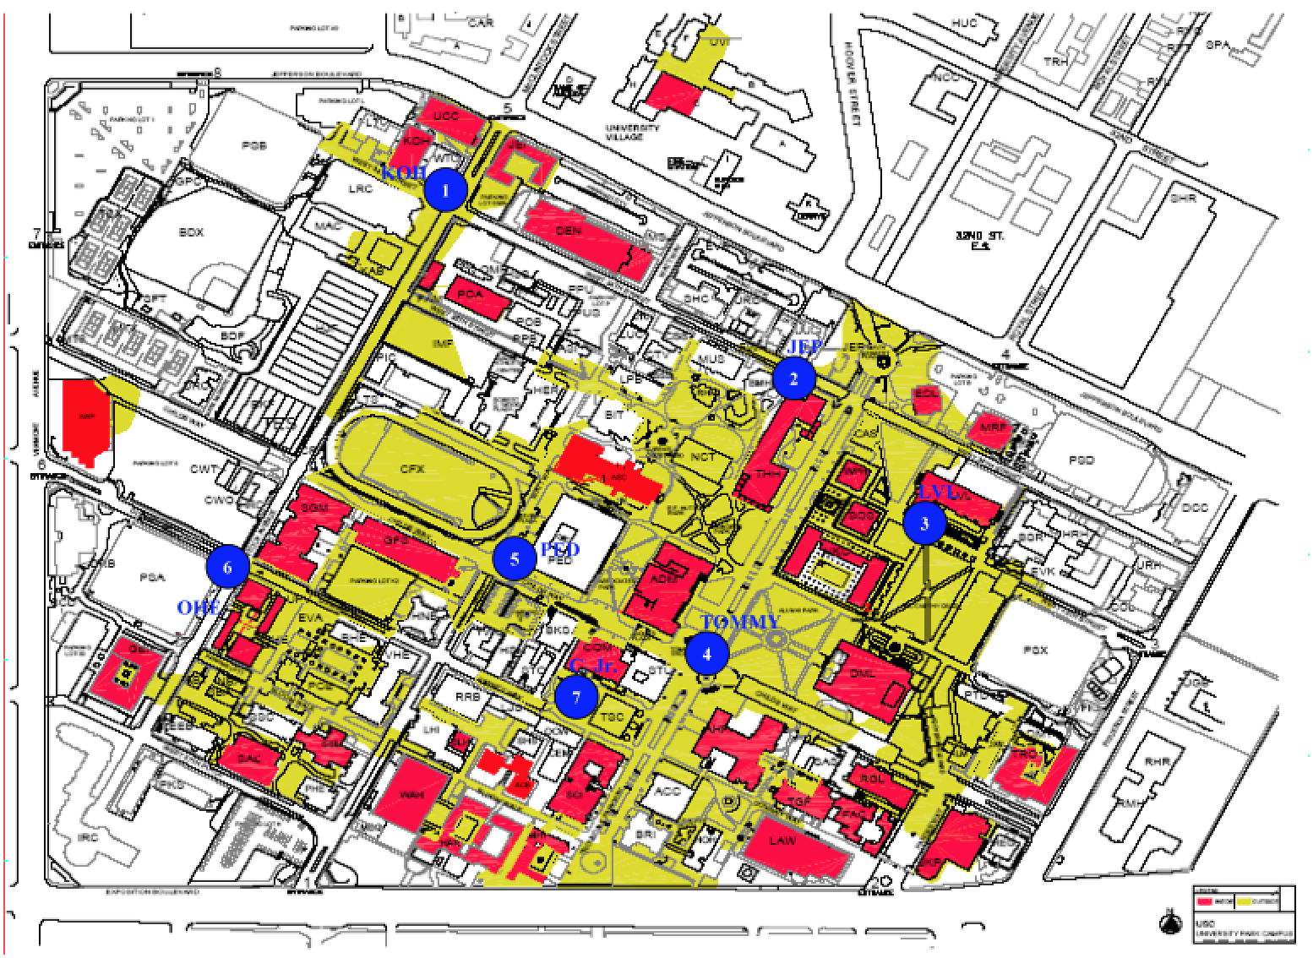
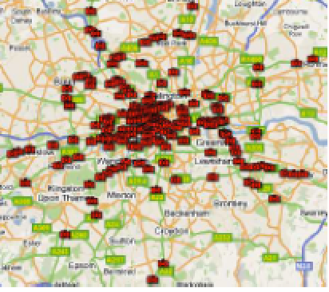
Community-wide Mobile Library
Vision: Library of
  Measurements: campus, street
  Realistic models: behavior, traffic
  Benchmarks – Data mining tools
Available libraries:
  CRAWDAD (Dartmouth, ‘05-)
  Pentland (MIT) reality mining, etc.
  MobiLib (USC & UFL, ’04-) cise.ufl.edu/~helmy/MobiLib (30+TB)
    65+ Traces from: USC, Dartmouth, MIT, UCSD, UCSB, UNC, UMass, GATech, Cambridge, UFL, …
    Tools for mobility modeling (IMPORTANT, TVC), data mining
Types of traces:
  Campuses (WLANs), Conference AP and encounter traces
  Municipal (off-campus) wireless APs,
  Taxi cabs, bus & vehicular traces (rare!)
Trace

Slide 9
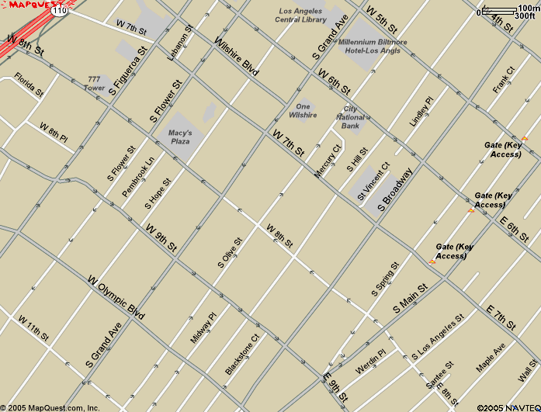
Streets - Manhattan
Synthetic Models, lack trace-driven models: Manhattan (MH) Model (Bai et al. ‘03)

Slide 10
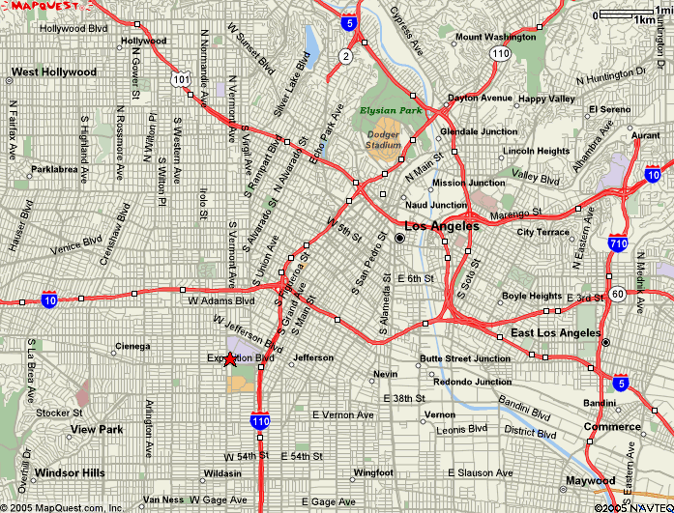
Synthetic Models, lack trace-driven models: Freeway (FWY) Model (Bai et al. ‘03)

Slide 11
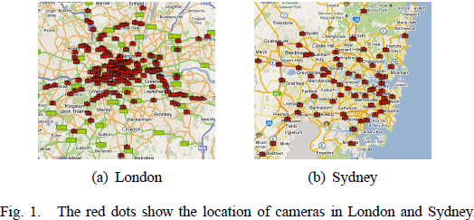
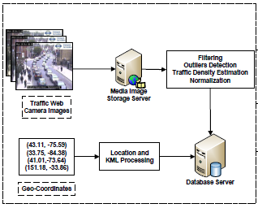
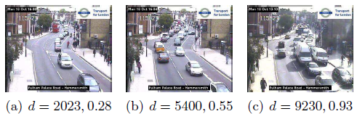
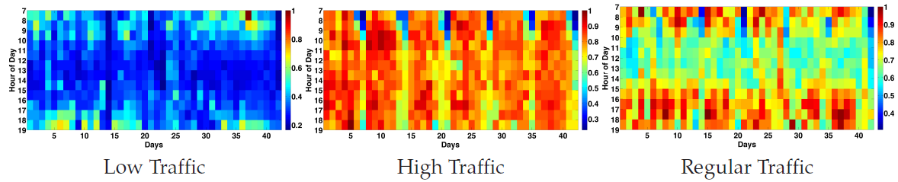
Vehicular Mobility Sensing at Planet Scale
* G. Thakur, P. Hui, A. Helmy
Vehicular Tracing System
Traffic density estimates
- Imagery data from webcams
- Estimate traffic density
- Spatio-temporal analysis, modeling
* IEEE INFOCOM NetSciCom 2012, GI 2013.
* ACM MobiSys HotPlanet 2012, * ACM SIGSPATIAL IWCTS 2013 (Best Paper Award)

Slide 12
Vehicular Traffic Modeling
Memory-less
Heavy-tailed distributions better at modeling empirical values of traffic densities.
Heavy-tailed distributions combined model more than 85% of all 700+ locations.
Heavy-tailed
Notes:
The table shows the 1st, 2nd and 3rd best fits and last two columns shows the models at 3 and 5% deviation.
We find that memory less models failed to capture the statistical properties of empirical distribution and heavy tailed distributions like Weibull are better at modeling the densities.
Btw, many current studies assume exponential or Poisson process.

Slide 13
Scaling of stochastic self-similar traffic
Granularity of traffic is scaled from 1 min to 10, 100, to 1000 mins
Plots are invariant to the chosen time granularity.
Notes:
what does it mean to be invariant ? and why does it is have an effect ? why its important ?
Network performance degrades gradually with increasing self-similarity. The more self-similar the traffic, the longer the queue size. The queue length distribution of self-similar traffic decays more slowly than with Poisson sources.
Self-similar traffic exhibits the persistence of clustering which has a negative impact on network performance.
With Poisson traffic (found in conventional telephony networks), clustering occurs in the short term but smooths out over the long term.
With self-similar traffic, the bursty behaviour may itself be bursty, which exacerbates the clustering phenomena, and degrades network performance. [11]
Many aspects of network quality of service depend on coping with traffic peaks that might cause network failures, such as Cell/packet loss and queue overflow Violation of delay bounds e.g. in video
Worst cases in statistical multiplexing Poisson processes are well-behaved because they are stateless, and peak loading is not sustained, so queues do not fill. With long-range order, peaks last longer and have greater impact: the equilibrium shifts for a while. [12]
In general, a long range dependence is referred when the auto-correlation function decays polynomially as opposed to exponential as a function of time.

Slide 14
Percentage locations with self-similar traffic
Shows distribution of seven estimators of Hurst parameter
Hurst parameter (H) value ranges from 0.5 – 0.9
Over 85% of 700+ locations, have H > 0.5

Slide 15
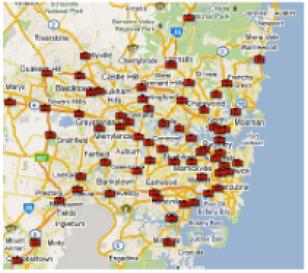


Spatio-Temporal Causality & Traffic Prediction
Sydney 67
camera locations
Causality (Granger) Network can predict traffic intensity 30mins ahead with 3-9% error
* ACM SIGSPATIAL - IWCTS 2013 (Best Paper Award)

Slide 16




En Route Framework
Need a trip model (an OD)!
Need to run simulation!
Need supporting flow and description data!
Traffic Modeling
Dataset
Simulation
Traffic Assignment
Structural Analysis
Measurements
O/D Estimation
Flow
Generation
R. Ketabi, B. Alipour, A. Helmy, IEEE INFOCOM – SmartCity, 2017 (Best Poster Award)
Notes:
Simplif

Slide 17

En Route Framework

Slide 18
En Route Framework (simplified)

Slide 19

En Route Framework ^{(contd.)}
Flow estimation from relative pixel density
  Observance of
  Macroscopic
  Fundamental
  Diagram (MFD)
  on Berkeley data
Notes:
For compatibility with induction loop detectors data, we use flow and occupancy measures.

Slide 20

En Route Framework ^{(contd.)}
Trip Duration Distribution
  Best fit analysis on SF and Beijing using maximum likelihood estimation & distributions (normal, exponential, beta, gamma, lognormal) determines Lognormal as the best-fit to model trip duration time.

Slide 21

En Route Framework ^{(contd.)}
Simulation
    SUMO (Simulation of Urban Mobility)
      Microscopic
      (suitable for individual
      vehicle trace generation)

Slide 22



Simulation Output & Validation
Trip duration follows lognormal distribution.
Number of cars per segment per minute shows an exponential trend (future study planned).
Occupancy distribution of vehicles matches (reasonably well) the original distribution
Further research needed for spatio-temporal scalable simulations, and vehicular profile based services (ride/car sharing, crowd participatory/opportunistic sensing)

