Slide 1
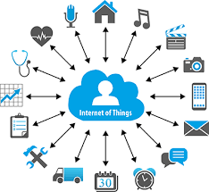
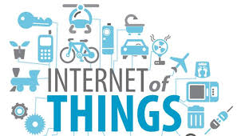
Data-driven Mobility Modeling for Network Evaluation and its Applications

Slide 2
Mobility Modeling?
A good part of this course will be about mobility modeling… so…
What is ‘mobility modeling’?
Definition of ‘Modeling’, what is a ‘Model’?
What is ‘Mobility’?

Slide 3
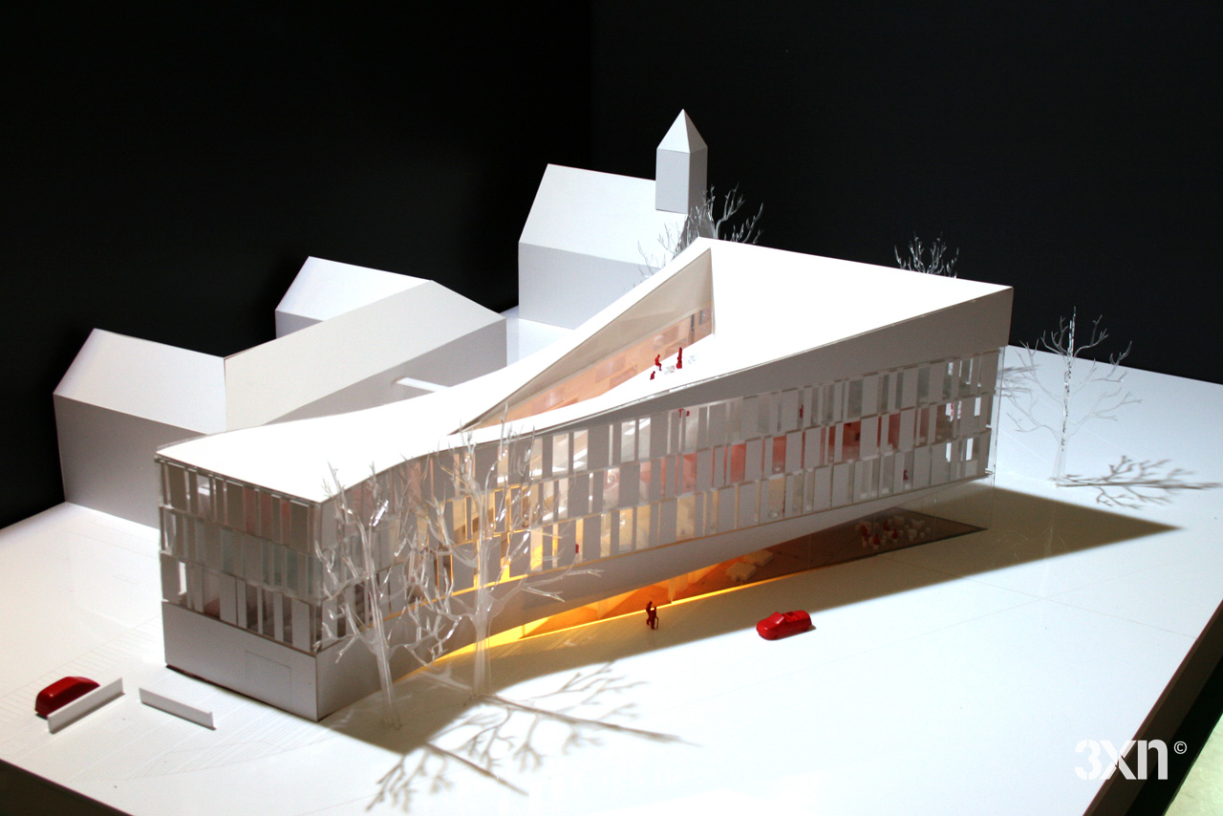
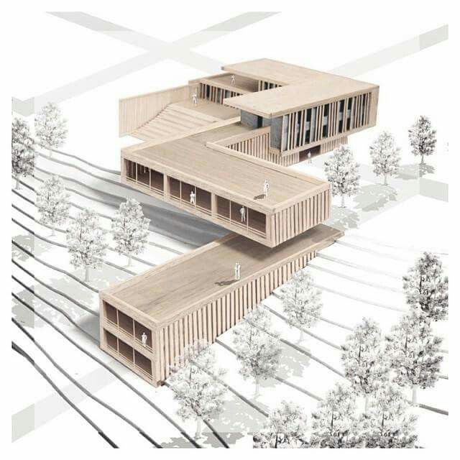
Model?

Slide 4
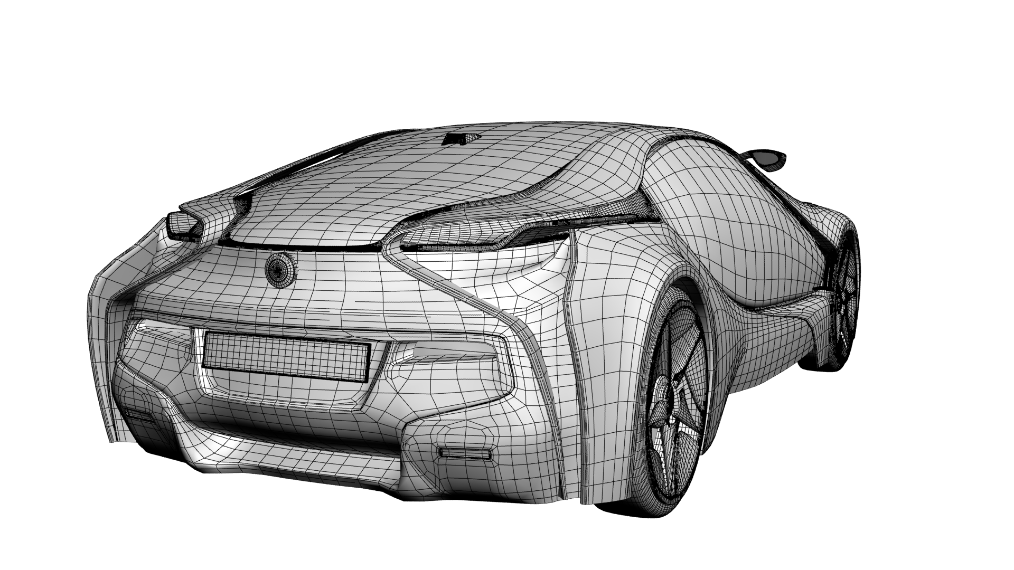
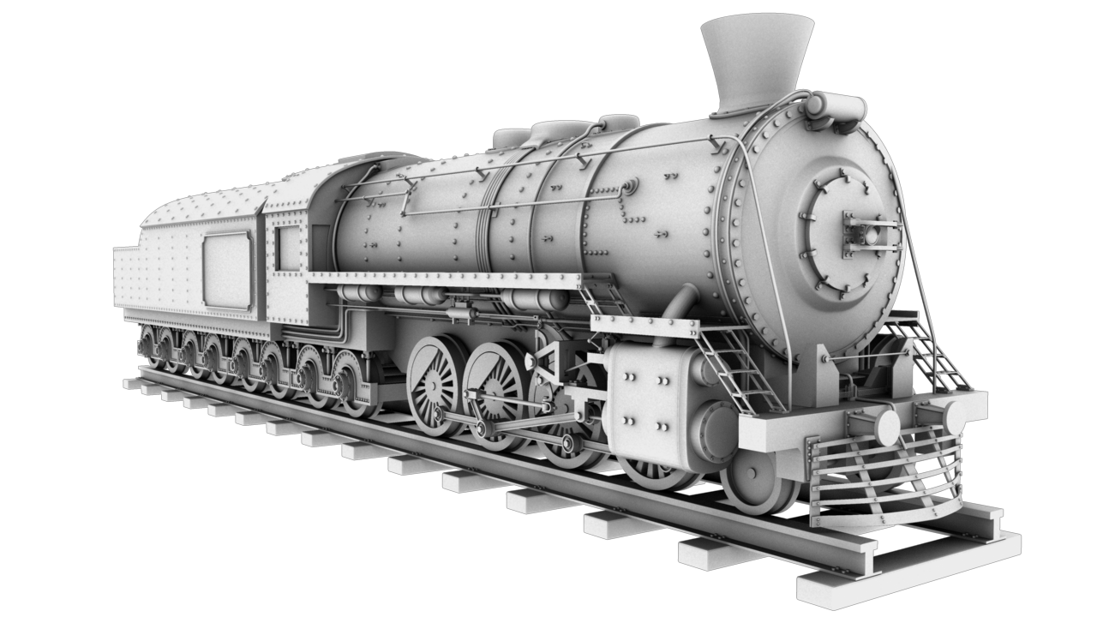
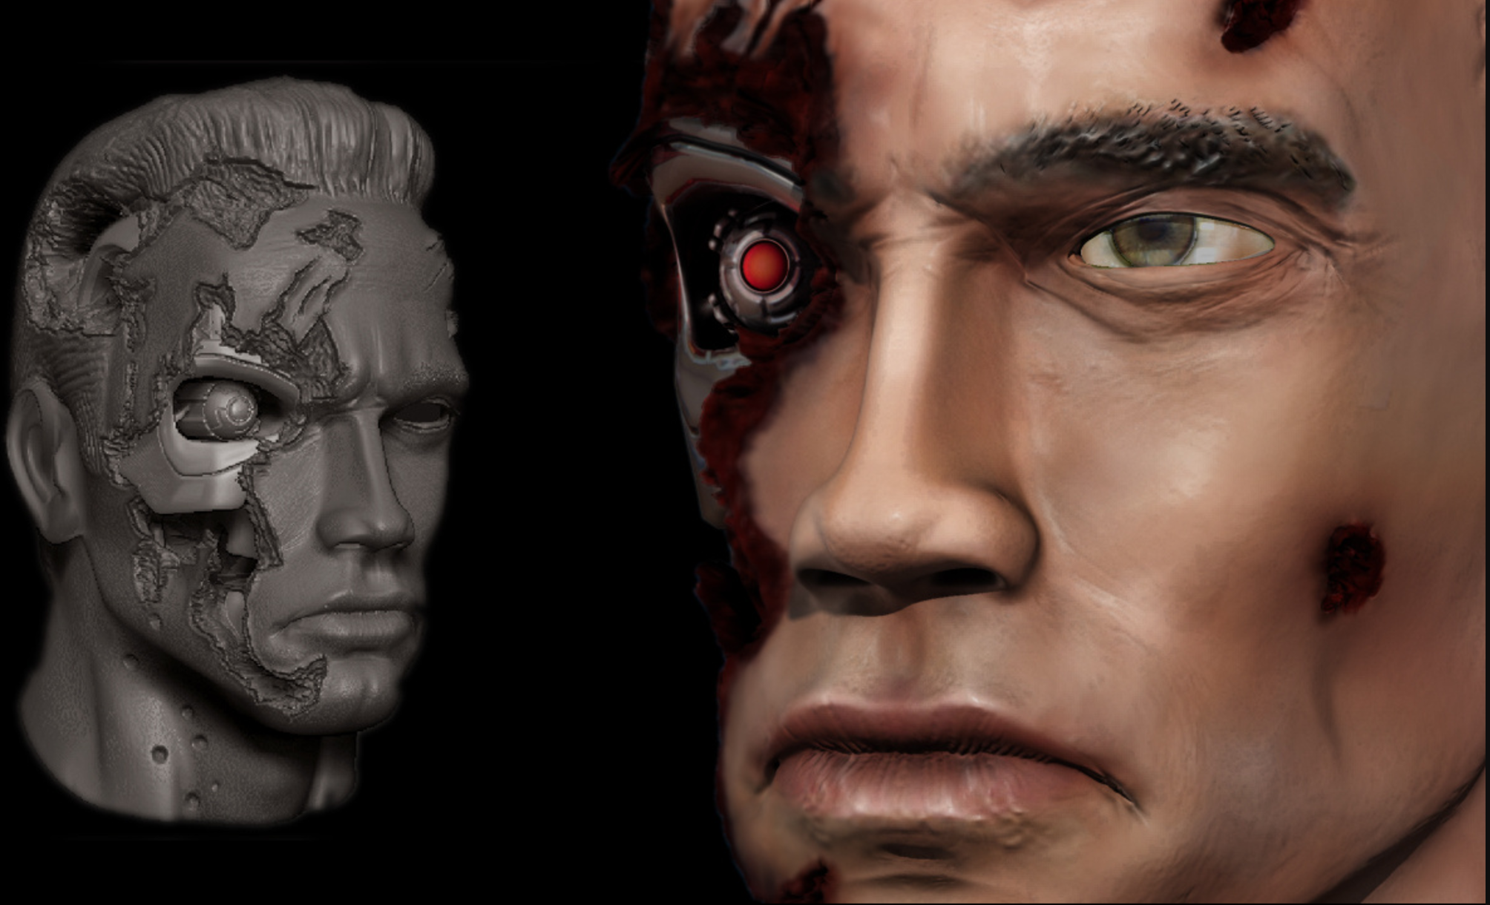
Model?

Slide 5
Modeling Definition (Related!)
Modeling or Model (Merriam-Webster)
A system of postulates, data and inferences presented as a mathematical description of an entity or state of affairs;
A computer simulation based on such a system, as in climate models …
Dictionary.com (Model n., v.)
Simplified representation of system/phenomenon, in sciences or economics, with hypotheses required to describe or explain it, often mathematically.
Simplified representation or description of a system or complex entity, esp. one designed to facilitate calculations and predictions
To simulate (a process, concept, or the operation of a system), commonly with the aid of a computer
in Medicine: In behavior modification, a treatment procedure in which the therapist models the target behavior which the learner is to imitate.
in Science: A systematic description of an object or phenomenon that shares important characteristics with the objector phenomenon. Scientific models can be material, visual, mathematical, or computational and are often used in the construction of scientific theories

Slide 6
Modeling Note
Definition:
Attempting to capture/reproduce important characteristics of real behavior under certain (controllable, variable, etc.) scenarios, within a range of operational conditions, within a margin of error…
it is not reality, and it will deviate from reality…
the question is: When will it deviate and by how much?
Why not just use the traces?
Modeling provides flexibility, rich set of scenarios, endless realities, to simulate, scale, and apply apriori to deployment
nonetheless there is always a question of whether it matches probable realities?

Slide 7
Mobility (Mobile) Definition
Mobility: the quality of being mobile
Webster
capable of moving or being moved : movable
Migratory: a mobile society of nomadic herders
characterized by the mixing of social groups
marked by the use of vehicles for transportation
Dictionary.com
adj. capable of moving or being moved readily.
Digital Technology: pertaining to or noting a cellphone, usually one with computing ability, or a portable, wireless computing device used while held in the hand, as in mobile tablet; mobilePDA; mobile app.
utilizing motor vehicles for ready movement
ability to move physically
Capacity for motion
Focus on and classify movement of people (device users and mobile societies) and vehicles (connected or to-be-connected in the future).

