Slide 1
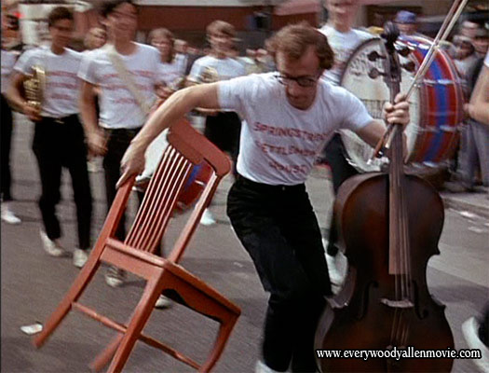
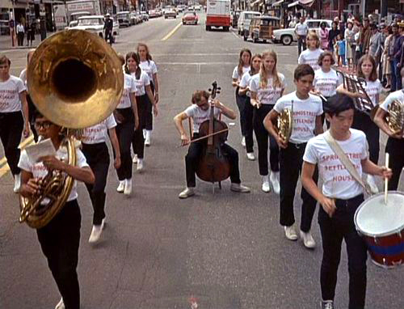
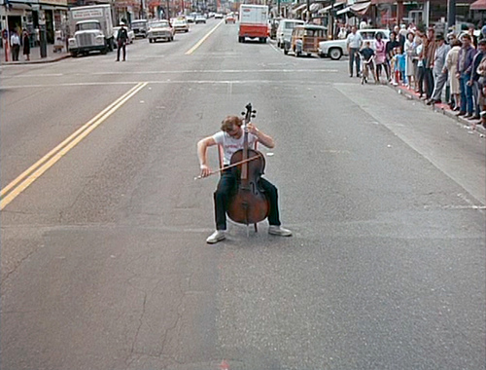
Flutes vs Cellos: Analyzing Mobility –Traffic Correlations in Large WLAN Traces
Cello ‘Mobility’!!
* B. Alipour, L. Tonneto, A. Ding, R. Ketabi, J. Ott, A. Helmy, IEEE INFOCOM 2018

Slide 2

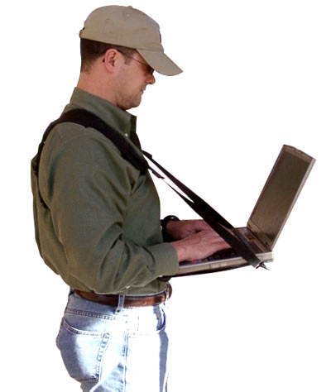
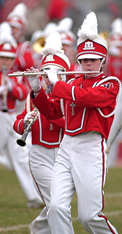
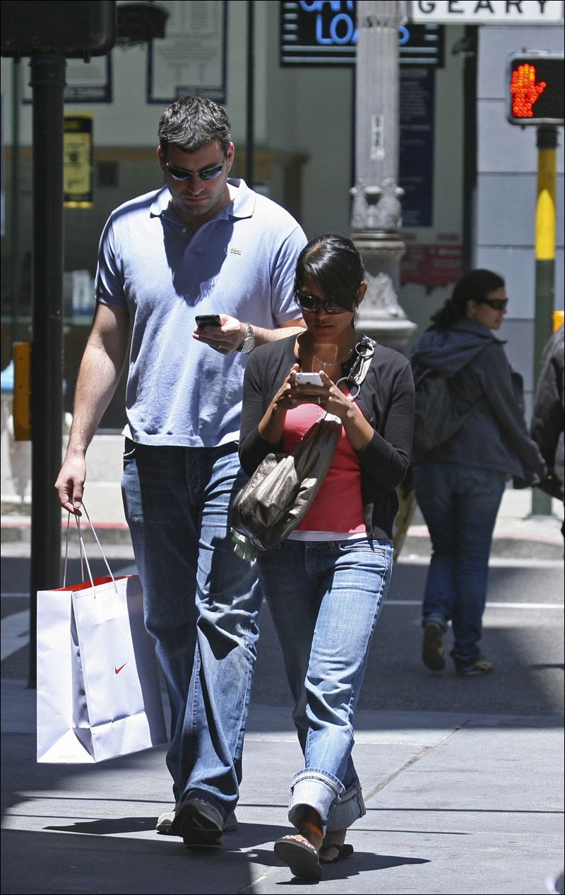
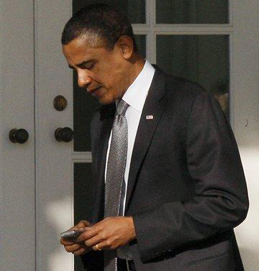
Flutes vs Cellos:
Cellos , Laptops = sit-to-use
Flutes, Smartphones = use-on-the-go

Slide 3
Motivation and Main Goals
Motivation:
  Earlier mobility modeling studies use pre-smartphone WLAN traces (device types not considered)
  Mobility and traffic models developed in isolation
  Mobility-traffic relation rarely (if any) studied across devices
Goals (Main Research Questions):
  (I) How different are mobility and traffic characteristics across device types, time and space?
  (II) What are the relationships / correlations between these characteristics?
  (III) Should new models be devised to capture these differences? And, if so, how?

Slide 4
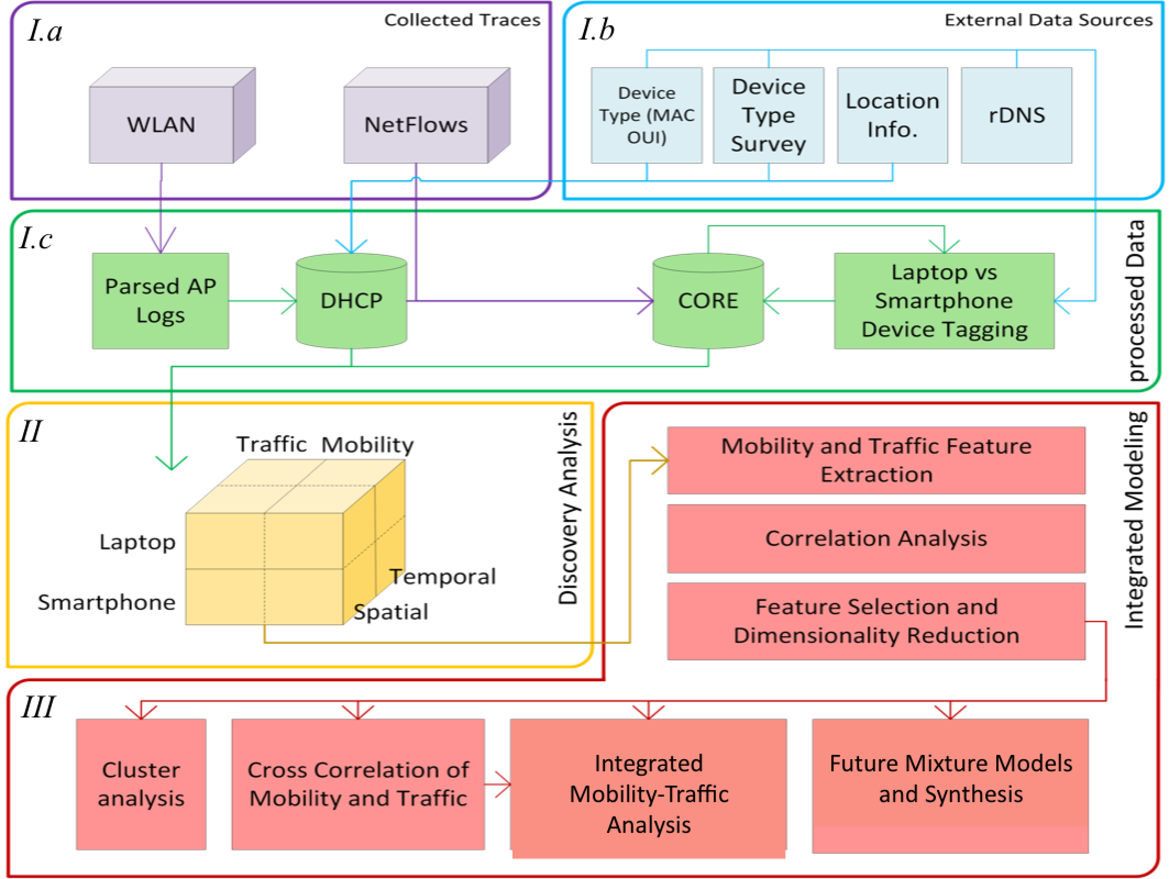
FLAMeS System Overview
(The Framework for Large-scale Analysis of the Mobile Society)

Slide 5
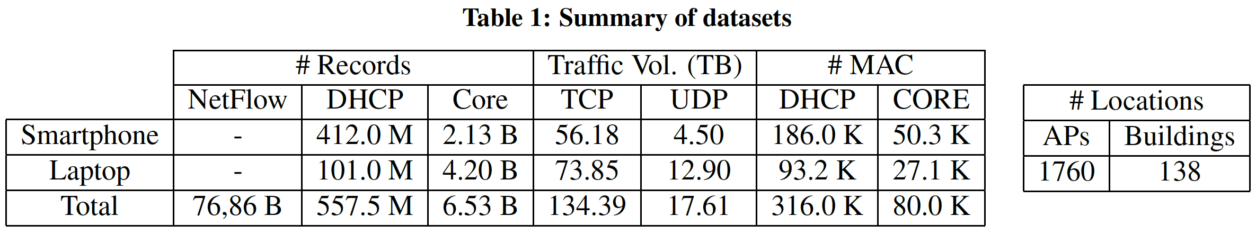
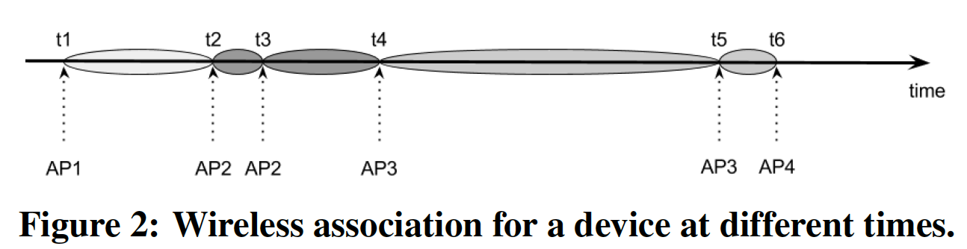
Datasets & Pre-processing:
30TB+, 25days
300GB, 479days
The WLAN logs, collected on university campus, contain wireless association and de-authentication events, for a period of 479 days in 2011-2012. Assuming MAC addresses are unique and unchanged, over 316,000 devices were online at least once.
Associations of a device with different APs at different times. The first session would have the IP given by AP1 and a lease time t₂−t₁ , and so on. (total of 5 sessions in this example) The last association is discarded as we do not know the duration of that IP assignment.

Slide 6
Datasets & Pre-processing (contd.):
NetFlow (top) and AP logs/DHCP (bottom) sample data
Bldg
Rm
Flr

Slide 7
Datasets & Pre-processing (contd.):
Device Classification (Flute or Cello? That’s the question!):
i- Identify a device manufacturer (with OUI) with first 3 octets of the MAC address
ii- Most manufacturers produce one type of device (either laptop or phone).
Some produce both (e.g., Apple), then OUI used for one type is not used for another.
We conducted a survey to help classify 30 MAC prefixes accurately.
Using OUI and survey information, could label 46% of devices (90k cellos, 56k flutes)
[can we get more help from NetFlow?]
iii- Observed over 3k devices (92% flutes) contacting admob.com (ad platform serving mainly smartphones and tablets (i.e. flutes) [augment algorithm]
‘obtain all OUIs (MAC prefix) that contacted admob; if it is unlabeled, mark it as a flute’
Overall, over 270k devices were labeled (180k as flutes):
- in AP logs: covering 86% of the devices
- in NetFlow and 97% in NetFlow traces,
Out of 80k devices in the NetFlow logs, 50 K flutes and 27 K cellos.

Slide 8
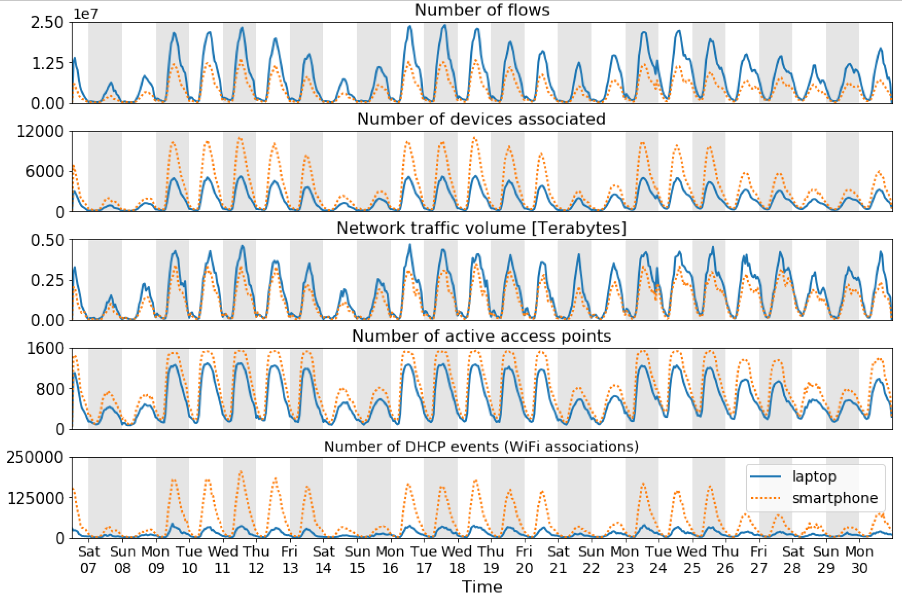
Time series for 25 days in April 2012. Original dataset 30TB+, over 300K devices

Slide 9
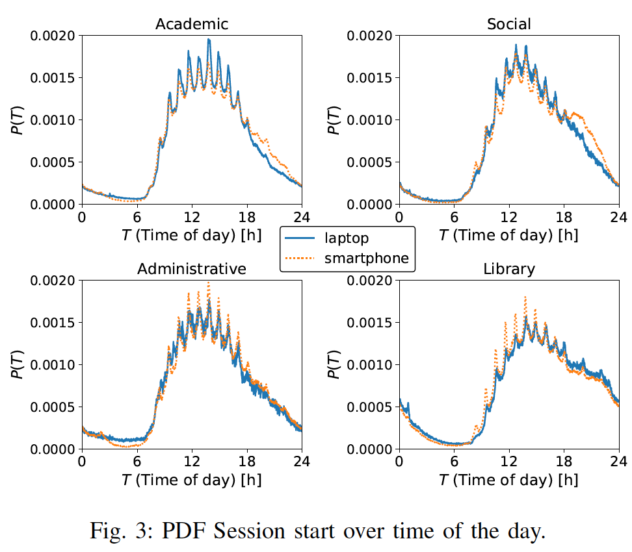
Break
Class

Slide 10
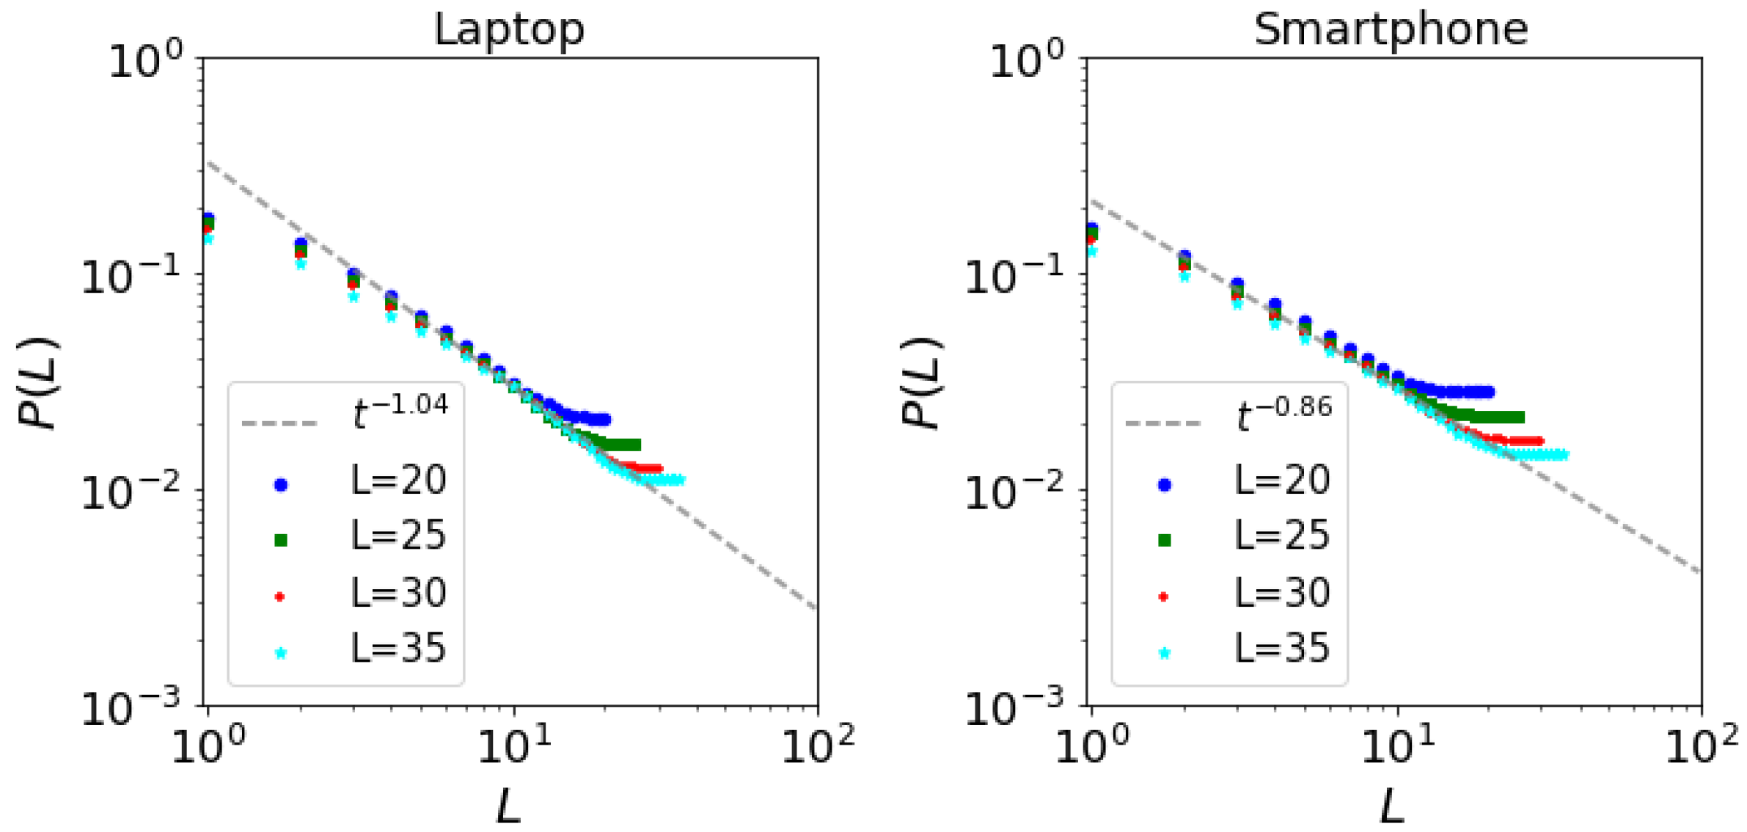
Zipf’s plot on L visited access points for L = 20,25,30,35.
The probability of finding a device at its L-th most visited location is shown in Fig. 7a. When taking buildings as aggregating points for location the values become L^{−1.36} for laptops and L^{−1.16} for smartphones.

Slide 11
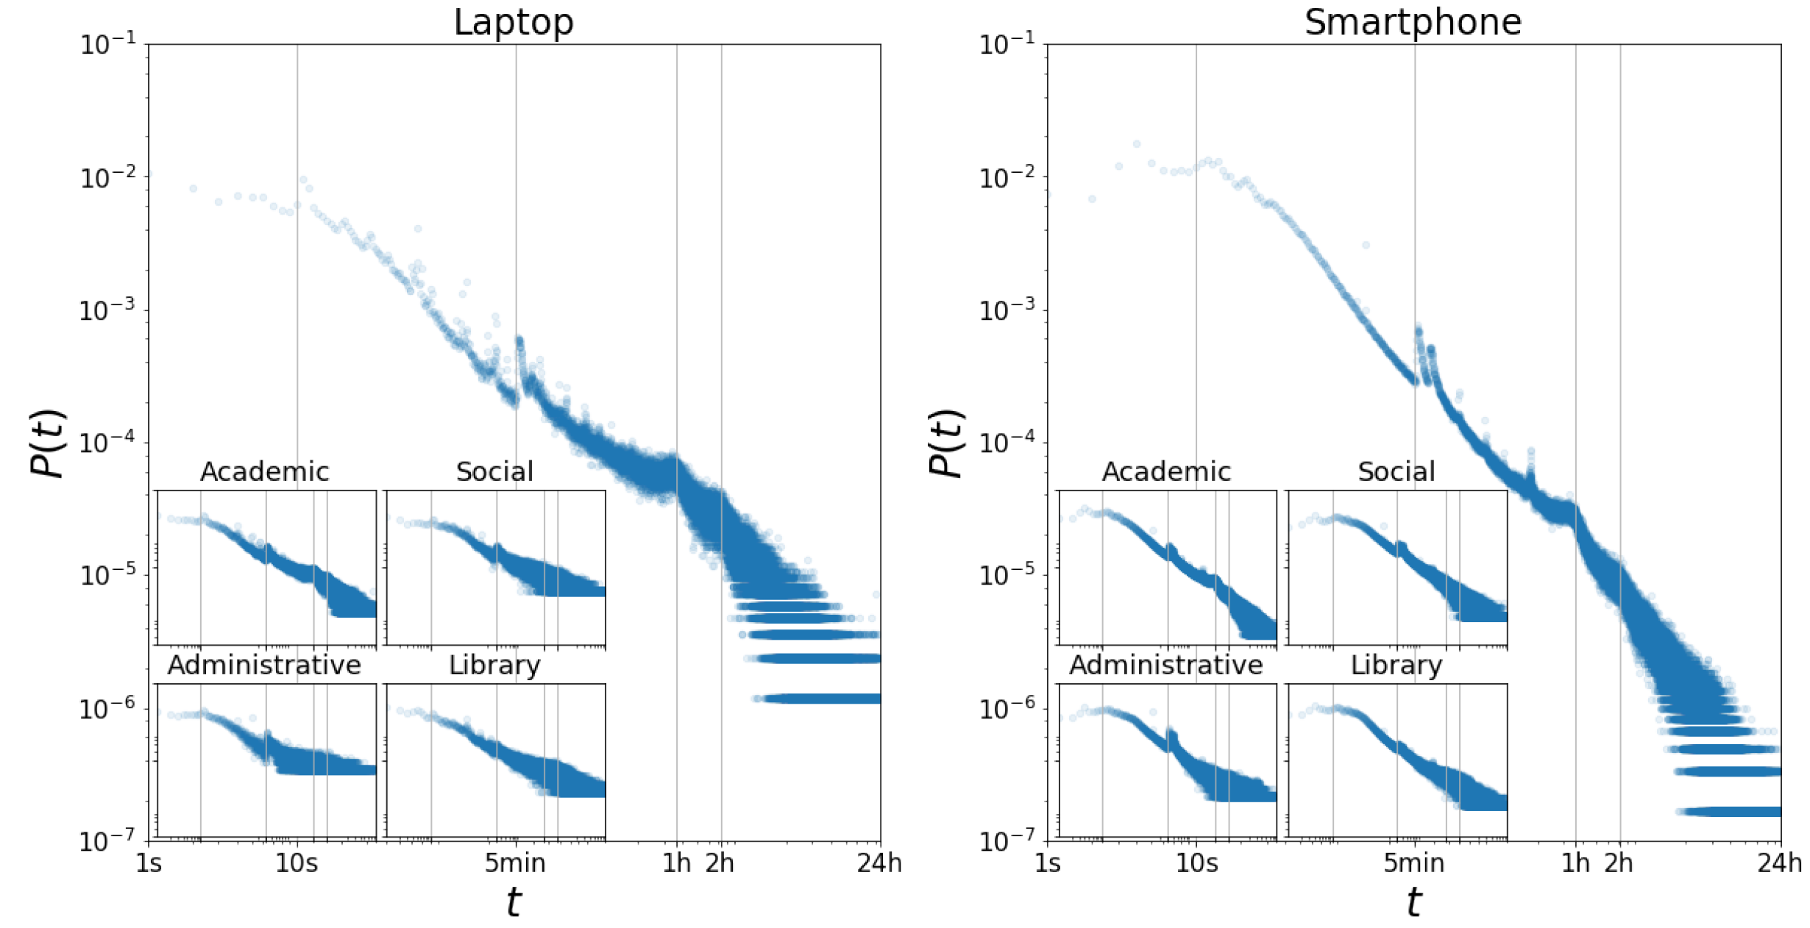
Probability P (t) of session duration t. The scale of all axes in smaller inner plots are the same as their parent plot.

Slide 12
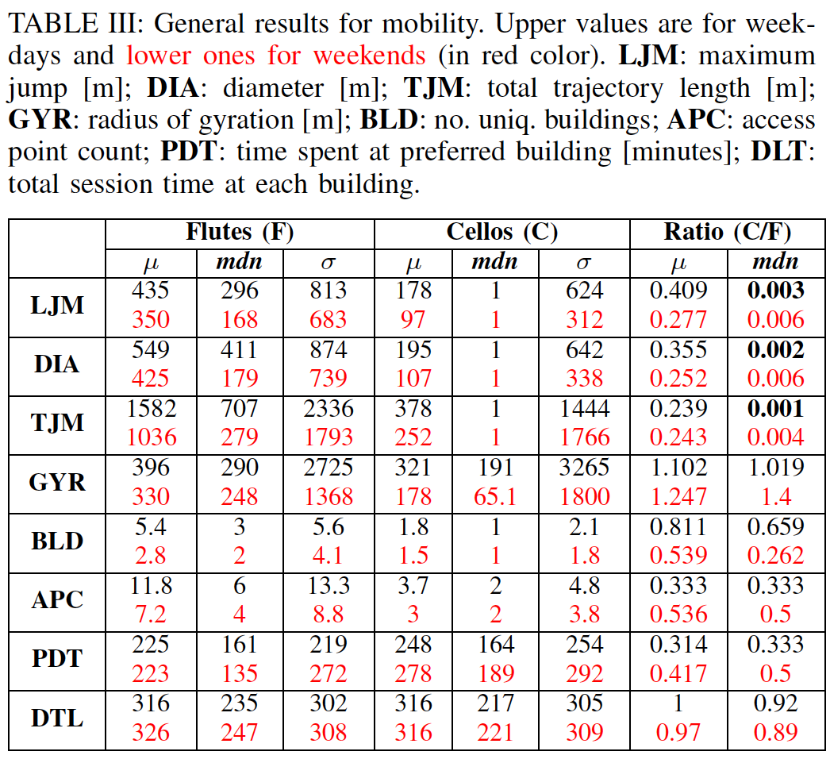
Weekday
Weekend
Mobility Features

Slide 13
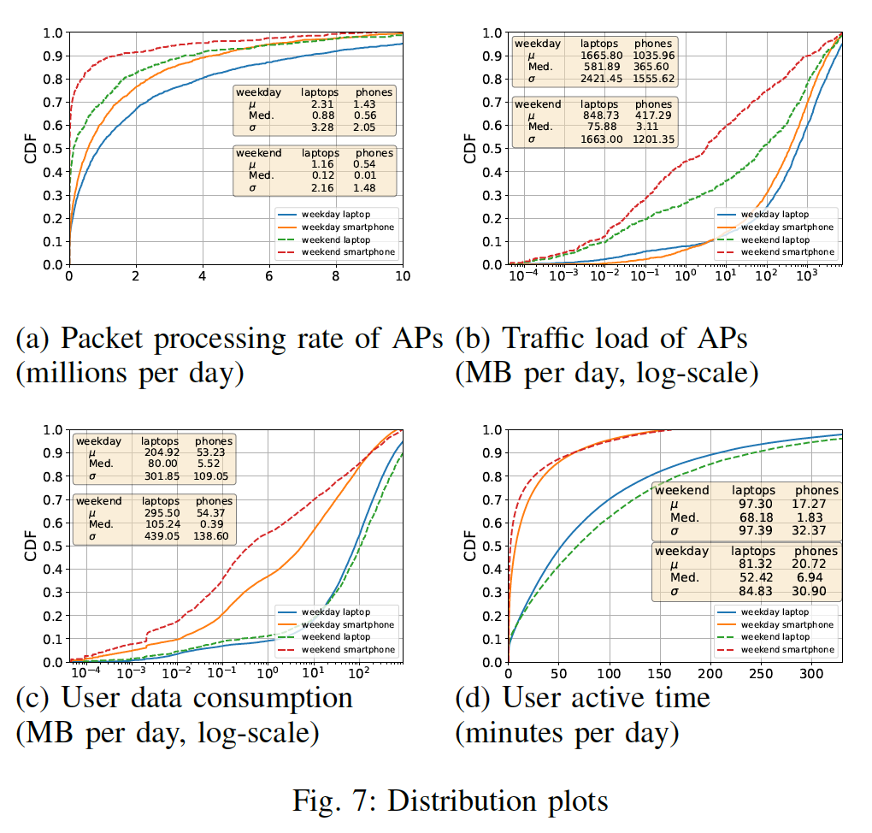

Slide 14
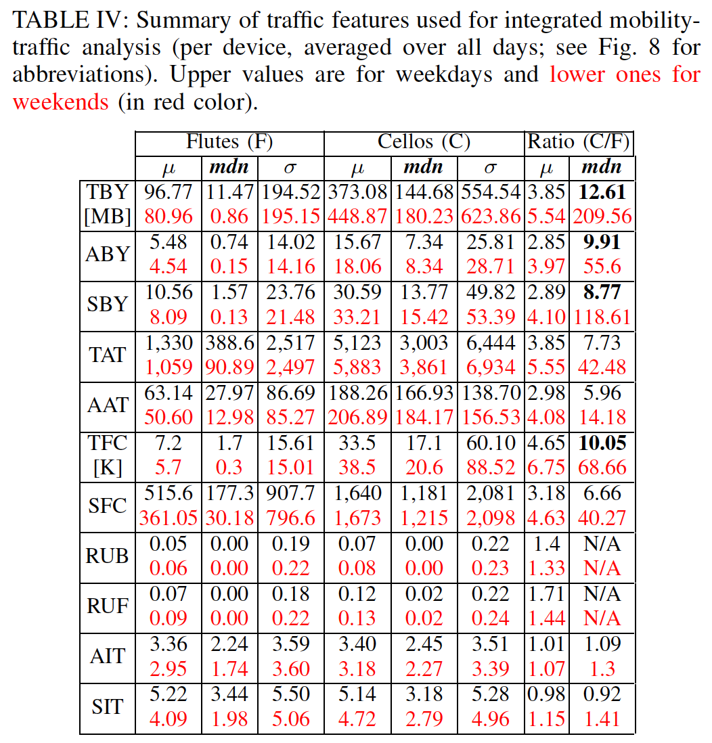
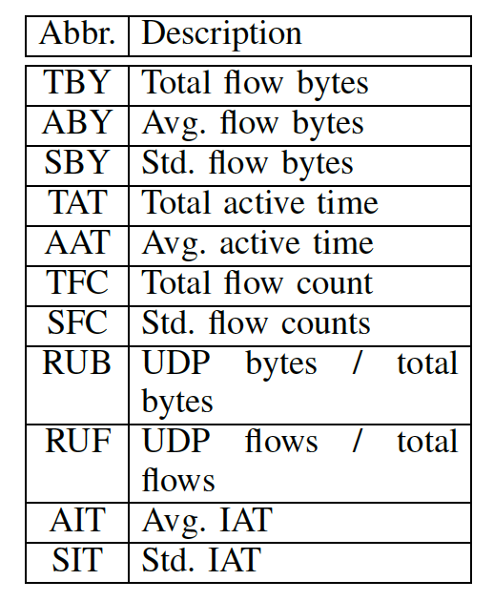
Weekday
Weekend
Network Traffic Features

Slide 15
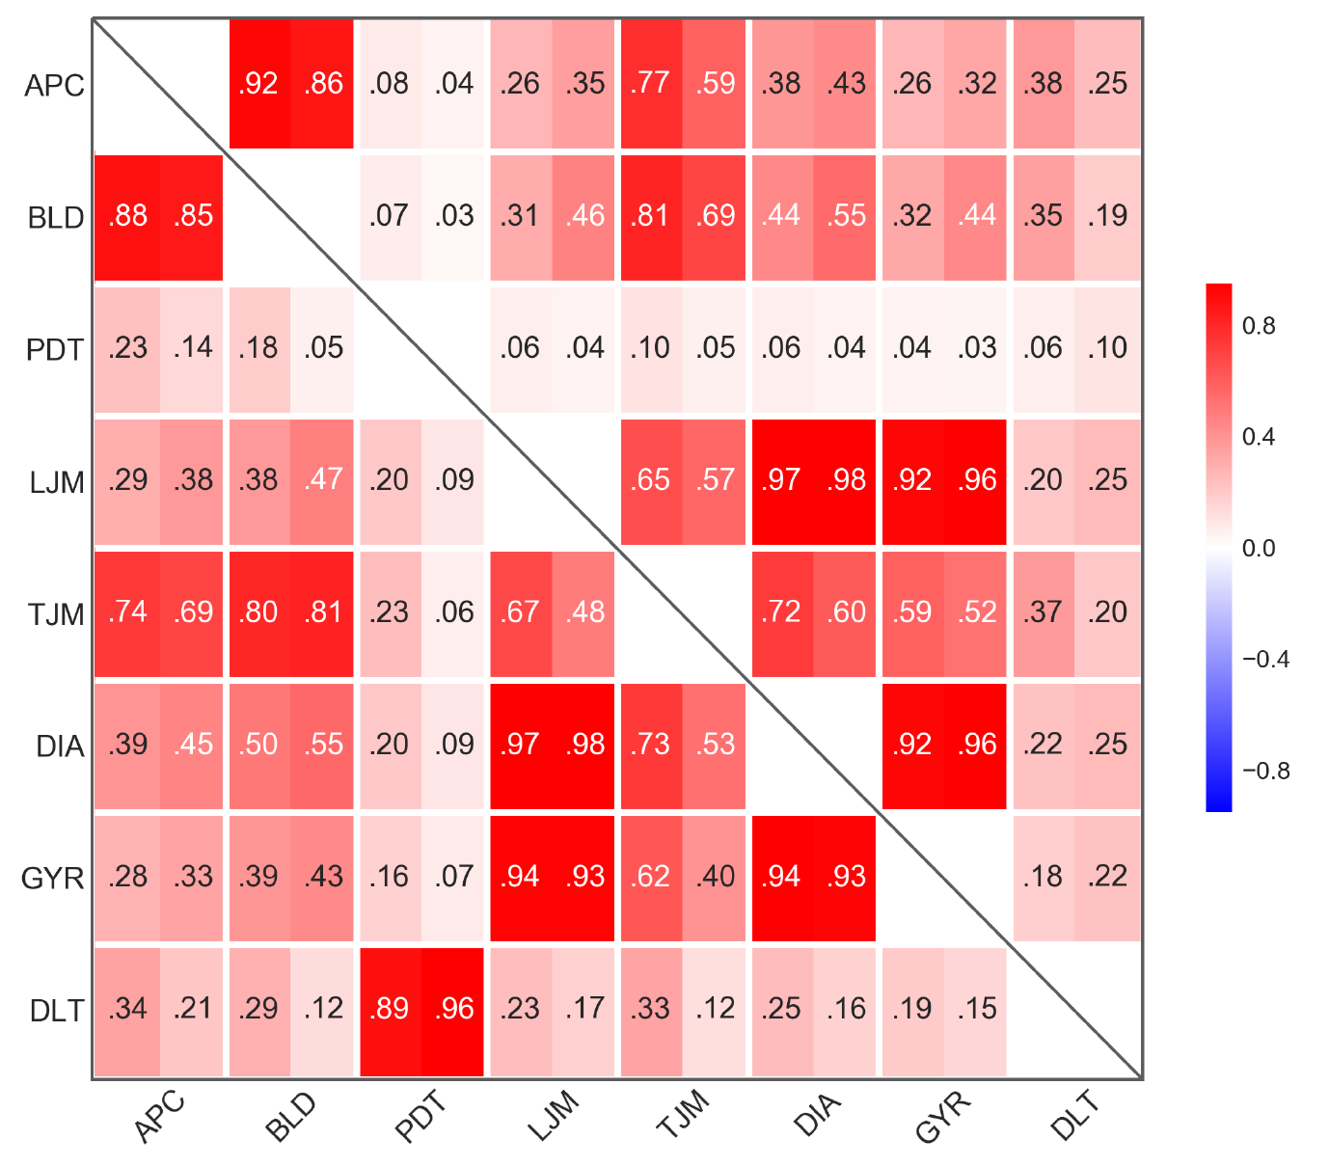
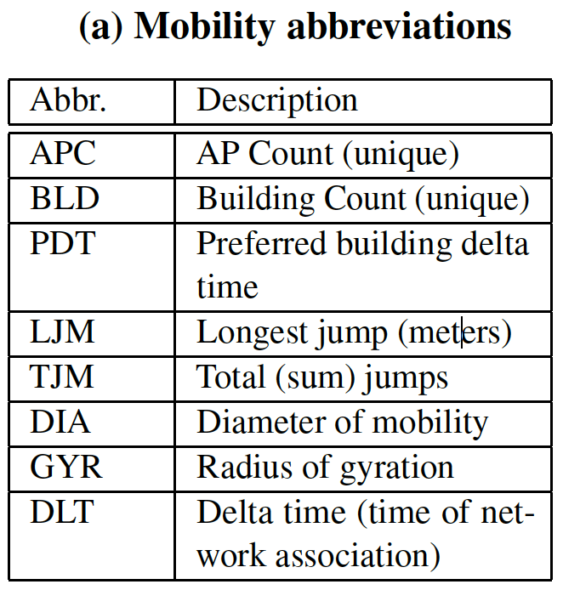
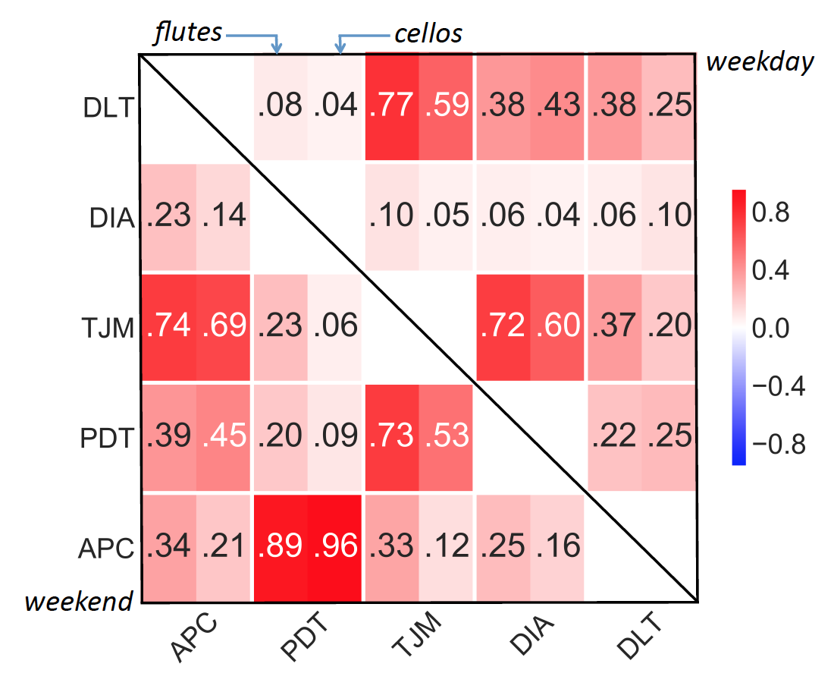
Correlation plot for mobility features, each cell’s left half is for smartphones and right half is for laptops, the upper right triangle is for weekdays and the lower left for weekends

Slide 16
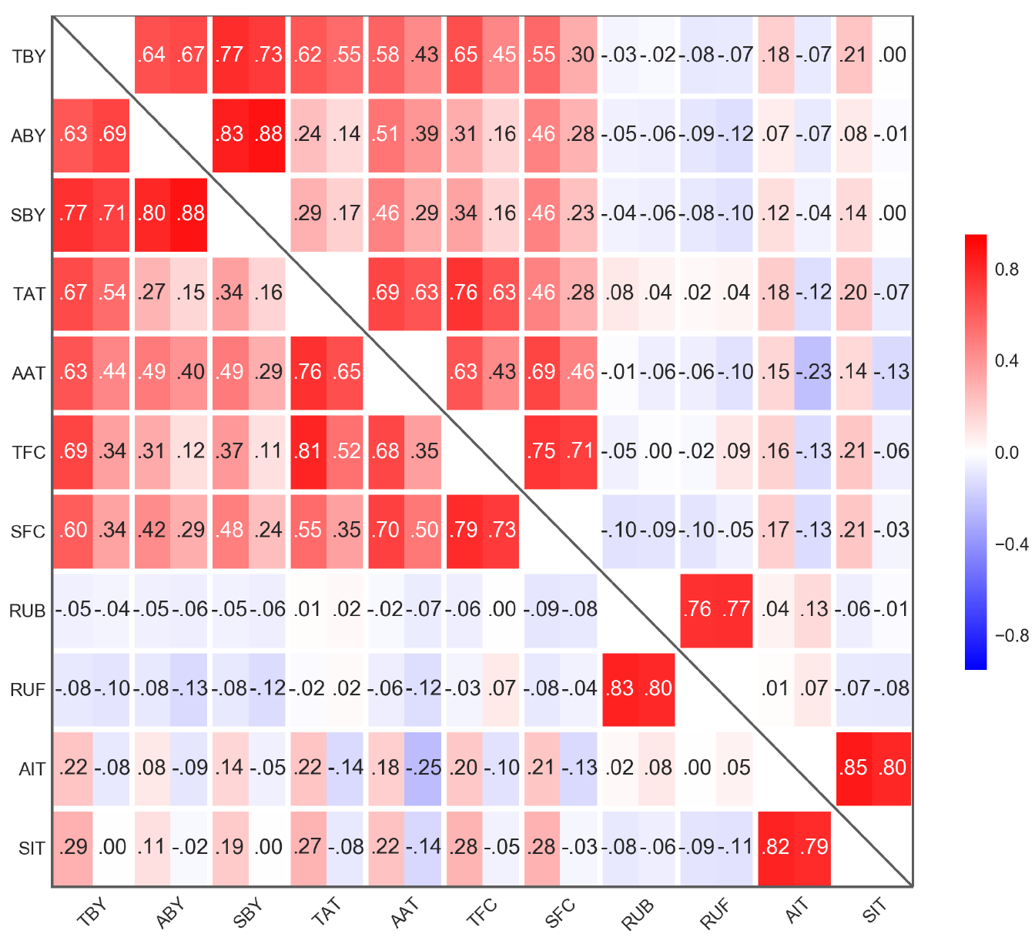
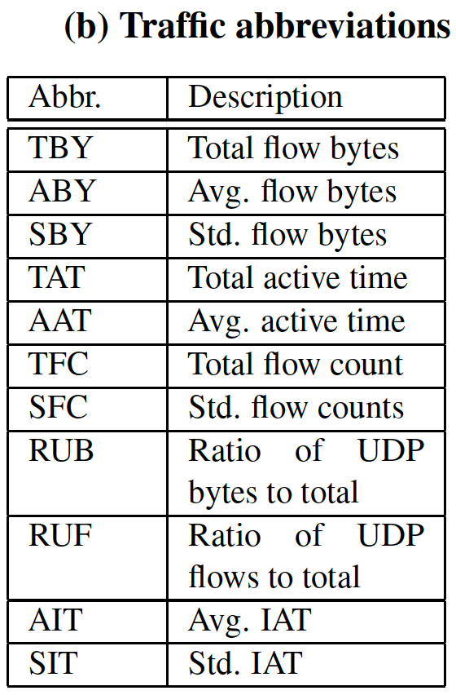
Weekdays
Weekends
Correlation plot for traffic features, each cell’s left half is for smartphones and right half is for laptops, the upper right triangle is for weekdays and the lower left for weekends

Slide 17
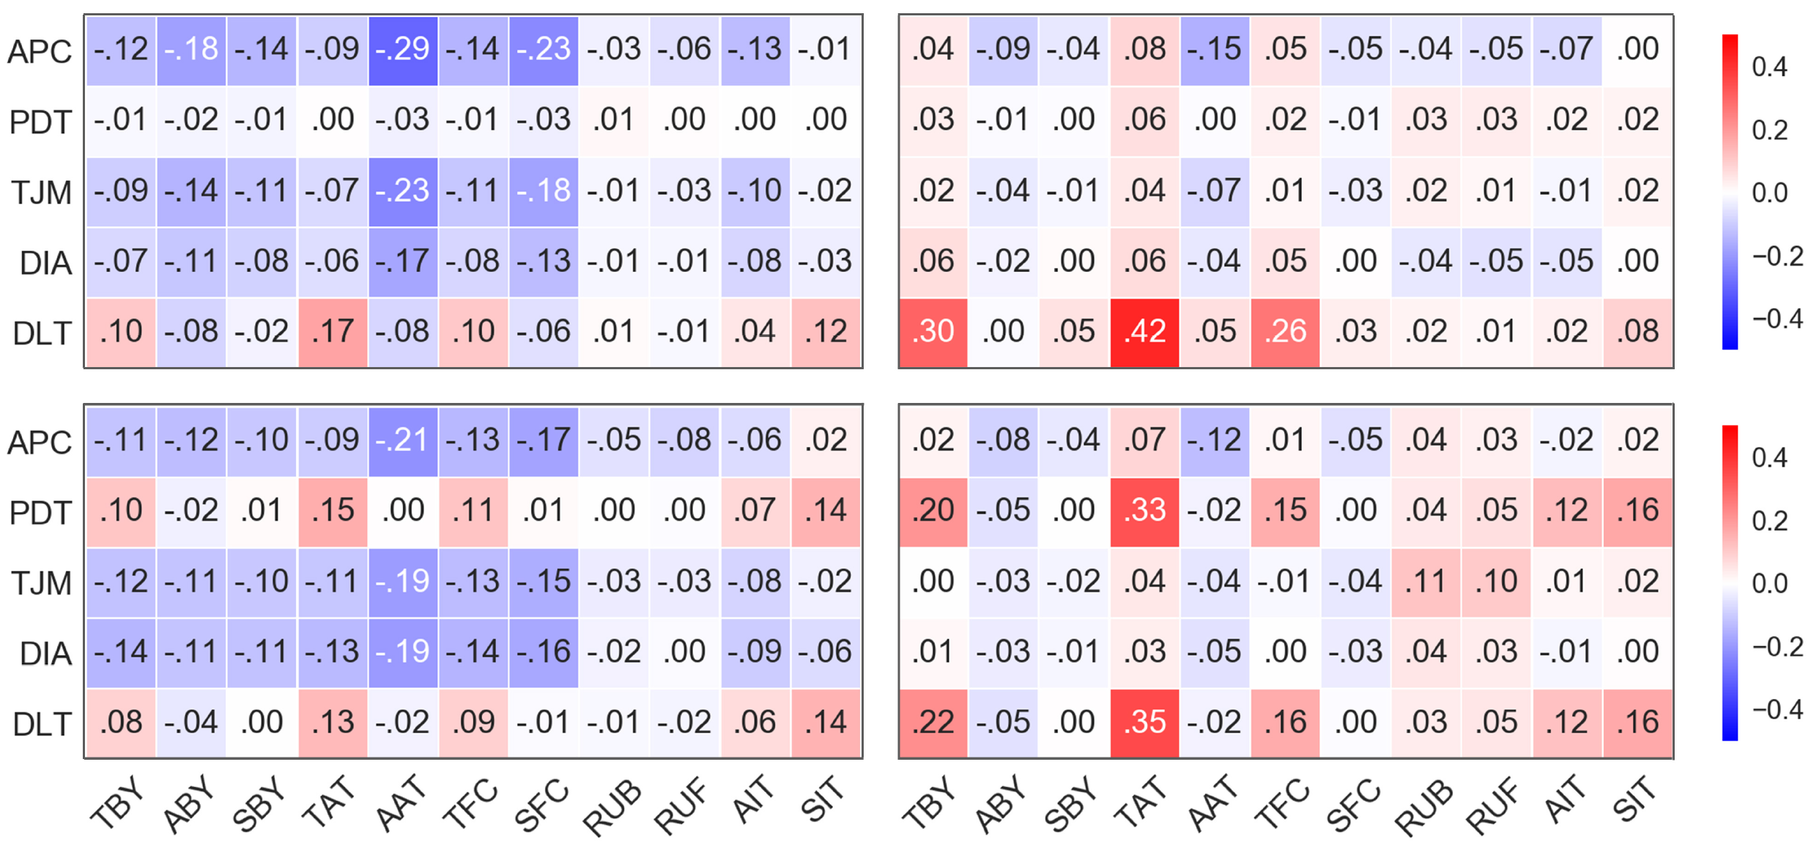
Mobility – Traffic Analysis
Mobility
Smartphone - Weekday
Laptop - Weekday
Traffic
Smartphone - Weekend
Laptop - Weekend
Correlation of mobility vs. traffic on weekdays (top) vs. weekends (bottom) for smartphones (left) and laptops (right).

Slide 18
Computing System
The size of the datasets is 30TB in raw text format, mostly consisting of NetFlow data and 0.5TB for AP logs. There were several challenges in managing and mining the largescale datasets that required a thorough preparation, to run on a fast machine with plenty of resources/memory.
We explored several techniques and pipelines for extraction, transformation, loading (ETL) and querying of big data and chose tools from Apache Hadoop ecosystem. We use Hive as our data warehouse (tables stored in Parquet format). Apache Spark is the compute engine for data processing and analysis tasks. Computation runs on two nodes, each with 64 cores and 0.5TB of memory. Further discussion of the system and comparison to others is out of scope of this document.

Slide 19
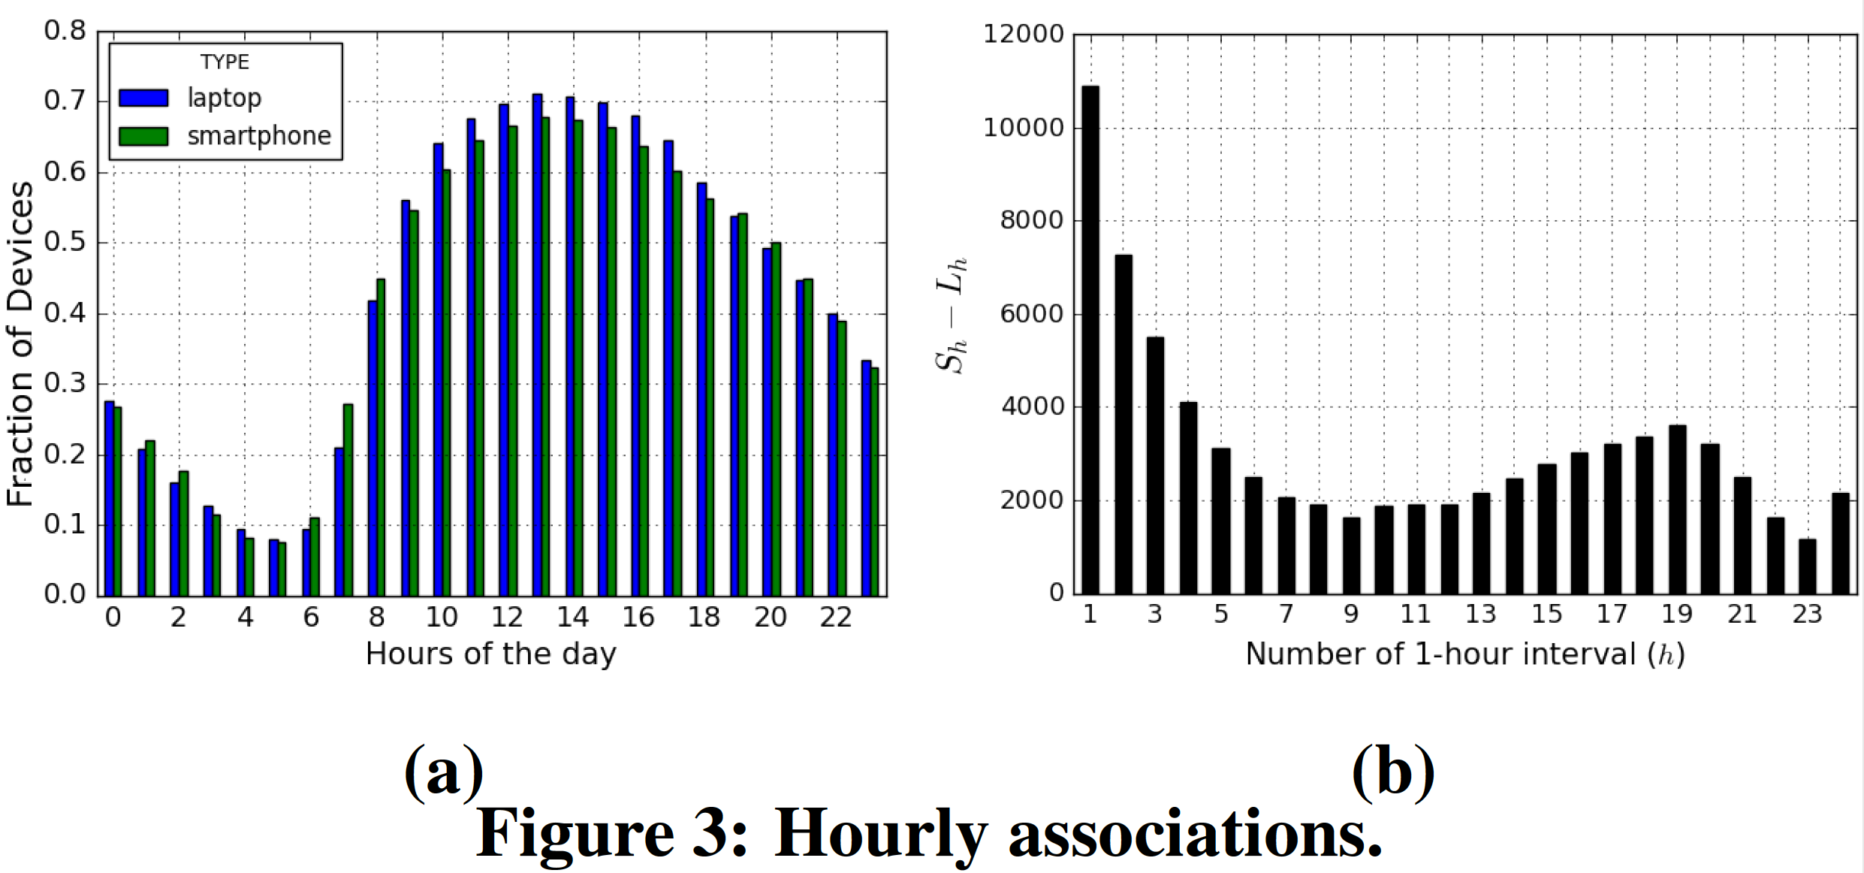
Fig. 3a shows the percentage of devices with at least one event as a function of hours of the day. The majority of devices appear online between 9am and 8pm, with the hours between 2am and 6am having less than 20% of devices associating. We find no major differences between flutes’ and cellos’ distributions, as many users potentially own both. As users arrive on campus and their phones announce their first location, they switch on their laptops.
Fig. 3b depicts Sh−Lh , where Sh and Lh are total number of smartphones and laptops respectively, with at least one record per hour, as a function of the number of hours online h . Flutes are predominant for short visits and very long stays, but the difference drops significantly at 9 hours, then increases. The rise after 9 hours is likely due to students living on campus, with always-on connected phones.

Slide 20
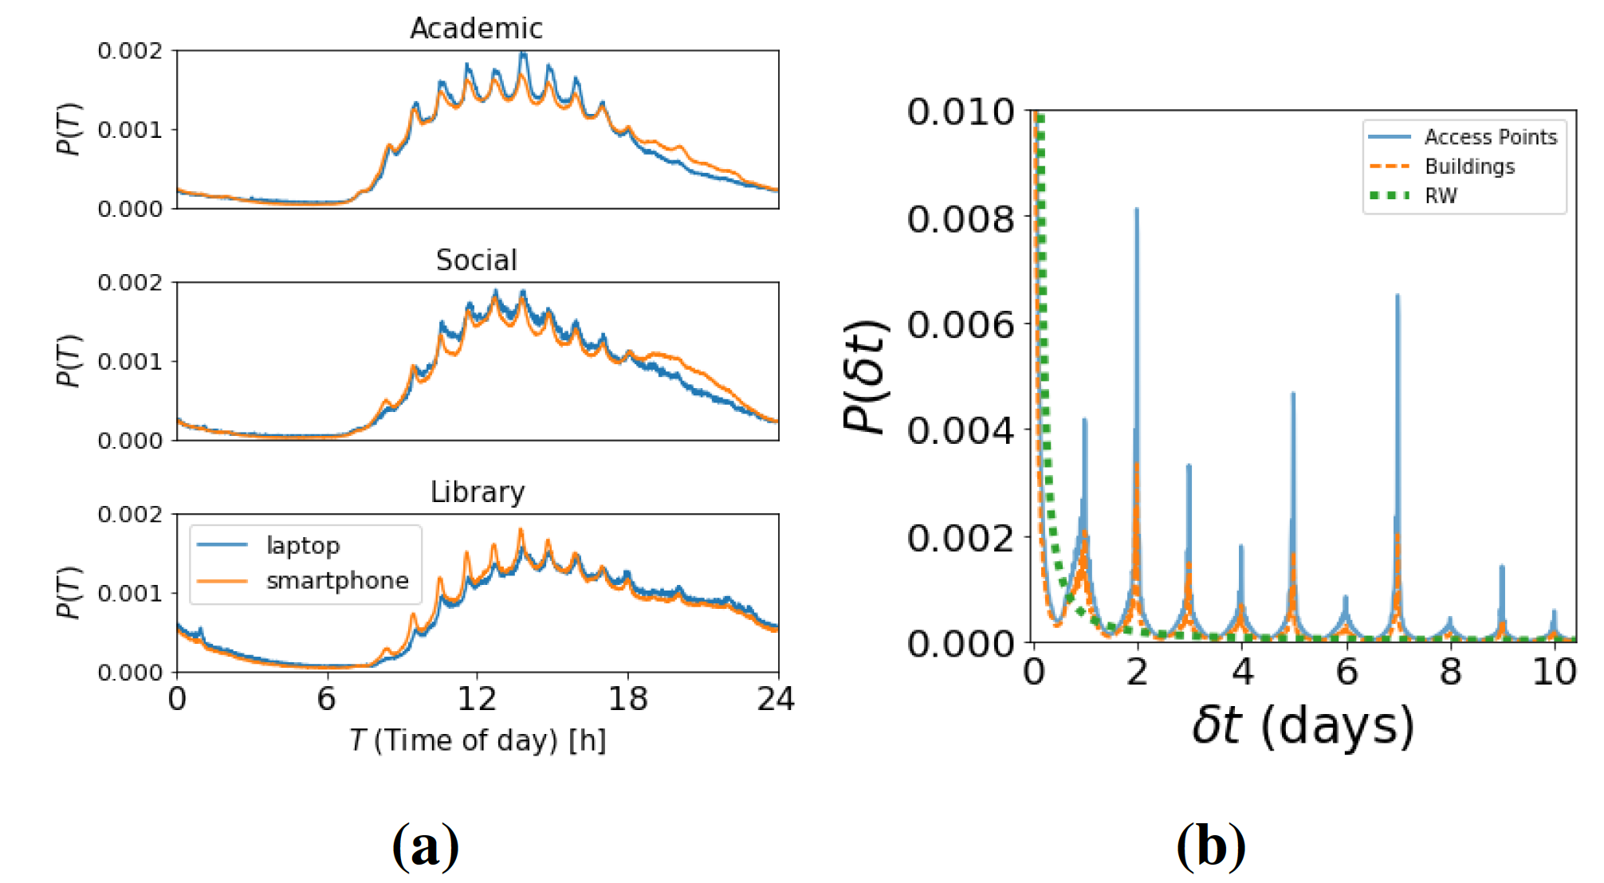
Figure 4: (a) PDF Session start over time of the day. (b) Probability to return to a previously visited location.
Distributions of session starts at different times of day in three building categories are depicted in Fig. 4a. Sessions’ start match the periodic beginning of classes, but mainly in Academic buildings, where users move mostly at the start and end of classes. At these places, activity drops sharply for laptops at 5pm, with some considerable smartphones activity until 8pm. For Social and Library buildings, probability of new sessions remains higher for a few more hours into the evening, when users tend to leave at different times.

Slide 21
We compare empirical values for devices to return to previously visited APs or buildings in Fig. 4b. We observe returning spikes at every 24 hours, with the highest peaks at 48 and 168 hours (2 and 7 days). This can be explained by the schedule of classes at the university.

Slide 22
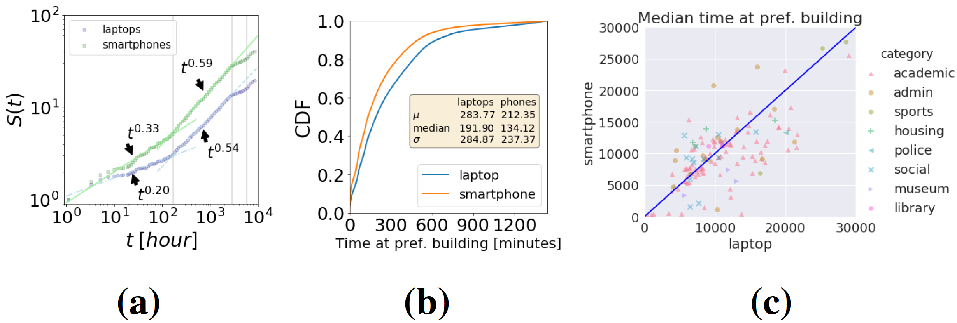
Figure 5: (a) Num. of visited locations S(t). Vertical lines at 7, 120 and 240 days. (b) & (c) on time spent at preferred building.
Fig. 5a highlights the differences between smartphones and laptops on the required time t to visit S(t) locations. After an initial exploration period of one week the rates of new visits change similarly for both device types, and new exploration rates show up at 120 and 240 days. These could be explained by the weekly schedules of the university as well as the usual length of a lecture term ( 3 months).
Fig. 5b depicts the time devices spend at their preferred building in a day. Interestingly, laptops have slightly longer stays but both have medians around 2 hours and 40 minutes. The similarity of the distributions, combined with a lower number of visited locations indicate that laptops are used mostly when users remain longer periods at places.

Slide 23
Fig. 5c shows a scatter of the median time spent at a user’s preferred building. Each dot represents this value for a given location. This plot shows that academic , police and museum buildings tend to have laptops staying longer, which makes sense intuitively, with students using laptops during lectures and staff working at the other two categories. On the contrary, for social and housing buildings, there is a higher probability of having smartphones staying longer, hinting at a tendency to use phones more in such places. Finally, administrative , sports and library buildings tend to have both types of devices staying for similar amounts of time. Analysis of inherited differences in browsing of online services given by this heterogeneity among buildings is left for future work.

Slide 24
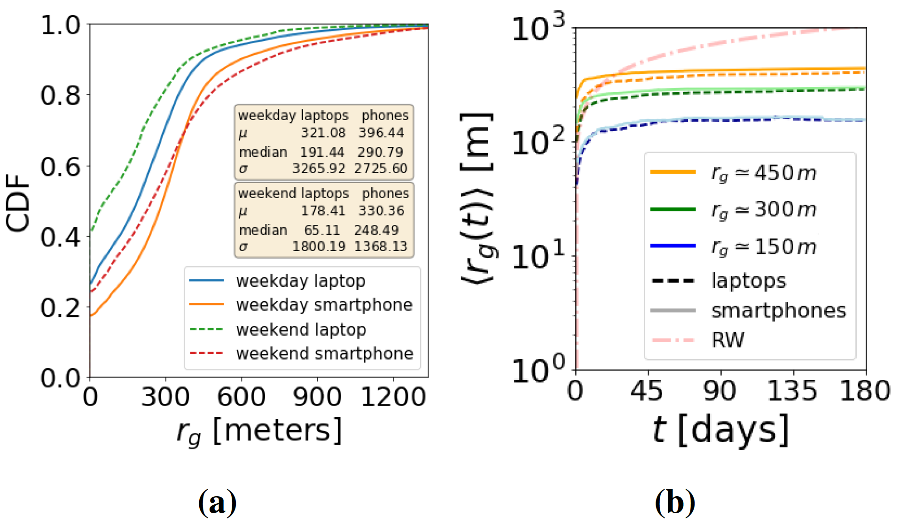
Figure 6: (a) CDF r_{g} for device types and week periods. (b) Average r_{g} after 6 months of observation.
Fig 6a: Comparing weekdays and weekends for laptops, we notice a great reduction in their overall mobility while for smartphones this difference is not so pronounced. This might be due to students having fewer activities on weekends, a tendency to study at a single building like libraries, or not carry their devices

Slide 25
Grouping devices by their rg after 6 months of observation, we look at its evolution since the first time they are observed. Fig. 6b compares rg {150, 300, 450} meters. Curiously, after an initial transient period of about 7 days this value remains relatively the same, even across different semesters.

Slide 26
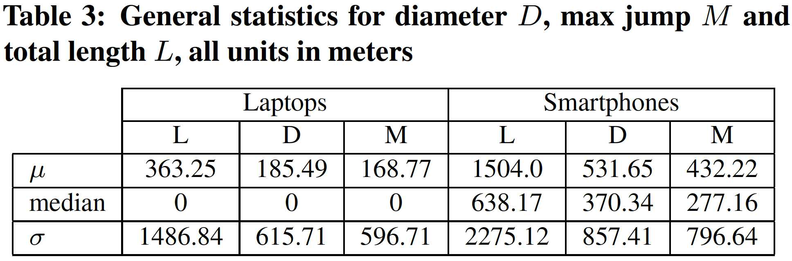

Slide 27
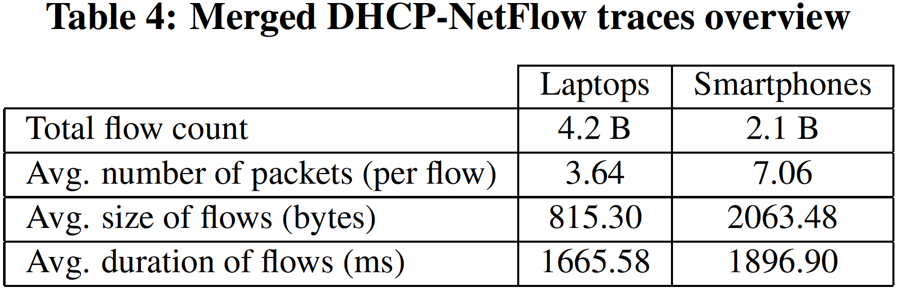

Slide 28
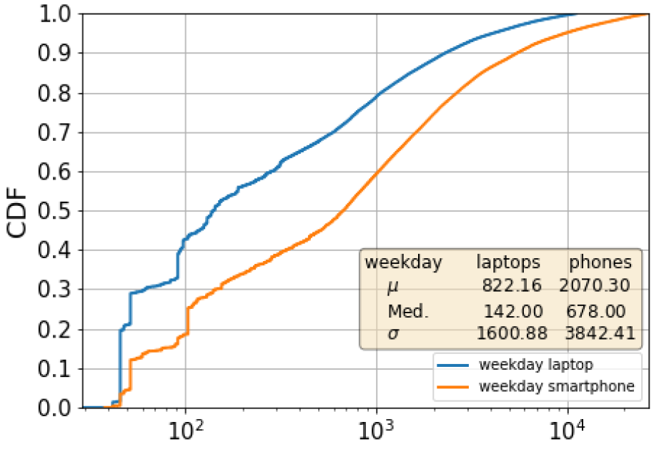
CDF of individual flow sizes (bytes, logscale x axis), similar pattern on weekends

Slide 29
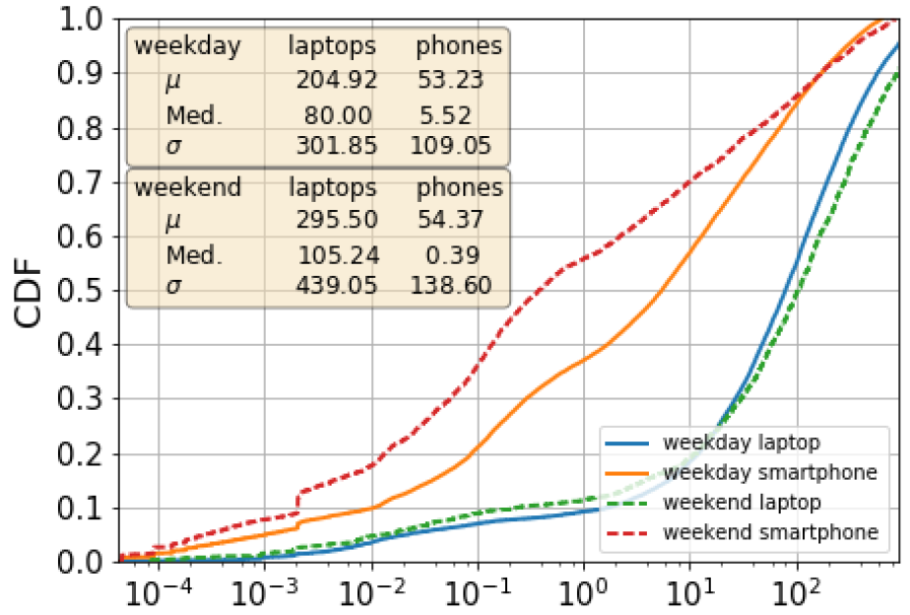
CDF of daily traffic consumption of users (MB, log-scale x axis)

Slide 30
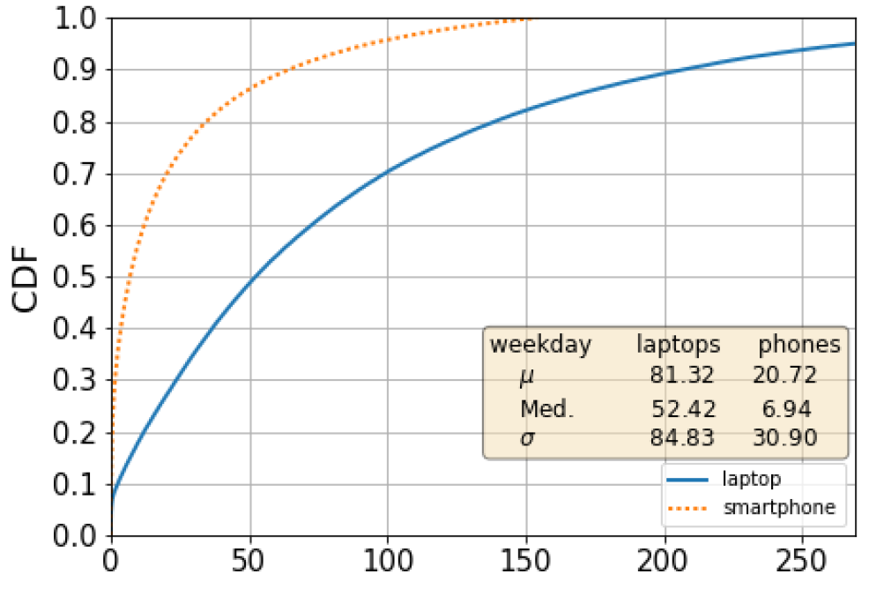
CDF of daily active time of users (minutes), similar pattern on weekends

Slide 31
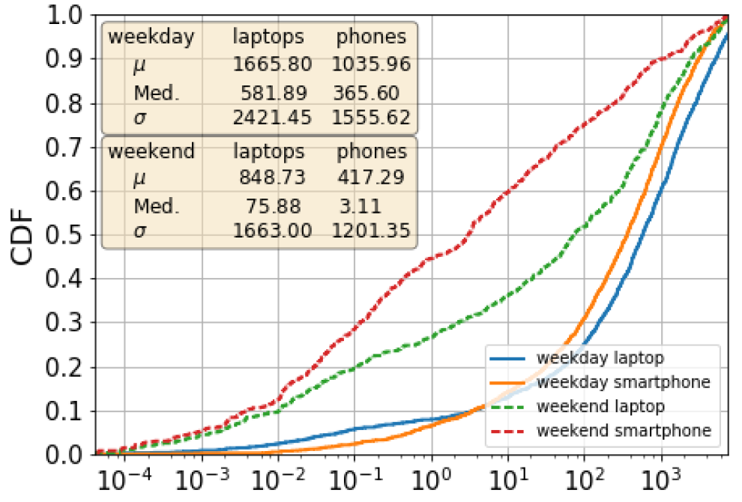
CDF of daily traffic load of APs (MB, log-scale x axis)

Slide 32
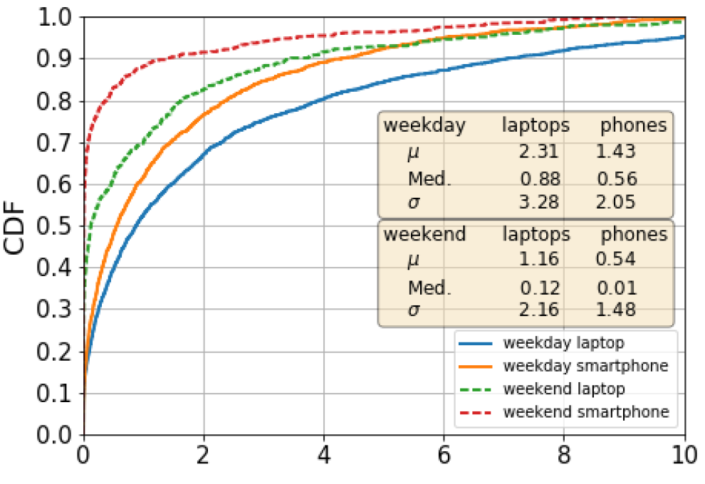
CDF of daily packet processing rate of APs (millions)

Slide 33
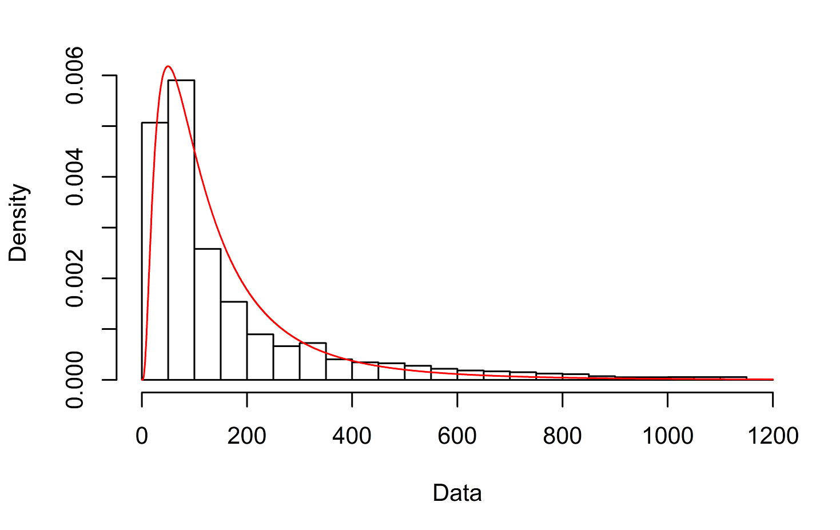
Distribution of average packet size and flow size fit Lognormal (Empirical and theoretical densities of former shown here)

Slide 34
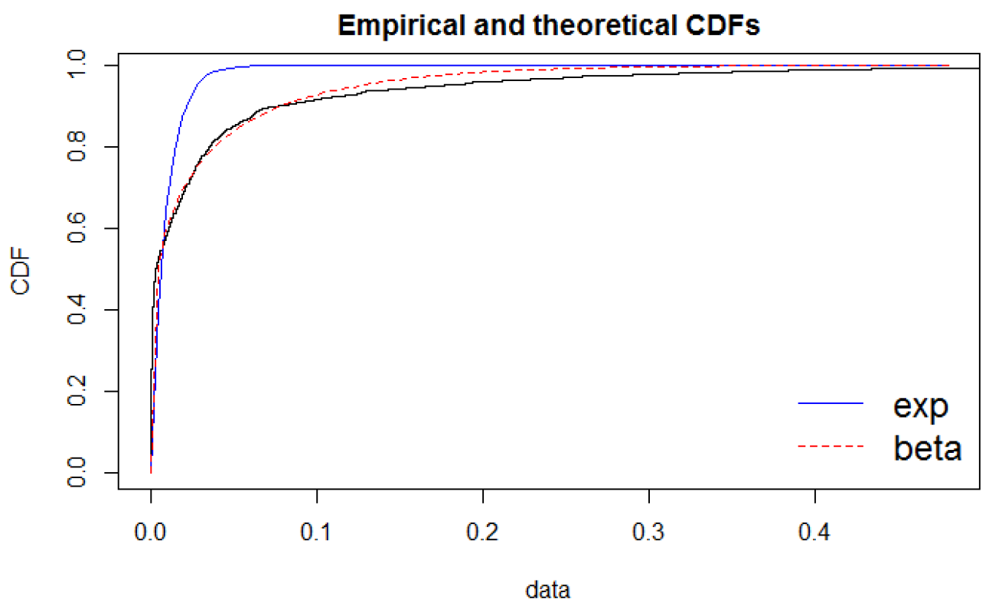
IAT ECDF compared with exponential and beta

Slide 35
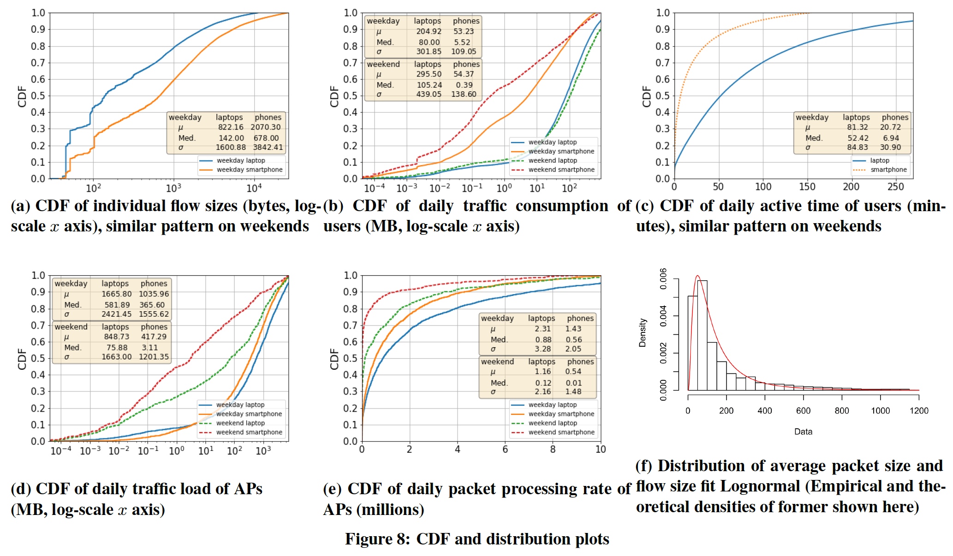

Slide 36
What are the metrics used for mobility and traffic and how to get the most significant ones…
Explain the M/L approach to deduce the most relevant metrics from the data

