Slide 1
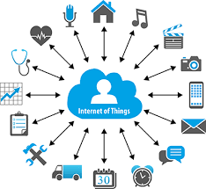
CIS4930/6930 Mobile Networking Towards a Networked Mobile Future (of People, Vehicles, Things and Data)
Ahmed Helmy
Computer and Information Science and Engineering (CISE) Department
^{University of Florida}
helmy@ufl.edu , http://www.cise.ufl.edu/~helmy
Founder & Director: Wireless Mobile Networking Lab

Slide 2
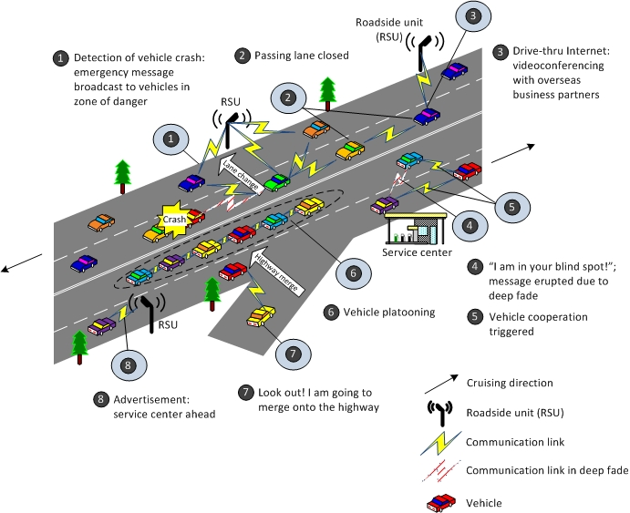
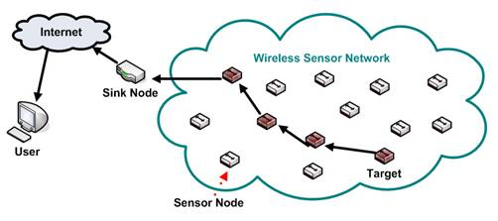
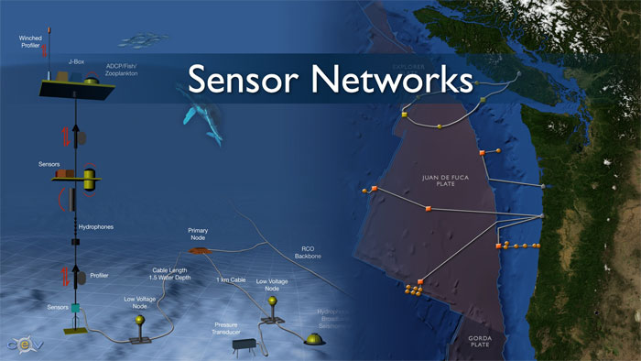
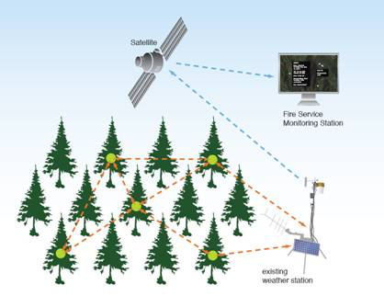
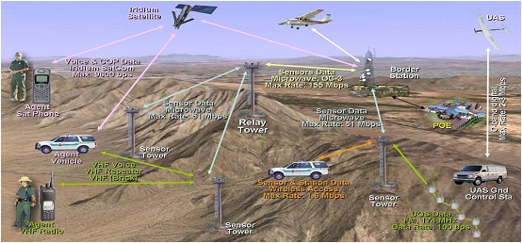
Emerging Mobile Networks: IoT Examples?
Generic structure of a sensor network
Vehicular Networks on Highways
Underwater sensor network
Environmental sensor network
Aerial sensor network

Slide 3
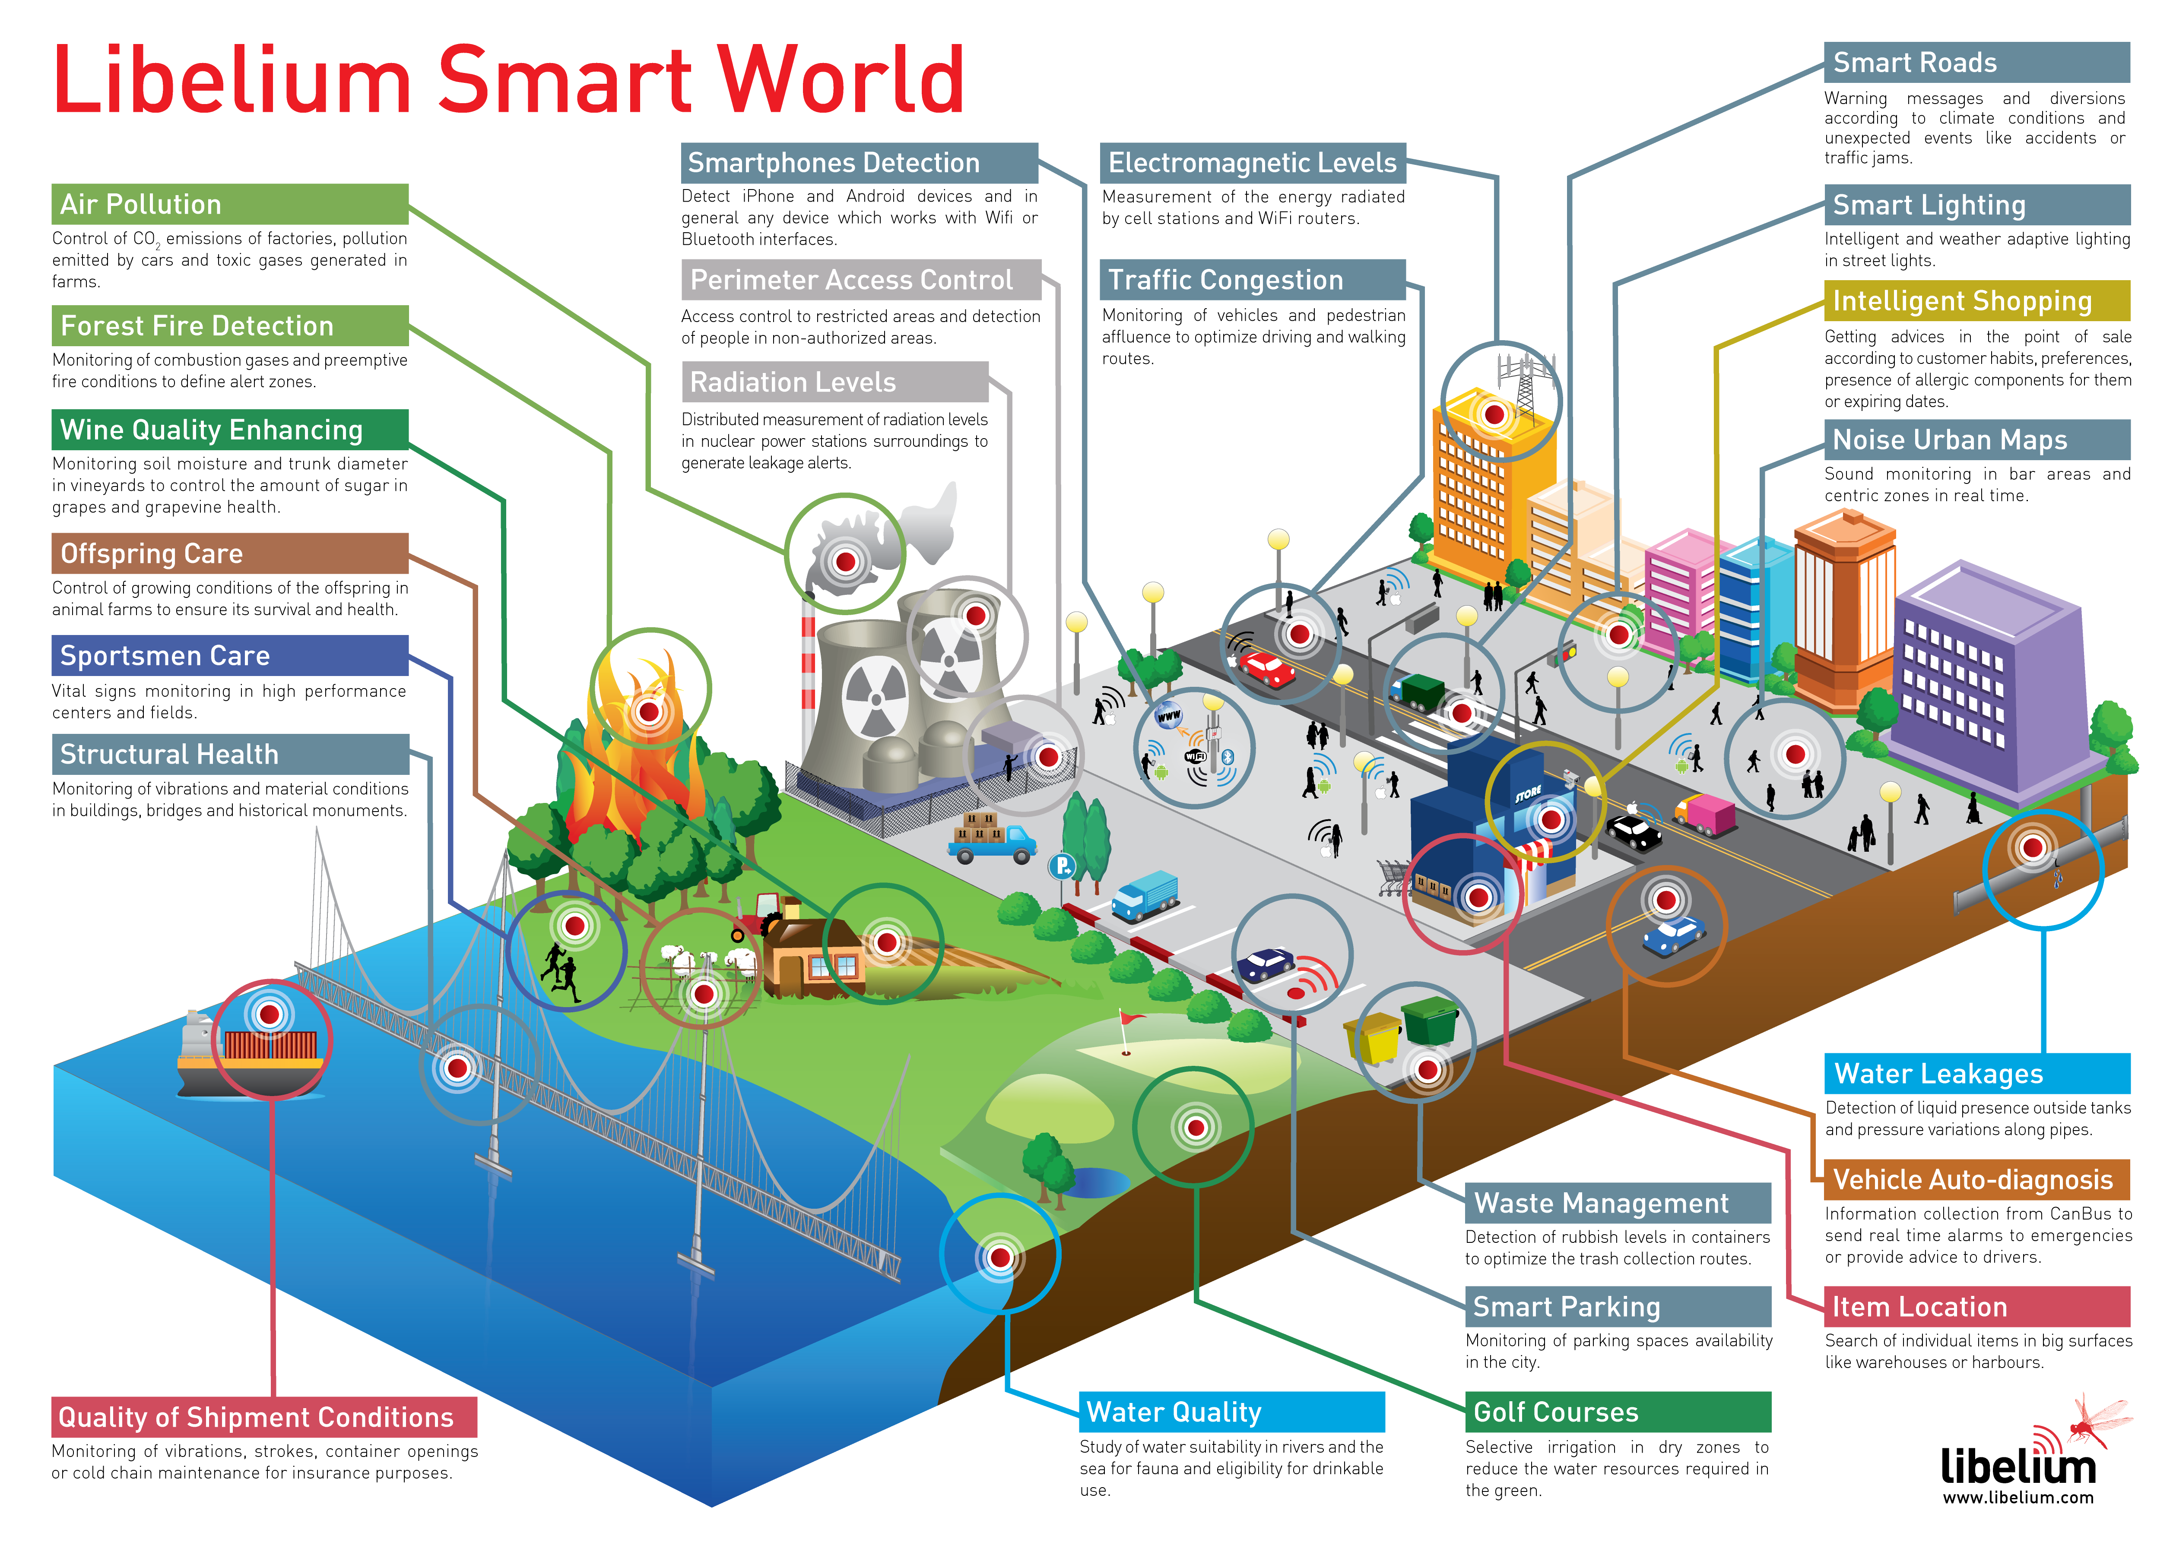
IoT Platform Example

Slide 4
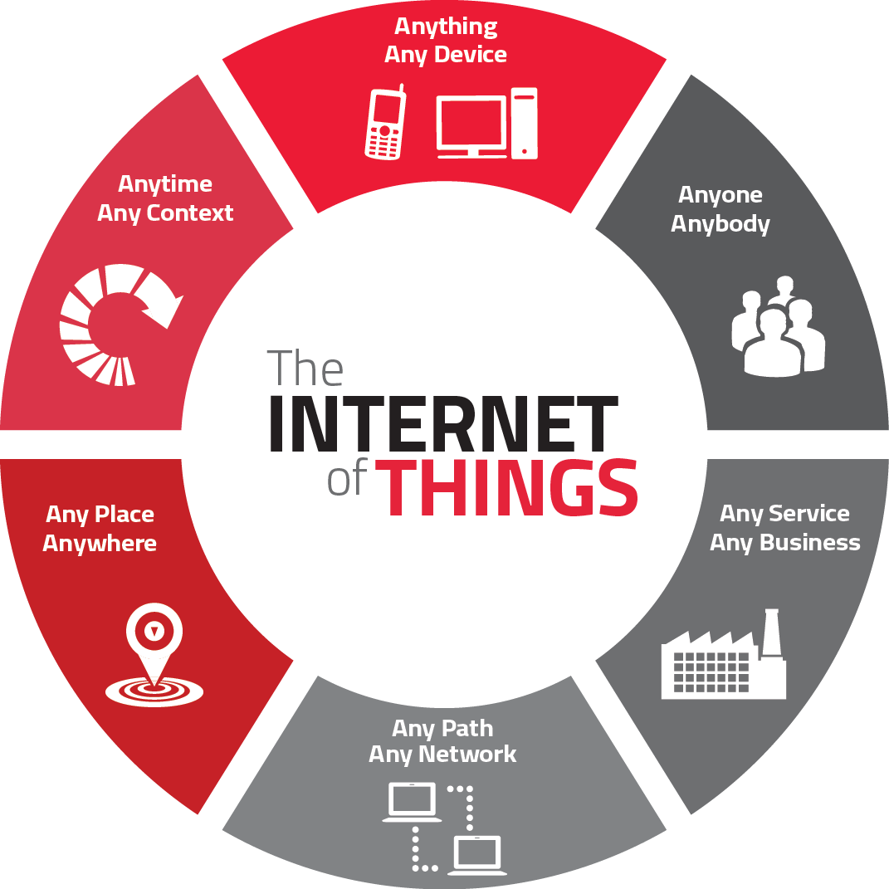
Still attempting to define IoT!
IoT (Things)
IoE (Everything)
IoA (Anything)
More important than the network, are the interactions and opportunities:
- Communication – Sensing - Computing

Slide 5
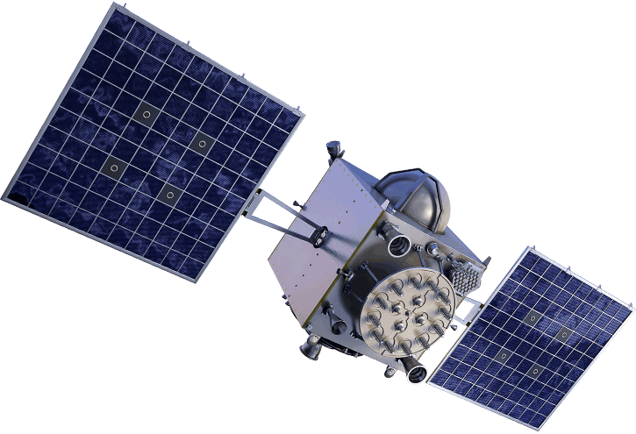
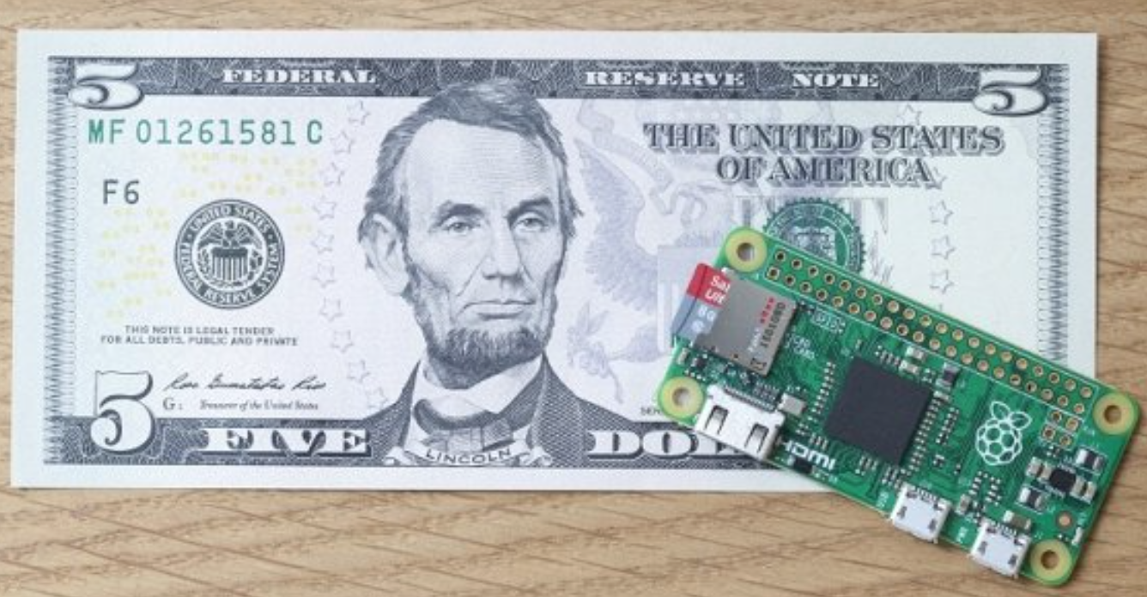
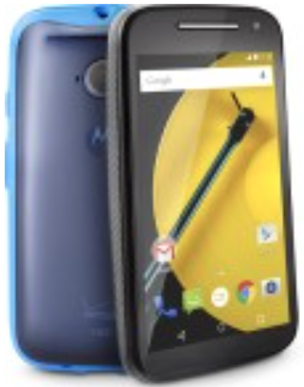
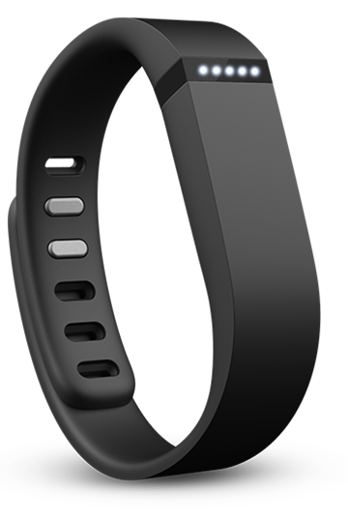
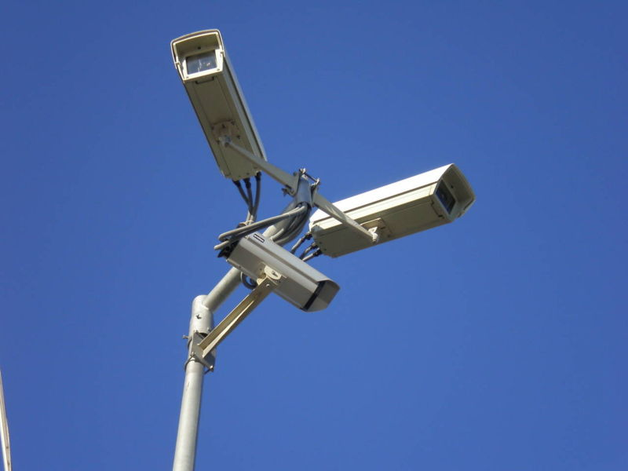
What Makes Us Ubiquitously Sensable?
$5 Rasberry pi zero
Ubiquity, capability, affordability of sensors
Integration of devices in everyday life
Cell phones, networked devices/sensors, credit cards, social media, webcams, satellites, wearables, grids, meters
Digital breadcrumbs, behavioral signatures
Tight coupling between devices & users
$9^{.99} Moto E

Slide 6
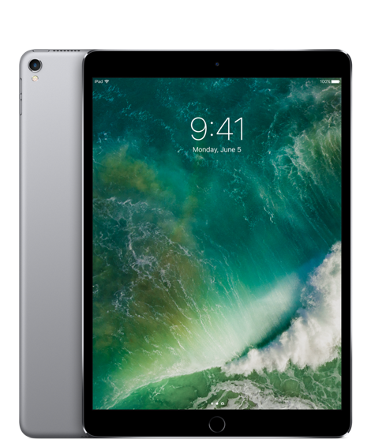
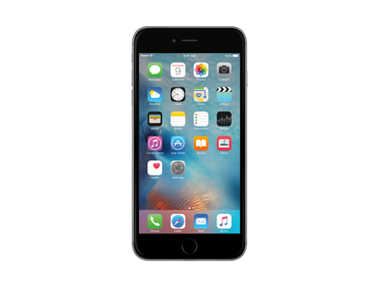
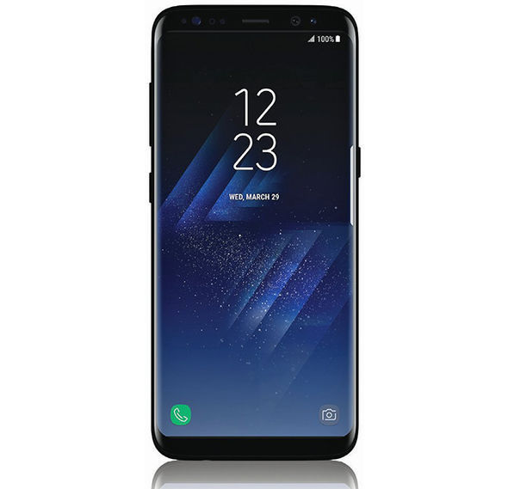
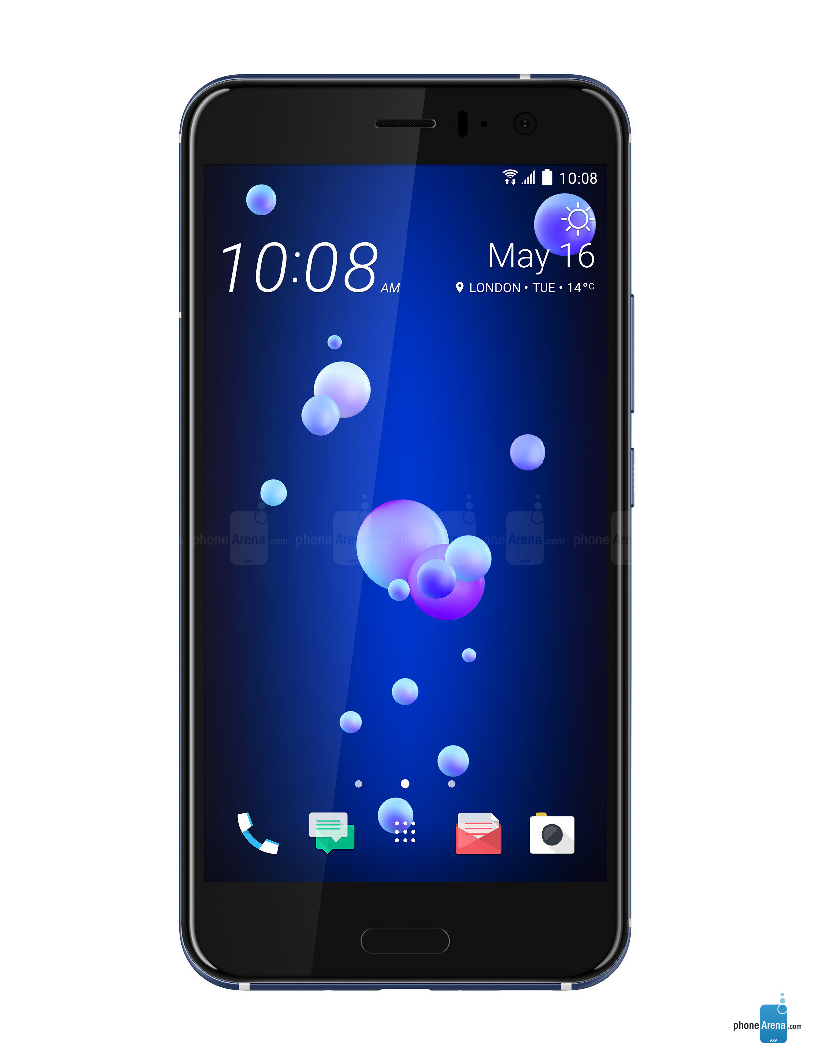
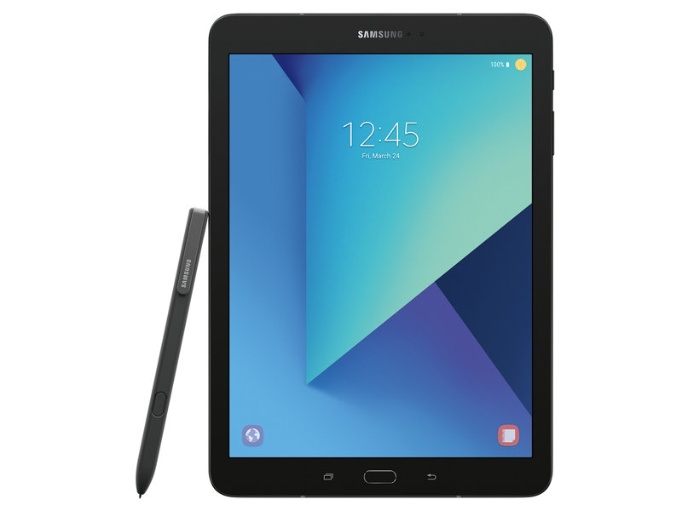
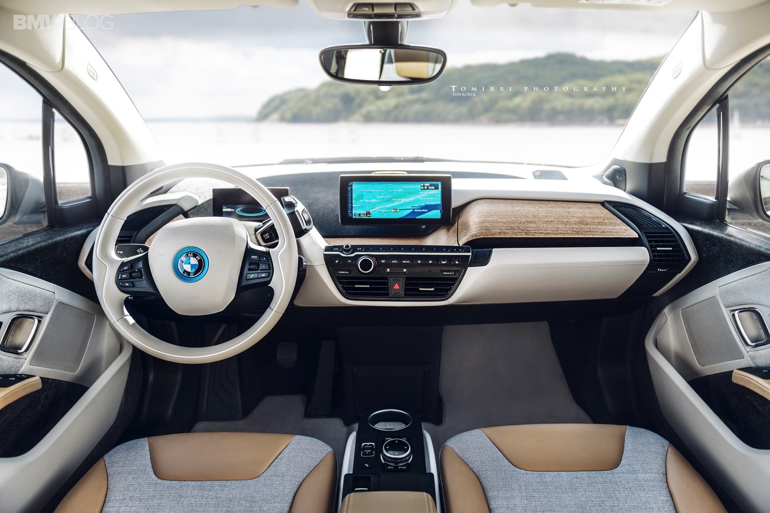
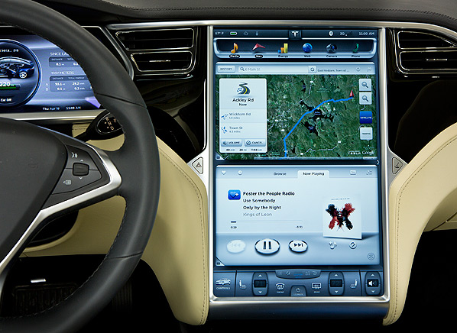
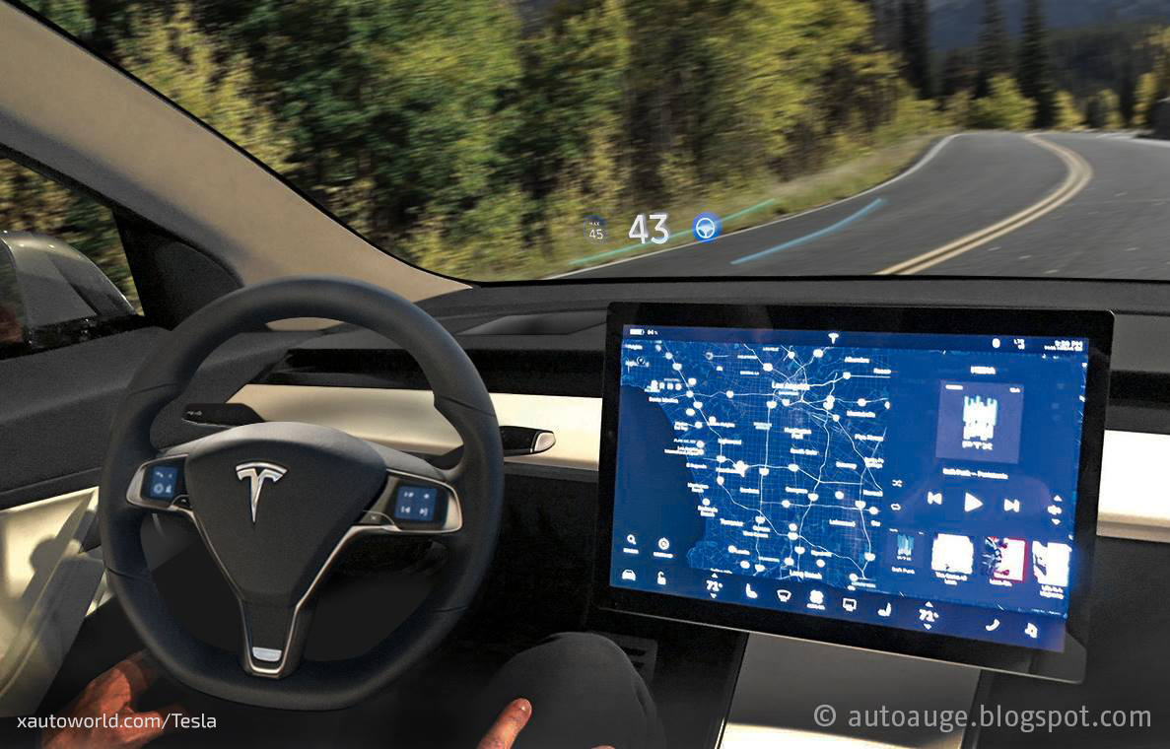
New Generations of Powerful Mobile Devices
Scale in numbers:
~7.37 Billion mobile network subscriptions globally !!
~2.3B smartphones worldwide and growing fast (2017)
Capabilities of mobile devices:
I- Sensors: accelerometer, gyro, proximity, compass, barometer, camera(s), mic, touch, GPS, heart rate, temperature, humidity …
II- Storage:1-6 GB RAM, Internal Mem: 16-128 GB, External Mem: 32-256 GB
III- Computing: quad/octa-core 1-2.5GHz CPU, GPU
IV- Communication: cellular 4G/LTE/5G, WiFi-AP/direct/adhoc, Bluetooth, NFC, DSRC!
Tight coupling between devices & users:
- Digital breadcrumbs, behavioral signatures (profiles!)
How to take advantage of this for new applications?
Notes:
Along with these changes on the transportation side, there’s been a revolution in the mobile device side that is evident everyday.
With great growth (really explosion) in smartphone technology, other ultra—portable devices (e.g., tablets), and even connected devices in cars!
The scale has been enormous in terms of numbers, capabilities and integration in everyday life, which created unprecedented coupling between the devices and their users… we (as users) leave digital breadcrumbs and create behavioral signatures (that I refer to as profiles)… and the question is, how can we utilize this data and these profiles to improve future networks and services!

Slide 7
Opportunities & Challenges
Human-centric data-rich society [Big People Data]
Big Data = Big issues in scale, privacy
Example areas of impact
Behavioral modeling, improved interaction
Smart-X: transportation, resource-efficiency (sustainability), health-care, education, public safety, productivity, …

Slide 8
Mobility Modeling?
A good part of this course will be about mobility modeling… so…
What is ‘mobility modeling’?
Definition of ‘Modeling’, what is a ‘Model’?
What is ‘Mobility’?

Slide 9
Course Structure
Three main components:
Lecture sessions/class participation
Assignments & experiments
Major Semester Project
(check syllabus for more details)
Web site: www.cise.ufl.edu/~helmy
also check prev. years from CIS6930,EE579/599/499
‘Student-centered, seminar-like, hands-on, thought-provoking, advanced research’ course in networking, with networking and wireless lab.

Slide 10
Course Components
A. Project:
4 milestones
(1) Initial proposal
(2) Refined proposal
(3) Initial report
(4) Final report
& Demo
C. Experiments &
Assignments (3)
Wireless & mobility tracing (encounter nets)
Friendship and trust measurements
(socializer games & apps)
Participatory mobile networking scenarios (project driven!)
B. Presentations
& discussions:
- Topic presentation
- Project presentation
- Paper readings,
reviews
& discussions
Attendance, discussion & 4 Reviews : 10%
Experiments: 3 x 10%= 30%
Project & Presentations: 60%
- Topic Presentation: 15%
- Project Presentation & Demo: 15%
- Written Proposal, Report, Demo: 30%

Slide 11
Milestones
Forming groups for experiments/projects (1st 2 weeks)
Paper reviews: 4 at least [distribute throughout!]
Experiments: 3 (one every ~month)
Initial Project Proposal (~5th week)
Final Project Proposal (~8th week)
Initial Project Report (~11th week)
Final Project Report/demos (last week of class)
Class presentations (sign up)
Project presentations (accdg to time, sign up)

Slide 12
Course Team
Teaching and Lab Assistants:
TA: TBA
Lab/Ph.D.: Babak, Roozbeh, Mimonah
= Student Groups:
- Around 5 groups, each of ‘2-4’ students
(experiment groups, project groups)
= Sessions:
- Lectures
Experiments (TBA) [all wireless/mobile]
Prof. Ahmed Helmy www.ufl.edu/cise/~helmy
(email: helmy@ufl.edu)

Slide 13
Lecture Topic Layout
Overview: Mobile networking, IoT, adhoc/sensor nets, course structure
Potential opportunities and challenges, possible directions for projects
Mobility Modeling:
Definition & Intro: Mobi… what?! Why?
Synthetic Mobility Modeling
Data-driven Modeling (Pedestrian, Vehicular)
Advanced: Profile-cast, Mobility-Traffic
Mobile Routing: Geographic, query resolution

Slide 14
Course Content
The main emphasis of the course is on measurements, protocols, modeling, analysis & apps for Mobile Ad Hoc Networks (MANets).
The material discussed will be mainly based on carefully selected research papers, book chapters.
Book "Ad Hoc Networking“, C. Perkins. Good collection of research papers [not required].
The Prof. will present the first few lectures then the students will present their topics.
This course is seminar-like & is student-driven.

Slide 15
Intro to Ad Hoc Networks
What is an ad hoc network?
Pure ad hoc
Homogeneous vs. heterogeneous nodes
Wired-wireless heterogeneous networks

Slide 16
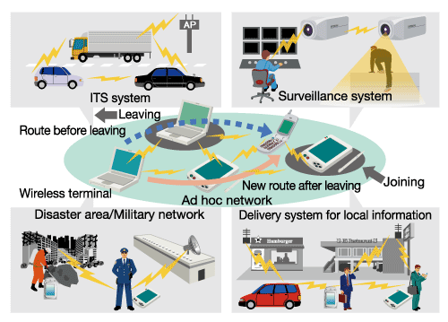
Networked Mobile Societies Anywhere, Anytime
Transportation/Vehicular Networks
Sensor Networks
Disaster & Emergency alerts
Local information delivery
Mobile Ad hoc, Sensor and Delay Tolerant Networks (DTNs)

Slide 17
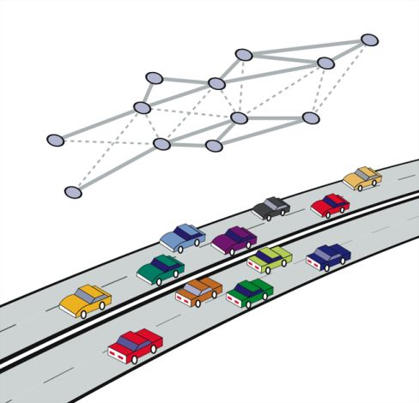
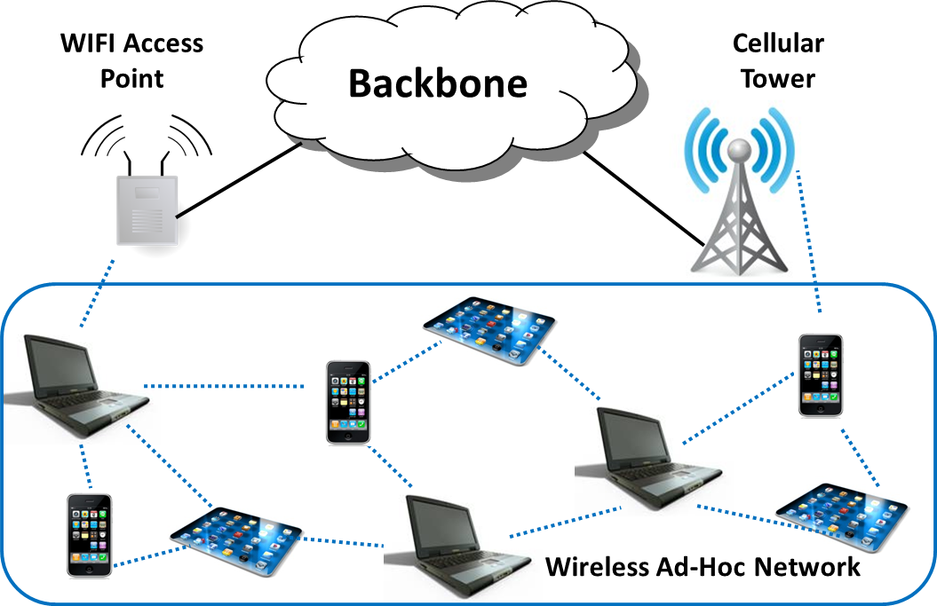
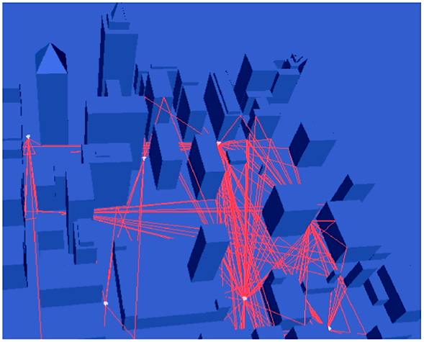
Example Ubiquitous (Sensing) Networks
Mobile devices (laptop, smartphones, tablets)
Vehicular Highway Nets
Hybrid urban ad hoc network (vehicular, pedestrian, hot spots,…)

Slide 18
What are characteristics of ad hoc vs. wired nets?
mobility and dynamics
higher BER and losses
power-constraints
infrastructure-less
Scale
Continuous change of location (addressing?) [wired is physically based]
Connectivity function of relative positions, radio power. May be asymmetric. (spatial vs. relational graph)
other?...

Slide 19
Implications of the Ad hoc environment on protocols?
Many routes may become invalid without ever being used
Protocols need to deal with higher losses and more dynamic environment
Need resource discovery and rendezvous mechanisms (no DNS or AS-based routing hierarchy)
Others…

Slide 20
Implications (contd.)
Unicast routing:
table-driven (LS & DV) vs. on-demand (DSR, AODV)
possible multi-path routing for increased robustness
Multicast routing
use of meshes instead of trees
Geographic routing
location-based routing
Security:
No notion of secure gateways or firewalls
Distributed, dynamic, scalable security. Harder!
Others … (loose hierarchy)

Slide 21
Sensor nets vs. ad hoc nets
mobility!
security!
node capabilty and power-constraints!
data-centric nature (vs. human/node centric)
mission/application specific
sensors may be dispensable

Slide 22
Topics
What is included in the "Ad Hoc Networking" – Charles Perkins book?
Edited chapters by the original authors on:
Unicast routing for ad hoc networks (DSDV, DSR, AODV/MAODV, TORA),
cluster-based routing and hierarchy,
zone routing (ZRP),
efficient link-state/broadcast.

Slide 23
Topics (contd.)
What is not included in the book but may be covered in class?
Multicast routing for ad hoc networks
Geographic (location-based) routing
Mobility modeling
Resource discovery.
Other topics (that are not specific to ad hoc networks) include:
Small worlds - peer-to-peer networks
IP mobility - STRESS.

Slide 24
Birds-Eye View: Research in the Mobile Networking Lab at UFL & USC
Architecture & Protocol Design
Methodology & Tools
Robust Geographic Wireless Services (Geo-Routing, Geocast, Rendezvous)
Test Synthesis (STRESS)
Query Resolution in Wireless Networks (ACQUIRE & Contacts)
Protocol Block Analysis (BRICS)
Gradient Routing (RUGGED)
Mobility Modeling
(IMPORTANT)
Multicast-based Mobility (M&M)
Worms, Traceback in Mobile Networks
Behavioral Analysis in Wireless Networks
(IMPACT & MobiLib)
Mobility-Assisted Protocols (MAID)
Socially-Aware Networks (AWARE)
iTrust, iCast (profile-cast), iTest

Slide 25
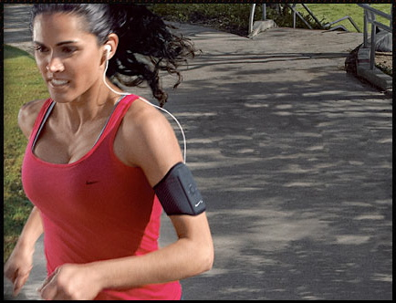
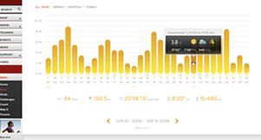
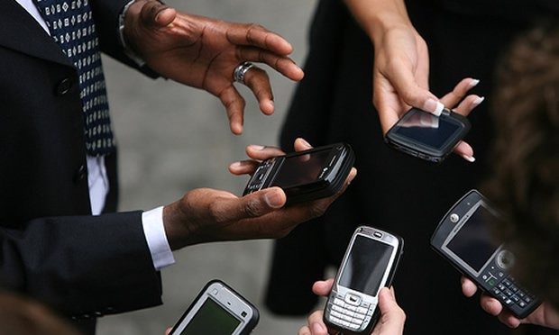
Emerging Behavior-Aware Services
Tight coupling between users, devices
Devices can infer user preferences, behavior
Capabilities: comm., comp., storage, sensing
New generation of behavior-aware protocols
Behavior: mobility, interest, trust, friendship,…
Apps: interest-cast, participatory sensing, crowd sourcing, mobile social nets, alert systems, …
New paradigms of communication,
computation, storage and sensing?!

Slide 26
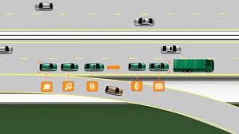
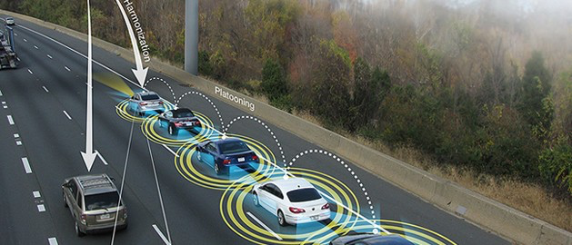
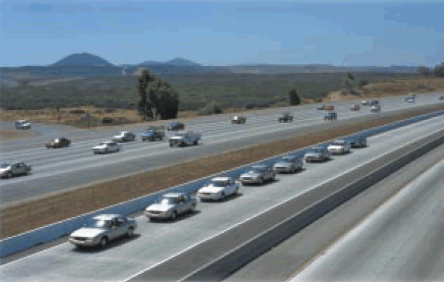
Platooning: Essential for Future VANET

Slide 27
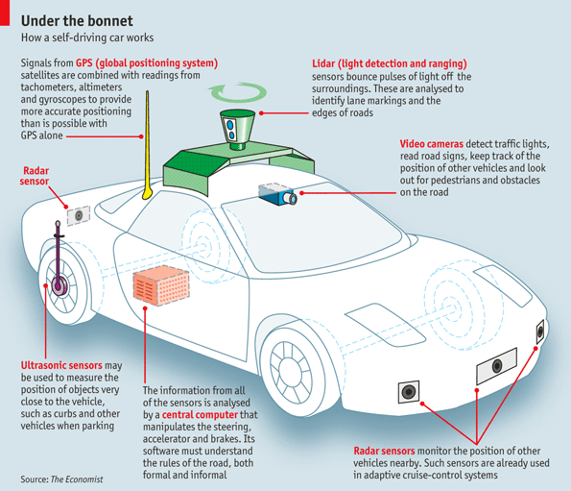
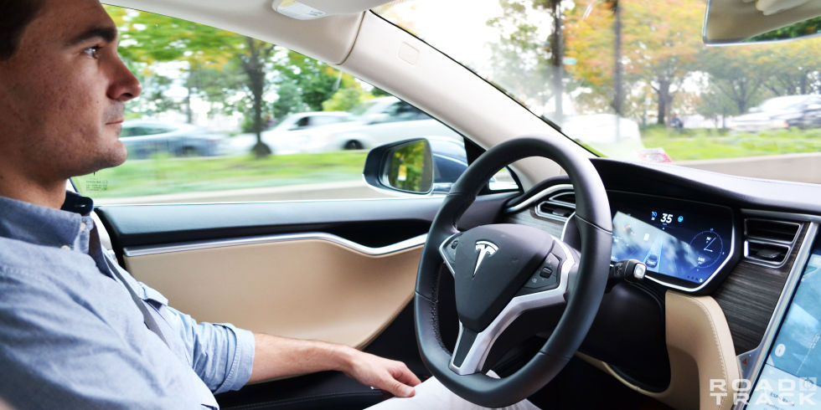
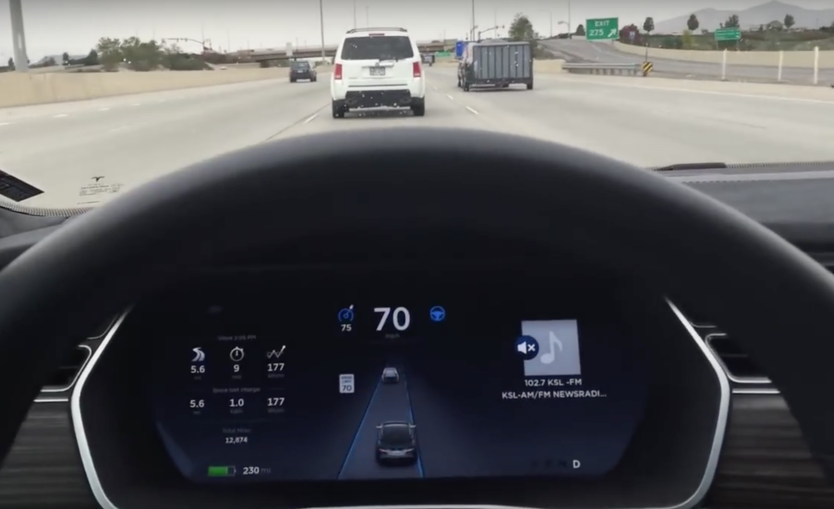
Self-driving as Platoon Enabler

Slide 28
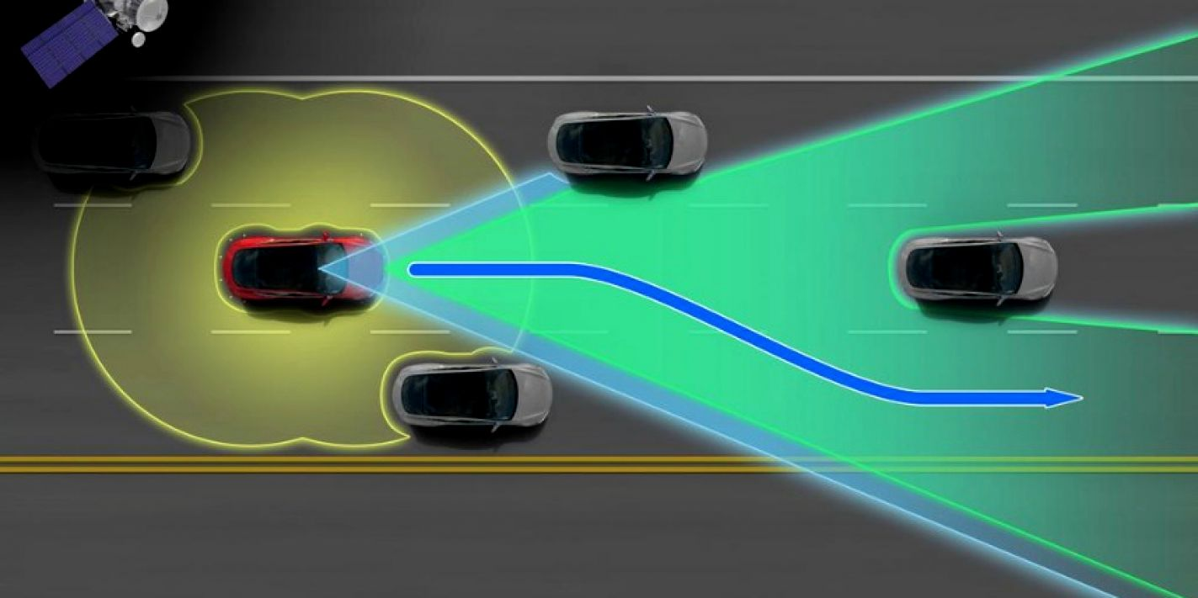
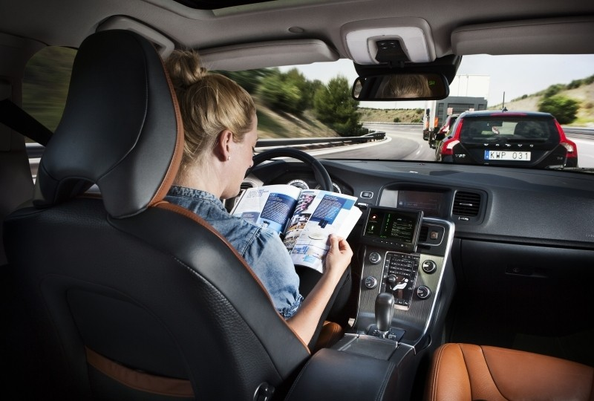
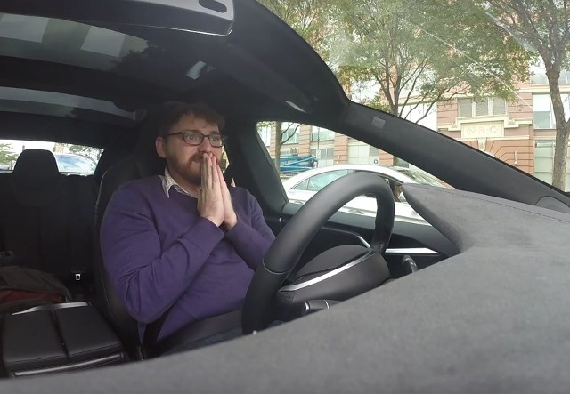
Really self-driving!

Slide 29
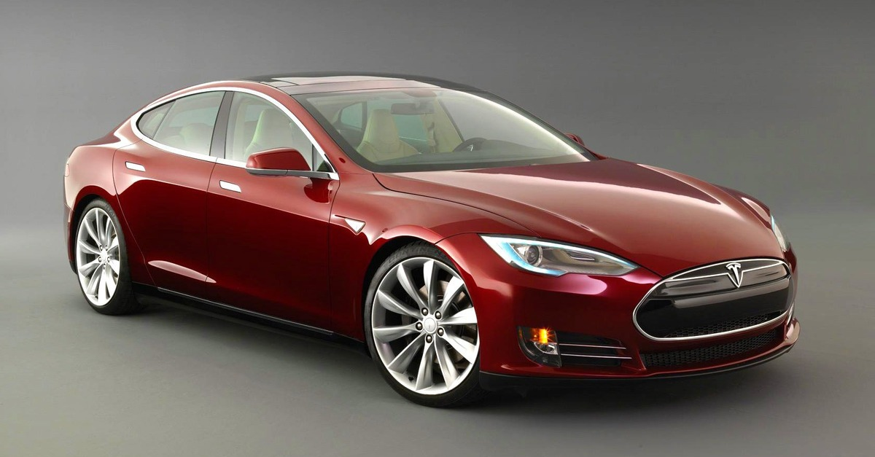
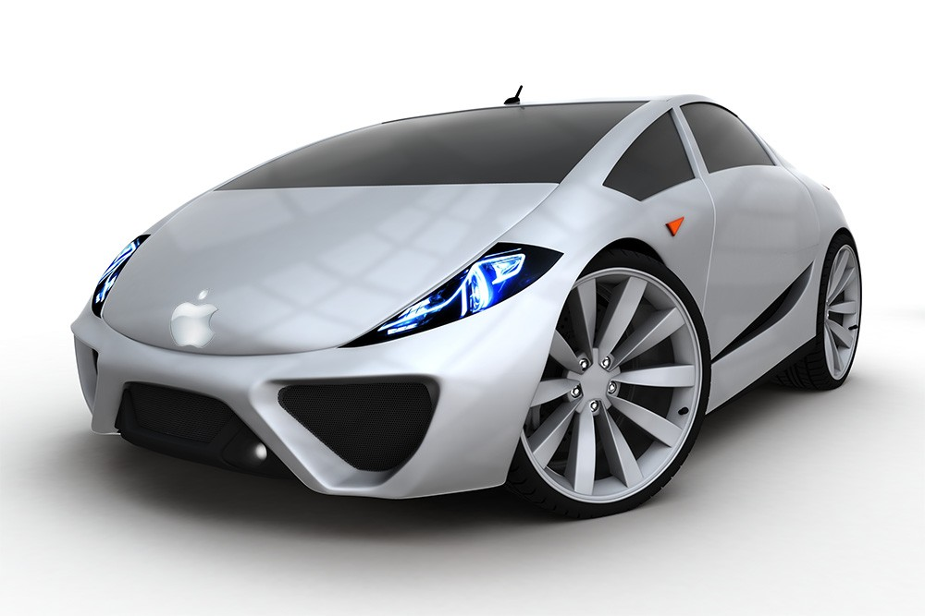
Does it Exist?

Slide 30
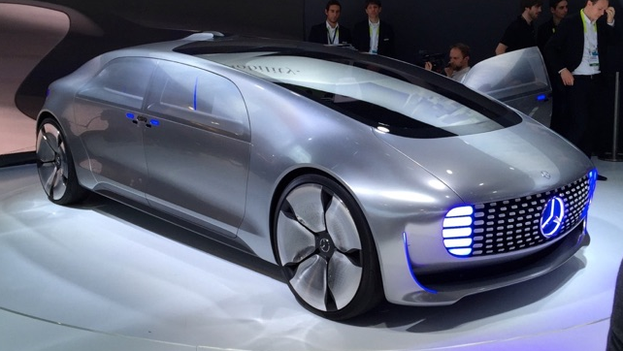
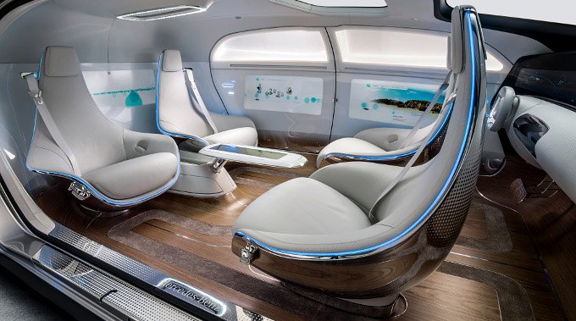

Slide 31
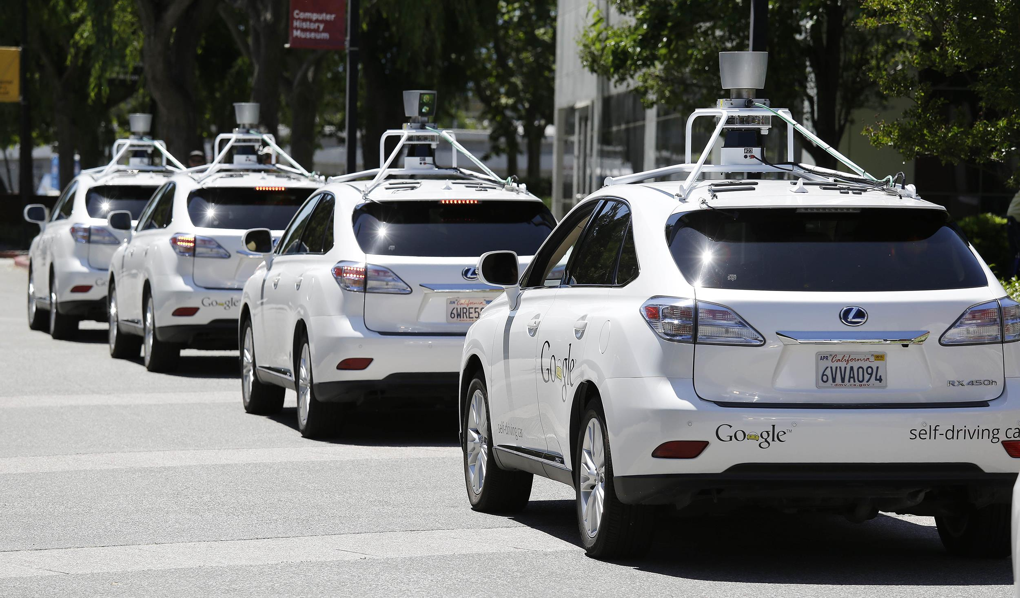
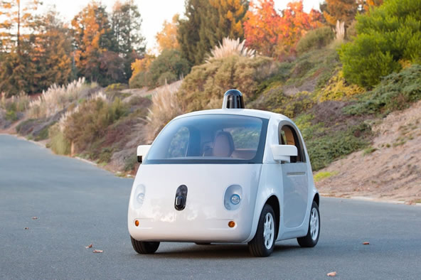

Slide 32
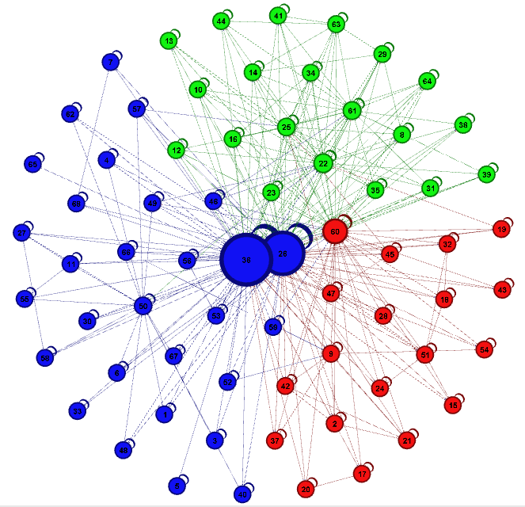
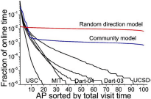
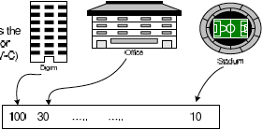
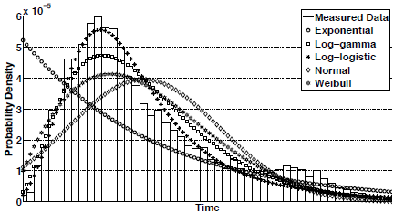
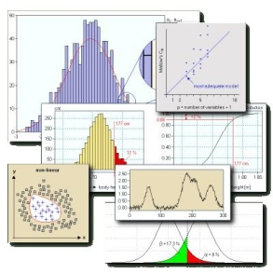
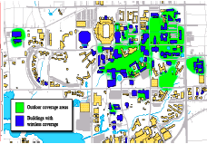
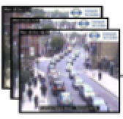
Systematic TRACE framework
Data-driven Mobile Network Mining, Modeling and Design
Billions of traces since 2004
MobiLib
Analyze
Trace
Represent
Characterize, Cluster
Employ(Model, Design)
- Mobility Modeling
- Adhoc & Sensor Network Design

Slide 33
Community-wide Mobile Library
Vision: Library of
Measurements: campus, street
Realistic models: behavior, traffic
Benchmarks – Data mining tools
Available libraries:
CRAWDAD (Dartmouth, ‘05-)
Pentland (MIT) reality mining, etc.
MobiLib (USC & UFL, ’04-) cise.ufl.edu/~helmy/MobiLib (30+TB)
65+ Traces from: USC, Dartmouth, MIT, UCSD, UCSB, UNC, UMass, GATech, Cambridge, UFL, …
Tools for mobility modeling (IMPORTANT, TVC), data mining
Types of traces:
Campuses (WLANs), Conference AP and encounter traces
Municipal (off-campus) wireless APs, Bus & vehicular
Trace

Slide 34
Extra Overview Slides
May help in ‘direction’ of a project
It does not include all possible projects, you can suggest your own
Make sure to have a ‘novelty’ and ‘challenge’ elements in the project
Talk to others, and form groups, then discuss
Talk/email me if you have ideas and not sure

Slide 35
Possible Projects: Mobility modeling:
Suggest a new mobility model and study its effects on a class of ad hoc networking protocols
Suggest a new mobility metric and use it to measure and study characteristics of mobility models and ad hoc networking protocols
Study effects of different mobility models on various ad hoc networking protocols, including (but not limited to) ad hoc:
unicast routing (e.g., DSR, DSDV, AODV, TORA, etc.)
multicast routing (e.g., ODMRP, CAMP, MAODV, etc.)
geographic routing (e.g., Geocast, GPSR, Grid/GLS, GeoTora)
hierarchical routing (e.g., ZRP, LANMAR, cluster-based, etc.)
others (Mobility-assisted protocols: EASE, FRESH, MARQ..)
Use stress-like approach to synthesize worst-case mobility scenarios
Helpful references: papers on IMPORTANT, BRICS, PATHS, MAID, IMPACT, MILMAN, Stress papers,… EASE/FRESH, Mobility increases...

Slide 36
Mobility Modeling and Analysis (contd.)
Use the mobility library of traces (MobiLib)
To analyze and understand characteristics of realistic mobility
Compare realistic (trace-based) mobility to ‘synthetic’ mobility models
Construct new models that are trace-based and extract their parameters from the traces
Contribute to extending the mobility library
By collecting traces of mobility based on surveys, observations, or other methods (with cis6930, ee555 students, etc.)
Are there fundamental characteristics of WLAN traces that do not change with technology (e.g., they apply to future ad hoc networks)?
Study human mobility/behavior for non-wireless traces or non-network traces and compare the characteristics
Suggest another way to investigate such question
References: IMPACT, MAID, other trace pprs, … TVC, Mining Behavioral Profiles

Slide 37
Context & Socially-aware Networks, Services & Apps
New services in encounter-based networks:
Peer-to-peer mobile networks of handhelds
Apps to identify friends, profiles, locations, etc.
Behavioral pattern recognition & prediction
Interest, gender, location & class-based services
Activity, role & trust identification
Message relaying & routing techniques
Network architecture for emergency and education
Refs. Profile-cast, gender-based analysis, predication, visualization posters & papers from lab students …

Slide 38
Social Discovery: iTrust/ConnectEnc* (downloadable from www.cise.ufl.edu/~helmy , or google itrust-uf )
* U. Kumar, A. Helmy, “Discovering Trustworthy Social Spaces", ACM SenSys - PhoneSense, Nov 2012.

Slide 39
Application: Mobile Health Care
Long term, continuous, multi-modal behavioral sensing
Differential behavioral analysis
Promise:
Early detection of risks, behavioral disorders
Targets:
Obesity, mobility, frailty
Directly related: encounter-
based infection trace-back (i-Hospital)

Slide 40
Application: Mobile Education
Similarity-aware collaborative group formation
Support groups against bullying
Next generation mobile classroom

Slide 41
Resource discovery and query resolution:
Study and analyze a contact-based approach for resource discovery in large-scale ad hoc networks (use detailed simulations in NS-2)
Suggest modifications of ZRP to implement efficient resource discovery
Suggest ways in which (partial or approximate) geographic information can improve contact-based architectures
Suggest ways in which contact-based archiectures can improve partial or inaccurate geographic routing
Helpful references: papers on CARD, MARQ, TRANSFER, ACQUIRE, Small large-scale wireless networks, ...

Slide 42
Storage-retrieval and rendezvous:
Suggest ways in which rendezvous regions (RRs) may be used for storage-retrieval in large-scale ad hoc networks
Propose a mixed RRs and contacts architecture for cases of imprecise location information
Compare RRs-based architecture to other approaches (e.g., GHT and Grid) qualitatively and quantitatively
Helpful references: papers on large-scale multicast in ad hoc nets, GHT, data-centric, Grid, Rendezvous Regions…

Slide 43
Geographic/location-based routing with partial or imprecise location information
Measuring and estimating inaccuracies in location measurement techniques (GPS and GPS-less) [this may easily include experimental lab part]
Correctness analysis of geographic/location-based protocols in presence of inaccuracies
Performance analysis of geographic/location-based protocols in presence of inaccuracies
Helpful references: papers on Goecast, Grid, GPSR, GeoTora, GPS-less location estimation , … others

Slide 44
Small worlds & Social Adhoc Networks
Small worlds in Wireless Networks
Show protocols and conditions for achievability and applicability of small worlds in ad hoc networks
Suggest new ways in which small worlds may be used in ad hoc networks
Use "small worlds of trust" as a basis for a security architecture in ad hoc networks
Helpful references: papers/books on small worlds, six degrees of separation, small large-scale wireless nets, BEBA, TESLA, Ariadne, On nodel encounters, …

Slide 45
Network Security for Wireless Networks
Trace-back techniques for Mobile Networks
Develop reasonable models for DoS/DDoS attacks in future ad hoc (potentially mobile) networks
Utilize mobility prediction mechanisms and countermeasures to alleviate such the attacks
Worm/Virus propagation models for wireless networks
Analyze the adequacy of epidemic models for modeling propagation of worms in wireless/mobile networks (e.g., using realistic mobility/encounter models/traces)
Develop defense techniques against such attacks
Examine feasibility of the Vaccine paradigm with counter worms
References: SWAT, ATTENTION, ART, VACCINE, other wireless security papers, … Sapon, Yongjin

Slide 46
Themes of Concentration
Mobile Devices as Human Sensors
Human Society as Sensor Network (Participatory Networking)
Behavior-based Networking & mSocial Nets
Examples:
iCast, Profile-cast
iTrust
iTest
Overall: designing, analyzing and implementing the new killer mobile App!!

Slide 47
Related websites:
www.cise.ufl.edu/~helmy
Teaching: ee499, ee599-03, cis6930 07, 08, 09
nile.cise.ufl.edu/MobiLib, nile.cise.ufl.edu/important
Publications (journals, conferences, book chapters)
Projects:
AWARE project
MARS project
M&M project - STRESS project
VINT project (the network simulator NS/NAM)
PIM project

Slide 48
General Network Design Framework

Slide 49
Network Protocol Architecture Methodology
Define the design space/domain parameters (the target environment)
Design requirements
Scale: #users, #systems, #sessions or calls
Reliability (availability)
Robustness (proper operation in presence of failure)
Performance: throughput, delay, jitter, overhead, etc.
Environment:
Topology (LAN, WAN) and connectivity
Characteristics of media:
wireless (high BER) vs fiber, mobile vs static, etc.
Demand, traffic, applications

Slide 50
Design: determine initial parameters of the network or/and protocol
Specification: state/stipulate clearly, crisply and formally, the rules that govern the operation of the network or protocol
Representation:
Finite state machine (FSM), pseudo code, English!
Observation:
Much of the spec deals with failures/anomalies
Most protocols (esp. network/mac layer) do not have clear robustness performance claims !
How can we evaluate/test them?

Slide 51
Evaluate the design:
Evaluation criteria
Performance (e.g., overhead, response time, throughput)
Correctness (e.g., absence of deadlocks or duplicates)
Evaluation/modeling methodology
Analysis (mathematical model) [e.g. blocking/cell delay in 1 switch]
Simulation
Hybrid [e.g. # of retransmissions of 100 TCP connections over 1000 node network]

Slide 52
Elements of Network Evaluation Studies*
Evaluation metrics:
correctness, performance [need clear definition]
Evaluation Methodology:
Analytical (queuing theory)
Network simulation (e.g., VINT/NS)
FSM search (e.g., STRESS)
Experimentation/measurements
Analysis of results and conclusions
* These are extremely important elements to define for the projects

