Slide 1
BitTorrent enabled Ad Hoc
Group 1
→Garvit Singh(1904-5598)
→Nitin Sharma(6399-9875)
→Aashna Goyal(0939-5415)
→Radhika Medury(9190-6268)

Slide 2
GARVIT-Approaches and Comparison
NITIN-BitHOC
RADHIKA-Cross Layer
AASHNA-Survey On Applications

Slide 3
Broadcast Based Approach
Broadcast implemented at any of the 2 levels
Peer discovery and network discovery can be both done by broadcast
  Too much of load on the network
  Not scalable
  Heavy power consumption

Slide 4
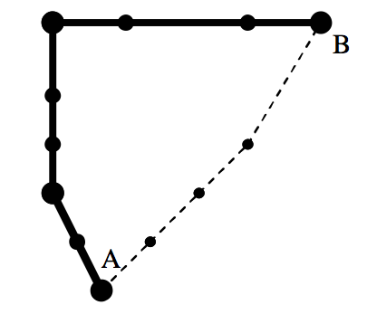
DHT Based Approach
Can be applied both for file discovery and route discovery
Less load on network + power efficient + scalable
Routing tables maintained at the peers.

Slide 5
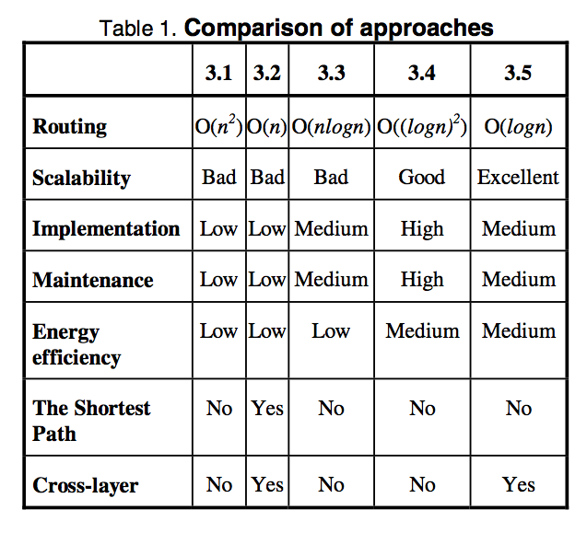
3.1-broadcast over broadcast
3.2-broadcast<cross-layer>
3.3-DHT over broadcast
3.4-DHT over DHT
3.5-DHT<cross-layer>

Slide 6
Strength & Weakness
How two common approaches work at P2P level and network routing level in Ad Hoc
Emphasis on route discovery not on route maintenance?
Does not talk about which approach it has taken for the cross layer design and how an effective approach can be taken up for designing the same.

