Slide 1
Geocast DTNs
Presented by:
Khulood Azwary
Kratika Gupta

Slide 2
A General Overview
Geocast deals with sending of the messages to a node in a specific geographic region.
Various protocols have been proposed over the years employing various methods for the same.
  Eg Greedy algorithm, zones/clustering, planarization in case of local maxima

Slide 3
GeoDTN+Nav: Geographic DTN Routing with Navigator Prediction for Urban Vehicular Environments
Pei-Chun Cheng · Kevin C. Lee · Mario Gerla · Jérôme Härri

Slide 4
GeoDTN+Nav
It is hybrid of greedy algorithm and perimeter mode and DTN in case it face partitioned network

Slide 5
GeoDTN+Nav
GPSR: Greedy Perimeter Stateless Routing .
GPCR: Greedy Perimeter Coordinator Routing.
Both use greedy algorithm to forward packets by selecting relays with the best progress toward the destination and recovery mode in such solution fail.
In recovery mode “local maximum” they use planarization and forward packet around the obstacle.

Slide 6
GeoDTN+Nav
It is complex and force a packet
to progress in small steps.
Routing loop in high mobility.
Increase latency.
Inability to to deliver packets
across partitions in case of
partitioned network.
However, DTN can forward packets through partition

Slide 7
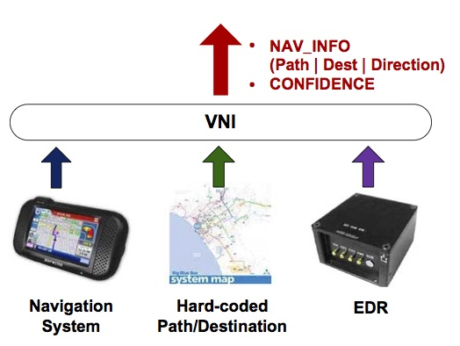
GeoDTN+Nav
Virtual navigation interface framework:
They classify vehicles based on traffic pattern.
Retrieving rout-info and confidence from vehicles.

Slide 8
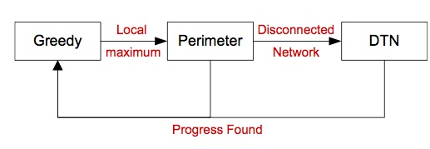
GeoDTN+Nav
Switch score is calculated for each neighbor.
It’s combined of three factors: P(h),Q(N_{i}),Dir(N_{i}).

Slide 9
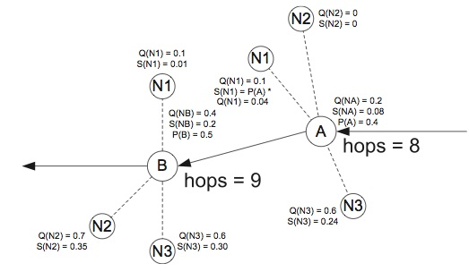
Switching from DTN to Greedy Mode

Slide 10
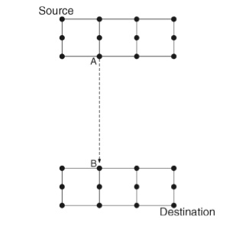
Synthetic topology

Slide 11
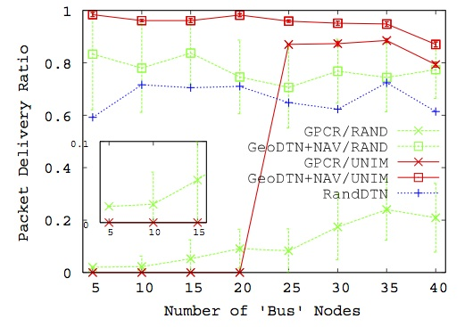

Slide 12
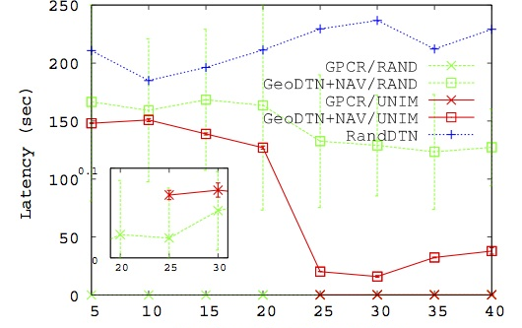

Slide 13
GeoDTN+Nav
Strengthens:
Using real traces from Intelligent Driver Model with Intersection Management (IDM-IM) by VanetMobiSim.
Inventing VNI (Virtual navigation interface )Framework.

Slide 14
GeoDTN+Nav
Weakness:
In addition to planarization weakness also it relies in mobility in DTN phase.
Doesn’t use of useful links between tow nodes on different roads.
Switching to greedy mode depends on distance between the initial local maximum node and destination.
Moving destination
Privacy issue.

Slide 15
A Novel Geocast Technique with Hole Detection in Underwater Sensor Network
Sanjay K. Dhurandher
Mohammad S. Obaidat
Megha Gupta

Slide 16
A Novel Geocast Technique with Hole Detection in Underwater Sensor Network
It consists of six parts:
Neighbor Table Formation Algorithm
Route Discovery Algorithm
Route Maintenance Algorithm
Multicast Tree Formation for routing in geocast region
Hole Detection in geocast region
Boundary routing around the geocast region.

Slide 17
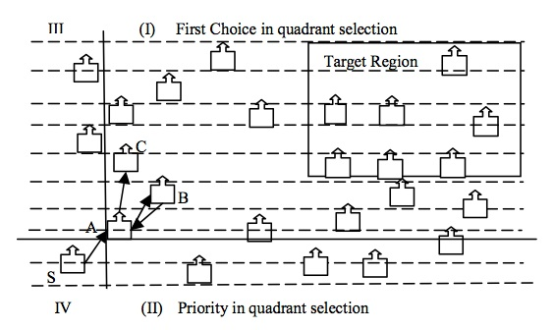

Slide 18
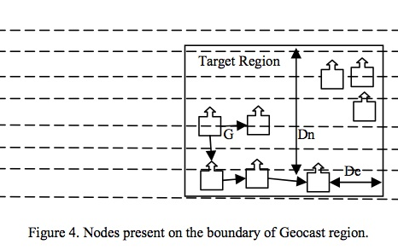

Slide 19
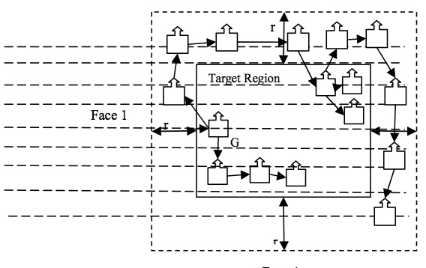

Slide 20
Weakness:
Overhead in first 2 algorithm part.
Doesn’t clear how to determine r in virtual area.
Scalability.

Slide 21
DTFR: A Geographic Routing Protocol for Wireless Delay Tolerant Networks
Anna Sidera, Stavros Toumpis

Slide 22
Routing
Sender sends the packet to a location known as Firework Center in geocast region according to past information (location and mobility pattern)

Slide 23
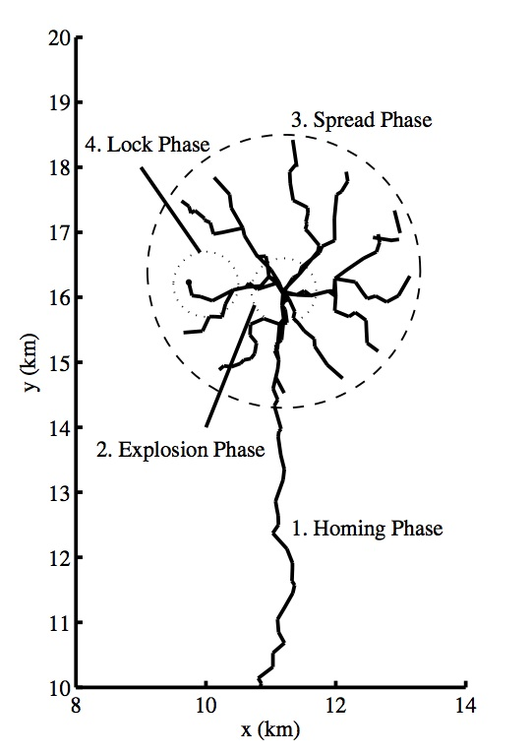
Works in 4 phases:
  Homing Phase
  Explosion Phase
  Spread Phase
  Lock Phase

Slide 24
Homing Phase
Greedy strategy used
Packet is forwarded as long as nodes are found closer to Firework Center
If no suitable node found, current holder of packet waits for one to emerge
Explosion Phase
Starts when packet reaches FC
A number of replicas of the packet are created

Slide 25
Spread Phase
Replicas are forwarded in various directions inside the geocast region to ensure delivery to destination
Firework Endpoints are also determined
Lock Phase
Starts when a known route to destination is encountered
This pre-calculated route is then used to send the packet to destination

Slide 26
Priority of Phases over the Other
Lock Phase > Homing Phase > Explosion Phase > Spread Phase

Slide 27
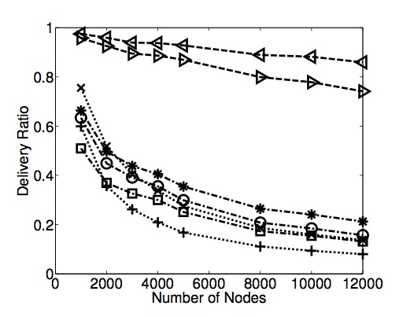
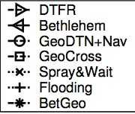

Slide 28
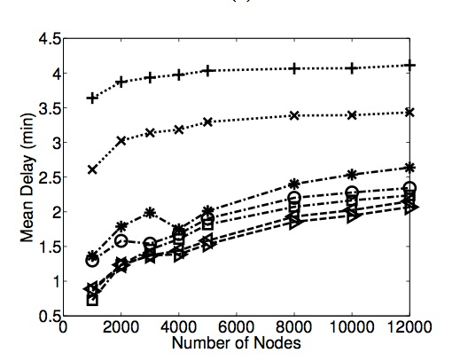

Slide 29
Weaknesses
Large number of nodes: This is not possible always.
During Homing Phase: though it is using greedy algorithm, but it waits for unlimited time until it gets a next suitable neighbor.
Tradeoff during Lock Phase between new route calculation and moving on pre-calculated route.

Slide 30
Delivery-Guaranteed Geocast in MANETs by using ZHLS
Wang-Cheol Song, Hanan Lutfiyya

Slide 31
Divides network into 2 overlapping zones:
  Zone level topology (with Zone LSPs)
  Node level topology (with Node LSPs)
Zone LSP: has intra-zone and inter-zone routing tables
Node LSP: has identifiers of
  nodes in the same zone, and
  Zone identifiers of neighbors in different zones (Gateway nodes)

Slide 32
Assumptions
Zone level topology is relatively stable minimizing the effect of mobility
Low simulation velocities, hence considered low mobility of nodes.

Slide 33
Routing
Gateway nodes send Zone LSPs to sender
Sender evaluates zone topology in the region
Sender determines 1 Zone in each island to send the to receive the packets, and unicasts packet to respective gateway nodes
Packets received are geocasted in the same region

Slide 34
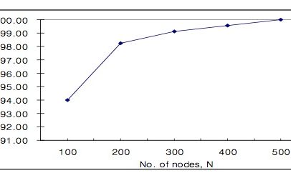

Slide 35
Weakness
Not considered the case for nodes with high mobility

Slide 36
Strength
Message delivery guarantee with very high delivery ratio

Slide 37
geoDTN: Geographic Routing in Disruption Tolerant Networks
Jo Agila Bitsch Link, Daniel Schmitz,
Klaus Wehrle

Slide 38
Decision based on:
  Previous node movements
  Probabilistic node meeting heuristic
Mobility vector
  Contains all information required for routing decision
  Cluster, Confidence
Neighbor score

Slide 39
Terminologies used:
Clusters: a bivariate normal distribution function collection containing location of observed nodes
Confidence (of a cluster): exponential decay function provides kind of guarantee of vector
Neighbor Score: value depends on the frequency with which 2 nodes are in radio range at common location

Slide 40
Routing: Mobility Vectors
Vectors of contacting nodes and their 2-hop neighbors exchanged
n_{i}
n_{k}
n_{j}
v_{nj}, v_{nk}

Slide 41
Routing: Mobility Vector Updates
n_{i} receives v_{nj}
  n_{i} updates its vectors according to the confidence values
n_{i} receives v_{nk} which it already has
  Update the vector with cluster with high confidence value
n_{i} receives v_{nk} which it does not have yet
  Complete vector adopted

Slide 42
Routing Modes
  Distance Mode
  Scoring Mode: when node is in vicinity of destination
  Rescue Mode: if message is stuck in local minimum

Slide 43
Routing Procedure
Whenever a node comes in radio range, message transfer through the node with higher score is chosen
If the score is below threshold, other modes are employed

Slide 44
Distance Mode
Hill climbing strategy used
Distance of a node to the destination is calculated in terms of confidence and probability

Slide 45
Rescue Mode
Hill climbing strategy may result in message bundle getting stuck in local minimum
Random walks used a solution

Slide 46
Scoring Mode
Used when bundle reaches vicinity of destination
Calculation of neighbor scores own neighbor scores with those of the neighborhood. Best score neighbor used to transfer the bundle

Slide 47
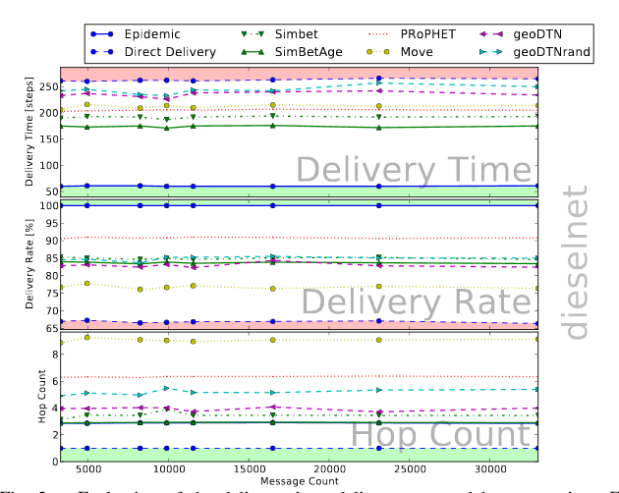

Slide 48
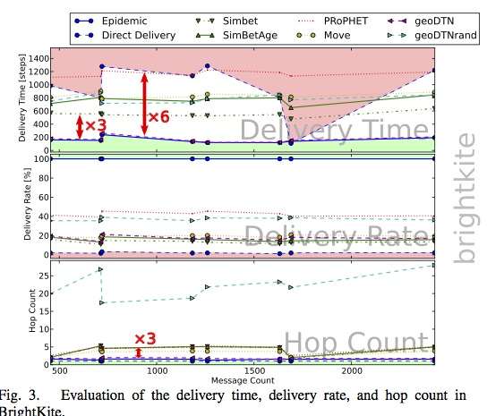

Slide 49
Strengths
Paper takes care of fairness among nodes and also energy efficiency while comparing with other existing routing methods.
Various aspects affecting routing decision (like confidence, cluster formation, scoring) are effectively chosen.
Tested for real world traces.

Slide 50
Thank You!!

