Slide 1
BitTorrent enabled Ad Hoc
Group 1
→Garvit Singh(1904-5598)
→Nitin Sharma(6399-9875)
→Aashna Goyal(0939-5415)
→Radhika Medury(9190-6268)

Slide 2
GARVIT-Approaches and Comparison
NITIN-BitHOC
RADHIKA- Cross Layer Architecture
AASHNA-Survey On Applications

Slide 3
Approaches for P2P file sharing over MANET

Slide 4
Broadcast Based Approach
Broadcast implemented at any of the 2 levels
Peer discovery and network discovery can be both done by broadcast
  Too much of load on the network
  Not scalable
  Heavy power consumption

Slide 5
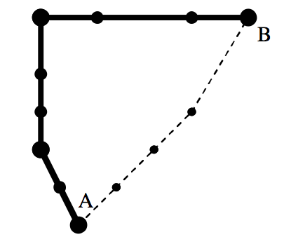
DHT Based Approach
Can be applied both for file discovery and route discovery
Less load on network + power efficient + scalable
Routing tables maintained at the peers.

Slide 6
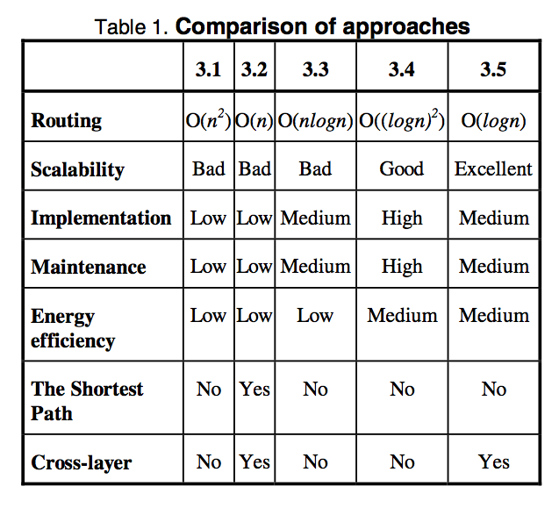
Cont..

Slide 7
Strength & Weakness
How two common approaches work at P2P level and network routing level in Ad Hoc
Emphasis on route discovery not on route maintenance?
Does not talk about which approach it has taken for the cross layer design and how an effective approach can be taken up for designing the same.

Slide 8
BitHoc: Bittorent for Wireless Ad Hoc networks

Slide 9

Why was/is Bittorent hard over wireless networks?
Scarcity of the resources due to their shared nature.
TCP performance drops
Limited energy, bandwidth and computation power.
Mobility
Complexity

Slide 10
Design Space
Archtecture | Design | Example | Result
Non-structured | Layered | Gnutella | Lower packet delivery ratio
Non-structured | Cross-layer | ORION | High transfer ratio
Structured | Layered | Pastry | Overhead in route maintenance
Structured | Cross-layer | Ekta | High packet deliver ratio

Slide 11
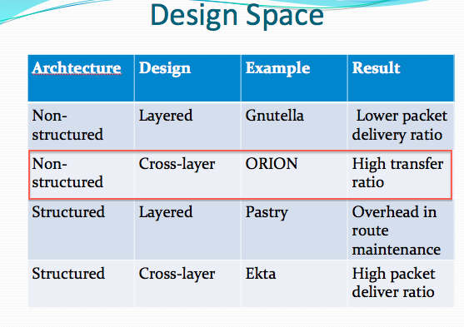

Slide 12
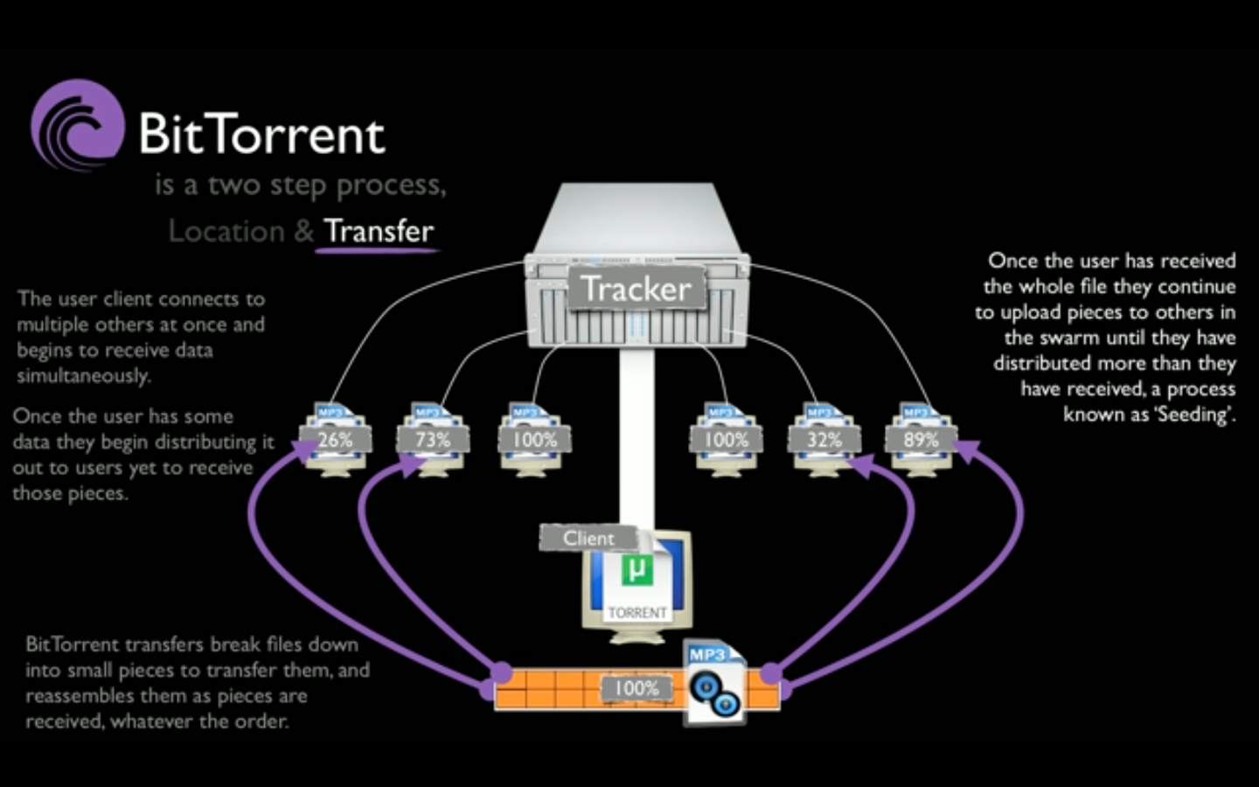

Slide 13
What solution is author Proposing?
BitHoc
Bittorent is topology unaware so limit the scope of neighborhood.
In unstructured architectures nodes have to be aware about the scope of the neighborhood.

Slide 14


Slide 15

Cont..
BitHoc
Balance between content download time and fair sharing.
Modify chocking algorithm
TTL of the message can help in deciding the scope of the neighborhood.

Slide 16
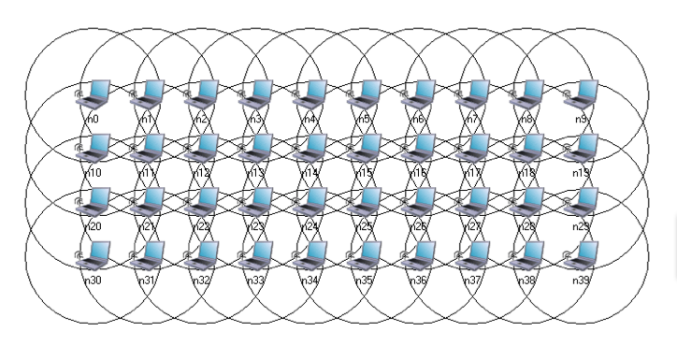
Experimental Observation

Slide 17
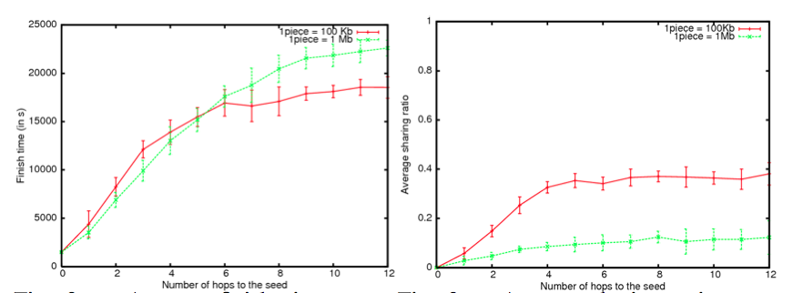
Results
Piece size is an important factor (Balance!!)

Slide 18
Cont…

Slide 19
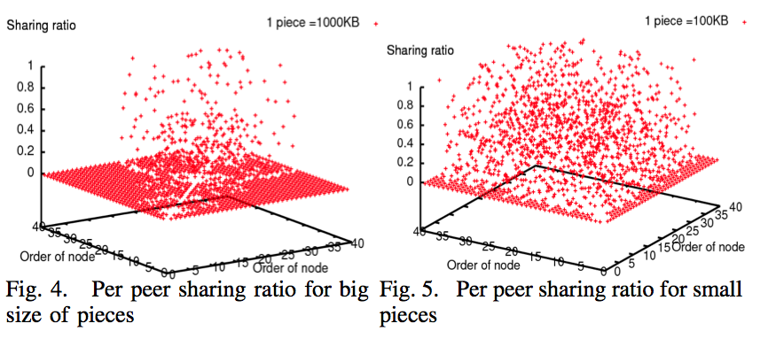
Cont…

Slide 20
Cont…

Slide 21
Problems with solutions!!
Reducing the neighborhood comes at the expense of a lower sharing ratio.
New chocking algorithms involves TCP connections with distant peers leading to performance degradation.
NEARBY NEIGHBORS TABLE (NNT) and FAR NEIGHBORS TABLE (FNT)– Extra overhead.

Slide 22

What will be borrow?
Broadcasting is not a good idea.
Small size of pieces.
Central tracker can be effective solution.
Can use DHT like approaches to reduce the complexity.

Slide 23
Recap ( DHT vs. Broadcast)
DHT is scalable as compared to broadcast.
Less load (DHT)
Routing tables maintained at peers ( DHT ).
Radhika -23

Slide 24
Cross Layer Architecture
MANET routing protocol + middleware which implements part of the p2p application layer protocol and a communication mechanism between both layers.
P2p Middleware divided into a set of components –
Messaging API, peer configuration, peer selection ,
query routing and forwarding
Radhika - 24

Slide 25
Strengths and Weaknesses
Provides a clear advantage over simply layering a traditional unstructured p2p system on top of a MANET.
Explores the benefits of exploiting interactions between layers to improve performance and reduce network overhead.
Radhika - 25

Slide 26
Survey
There is a survey of alternative network architectures, protocols and implementations proposed for mobile peer-to-peer networking.
Objective is to provide a complete overview on the mobile peer to peer technology.
Notes:
The paper is centred on mobile peer-to-peer systems for mobile phones.

Slide 27
Contd...
Peer to peer content distribution is a very interesting paradigm in cellular environments .
Mobile peer to peer has been developed for P2P networking in mobile ad hoc environments. MPP implements an efficient signaling messages mechanism and cross layer communication between the network layer and application layer.
Notes:
Survey included

Slide 28
Challenges
This involves new challenges due to constraints present in mobile devices :
Memory
Processing power
Network accessibility problems with low bit rates , high latency, packet losses etc.
Battery consumption
Mobile issues

Slide 29
Mobile peer to peer content sharing Applications
Generic engine-This engine facilitates quick and robust data modeling by providing a metamodel-based generative mechanism
Jmobipeer- JMobipeer is a framework designed to work on J2ME enabled mobile devices on mobile ad hoc networks.
Notes:
Mobile Peer to Peer Content Sharing Application is an innovative proposal of an
architecture of mobile peer to peer content sharing services
-This engine facilitates quick and robust data
modeling by providing a metamodel-based generative mechanism.
-This framework uses a reactive routing algorithm
although due to the modularity of its architecture the routing algorithm can be replaced
with any other.
-Proem is a platform for the development of P2P collaborative applications in mobile
ad- hoc networking environments.

Slide 30
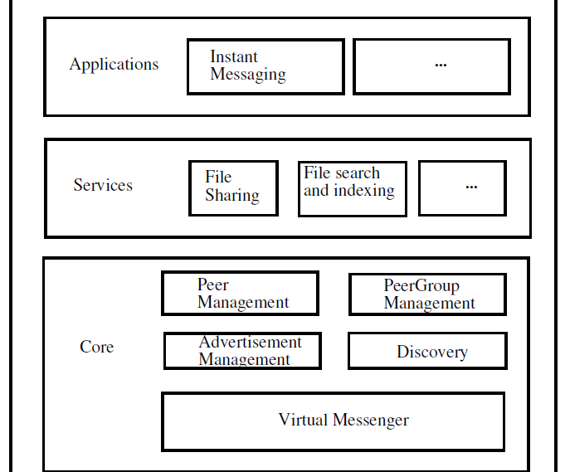

Slide 31
Contd...
Proem is a platform for the development of P2P collaborative applications in mobile ad- hoc networking environments.
The Proem middleware consists of three main components: an application runtime environment, a set of middleware services, and a protocol stack. Proem defines four protocols, one low level transport protocol and three higher-level protocols.
Proem differs from previous platforms by focusing on the requirements of face-to face applications.
Notes:
Proem-Proem provides a runtime environment for the execution peerlets.

Slide 32

Questions?

