Slide 1




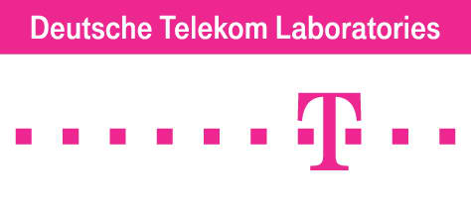
Data-driven Mobile Social Networking (The Next Frontier: Behavioral Spaces)
Ahmed Helmy
Computer and Information Science and Engineering (CISE) Department
^{University of Florida}
helmy@ufl.edu , http://www.cise.ufl.edu/~helmy
Founder & Director: Wireless Mobile Networking Lab http://nile.cise.ufl.edu
Funded by:

Slide 2





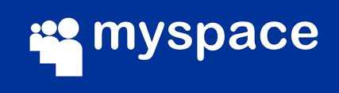










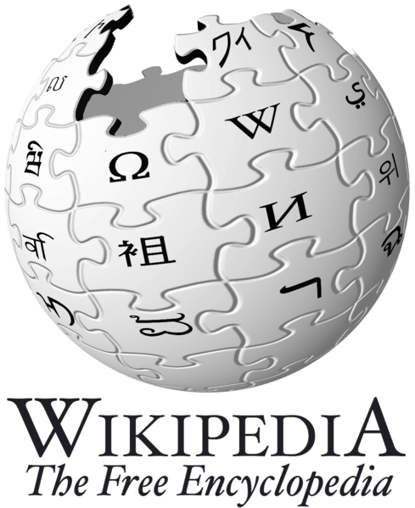



Today’s Social Networks

Slide 3
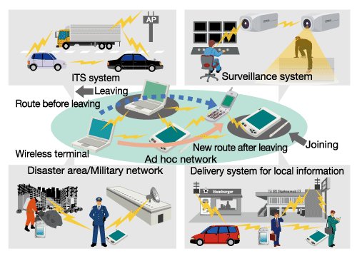
Networked Mobile Societies Anywhere, Anytime
Transportation/Vehicular Networks
Sensor Networks
Disaster & Emergency alerts
Mobile Ad hoc, Sensor and Delay Tolerant Networks

Slide 4
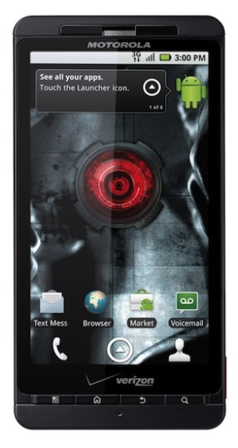
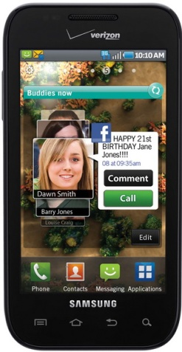
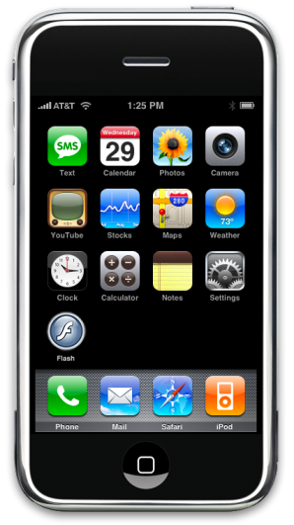
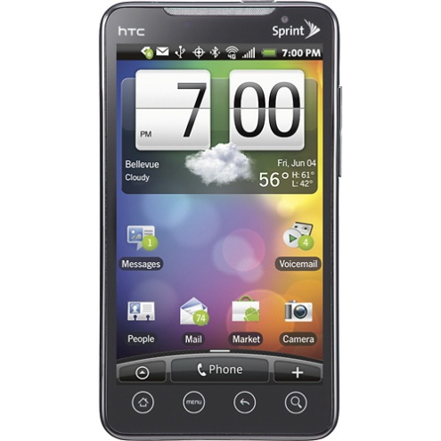
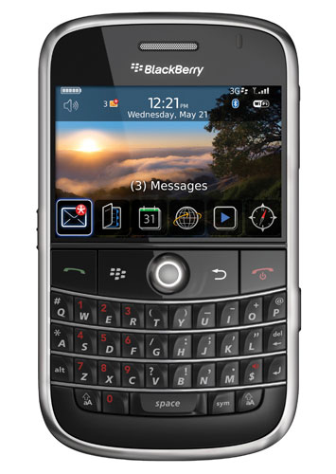
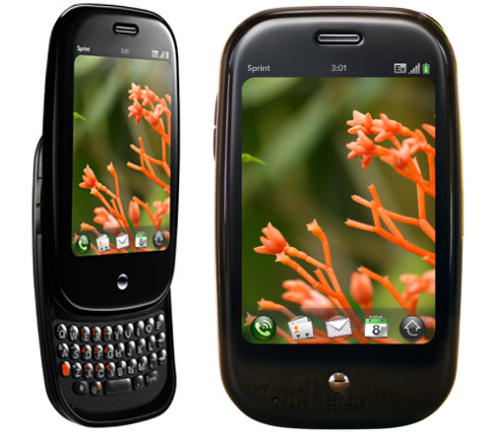
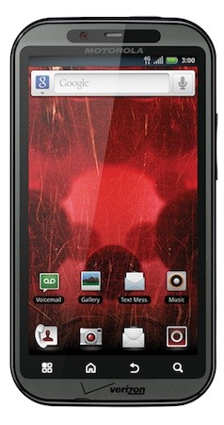
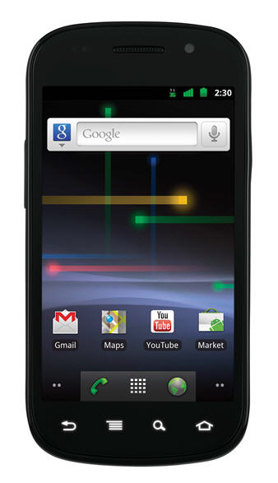
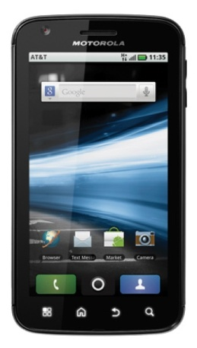
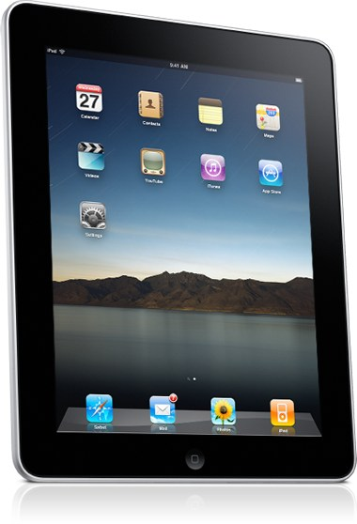
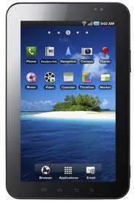
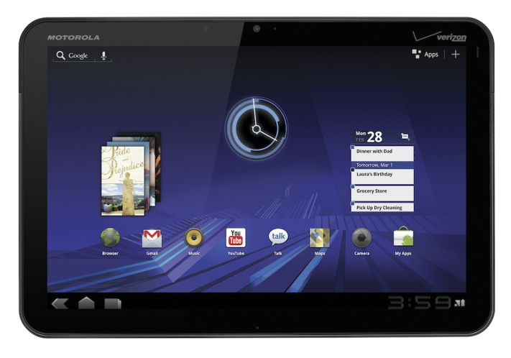
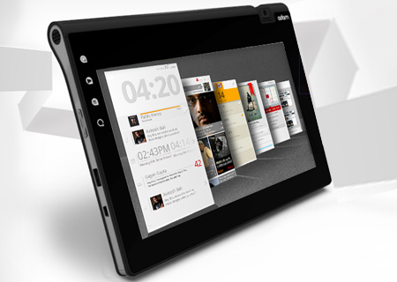
New Generations of Powerful Mobile Devices
Galaxy S
HTC EVO
Blackberry Bold
Palm Pre
iPhone
Droid X
?
?
Bionic
Nexus S
Atrix
Next Droid
iPhone 5
Over 5 Billion mobile phones and devices globally !! (Feb 2011)
iPad 2
Notion-Ink-Adam
Galaxy Tab
Motorola Xoom

Slide 5
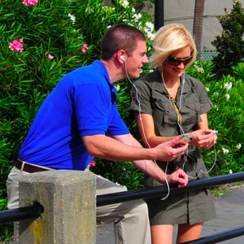
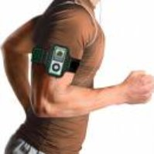
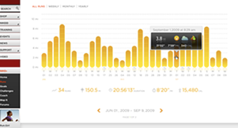
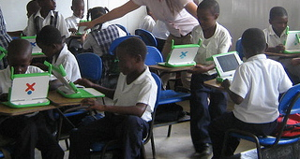
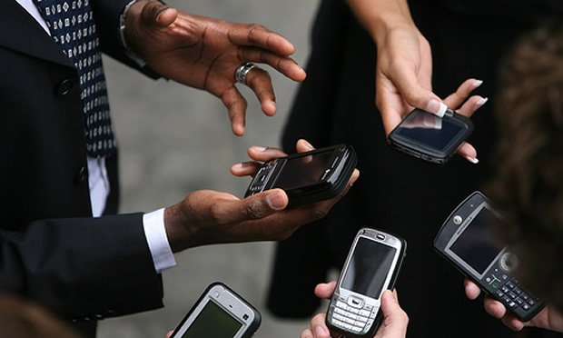
Emerging Behavior-Aware Services
Tight coupling between users, devices
Devices can infer user preferences, behavior
Capabilities: comm., comp., storage, sensing
New generation of behavior-aware protocols
Behavior: mobility, interest, trust, friendship,…
Apps: interest-cast, participatory sensing, crowd sourcing, mobile social nets, alert systems, …
New paradigms of communication?!

Slide 6
Paradigm Shift in Protocol Design
Used to:
Design general purpose protocols
Evaluate using models (random mobility, traffic, …)
Deployment context: Modify to improve performance and failures for specific context
May end up with suboptimal performance or failures due to lack of context in the design phase
Propose to:
Analyze, model deployment context
Design ‘application class’-specific parameterized protocols
Utilize insights from context analysis to fine-tune protocol parameters

Slide 7
Main Research Questions
Q1: How to gain insight into deployment context?
Q2: How to utilize insight to design future services?
Approach
Extensive trace-based analysis to identify dominant trends & characteristics
Analyze user behavioral patterns
I. Individual user behavior and mobility
II. Collective user behavior: grouping, encounters
Integrate findings in modeling and protocol design
I. User mobility modeling – II. Behavioral grouping
III. Information dissemination in mobile societies, profile-cast

Slide 8

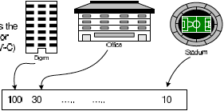
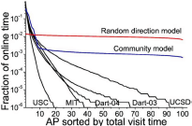
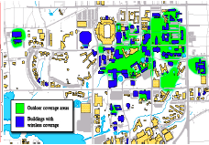
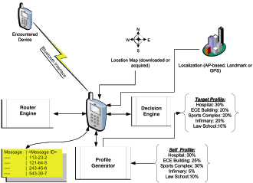
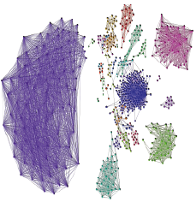
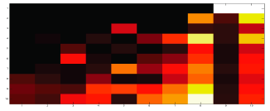
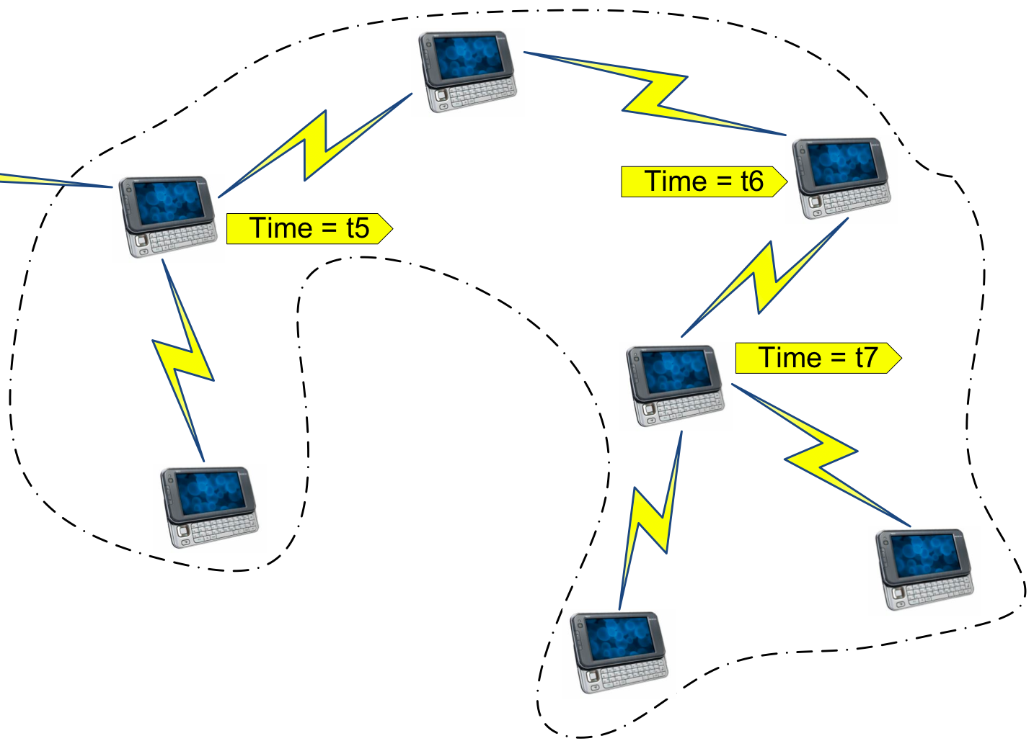
Systematic TRACE framework
MobiLib
Analyze
Trace
Represent
Employ
(Modeling, Protocol Design)
Characterize, Cluster

Slide 9
Community-wide Wireless/Mobility Library
Vision: Library of
Measurements from Universities, vehicular networks
Realistic models of behavior (mobility, traffic, encounters)
Simulation benchmarks - Tools for trace data mining
Available libraries:
CRAWDAD (Dartmouth, ‘05-) crawdad.cs.dartmouth.edu MobiLib (USC & UFL, ’04-) nile.cise.ufl.edu/MobiLib
65+ Traces from: USC, Dartmouth, MIT, UCSD, UCSB, UNC, UMass, GATech, Cambridge, UFL, …
Tools for mobility modeling (IMPORTANT, TVC), data mining
Types of traces:
Campuses (WLANs), Conference AP and encounter traces
Municipal (off-campus) wireless APs, Bus & vehicular
Trace

Slide 10
Case Study: IMPACT: Investigation of Mobile-user Patterns Across University Campuses using WLAN Trace Analysis*
- 4 major campuses – 30 day traces studied from 2+ years of traces
- Total users > 12,000 users - Total Access Points > 1,300
Trace source | Trace duration | User type | Environment | Collection method | Analyzed part
MIT | 7/20/02 – 8/17/02 | Generic | 3 corporate buildings | Polling | Whole trace
Dartmouth | 4/01/01 – 6/30/04 | Generic w/ subgroup | University campus | Event-based | July ’03 April ’04
UCSD | 9/22/02 – 12/8/02 | PDA only | University campus | Polling | 09/22/02- 10/21/02
USC | 4/20/05 – 3/31/06 | Generic | University campus | Event-based (Bldg) | 04/20/05-05/19/05
* W. Hsu, A. Helmy, “IMPACT: Investigation of Mobile-user Patterns Across University Campuses using
WLAN Trace Analysis”, two papers at IEEE Wireless Networks Measurements (WiNMee), April 2006 and
IEEE Transactions on Mobile Computing, Nov. 2010.

Slide 11
Case study I – Individual Mobility

Slide 12
Classification of Mobility Models
Mobility
Space
Geographic
Restriction
Spatial
Correlation
Temporal
Correlation
* F. Bai, A. Helmy, "A Survey of Mobility Modeling and Analysis in Wireles Adhoc Networks", Book Chapter in the book "Wireless Ad Hoc and Sensor Networks”, Kluwer Academic Publishers, June 2004 & Book Chapter on “Vehicular Mobility”, 2011.

Slide 13
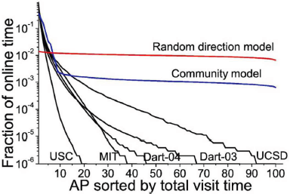
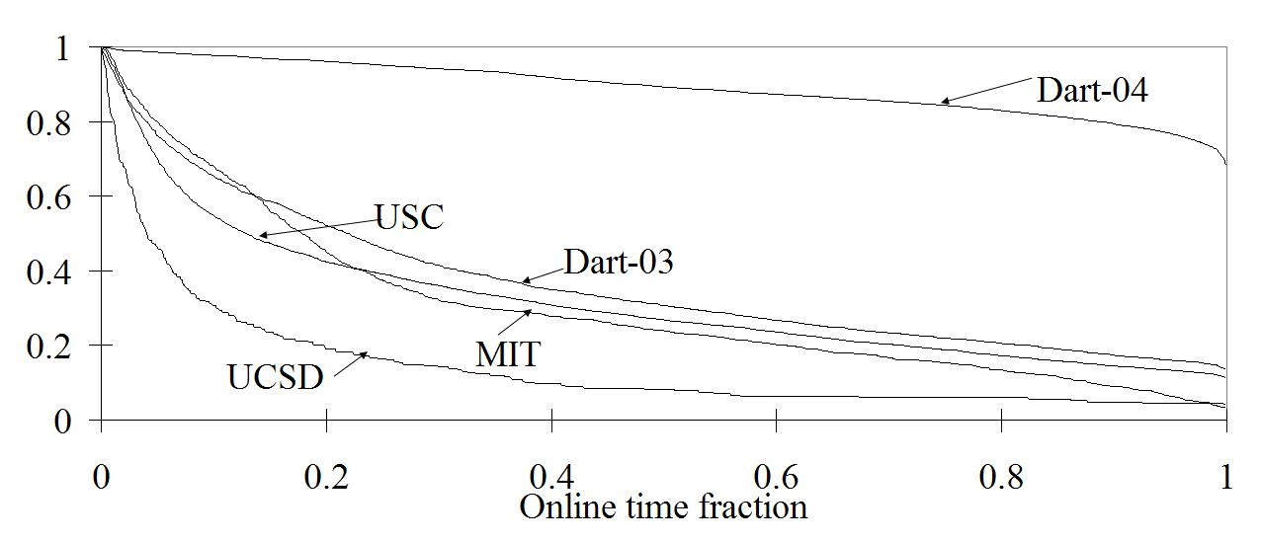
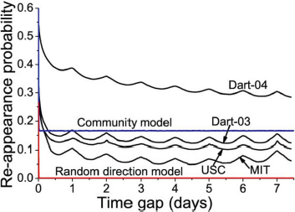
Spatio-temporal Mobility in WLANs
Skewed location preference
Simple existing models are very different from the spatio-temporal characteristics in WLANs
On/off activity pattern
95% on-line time at 5 most visited APs
Periodic re-appearance
Prob.(online time fraction > x)
Characterize
Periodic repetition peaks daily/weekly

Slide 14
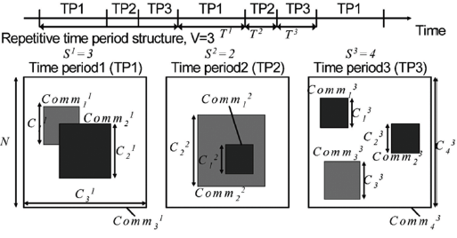
The TVC Model: Reproducing Mobility Characteristics
Skewed location visiting preference
Time-Variant Community (TVC) Model:
1- Assigns communities (locations) to users
to re-produce location visiting preference
2- Varies temporal assignment of communities to re-produce the periodic re-appearance
CCDF
Periodic re-appearance
IEEE INFOCOM 2007
IEEE/ACM Trans. on Networking 2009
* Model-simplified: single community per node. Model-complex: multiple communities
** Similar matches achieved for USC and Dartmouth traces

Slide 15
Analysis of Protocol Performance (Epidemic)
Overhead Avg error=61%
Delay Avg error=80%
Table I. Average error between model and trace-based performance
 | IBM Watson (MIT) | Infocom (Haggle)
Delay | 80% | 79%
Reachability | 78% | 57%
Overhead | 61% | 55%
Despite matching several metrics (location periodic patterns, encounter distribution), existing models cannot meaningfully capture mobile DTN routing performance.
Need to re-visit mobility modeling!
* Thakur, Hsu, Kumar, Helmy, IEEE IWCMC 2011, Int’l Journal on Sensor Networks 2012 (invited)

Slide 16
Case study III – Groups in WLAN

Slide 17
Case Study III: Goal
Identify similar users (in terms of long run mobility preferences) from the diverse WLAN user population
Understand the constituents of the population
Identify potential groups for group-aware service
Approach: Classify users based on their mobility trends and location-visiting preferences

Slide 18
Representation of User Association Patterns
* W. Hsu, D. Dutta, A. Helmy, “Mining Behavioral Groups in WLANs”, ACM MobiCom 2007,
IEEE Transactions on Mobile Computing (TMC). Accepted, Sept 2011
Summarize user association per day by a vector
a = {a_{j} : fraction of online time user i spends at AP_{j} on day d}
Sum long-run mobility in “association matrix”
Office, 10AM -12PM
Library, 3PM – 4PM -Class, 6PM – 8PM
Association vector: (library, office, class) =(0.2, 0.4, 0.4)
Example association matrix to describe a given user’s location visiting preference
Represent

Slide 19


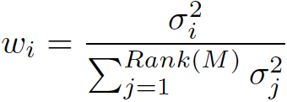
Eigen-behaviors & Behavioral Similarity Distance
Eigen-behaviors (EB): Vectors describing maximum remaining power in assoc. matrix M (through SVD):
- Eigen-vectors:
- Eigen-values:
- Relative importance:
Eigen-behavior Distance weighted inner products of EBs
Assoc. patterns can be re-constructed with low rank & error
For over 99% of users, < 7 vectors capture > 90% of M’s power
Sim(U,V)
Multi-dimensional
Behavioral
Space
V
U

Slide 20
User Groups in WLAN - Observations
Identified hundreds of distinct groups of similar users
Skewed group size distribution –
the largest 10 groups account for more than 30% of the population
Power-law distributed of group sizes
Some groups visit multiple locations with similar importance –
taking the most important location for each user is not sufficient
“Power-law distributed of group sizes”
Videos

Slide 21
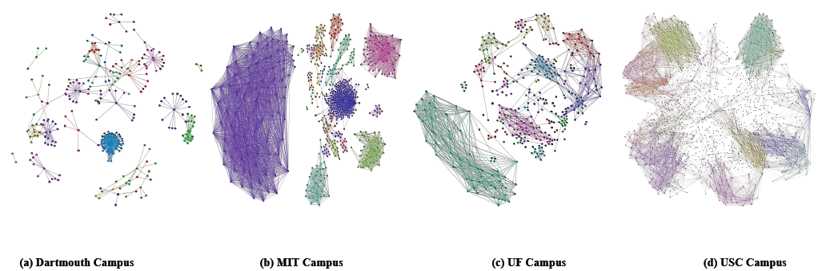
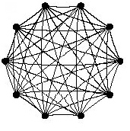
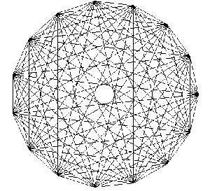
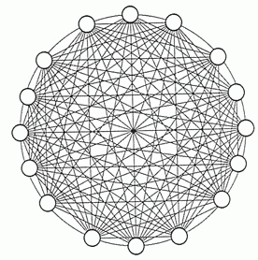
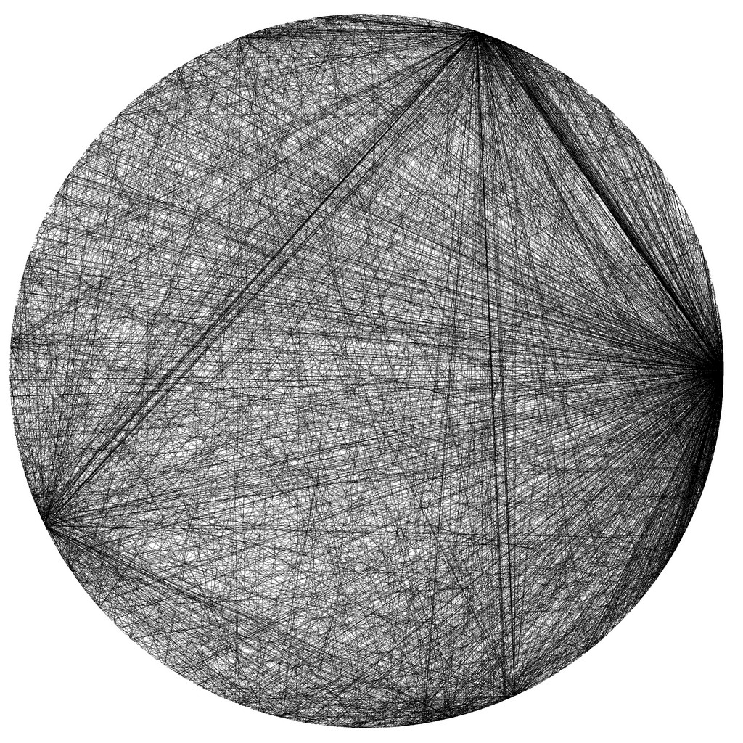
Behavioral Similarity Graphs
Random and community models produce fully connected similarity graphs
G. Thakur, A. Helmy, W. Hsu, “Similarity analysis and modeling of similarity in mobile societies: The missing link”, ACM MobiCom
CHANTS, Sept. 2010.

Slide 22
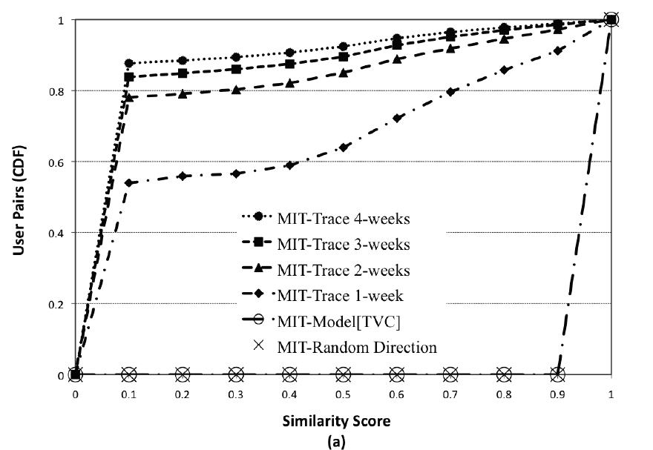
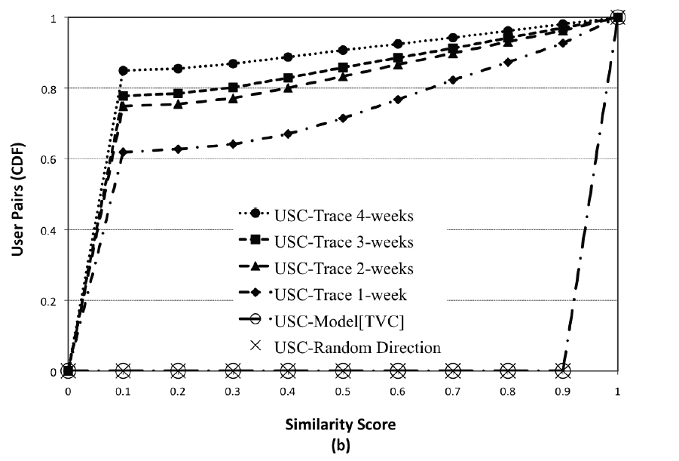
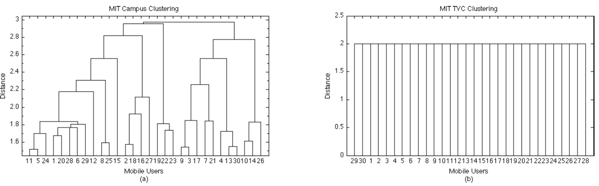
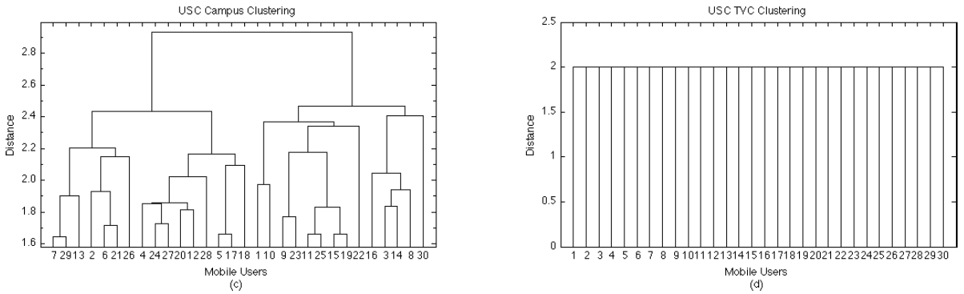
Behavioral Similarity: The Missing Link
Models
Models
Traces
Traces
Traces
Models
Existing models produce behaviorally homogeneous users and lack the richness
of behavioral structure in real traces. Richer models are needed !

Slide 23
Profile-cast: A New Communication Paradigm W. Hsu, D. Dutta, A. Helmy, ACM Mobicom 2007, WCNC 2008, AdHoc Nets Jrnl 2011
Payload
Dest Address
Payload
Target Profile
Sending messages to others with similar behavior, without knowing their identity
Announcements to users with specific behavioral profile V
Interest-based ads, similarity resource discovery
Case study: Delay Tolerant Networks (DTNs)
B
C
Is E similar to V?
Is B similar to V?
?
E
D
Is C/D similar to V?
A

Slide 24
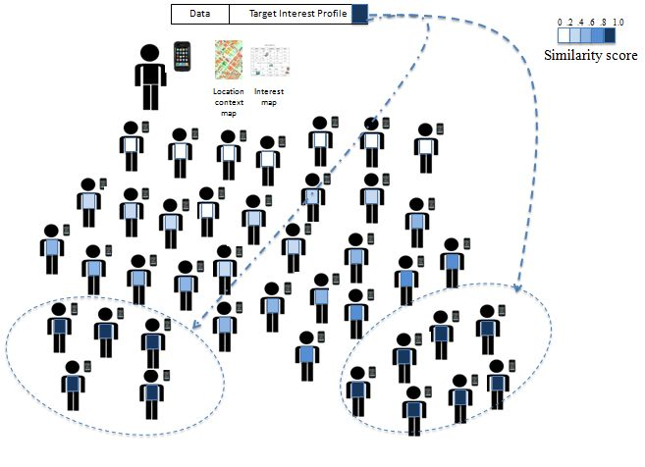
Instead of using a destination address (e.g., unicast, broadcast), destination is defined by the target interest profiles. Destination(s) match based on a similarity score, inferred based on user behavioral aspects .

Slide 25
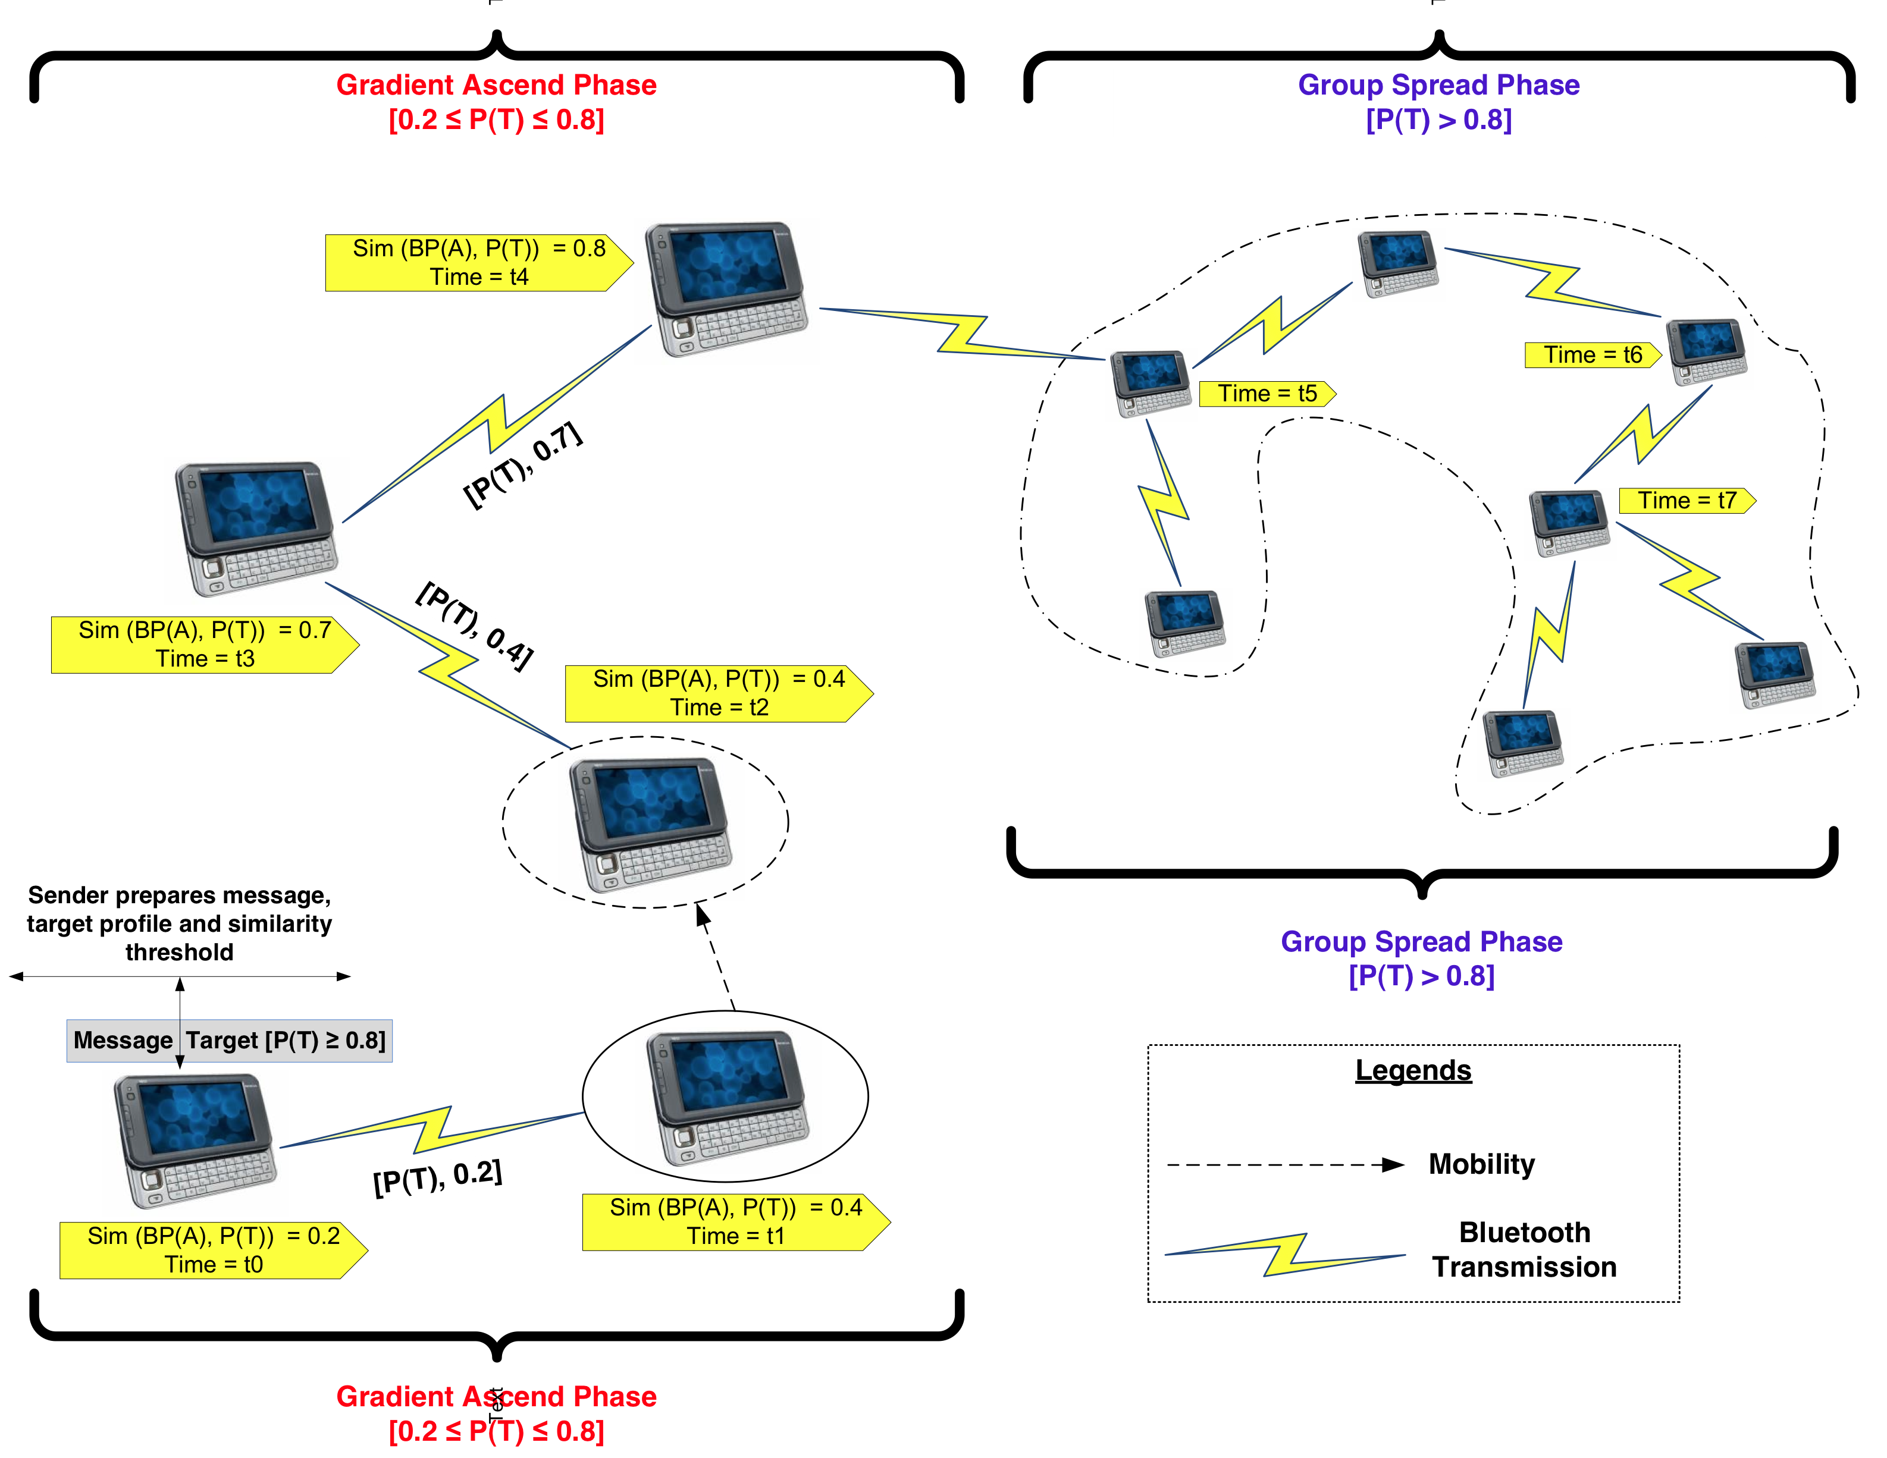
Profile-cast CSI protocol: Target-mode
S
Sim (BP(A), P(T)) = similarity of node’s behavioral profile to the target profile

Slide 26
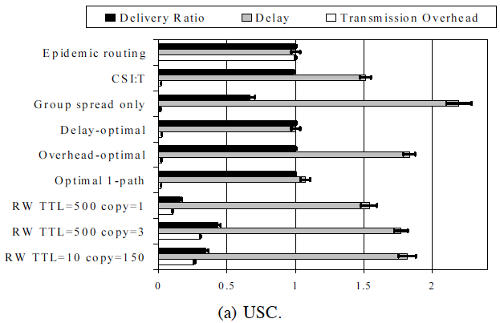
Profile-cast Evaluation
* Results presented as the ratio to epidemic routing
Over 96% delivery ratio – Over 98% reduction in overhead w.r.t. Epidemic
RW < 45% delivery
Strikes a near-optimal balance between delivery, overhead and delay
Video

Slide 27
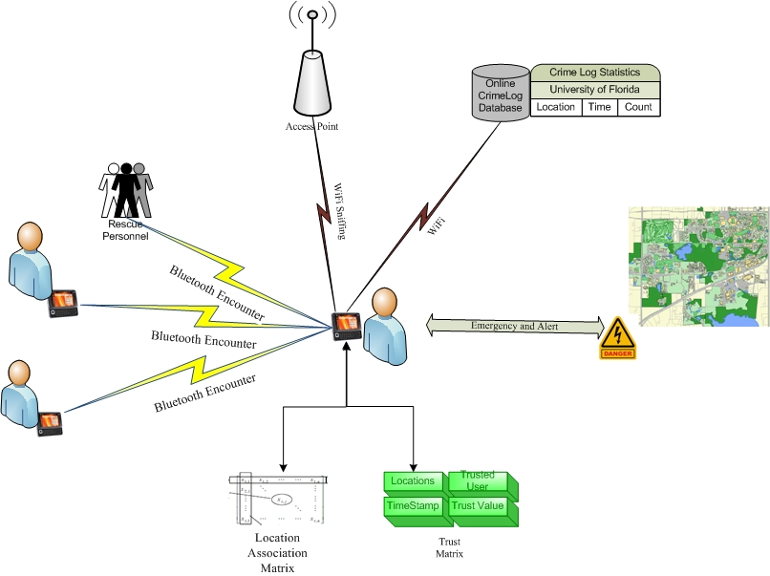
SOS: Sending Stress Signals via Trusted Nodes
Locator
External Sources
Scanner
Distress Signaling
Profiler
Trust
Module
IEEE GlobeCom 2010

Slide 28
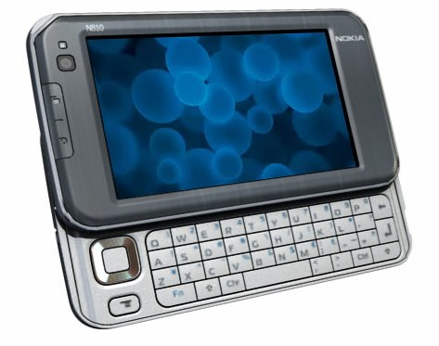

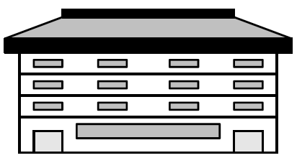
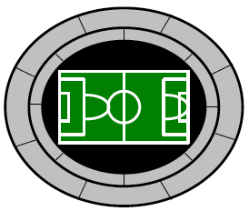

Office (O)
Standium (S)
[1]
Behavior Matrix
SVD
Dorm (D)
[3]
[2]
Devices construct behavioral matrices based on location visitation patterns. SVD is used to obtain a summary of the major visitation trends and used for similarity comparisons.
Behavior Matrix Trust Adviser Filters
ACM IWCMC 2010

Slide 29




Experiments, Apps (on going)
iTrust
SOS

Slide 30

Mining for Interest: Behavior Beyond Mobility
User’s web access and traffic patterns, applications used represent other dimensions of interest and behavior
Further analysis of network measurements (e.g., Netflow) can reveal behavioral characteristics in these dimensions
Netflow traces are orders of magnitude larger than WLANs (WLANs: dozens of millions, Netflows: dozens of billions)
Challenge: from ‘big data’ to information and knowledge
starting Mar 11
Table I. Wireless Network Traces (MobiLib – UF)

Slide 31


DATA COLLECTION
Billions of netflow records
3 billion for Feb-Apr 2008
DHCP: IP to user assignments
AP logs: Location of access
External info: domain resolution/building map
User’s Device MAC
Web Domain

Slide 32

DATA PROCESSING
Integration
To find user, domain and building for each flow record
Aggregation
For Top 100 active domains , 22816 users, 79 buildings on:
Total online time (per min)
[Number of Flows]
domain 1 domain 2 … domain m
building 1 building 2 …building k
user 1
user 1
user 2
x(i,j): percentage of online time for user i at domain j
user 2
x(i,j): percentage of online time for user i at building j
.
.
.
.
.
.
user n
user n

Slide 33
GLOBAL DATA MODELING & ANALYSIS
Information Theoretic Co-clustering [1] for simultaneous clustering of mobile users and web domains and discovering behavioral groups (e.g., Mac users who frequently visit washingtonpost and cnet)
black to white: values from min to max.
Interest (Association) level matrix: Shows how different groups of users are interested in different groups of domain.
Moghaddam, Helmy, Ranka, Somaya, ACM MSWIM 2010.

Slide 34

GLOBAL DATA MODELING & ANALYSIS [8]
User groups
behavioral groups
Domain groups
- Users can be modeled using few (~10) clusters with clearly disjoint and meaningful profiles. This behavior is very stable (with ~90% similarity) from month to month.

Slide 35


Web-usage Spatio-temporal multi-D Clustering
Location-based Analysis: Hierarchical Clustering of buildings
Building categories based on actual context
Dissimilarity
Buildings IDs
Buildings IDs
Clusters of buildings (A-J)
Building IDs (1-79)
Building Abbreviations
Many of buildings in the same category are clustered together. This trend is table from month to month (Feb through Apr)

Slide 36

Location-based Clique Analysis
Graph representation of dissimilarity matrix for different buildings using the threshold of 0.06.
Most buildings in the same category form a clique in the graph

Slide 37
Future Work on Netflow Analysis
Scale is still an issue
Introduce more efficient mining techniques
Add multi-dimensional processing capability
Investigate scalable data mining systems [on-going]
Meaningful visualization of results in multi-dimensions
Behavior may not lend itself to one cluster
Need flexible, fuzzy clustering
Centralized algorithms require global knowledge
Not fit for distributed implementation, protocols
Need more distributed, localized algorithms

Slide 38






Self-organizing Maps (SoMs)
The topology-preserving mapping keeps the more similar data groups closer together in the final map
SoM
After
clustering
Users vs Web domains
Users vs Locations
Users vs domains vs locations
(multi-aspect SoM)
* S. Moghaddam, A. Helmy, “Internet Usage Modeling of Large Wireless Networks Using Self-Organizing Maps”, IEEE SCENES (MASS workshop), Nov 2010, ACM MSWiM , Nov. 2011.

Slide 39

INTEREST & CORRELATION ANALYSIS
Feature map:
projection of the SOM on any of domains
shows how users in different regions are interested in that domain
Red areas show high interest
Blue areas show low interest

Slide 40
INTEREST & CORRELATION ANALYSIS
advertisement / marketing
Major visitation (interest) of users in Orange cluster: advertisement / marketing

Slide 41
Future Directions (Applications)
Behavior aware push/caching services (targeted ads, events of interest, announcements)
Caching based on behavioral prediction
Detecting abnormal user behavior & access patterns based on previous profiles
Can we extend this paradigm to include social aspects (trust, friendship, cooperation)?
Privacy issues and mobile k-anonymity
Participatory sensing, deputizing the community

Slide 42



Mobile Testbed with an Attitude!
(Architectural Overview)
Personalized Networks of Robots + Participatory Testing
Communityof Mobile Users
Simulation
Emulation
Controlled!
Chaotic!

Slide 43
Challenges & Goals
Challenges for Mobile Testbeds
Support realistic behavior, movement of mobile nodes
Extension outside the lab environment
Scalability - Open to other researchers
Goals & Approach
Represent behavior through integration of user personality
Capture community (and attitude) through similarity
Architect a testbed bridging gap between
Controlled lab environment & chaotic participatory environment
Support personality-aware mobile nodes and purposeful profile-based participatory testing

Slide 44


Building personalities (i.e., attitudes) for mobile nodes
Behavior Matrix M1
Behavior Matrix M2
SVD
SVD
GreenTeam (Jerry)
RedTeam (Tom)
Building communities of autonomous mobile nodes to interact with:
each other in a semi-controlled manner, and
with participatory testers to form friendship, trust, interest …

Slide 45


Mobile Testbed with an Attitude!
Two main components of this testbed.
The first consists of a network of robots with personality-mimicking, human-encounter behaviors. The personality is build upon behavioral profiling of mobile users.
The second integrates the testbed with the human society using participatory testing utilizing crowd sourcing.
IEEE GlobeCom, Dec 2010
WINTECH, ACM MobiCom, Sep 2010
* Runner-up, Best Demo Competition

Slide 46
Grand Challenges, Opportunities: Health Care & Education
Applications
Emergency management
[Customized Collaboration]
[Bullying Support Groups]
Security
Health Care
Education
[Support Group Formation for:
Depression, Frailty, Alzheimer]
Automatic Community Formation
Differential Behavioral Analysis
Behavior-based Networking
[Simi-cast]
Trust Advisers
Behavior-based Networking
Privacy
Information Hiding
Mobile Networks Architectural Spectrum
Data Vault
Opportunistic Networks
Participatory
Sensing
Model-informed
Design
Enabling Technologies & Data
[Glade]
Mobile Measurements & Sensing
Behavioral Modeling
Scalable Data Mining & Computing
Big Data
[Dictate]
Multi-dimensional Analysis
* Potential NSF Science & Technology Center 2013

Slide 47


Application: Mobile Health Care
Long term, continuous, multi-modal behavioral sensing
Differential behavioral analysis
Promise:
Early detection of risks, behavioral disorders
Targets:
Obesity, mobility, frailty

Slide 48


Application: Mobile Health Care
Similarity-based support group formation
Promise:
Disease self-management, self-efficacy
Targets:
Diabetes, depression, social isolation, elderly care, Alzheimer care

Slide 49




Application: Education
Similarity-aware collaborative group formation
Support groups against bullying
Next generation mobile classroom

Slide 50


The Next Generation (Boundless) Classroom
Students
sensor
sensor
sensor
sensor
sensor
sensor-adhoc
WLAN/adhoc
Embedded sensor network
WLAN/adhoc
sensor
sensor
sensor
Multi-party conference
Tele-collaboration tools
sensor
sensor
sensor-adhoc
Instructor
WLAN/adhoc
Challenges
Integration of wired Internet, WLANs, Adhoc Mobile and Sensor Networks
Will this paradigm provide better learning experience for the students?
sensor
sensor
sensor
sensor
sensor-adhoc
Real world group experiments (structural health monitoring)

Slide 51

Disaster Relief (Self-Configuring) Networks
sensor
sensor
sensor
sensor
sensor
sensor
sensor
sensor
sensor
sensor
sensor
sensor
sensor
sensor
sensor
sensor
sensor
sensor
sensor
sensor

Slide 52



Vehicular Mobility and Traffic Congestion Mitigation
* G. Thakur, B. Hui, A. Helmy, ACM MobiCom (demo/poster), 2011
Collect vehicle measurements at scale
Use images from ~4,000 webcams
Estimate traffic density via image processing algorithms
Spatio-temporal analysis to model data
Utilize insight for vehicular
network design and traffic
congestion mitigation
Vehicular Tracing System
Traffic density estimates

Slide 53


Thank you!
Ahmed Helmy helmy@ufl.edu
URL: www.cise.ufl.edu/~helmy
NOMADS, MobiLib: nile.cise.ufl.edu/MobiLib
* Thanks to my students and collaborators

