Slide 1

TCP over ATM:
UBR: for delay-tolerant applications
e.g., ftp, telnet
ABR:
for delay sensitive applications, e.g., on-line sessions
provides explicit congestion signaling
TCP over UBR:
observation: when ATM cell is dropped, all other ATM cells that belong to the same IP datagram are useless

Slide 2
solution: develop discard strategy to minimize transmission of useless cells
(1) Partial Packet Discard (PPD):
when a cell is dropped at a switch, all cells belonging to the same datagram are dropped
switch identifies the end of IP datagram using type-bit in ATM header in AAL 5
on average: ½ datagram worth of ATM cells are transmitted uselessly

Slide 3
(2) Early Packet Discard (EPD):
when buffer exceeds a threshold, drop complete IP datragrams
problem of fairness: the shorter the datagram, the higher the probability of drop
(3) add fairness using fair buffer allocation (FBA):
when EPD is invoked drop from connections using more than their fair share

Slide 4
the number of VC connections is V
if N is the current occupancy, then the fair share is N/V
the weight w(i)=N(i)/[N/V], where N(i) is occupancy of connection I
policy to drop: if (N>R) and w(i)>z then drop, where R is the congestion threshold and z~1

Slide 7
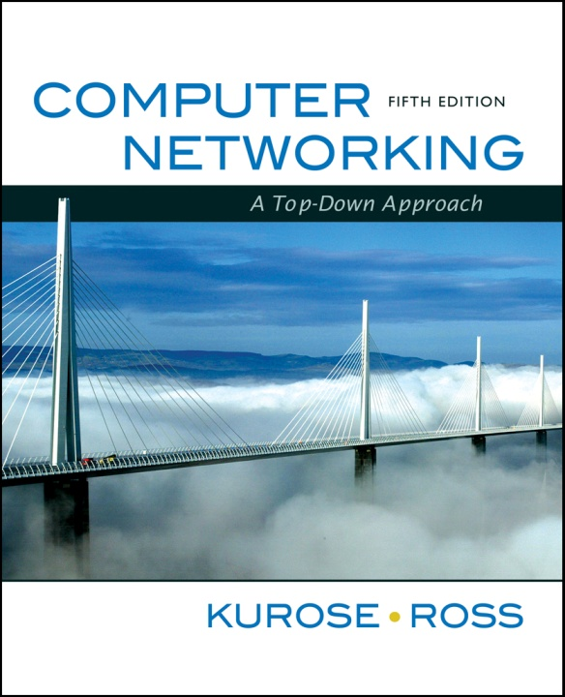
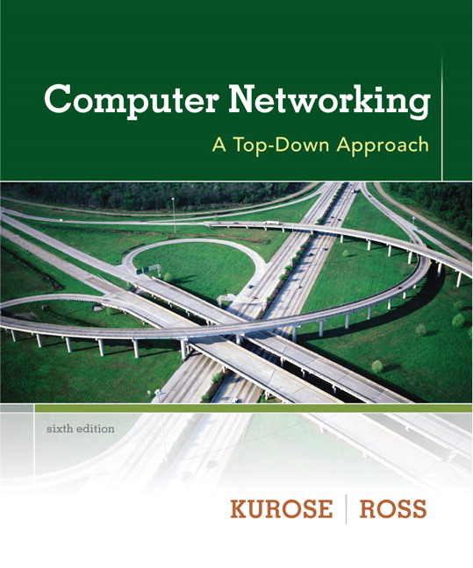
Chapter 6 Wireless and Mobile Networks
Computer Networking: A Top Down Approach. Jim Kurose, Keith Ross Addison-Wesley.

Slide 8
Chapter 6: Wireless and Mobile Networks
Background:
# wireless (mobile) phone subscribers now exceeds # wired phone subscribers!
computer nets: laptops, palmtops, smartphones, Internet-enabled phone promise anytime wireless Internet access (and sometimes untethered operation)
two important (but different) challenges
wireless: communication over wireless link
mobility: handling the mobile user who changes point of attachment to network

Slide 9
Chapter 6 outline
6.1 Introduction
Wireless
6.2 Wireless links, characteristics
6.3 IEEE 802.11 wireless LANs (“wi-fi”)
6.4 Cellular Internet Access
architecture
standards (e.g., GSM)
Mobility
6.5 Principles: addressing and routing to mobile users
6.6 Mobile IP
6.7 Handling mobility in cellular networks
6.8 Mobility and higher-layer protocols
6.9 Summary

Slide 10
Elements of a wireless network
wireless hosts
laptop, PDA, IP phone
run applications
may be stationary (non-mobile) or mobile
wireless does not always mean mobility
network
infrastructure

Slide 11
Elements of a wireless network
base station
typically connected to wired network
relay - responsible for sending packets between wired network and wireless host(s) in its “area”
e.g., cell towers, 802.11 access points
network
infrastructure

Slide 12
Elements of a wireless network
wireless link
typically used to connect mobile(s) to base station
also used as backbone link
multiple access protocol coordinates link access
various data rates, transmission distance
network
infrastructure

Slide 13
Characteristics of selected wireless link standards
200
802.11n
54
802.11a,g
802.11a,g point-to-point
data
5-11
802.11b
802.16 (WiMAX), LTE
4G?!
3G cellular
enhanced
4
UMTS/WCDMA-HSPDA, CDMA2000-1xEVDO
Data rate (Mbps)
1
802.15
.384
UMTS/WCDMA, CDMA2000
3G
.056
IS-95, CDMA, GSM
2G
Indoor
10-30m
Outdoor
50-200m
Mid-range
outdoor
200m – 4 Km
Long-range
outdoor
5Km – 20 Km

Slide 14
Elements of a wireless network
infrastructure mode
base station connects mobiles into wired network
handoff: mobile changes base station providing connection into wired network
network
infrastructure

Slide 15
Elements of a wireless network
ad hoc mode
no base stations
nodes can only transmit to other nodes within link coverage
nodes organize themselves into a network: route among themselves

Slide 16
Wireless network taxonomy
single hop
multiple hops
host connects to
base station (WiFi,
WiMAX, cellular)
which connects to
larger Internet
host may have to
relay through several
wireless nodes to
connect to larger
Internet: mesh net
infrastructure
(e.g., APs)
no base station, no
connection to larger
Internet. May have to
relay to reach other
a given wireless node
MANET, VANET
no
infrastructure
no base station, no
connection to larger
Internet (Bluetooth,
ad hoc nets)
Mobile Adhoc Networks
Wireless Sensor Networks (WSNs)
Delay Tolerant Networks (DTNs)
Vehicular Adhoc Networks

Slide 17
Wireless Communication Systems & Networking
What complicates wireless networking vs. wired networking?

Slide 18
1- Channel characteristics
for satellite we get extended propagation delays
high bit error rate ‘BER’ (higher than optical fiber and coax.)
asymmetry in bandwidth and delay
unidirectional links
effects of wave propagation, attenuation,… etc.
2- Mobility: continuous and introduces topology dynamics
3- Power constraints in lots of the wireless devices

Slide 19
Wireless Link Characteristics (1)
Differences from wired link ….
decreased signal strength: radio signal attenuates as it propagates through matter (path loss)
interference from other sources: standardized wireless network frequencies (e.g., 2.4 GHz) shared by other devices (e.g., phone); devices (motors) interfere as well
multipath propagation: radio signal reflects off objects ground, arriving ad destination at slightly different times
…. make communication across (even a point to point) wireless link much more “difficult”

Slide 20
Wireless Link Characteristics (2)
10⁻¹
SNR: signal-to-noise ratio
larger SNR – easier to extract signal from noise (a “good thing”)
SNR versus BER tradeoffs
given physical layer: increase power -> increase SNR->decrease BER
given SNR: choose physical layer that meets BER requirement, giving highest thruput
SNR may change with mobility: dynamically adapt physical layer (modulation technique, rate)
10⁻²
10⁻³
BER
10⁻⁴
10⁻⁵
10⁻⁶
10⁻⁷
10
20
30
40
SNR(dB)
QAM256 (8 Mbps)
QAM16 (4 Mbps)
BPSK (1 Mbps)
Quadrature Amplitude Modulation (QAM)
Binary Phase Shift Keying (BPSK)

Slide 21
Wireless network characteristics
Multiple wireless senders and receivers create additional problems (beyond multiple access):
A
B
C
C
A’s signal
strength
C’s signal
strength
B
A
Hidden terminal problem
B, A hear each other
B, C hear each other
A, C can not hear each other
means A, C unaware of their interference at B
space
Signal attenuation:
B, A hear each other
B, C hear each other
A, C can not hear each other interfering at B

Slide 22
Chapter 6 outline
6.1 Introduction
Wireless
6.2 Wireless links, characteristics
CDMA
6.3 IEEE 802.11 wireless LANs (“wi-fi”)
6.4 cellular Internet access
architecture
standards (e.g., GSM)
Mobility
6.5 Principles: addressing and routing to mobile users
6.6 Mobile IP
6.7 Handling mobility in cellular networks
6.8 Mobility and higher-layer protocols
6.9 Summary

Slide 23
IEEE 802.11 Wireless LAN
802.11b
2.4-5 GHz unlicensed spectrum
up to 11 Mbps
direct sequence spread spectrum (DSSS) in physical layer (CDMA: code division multiple access)
all hosts use same chipping code
802.11a
5-6 GHz range
up to 54 Mbps
802.11g
2.4-5 GHz range
up to 54 Mbps
802.11n: multiple antennae
2.4-5 GHz range
up to 200 Mbps
all use CSMA/CA for multiple access
all have base-station and ad-hoc network versions

Slide 24
802.11 LAN architecture
wireless host communicates with base station
base station = access point (AP)
Basic Service Set (BSS) (aka “cell”) in infrastructure mode contains:
wireless hosts
access point (AP): base station
ad hoc mode: hosts only
Internet
hub, switch
or router
AP
BSS 1
AP
BSS 2

Slide 25
802.11: Channels, association
802.11b: 2.4GHz-2.485GHz spectrum divided into 11 channels at different frequencies
AP admin chooses frequency for AP
interference possible: channel can be same as that chosen by neighboring AP!
host: must associate with an AP
scans channels, listening for beacon frames containing AP’s name service set ID (SSID) and MAC address
selects AP to associate with
may perform authentication
will typically run DHCP to get IP address in AP’s subnet

Slide 26
802.11: passive/active scanning
BBS 1
BBS 2
BBS 1
BBS 2
AP 1
AP 2
AP 1
1
AP 2
1
1
2
2
2
3
3
4
H1
H1
Passive Scanning:
beacon frames sent from APs
association Request frame sent: H1 to selected AP
association Response frame sent: selected AP to H1
Active Scanning:
Probe Request frame broadcast from H1
Probes response frame sent from APs
Association Request frame sent: H1 to selected AP
Association Response frame sent: selected AP to H1

Slide 27
IEEE 802.11: multiple access
avoid collisions: 2⁺ nodes transmitting at same time
802.11: CSMA - sense before transmitting
don’t collide with ongoing transmission by other node
802.11: no collision detection!
difficult to receive (sense collisions) when transmitting due to weak received signals (fading)
can’t sense all collisions in any case: hidden terminal, fading
goal: avoid collisions: CSMA/C(ollision)A(voidance)
A
B
C
C
A’s signal
strength
C’s signal
strength
B
A
space

Slide 28
IEEE 802.11 MAC Protocol: CSMA/CA
sender
receiver
802.11 sender
1 if sense channel idle for DIFS then
transmit entire frame (no CD)
2 if sense channel busy then
start random backoff time
timer counts down while channel idle
transmit when timer expires
if no ACK, increase random backoff interval, repeat 2
802.11 receiver
- if frame received OK
return ACK after SIFS (ACK needed
due to hidden terminal problem)
DIFS
data
SIFS
ACK
Distributed Inter-frame Spacing (DIFS)
Short Inter-frame Spacing (SIFS)

Slide 29
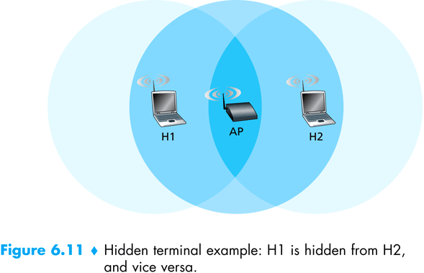
Hidden Terminal Problem in WLANs

Slide 30
Avoiding collisions: RTS/CTS
idea: allow sender to “reserve” channel rather than random access of data frames: avoid collisions of long data frames
sender first transmits small request-to-send (RTS) packets to BS using CSMA
RTSs may still collide with each other (but they’re short)
BS broadcasts clear-to-send (CTS) in response to RTS
RTS heard by all nodes
sender transmits data frame
other stations defer transmissions
avoid data frame collisions completely
using small reservation packets!

Slide 31
Collision Avoidance: RTS-CTS exchange
A
B
AP
RTS(B)
RTS(A)
reservation collision
RTS(A)
CTS(A)
CTS(A)
DATA (A)
defer
time
ACK(A)
ACK(A)

Slide 32
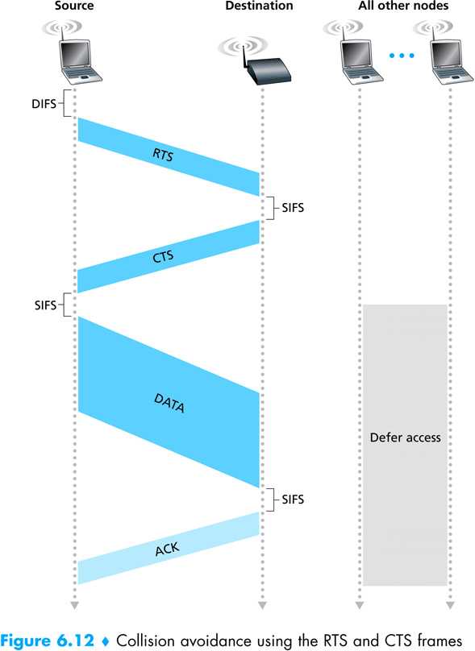
Check Animations on-line (applet & ns)

Slide 33
802.11 frame: addressing
2
2
6
6
6
2
6
0 - 2312
4
frame
control
duration
address
1
address
2
address
3
seq
control
address
4
payload
CRC
Address 4: used only in ad hoc mode
Address 1: MAC address
of wireless host or AP
to receive this frame
Address 3: MAC address
of router interface to which AP is attached
Address 2: MAC address
of wireless host or AP
transmitting this frame

Slide 34
802.11 frame: addressing
Internet
H1
R1
router
AP
R1 MAC addr AP MAC addr
dest. address
source address
802.3 frame
AP MAC addr H1 MAC addr R1 MAC addr
address 1
address 2
address 3
802.11 frame

Slide 35
802.11 frame: more
frame seq #
(for reliable ARQ)
duration of reserved
transmission time (RTS/CTS)
2
2
6
6
6
2
6
0 - 2312
4
frame
control
duration
address
1
address
2
address
3
seq
control
address
4
payload
CRC
2
2
4
1
1
1
1
1
1
1
1
Protocol
version
Type
Subtype
To
AP
From
AP
More
frag
Retry
Power
mgt
More
data
WEP
Rsvd
frame type
(RTS, CTS, ACK, data)

Slide 36
802.11: mobility within same subnet
H1 remains in same IP subnet: IP address can remain same
switch: which AP is associated with H1?
self-learning (Ch. 5): switch will see frame from H1 and “remember” which switch port can be used to reach H1
router
hub or
switch
BBS 1
AP 1
AP 2
H1
BBS 2

Slide 37
802.11: advanced capabilities
Rate Adaptation
base station, mobile dynamically change transmission rate (physical layer modulation technique) as mobile moves, SNR varies
10⁻¹
10⁻²
10⁻³
BER
10⁻⁴
10⁻⁵
10⁻⁶
10⁻⁷
10
20
30
40
SNR(dB)
1. SNR decreases, BER increase as node moves away from base station
QAM256 (8 Mbps)
QAM16 (4 Mbps)
2. When BER becomes too high, switch to lower transmission rate but with lower BER
BPSK (1 Mbps)
operating point
Rate adaptation can change rate from
100Mbps to 1Mbps !!
Does this affect higher protocol layers?

Slide 38
802.11: advanced capabilities
Power Management
node-to-AP: “I am going to sleep until next beacon frame”
AP knows not to transmit frames to this node
node wakes up before next beacon frame
beacon frame: contains list of mobiles with AP-to-mobile frames waiting to be sent
node will stay awake if AP-to-mobile frames to be sent; otherwise sleep again until next beacon frame (typically after 100msec)

Slide 39
802.15: personal area network
less than 10 m diameter
replacement for cables (mouse, keyboard, headphones)
ad hoc: no infrastructure
master/slaves:
slaves request permission to send (to master)
master grants requests
802.15: evolved from Bluetooth specification
2.4-2.5 GHz radio band
up to 721 kbps
S
P
P
radius of
coverage
M
S
S
P
P
M
Master device
Slave device
Parked device (inactive)
S
P

Slide 40
Chapter 6 outline
6.1 Introduction
Wireless
6.2 Wireless links, characteristics
CDMA
6.3 IEEE 802.11 wireless LANs (“wi-fi”)
6.4 Cellular Internet Access
architecture
standards (e.g., GSM)
Mobility
6.5 Principles: addressing and routing to mobile users
6.6 Mobile IP
6.7 Handling mobility in cellular networks
6.8 Mobility and higher-layer protocols
6.9 Summary

Slide 41

Components of cellular network architecture
MSC
connects cells to wide area net
manages call setup (more later!)
handles mobility (more later!)
cell
covers geographical region
base station (BS) analogous to 802.11 AP
mobile users attach to network through BS
air-interface: physical and link layer protocol between mobile and BS
Mobile
Switching
Center
Public telephone
network, and
Internet
Mobile
Switching
Center
wired network

Slide 42
Wireless Comm. Systems
In general a wireless communication network consists of:
1- Users (mobile station)
2- Base Station (BS): connects users to MSC
3- Mobile Switching Center (MSC):
connects the base stations with each other, and to the PSTN (public switched telephone network)

Slide 43
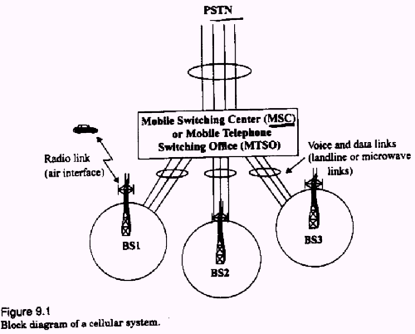

Slide 44
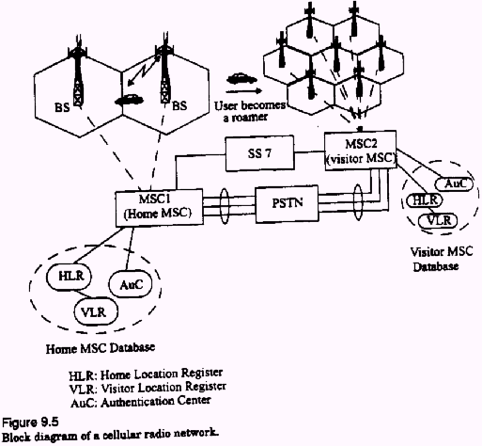

Slide 45
Cellular Comm./Networking Terminology
Hand-off: the process of transferring the mobile from one base station to another
Roamer: a mobile operating in a coverage area other than the one in which it subscribed (moving to another MSC)

Slide 46
Cellular Telephone Systems
A cellular system services a large number of users over extended geographical coverage with limited frequency spectrum.
High capacity is attained by limiting the coverage of the base station to a cell, so that the same frequency can be re-used in other cells
A problem may occur when moving from one cell to another while keeping the call un-interrupted. [the hand-off problem]

Slide 47
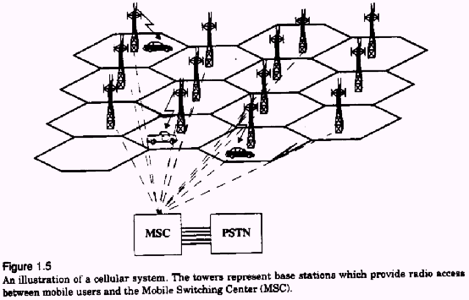

Slide 48
Design concepts: The Cellular Concept and Frequency Re-use
The cellular concept was introduced to solve the problem of frequency limitation (or spectral congestion) and user capacity
Replace a single high power base station with several lower power base stations, each covering a smaller geographical area, a ‘cell’.
Each of the base stations is allocated a number of channels (portion of the overall system channels)

Slide 49
Neighboring base stations (would in general) use different frequency channels to reduce interference.
(more later on interference, channel assignment and frequency planning)

Slide 50
Frequency Re-use
A cell uses a set of frequencies
A ‘cluster’ holds several cells
Frequency re-use factor: 1/#cells per cluster

Slide 51
Cluster
B
G
C
B
Cell
A
G
C
B
F
D
A
G
C
E
F
D
A
B
E
F
D
G
C
B
E
A
G
C
F
D
A
E
F
D
E
Cellular frequency re-use concept: cells with the same letter use the same set of frequencies.
A cluster of cells (highlighted in bold) is replicated over the coverage area. The cluster size,
N, is equal to 7. Since each cell contains one-seventh of the overall channels, the cell
frequency re-use factor is 1/7.
This requires channel/frequency planning and allocation!

Slide 52
Analysis
A cellular system with ‘S’ duplex channels
Each cell has ‘k’ channels. There are N cells with identical number of channels: S=kN
If the cluster is repeated M times then (overall capacity)=MS=MkN
N: cluster size, typically 4,7,12
Frequency re-use factor = 1/N
Each cell is assigned 1/N of total bandwidth

Slide 53
Example: Total of 33MHz bandwidth is available. Cellular phone channel uses 25kHz in simplex mode (i.e. 50kHz in duplex mode). Get the number of channels available per cell if we have 4-cell re-use. If 1 MHz is allocated for control. How many control channels per cell will there be?

Slide 54
Each duplex channel uses 2x25kHz=50kHz
Total number of channels=33M/50k=660 channels
For 4-cell reuse, channels per cell = 660/4=165
1Mhz of control
Total control 1MHz/50k=20 control channels
number of control channels per cell = 20/4 =5, 165-5=160 voice channels per cell

Slide 55
Channel assignment strategies
Channel assignment affects handoff
(1) Fixed Assignment:
Each cell is allocated a pre-determined set of channels or frequencies
If a call request is made and no available channels exist, then it will be blocked (may lead to high blocking probability)
The notion of ‘borrowing’ may be used to alleviate blocking.

Slide 56
(2) Dynamic Assignment:
channels allocated on-demand
Reduces blocking (similar in concept to the shared buffer switch)
Requires that the MSC collects real-time iformation about channel occupancy, traffic distribution, radio signal strength indications (RSSI), periodically for all channels

Slide 57
Hand-off strategies
Mobile moves into a different cell
It monitors the signal strength from the current base station
When power drops below a certain threshold we need hand off

Slide 58
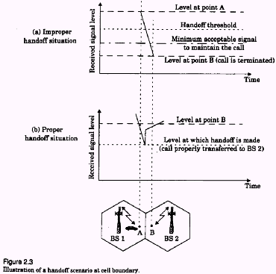

Slide 59
During handoff: to avoid call termination, allow a safety margin
Δ=Power__{handoff} – Power__{min usable}
Note:
Does handoff occur only during movement?
Even if the mobile is stationary, the signal strength may vary
with changes in the surrounding environment, so we may need
a handoff

Slide 60
Handoff in 1st generation:
Strength of signal measurement is done by the base station and supervised by MSC
Hand off in 2nd generation:
In TDMA: it is mobile assisted handoff (MAHO).
Every mobile measures the strength of signal to base stations and reports to the serving base station
Mobile performs measurement during idle time slots

Slide 61
In CDMA: (code division multiple access)
Soft handoff:
No change of channel, only change of base station
The cells use the same frequency and channels
[More later when we talk about CDMA/TDMA]

Slide 62

Interference in Cellular Networks
Main types on interference:
‘Co-channel’ interference
‘Adjacent channel’ interference
External sources
Effects of fading
…

Slide 63
Co-channel Interference
Exists between signals from co-channel cells (in different clusters)
Co-channel cells are those cells that use the same set of frequencies
Co-channel interference cannot be reduced by strengthening the signal.

Slide 64
It is a function of the radius of the cell (R) and the distance between centers of the nearest co-channel cells (D)
Q=D/R, “Q: channel re-use ratio”
As Q increases, the spatial separation between co-channels relative to the cell size increases, so interference decreases

Slide 65
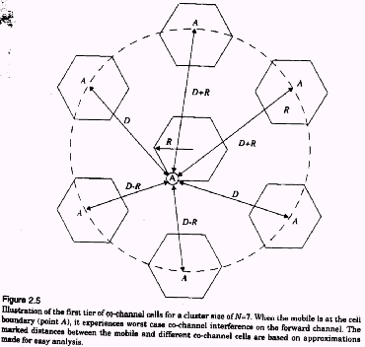
Illustration of co-channel cells for a cluster size of N=7.
When the mobile is at the cell boundary (A), it experiences
worst case co-channel interference on the forward channel.

Slide 66
Adjacent Channel Interference
Signals that occupy frequency spectrum adjacent to the desired signal, may cause interference due to imperfect filtering (at the receivers).
The worst interference occurs when the adjacent frequencies are used within the same cell
Can be reduced by filtering and careful channel assignment

Slide 67
(1) Channel assignment in a cell:
Instead of assigning channels from a contiguous band of frequencies
Channels are assigned such that frequency separations between channels are maximized.
For example, by sequentially assigning adjacent bands to different cells
This is called ‘frequency planning’.
(2) A filter is used in the base station to reject power from adjacent channels.

Slide 68
1
2
3
4
5
6
7
8
9
10
11
12
13
14
freq
B
2
9
G
4
C
5
11
12
1
A
8
F
6
D
7
13
14
E
3
10
Frequency Planning/Channel Assignment

Slide 69
Multiple Access (MA) Techniques for Wireless Communications
MA schemes allow multiple mobile users to share a limited frequency spectrum.
Main MA schemes: FDMA, TDMA, SSMA (FHMA, CDMA [DSMA]), SDMA

Slide 70
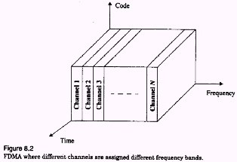
FDMA

Slide 71
Frequency Division Multiple Access (FDMA)
Assigns individual channels to individual users on demand
Only 1 user utilizes the channel at a time. Idle times are wasted. Capacity is not shared.
Communication is continuous
Does not need synchronization
Costly filters at the base station
Need guard bands to alleviate interference

Slide 72
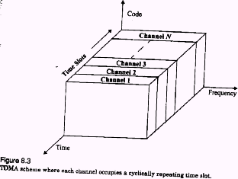
TDMA

Slide 73
Time Division Multiple Access (TDMA)
In a time slot only 1 user transmits (or receives)
Several users share a single frequency channel
Transmission is non-continuous
Power consumption is lower than FDMA (e.g., the transmitter can be turned off when idle)
During idle time, a mobile performs MAHO
Synchronization is needed

Slide 74
Spread Spectrum Multiple Access (SSMA)
Traditional communication techniques
Strive to conserve bandwidth
By contrast, Spread spectrum techniques
use bandwidth several orders of magnitude larger than the min. required bandwidth !!

Slide 75
Spread Spectrum Multiple Access (SSMA)
Spread spectrum techniques use bandwidth larger than the min. required bandwidth
Modulation:
Uses pseudo-noise (PN) sequence to convert the signal into wideband
The PN is random, but can be re-produced by receiver
Demodulation:
Correct correlation using a PN re-produces the signal
Using wrong PN sequence produces noise, hence this scheme is ‘secure’

Slide 76
Spread Spectrum (SS) uses two techniques:
(1) FHMA: frequency hopped MA
(1) DSMA: direct sequence MA (also called CDMA: code division multiple access)
Frequency Hopped MA (FHMA)
Frequencies of individual users are varied in a pseudo-random fashion within the wideband range
The signal is broken into bursts and each burst is sent on a different frequency

Slide 77
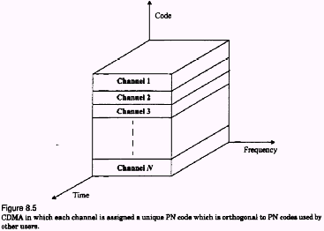
CDMA

Slide 78
Code Division Multiple Access (CDMA)
used in several wireless broadcast channels (cellular, satellite, etc) standards
unique “code” assigned to each user; i.e., code set partitioning
all users share same frequency, but each user has own “chipping” sequence (i.e., code) to encode data
encoded signal = (original data) X (chipping sequence)
decoding: inner-product of encoded signal and chipping sequence
allows multiple users to “coexist” and transmit simultaneously with minimal interference (if codes are “orthogonal”)

Slide 79
Speading the signal power over a wide spread of the frequency spectrum reduces fading effects
only part of the spectrum, hence only part of the signal, is affected by fading
No frequency planning required since users use the same frequency
Soft hand-off can be provided since all the cells use the same frequency. MSC monitors signals.
In soft hand-off the channel (or frequency) remains the same and the base station changes

Slide 80
Direct Sequence Spread Spectrum
Original signal is m(t)
The spreading signal is p(t) [the PN sequence]
The spread spectrum signal is S_{ss}(t)
A single pulse or symbol of the PN waveform is called a chip

Slide 81
S_{ss}(t) ~ m(t)p(t)cos(2πf_{c}t+θ)
B: is the bandwidth of m(t)cos(2πf_{c}t+θ)
W_{ss}: is the bandwidth of S_{ss}(t)
W_{ss} >> B
Phase modulation
S_{ss}(t)
Data m(t)
Transmitted Signal
p(t)
PN Code
Generator
Oscillator
f_{c}
Chip Clock
Block diagram of a DS-SS system with binary phase modulation
Transmitter

Slide 82
Symbol
(A)
Channel
encoder
(B)
f(B,C)
(C)
Chip
Symbol duration for m(t): Ts
Chip duration for p(t): Tc
Processing Gain PG=W_{ss}/B=Ts/Tc, a measure of interference rejection capability

Slide 83
Bit stream
(A)
Ts
Encoded
stream
(B)
m(t)
Tc
Pseudo-noise
sequence
(C)
p(t)

Slide 84
Example:
f(B,C)=B⊕C, where
1 ⊕ 1= 0
1 ⊕ 0 = 1
0 ⊕ 0 = 0
if we have received f(B,C) and we are able to re-generate the PN (C), then we can get B.

Slide 85
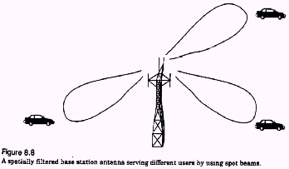
Space Division MA (SDMA)
Controls the radiated energy for each user in space using spot beam (directional) antennas

Slide 86
Hybrid Multiple Access Systems
Time division frequency hopping (TDFH): (used in some versions of GSM)
User can hop to new frequency at the start of a new TDMA frame
Hence reducing interference and fading effects
User hops over pre-defined frequencies

Slide 87
FDMA/CDMA:
The available bandwidth is split into subspectra. In each subspectrum CDMA is used
Allows to assign subspectra on-demand

Slide 88
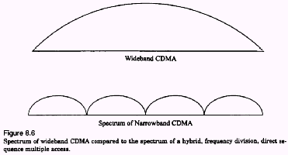
FDMA/CDMA

Slide 89
Cellular networks: the first hop
Techniques for sharing mobile-to-BS radio spectrum
combined FDMA/TDMA: divide spectrum in frequency channels, divide each channel into time slots
time slots
frequency
bands

Slide 90
Cellular standards: brief survey
2G systems: voice channels
IS-136 TDMA: combined FDMA/TDMA (north america)
GSM (global system for mobile communications): combined FDMA/TDMA
most widely deployed
IS-95 CDMA: code division multiple access
CDMA-2000
TDMA/FDMA
GPRS
EDGE
UMTS
Don’t drown in a bowl
of alphabet soup: use this
for reference only ☺
IS-136
GSM
IS-95

Slide 91
Cellular standards: brief survey
2.5 G systems: voice and data channels
for those who can’t wait for 3G service: 2G extensions
general packet radio service (GPRS)
evolved from GSM
data sent on multiple channels (if available)
enhanced data rates for global evolution (EDGE)
also evolved from GSM, using enhanced modulation
data rates up to 384K
CDMA-2000 (phase 1)
data rates up to 144K
evolved from IS-95

Slide 92
Cellular standards: brief survey
3G systems: voice/data
Universal Mobile Telecommunications Service (UMTS)
data service: High Speed Uplink/Downlink packet Access (HSDPA/HSUPA): 3 Mbps (
CDMA-2000: CDMA in TDMA slots
data service: 1xEvolution Data Optimized (1xEVDO) up to 14 Mbps (Verizon 3G: ~2.5Mbps)
Other (future):
LTE (Long Term Evolution): new standard, may become universal replacing GSM and CDMA. Competitor of WiMax. Uses OFDMA (Orthogonal frequency division multiple access) and MIMO (multipl-input multiple-output) data transmission using multiple smart antennas (~2010-2011 time frame).

Slide 93
Chapter 6 outline
6.1 Introduction
Wireless
6.2 Wireless links, characteristics
CDMA
6.3 IEEE 802.11 wireless LANs (“wi-fi”)
6.4 Cellular Internet Access
architecture
standards (e.g., GSM)
Mobility
6.5 Principles: addressing and routing to mobile users
6.6 Mobile IP
6.7 Handling mobility in cellular networks
6.8 Mobility and higher-layer protocols
6.9 Summary

Slide 94
What is mobility?
spectrum of mobility, from the network perspective:
no mobility
high mobility
mobile wireless user,
using same access
point
mobile user, connecting/ disconnecting from network using DHCP.
mobile user, passing through multiple access point while maintaining ongoing connections (like cell phone)

Slide 95
Mobility: Vocabulary
home network: permanent “home” of mobile
(e.g., 128.119.40/24)
home agent: entity that will perform mobility functions on behalf of mobile, when mobile is remote
wide area network
Permanent address: address in home network, can always be used to reach mobile
e.g., 128.119.40.186
correspondent

Slide 96
Mobility: more vocabulary
visited network: network in which mobile currently resides (e.g., 79.129.13/24)
Permanent address: remains constant (e.g., 128.119.40.186)
Care-of-address: address in visited network.
(e.g., 79,129.13.2)
wide area network
foreign agent: entity in visited network that performs mobility functions on behalf of mobile.
correspondent: wants to communicate with mobile

Slide 97

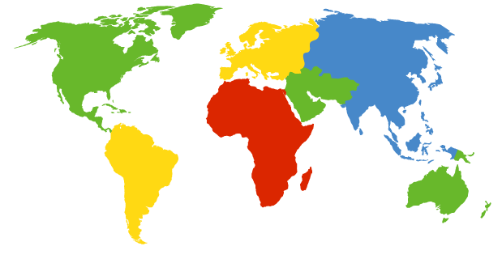

How do you contact a mobile friend:
Consider friend frequently changing addresses, how do you find her?
I wonder where Alice moved to?
search all phone books?
call her parents?
expect her to let you know where he/she is?

Slide 98
Mobility: approaches
Let routing handle it: routers advertise permanent address of mobile-nodes-in-residence via usual routing table exchange.
routing tables indicate where each mobile located
no changes to end-systems
Let end-systems handle it:
indirect routing: communication from correspondent to mobile goes through home agent, then forwarded to remote
direct routing: correspondent gets foreign address of mobile, sends directly to mobile

Slide 99
Mobility: approaches
Let routing handle it: routers advertise permanent address of mobile-nodes-in-residence via usual routing table exchange.
routing tables indicate where each mobile located
no changes to end-systems
let end-systems handle it:
indirect routing: communication from correspondent to mobile goes through home agent, then forwarded to remote
direct routing: correspondent gets foreign address of mobile, sends directly to mobile
not
scalable
to millions of
mobiles

Slide 100
Mobility: registration
visited network
home network
1
2
wide area network
mobile contacts foreign agent on entering visited network
foreign agent contacts home agent home: “this mobile is resident in my network”
End result:
Foreign agent knows about mobile
Home agent knows location of mobile

Slide 101
Mobility via Indirect Routing
foreign agent receives packets, forwards to mobile
home agent intercepts packets, forwards to foreign agent
visited
network
home
network
3
wide area network
2
1
correspondent addresses packets using home address of mobile
4
mobile replies directly to correspondent

Slide 102
Indirect Routing: comments
Mobile uses two addresses:
permanent address: used by correspondent (hence mobile location is transparent to correspondent)
care-of-address: used by home agent to forward datagrams to mobile
foreign agent functions may be done by mobile itself
triangle routing: correspondent-home-network-mobile
inefficient when
correspondent, mobile
are in same network

Slide 103
Indirect Routing: moving between networks
suppose mobile user moves to another network
registers with new foreign agent
new foreign agent registers with home agent
home agent update care-of-address for mobile
packets continue to be forwarded to mobile (but with new care-of-address)
mobility, changing foreign networks transparent: on going connections can be maintained!

Slide 104
Mobility via Direct Routing
foreign agent receives packets, forwards to mobile
correspondent forwards to foreign agent
visited
network
home
network
4
wide area network
2
3
correspondent requests, receives foreign address of mobile
1
4
mobile replies directly to correspondent

Slide 105
Mobility via Direct Routing: comments
overcome triangle routing problem
non-transparent to correspondent: correspondent must get care-of-address from home agent
what if mobile changes visited network?

Slide 106
Accommodating mobility with direct routing
anchor foreign agent: FA in first visited network
data always routed first to anchor FA
when mobile moves: new FA arranges to have data forwarded from old FA (chaining)
foreign net visited
at session start
anchor
foreign
agent
wide area network
2
1
4
5
3
new
foreign
network
correspondent
agent
new foreign
agent
correspondent

Slide 107
Chapter 6 outline
6.1 Introduction
Wireless
6.2 Wireless links, characteristics
CDMA
6.3 IEEE 802.11 wireless LANs (“wi-fi”)
6.4 Cellular Internet Access
architecture
standards (e.g., GSM)
Mobility
6.5 Principles: addressing and routing to mobile users
6.6 Mobile IP
6.7 Handling mobility in cellular networks
6.8 Mobility and higher-layer protocols
6.9 Summary

Slide 108
Mobile IP
RFC 2002, RFC 3344.
Goals:
Attempts to provide support for host mobility while maintaining ‘transparency’:
the correspondent node need not know the location of the mobile node
the connection already established should be maintained during movement even if the mobile node changes its network point of attachment

Slide 109
Mobile IP
has many features we’ve seen:
home agents, foreign agents, foreign-agent registration, care-of-addresses, encapsulation (packet-within-a-packet)
three components to standard:
indirect routing of datagrams
agent discovery
registration with home agent

Slide 110
Mobile IP
Each mobile node has a home network, home address and home agent
Correspondent Node
Home Agent (HA)
Home Network
Mobile Node

Slide 111
When mobile node (MN) moves to a foreign network it obtains a
care-of-address (COA) from the foreign agent (FA) that registers
it with the home agent (HA)
COA is used by HA to forward packets destined to MN
Foreign Agent (FA)
Advertisement (FA,COA)
Foreign Network
Solicitation
Correspondent Node
Register
Mobile Node
Register (HA)
Home Agent
Home Network

Slide 112
Mobile IP: registration example

Slide 113
Mobile IP: indirect routing
foreign-agent-to-mobile packet
packet sent by home agent to foreign agent: a packet within a packet
dest: 128.119.40.186
dest: 79.129.13.2
dest: 128.119.40.186
Permanent address: 128.119.40.186
Care-of address: 79.129.13.2
dest: 128.119.40.186
packet sent by correspondent

Slide 114
Packets sent by MN go
directly to CN
Correspondent
Node (CN)
Mobile Node (MN)
Packets to MN are
picked up by the HA
and tunneled to MN
Home Agent (HA)
Triangle Routing in Mobile-IP

Slide 115
Triangular routing can be very inefficient, especially when
C << B+A, where A (as shown) is the shortest path from
CN to MN
C
Correspondent
Node (CN)
Mobile Node (MN)
A
B
Home Agent (HA)
Triangle Routing in Mobile-IP

Slide 116
Drawbacks of Mobile IP
Other than (the main problem) of triangular routing
Mobile IP incurs lots of communication with the home agent with every movement
so, may not be fit for ‘micro’ mobility [e.g., move between rooms or buildings within the same network domain]
handoff delays are significant since registration/packets need to go through the home agent first

Slide 117
Suggested solutions
To avoid triangular routing
use ‘route optimization’
use micro-mobility architectures
Cellular IP (CIP)
Hawaii
Multicast-based Mobility (M&M)

Slide 118
(3) When MN gets packets from CN
it sends a Binding Update to CN with
its new address
(4) CN changes the destination
address of the packets to go to
MN’s new address
Correspondent
Node (CN)
Mobile Node (MN)
(2) Initial packets
to MN are sent
through HA to MN
(1) MN registers with HA as in
basic Mobile IP.
Home Agent (HA)
Route Optimization (simple illustration)

Slide 119
With route optimization
Triangular routing is avoided
Still have problems with micro mobility and smooth hand-off
Need additional mechanisms to deal with these issues, which makes the protocol complex.

Slide 120
Micro-Mobility
Hierarchical approach to mobility:
During frequent, intra-domain, movement only local efficient handoff is performed without notifying the home agent (HA) or the correspondent node (CN)
For inter-domain mobility use Mobile IP. Notify HA or CN only during inter-domain movement

Slide 121
Distribution tree dynamics while roaming
Domain Root
FA or CN
Wireless link
Mobile Node

Slide 122
M&M: Join/Prune dynamics to modify distribution
Domain Root
Wireless link
Mobile Node

Slide 123
Components of cellular network architecture
recall:
correspondent
wired public telephone
network
MSC
MSC
MSC
MSC
MSC
different cellular networks,
operated by different providers

Slide 124
Handling mobility in cellular networks
home network: network of cellular provider you subscribe to (e.g., Sprint PCS, Verizon)
home location register (HLR): database in home network containing permanent cell phone #, profile information (services, preferences, billing), information about current location (could be in another network)
visited network: network in which mobile currently resides
visitor location register (VLR): database with entry for each user currently in network
could be home network

Slide 125
GSM: indirect routing to mobile
HLR
home
network
2
correspondent
home
Mobile
Switching
Center
home MSC consults HLR,
gets roaming number of
mobile in visited network
1
call routed
to home network
3
Public switched
telephone
network
VLR
Mobile
Switching
Center
4
home MSC sets up 2nd leg of call
to MSC in visited network
mobile
user
MSC in visited network completes
call through base station to mobile
visited
network

Slide 126
GSM: handoff with common MSC
Handoff goal: route call via new base station (without interruption)
reasons for handoff:
stronger signal to/from new BSS (continuing connectivity, less battery drain)
load balance: free up channel in current BSS
GSM doesn’t mandate why to perform handoff (policy), only how (mechanism)
handoff initiated by old BSS
VLR
Mobile
Switching
Center
old
routing
new
routing
old BSS
new BSS

Slide 127
GSM: handoff with common MSC
1. old BSS informs MSC of impending handoff, provides list of 1⁺ new BSSs
2. MSC sets up path (allocates resources) to new BSS
3. new BSS allocates radio channel for use by mobile
4. new BSS signals MSC, old BSS: ready
5. old BSS tells mobile: perform handoff to new BSS
6. mobile, new BSS signal to activate new channel
7. mobile signals via new BSS to MSC: handoff complete. MSC reroutes call
8 MSC-old-BSS resources released
VLR
Mobile
Switching
Center
4
2
1
8
7
3
old BSS
5
6
new BSS

Slide 128
GSM: handoff between MSCs
anchor MSC: first MSC visited during call
call remains routed through anchor MSC
new MSCs add on to end of MSC chain as mobile moves to new MSC
IS-41 allows optional path minimization step to shorten multi-MSC chain
home network
correspondent
Home MSC
anchor MSC
PSTN
MSC
MSC
MSC
(a) before handoff

Slide 129
GSM: handoff between MSCs
anchor MSC: first MSC visited during call
call remains routed through anchor MSC
new MSCs add on to end of MSC chain as mobile moves to new MSC
IS-41 allows optional path minimization step to shorten multi-MSC chain
home network
correspondent
Home MSC
anchor MSC
PSTN
MSC
MSC
MSC
(b) after handoff

Slide 130
Mobility: GSM versus Mobile IP
GSM element |  | Comment on GSM element | Mobile IP element
Home system | Network to which mobile user’s permanent phone number belongs |  |  | Home network
Gateway Mobile Switching Center, or “home MSC”. Home Location Register (HLR) | Home MSC: point of contact to obtain routable address of mobile user. HLR: database in home system containing permanent phone number, profile information, current location of mobile user, subscription information |  |  | Home agent
Visited System | Network other than home system where mobile user is currently residing |  |  | Visited network
Visited Mobile services Switching Center. Visitor Location Record (VLR) | Visited MSC: responsible for setting up calls to/from mobile nodes in cells associated with MSC. VLR: temporary database entry in visited system, containing subscription information for each visiting mobile user |  |  | Foreign agent
Mobile Station Roaming Number (MSRN), or “roaming number” | Routable address for telephone call segment between home MSC and visited MSC, visible to neither the mobile nor the correspondent. |  |  | Care-of-address

Slide 131
Wireless, mobility: impact on higher layer protocols
logically, impact should be minimal …
best effort service model remains unchanged
TCP and UDP can (and do) run over wireless, mobile
… but performance-wise:
packet loss/delay due to bit-errors (discarded packets, delays for link-layer retransmissions), and handoff
TCP interprets loss as congestion, will decrease congestion window un-necessarily
delay impairments for real-time traffic
limited bandwidth of wireless links

Slide 132
Chapter 6 Summary
Wireless
wireless links:
capacity, distance
channel impairments
CDMA
IEEE 802.11 (“wi-fi”)
CSMA/CA reflects wireless channel characteristics
cellular access
architecture
standards (e.g., GSM, CDMA-2000, UMTS)
Mobility
principles: addressing, routing to mobile users
home, visited networks
direct, indirect routing
care-of-addresses
case studies
mobile IP
mobility in GSM
impact on higher-layer protocols

Slide 133
Code Division Multiple Access (CDMA)
used in several wireless broadcast channels (cellular, satellite, etc) standards
unique “code” assigned to each user; i.e., code set partitioning
all users share same frequency, but each user has own “chipping” sequence (i.e., code) to encode data
encoded signal = (original data) X (chipping sequence)
decoding: inner-product of encoded signal and chipping sequence
allows multiple users to “coexist” and transmit simultaneously with minimal interference (if codes are “orthogonal”)

Slide 134
CDMA Encode/Decode
channel output Z_{i,m}
Z_{i,m}= d_{i}.c_{m}
data
bits
d₀ = 1
1
1
1
1
1
d₁ = -1
1
1
1
-
-
-
-
1
-
-
-
1
-
1
1
1
1
1
sender
1
1
slot 1
channel
output
slot 0
channel
output
1
1
1
1
1
code
1
1
-
-
-
1
-
1
1
1
-
-
-
1
-
1
1
1
slot 1
slot 0
M
D_{i} = Σ Z_{i,m}.c_{m}
m=1
M
received
input
1
1
1
1
1
1
1
1
d₀ = 1
-
-
-
-
1
-
-
-
1
-
1
1
1
1
1
1
d₁ = -1
1
slot 1
channel
output
slot 0
channel
output
1
1
1
1
1
code
1
1
-
-
-
1
-
1
1
1
-
-
-
1
-
1
1
1
receiver
slot 1
slot 0

Slide 135
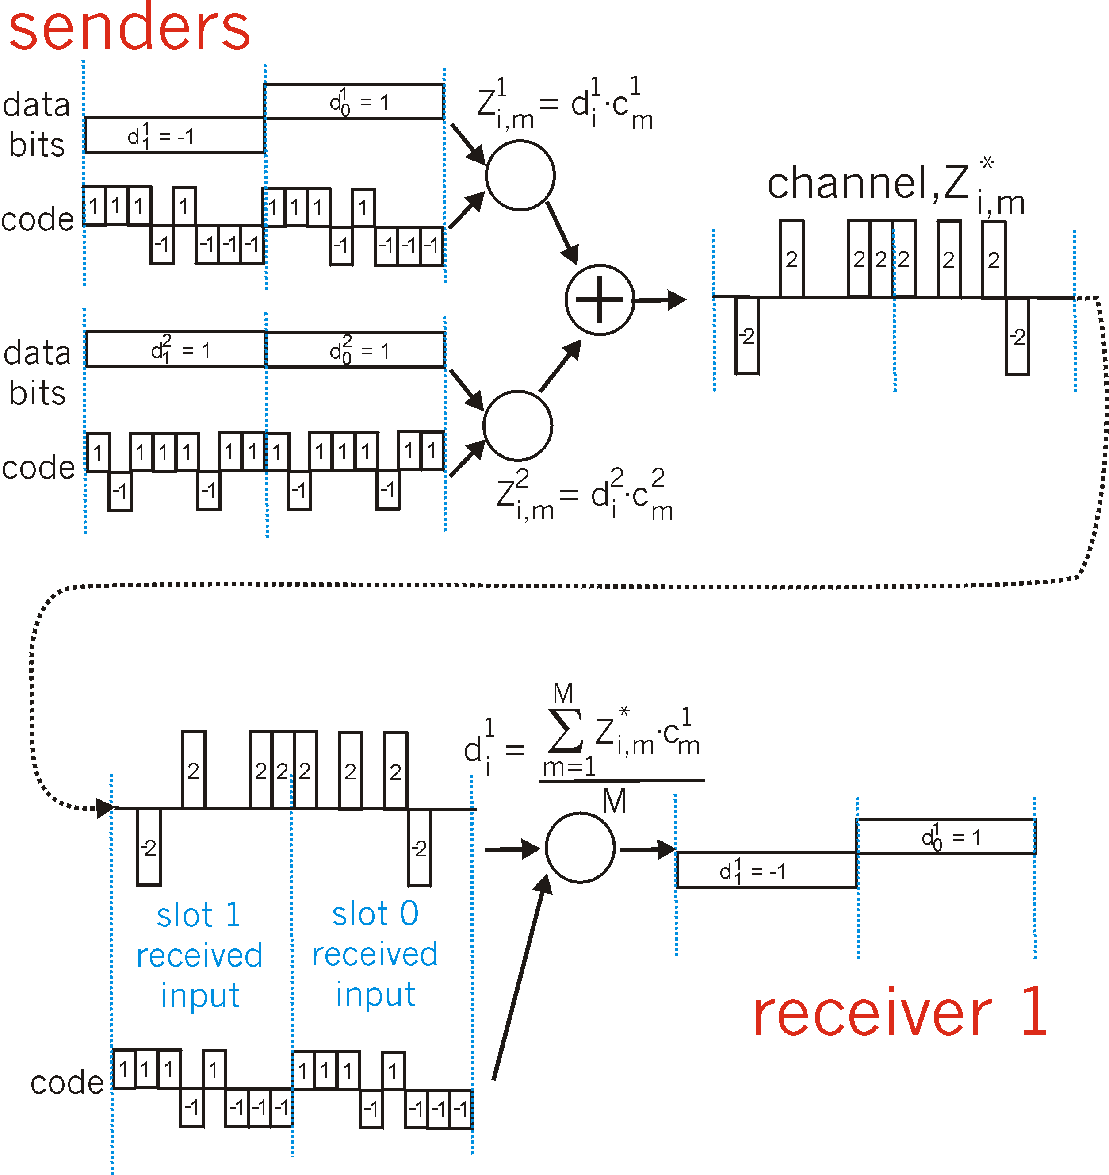
CDMA: two-sender interference

