Slide 1
Modeling & Analysis
Mathematical Modeling:
  probability theory
  queuing theory
  application to network models
Simulation:
  topology models
  traffic models
  dynamic models/failure models
  protocol models

Slide 2
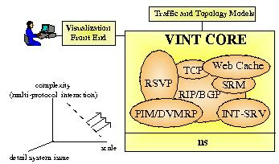
Simulation tools
VINT (Virtual InterNet Testbed):
  catarina.usc.edu/vint [USC/ISI, UCB,LBL,Xerox]
  network simulator (NS), network animator (NAM)
  library of protocols:
    TCP variants
    multicast/unicast routing
    routing in ad-hoc networks
    real-time protocols (RTP)
    …. Other channel/protocol
    models & test-suites
  extensible framework (Tcl/tk & C++)
  Check the ‘Simulator’ link thru the class website

Slide 3
OPNET:
  commercial simulator
  strength in wireless channel modeling
GlomoSim (QualNet): UCLA, parsec simulator
Research resources:
  ACM & IEEE journals and conferences
  SIGCOMM, INFOCOM, Transactions on Networking (TON), MobiCom
  IEEE Computer, Spectrum, ACM Communications magazine
  www.acm.org, www.ieee.org

Slide 4
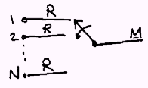
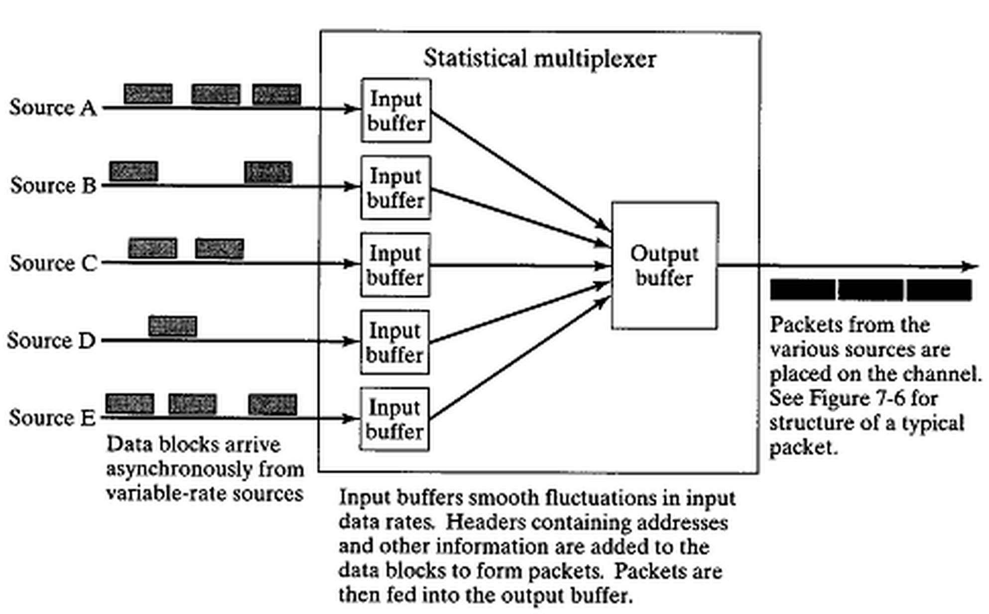
N: number of sources
R: source rate (when ‘ON’)
M: output link capacity
α: percentage ‘ON’ time
Av. Input = α.N.R
Utilization (ρ)=α.N.R/M

Slide 6
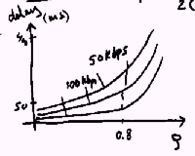
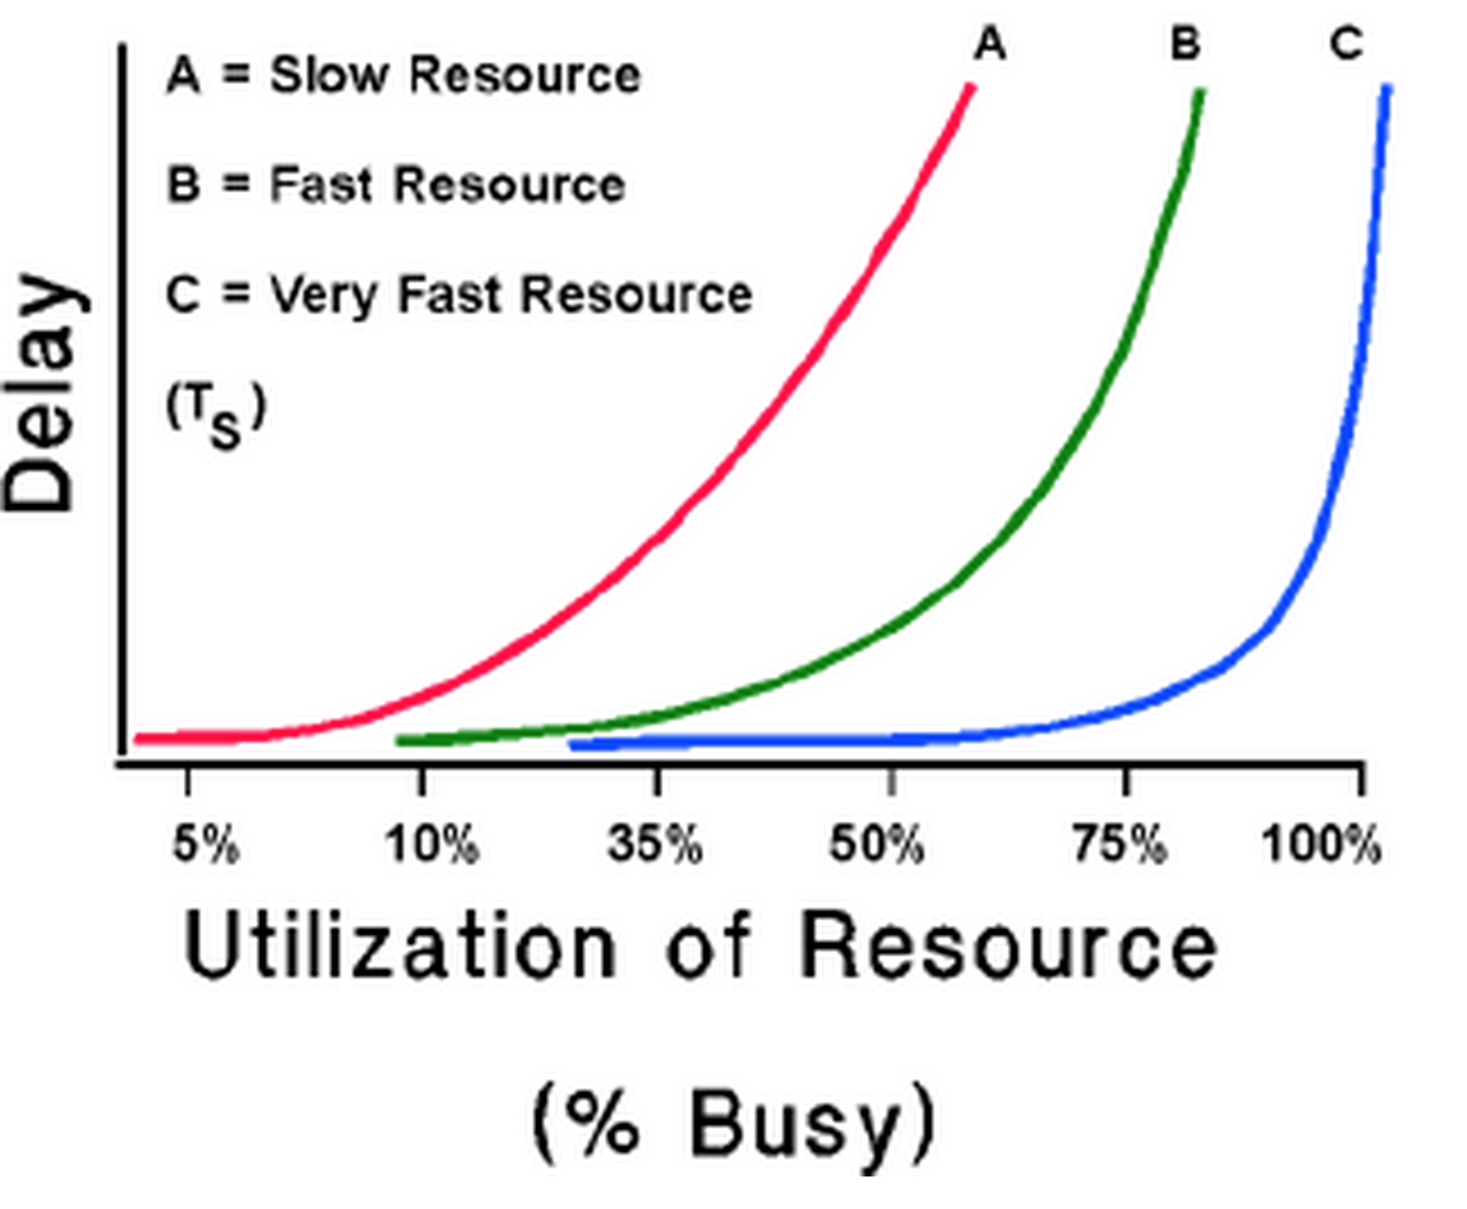

Slide 7
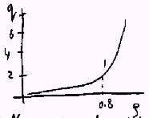
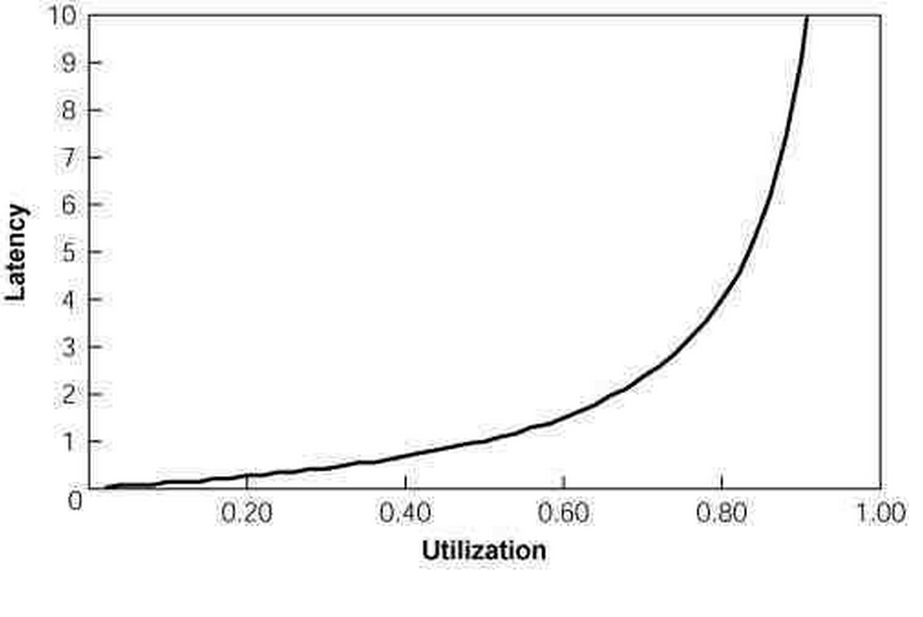
As ρ increases, so do buffer requirements and delay
The buffer size ‘q’ only depends on ρ

Slide 8
Queuing Example
10M
(I)
Increase sources to 10N, should we:
(I). Use upgraded capacity of 10M
(II). Use 10 parallel queues
M
M
(II)
M
M

Slide 9
Queuing Example (contd.)
If N=10, R=100, α=0.4, M=500
Or N=100, M=5000
ρ=α.N.R/M=0.8, q=2.4
a smaller amount of buffer space per source is needed to handle larger number of sources
variance of q increases with ρ
For a finite buffer: probability of loss increases with utilization ρ>0.8 undesirable

Slide 10


Chapter 3
Transport Layer
Computer Networking: A Top Down Approach.
Jim Kurose, Keith Ross
Addison-Wesley.

Slide 11
Chapter 3: Transport Layer
Our goals:
understand principles behind transport layer services:
  Multiplexing, demultiplexing
  reliable data transfer
  flow control
  congestion control
learn about transport layer protocols in the Internet:
  UDP: connectionless transport
  TCP: connection-oriented transport
  TCP congestion control

Slide 12
Chapter 3 outline
3.1 Transport-layer services
3.2 Multiplexing and demultiplexing
3.3 Connectionless transport: UDP
3.4 Principles of reliable data transfer
3.5 Connection-oriented transport: TCP
  segment structure
  reliable data transfer
  flow control
  connection management
3.6 Principles of congestion control
3.7 TCP congestion control

Slide 13

Transport services and protocols
application
transport
network
data link
physical
provide logical communication between app processes running on different hosts
transport protocols run in end systems
  send side: breaks app messages into segments, passes to network layer
  rcv side: reassembles segments into messages, passes to app layer
more than one transport protocol available to apps
  Internet: TCP and UDP
logical end-end transport
application
transport
network
data link
physical

Slide 14
Internet transport-layer protocols
reliable, in-order delivery to app: TCP
  congestion control
  flow control
  connection setup
unreliable, unordered delivery to app: UDP
  no-frills extension of “best-effort” IP
services not available:
  delay guarantees
  bandwidth guarantees
application
transport
network
data link
physical
network
data link
physical
network
data link
physical
logical end-end transport
network
data link
physical
network
data link
physical
network
data link
physical
network
data link
physical
application
transport
network
data link
physical

Slide 15
Chapter 3 outline
3.1 Transport-layer services
3.2 Multiplexing and demultiplexing
3.3 Connectionless transport: UDP
3.4 Principles of reliable data transfer
3.5 Connection-oriented transport: TCP
  segment structure
  reliable data transfer
  flow control
  connection management
3.6 Principles of congestion control
3.7 TCP congestion control

Slide 16
Multiplexing/demultiplexing
Demultiplexing at rcv host:
Multiplexing at send host:
delivering received segments
to correct socket
gathering data from multiple
sockets, enveloping data with
header (later used for
demultiplexing)
= socket
= process
application
application
application
P4
P3
P1
P2
P1
transport
transport
transport
network
network
network
link
link
link
physical
physical
physical
host 1
host 2
host 3

Slide 17
How demultiplexing works:
General for TCP and UDP
host receives IP datagrams
  each datagram has source, destination IP addresses
  each datagram carries 1 transport-layer segment
  each segment has source, destination port numbers
host uses IP addresses & port numbers to direct segment to appropriate socket, process, application
32 bits
source port #
dest port #
other header fields
application
data
(message)
TCP/UDP segment format

Slide 18
Connectionless demultiplexing
When host receives UDP segment:
  checks destination port number in segment
  directs UDP segment to socket with that port number
IP datagrams with different source IP addresses and/or source port numbers directed to same socket
Create sockets with port numbers:
DatagramSocket mySocket1 = new DatagramSocket(12534);
DatagramSocket mySocket2 = new DatagramSocket(12535);
UDP socket identified by two-tuple:
(dest IP address, dest port number)

Slide 19
Connectionless demux (cont)
DatagramSocket serverSocket = new DatagramSocket(6428);
P2
P1
P3
P1
SP: 6428
SP: 6428
DP: 9157
DP: 5775
SP: 9157
SP: 5775
client
IP: A
DP: 6428
server
IP: C
DP: 6428
Client
IP:B
SP provides “return address”

Slide 20
Connection-oriented demux
TCP socket identified by 4-tuple:
  source IP address
  source port number
  dest IP address
  dest port number
recv host uses all four values to direct segment to appropriate socket
Server host may support many simultaneous TCP sockets:
  each socket identified by its own 4-tuple
Web servers have different sockets for each connecting client
  non-persistent HTTP will have different socket for each request

Slide 21
Connection-oriented demux (cont)
P1
P4
P5
P6
P2
P1
P3
SP: 5775
DP: 80
S-IP: B
D-IP:C
SP: 9157
SP: 9157
client
IP: A
DP: 80
server
IP: C
DP: 80
Client
IP:B
S-IP: A
S-IP: B
D-IP:C
D-IP:C

Slide 22
Chapter 3 outline
3.1 Transport-layer services
3.2 Multiplexing and demultiplexing
3.3 Connectionless transport: UDP
3.4 Principles of reliable data transfer
3.5 Connection-oriented transport: TCP
  segment structure
  reliable data transfer
  flow control
  connection management
3.6 Principles of congestion control
3.7 TCP congestion control

Slide 23
UDP: User Datagram Protocol [RFC 768]
“no frills,” “bare bones” transport protocol
“best effort” service, UDP segments may be:
  lost
  delivered out of order to app
connectionless:
  no handshaking between UDP sender, receiver
  each UDP segment handled independently
Why is there a UDP?
no connection establishment (which can add delay)
simple: no connection state at sender, receiver
small segment header
no congestion control: UDP can blast away as fast as desired (more later on interaction with TCP!)

Slide 24
UDP: more
often used for streaming multimedia apps
  loss tolerant
  rate sensitive
other UDP uses
  DNS
  SNMP (net mgmt)
reliable transfer over UDP: add reliability at app layer
  application-specific error recovery!
used for multicast, broadcast in addition to unicast (point-point)
32 bits
Length, in
bytes of UDP
segment,
including
header
source port #
dest port #
length
checksum
Application
data
(message)
UDP segment format

Slide 25
Chapter 3 outline
3.1 Transport-layer services
3.2 Multiplexing and demultiplexing
3.3 Connectionless transport: UDP
3.4 Principles of reliable data transfer
3.5 Connection-oriented transport: TCP
  segment structure
  reliable data transfer
  flow control
  connection management
3.6 Principles of congestion control
3.7 TCP congestion control

Slide 26
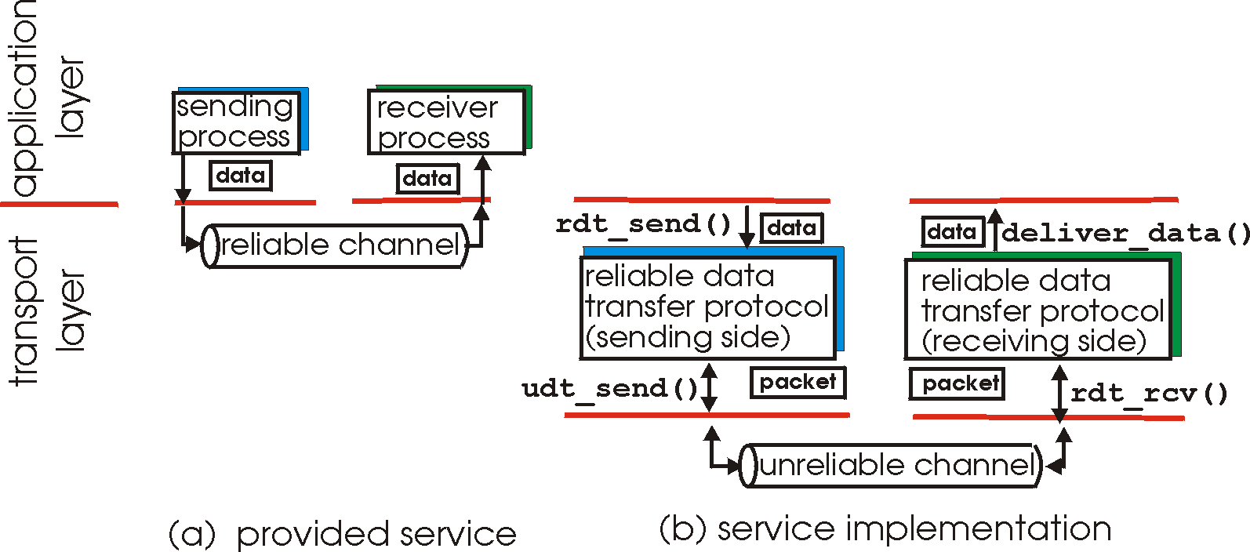
Principles of Reliable data transfer
important in app., transport, link layers
top-10 list of important networking topics!
characteristics of unreliable channel will determine complexity of reliable data transfer protocol (rdt)

Slide 27
Principles of Reliable data transfer
important in app., transport, link layers
top-10 list of important networking topics!
characteristics of unreliable channel will determine complexity of reliable data transfer protocol (rdt)

Slide 28
Principles of Reliable data transfer
important in app., transport, link layers
top-10 list of important networking topics!
characteristics of unreliable channel will determine complexity of reliable data transfer protocol (rdt)

Slide 29
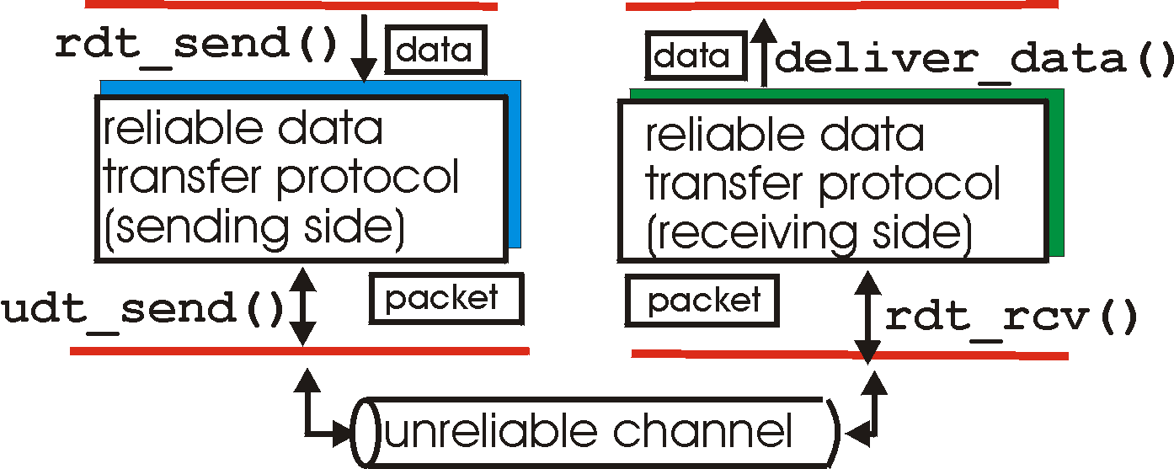
Reliable data transfer: getting started
rdt_send(): called from above, (e.g., by app.). Passed data to
deliver to receiver upper layer
deliver_data(): called by rdt to deliver data to upper
send
side
receive
side
udt_send(): called by rdt,
to transfer packet over
unreliable channel to receiver
rdt_rcv(): called when packet arrives on rcv-side of channel

Slide 30
Flow Control
End-to-end flow and Congestion control study is complicated by:
  Heterogeneous resources (links, switches, applications)
  Different delays due to network dynamics
  Effects of background traffic
We start with a simple case: hop-by-hop flow control

Slide 31
Hop-by-hop flow control
Approaches/techniques for hop-by-hop flow control
  Stop-and-wait
  sliding window
    Go back N
    Selective reject

Slide 32
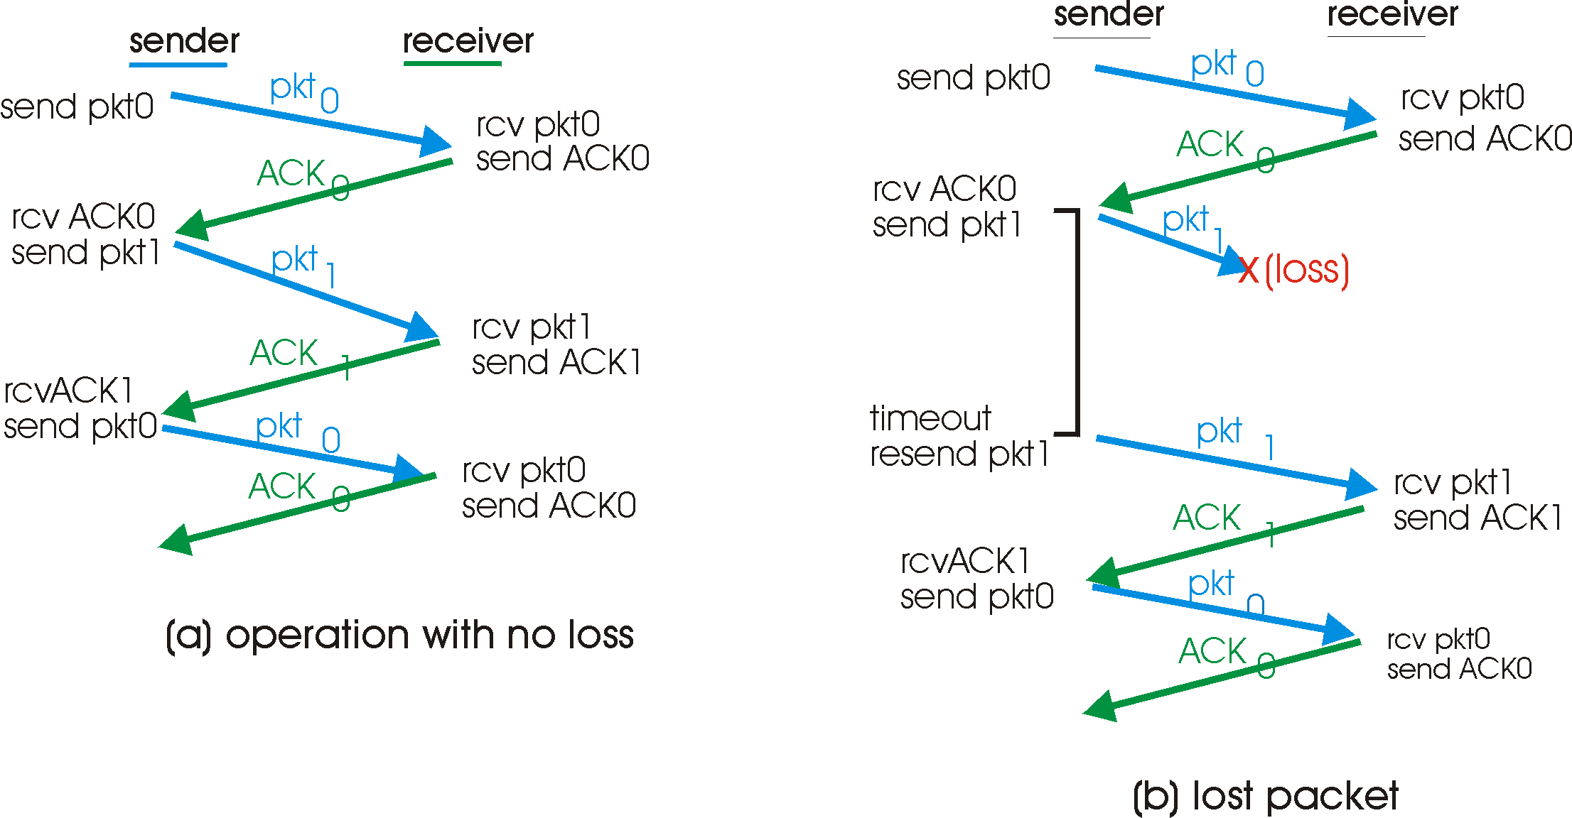
Stop-and-wait: reliable transfer over a reliable channel
underlying channel perfectly reliable
  no bit errors, no loss of packets
stop and wait
Sender sends one packet,
then waits for receiver
response

Slide 33
channel with bit errors
underlying channel may flip bits in packet
  checksum to detect bit errors
the question: how to recover from errors:
  acknowledgements (ACKs): receiver explicitly tells sender that pkt received OK
  negative acknowledgements (NAKs): receiver explicitly tells sender that pkt had errors
  sender retransmits pkt on receipt of NAK
new mechanisms for:
  error detection
  receiver feedback: control msgs (ACK,NAK) rcvr->sender

Slide 34
Stop-and-wait operation Summary
Stop and wait:
  sender awaits for ACK to send another frame
  sender uses a timer to re-transmit if no ACKs
  if ACK is lost:
    A sends frame, B’s ACK gets lost
    A times out & re-transmits the frame, B receives duplicates
    Sequence numbers are added (frame0,1 ACK0,1)
  timeout: should be related to round trip time estimates
    if too small → unnecessary re-transmission
    if too large → long delays

Slide 35
Stop-and-wait with lost packet/frame

Slide 36
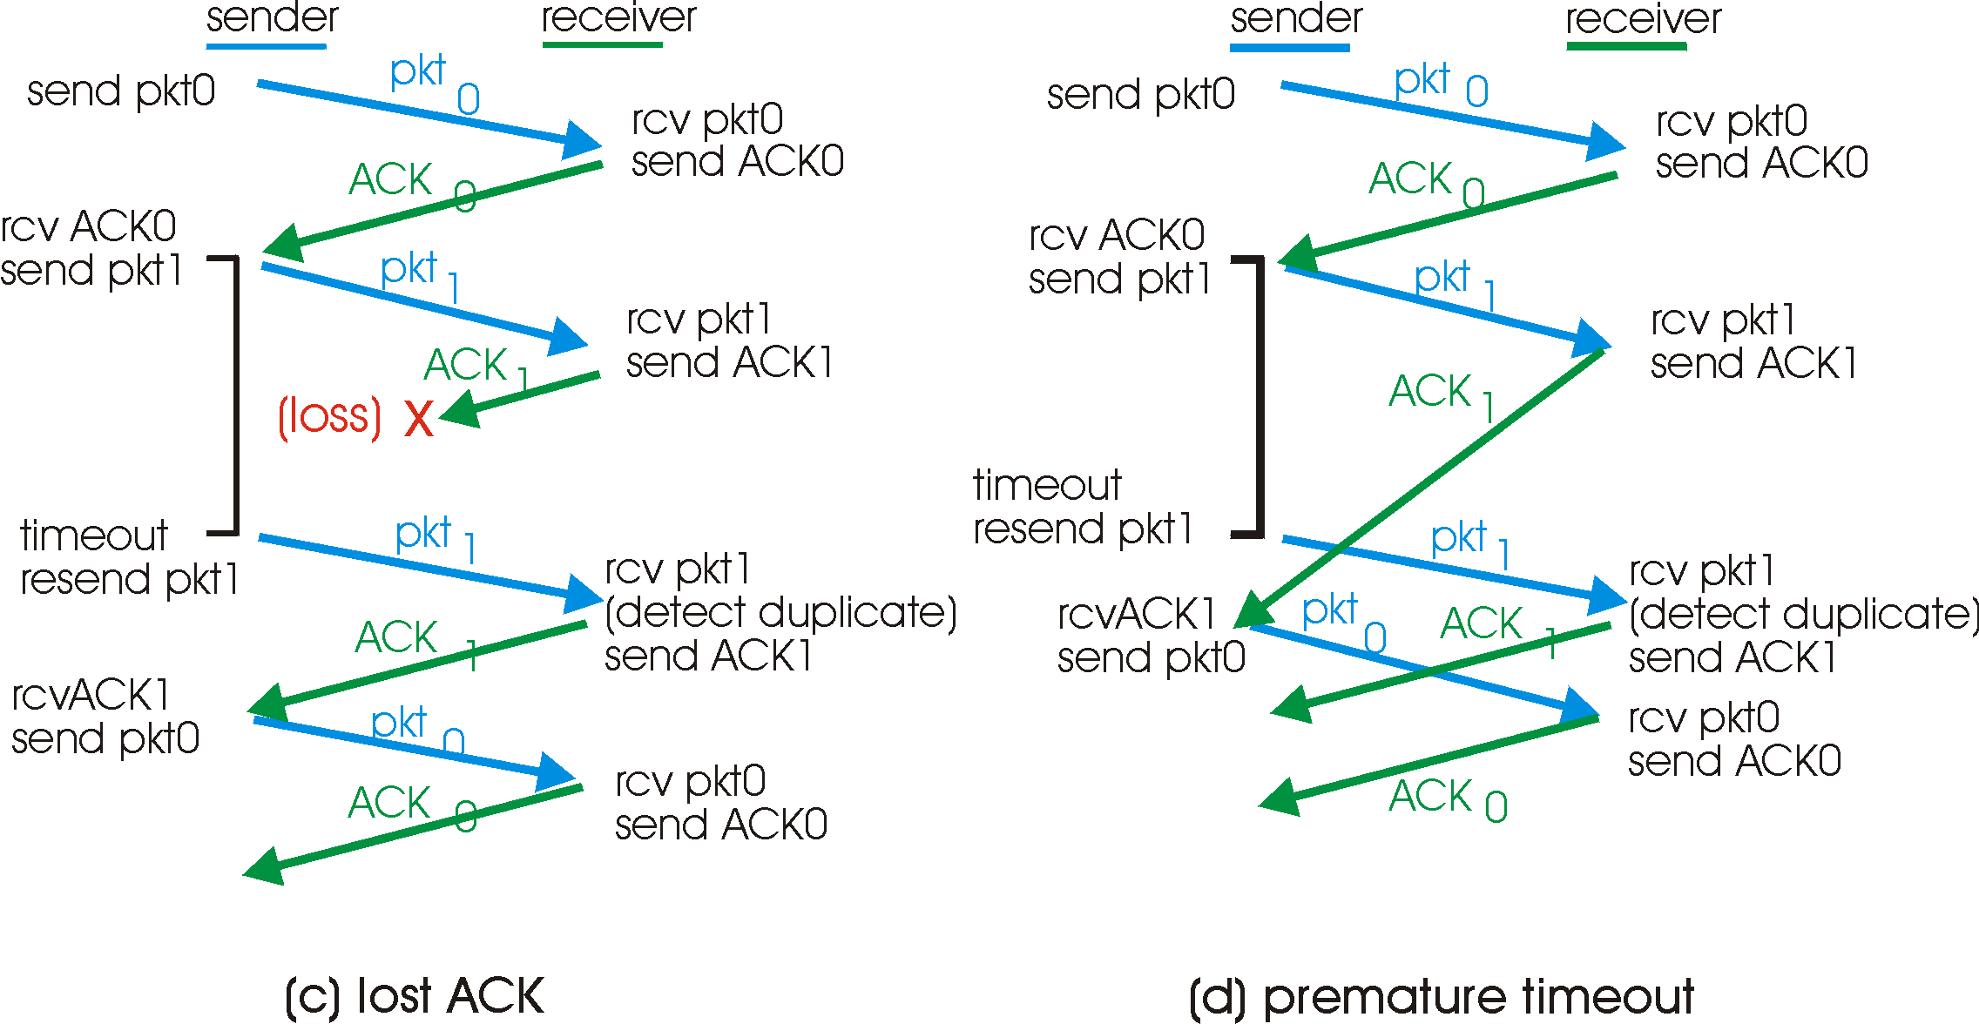

Slide 37
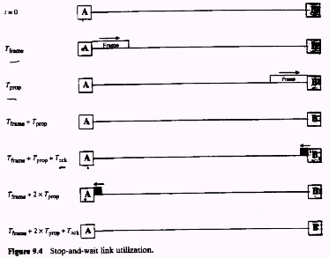

Slide 38
Stop and wait performance
utilization – fraction of time sender busy sending
ideal case (error free)
  u=Tframe/(Tframe+2Tprop)=1/(1+2a), a=Tprop/Tframe

Slide 39
Performance of stop-and-wait
example: 1 Gbps link, 15 ms e-e prop. delay, 1KB packet:
T
=
L (packet length in bits)
8kb/pkt
transmit
=
= 8 microsec
R (transmission rate, bps)
10**9 b/sec
  U _{sender}: utilization – fraction of time sender busy sending
  1KB pkt every 30 msec -> 33kB/sec thruput over 1 Gbps link
  network protocol limits use of physical resources!

Slide 40
stop-and-wait operation
sender
receiver
first packet bit transmitted, t = 0
last packet bit transmitted, t = L / R
first packet bit arrives
RTT
last packet bit arrives, send ACK
ACK arrives, send next
packet, t = RTT + L / R

Slide 41
Sliding window techniques
TCP is a variant of sliding window
Includes Go back N (GBN) and selective repeat/reject
Allows for outstanding packets without Ack
More complex than stop and wait
Need to buffer un-Ack’ed packets & more book-keeping than stop-and-wait

Slide 42
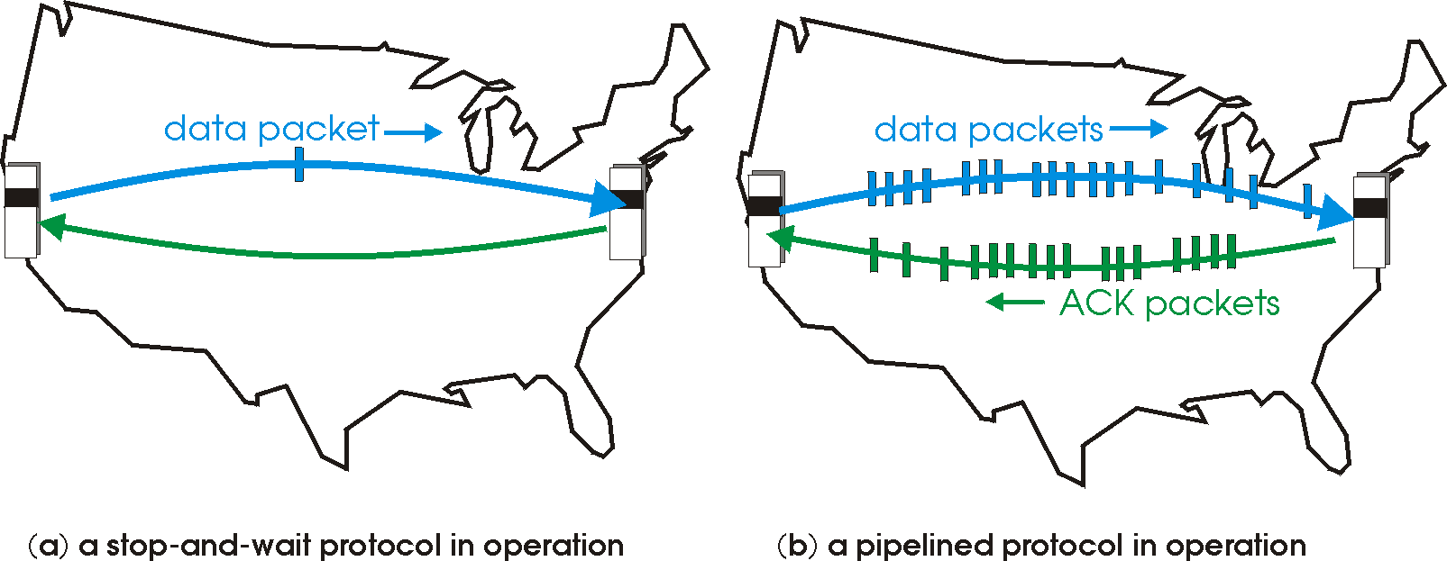
Pipelined (sliding window) protocols
Pipelining: sender allows multiple, “in-flight”, yet-to-be-acknowledged pkts
  range of sequence numbers must be increased
  buffering at sender and/or receiver
Two generic forms of pipelined protocols: go-Back-N, selective repeat

Slide 43
Pipelining: increased utilization
sender
receiver
first packet bit transmitted, t = 0
last bit transmitted, t = L / R
first packet bit arrives
RTT
last packet bit arrives, send ACK
last bit of 2nd packet arrives, send ACK
last bit of 3rd packet arrives, send ACK
ACK arrives, send next
packet, t = RTT + L / R
Increase utilization
by a factor of 3!

Slide 44
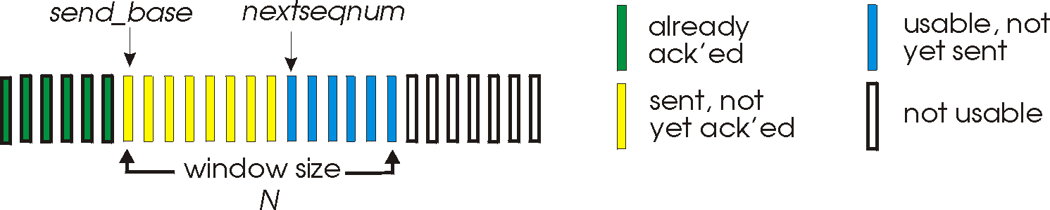
Go-Back-N
Sender:
k-bit seq # in pkt header
“window” of up to N, consecutive unack’ed pkts allowed
ACK(n): ACKs all pkts up to, including seq # n - “cumulative ACK”
  may receive duplicate ACKs (more later…)
timer for each in-flight pkt
timeout(n): retransmit pkt n and all higher seq # pkts in window

Slide 45
GBN: receiver side
ACK-only: always send ACK for correctly-received pkt with highest in-order seq #
  may generate duplicate ACKs
  need only remember expected seq num
out-of-order pkt:
  discard (don’t buffer) -> no receiver buffering!
  Re-ACK pkt with highest in-order seq #

Slide 46
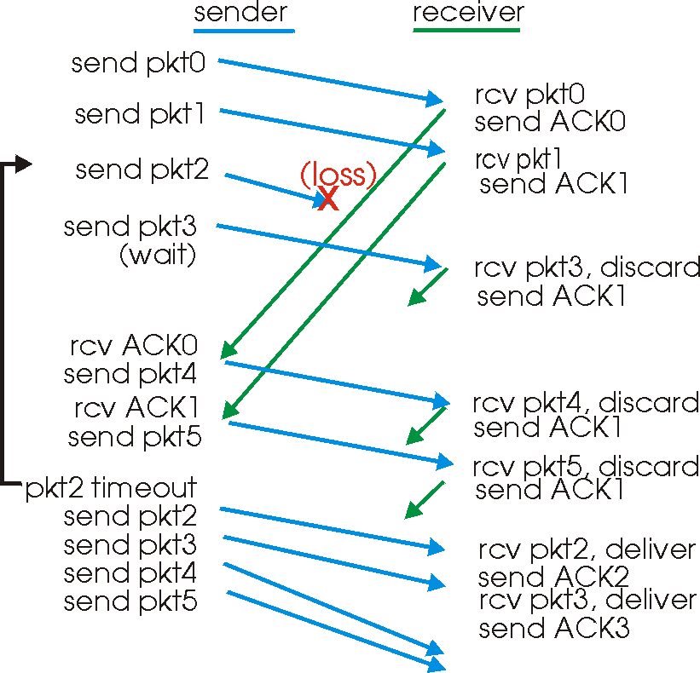
GBN in action

Slide 47
Selective Repeat
receiver individually acknowledges all correctly received pkts
  buffers pkts, as needed, for eventual in-order delivery to upper layer
sender only resends pkts for which ACK not received
  sender timer for each unACKed pkt
sender window
  N consecutive seq #’s
  limits seq #s of sent, unACKed pkts

Slide 48
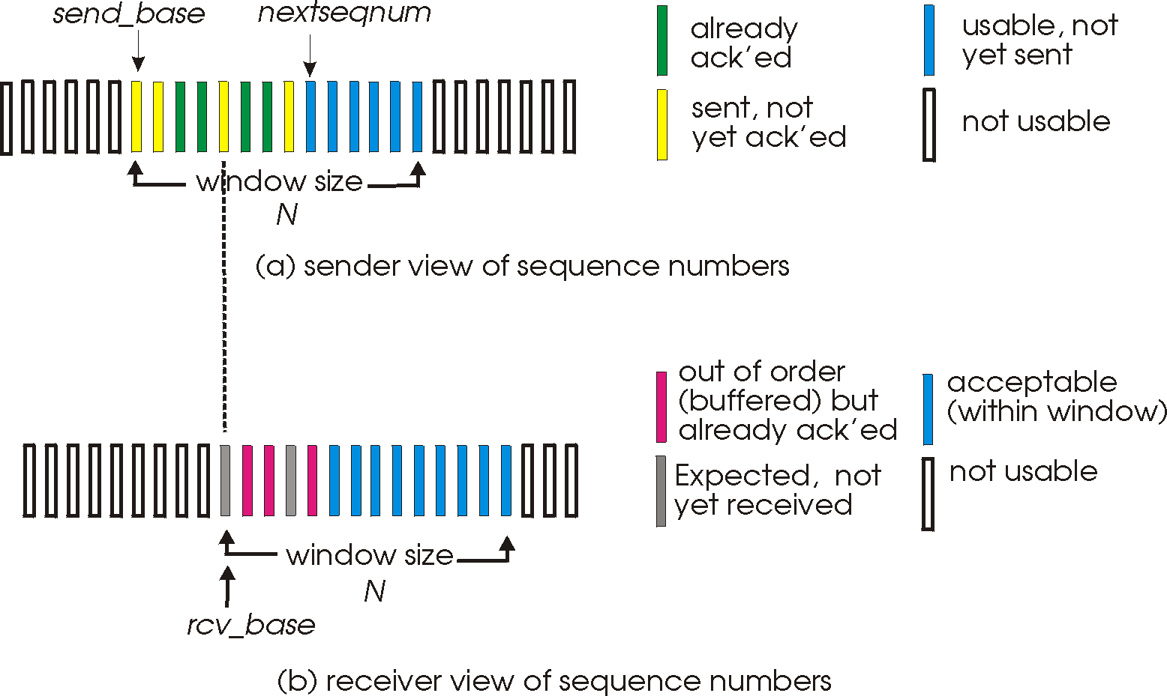
Selective repeat: sender, receiver windows

Slide 49
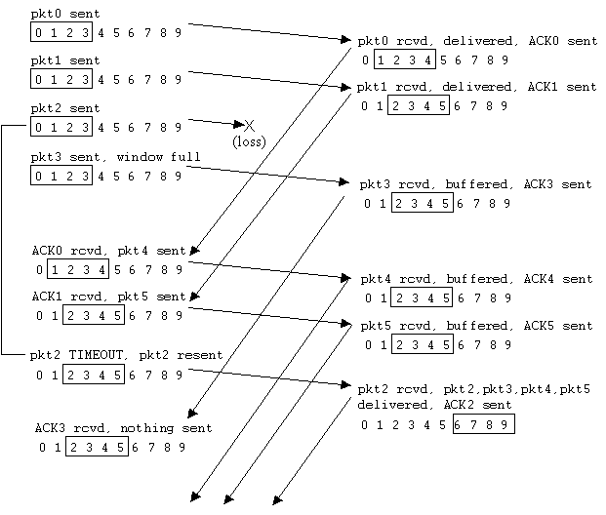
Selective repeat in action

Slide 50
performance:
selective repeat:
  error-free case:
    if the window is w such that the pipe is full→U=100%
    otherwise U=w*Ustop-and-wait=w/(1+2a)
  in case of error:
    if w fills the pipe U=1-p
    otherwise U=w*Ustop-and-wait=w(1-p)/(1+2a)

Slide 51
TCP: Overview RFCs: 793, 1122, 1323, 2018, 2581
point-to-point:
  one sender, one receiver
reliable, in-order byte stream:
  no “message boundaries”
pipelined:
  TCP congestion and flow control set window size
send & receive buffers
full duplex data:
  bi-directional data flow in same connection
  MSS: maximum segment size
connection-oriented:
  handshaking (exchange of control msgs) init’s sender, receiver state before data exchange
flow controlled:
  sender will not overwhelm receiver

Slide 52
TCP segment structure
32 bits
URG: urgent data
(generally not used)
counting
by bytes
of data
(not segments!)
source port #
dest port #
sequence number
ACK: ACK #
valid
acknowledgement number
head
len
not
used
U
Receive window
A
P
R
S
PSH: push data now
(generally not used)
F
# bytes
rcvr willing
to accept
checksum
Urg data pnter
RST, SYN, FIN:
connection estab
(setup, teardown
commands)
Options (variable length)
application
data
(variable length)
Internet
checksum
(as in UDP)

Slide 53
Receive window: credit (in octets) that the receiver is willing to accept from the sender starting from ack #
flags:
  SYN: synchronizing at initail connection time
  FIN: end of sender data
  PSH: when used at sender the data is transmitted immediately, when at receiver, it is accepted immediately
options:
  window scale factor (WSF): actual window = 2^{F}xwindow field, where F is the number in the WSF
  timestamp option: helps in RTT (round-trip-time) calculations

Slide 54
credit allocation scheme
  (A=i,W=j) [A=Ack, W=window]: receiver acks up to ‘i-1’ bytes and allows/anticipates i up to i+j-1
  receiver can use the cumulative ack option and not respond immediately
performance: depends on
  transmission rate, propagation, window size, queuing delays, retransmission strategy which depends on RTT estimates that affect timeouts and are affected by network dynamics, receive policy (ack), background traffic….. it is complex!

Slide 55
TCP seq. #’s and ACKs
Seq. #’s:
  byte stream “number” of first byte in segment’s data
ACKs:
  seq # of next byte expected from other side
  cumulative ACK
Q: how receiver handles out-of-order segments
  A: TCP spec doesn’t say, - up to implementor
Host A
Host B
User
types
‘C’
Seq=42, ACK=79, data = ‘C’
host ACKs
receipt of
‘C’, echoes
back ‘C’
Seq=79, ACK=43, data = ‘C’
host ACKs
receipt
of echoed
‘C’
Seq=43, ACK=80
time
simple telnet scenario

Slide 56
TCP retransmission strategy:
TCP performs end-to-end flow/congestion control and error recovery
TCP depends on implicit congestion signaling and uses an adaptive re-transmission timer, based on average observation of the ack delays.

Slide 57
Ack delays may be misleading due to the following reasons:
  Cumulative acks render this estimate inaccurate
  Abrupt changes in the network
  If ack is received for a re-transmitted packet, sender cannot distinguish between ack for the original packet and ack for the re-transmitted packet

Slide 58
Reliability in TCP
Components of reliability
  1. Sequence numbers
  2. Retransmissions
  3. Timeout Mechanism(s): function of the round trip time (RTT) between the two hosts (is it static?)

Slide 59
TCP Round Trip Time and Timeout
Q: how to set TCP timeout value?
longer than RTT
  but RTT varies
too short: premature timeout
  unnecessary retransmissions
too long: slow reaction to segment loss
Q: how to estimate RTT?
SampleRTT: measured time from segment transmission until ACK receipt
  ignore retransmissions
SampleRTT will vary, want estimated RTT “smoother”
  average several recent measurements, not just current SampleRTT

Slide 60
TCP Round Trip Time and Timeout
EstimatedRTT(k) = (1- α)*EstimatedRTT(k-1) + α*SampleRTT(k)
=(1- α)*((1- α)*EstimatedRTT(k-2)+ α*SampleRTT(k-1))+ α *SampleRTT(k)
=(1- α)^{k} *SampleRTT(0)+ α(1- α)^{k-1} *SampleRTT)(1)+…+ α *SampleRTT(k)
Exponential weighted moving average (EWMA)
influence of past sample decreases exponentially fast
typical value: α = 0.125

Slide 61
Example RTT estimation:

Slide 62
∝=0.5
∝=0.125

Slide 63
∝=0.125
∝=0.125

Slide 64
TCP Round Trip Time and Timeout
Setting the timeout
EstimtedRTT plus “safety margin”
  large variation in EstimatedRTT -> larger safety margin
1. estimate how much SampleRTT deviates from EstimatedRTT:
DevRTT = (1-β)*DevRTT +
β*|SampleRTT-EstimatedRTT|
(typically, β = 0.25)
2. set timeout interval:
TimeoutInterval = EstimatedRTT + 4*DevRTT
  3. For further re-transmissions (if the 1st re-tx was not Ack’ed)
  - RTO=q.RTO, q=2 for exponential backoff
  - similar to Ethernet CSMA/CD backoff

Slide 65
TCP reliable data transfer
TCP creates reliable service on top of IP’s unreliable service
Pipelined segments
Cumulative acks
TCP uses single retransmission timer
Retransmissions are triggered by:
  timeout events
  duplicate acks
Initially consider simplified TCP sender:
  ignore duplicate acks
  ignore flow control, congestion control

Slide 66
TCP: retransmission scenarios
Host A
Host B
Host A
Host B
Seq=92, 8 bytes data
Seq=92, 8 bytes data
Seq=100, 20 bytes data
timeout
ACK=100
Seq=92 timeout
X
ACK=100
loss
ACK=120
Seq=92, 8 bytes data
Sendbase
= 100
Seq=92, 8 bytes data
SendBase
= 120
Seq=92 timeout
ACK=120
ACK=100
SendBase
= 100
SendBase
= 120
premature timeout
time
time
lost ACK scenario

Slide 67
TCP retransmission scenarios (more)
Host A
Host B
Seq=92, 8 bytes data
ACK=100
timeout
Seq=100, 20 bytes data
X
loss
SendBase
= 120
ACK=120
time
Cumulative ACK scenario

Slide 68
Fast Retransmit
Time-out period often relatively long:
  long delay before resending lost packet
Detect lost segments via duplicate ACKs.
  Sender often sends many segments back-to-back
  If segment is lost, there will likely be many duplicate ACKs.
If sender receives 3 ACKs for the same data, it supposes that segment after ACKed data was lost:
  fast retransmit: resend segment before timer expires

Slide 69
(Self-clocking)

Slide 70
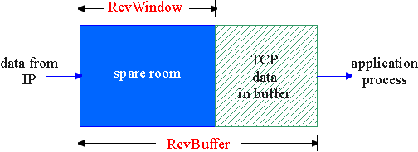
TCP Flow Control
flow control
sender won’t overflow
receiver’s buffer by
transmitting too much, too fast
receive side of TCP connection has a receive buffer:
match the send rate to the receiving app’s drain rate
app process may be slow at reading from buffer (low drain rate)

Slide 71
Principles of Congestion Control
Congestion:
informally: “too many sources sending too much data too fast for network to handle”
different from flow control!
manifestations:
  lost packets (buffer overflow at routers)
  long delays (queueing in router buffers)
a key problem in the design of computer networks

Slide 72
Congestion Control & Traffic Management
Does adding bandwidth to the network or increasing the buffer sizes solve the problem of congestion?
No. We cannot over-engineer the whole network due to:
Increased traffic from applications (multimedia,etc.)
Legacy systems (expensive to update)
Unpredictable traffic mix inside the network: where is the bottleneck?
Congestion control & traffic management is needed
  To provide fairness
  To provide QoS and priorities

Slide 73
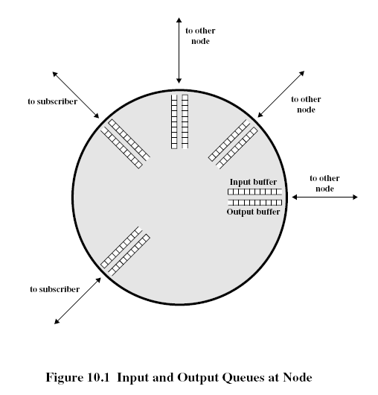
Network Congestion
Modeling the network as network of queues: (in switches and routers)
  Store and forward
  Statistical multiplexing
Limitations: -on buffer size
  -> contributes to packet loss
if we increase buffer size?
  excessive delays
if infinite buffers
  infinite delays

Slide 74
solutions:
  policies for packet service and packet discard to limit delays
  congestion notification and flow/congestion control to limit arrival rate
  buffer management: input buffers, output buffers, shared buffers

Slide 75

Notes on congestion and delay
fluid flow model
arrival > departure --> queue build-up --> overflow and excessive delays
TTL field: time-to-live
  Limits number of hops traversed
  Limits the time
Infinite buffer --> queue build-up and TTL decremented --> Tput goes to 0
Arrival
Rate
Departure
Rate

Slide 76
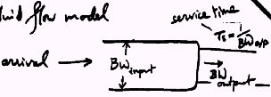

Using the fluid flow model to reason about relative flow delays in the Internet
Service Time: Ts=1/BW_{output}
Flow Arrival
BW_{input}
Bw_{output}
Bandwidth is split between flows such that flow 1 gets f1 fraction, flow 2 gets f2 … so on.

Slide 77
  f1 is fraction of the bandwidth given to flow 1
  f2 is fraction of the bandwidth given to flow 2
  λ1 is the arrival rate for flow 1
  λ2 is the arrival rate for flow 2
for M/D/1: delay Tq=Ts[1+ρ/[2(1-ρ)]]
  The total server utilization, ρ=Ts. λ
  Fraction time utilized by flow i, Ti =Ts/fi
  (or the bandwidth utilized by flow i, Bi=Bs.fi, where Bi=1/Ti and Bs=1/Ts=M [the total b.w.])
  The utilization for flow i, ρi = λi.Ti= λi/(Bs.fi)

Slide 78
Tq and q = f(ρ)
If utilization is the same, then queuing delay is the same
Delay for flow i= f(ρi)
  ρi= λi.Ti= Ts.λi/fi
Condition for constant delay for all flows
  λi/fi is constant

Slide 79
Propagation of congestion
if flow control is used hop-by-hop then congestion may propagate throughout the network

Slide 80
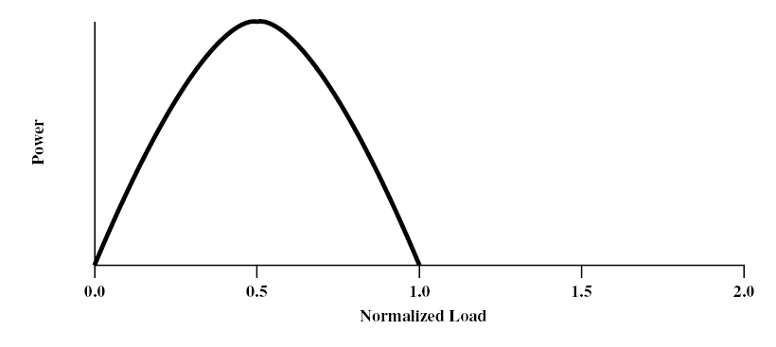
congestion phases and effects
ideal case: infinite buffers,
  Tput increases with demand & saturates at network capacity
Delay
Tput/Gput
Network Power = Tput/delay
Representative of Tput-delay design trade-off

Slide 81
practical case: finite buffers, loss
no congestion --> near ideal performance
overall moderate congestion:
  severe congestion in some nodes
  dynamics of the network/routing and overhead of protocol adaptation decreases the network Tput
severe congestion:
  loss of packets and increased discards
  extended delays leading to timeouts
  both factors trigger re-transmissions
  leads to chain-reaction bringing the Tput down

Slide 82
(I)
(II)
(III)
(I) No Congestion
(II) Moderate Congestion
(III) Severe Congestion (Collapse)
What is the best operational point and how do we get (and stay) there?

Slide 83
Congestion Control (CC)
Congestion is a key issue in network design
various techniques for CC
1.Back pressure
  hop-by-hop flow control (X.25, HDLC, Go back N)
  May propagate congestion in the network
2.Choke packet
  generated by the congested node & sent back to source
  example: ICMP source quench
  sent due to packet discard or in anticipation of congestion

Slide 84
Congestion Control (CC) (contd.)
3.Implicit congestion signaling
  used in TCP
  delay increase or packet discard to detect congestion
  may erroneously signal congestion (i.e., not always reliable) [e.g., over wireless links]
  done end-to-end without network assistance
  TCP cuts down its window/rate

Slide 85
Congestion Control (CC) (contd.)
4.Explicit congestion signaling
  (network assisted congestion control)
  gets indication from the network
    forward: going to destination
    backward: going to source
  3 approaches
    Binary: uses 1 bit (DECbit, TCP/IP ECN, ATM)
    Rate based: specifying bps (ATM)
    Credit based: indicates how much the source can send (in a window)

Slide 87
TCP congestion control: additive increase, multiplicative decrease
Approach: increase transmission rate (window size), probing for usable bandwidth, until loss occurs
  additive increase: increase rate (or congestion window) CongWin until loss detected
  multiplicative decrease: cut CongWin in half after loss
Saw tooth
behavior: probing
for bandwidth
congestion window size
time

Slide 88
TCP Congestion Control: details
sender limits transmission:
LastByteSent-LastByteAcked
≤ CongWin
Roughly,
CongWin is dynamic, function of perceived network congestion
How does sender perceive congestion?
loss event = timeout or duplicate Acks
TCP sender reduces rate (CongWin) after loss event
three mechanisms:
  AIMD
  slow start
  conservative after timeout events
CongWin
rate =
Bytes/sec
RTT

Slide 89
TCP window management
At any time the allowed window (awnd): awnd=MIN[RcvWin, CongWin],
where RcvWin is given by the receiver (i.e., Receive Window) and CongWin is the congestion window
Slow-start algorithm:
  start with CongWin=1, then CongWin=CongWin+1 with every ‘Ack’
  This leads to ‘doubling’ of the CongWin with RTT; i.e., exponential increase

Slide 90
TCP Slow Start (more)
When connection begins, increase rate exponentially until first loss event:
  double CongWin every RTT
  done by incrementing CongWin for every ACK received
Summary: initial rate is slow but ramps up exponentially fast
Host A
Host B
one segment
RTT
two segments
four segments
time

Slide 91
TCP congestion control
Initially we use Slow start:
CongWin = CongWin + 1 with every Ack
When timeout occurs we enter congestion avoidance:
  ssthresh=CongWin/2, CongWin=1
  slow start until ssthresh, then increase ‘linearly’
  CongWin=CongWin+1 with every RTT, or
  CongWin=CongWin+1/CongWin for every Ack
additive increase, multiplicative decrease (AIMD)

Slide 93
Slow start
Exponential increase
Congestion Avoidance
Linear increase
CongWin
(RTT)

Slide 94
Fast Retransmit & Recovery
Fast retransmit:
  receiver sends Ack with last in-order segment for every out-of-order segment received
  when sender receives 3 duplicate Acks it retransmits the missing/expected segment
Fast recovery: when 3rd dup Ack arrives
  ssthresh=CongWin/2
  retransmit segment, set CongWin=ssthresh+3
  for every duplicate Ack: CongWin=CongWin+1
  (note: beginning of window is ‘frozen’)
  after receiver gets cumulative Ack: CongWin=ssthresh
  (beginning of window advances to last Ack’ed segment)
CongWin

Slide 96
TCP Fairness
Fairness goal: if K TCP sessions share same bottleneck link of bandwidth R, each should have average rate of R/K
TCP connection 1
TCP
connection 2
bottleneck
router
capacity R

Slide 97
Fairness (more)
Fairness and UDP
Multimedia apps often do not use TCP
  do not want rate throttled by congestion control
Instead use UDP:
  pump audio/video at constant rate, tolerate packet loss
Research area: TCP friendly protocols!
Fairness and parallel TCP connections
nothing prevents app from opening parallel connections between 2 hosts.
Web browsers do this
Example: link of rate R supporting 9 connections;
  new app asks for 1 TCP, gets rate R/10
  new app asks for 11 TCPs, gets R/2 !

Slide 98
Congestion Control with Explicit Notification
TCP uses implicit signaling
ATM (ABR) uses explicit signaling using RM (resource management) cells
ATM: Asynchronous Transfer Mode, ABR: Available Bit Rate
ABR Congestion notification and congestion avoidance
parameters:
  peak cell rate (PCR)
  minimum cell rate (MCR)
  initial cell rate(ICR)

Slide 99
ABR uses resource management cell (RM cell) with fields:
  CI (congestion indication)
  NI (no increase)
  ER (explicit rate)
Types of RM cells:
  Forward RM (FRM)
  Backward RM (BRM)

Slide 101
Congestion Control in ABR
The source reacts to congestion notification by decreasing its rate (rate-based vs. window-based for TCP)
Rate adaptation algorithm:
  If CI=0,NI=0
    Rate increase by factor ‘RIF’ (e.g., 1/16)
    Rate = Rate + PCR/16
  Else If CI=1
    Rate decrease by factor ‘RDF’ (e.g., 1/4)
    Rate=Rate-Rate*1/4

Slide 103
Which VC to notify when congestion occurs?
  FIFO, if Qlength > 80%, then keep notifying arriving cells until Qlength < lower threshold (this is unfair)
  Use several queues: called Fair Queuing
  Use fair allocation = target rate/# of VCs = R/N
    If current cell rate (CCR) > fair share, then notify the corresponding VC

Slide 104
What to notify?
  CI
  NI
  ER (explicit rate) schemes perform the steps:
      Compute the fair share
      Determine load & congestion
      Compute the explicit rate & send it back to the source
  Should we put this functionality in the network?

