Slide 1
CNT 4007C Fundamentals of Computer Networks
Ahmed Helmy
Computer & Information Science & Engineering (CISE) Dept
University of Florida
http://www.cise.ufl.edu/~helmy

Slide 2
Course Outline
4 homeworks (30%) [including on-line Labs] + 2 exams (mid-term 30% & final exam 40%)
1 mid-term (30%) covering 1st half of semester
  Internet Architecture & Analysis, Layering, Multiplexing, Applications, Transport, Congestion Control, MAC protocols (partial !) [based on progress]
Final exam (40%) covering 2nd half
  MAC protocols (partial), Wireless and Mobile Networking, Routing (unicast routing, multicast intro)
1 required text book (Kurose, Ross… 6th Edition)
Lecture slides: modified version of book slides + supp. Materials & notes as needed

Slide 3
(Open) Questions to think about:
Throughout the semester we can ask the following questions about the functionality, design and analysis of the Internet:
What do you like about the Internet?
What do you not like about the Internet and would want to change?
How would you change it and how would you achieve such change? How would you evaluate the effects of your change (positive and negative)?

Slide 4
Intro & Motivation
What’s the Internet to you?
  Web browsers, wireless Internet Cafés, cellular phones!, home networks, networked cars (vehicular), networked embedded devices, Internet-of-Things (IoT), smart home, city, highway, school, hospital, wearables …. inter-planetary networks (DTNs)?…
  Very complex, time varying, hard to capture !
Why study the Internet?
  To learn engineering lessons from history
  Analyze today’s problems and improve performance
  Provide future designs for better Internet and new architectures and applications for new funcationality
  Is the Internet the only form of computer networking? (open question)

Slide 5
Topics (Chapters) to Cover
From main text book (Kurose, Ross)
  Ch1: Overview, Intro
  Ch2: Applications
  Ch3: Transport Layer
  Ch4: Network Layer
  Ch5: Link Layer, MAC, LANs
  Ch6: Wireless, Mobile Networks
  Ch7: Multimedia [partial: Diffserv, Intserv]
  Ch8: Security [partial]
Notes:
  Ordering maybe slightly modified as semester progresses.
  Personal notes, additions will be provided by Prof. as needed.
  This is not a programming class (although we will use some prog.). It is not a security class, although we’ll introduce security issues and discuss briefly!

Slide 6


Chapter 1
Introduction
Computer Networking: A Top Down Approach ,
4th edition.
Jim Kurose, Keith Ross
Addison-Wesley, July 2007. (Updated Apr 09, Sept 10). (Updated Aug 2012).

Slide 7
Chapter 1: Introduction
Overview:
what’s the Internet?
what’s a protocol?
network edge; hosts, access net, physical media
network core: Internet structure
protocol layers, service models
network core: packet/circuit switching,
performance: loss, delay, throughput
security
history

Slide 8
Chapter 1: roadmap
  1.1 What is the Internet?
  1.2 Network edge
    end systems, access networks, links
  1.3 Network core
    circuit switching, packet switching, network structure
  1.4 Delay, loss and throughput in packet-switched networks
  1.5 Protocol layers, service models
  1.6 Networks under attack: security
  1.7 History

Slide 9

What’s the Internet: “nuts and bolts” view
PC
millions of connected computing devices: hosts = end systems
  run network apps
Mobile network
server
Global ISP
wireless
laptop
cellular
handheld
Home network
communication links
  fiber, copper, radio, satellite
  transmission rate (bandwidth)
Regional ISP
access
points
Institutional network
wired
links
routers:
  forward packets (chunks of data)
router

Slide 10
What’s the Internet: “nuts and bolts” view
protocols control sending, receiving of msgs
  TCP, IP, HTTP, Ethernet
Internet:
“network of networks”
  loosely hierarchical
  public Internet versus private intranet
Internet standards
  RFC: Request for comments
  IETF: Internet Engineering Task Force
Mobile network
Global ISP
Home network
Regional ISP
Institutional network

Slide 11
What’s the Internet: a service view
communication infrastructure enables distributed applications:
  Web, VoIP, email, games, e-commerce, file sharing
communication services provided to apps:
  reliable data delivery from source to destination
  “best effort” (unreliable) data delivery

Slide 12
What’s a protocol?
Network protocols:
All communication in Internet governed by protocols
Generic protocol:
  specific messages sent
  specific actions taken when messages are received, or other events (e.g., timer expiration, exception detection)
Protocol Representation:
  Finite State Machines
  Protocol Specification, via Standards
protocols define format, order of messages sent and received among network entities, and actions taken on message transmission, receipt

Slide 13
What’s a protocol?
Example sequence of a computer network protocol:
host
server
TCP connection
request
TCP connection
response
Get http://www.ufl.edu
<file>
time
Protocol Design and Analysis are extremely important in Internet study, development and research

Slide 14
Chapter 1: roadmap
  1.1 What is the Internet?
  1.2 Network edge
    end systems, access networks, links
  1.3 Network core
    circuit switching, packet switching, network structure
  1.4 Delay, loss and throughput in packet-switched networks
  1.5 Protocol layers, service models
  1.6 Networks under attack: security
  1.7 History

Slide 15
A closer look at network structure:
Network edge: applications and hosts
Access networks, physical media: wired, wireless communication links
Network core:
  interconnected routers
  network of networks

Slide 16
The network edge:
End systems (hosts):
  run application programs
  e.g. Web, email
  at “edge of network”
peer-peer
Client-server model
  client host requests, receives service from always-on server
  e.g. Web browser/server; email client/server
client/server
Peer-to-peer model:
  minimal (or no) use of dedicated servers
  e.g. Skype, BitTorrenth

Slide 17
Network edge: reliable data transfer service
Goal: data transfer between end systems
handshaking: setup (prepare for) data transfer ahead of time
  Hello, initial establishment
  set up “state” in two communicating hosts
TCP - Transmission Control Protocol
  Internet’s reliable data transfer service
TCP service [RFC 793]
reliable, in-order byte-stream data transfer
  loss: acknowledgements and retransmissions
flow control:
  sender won’t overwhelm receiver
congestion control:
  senders “slow down sending rate” when network congested

Slide 18
Network edge: best effort (unreliable) data transfer service
Goal: data transfer between end systems
  same as before!
UDP - User Datagram Protocol [RFC 768]:
  connectionless
  unreliable data transfer
  no flow control
  no congestion control
App’s using TCP:
HTTP (Web), FTP (file transfer), Telnet (remote login), SMTP (email)
App’s using UDP:
streaming media, teleconferencing, DNS, Internet telephony

Slide 19
Access networks and physical media
Q: How to connect end systems to edge router?
residential access nets
institutional access networks (school, company)
mobile access networks
Keep in mind:
bandwidth (bits per second) of access network?
shared or dedicated?

Slide 20
Residential access: point to point access
Dialup via modem
  up to 56Kbps direct access to router (often less)
  Can’t surf and phone at same time: can’t be “always on”
DSL: digital subscriber line
  deployment: telephone company (typically)
  up to 1 Mbps upstream (today typically < 256 kbps)
  up to 8 Mbps downstream (today typically < 1 Mbps)
  dedicated physical line to telephone central office

Slide 21
Residential access: cable modems
uses cable TV infrastructure, rather than telephone infrastructure
HFC: hybrid fiber coax
  asymmetric: up to 30Mbps downstream, 2 Mbps upstream
network of cable and fiber attaches homes to ISP router
  homes share access to router
  unlike DSL, which has dedicated access

Slide 22
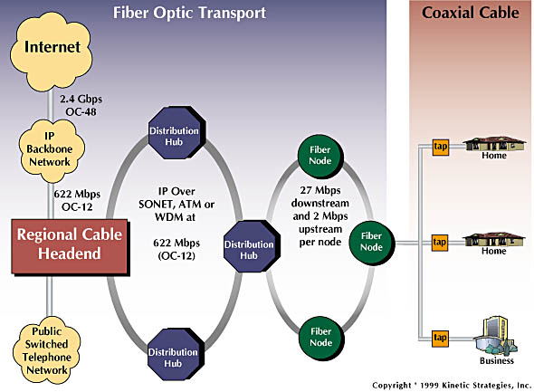
Residential access: cable modems

Slide 23

Cable Network Architecture: Overview
Typically 500 to 5,000 homes
cable headend
cable distribution
network (simplified)
home

Slide 24
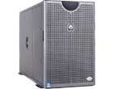
Cable Network Architecture: Overview
server(s)
cable headend
cable distribution
network
home

Slide 25
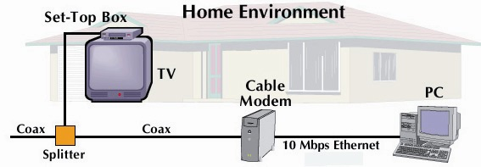
Cable Network Architecture: Overview
cable headend
cable distribution
network (simplified)
home

Slide 26
Cable Network Architecture: Overview
FDM (frequency
division multiplexing)
[more shortly]
C
O
N
T
R
O
L
V
I
D
E
O
V
I
D
E
O
V
I
D
E
O
V
I
D
E
O
V
I
D
E
O
V
I
D
E
O
D
A
T
A
D
A
T
A
1
2
3
4
5
6
7
8
9
Channels
cable headend
cable distribution
network
home

Slide 27
Ethernet Internet access
100 Mbps
institutional
router
Ethernet
switch
to institution’s
ISP
100 Mbps
1 Gbps
100 Mbps
server
typically used in companies, universities, etc
  10 Mbps, 100Mbps, 1Gbps, 10Gbps Ethernet
  today, end systems typically connect into Ethernet switch
Introduction 1-27

Slide 28
Wireless access networks
shared wireless access network connects end system to router
  via base station aka “access point”
wireless LANs:
  802.11b/g/n (WiFi): 11, 54, 111 Mbps
wider-area wireless access
  provided by telco operator
  ~1Mbps over cellular (EVDO, HSDPA)
  WiMAX, LTE (10’s Mbps) over wide area
Wireless Networks: Chapter 6
Future:
  Mobile Ad Hoc and Sensor Networks!
router
base
station
mobile
hosts

Slide 29
Home networks
Typical home network components:
DSL or cable modem
router/firewall/NAT
Ethernet
wireless access point
wireless
laptops
to/from
cable
headend
cable
modem
router/
firewall
wireless
access
point
Ethernet

Slide 30
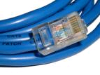
Physical Media
Twisted Pair (TP)
two insulated copper wires
  Category 3: traditional phone wires, 10 Mbps Ethernet
  Category 5:
  100Mbps Ethernet
Bit: propagates between
transmitter/rcvr pairs
physical link: what lies between transmitter & receiver
guided media:
  signals propagate in solid media: copper, fiber, coax
unguided media:
  signals propagate freely, e.g., radio

Slide 31


Physical Media: coax, fiber
Fiber optic cable:
glass fiber carrying light pulses, each pulse a bit
high-speed operation:
  high-speed point-to-point transmission (100’s Gps)
  WDM Networks: Wavelength
  division multiplexing
low error rate: repeaters spaced far apart ; immune to electromagnetic noise
Coaxial cable:
two concentric copper conductors
bidirectional
baseband:
  single channel on cable
  legacy Ethernet
broadband:
  multiple channels on cable
  HFC (hybrid fiber-coax)

Slide 32
Physical media: radio
signal carried in electromagnetic spectrum
no physical “wire”,…
bidirectional
propagation environment effects:
  reflection
  obstruction by objects
  Interference
dynamic link characteristics …
Radio link types:
terrestrial microwave
  e.g. up to 45 Mbps channels
LAN (e.g., Wifi)
  11Mbps, 54 Mbps
wide-area (e.g., cellular)
  3G/4G cellular: ~ 1-10 Mbps
satellite
  Kbps to 45Mbps channel (or multiple smaller channels)
  270 msec end-end delay
  geosynchronous versus low altitude

Slide 33
Chapter 1: roadmap
  1.1 What is the Internet?
  1.2 Network edge
    end systems, access networks, links
  1.3 Network core
    network structure, circuit switching, packet switching
  1.4 Delay, loss and throughput in packet-switched networks
  1.5 Protocol layers, service models
  1.6 Networks under attack: security
  1.7 History

Slide 34
Internet Structure: loose hierarchy
hierarchy based on administrative regions/providers

Slide 35
Internet structure: network of networks
roughly hierarchical
at center: small # of well-connected large networks
  “tier-1” commercial ISPs (e.g., Verizon, Sprint, AT&T, Qwest, Level3), national & international coverage
  large content distributors (Google, Akamai, Microsoft)
  treat each other as equals (no charges)
IXP
IXP
Tier-1 ISPs &
Content Distributors, interconnect (peer) privately
Tier 1 ISP
Large Content
Distributor
(e.g., Akamai)
Large Content
Distributor
(e.g., Google)
Tier 1 ISP
Tier 1 ISP
… or at Internet Exchange Points IXPs
Introduction 1-35

Slide 36
Tier-1 ISP: e.g., Sprint
POP: point-of-presence
to/from backbone
…
peering
….
…
…
…
to/from customers
Introduction 1-36

Slide 37
Internet structure: network of networks
“tier-2” ISPs: smaller (often regional) ISPs
  connect to one or more tier-1 (provider) ISPs
    each tier-1 has many tier-2 customer nets
    tier 2 pays tier 1 provider
  tier-2 nets sometimes peer directly with each other (bypassing tier 1) , or at IXP
Tier 2
ISP
IXP
IXP
Tier 2
ISP
Tier 2
ISP
Tier 1 ISP
Large Content
Distributor
(e.g., Akamai)
Large Content
Distributor
(e.g., Google)
Tier 1 ISP
Tier 1 ISP
Tier 2
ISP
Tier 2
ISP
Tier 2
ISP
Tier 2
ISP
Tier 2
ISP
Tier 2
ISP
Introduction 1-37
Notes:
37

Slide 38
Internet structure: network of networks
“Tier-3” ISPs, local ISPs
customer of tier 1 or tier 2 network
  last hop (“access”) network (closest to end systems)
Tier 2
ISP
IXP
IXP
Tier 2
ISP
Tier 2
ISP
Tier 1 ISP
Large Content
Distributor
(e.g., Akamai)
Large Content
Distributor
(e.g., Google)
Tier 1 ISP
Tier 1 ISP
Tier 2
ISP
Tier 2
ISP
Tier 2
ISP
Tier 2
ISP
Tier 2
ISP
Tier 2
ISP
Introduction 1-38
Notes:
38

Slide 39
Internet structure: network of networks
a packet passes through many networks from source host to destination host
Tier 2
ISP
IXP
IXP
Tier 2
ISP
Tier 2
ISP
Tier 1 ISP
Large Content
Distributor
(e.g., Akamai)
Large Content
Distributor
(e.g., Google)
Tier 1 ISP
Tier 1 ISP
Tier 2
ISP
Tier 2
ISP
Tier 2
ISP
Tier 2
ISP
Tier 2
ISP
Tier 2
ISP
Introduction 1-39
Notes:
39

Slide 40
Internet structure: network of networks
a packet passes through many networks down and up the hierarchy!
local
ISP
Tier 3
ISP
local
ISP
local
ISP
local
ISP
Tier-2 ISP
Tier-2 ISP
Tier 1 ISP
Tier 1 ISP
Tier 1 ISP
Tier-2 ISP
Tier-2 ISP
Tier-2 ISP
local
ISP
local
ISP
local
ISP
local
ISP

Slide 41
Internet Hierarchy
hierarchy based on routing (more later)

Slide 42
Hierarchical Architecture (+s, -s)
Advantages
  Isolates and scopes internal dynamics: dampens oscillations, providing stability to the overall network
  Supports scalability: aggregation/summary per domain for smaller, more efficient routing tables
  Allows for flexibility: domains deploy different protocols, policies …
Disadvantages
  Overhead of establishing and maintaining the hierarchy (esp. for mobile, dynamic nets)
  Sub-optimality of routing …

Slide 43
So, what does the Internet look like? Have you seen it lately?!
100 node transit-stub topology

Slide 44
Map of the multicast backbone [Mbone] (~3000 nodes) [2002]

Slide 45

Map of the Internet (~50,000 nodes)

Slide 46
It is not simple…
It is really complex
  in scale
  in interactions and dynamics
  in failure modes (loss, crashes, loops, etc)
We need a very systematic approach to design protocols for such a complex network

Slide 47
Chapter 1: roadmap
  1.1 What is the Internet?
  1.2 Network edge
    end systems, access networks, links
  1.3 Network core
    circuit switching, packet switching, network structure
  1.4 Delay, loss and throughput in packet-switched networks
  1.5 Protocol layers, service models
  1.6 Networks under attack: security
  1.7 History

Slide 48
Protocol “Layers”
Networks are complex!
many “pieces”:
  hosts
  routers
  links of various media
  applications
  protocols
  hardware, software
Question:
Is there any hope of organizing structure of network?
Or at least our discussion of networks?

Slide 49
Why layering?
Dealing with complex systems:
explicit structure allows identification, relationship of complex system’s pieces
  layered reference model for discussion
modularization eases maintenance, updating of system
  change of implementation of layer’s service transparent to rest of system
  change in one layer doesn’t affect rest of system
  (is this true?!)
Can layering be considered harmful?

Slide 50
Internet protocol stack
application: supporting network applications
  FTP, SMTP, HTTP
transport: process-process data transfer
  TCP, UDP
network: routing of datagrams from source to destination
  IP, routing protocols
link: data transfer between neighboring network elements
  PPP, Ethernet
physical: bits “on the wire”
application
transport
network
link
physical

Slide 51
ISO/OSI reference model
presentation: allow applications to interpret meaning of data, e.g., encryption, compression, machine-specific conventions
session: synchronization, checkpointing, recovery of data exchange
Internet stack “missing” these layers!
  these services, if needed, must be implemented in application
  needed?
Other protocol stacks? ATM, …
application
presentation
session
transport
network
link
physical

Slide 52
Encapsulation
source
message
M
application
transport
network
link
physical
segment
H_{t}
M
H_{t}
datagram
H_{n}
H_{n}
H_{t}
M
frame
H_{l}
H_{n}
H_{t}
M
link
physical
switch
destination
H_{n}
H_{t}
M
network
link
physical
M
application
transport
network
link
physical
H_{l}
H_{n}
H_{t}
M
H_{n}
H_{t}
M
H_{t}
M
H_{n}
H_{t}
M
H_{l}
H_{n}
H_{t}
M
router

Slide 53
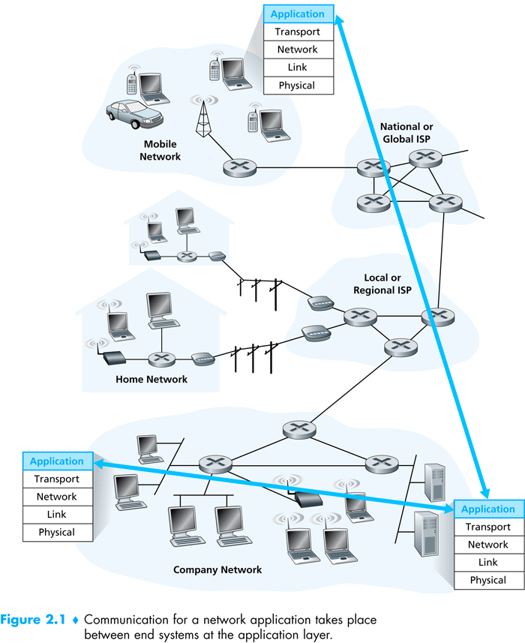

Slide 54
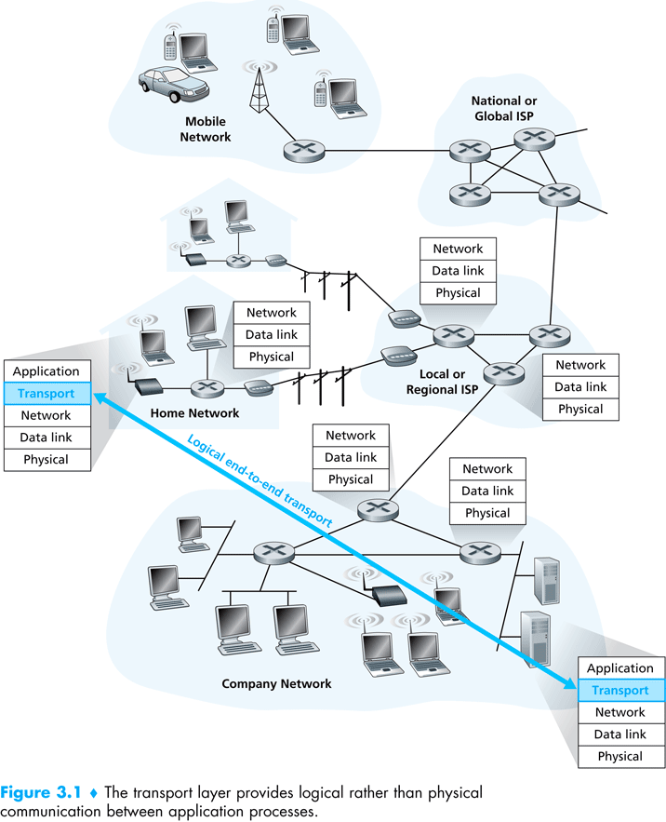

Slide 55
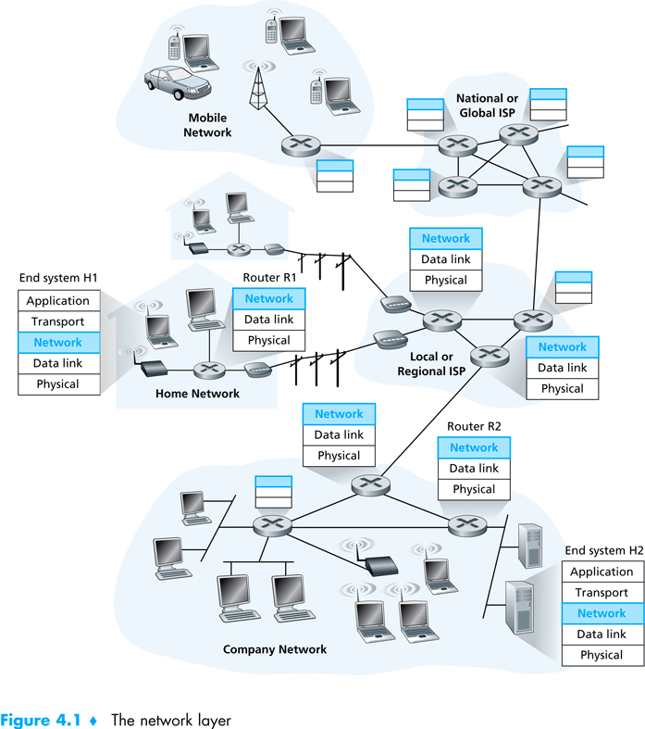

Slide 56
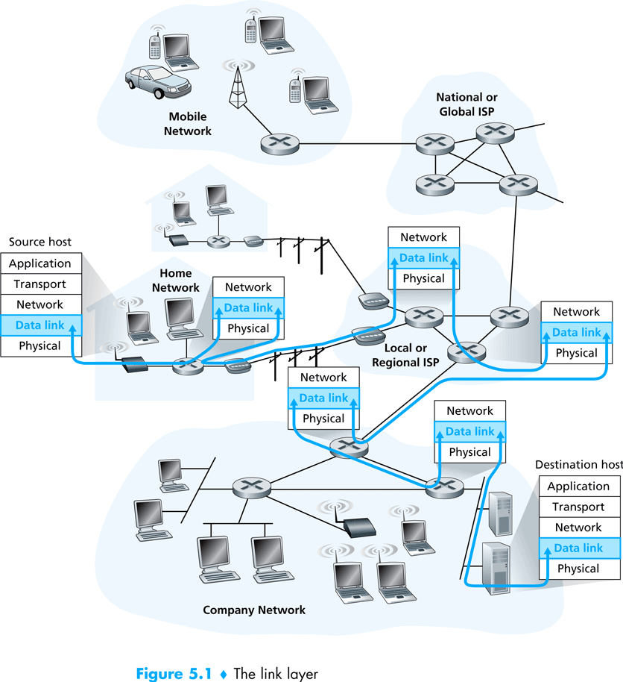

Slide 57
Layering & protocol stacks: (the protocol hour glass – thin waste)

Slide 58
Chapter 1: roadmap
  1.1 What is the Internet?
  1.2 Network edge
    end systems, access networks, links
  1.3 Network core
    circuit switching, packet switching, network structure
  1.4 Delay, loss and throughput in packet-switched networks
  1.5 Protocol layers, service models
  1.6 Networks under attack: security
  1.7 History

Slide 59
The Network Core
mesh of interconnected routers
the fundamental question: how is data transferred through net?
  circuit switching: dedicated circuit per call: telephone net
  packet-switching: data sent thru net in discrete “chunks”

Slide 60
Network Core: Circuit Switching
End-to-end resources reserved for “call”
link bandwidth, switch capacity
dedicated resources: no sharing
circuit-like (guaranteed) performance
call setup required
re-establish call upon failure

Slide 61
Network Core: Circuit Switching
network resources (e.g., bandwidth) divided into “pieces”
pieces allocated to calls
resource piece idle if not used by owning call (no sharing)
MULTIPLEXING: dividing link bandwidth into “pieces”
  frequency division
  time division
Multiplexing is so fundamental and influences many aspects of the technology, including congestion, buffering, delays, routing, …

Slide 62
Circuit Switching: FDM and TDM
Example:
FDM
4 users
frequency
time
TDM
frequency
time
Notes:
Two simple multiple access control techniques.
Each mobile’s share of the bandwidth is divided into portions for the uplink and the downlink. Also, possibly, out of band signaling.
As we will see, used in AMPS, GSM, IS-54/136

Slide 63
Numerical example
How long does it take to send a file of 640k bits from host A to host B over a circuit-switched network?
  All links are 1.536 Mbps
  Each link uses TDM with 24 slots/sec
  500 msec to establish end-to-end circuit
Let’s work it out!
Each link gets 1.526Mbps/24=64kbps
Time needed for 640kbps=640/64+0.5=10.5 seconds
Plus propagation! (for 20km link prop del~100 Micro sec)
Plus queuing delay?? [In circuit switched (TDM) networks there’s blocking and no queuing, in general]

Slide 64
Internet Design Goals/Principles
Scalability & economic access:
  Resource sharing, reduce reservations, allow for higher utilization
  Use of packet switching (statistical multiplexing) instead of circuit switching
Robustness:
  Re-routing around failures
  Stateless connections, dynamic routing
Reliablility:
  Timed retransmission, based on acks, seq. #s
Evolvable:
  Minimize complexity in the network and push functionality to the edges (end-to-end principles)
* to revisit during history discussion

Slide 65
Network Core: Packet Switching
each end-end data stream divided into packets
user A, B packets share network resources
each packet uses full link bandwidth
resources used as needed
resource contention:
aggregate resource demand can exceed amount available
congestion: packets queue, wait for link use
store and forward: packets move one hop at a time
  Node receives complete packet before forwarding
Bandwidth division into “pieces”
Dedicated allocation
Resource reservation

Slide 66
Packet Switching: Statistical Multiplexing
100 Mb/s
Ethernet
A
C
statistical multiplexing
1.5 Mb/s
B
queue of packets
waiting for output
link
D
E
Sequence of A & B packets does not have fixed pattern, bandwidth shared on demand ➔ statistical multiplexing.
TDM: each host gets same slot in revolving TDM frame.

Slide 67
Packet-switching: store-and-forward
L
R
R
R
takes L/R seconds to transmit (push out) packet of L bits on to link at R bps
store and forward: entire packet must arrive at router before it can be transmitted on next link
delay = 3L/R (assuming zero propagation delay)
Example:
L = 7.5 Mbits
R = 1.5 Mbps
transmission delay = 15 sec
more on delay shortly …

Slide 68
Packet switching versus circuit switching
Packet switching allows more users to use network!
1 Mb/s link
each user:
  100 kb/s when “active”
  active 10% of time
circuit-switching:
  10 users
packet switching:
  with 35 users, probability > 10 active at same time is less than .0004
N users
1 Mbps link
Q: how did we get value 0.0004?
Use binomial distribution …

Slide 69
Probability Background: variables, stats and distributions
Discrete random variables:
where E[X] is the expected (or mean) value
2nd moment:

Slide 70
Continuous random variables:
where F[x] is the cumulative distribution, f(y) is the probability density function,
  F[-∞]=0, F[∞]=1
Variance:
  Var[X]=E[(X-E[X])²]=E[X²]-(E[X])²
Standard deviation

Slide 71
Bernoulli experiment:
  probability of success p, failure q=1-p
Geometric distribution:
  X is the number of (independent identically distributed i.i.d.) Bernoulli experiments to get success
  Pr[X=k]=q^{k-1}p (1st k-1 failures then success)
  E(X)=ΣkPr[X=k]=1/p
  p=0.1, E(X)=1/p=10
0.9
S
0.1

Slide 72
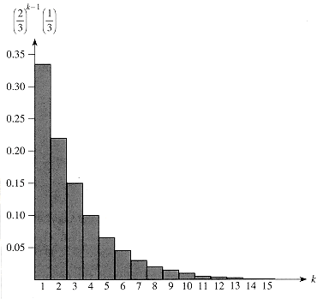
Geometric Distribution
A geometric distribution with probability p=1/3 and a probability q = 1-p of failure. The expectation (mean) of the distribution is 1/p=3.

Slide 73
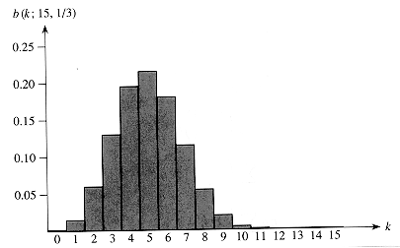
Binomial distribution:
    x is the number of successes in n Bernoulli experiments/trials
    E[X]=np
The binomial distribution b(k: 15, 1/3) resulting from n=15 Bernoulli trials each with probability p=1/3 of success. The expectation (mean) of the distribution is np=5.

Slide 74
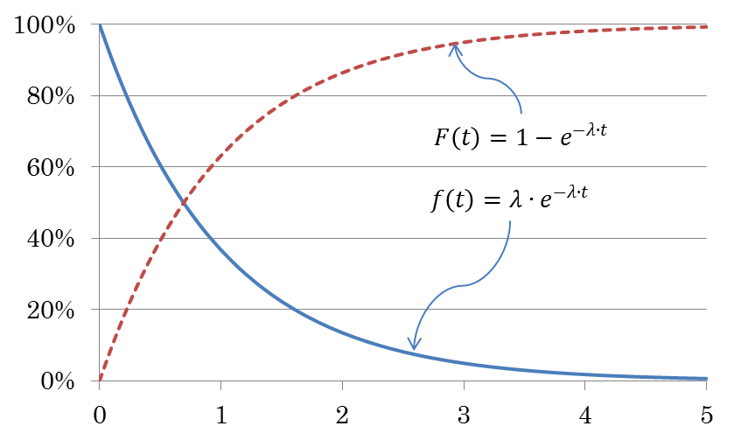
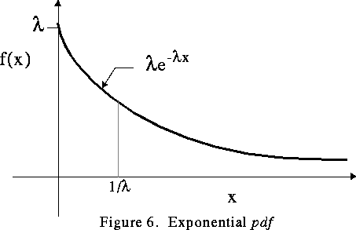
Exponential distribution:
F[x]=1-e^{-λx}, f(x)=λe^{-λx}, Pr[X>x]=1-F[x]=e^{-λx}, E[X]=1/λ

Slide 75
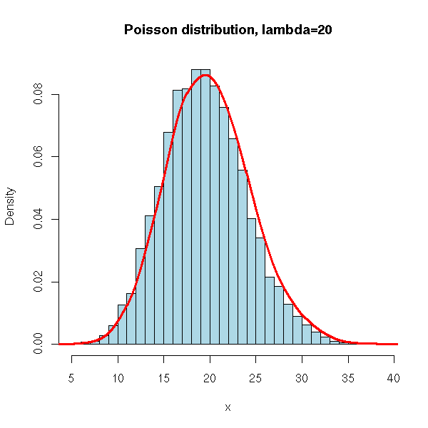
Poisson Distribution:
Pr[X=k]= (λ^{k}/k!) e^{-λ},E[X]=Var[X]= λ
Used in queuing theory:
    Pr[k items arriving in T interval]= ((λT)^{k}/k!) e^{-λT},
    Expected number of items to arrive in T=λT, where λ is the rate of arrival

Slide 76
Poisson processes are used in M/M/1 and M/D/1 queuing models
Inter-arrival times Ta
  Pr[Ta<t]=1-e^{-λt}, E[Ta]=1/λ, is exponentially distributed
good for modeling human generated actions
  phone call arrivals
  call duration
  telnet/ftp session arrivals

Slide 77
Autocorrelation function R(t1,t2) is a measure of the relationship between the instances of the stochastic process at time t1 & t2 [x(t1) & x(t2)]
  R(t1,t2)=E[x(t1).x(t2)]
  A related measure is the autocovariance C(t1,t2)=R(t1,t2)-μ(t1).μ(t2), where μ(t) is the mean of the stochastic process
  Autocorrelation measures the degree of dependence between instances of the stochastic process
  If R→0 as t2-t1 is large → no correlation between the different instants → short memory process
  If R is substantial for large Δt, then there is high correlation between values and this is considered a long memory process

Slide 78
Packet switching versus circuit switching
Is packet switching a “slam dunk winner?”
great for bursty data
  resource sharing (scalable!)
  simpler, no call setup, more robust (re-routing)
excessive congestion: packet delay and loss
  Without admission control: protocols needed for reliable data transfer, congestion control
Q: How to provide circuit-like behavior?
  bandwidth guarantees needed for audio/video apps
  still an unsolved problem (chapter 7), virtual circuit

Slide 79
Chapter 1: roadmap
  1.1 What is the Internet?
  1.2 Network edge
    end systems, access networks, links
  1.3 Network core
    circuit switching, packet switching, network structure
  1.4 Delay, loss and throughput in packet-switched networks
  1.5 Protocol layers, service models
  1.6 Networks under attack: security
  1.7 History

Slide 80
How do loss and delay occur?
packets queue in router buffers
packet arrival rate to link exceeds output link capacity
packets queue, wait for turn
packet being transmitted (delay)
A
B
packets queueing (delay)
free (available) buffers: arriving packets
dropped (loss) if no free buffers

Slide 81
Four sources of packet delay
1. nodal processing:
  check bit errors
  determine output link
2. queueing
  time waiting at output link for transmission
  depends on congestion level of router
transmission
A
propagation
B
nodal
processing
queueing

Slide 82
Delay in packet-switched networks
3. Transmission delay:
R=link bandwidth (bps)
L=packet length (bits)
time to send bits into link = L/R
4. Propagation delay:
d = length of physical link
s = propagation speed in medium (~2x10⁸ m/sec)
propagation delay = d/s
Note: s and R are very different quantities!
transmission
A
propagation
B
nodal
processing
queueing

Slide 83
Nodal delay
d_{proc} = processing delay
  typically a few microsecs or less
d_{queue} = queuing delay
  depends on congestion
d_{trans} = transmission delay
  = L/R, significant for low-speed links
d_{prop} = propagation delay
  a few microsecs to hundreds of msecs

Slide 84
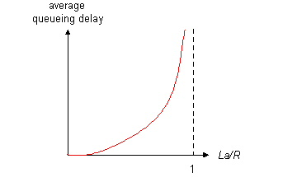

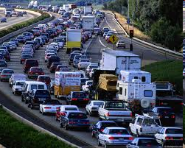
Queueing delay (revisited)
R: link bandwidth (bps)
L: packet length (bits)
a: average packet arrival rate
average queueing delay
traffic intensity
= La/R
La/R ~ 0
La/R ~ 0: avg. queueing delay small
La/R -> 1: avg. queueing delay large
La/R > 1: more “work” arriving
than can be serviced, average delay infinite!
La/R -> 1
Introduction 1-84

Slide 85
“Real” Internet delays and routes
What do “real” Internet delay & loss look like?
Traceroute program: provides delay measurement from source to router along end-end Internet path towards destination. For all i:
  sends three packets that will reach router i on path towards destination
  router i will return packets to sender
  sender times interval between transmission and reply.
3 probes
3 probes
3 probes

Slide 86
“Real” Internet delays and routes
traceroute: gaia.cs.umass.edu to www.eurecom.fr
Three delay measurements from
gaia.cs.umass.edu to cs-gw.cs.umass.edu
1 cs-gw (128.119.240.254) 1 ms 1 ms 2 ms
2 border1-rt-fa5-1-0.gw.umass.edu (128.119.3.145) 1 ms 1 ms 2 ms
3 cht-vbns.gw.umass.edu (128.119.3.130) 6 ms 5 ms 5 ms
4 jn1-at1-0-0-19.wor.vbns.net (204.147.132.129) 16 ms 11 ms 13 ms
5 jn1-so7-0-0-0.wae.vbns.net (204.147.136.136) 21 ms 18 ms 18 ms
6 abilene-vbns.abilene.ucaid.edu (198.32.11.9) 22 ms 18 ms 22 ms
7 nycm-wash.abilene.ucaid.edu (198.32.8.46) 22 ms 22 ms 22 ms
8 62.40.103.253 (62.40.103.253) 104 ms 109 ms 106 ms
9 de2-1.de1.de.geant.net (62.40.96.129) 109 ms 102 ms 104 ms
10 de.fr1.fr.geant.net (62.40.96.50) 113 ms 121 ms 114 ms
11 renater-gw.fr1.fr.geant.net (62.40.103.54) 112 ms 114 ms 112 ms
12 nio-n2.cssi.renater.fr (193.51.206.13) 111 ms 114 ms 116 ms
13 nice.cssi.renater.fr (195.220.98.102) 123 ms 125 ms 124 ms
14 r3t2-nice.cssi.renater.fr (195.220.98.110) 126 ms 126 ms 124 ms
15 eurecom-valbonne.r3t2.ft.net (193.48.50.54) 135 ms 128 ms 133 ms
16 194.214.211.25 (194.214.211.25) 126 ms 128 ms 126 ms
17 * * *
18 * * *
19 fantasia.eurecom.fr (193.55.113.142) 132 ms 128 ms 136 ms
trans-oceanic
link
* means no response (probe lost, router not replying)

Slide 87
Packet loss
queue (aka buffer) preceding link in buffer has finite capacity
packet arriving to full queue dropped (aka lost)
lost packet may be retransmitted by previous node, by source end system, or not at all
buffer
(waiting area)
packet being transmitted
A
B
packet arriving to
full buffer is lost

Slide 88
Throughput
throughput: rate (bits/time unit) at which bits transferred between sender/receiver
  instantaneous: rate at given point in time
  average: rate over long(er) period of time
link capacity
R_{s} bits/sec
link capacity
R_{c} bits/sec
server, with
file of F bits
to send to client
pipe that can carry
fluid at rate
R_{s} bits/sec)
pipe that can carry
fluid at rate
R_{c} bits/sec)
server sends bits
(fluid) into pipe

Slide 89
Throughput (more)
R_{s} < R_{c} What is average end-end throughput?
R_{s} bits/sec
R_{c} bits/sec
R_{s} > R_{c} What is average end-end throughput?
R_{s} bits/sec
R_{c} bits/sec
bottleneck link
link on end-end path that constrains end-end throughput

Slide 90
Throughput: Internet scenario
R_{s}
per-connection end-end throughput: min(R_{c},R_{s},R/10)
in practice: R_{c} or R_{s} is often bottleneck
R_{s}
R_{s}
R
R_{c}
R_{c}
R_{c}
10 connections (fairly) share backbone bottleneck link R bits/sec

Slide 91
Chapter 1: roadmap
  1.1 What is the Internet?
  1.2 Network edge
    end systems, access networks, links
  1.3 Network core
    circuit switching, packet switching, network structure
  1.4 Delay, loss and throughput in packet-switched networks
  1.5 Protocol layers, service models
  1.6 Networks under attack: security
  1.7 History

Slide 92
Network Security
field of network security:
  how bad guys can attack computer networks
  how we can defend networks against attacks
  how to design architectures that are immune to attacks
Internet not originally designed with (much) security in mind
  original vision: “a group of mutually trusting users attached to a transparent network” ☺
  Internet protocol designers playing “catch-up”
  security considerations in all layers!
Introduction 1-92

Slide 93
Bad guys: put malware into hosts via Internet
malware can get in host from a virus, worm, or Trojan horse.
spyware malware can record keystrokes, web sites visited, upload info to collection site.
infected host can be enrolled in botnet, used for spam and DDoS attacks.
malware often self-replicating: from one infected host, seeks entry into other hosts
Introduction 1-93

Slide 94
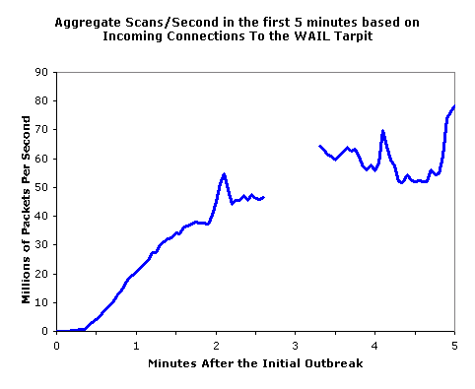
Bad guys: put malware into hosts via Internet
Trojan horse
  hidden part of some otherwise useful software
  today often in Web page (Active-X, plugin)
virus
  infection by receiving object (e.g., e-mail attachment), actively executing
  self-replicating: propagate itself to other hosts, users
worm:
  infection by passively receiving object that gets itself executed
  self- replicating: propagates to other hosts, users
Sapphire Worm: aggregate scans/sec
in first 5 minutes of outbreak (CAIDA, UWisc data)
Introduction 1-94

Slide 95
Bad guys: attack server, network infrastructure
Denial of Service (DoS): attackers make resources (server, bandwidth) unavailable to legitimate traffic by overwhelming resource with bogus traffic
1. select target
2. break into hosts around the network (see botnet)
3. send packets to target from compromised hosts
target
Introduction 1-95

Slide 96
The bad guys can sniff packets
Packet sniffing:
  broadcast media (shared Ethernet, wireless)
  promiscuous network interface reads/records all packets (e.g., including passwords!) passing by
A
C
src:B dest:A payload
B
  Wireshark software used for end-of-chapter labs is a (free) packet-sniffer
Introduction 1-96

Slide 97
The bad guys can use false source addresses
IP spoofing: send packet with false source address
A
C
src:B dest:A payload
B
Introduction 1-97

Slide 98
The bad guys can record and playback
record-and-playback: sniff sensitive info (e.g., password), and use later
  password holder is that user from system point of view
C
A
src:B dest:A user: B; password: foo
B
… lots more on security (throughout, Chapter 8)
Introduction 1-98

Slide 99
Network Security
chapter 8: focus on security
crypographic techniques: obvious uses and not so obvious uses
provides challenging issues, esp. for emerging mobile networks

Slide 100
Chapter 1: roadmap
  1.1 What is the Internet?
  1.2 Network edge
    end systems, access networks, links
  1.3 Network core
    circuit switching, packet switching, network structure
  1.4 Delay, loss and throughput in packet-switched networks
  1.5 Protocol layers, service models
  1.6 Networks under attack: security
  1.7 History

Slide 101
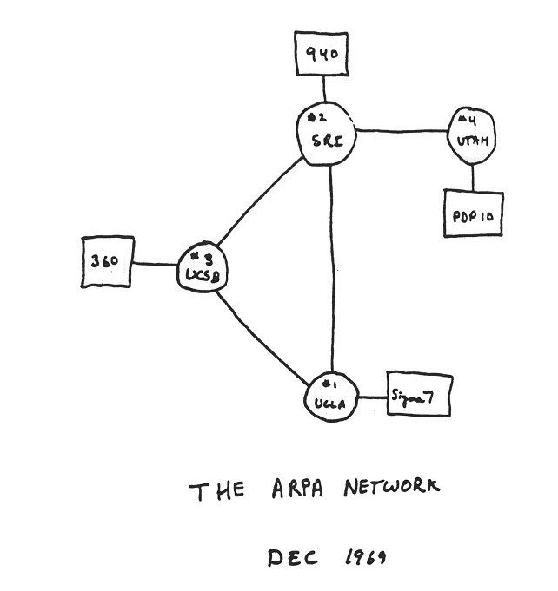
Internet History
1961-1972: Early packet-switching principles
1961: Kleinrock - queueing theory shows effectiveness of packet-switching
1964: Baran - packet-switching in military nets
1967: ARPAnet conceived by Advanced Research Projects Agency
1969: first ARPAnet node operational
1972:
  ARPAnet public demonstration
  NCP (Network Control Protocol) first host-host protocol
  first e-mail program
  ARPAnet has 15 nodes

Slide 102
Internet History
1972-1980: Internetworking, new and proprietary nets
1970: ALOHAnet satellite network in Hawaii
1974: Cerf and Kahn - architecture for interconnecting networks
1976: Ethernet at Xerox PARC
ate70’s: proprietary architectures: DECnet, SNA, XNA
late 70’s: switching fixed length packets (ATM precursor)
1979: ARPAnet has 200 nodes
Cerf and Kahn’s internetworking principles:
  minimalism, autonomy - no internal changes required to interconnect networks
  best effort service model
  stateless routers
  decentralized control
define today’s Internet architecture

Slide 103
Internet History
1980-1990: new protocols, a proliferation of networks
1983: deployment of TCP/IP
1982: smtp e-mail protocol defined
1983: DNS defined for name-to-IP-address translation
1985: ftp protocol defined
1988: TCP congestion control
new national networks: Csnet, BITnet, NSFnet, Minitel
100,000 hosts connected to confederation of networks

Slide 104
Internet History
1990, 2000’s: commercialization, the Web, new apps
Early 1990’s: ARPAnet decommissioned
1991: NSF lifts restrictions on commercial use of NSFnet (decommissioned, 1995)
early 1990s: Web
  hypertext [Bush 1945, Nelson 1960’s]
  HTML, HTTP: Berners-Lee
  1994: Mosaic, later Netscape
  late 1990’s: commercialization of the Web
Late 1990’s – 2000’s:
more killer apps: instant messaging, P2P file sharing
network security to forefront
est. 50 million host, 100 million+ users
backbone links running at Gbps

Slide 105
Internet History
2007:
~500 million hosts
Voice, Video over IP
P2P applications: Napster, BitTorrent (file sharing) Skype (VoIP), PPLive (video)
more applications: YouTube, gaming, social networking
wireless, mobility, networked embedded sensors,…

Slide 106
Introduction: Summary
Covered a “ton” of material!
Internet overview
what’s a protocol?
network edge, core, access network
  packet-switching versus circuit-switching
  Internet structure
performance: loss, delay, throughput
layering, service models
security
history
You now have:
context, overview, “feel” of networking
more depth, detail to follow!

