Slide 1
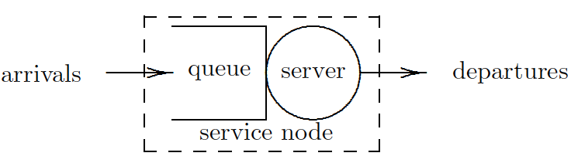
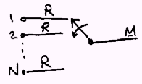

Modeling using queuing theory
if N.R=M then input capacity = capacity of multiplexed link => TDM
if N.R>M but α.N.R<M then this may be modeled by a queuing system to analyze its performance

Slide 2
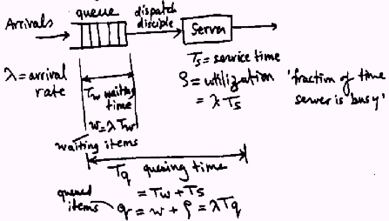
Queuing system for single server

Slide 3
Inputs/Outputs of Queuing Theory
Given:
arrival rate
service time
queuing discipline
Output:
wait time, and queuing delay
waiting items, and queued items

Slide 4
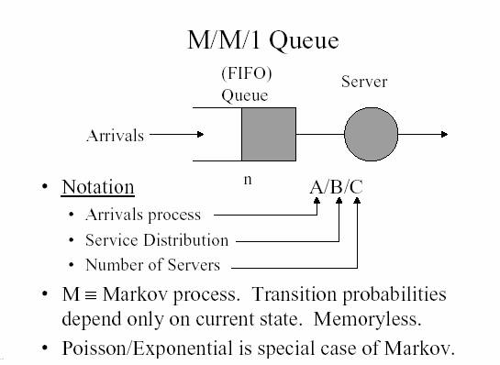

Slide 5
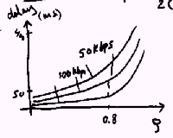

Slide 6
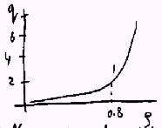
As ρ increases, so do buffer requirements and delay
The buffer size ‘q’ only depends on ρ

Slide 7
Queuing Example
If N=10, R=100, α=0.4, M=500
Or N=100, M=5000
ρ=α.N.R/M=0.8, q=2.4
a smaller amount of buffer space per source is needed to handle larger number of sources
variance of q increases with ρ
For a finite buffer: probability of loss increases with utilization ρ>0.8 undesirable

Slide 8

Chapter 3 Transport Layer
Computer Networking: A Top Down Approach, 5th edition. Jim Kurose, Keith Ross Addison-Wesley, April 2009.
Computer Networking: A Top Down Approach 4th edition. Jim Kurose, Keith Ross Addison-Wesley, July 2007.

Slide 9

Internet transport-layer protocols
reliable, in-order delivery to app: TCP
congestion control
flow control
connection setup
unreliable, unordered delivery to app: UDP
no-frills extension of “best-effort” IP
services not available:
delay guarantees
bandwidth guarantees
application
transport
network
data link
physical
network
data link
physical
network
data link
physical
logical end-end transport
network
data link
physical
network
data link
physical
network
data link
physical
network
data link
physical
application
transport
network
data link
physical

Slide 10
Connectionless demultiplexing
When host receives UDP segment:
checks destination port number in segment
directs UDP segment to socket with that port number
IP datagrams with different source IP addresses and/or source port numbers directed to same socket
Create sockets with port numbers:
DatagramSocket mySocket1 = new DatagramSocket(12534);
DatagramSocket mySocket2 = new DatagramSocket(12535);
UDP socket identified by two-tuple:
(dest IP address, dest port number)

Slide 11
Connectionless demux (cont)
DatagramSocket serverSocket = new DatagramSocket(6428);
P2
P1
P3
P1
SP: 6428
SP: 6428
DP: 9157
DP: 5775
SP: 9157
SP: 5775
client
IP: A
DP: 6428
server
IP: C
DP: 6428
Client
IP:B
SP provides “return address”

Slide 12
Connection-oriented demux
TCP socket identified by 4-tuple:
source IP address
source port number
dest IP address
dest port number
recv host uses all four values to direct segment to appropriate socket
Server host may support many simultaneous TCP sockets:
each socket identified by its own 4-tuple
Web servers have different sockets for each connecting client
non-persistent HTTP will have different socket for each request

Slide 13
Connection-oriented demux (cont)
P1
P4
P5
P6
P2
P1
P3
SP: 5775
DP: 80
S-IP: B
D-IP:C
SP: 9157
SP: 9157
client
IP: A
DP: 80
server
IP: C
DP: 80
Client
IP:B
S-IP: A
S-IP: B
D-IP:C
D-IP:C

Slide 14
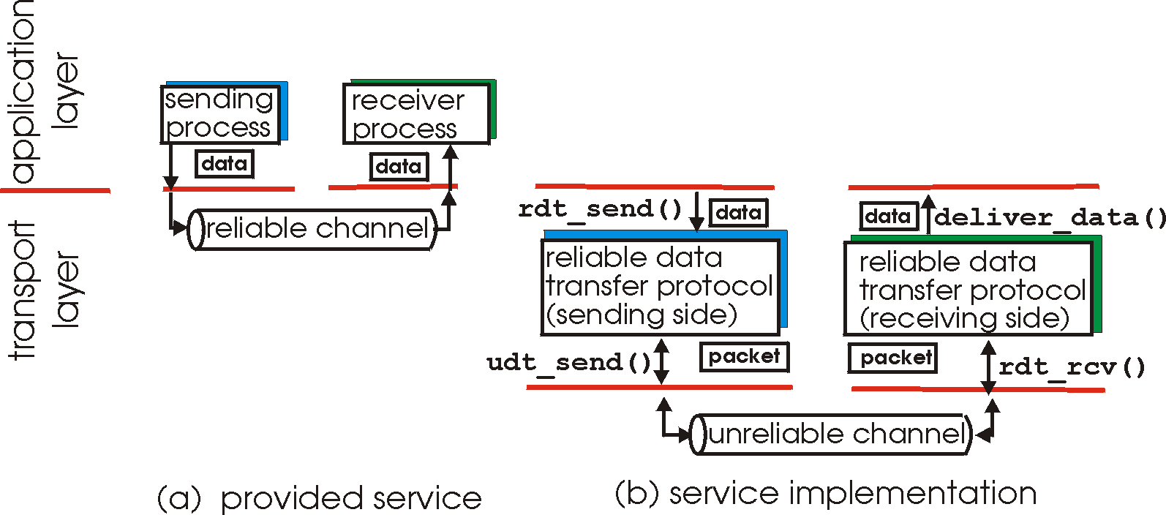
Principles of Reliable data transfer
important in app., transport, link layers
top-10 list of important networking topics!
characteristics of unreliable channel will determine complexity of reliable data transfer protocol (rdt)

Slide 15
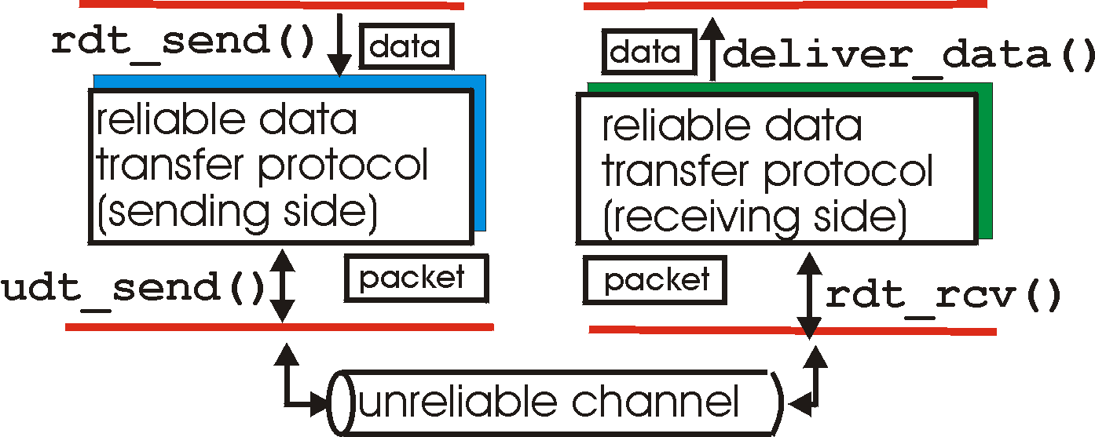
Reliable data transfer: getting started
rdt_send(): called from above, (e.g., by app.). Passed data to
deliver to receiver upper layer
deliver_data(): called by rdt to deliver data to upper
send
side
receive
side
udt_send(): called by rdt,
to transfer packet over
unreliable channel to receiver
rdt_rcv(): called when packet arrives on rcv-side of channel

Slide 16
Hop-by-hop flow control
Approaches/techniques for hop-by-hop flow control
Stop-and-wait
sliding window
Go back N
Selective reject

Slide 17
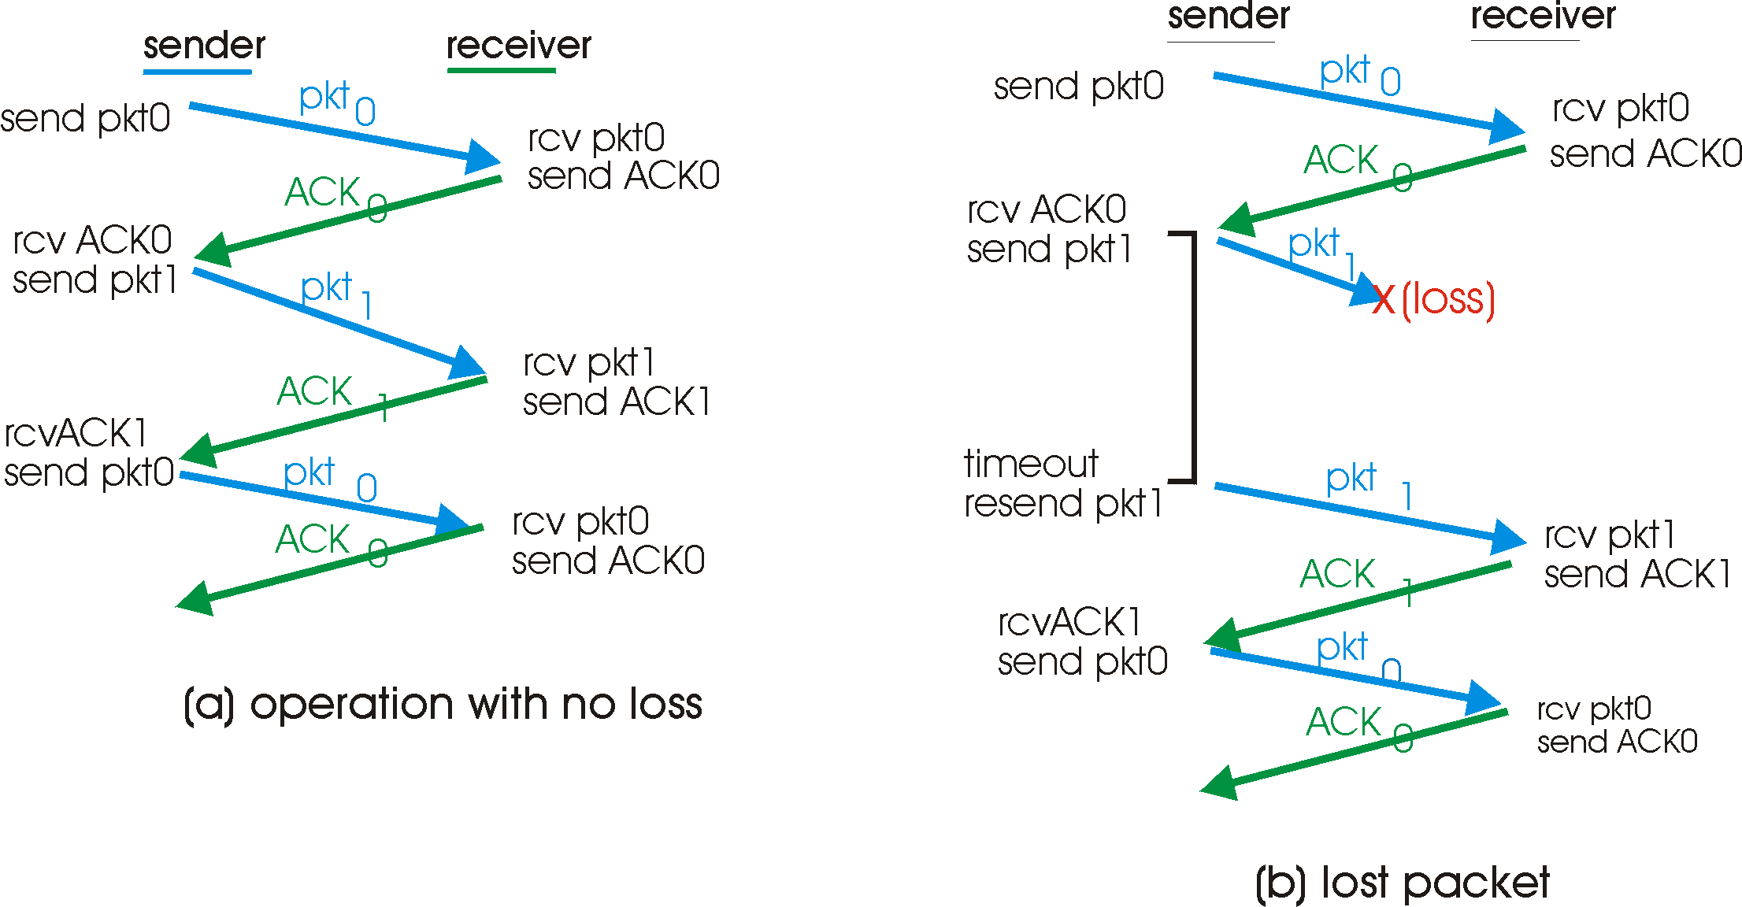
Stop-and-wait: reliable transfer over a reliable channel
underlying channel perfectly reliable
no bit errors, no loss of packets
stop and wait
Sender sends one packet,
then waits for receiver
response

Slide 18
channel with bit errors
underlying channel may flip bits in packet
checksum to detect bit errors
the question: how to recover from errors:
acknowledgements (ACKs): receiver explicitly tells sender that pkt received OK
negative acknowledgements (NAKs): receiver explicitly tells sender that pkt had errors
sender retransmits pkt on receipt of NAK
new mechanisms for:
error detection
receiver feedback: control msgs (ACK,NAK) rcvr->sender

Slide 19
Stop-and-wait with lost packet/frame

Slide 20
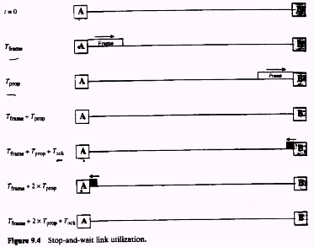

Slide 21
Stop and wait performance
utilization – fraction of time sender busy sending
ideal case (error free)
u=Tframe/(Tframe+2Tprop)=1/(1+2a), a=Tprop/Tframe

Slide 22
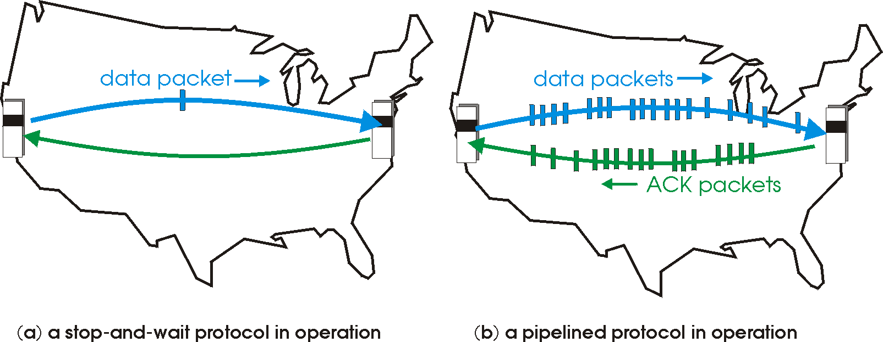
Pipelined (sliding window) protocols
Pipelining: sender allows multiple, “in-flight”, yet-to-be-acknowledged pkts
range of sequence numbers must be increased
buffering at sender and/or receiver
Two generic forms of pipelined protocols: go-Back-N, selective repeat

Slide 23
Pipelining: increased utilization
sender
receiver
first packet bit transmitted, t = 0
last bit transmitted, t = L / R
first packet bit arrives
RTT
last packet bit arrives, send ACK
last bit of 2nd packet arrives, send ACK
last bit of 3rd packet arrives, send ACK
ACK arrives, send next
packet, t = RTT + L / R
Increase utilization
by a factor of 3!

Slide 24
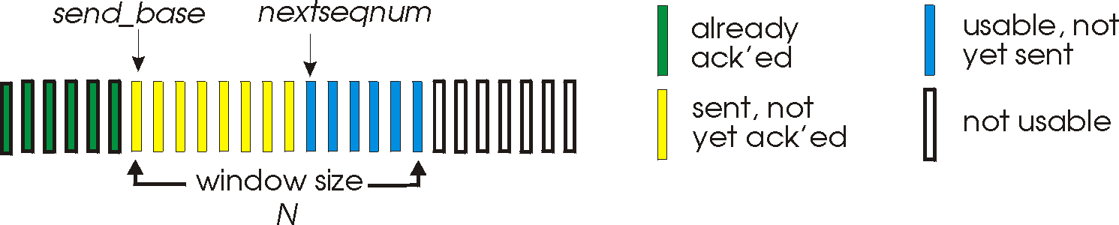
Go-Back-N
Sender:
k-bit seq # in pkt header
“window” of up to N, consecutive unack’ed pkts allowed
ACK(n): ACKs all pkts up to, including seq # n - “cumulative ACK”
may receive duplicate ACKs (more later…)
timer for each in-flight pkt
timeout(n): retransmit pkt n and all higher seq # pkts in window

Slide 25
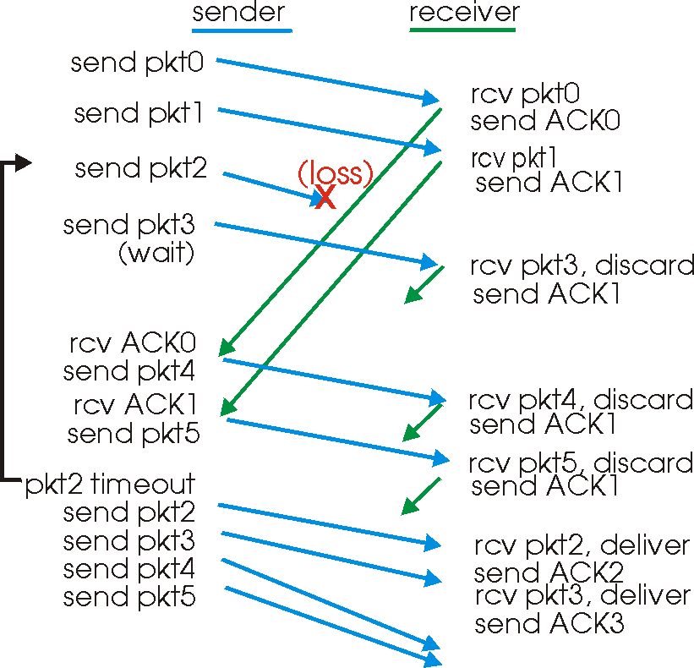
GBN in action

Slide 26
Selective Repeat
receiver individually acknowledges all correctly received pkts
buffers pkts, as needed, for eventual in-order delivery to upper layer
sender only resends pkts for which ACK not received
sender timer for each unACKed pkt
sender window
N consecutive seq #’s
limits seq #s of sent, unACKed pkts

Slide 27
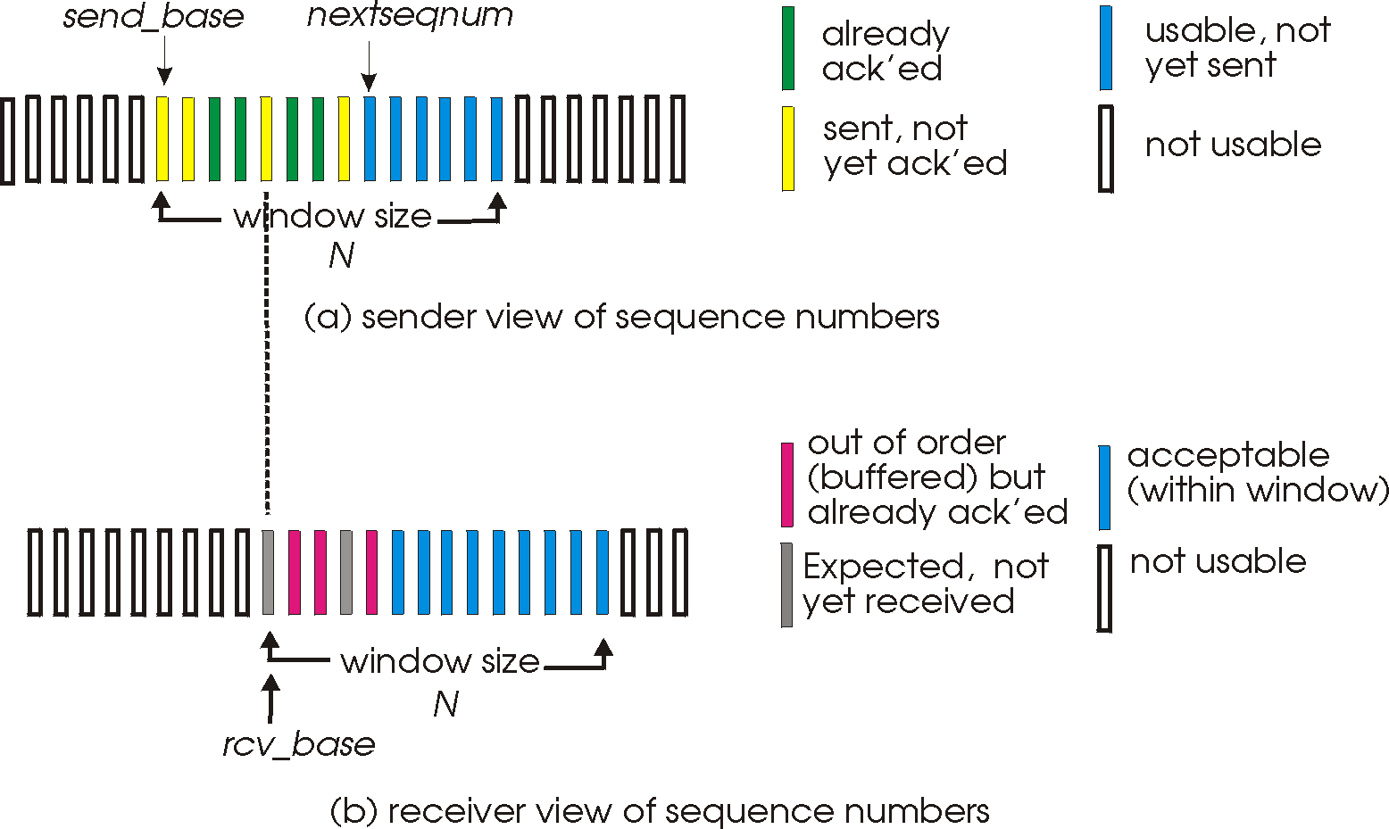
Selective repeat: sender, receiver windows

Slide 28
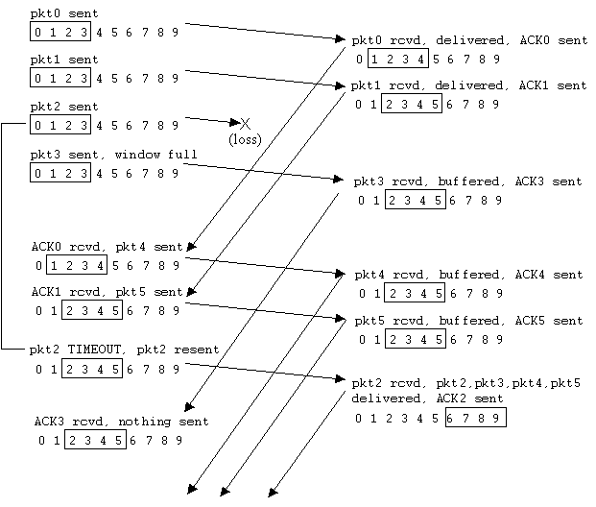
Selective repeat in action

Slide 29
performance:
selective repeat:
error-free case:
if the window is w such that the pipe is full→U=100%
otherwise U=w*Ustop-and-wait=w/(1+2a)
in case of error:
if w fills the pipe U=1-p
otherwise U=w*Ustop-and-wait=w(1-p)/(1+2a)

Slide 30
TCP: Overview RFCs: 793, 1122, 1323, 2018, 2581
point-to-point:
one sender, one receiver
reliable, in-order byte stream:
no “message boundaries”
pipelined:
TCP congestion and flow control set window size
send & receive buffers
full duplex data:
bi-directional data flow in same connection
MSS: maximum segment size
connection-oriented:
handshaking (exchange of control msgs) init’s sender, receiver state before data exchange
flow controlled:
sender will not overwhelm receiver

Slide 31
TCP segment structure
32 bits
URG: urgent data
(generally not used)
counting
by bytes
of data
(not segments!)
source port #
dest port #
sequence number
ACK: ACK #
valid
acknowledgement number
head
len
not
used
U
Receive window
A
P
R
S
PSH: push data now
(generally not used)
F
# bytes
rcvr willing
to accept
checksum
Urg data pnter
RST, SYN, FIN:
connection estab
(setup, teardown
commands)
Options (variable length)
application
data
(variable length)
Internet
checksum
(as in UDP)

Slide 32
Reliability in TCP
Components of reliability
1. Sequence numbers
2. Retransmissions
3. Timeout Mechanism(s): function of the round trip time (RTT) between the two hosts (is it static?)

Slide 33
TCP Round Trip Time and Timeout
EstimatedRTT(k) = (1- α)*EstimatedRTT(k-1) + α*SampleRTT(k)
=(1- α)*((1- α)*EstimatedRTT(k-2)+ α*SampleRTT(k-1))+ α *SampleRTT(k)
=(1- α)^{k} *SampleRTT(0)+ α(1- α)^{k-1} *SampleRTT)(1)+…+ α *SampleRTT(k)
Exponential weighted moving average (EWMA)
influence of past sample decreases exponentially fast
typical value: α = 0.125

Slide 34
Example RTT estimation:

Slide 35
TCP Round Trip Time and Timeout
Setting the timeout
EstimtedRTT plus “safety margin”
large variation in EstimatedRTT -> larger safety margin
1. estimate how much SampleRTT deviates from EstimatedRTT:
DevRTT = (1-β)*DevRTT +
β*|SampleRTT-EstimatedRTT|
(typically, β = 0.25)
2. set timeout interval:
TimeoutInterval = EstimatedRTT + 4*DevRTT
3. For further re-transmissions (if the 1st re-tx was not Ack’ed)
- RTO=q.RTO, q=2 for exponential backoff
- similar to Ethernet CSMA/CD backoff

Slide 36
TCP reliable data transfer
TCP creates reliable service on top of IP’s unreliable service
Pipelined segments
Cumulative acks
TCP uses single retransmission timer
Retransmissions are triggered by:
timeout events
duplicate acks
Initially consider simplified TCP sender:
ignore duplicate acks
ignore flow control, congestion control

Slide 37
TCP: retransmission scenarios
Host A
Host B
Host A
Host B
Seq=92, 8 bytes data
Seq=92, 8 bytes data
Seq=100, 20 bytes data
timeout
ACK=100
Seq=92 timeout
X
ACK=100
loss
ACK=120
Seq=92, 8 bytes data
Sendbase
= 100
Seq=92, 8 bytes data
SendBase
= 120
Seq=92 timeout
ACK=120
ACK=100
SendBase
= 100
SendBase
= 120
premature timeout
time
time
lost ACK scenario

Slide 38
TCP retransmission scenarios (more)
Host A
Host B
Seq=92, 8 bytes data
ACK=100
timeout
Seq=100, 20 bytes data
X
loss
SendBase
= 120
ACK=120
time
Cumulative ACK scenario

Slide 39
Fast Retransmit
Time-out period often relatively long:
long delay before resending lost packet
Detect lost segments via duplicate ACKs.
Sender often sends many segments back-to-back
If segment is lost, there will likely be many duplicate ACKs.
If sender receives 3 ACKs for the same data, it supposes that segment after ACKed data was lost:
fast retransmit: resend segment before timer expires

Slide 40
(Self-clocking)

Slide 41
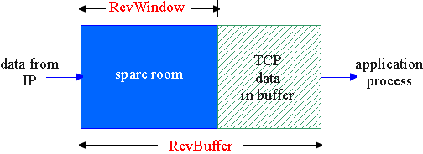
TCP Flow Control
flow control
sender won’t overflow
receiver’s buffer by
transmitting too much, too fast
receive side of TCP connection has a receive buffer:
match the send rate to the receiving app’s drain rate
app process may be slow at reading from buffer (low drain rate)

Slide 42
Principles of Congestion Control
Congestion:
informally: “too many sources sending too much data too fast for network to handle”
different from flow control!
manifestations:
lost packets (buffer overflow at routers)
long delays (queueing in router buffers)
a key problem in the design of computer networks

Slide 43
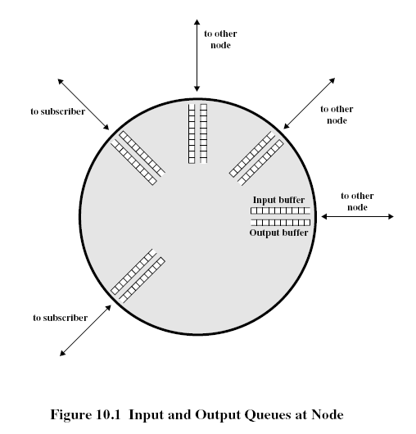
Network Congestion
Modeling the network as network of queues: (in switches and routers)
Store and forward
Statistical multiplexing
Limitations: -on buffer size
-> contributes to packet loss
if we increase buffer size?
excessive delays
if infinite buffers
infinite delays

Slide 44
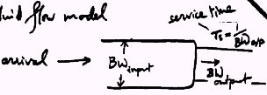

Using the fluid flow model to reason about relative flow delays in the Internet
Service Time: Ts=1/BW_{output}
Flow Arrival
BW_{input}
Bw_{output}
Bandwidth is split between flows such that flow 1 gets f1 fraction, flow 2 gets f2 … so on.

Slide 45
Tq and q = f(ρ)
If utilization is the same, then queuing delay is the same
Delay for flow i= f(ρi)
ρi= λi.Ti= Ts.λi/fi
Condition for constant delay for all flows
λi/fi is constant

Slide 46
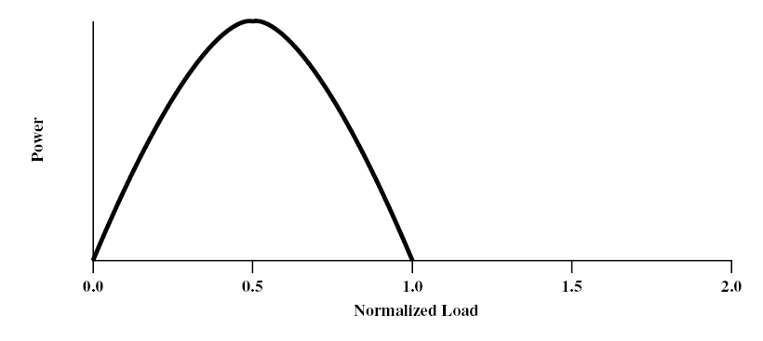
congestion phases and effects
ideal case: infinite buffers,
Tput increases with demand & saturates at network capacity
Delay
Tput/Gput
Network Power = Tput/delay
Representative of Tput-delay design trade-off

Slide 47
practical case: finite buffers, loss
no congestion --> near ideal performance
overall moderate congestion:
severe congestion in some nodes
dynamics of the network/routing and overhead of protocol adaptation decreases the network Tput
severe congestion:
loss of packets and increased discards
extended delays leading to timeouts
both factors trigger re-transmissions
leads to chain-reaction bringing the Tput down

Slide 48
(I)
(II)
(III)
(I) No Congestion
(II) Moderate Congestion
(III) Severe Congestion (Collapse)
What is the best operational point and how do we get (and stay) there?

Slide 49
Congestion Control (CC)
Congestion is a key issue in network design
various techniques for CC
1.Back pressure
hop-by-hop flow control (X.25, HDLC, Go back N)
May propagate congestion in the network
2.Choke packet
generated by the congested node & sent back to source
example: ICMP source quench
sent due to packet discard or in anticipation of congestion

Slide 50
Congestion Control (CC) (contd.)
3.Implicit congestion signaling
used in TCP
delay increase or packet discard to detect congestion
may erroneously signal congestion (i.e., not always reliable) [e.g., over wireless links]
done end-to-end without network assistance
TCP cuts down its window/rate

Slide 51
Congestion Control (CC) (contd.)
4.Explicit congestion signaling
(network assisted congestion control)
gets indication from the network
forward: going to destination
backward: going to source
3 approaches
Binary: uses 1 bit (DECbit, TCP/IP ECN, ATM)
Rate based: specifying bps (ATM)
Credit based: indicates how much the source can send (in a window)

Slide 53
TCP congestion control: additive increase, multiplicative decrease
Approach: increase transmission rate (window size), probing for usable bandwidth, until loss occurs
additive increase: increase rate (or congestion window) CongWin until loss detected
multiplicative decrease: cut CongWin in half after loss
Saw tooth
behavior: probing
for bandwidth
congestion window size
time

Slide 54
TCP Congestion Control: details
sender limits transmission:
LastByteSent-LastByteAcked
≤ CongWin
Roughly,
CongWin is dynamic, function of perceived network congestion
How does sender perceive congestion?
loss event = timeout or duplicate Acks
TCP sender reduces rate (CongWin) after loss event
three mechanisms:
AIMD
slow start
conservative after timeout events
CongWin
rate =
Bytes/sec
RTT

Slide 55
TCP window management
At any time the allowed window (awnd): awnd=MIN[RcvWin, CongWin],
where RcvWin is given by the receiver (i.e., Receive Window) and CongWin is the congestion window
Slow-start algorithm:
start with CongWin=1, then CongWin=CongWin+1 with every ‘Ack’
This leads to ‘doubling’ of the CongWin with RTT; i.e., exponential increase

Slide 56
TCP Slow Start (more)
When connection begins, increase rate exponentially until first loss event:
double CongWin every RTT
done by incrementing CongWin for every ACK received
Summary: initial rate is slow but ramps up exponentially fast
Host A
Host B
one segment
RTT
two segments
four segments
time

Slide 57
TCP congestion control
Initially we use Slow start:
CongWin = CongWin + 1 with every Ack
When timeout occurs we enter congestion avoidance:
ssthresh=CongWin/2, CongWin=1
slow start until ssthresh, then increase ‘linearly’
CongWin=CongWin+1 with every RTT, or
CongWin=CongWin+1/CongWin for every Ack
additive increase, multiplicative decrease (AIMD)

Slide 59
Slow start
Exponential increase
Congestion Avoidance
Linear increase
CongWin
(RTT)

Slide 60
Fast Retransmit & Recovery
Fast retransmit:
receiver sends Ack with last in-order segment for every out-of-order segment received
when sender receives 3 duplicate Acks it retransmits the missing/expected segment
Fast recovery: when 3rd dup Ack arrives
ssthresh=CongWin/2
retransmit segment, set CongWin=ssthresh+3
for every duplicate Ack: CongWin=CongWin+1
(note: beginning of window is ‘frozen’)
after receiver gets cumulative Ack: CongWin=ssthresh
(beginning of window advances to last Ack’ed segment)
CongWin

Slide 62
TCP Fairness
Fairness goal: if K TCP sessions share same bottleneck link of bandwidth R, each should have average rate of R/K
TCP connection 1
TCP
connection 2
bottleneck
router
capacity R

Slide 63
Fairness (more)
Fairness and UDP
Multimedia apps often do not use TCP
do not want rate throttled by congestion control
Instead use UDP:
pump audio/video at constant rate, tolerate packet loss
Research area: TCP friendly protocols!
Fairness and parallel TCP connections
nothing prevents app from opening parallel connections between 2 hosts.
Web browsers do this
Example: link of rate R supporting 9 connections;
new app asks for 1 TCP, gets rate R/10
new app asks for 11 TCPs, gets R/2 !

Slide 64
Congestion Control with Explicit Notification
TCP uses implicit signaling
ATM (ABR) uses explicit signaling using RM (resource management) cells
ATM: Asynchronous Transfer Mode, ABR: Available Bit Rate
ABR Congestion notification and congestion avoidance
parameters:
peak cell rate (PCR)
minimum cell rate (MCR)
initial cell rate(ICR)

Slide 65
ABR uses resource management cell (RM cell) with fields:
CI (congestion indication)
NI (no increase)
ER (explicit rate)
Types of RM cells:
Forward RM (FRM)
Backward RM (BRM)

Slide 67
Congestion Control in ABR
The source reacts to congestion notification by decreasing its rate (rate-based vs. window-based for TCP)
Rate adaptation algorithm:
If CI=0,NI=0
Rate increase by factor ‘RIF’ (e.g., 1/16)
Rate = Rate + PCR/16
Else If CI=1
Rate decrease by factor ‘RDF’ (e.g., 1/4)
Rate=Rate-Rate*1/4

