Slide 1
Modeling Strawson’s Thin Subjects using Category Theory
Anand Rangarajan
Dept. of Computer and Information Science and Engineering
University of Florida

Slide 2
The Hard Problem
Why is anything accompanied by experience (Chalmers)?
Mainstream response: Emergence
Alternatives
Structure and dynamics
Information processing
Neuronal dynamics
Physicalism and Materialism
Panpsychism (Rosenberg, Skrbina, Strawson)
Dual aspect Theory (Atmanspacher)
Neutral Monism (Banks)
Idealism (Kastrup)
Ignorance and physicalism (Stoljar, Montero)
Self-organization
Complexity
Systems theory
Confused with holism

Slide 3
Emergence
Description
Slogan
Consciousness arises from complex systems
Perspective
Problem
Application
Emergent properties as behavior of complex information processing systems
Thresholds left unspecified for emergence of consciousness
Complex systems view of the world
Most forms of AI, living systems, simulators etc.

Slide 4
Alternatives to Emergence
Panpsychism
Experience fades out as you go down in complexity (Pan proto-psychism, Pan proto-experientialism)
Neutral Monism
Dual-aspect theory
Idealism
Matter and experience derived from unitary subject: Transcendental Idealism
Holism
Matter and mind are both derived from neutral entity
Interiors all the way down, interior/exterior divide
Experience is a holistic property of nature

Slide 5
Systems versus Particles
Our slogan: Complex AI systems are not accompanied by experience
Age old distinction: systems versus particles (back to 19th century atomism)
Systems: Capable of complex information processing
Particles: Highly unified and spatiotemporally bounded
Systems: Wrong way of thinking about consciousness
Intuition: Connection between radically unified experience and particles?
Strawson’s thin subjects highly suggestive

Slide 6
Thin Subjects (Strawson)
Claim: Experience always accompanied by subject of experience (SoE)
Controversial
Thin subject of experience: Strawson’s alternative to Cartesian thick subjects
Momentary
Spatio-temporally bounded
Grounding intuition: Experience feels unitary as if happening to one subject
Criticism: Doubling of mysteries – experience and SoE
Strawson’s response: Akin to objects (subjects) and properties (experience)
The Crazy Hypothesis: Thin subjects are like particles (but of a very new kind)

Slide 7
Thin Subjects, the Physical and Selfons
SoE more akin to a particle than a system (crazy hypothesis)
Natural rather than artifactual or cultural
Bid goodbye to the 19th century: Particles are formed in quantum field theory (QFT) via second quantization
SoEs are special “selfons” accompanied by experience (Rangarajan)
Second quantization in QFT creates selfons from basic fields
But second quantization is a functor (as in category theory pointed out by Edward Nelson)!
Can we model SoEs (or selfons) using category theory?
Generalize from QM, QFT and move to modeling using category theory

Slide 8
The story so far
Why is anything accompanied by experience?
Emergence hypothesis: Experience emerges in a sufficiently complex system
Unworkable. Complex AI systems not accompanied by experience
Particle thinking: Age old alternative to systems thinking
Intuition: Link between unitary nature of experience and unity of particle
Strawson: Unitary nature of experience because of thin subjects
Thin subjects are akin to new particles (crazy hypothesis): selfons
Particles are set up via second quantization in QFT: waves act like particles
Second quantization is a functor as in category theory

Slide 9
Category Theory: Basics
$$id_{y}$$
$$id_{x}$$
$$x$$
$$f$$
$$y$$
$$g$$
$$h$$
$$id_{z}$$
Definition: A category $𝒞$ has constituents:
Objects: A collection $Ob(𝒞)$, elements called objects
Morphisms: For every pair $x, y∈Ob\left(𝒞\right)$ a set of morphisms $f:x→y$ from $x$ to $y$
Identity: For every object $x∈Ob(𝒞)$ an identity morphism ${id}_{x}$ on $x$
Composition: For every three objects $x, y, z∈Ob\left(𝒞\right)$, if $f:x→y$, $g:y→z$ and $h:x→z$ then $h=g∘f:x→z$
Intuition: Morphisms are the glue relating objects
Composition formula: Transitivity in object relations
Relevance to HP: Selfons as objects (accompanied by experience) and intersubjectivity as evidence of morphisms
$$z$$

Slide 10
Category Theory: Functors
$$id_{x}$$
$$x$$
$$f$$
$$y$$
$$id_{y}$$
$$𝒞$$
$$ℱ$$
$$id_{ℱ(x)}$$
$$ℱ(f)$$
Relating categories to each other
Definition: If $𝒞$ and $𝒞^{′}$ are categories, a functor $ℱ$
Associates to each object $x$ in $𝒞$, an object $ℱ(x)$ in $𝒞^{′}$
Associates to each morphism $f:x→y$, a morphism $ℱ\left(f\right):ℱ\left(x\right)→ℱ(y)$
Following conditions must hold:
$ℱ\left({id}_{x}\right)={id}_{ℱ(x)}$ and $ℱ\left(g∘f\right)=ℱ\left(g\right)∘ℱ(f)$ where $f,g$ are morphisms
Intuition: Functors map objects and morphisms from one category to another
Relevance to physics: Second quantization is a functor
Relevance to HP: Map basic physical objects and transformations to selfons and intersubjectivity respectively
$$id_{ℱ(y)}$$
$$ℱ(x)$$
$$ℱ(y)$$
$$𝒞^{′}$$

Slide 11

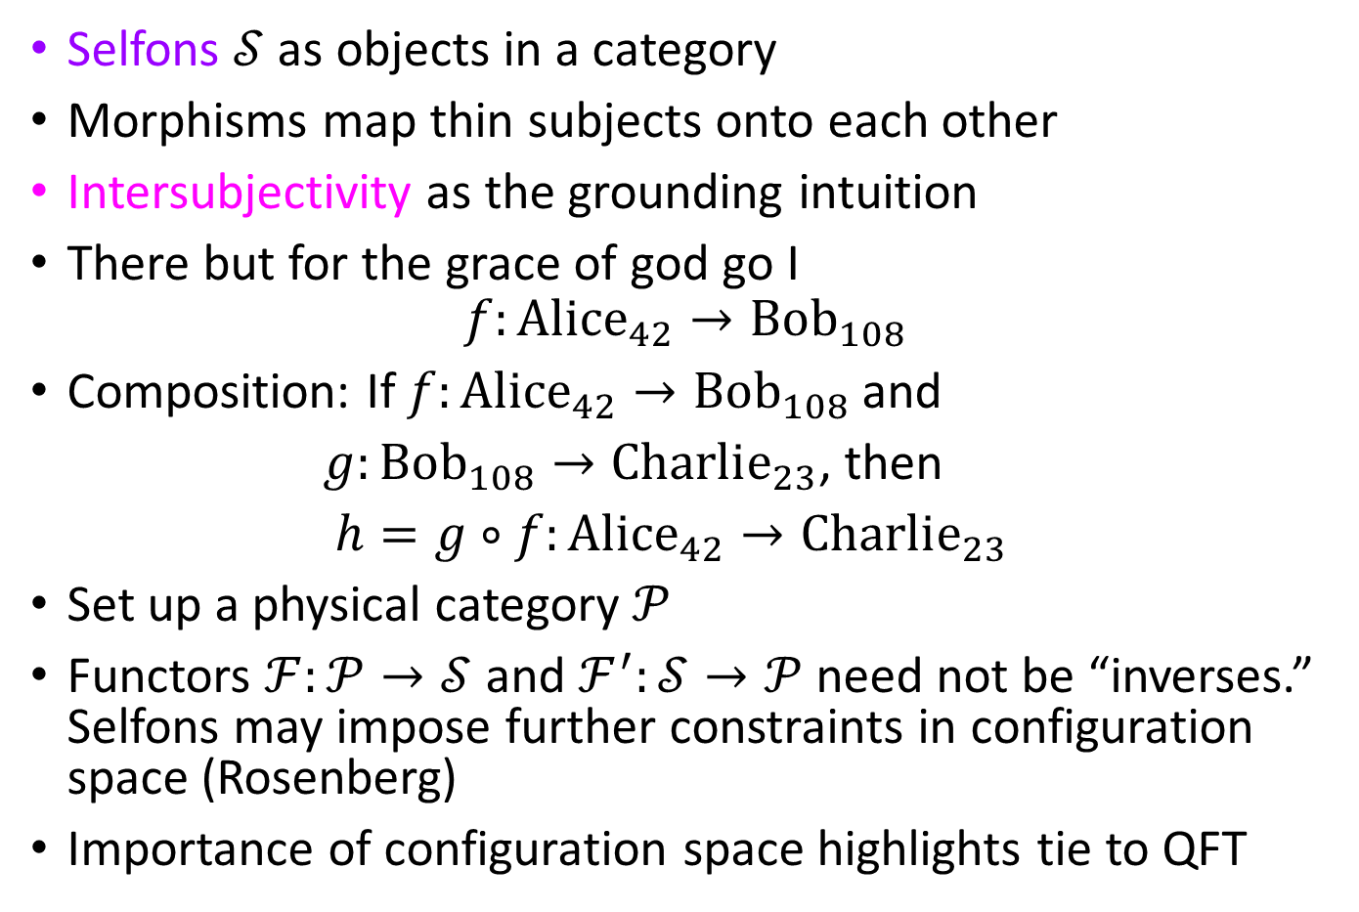
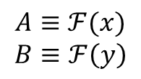
Selfons as a Category
$$id_{B}$$
$$id_{A}$$
$$A$$
$$f$$
Selfons $𝒮$ as objects in a category
Morphisms map thin subjects onto each other
Intersubjectivity as the grounding intuition
There but for the grace of god go I
$$f:Alice_{42}→Bob_{108}$$
Composition: If $f:Alice_{42}→Bob_{108}$ and
$g:Bob_{108}→Charlie_{23}$, then
$h=g∘f:Alice_{42}→Charlie_{23}$
Set up a physical category $𝒫$
Functors $ℱ:𝒫→𝒮$ and $ℱ^{′}:𝒮→𝒫$ need not be “inverses.” Selfons may impose further constraints in configuration space (Rosenberg)
Importance of configuration space highlights tie to QFT
$$B$$
$$A:Alice_{42}$$
$$B:Bob_{108}$$
$$C:Charlie_{23}$$
$$g$$
$$h$$
$$id_{C}$$
$$C$$
$$id_{ℱ(x)}$$
$$A$$
$$ℱ(f)$$
$$B$$
$$id_{ℱ(y)}$$
$$ℱ(x)$$
$$ℱ(y)$$
$$𝒮$$
$$A≡ℱ(x)$$
$$B≡ℱ\left(y\right)$$
$$ℱ$$
$$ℱ′$$
$$id_{x}$$
$$x$$
$$f$$
$$y$$
$$id_{y}$$
$$𝒫$$

Slide 12
Categories need not be equivalent
Functors can exist between non-equivalent categories
Brains | Thin subjects
Functor from the physical to the category of brain states | Functor from the physical to selfons
Equivalent categories | Non-equivalent categories
Information processing in brains: a convenient shorthand | Selfons can enact constraints restricting sets of possibilities
Natural fit: phase space dynamics | Natural fit: configuration space dynamics

Slide 13
QM, QFT and Category Theory
The major advance in QM:
From Poisson manifolds and Poisson maps to Hilbert spaces and unitary operators
From phase space to configuration space
Particles act like waves
The major advance in QFT:
Particles are now seen as excitations of quantum fields
From Hilbert space to Fock space: Second quantization
Waves act like particles
An advance due to Category Theory?
Generalizes second quantization
From sets and relations to objects and morphisms
SoEs modeled as objects in a selfon category

Slide 14
Conclusions
Complex AI systems are not accompanied by experience
Particle thinking alternative to systems thinking
Unity of particle similar to unitary nature of experience
Thin subjects of experience (Strawson): unified, spatiotemporally bounded
Thin subjects are akin to new particles - selfons: crazy hypothesis
Particles set up via second quantization in quantum field theory
Second quantization is a functor (category theory)!
Model thin subjects using category theory
Brain state category equivalent to physical category
Selfons may not be equivalent to the physical

Slide 15
References
Dual-aspect Monism à la Pauli and Jung, Harald Atmanspacher, J. Conscious Studies, 19(9-10):96-120, 2012.
The Conscious Mind: In Search of a Fundamental Theory, David J. Chalmers, Oxford University Press, 1996.
The Structure of Objects, Kathrin Koslicki, Oxford University Press, 2008.
The Ultimate Constituents of the Material World: In Search of an Ontology for Fundamental Physics, Meinard Kuhlmann, Ontos Verlag, 2010
Natural Kinds and Conceptual Change, Joseph LaPorte, Cambridge University Press, 2004.
Subjects of Experience, Edward J. Lowe, Cambridge University Press, 1996.
Can a Quantum Field Theory Ontology help resolve the Problem of Consciousness, Anand Rangarajan, Quantum Reality and Theory of Śūnya, Springer Nature, pp. 13-26, 2019.
A Place For Consciousness: Probing the Deep Structure of the Natural World, Gregg Rosenberg, Oxford Univ. Press, 2004.
Quantum Field Theory and the Standard Model, Matthew D. Schwartz, Cambridge Univ. Press, 2013
Category Theory for the Sciences, David I. Spivak, The MIT Press, 2014.
Ignorance and Imagination: The Epistemic Origin of the Problem of Consciousness, Daniel Stoljar, Oxford University Press, 2006.
Physicalism, Daniel Stoljar, Routledge, 2010.
Selves: An Essay in Revisionary Metaphysics, Galen Strawson, Clarendon Press, 2009.
Material Beings, Peter van Inwagen, Cornell University Press, 1990.

Slide 16
Contact information:
Prof. Anand Rangarajan
Department of Computer and Information Science and Engineering
University of Florida
E-mail: anandr@ufl.edu

