Slide 1
Can Quantum Field Theory Ontologies Help Resolve the Hard Problem?
Anand Rangarajan
Dept. of Computer and Information Science and Engineering
University of Florida
Gainesville, FL, USA

Slide 2
Roadmap
Summary of approaches
Subjects of experience
A new physicalism
Quantum field theory ontologies
Conclusions

Slide 3
Realistic physicalism & experience
How do we accommodate experience (Hard Problem)?
When more radical alternatives like idealism or mysticism are ruled out, only physicalism remains.
Emergence - most popular physicalist approach.
  Complexity problem: When does experience emerge?
Does realistic physicalism entail panpsychism?
  Combination problem: How do qualia combine?
Are these the only alternatives at present?

Slide 4
Panpsychism, Emergence & Physicalism
Physicalism
Panpsychism
Emergence
Combination problem
Complexity problem
Conservative option
Emergence
Radical option
Reformulate physicalism
Conservative option
Panpsychism

Slide 5
Phenomenology: Thin Subjects
Persons and selves as subjects of experience (SoE) (Lowe).
“A subject of experience is something that exists only if experience exists of which it is a subject” (Strawson).
“The thinking or the existence of the thought and the existence of my own self are one and the same” (Kant).
Thin subjects (SESMET): subjects that persist for brief periods of time, a “gappy process” (Strawson).
Equivalent conceptions (Zahavi, Almaas)

Slide 6

Physicalism = Physicalism + X
Add ingredient X to physicalism.
Physicalism should remain physicalism despite X.
Re-examine panpsychism and emergence in light of new physicalism.
It is accompanied by experience because X is always accompanied by experience.

Slide 7
QFT Ontologies

Slide 8
Quantum Field Theory
Consciousness studies obsessed with first quantization: how do particles act like waves.
Quantum field theory: How do waves act like particles? Sets up field-particle relation.
Can we set up SoE relation using QFT?
``First quantization is a mystery but second quantization is a functor”
John Baez, Somewhere on the Internet.

Slide 9
Summary of QFT
Different formulations: Lagrangian and Algebraic (AQFT)
Lagrangian point of view:
  Begin with Lagrangian and use second quantization to obtain QFT
AQFT point of view:
  Net of algebras of observables (Haag)
In both approaches, ontological status of ultimate constituents (fields or “coordinatized” observables) is unclear
Particles: Excitation of field, quantization, state? (Kuhlmann)

Slide 10
Particles
Individuality
Discreteness
Primitive thisness (Elementary particle)
Localizability?
Interpretation of QFT: Difficult
Elementary (fundamental) or composite?
Can we take advantage of this murky ontology?

Slide 11
SelfOns and physicalism
Payoff: Add selfons to the physical
New holistic principle set up by a new field-particle relation (avoids sui generis)
Freedom to do this due to murkiness of existing QFT
Selfons accompanied by experience

Slide 12

SelfOn: Physical thin subjects
Fundamental physics: Set of quantum fields or equivalent.
New relation linking SoE to physical.
SelfOn (selfon): Thin subjects realized from basic fields.
Akin to a new particle formed using QFT.
SoEs: objects of natural kind SelfOn.
Star Trek DS9: The Search (Part I)
URL withheld

Slide 13
Phenomenology, Philosophy and Physics
Phenomenology | Philosophy | Physics
Thin subject | Subject of Experience | SelfOn
 | SoE relation | Particle Field
Experience | Physical property | SelfOn state
Intersubjectivity | SoEs form natural kind | SelfOn interactions
Gappiness | Spatiotemporal bound | SelfOns appear and decay
Unified | Discreteness | Whole without parts?

Slide 14
SelfOns: Fundamental or Composite?
Particles: Elementary or composite?
QFT + Gravitation: ALL that’s really going on
Elementary or fundamental particle: Fermions and bosons (standard model)
Composite "particles”: Composed of more fundamental particles, decay relations
SelfOns: Neither fundamental nor composite? Midlevel?
Do we have freedom to include selfons?

Slide 15
Fields, Particles and SelfOns
Eliminativism: There are only (quantum) fields, no particles, no selfons.
Naturalistic dualism: There are only (quantum) fields and selfons.
Materialistic dualism: There are (quantum) fields, particles and selfons.
Interactionist dualism: There are only particles and selfons.
Materialistic monism: There are only (quantum) fields and particles, no selfons.

Slide 16
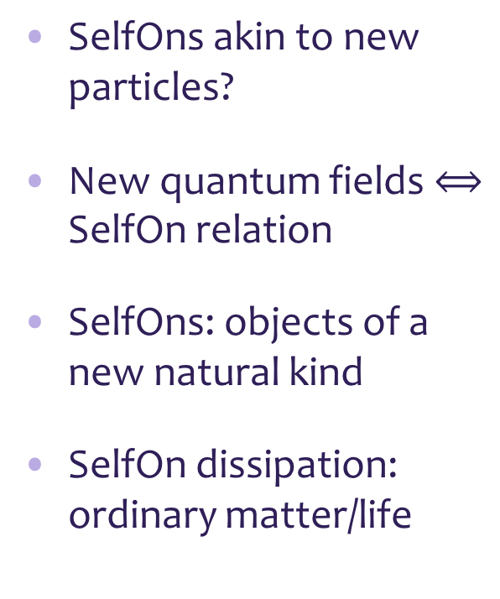
SelfOns: Akin to Particles
SelfOns akin to new particles?
New quantum fields $⟺$ SelfOn relation
SelfOns: objects of a new natural kind
SelfOn dissipation: ordinary matter/life
SelfOns and Intersubjectivity
Life
Matter
Quantum Fields: Base

Slide 17
Objections
There is experience (Chalmers).
Experience implies (thin) subjects of experience (Strawson).
Everything is physical or entailed by the physical (Stoljar).
SoE are physical objects of a new natural kind.
SelfOns are SoEs set up via new field-particle relation
Physical is primary.
Denied by eliminativists.
Denied by materialists and some panpsychists.
Denied by interactionist dualists.
Denied by idealists and property dualists.
Denied by physicists?
Denied by neutral monists.

Slide 18
Discussion
“Why is it accompanied by experience?” (Chalmers).
“Everything is physical or entailed by the physical” (Stoljar).
“Until more is said it amounts to simply dismissing of…the intuition that the experiential cannot emerge from the non-experiential” (Strawson).
Expand physicalism: Physicalism = Physicalism + y (Montero).
Compositionality: “There exists a y the x’s compose if and only if the activity of the x’s compose a life” (van Inwagen).
Experience implies a subject of experience (Lowe, Frege).
Subjects of experience (SoE) are physical objects of a certain natural kind (following Koslicki).
SelfOns – formed by new holistic relation - are SoEs accompanied by experience.

Slide 19
References
The Conscious Mind: In Search of a Fundamental Theory, David J. Chalmers, Oxford University Press, 1996.
Ignorance and Imagination: The Epistemic Origin of the Problem of Consciousness, Daniel Stoljar, Oxford University Press, 2006.
Physicalism, Daniel Stoljar, Routledge, 2010.
Selves: An essay in revisionary metaphysics, Galen Strawson, Clarendon Press, 2009.
Subjects of Experience, Edward J. Lowe, Cambridge University Press, 1996.
Material Beings, Peter van Inwagen, Cornell University Press, 1990.
The Ultimate Constituents of the Material World: In Search of an Ontology for Fundamental Physics, Meinard Kuhlmann, ontos verlag, 2010
Quantum field theory and the standard model, M. D. Schwartz, Cambridge Univ. Press, 2013
Everything Must Go, James Ladyman and Don Ross with David Spurrett and John Collier, Oxford University Press, 2010.
The Structure of Objects, Kathrin Koslicki, Oxford University Press, 2008.
Natural Kinds and Conceptual Change, Joseph LaPorte, Cambridge University Press, 2004.
Objects and Persons, Trenton Merricks, Clarendon Press, 2001.
More Kinds of Being, Edward J. Lowe, Wiley-Blackwell, 2009.
x

Slide 20
Thank You

Slide 21
Substances versus properties
Approach raises intriguing picture of substance (SoE) linked to properties via a new field-particle relation.
Not property or substance dualism but weird hybrid.
No worry over natural kinds if there is only one kind of substance, namely, SoE.
Substance introduced only to accommodate experience seems jury rigged.
May be democratizing Spinoza (matter and mind as properties of single substance/God).

