Slide 1
Compositional Subjects
Anand Rangarajan
Dept. of Computer and Information Science and Engineering
University of Florida
Gainesville, FL, USA

Slide 2
Realistic physicalism & experience
How do we accommodate experience (Hard Problem)?
When more radical alternatives like idealism or mysticism are ruled out, only physicalism remains.
Emergence - most popular physicalist approach.
  Complexity problem: When does experience emerge?
Does realistic physicalism entail panpsychism?
  Combination problem: How do qualia combine?
Are these the only alternatives at present?

Slide 3
Panpsychism, Emergence & Physicalism
Physicalism
Panpsychism
Emergence
Combination problem
Complexity problem
Conservative option
Emergence
Radical option
Reformulate physicalism
Conservative option
Panpsychism

Slide 4
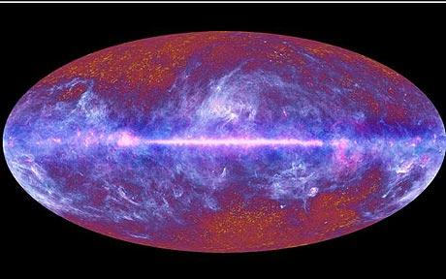
Physicalism
“Everything is physical”: explanatory gap.
Can physicalism be expanded to accommodate consciousness?
Why is it accompanied by experience? (Chalmers)
Forced into speculative ontology because of hard problem.
Source: esa.int

Slide 5

Physicalism = Physicalism + X
Add ingredient X to physicalism.
Physicalism should remain physicalism despite X.
Re-examine panpsychism and emergence in light of new physicalism.
It is accompanied by experience because X is always accompanied by experience.

Slide 6
A fundamental compositionality
A counter-intuitive proposal.
Assertion: Physicalism + fundamental compositionality accompanied by experience.
Letter but not the spirit of panpsychism: fundamental but not pan.
Spirit but not the letter of emergence: non-reductive but fundamental.
New ingredient
X
Physicalism
Experience
Subjects
Compositionality

Slide 7
Compositions versus Combinations
Fundamental composition of basic elements contrasted with combinations of basic elements.
Phenomenology
Chemistry
Combination
Fundamental Composition
Physics
Basic Elements
Basic Elements
Physics
Fundamental composition accompanied by experience

Slide 8
Phenomenology: Thin Subjects
Persons and selves as subjects of experience (SoE) (Lowe).
“A subject of experience is something that exists only if experience exists of which it is a subject” (Strawson).
“The thinking or the existence of the thought and the existence of my own self are one and the same” (Kant).
Thin subjects (SESMET): subjects that persist for brief periods of time, a “gappy process” (Strawson).
mere self in Mahayana Buddhism (Tsongkhapa).
Notion goes back at least to Frege in the west.

Slide 9
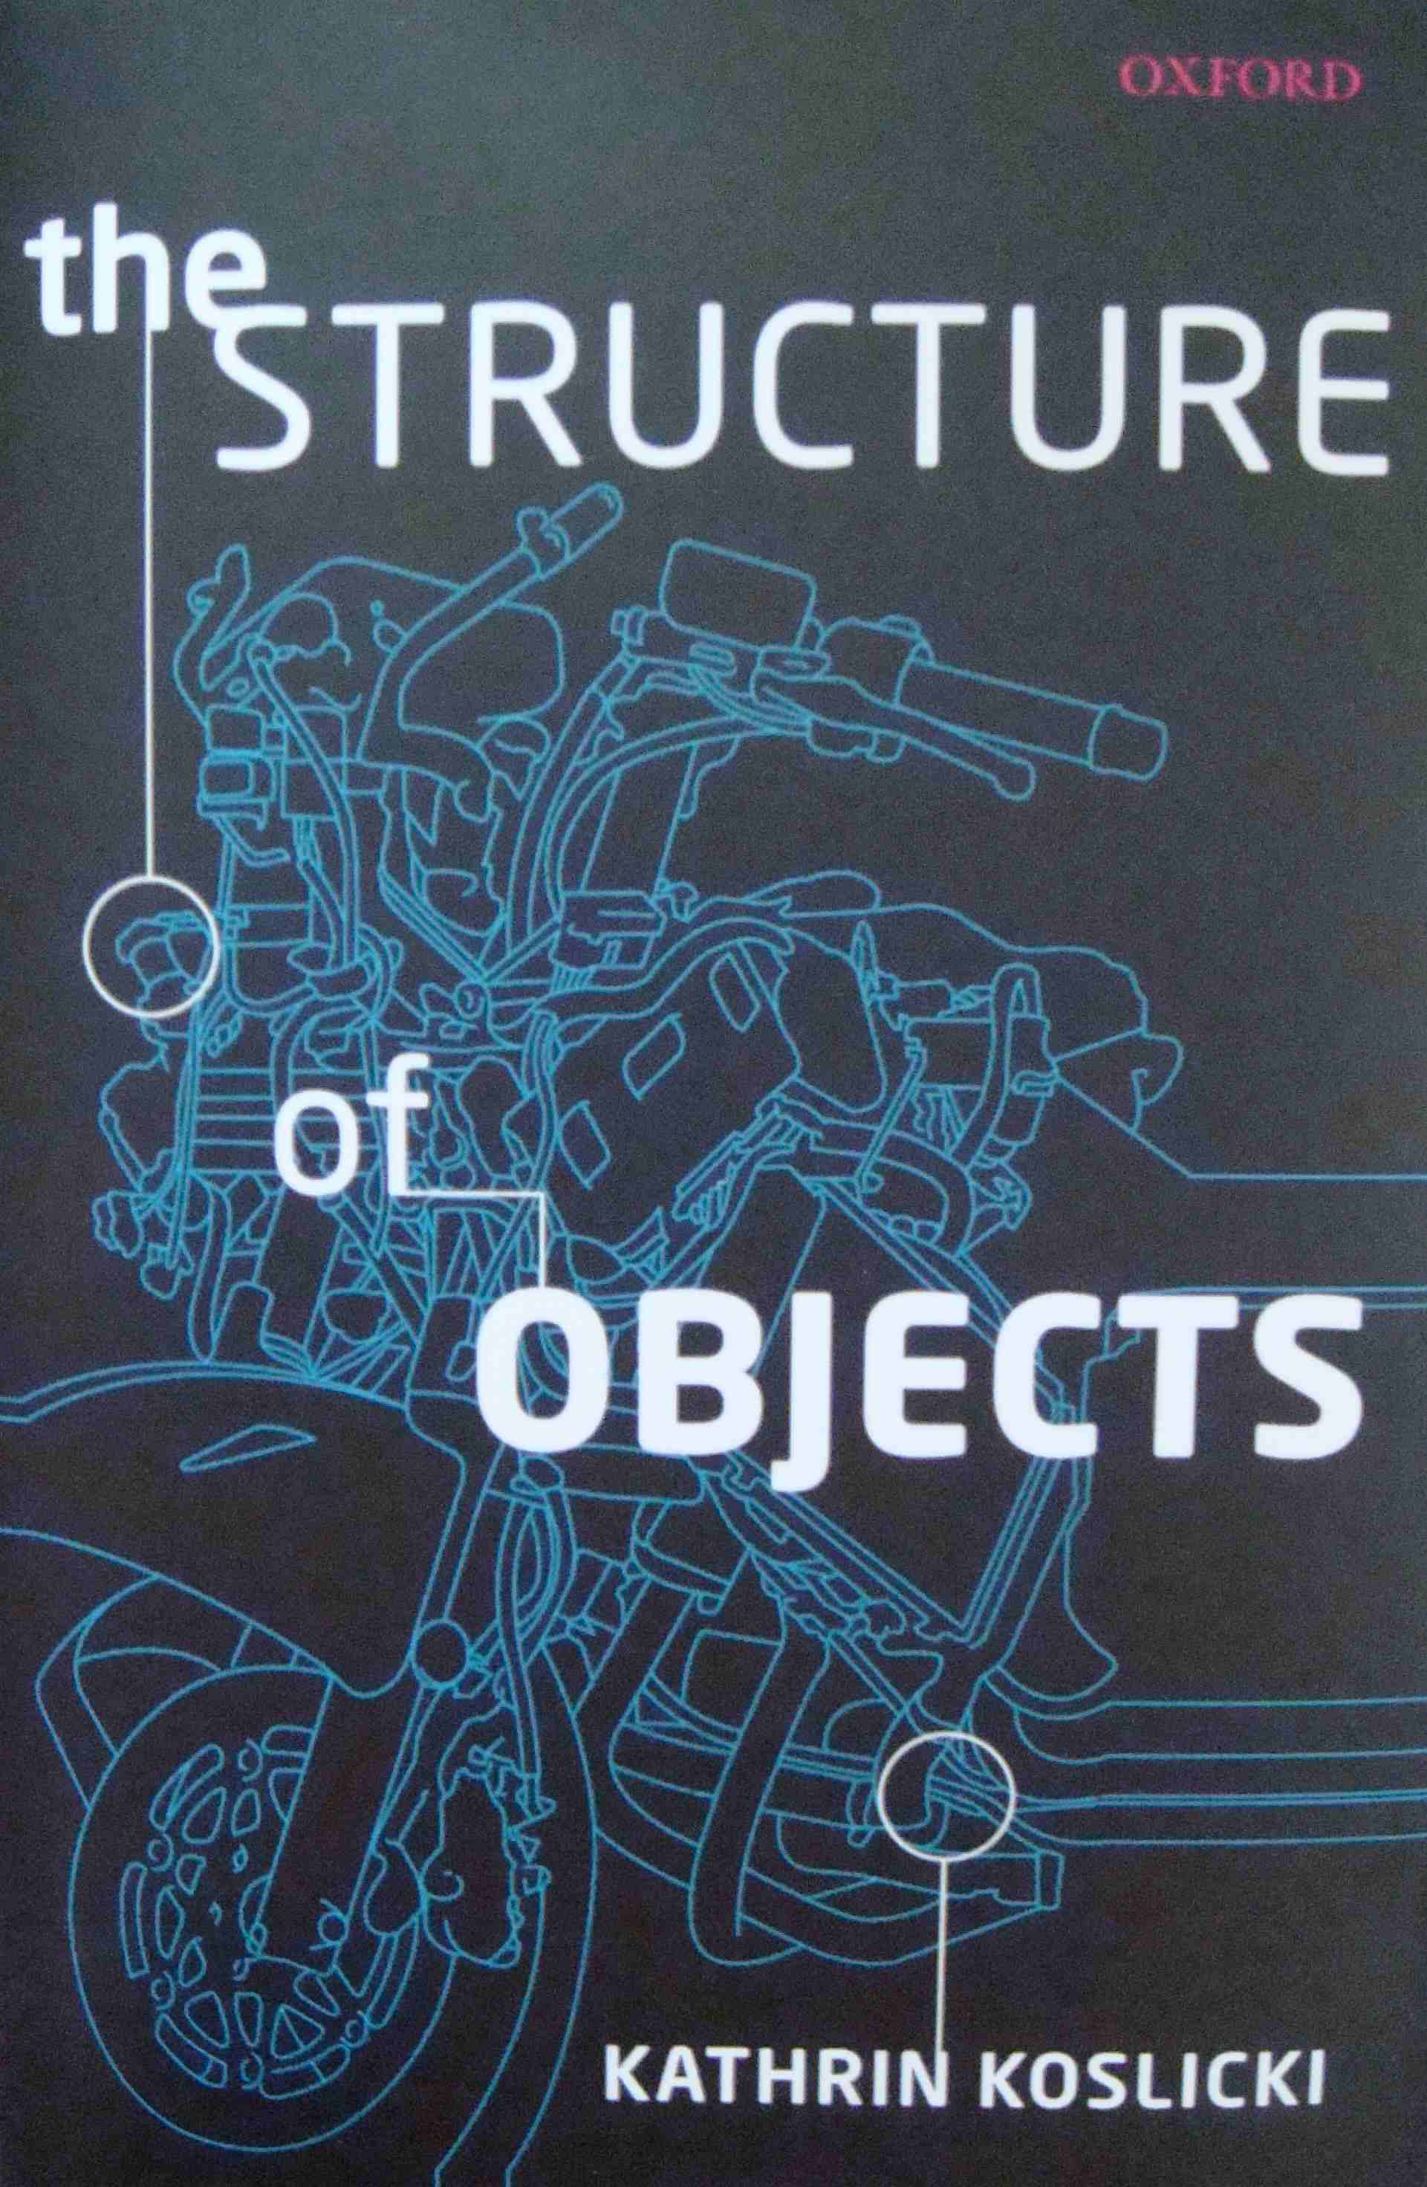
Restricted Compositionality Principle (RCP)
New ingredient
X
Physicalism
Experience
Subjects
Compositionality
Kathrin Koslicki’s work.
RCP: Some objects compose an object O, of kind K, just in case satisfy the constraints dictated by some formal components, associated with objects of kind, K.
Weak Supplementation Principle.
Avoid proliferation of sui generis relations.
Relies on ontology of natural kinds.
Material and formal parts of object (composition).

Slide 10
SoE as Natural Kinds
Restricted compositionality principle requires commitment to ontology of natural kinds.
SoE as a natural kind term:
  Appeal to same-kind relation between SoE objects.
  Non-descriptive and does not require rigidity (Koslicki).
  Requires mechanism for picking out same kind object.
Intersubjectivity as mechanism? Clearly controversial.
  I see You, Y’All, namaste.
  Second person as foundation for SoE?
  Could be wrong but more importantly could also be right.
SoE in psychology:
  analogous to species in biology.
  Different SoE: prehension, sensation, emotion, cognition, visualization.

Slide 11
Subject of Experience (SoE): Sensation
“An irreducible gap between physics and sensation which physiology cannot bridge”, Richard Gregory, Mind in Science, 1982.
SoE of sensation: SoE_{s} – a sensation natural kind object.
Intersubjective mechanism: I feel your touch, I see you touch something.
Formal parts: Relation between physiology (old physical) and new object.
SoE_{s}:
  composed of low-level material entities.
  same kind sensation relation between different SoE_{s}.
  When SoE_{s} thin subject arises, accompanied by sensation.
Fundamental Question: Sensation separated from perception, emotion, cognition, visualization - hence SoE_{s} ?

Slide 12
Oppositions
Substance
Tropes
Experience implies subjects of experience (SoE)
Everything is physical or entailed by the physical (Stoljar)
SoE are physical (compositions)
Compositions have material and formal parts
Formal parts require commitment to ontology of natural kinds
SoE are natural kind objects
Experience implies incompleteness of physical
Physicalism does not imply that microphysicalism is true (Hüttemann)
Mid-level compositionality principle?
Relations between “old” physical properties and experiential properties?
Tropes-based natural kinds to help avoid sui generis relations?
Mid-level properties “corresponding” to bundles of experience?

Slide 13
Objections
There is experience (Chalmers).
Experience implies (thin) subjects of experience (Strawson).
Everything is physical or entailed by the physical (Stoljar).
Physicalism does not imply microphysicalism (Hüttemann).
SoE are physical compositions of a certain natural kind (foll. Koslicki).
Denied by eliminativists.
Denied by materialists and some panpsychists.
Denied by interactionist dualists.
Very controversial and denied by many physicalists.
Denied by idealists and property dualists.

Slide 14
Discussion
“Why is it accompanied by experience?” (Chalmers).
“Everything is physical or entailed by the physical” (Stoljar).
“Until more is said it amounts to simply dismissing of…the intuition that the experiential cannot emerge from the non-experiential” (Strawson).
Expand physicalism: Physicalism = Physicalism + y (Montero).
Compositionality: “There exists a y the x’s compose if and only if the activity of the x’s compose a life” (van Inwagen).
Experience implies a subject of experience (Lowe).
Subjects of experience (SoE) are physical compositions of a certain natural kind (following Koslicki).

Slide 15
References
The Conscious Mind: In Search of a Fundamental Theory, David J. Chalmers, Oxford University Press, 1996.
Ignorance and Imagination: The Epistemic Origin of the Problem of Consciousness, Daniel Stoljar, Oxford University Press, 2006.
Physicalism, Daniel Stoljar, Routledge, 2010.
Selves: An essay in revisionary metaphysics, Galen Strawson, Clarendon Press, 2009.
Subjects of Experience, Edward J. Lowe, Cambridge University Press, 1996.
Material Beings, Peter van Inwagen, Cornell University Press, 1990.
What’s Wrong with Microphysicalism, Andreas Hüttemann, Routledge, 2004.
Everything Must Go, James Ladyman and Don Ross with David Spurrett and John Collier, Oxford University Press, 2010.
The Structure of Objects, Kathrin Koslicki, Oxford University Press, 2008.
Natural Kinds and Conceptual Change, Joseph LaPorte, Cambridge University Press, 2004.
Objects and Persons, Trenton Merricks, Clarendon Press, 2001.
More Kinds of Being, Edward J. Lowe, Wiley-Blackwell, 2009.

Slide 16
Thank You
We are indebted to Leopold Stubenberg for pointing out Koslicki’s work
All mistakes are of course ours

Slide 17
Objections
New ingredient merely motivated by subjects of experience.
Freedom for adding compositions to physicalism not fleshed out.
Experience epiphenomenal due to causal closure?
What actually distinguishes compositions from combinations?

Slide 18
Compositions acting on possibilities
Current quantum field theories: evolution of scalar and vector fields in time.
Instead we envisage a basic physicalism with a restriction operator on set of possibilities.
Compositionality: further restriction on possibilities accompanied by experience.
Physicalism in terms of operators restricting sets of possibilities is almost surely wrong (and goes beyond philosophy).

Slide 19
Substances versus properties
Approach raises intriguing picture of substance (SoE) linked to properties via compositionality relation.
Not property or substance dualism but weird hybrid.
No worry over natural kinds if there is only one kind of substance, namely, SoE.
Substance introduced only to accommodate experience seems jury rigged.
May be democratizing Spinoza (matter and mind as properties of single substance/God).

